Slide 1
Biomass
delivered biomass
Coefficient: energy demand per calorie consumed
Biomass
Biomass cogen
Food demand
Food processing
Coal
delivered coal
Coal
Coal cogen
elect_td_ind
Process heat food processing
Refined liquids
refined liquids industrial
Refined liquids
Refined liquids cogen
Heat
Heat
district heat
Gas
Gas
Gas cogen
wholesale gas
Gas with solar
global solar resource
Electricity
Electricity
Electric heat pump
elect_td_ind
Electricity with solar

Slide 2
Biomass
delivered biomass
Coefficient: energy demand per calorie consumed
Biomass
Biomass cogen
Food demand
Food processing
Coal
delivered coal
Coal
Coal cogen
elect_td_ind
Process heat food processing
Refined liquids
refined liquids industrial
Refined liquids
Refined liquids cogen
Food demand
Staples
Corn
Crop inputs
EJ per Pcal
Non-staples
Fruits + veg
Crop inputs
EJ per Pcal
…
…
Rice
Crop inputs
EJ per Pcal
Fiber crop
Crop inputs
EJ per Pcal
Heat
Heat
district heat
Gas
Gas
Gas cogen
wholesale gas
Gas with solar
global solar resource
Electricity
Electricity
Electric heat pump
elect_td_ind
Electricity with solar

Slide 3
Biomass
delivered biomass
Coefficient: energy demand per calorie consumed
Biomass
Biomass cogen
Food demand
Food processing
Coal
delivered coal
Coal
Coal cogen
elect_td_ind
Process heat food processing
Refined liquids
refined liquids industrial
Refined liquids
Refined liquids cogen
Food demand
Staples
Corn
Crop inputs
Food processing
Non-staples
Fruits + veg
Crop inputs
Food processing
…
…
Rice
Crop inputs
Food processing
Fiber crop
Crop inputs
Food processing
Heat
Heat
district heat
Gas
Gas
Gas cogen
wholesale gas
Gas with solar
global solar resource
Electricity
Electricity
Electric heat pump
elect_td_ind
Electricity with solar

Slide 4
Old

Slide 5
Food processing linkage structure
Food processing
Process heat
Biomass
Coal
Gas
Refined liquids
Electricity
Electricity
Solar thermal
Electric heat pumps
Heat
Food demand
Staples
Corn
Crop inputs
EJ per calorie
Non-staples
Fruits + veg
Crop inputs
EJ per calorie
…
…
Rice
Crop inputs
EJ per calorie
Fiber crop
Crop inputs
EJ per calorie
*No price for the energy inputs to crops
Food processing

Slide 6
Food processing linkage structure
Food processing
Process heat
Biomass
Coal
Gas
Refined liquids
Electricity
Geothermal heat pumps
Electricity
Solar thermal
Electric heat pumps
Heat
Food demand
Staples
Corn
Crop inputs
EJ per calorie
Non-staples
Fruits + veg
Crop inputs
EJ per calorie
…
…
Rice
Crop inputs
EJ per calorie
Fiber crop
Crop inputs
EJ per calorie
*No price for the energy inputs to crops
Food processing

Slide 7
Food demand
Coefficient: energy demand per calorie consumed
Food processing
Process heat food processing
elect_td_ind
Biomass
Coal
Refined liquids
Gas
Heat
Electricity
Solar
Biomass
Coal
Refined liquids
Gas
Heat
Electric heat
Solar thermal
Biomass cogen
Coal cogen
Refined liquids cogen
Gas cogen
Electric heat pumps
delivered biomass
delivered coal
refined liquids industrial
wholesale gas
district heat
elect_td_ind
global solar resource

Slide 8
Food demand
Coefficient: energy demand per calorie consumed
Food processing
Process heat food processing
elect_td_ind
Biomass
Coal
Refined liquids
Gas
Heat
Electricity
Geothermal
Solar
Biomass
Coal
Refined liquids
Gas
Heat
Electric heat
Geothermal heat pumps
Solar thermal
Biomass cogen
Coal cogen
Refined liquids cogen
Gas cogen
Electric heat pumps
delivered biomass
delivered coal
refined liquids industrial
wholesale gas
district heat
elect_td_ind
geothermal
global solar resource

Slide 9
Food demand
Coefficient: energy demand per calorie consumed
Food processing
Process heat
Electricity
Biomass
Gas
Coal
Refined liquids
Heat
Electricity
Electric heat pumps
Geothermal heat pumps
Solar thermal

Slide 10
Food processing energy use
Process heat
Biomass
Coal
Gas
Refined liquids
Electricity
Geothermal heat pumps
Electricity
Solar thermal
Electric heat pumps
Heat
Coefficient: energy demand per calorie consumed
Food demand

Slide 11
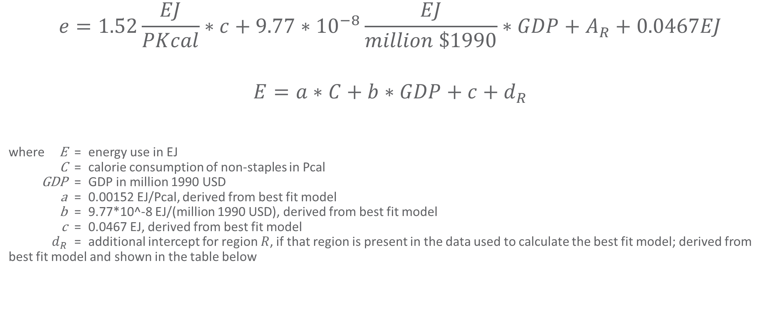
Model for infilling food processing energy use data
$$e=1.52\frac{EJ}{PKcal}∗c+9.77∗{10}^{−8}\frac{EJ}{million \$1990}∗GDP+A_{R}+0.0467EJ$$
$$E=a∗C+b∗GDP+c+d_{R}$$
where E = energy use in EJ
C = calorie consumption of non-staples in Pcal
GDP = GDP in million 1990 USD
a = 0.00152 EJ/Pcal, derived from best fit model
b = 9.77*10^-8 EJ/(million 1990 USD), derived from best fit model
c = 0.0467 EJ, derived from best fit model
$d_{R}$ = additional intercept for region $R$, if that region is present in the data used to calculate the best fit model; derived from best fit model and shown in the table below

