Slide 1
Food processing discussion
Notes:
Stock image of cloud formations

Slide 2
Food processing work overview
Goal: break out food processing from “other industry”
Food processing
Process heat
Biomass
Coal
Gas
Refined liquids
Electricity
Solar thermal
Geothermal heat pumps
Electricity
Heat
Food
Food demand
Proposed plan:
Break out food processing simply, with a demand set by income and price elasticities, as typical for GCAM industries
Implement a one-directional linkage between food demand and food processing energy use, where food demand (output calories) sets the scale of food processing energy use
Explore effect of food processing energy use on food production (just check)

Slide 3
Food processing work overview
Goal: break out food processing from “other industry”
Food processing
Process heat
Biomass
Coal
Gas
Refined liquids
Electricity
Solar thermal
Geothermal heat pumps
Electricity
Heat
Food
Food demand
Proposed plan:
Break out food processing simply, with a demand set by income and price elasticities, as typical for GCAM industries
Implement a one-directional linkage between food demand and food processing energy use, where food demand (output calories) sets the scale of food processing energy use
Explore effect of food processing energy use on food production (just check)
Current status:
Functioning breakout for food processing sector (but with default assumptions for almost everything), including non-CO₂ emissions
Additional explorations of food processing energy use and food demand relationship
Plan for linkage

Slide 4
Food processing linkage structure
Obtain the coefficient of EJ of food processing energy use per calorie consumed for each region
Use those coefficients, and the consumption of food, to determine the energy used for food processing based on food demand
Initially, coefficients will be the same for all commodities, but this could be updated later
Coefficients will also be constant with time after 2015, but could be changed exogenously to reflect different scenarios

Slide 5
Food processing linkage structure
Food processing
Process heat
Biomass
Coal
Gas
Refined liquids
Electricity
Solar thermal
Geothermal heat pumps
Electricity
Heat
Food demand
Staples
Corn
Crop inputs
EJ per calorie
Non-staples
Fruits + veg
Crop inputs
EJ per calorie
…
…
Rice
Crop inputs
EJ per calorie
Fiber crop
Crop inputs
EJ per calorie
*No price for the energy inputs to crops
Food processing

Slide 6
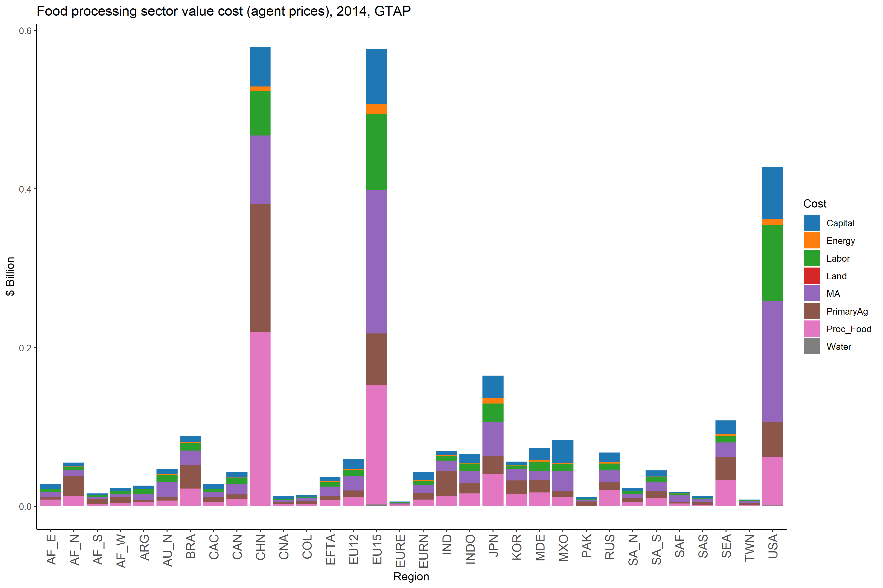
Non-energy costs
Potential sources:
GTAP data
Pro – includes capital vs labor vs other costs
Con – does not separate costs by technology/fuel (e.g., cost of gas-based techs vs coal-based techs)

Slide 7
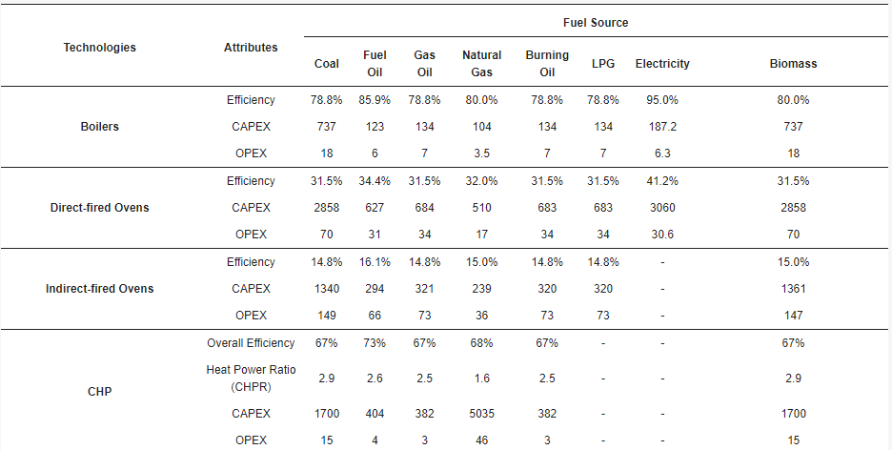
Non-energy costs
Potential sources:
GTAP data
Pro – includes capital vs labor vs other costs
Con – does not separate costs by technology/fuel (e.g., cost of gas-based techs vs coal-based techs)
Gowreesunker et al., 2018
Pro – separates costs by technology and fuel
Con – almost too much technology detail, would need to assume a capacity factor to convert capital costs to energy units
CAPEX: £m/GW_output, or £m/GWe_output for CHP systems
OPEX: £m/PJ_output, or £m/PJe_output

Slide 8
Non-energy costs
Potential sources:
GTAP data
Pro – includes capital vs labor vs other costs
Con – does not separate costs by technology/fuel (e.g., cost of gas-based techs vs coal-based techs)
Gowreesunker et al., 2018
Pro – separates costs by technology and fuel
Con – almost too much technology detail, would need to assume a capacity factor to convert capital costs to energy units
Sources for the overall costs per PKcal?
CAPEX: £m/GW_output, or £m/GWe_output for CHP systems
OPEX: £m/PJ_output, or £m/PJe_output

Slide 9
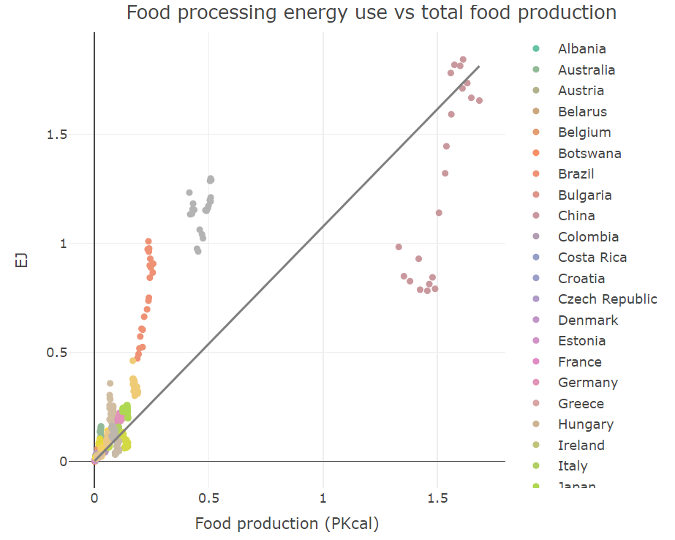
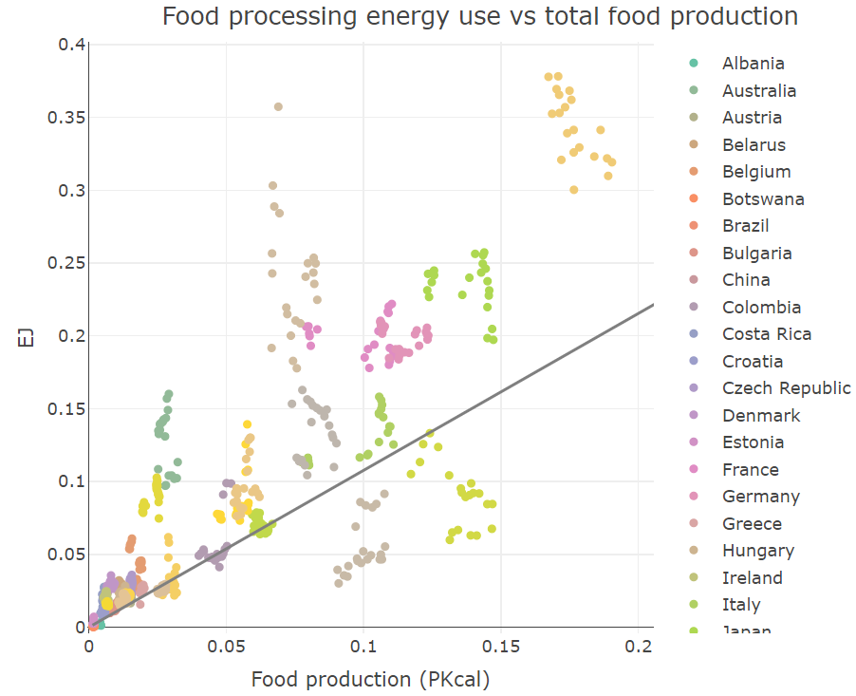
Food processing energy and food demand relationship
Simple relationship: energy ~ food consumption; 1995-2015 for selected regions
Coefficient: 1.08 EJ/PKcal
R squared: 0.75
file:///C:/Users/spei632/Documents/GCAM_industry/food_processing/initial_exploration/food_processing_energy_production_exploration.html

Slide 10
Food processing energy and food production relationship
Simple relationship: energy ~ staples consumption + meat consumption + non-meat nonstaples consumption; 1995-2015
Coefficients: -0.67 EJ/PKcal (staples)
6.82 EJ/PKcal (nonstaples other)
(meat not significant)
R squared: 0.95
file:///C:/Users/spei632/Documents/GCAM_industry/food_processing/initial_exploration/food_processing_energy_production_exploration.html

Slide 11
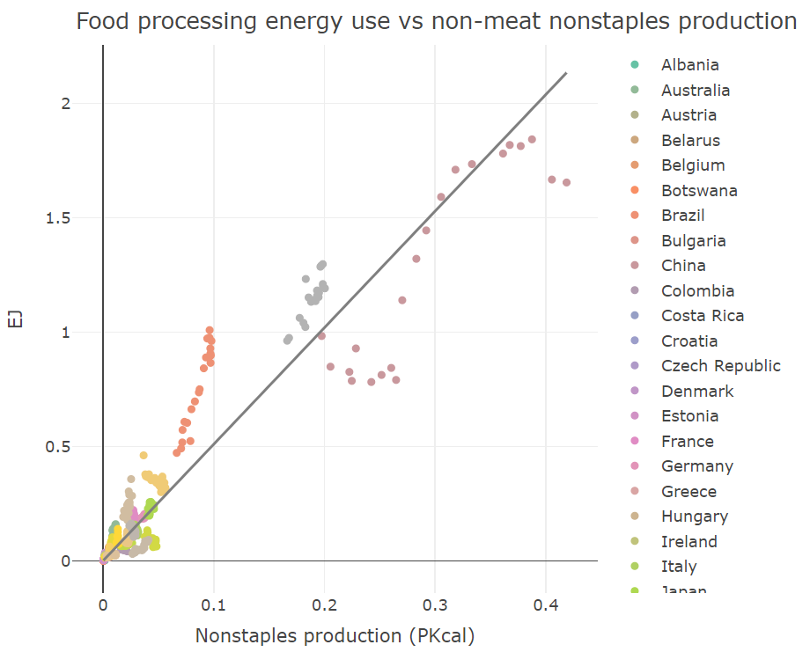
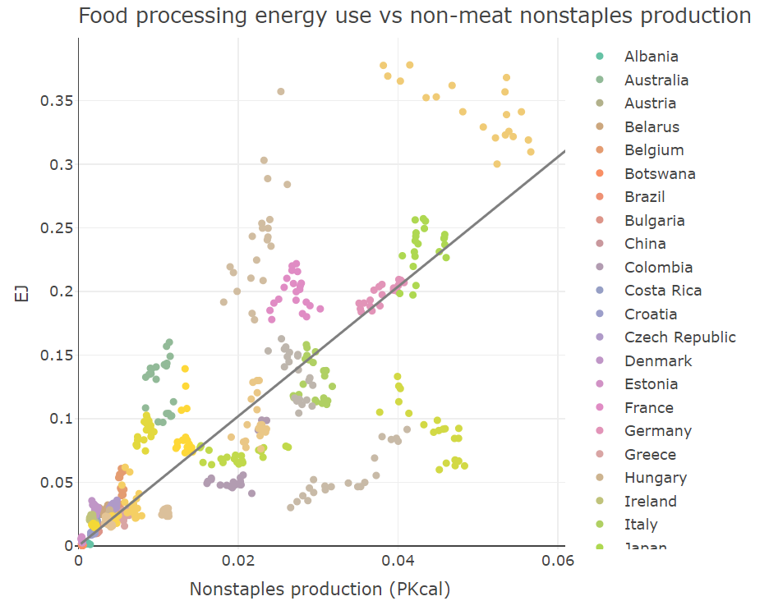
Food processing energy and food production relationship
Simple relationship: energy ~ non-meat nonstaples consumption; 1995-2015
Coefficient: 5.1 EJ/PKcal
R squared: 0.92
file:///C:/Users/spei632/Documents/GCAM_industry/food_processing/initial_exploration/food_processing_energy_production_exploration.html

Slide 12
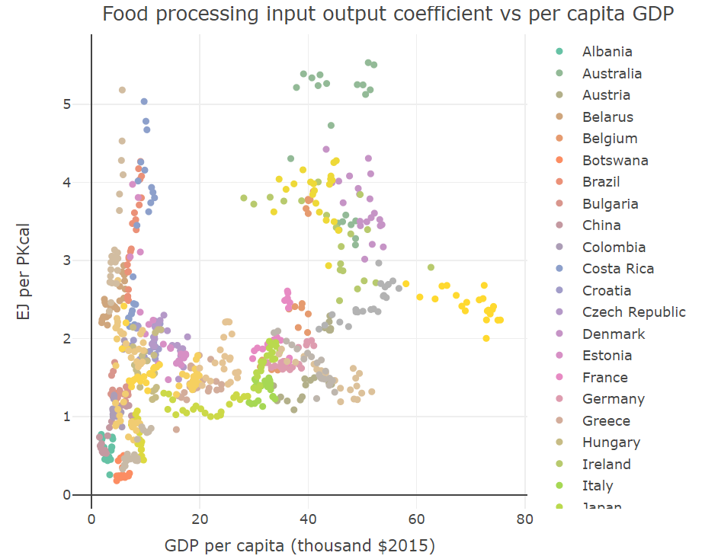
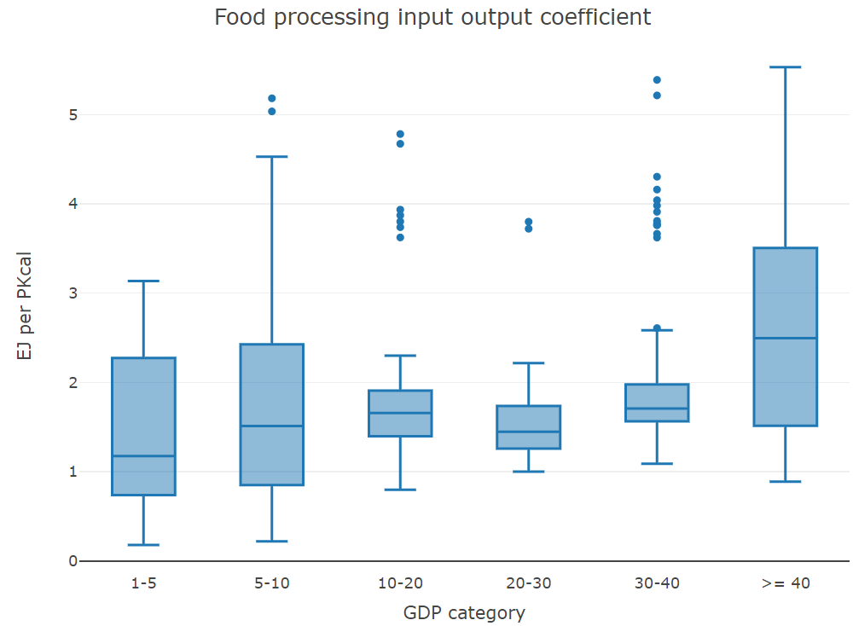
Food processing energy and food production relationship
Could group by GDP and calculate group mean, though there is a lot of spread
file:///C:/Users/spei632/Documents/GCAM_industry/food_processing/initial_exploration/food_processing_energy_production_exploration.html

Slide 13
Food processing work overview
Goal: break out food processing from “other industry”
Food processing
Process heat
Biomass
Coal
Gas
Refined liquids
Electricity
Solar thermal
Geothermal heat pumps
Electricity
Heat
Food
Food demand
Proposed plan:
Break out food processing simply, with a demand set by income and price elasticities, as typical for GCAM industries
Implement a one-directional linkage between food demand and food processing energy use, where food demand (output calories) sets the scale of food processing energy use
Explore effect of food processing energy use on food production (just check)
Next steps:
Revise assumptions (starting with non-energy cost)
Refine non-CO₂ emissions
Break out water consumption
Allocate historical cogen
Refine food processing energy use and food consumption relationship
Implement linkage

Slide 14
Food processing work overview
Goal: break out food processing from “other industry”
Food processing
Process heat
Biomass
Coal
Gas
Refined liquids
Electricity
Solar thermal
Geothermal heat pumps
Electricity
Heat
Food
Food demand
Proposed plan:
Break out food processing simply, with a demand set by income and price elasticities, as typical for GCAM industries
Implement a one-directional linkage between food demand and food processing energy use, where food demand (output calories) sets the scale of food processing energy use
Explore effect of food processing energy use on food production (just check)
Next steps:
Revise assumptions (starting with non-energy cost)
Refine non-CO₂ emissions
Break out water consumption
Allocate historical cogen
Refine food processing energy use and food consumption relationship
Implement linkage
*allocation on deception?

Slide 16
Current breakout challenges
Allocating cogen to food processing
→ to do, likely based on share of overall fuel use
Allocating some of “other industrial energy use” to food processing
→ will be addressed using the derived relationship between food production and food processing energy use
Allocating some electricity consumption to process heat (rather than direct use)
→ currently implemented as allocating some electricity to process heat if, in all years, the fraction of food processing energy use that is supplied by electricity is > 0.6; could be refined (and may not be necessary once the reallocation of energy use is complete)

Slide 17
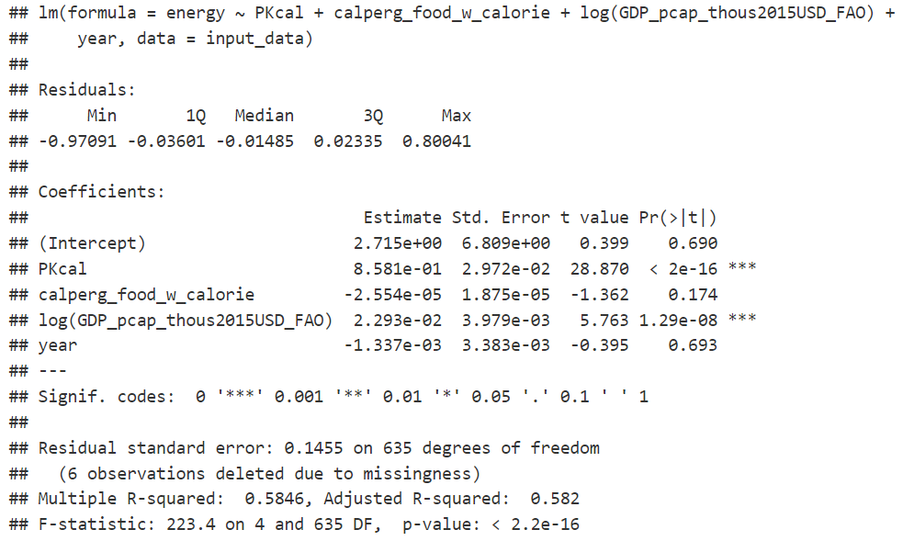
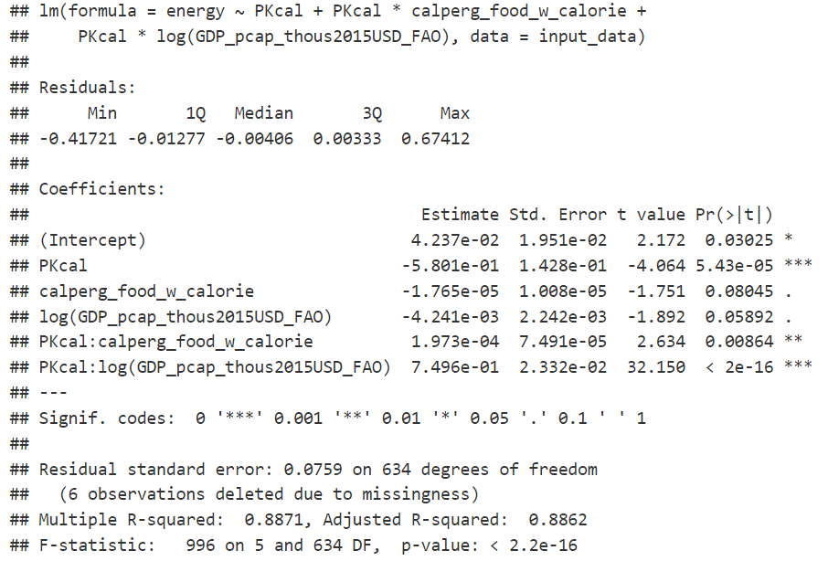
Food processing energy use and food production
Initial model:
Food processing energy use ~ food production + GDP per capita + conversion rate of food to calories
+ interaction term: production*GDP per capita
+ interaction term: production*conversion rate of food to calories
2010-2015, all regions and years with nonzero food processing energy use and food production (~650 observations)

Slide 18
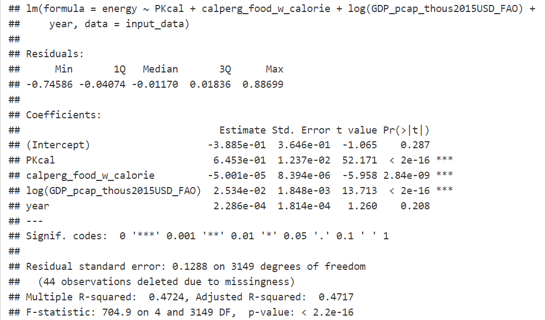
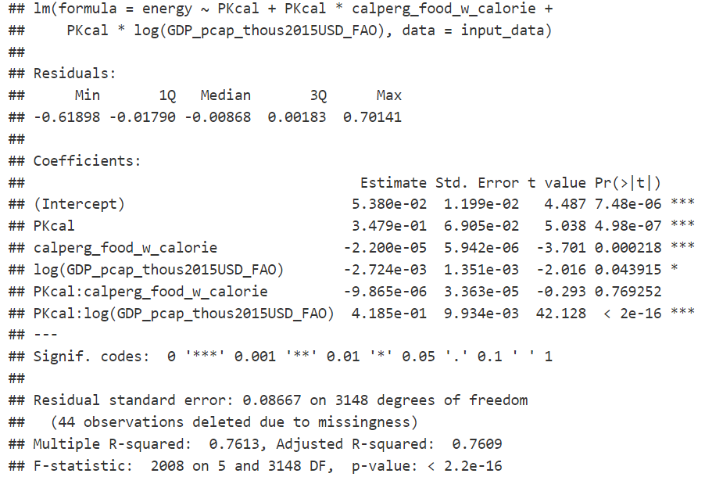
Food processing energy use and food production
Initial model:
Food processing energy use ~ food production + GDP per capita + conversion rate of food to calories
+ interaction term: production*GDP per capita
+ interaction term: production*conversion rate of food to calories
1971-2015, all regions and years with nonzero food processing energy use and food production (~3150 observations)

Slide 19
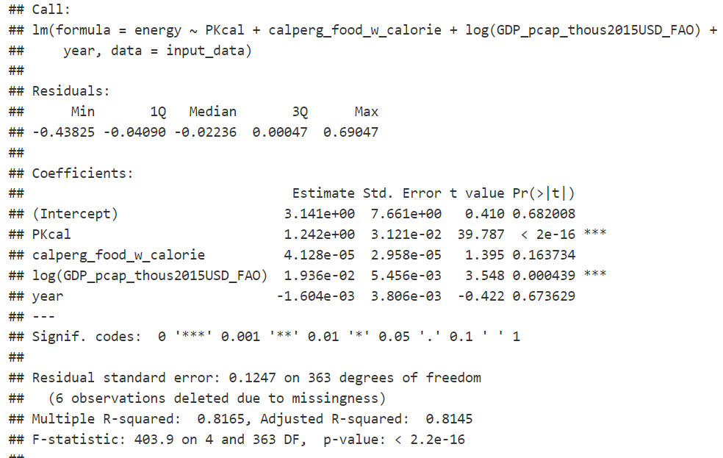
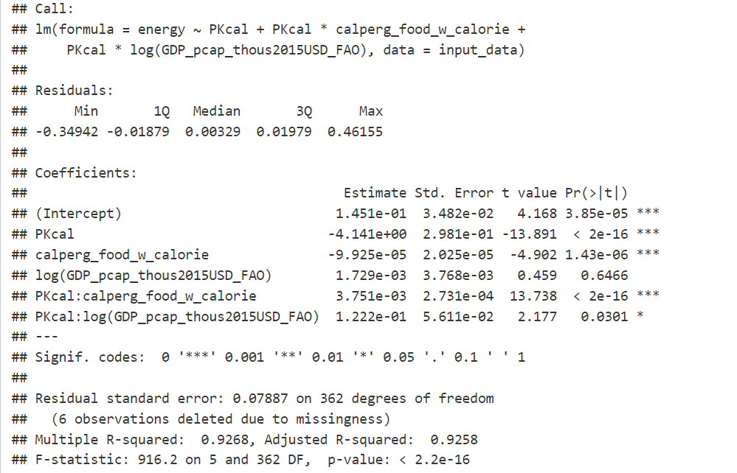
Food processing energy use and food production
Initial model:
Food processing energy use ~ food production + GDP per capita + conversion rate of food to calories
+ interaction term: production*GDP per capita
+ interaction term: production*conversion rate of food to calories
2010-2015, all regions and years with nonzero food processing energy use and food production, and where no fuels are fully allocated to other industry (~370 observations)

Slide 20
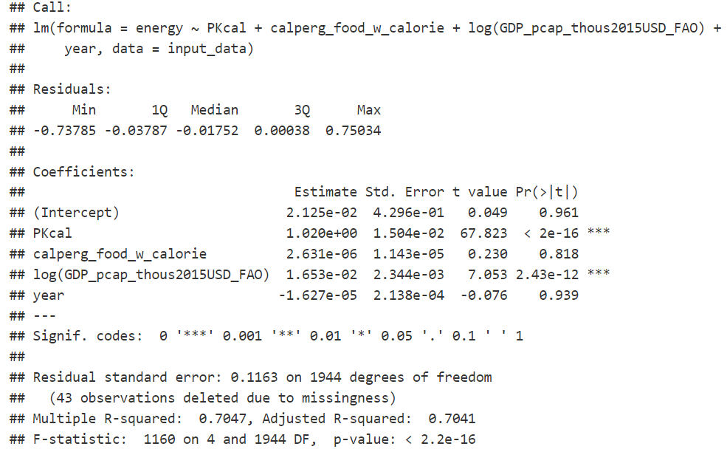
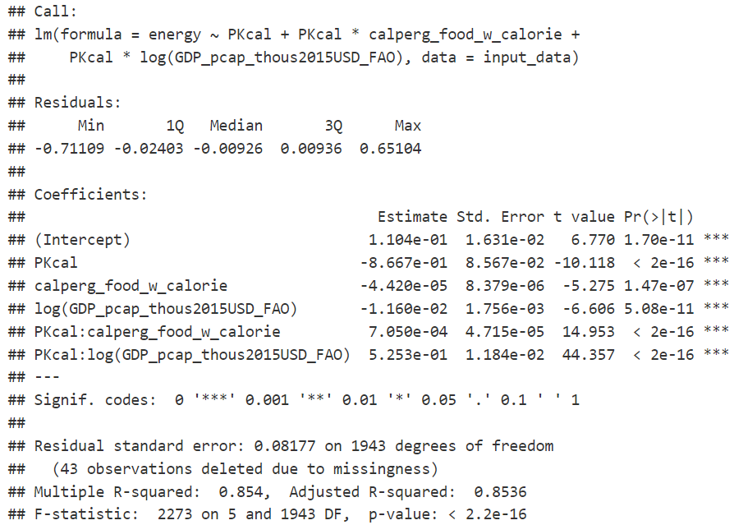
Food processing energy use and food production
Initial model:
Food processing energy use ~ food production + GDP per capita + conversion rate of food to calories
+ interaction term: production*GDP per capita
+ interaction term: production*conversion rate of food to calories
1971-2015, all regions and years with nonzero food processing energy use and food production, and where no fuels are fully allocated to other industry (~1950 observations)

Slide 21
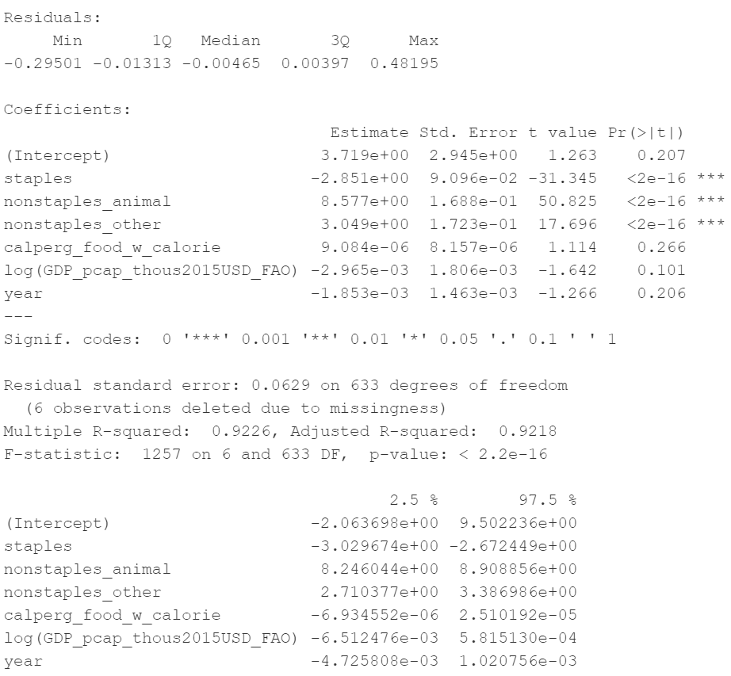
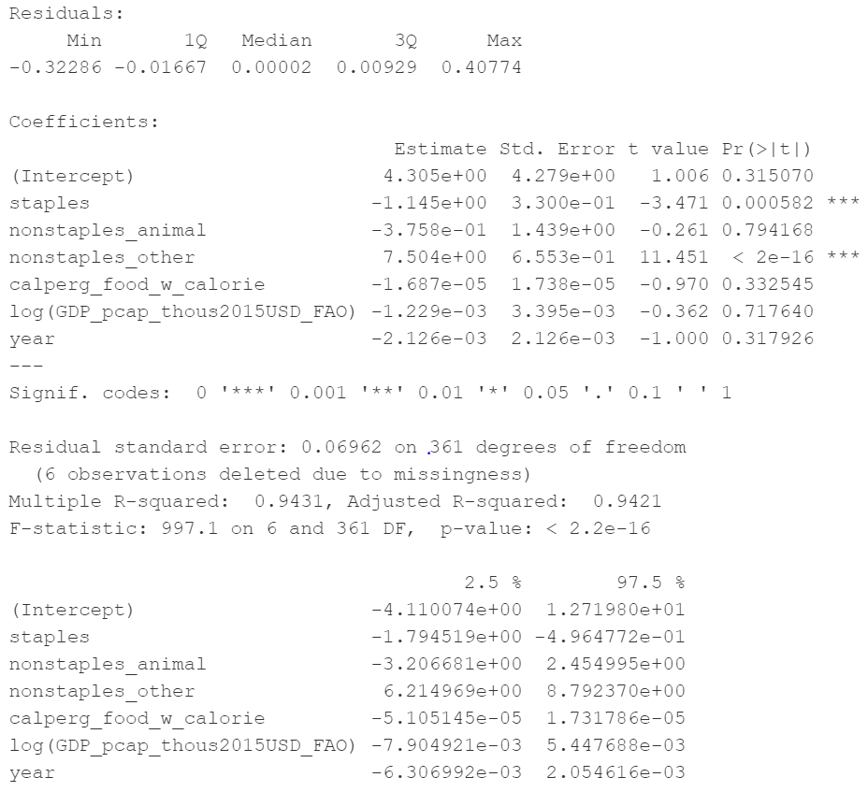
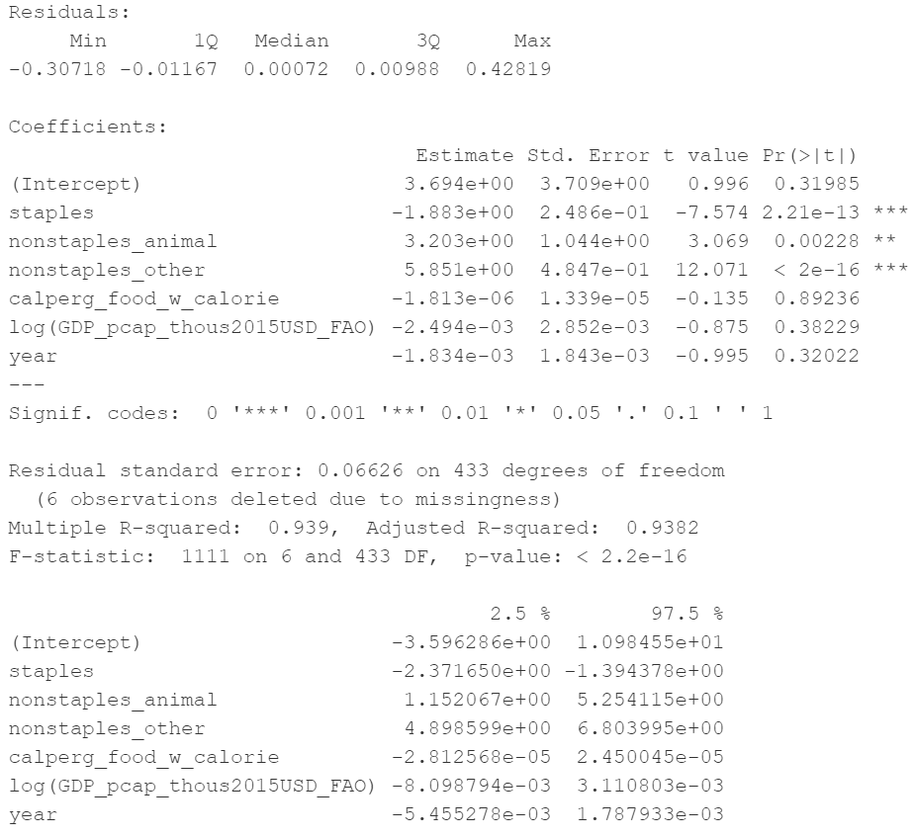
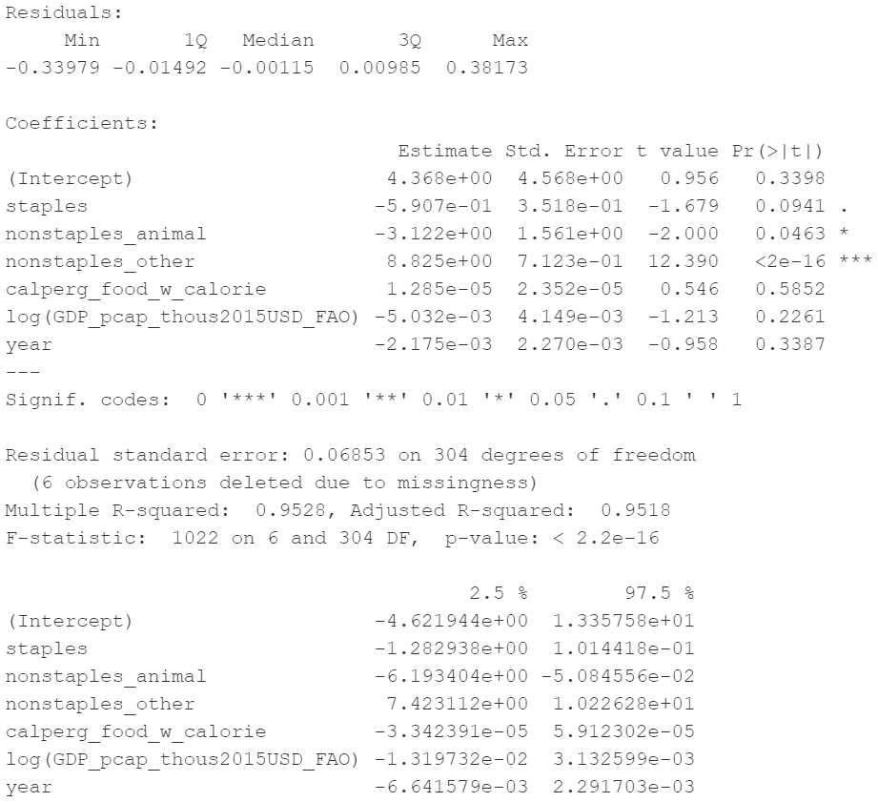
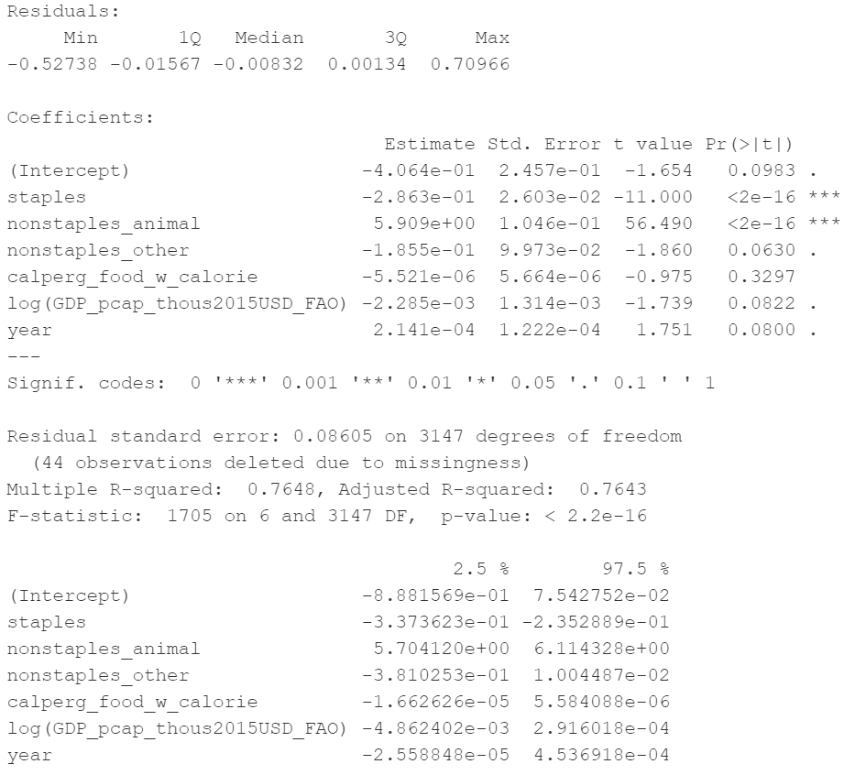
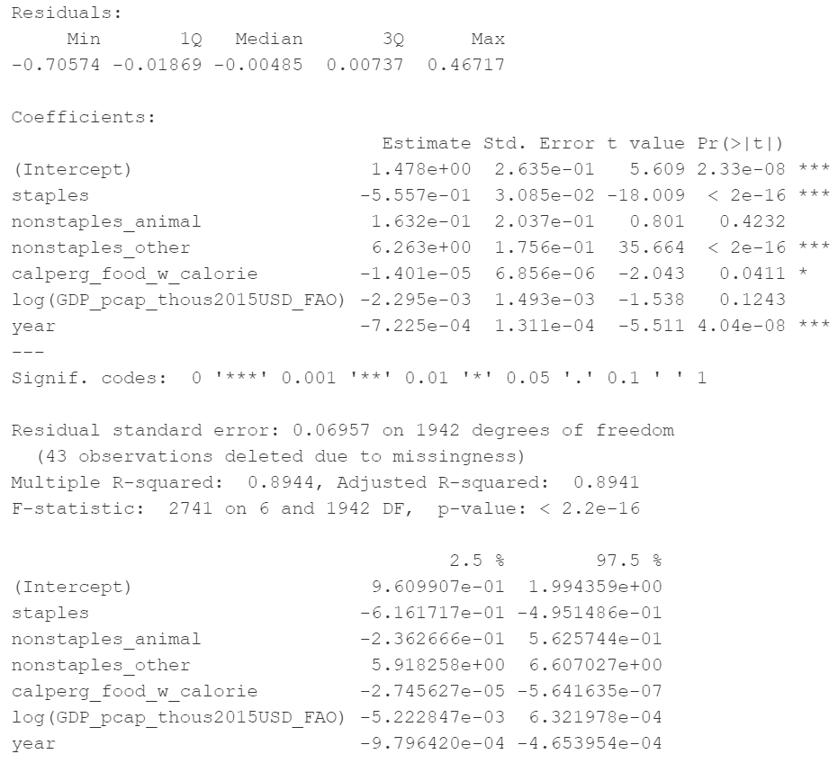

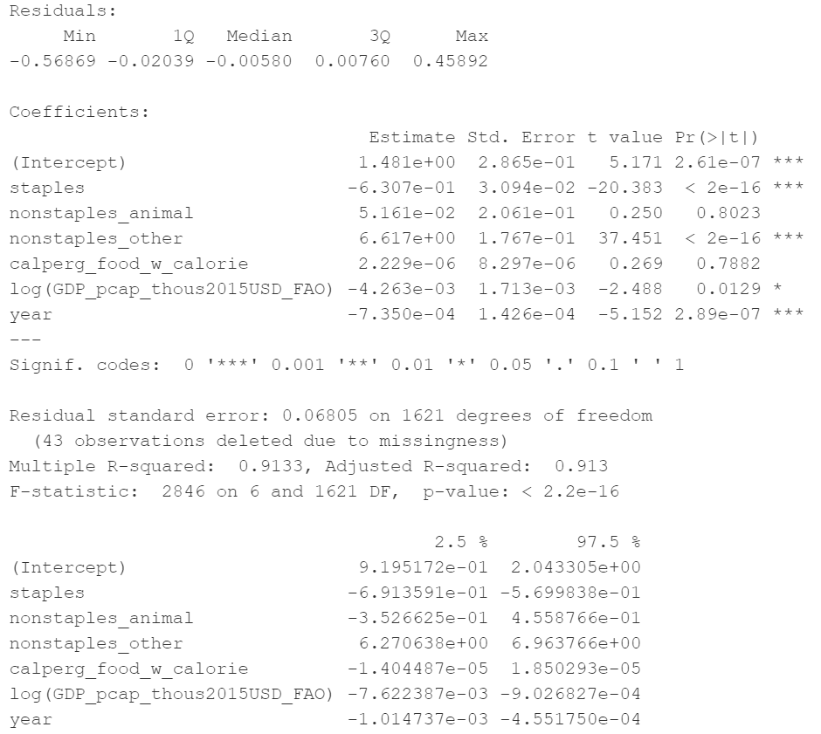
Food processing energy use and food production
Separating by type of food
2010-2015, all nonzero data
2010-2015, no fuels fully in non-specified industry
2010-2015, fractional energy constraints
2010-2015, fractional energy constraints by fuel
-
+
+
-
+
-
+
+
-
+
1973-2015, all nonzero data
1973-2015, no fuels fully in non-specified industry
1973-2015, fractional energy constraints
1973-2015, fractional energy constraints by fuel
-
+
-
+
-
+
-
+

Slide 22
Food processing energy use and food production
Initial model:
Food processing energy use ~ food production + GDP per capita + conversion rate of food to calories
+ interaction term: production*GDP per capita
+ interaction term: production*conversion rate of food to calories
2010-2015, all regions and years with nonzero food processing energy use and food production
Residual standard error: 0.08607 (~650 observations)
R squared: 0.8536
Coefficients:
Term | Coefficient | Significance
PKcal | 0.93 | Y
cal per g | -0.000069 | Y
GDP per cap (thous USD/person) | 0.0022 | Y
PKcal * tcal per g | -0.0012 | Y
Pkcal * GDP per cap | 0.045 | Y
(mean-centered values for independent variables)

Slide 23
Food processing energy use and food production
Initial model:
Food processing energy use ~ food production + GDP per capita + conversion rate of food to calories
+ interaction term: production*GDP per capita
+ interaction term: production*conversion rate of food to calories
1971-2015, all regions and years with nonzero food processing energy use and food production
Residual standard error: 0.08936 (~3150 observations)
R squared: 0.7459
Coefficients:
Term | Coefficient | Significance
PKcal | 0.97 | Y
cal per g | -0.000054 | Y
GDP per cap (thous USD/person) | 0.0018 | Y
PKcal * cal per g | -0.00081 | Y
Pkcal * GDP per cap | 0.032 | Y
(mean-centered values for independent variables)

Slide 24
Food processing energy use and food production
Initial model:
Food processing energy use ~ food production + GDP per capita + conversion rate of food to calories
+ interaction term: production*GDP per capita
+ interaction term: production*conversion rate of food to calories
2010-2015, all regions and years with nonzero food processing energy use and food production, and where no fuels are fully allocated to other industry (~370 observations)
Residual standard error: 0.07879
R squared: 0.9259
Coefficients:
Term | Coefficient | Significance
PKcal | 2.4 | Y
cal per g | 0.00013 | Y
GDP per cap (thous USD/person) | 0.00049 | Y
PKcal * cal per g | 0.0037 | Y
Pkcal * GDP per cap | 0.0059 | Y
(mean-centered values for independent variables)

Slide 25
Food processing energy use and food production
Initial model:
Food processing energy use ~ food production + GDP per capita + conversion rate of food to calories
+ interaction term: production*GDP per capita
+ interaction term: production*conversion rate of food to calories
2010-2015, all regions and years with nonzero food processing energy use and food production, and where no fuels are fully allocated to other industry (~370 observations)
Residual standard error: 0.07879
R squared: 0.9259
Coefficients:
Term | Coefficient | Significance
PKcal | 2.4 (vs 0.93) | Y
cal per g | 0.00013 (vs -0.000069) | Y
GDP per cap (thous USD/person) | 0.00049 (vs 0.0022) | Y
PKcal * cal per g | 0.0037 (vs -0.0012) | Y
Pkcal * GDP per cap | 0.0059 (vs 0.045) | Y
(mean-centered values for independent variables)

Slide 26
Food processing energy use and food production
Initial model:
Food processing energy use ~ food production + GDP per capita + conversion rate of food to calories
+ interaction term: production*GDP per capita
+ interaction term: production*conversion rate of food to calories
1971-2015, all regions and years with nonzero food processing energy use and food production, and where no fuels are fully allocated to other industry (~1950 observations)
Residual standard error: 0.08996
R squared: 0.8228
Coefficients:
Term | Coefficient | Significance
PKcal | 1.3 | Y
cal per g | -0.000023 | Y
GDP per cap (thous USD/person) | 0.0013 | Y
PKcal * cal per g | -0.00022 | Y
Pkcal * GDP per cap | 0.0033 | Y
(mean-centered values for independent variables)

Slide 27
Food processing energy use and food production
Initial model:
Food processing energy use ~ food production + GDP per capita + conversion rate of food to calories
+ interaction term: production*GDP per capita
+ interaction term: production*conversion rate of food to calories
1971-2015, all regions and years with nonzero food processing energy use and food production, and where no fuels are fully allocated to other industry (~1950 observations)
Residual standard error: 0.08996
R squared: 0.8228
Coefficients:
Term | Coefficient | Significance
PKcal | 1.3 (vs 0.97) | Y
cal per g | -0.000023 (vs -0.000054) | Y
GDP per cap (thous USD/person) | 0.0013 (vs 0.0018) | Y
PKcal * cal per g | -0.00022 (vs -0.00081) | Y
Pkcal * GDP per cap | 0.0033 (vs 0.032) | Y
(mean-centered values for independent variables)

Slide 28
Food processing energy use and food production
Initial model:
Food processing energy use ~ food production + GDP per capita + conversion rate of food to calories
+ interaction term: production*GDP per capita
+ interaction term: production*conversion rate of food to calories
2010-2015, all regions and years with fractions of total industry energy used in food processing and other industry are within specified ranges (~440 observations)
Residual standard error: 0.08996
R squared: 0.8228
Coefficients:
Term | Coefficient | Significance
PKcal | 2.2 | Y
cal per g | 0.000069 | Y
GDP per cap (thous USD/person) | 0.0010 | Y
PKcal * cal per g | 0.0025 | Y
Pkcal * GDP per cap | 0.015 | Y
(mean-centered values for independent variables)

