Slide 1
Food processing discussion
Notes:
Stock image of cloud formations

Slide 2
Food processing sector overview
Main uses of energy in food processing, across all subsectors¹:
Process heating and drying (59%)
Cooling and refrigeration (16%)
Mechanical equipment (12%)
Infrastructure (HVAC and lighting) (8%)
Energy intensive processes include “materials reception and preparation; size reduction, mixing and forming; separation techniques; product processing technologies; heat processing; concentration by heat; chilling and freezing; post-processing operations; and utility processes”²
Wang, 2014, https://link.springer.com/article/10.1007/s12053-014-9256-8?utm_source=getftr&utm_medium=getftr&utm_campaign=getftr_pilot
UK Industrial Decarbonisation & Energy Efficiency Roadmaps to 2050 – Food and Drink, 2015, https://assets.publishing.service.gov.uk/government/uploads/system/uploads/attachment_data/file/416672/Food_and_Drink_Report.pdf

Slide 3
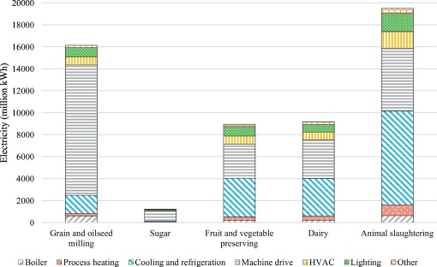
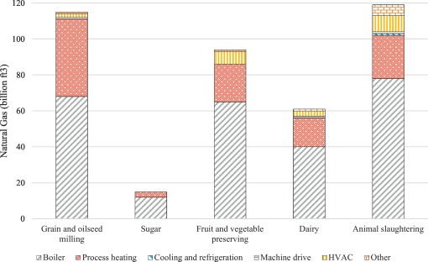
Food processing sector overview
US electricity and natural gas use in the food processing sector
Compton et al., 2018, https://www.sciencedirect.com/science/article/pii/S1466856418301917

Slide 4
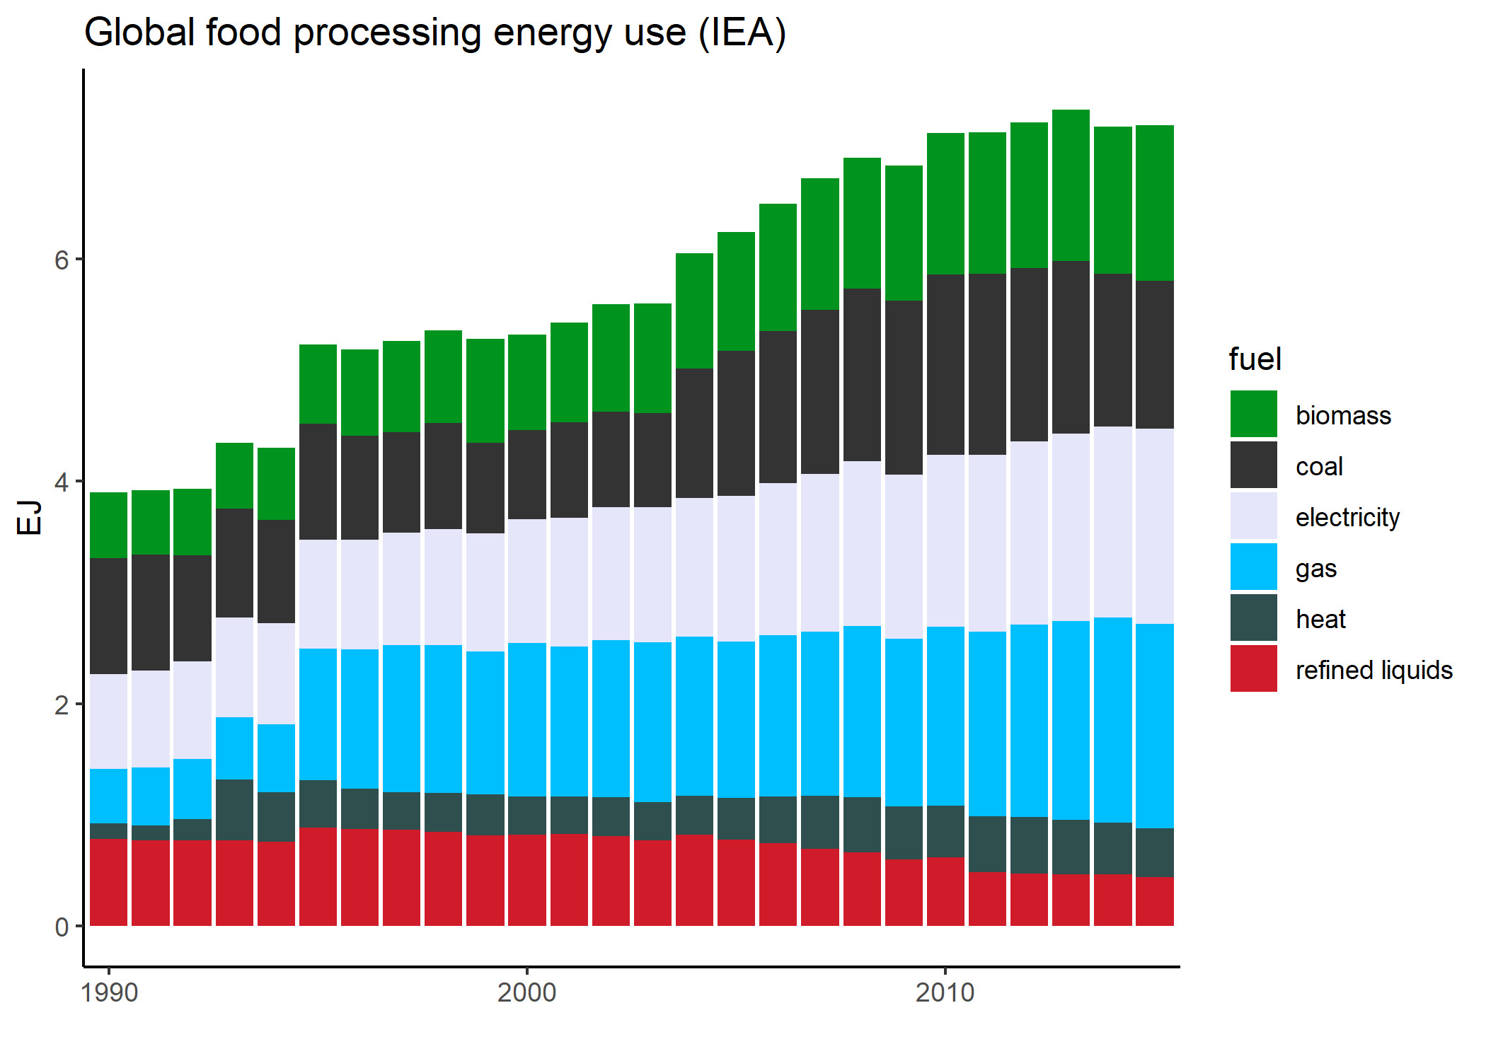
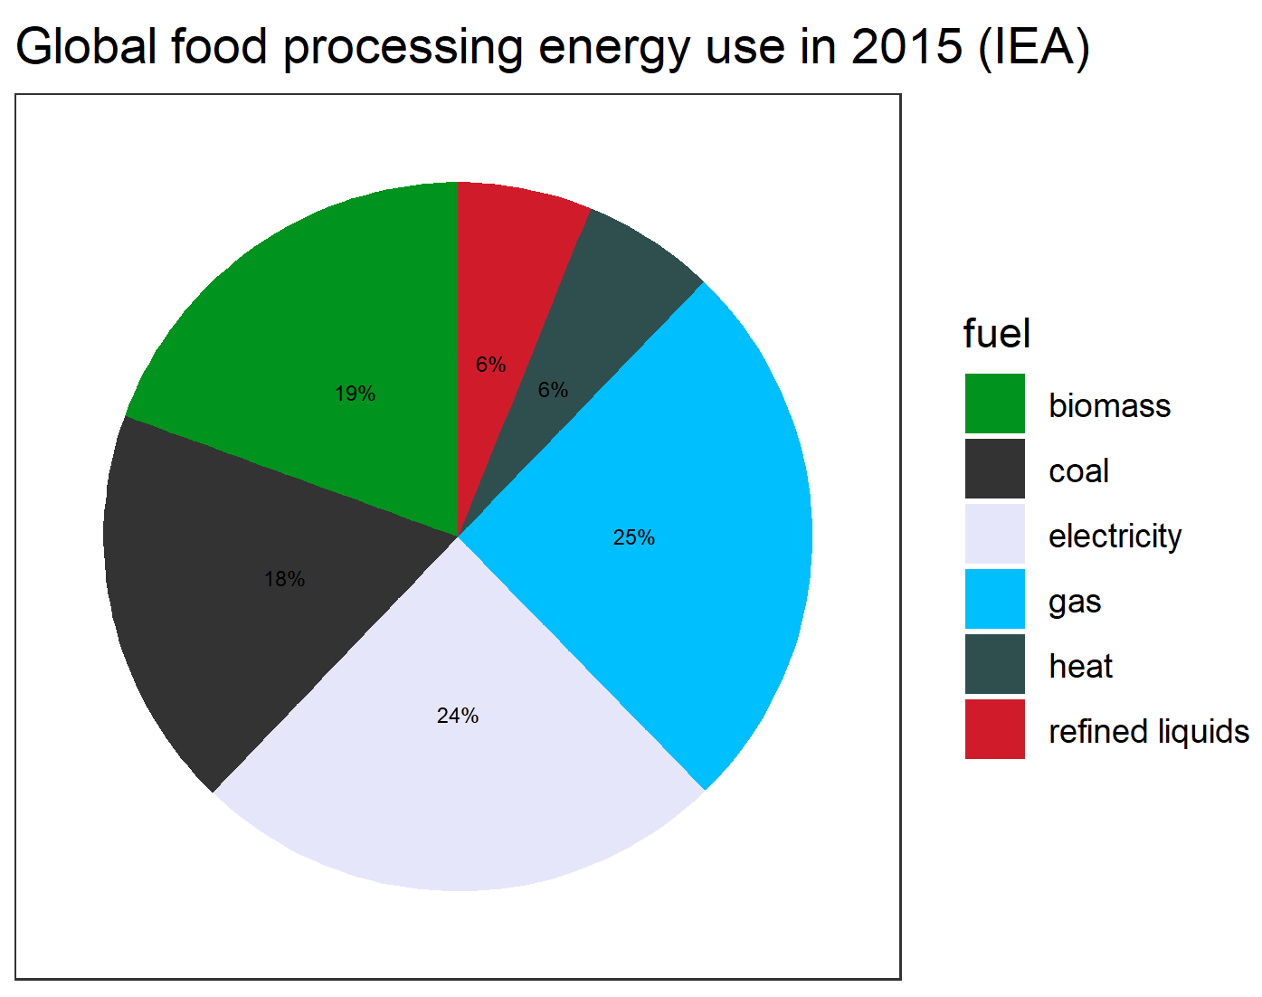
Food processing sector overview – IEA data

Slide 5
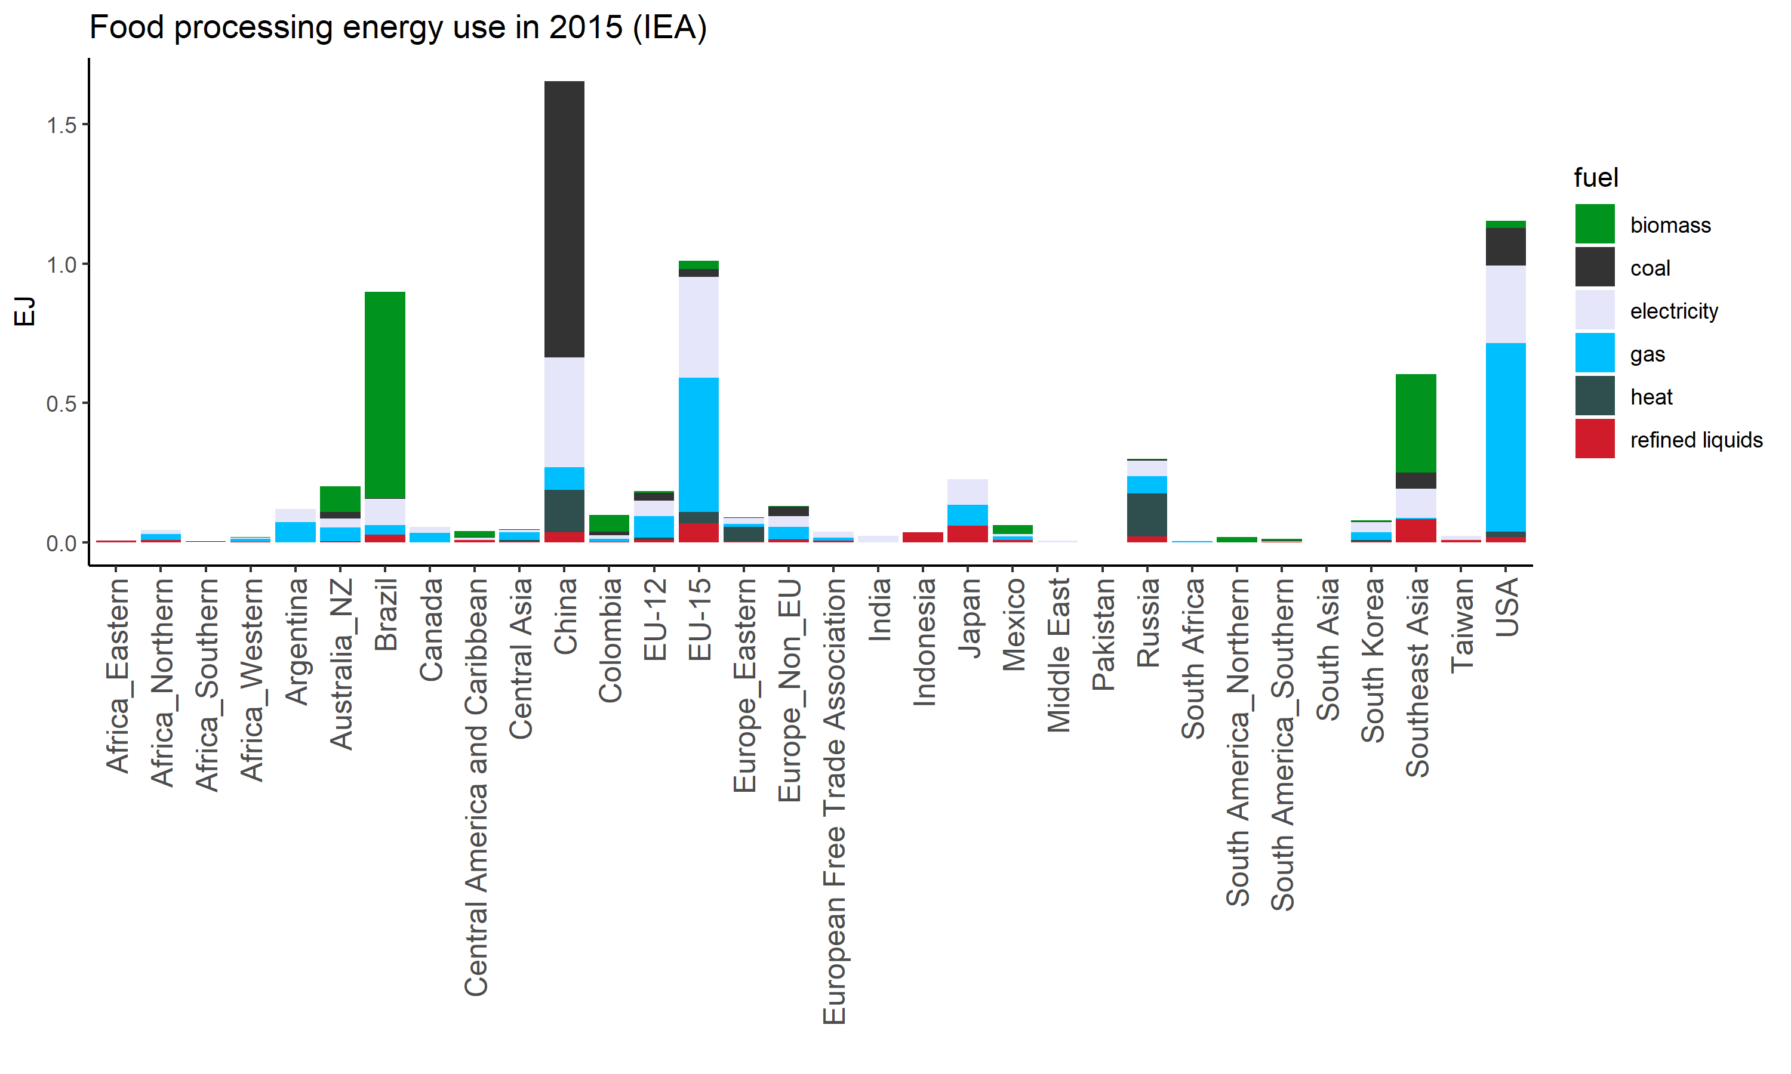
Food processing sector overview – IEA data

Slide 6
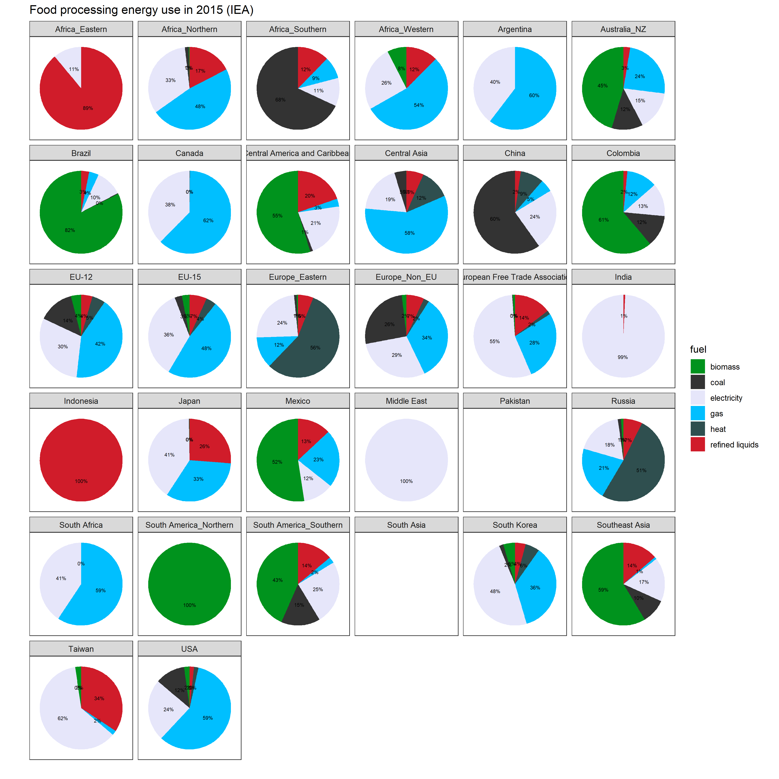
Food processing sector overview – IEA data
Notes:
Pakistan and South Asia do have food processing data in Comtrade, so this is likely missing in IEA

Slide 7
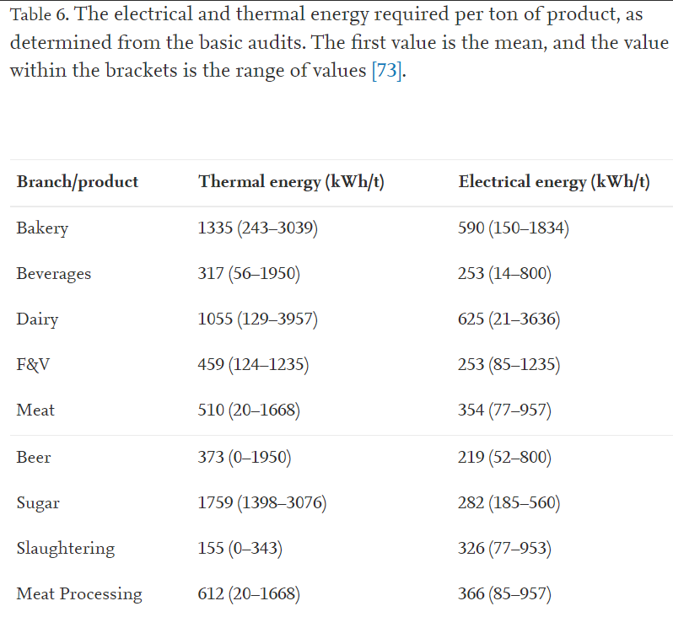
Food processing sector overview
From energy audits for small and medium-sized food and beverage companies in Austria, France, Germany, Poland, Spain, UK
Meyers et al., 2016, https://www.sciencedirect.com/science/article/pii/S0360544216303644

Slide 8
Food processing sector overview
Energy-saving and decarbonization options:
Energy efficiency measures, process optimization
Electrification of heat (heat pumps and electric boilers)
CHP/cogen
Fuel switching to renewables – biomass, solar thermal, geothermal heat pumps
Waste heat utilization
Food waste reduction, demand-side measures
(Note: CCS, hydrogen seem less likely to play a role for food processing)

Slide 9
Questions
Where do we want to add in the energy coefficients and non-energy costs?
At the level of regional corn (Mt) → Corn (Mkcal), with a nesting for level of processing
Pros – more detailed representation, allows for evaluation of shifting food consumption and preferences
Cons – data availability?
At the level of crops feeding into FoodDemand_Staples and FoodDemand_NonStaples
Pros – simpler to implement
Cons – would this adequately represent the heterogeneity of the sector? Changes in types of food consumed would not be reflected in changes in energy use

Slide 10
Questions
Where do we want to add in the energy coefficients and non-energy costs?
At the level of regional corn (Mt) → Corn (Mkcal), with a nesting for level of processing
Pros – more detailed representation, allows for evaluation of shifting food consumption and preferences
Cons – data availability?
At the level of crops feeding into FoodDemand_Staples and FoodDemand_NonStaples
Pros – simpler to implement
Cons – would this adequately represent the heterogeneity of the sector? Changes in types of food consumed would not be reflected in changes in energy use
Technologies
Process heating and drying (including boilers) – biomass, coal, gas, refined liquids, (grid) electricity (inc. heat pumps), CHP, solar thermal, geothermal heat pumps
Refrigeration and cooling – (grid) electricity (inc. heat pumps), CHP, geothermal heat pumps
Mechanical equipment – (grid) electricity, CHP
Infrastructure (HVAC + lighting) – (grid) electricity, CHP, gas (for space heating)

Slide 11
Questions
Staples – processed
Heating – gas, electricity, etc
Cooling – electricity,
Other
Processed
Dairy – all fuels
Meat
Grain
Sugar
Fruits + veggies

Slide 12
Brainstorming
Staples – processed
Heating – gas, electricity, etc
Cooling – electricity,
Other
Processed
Dairy – all fuels
Meat
Grain
Sugar
Fruits + veggies

Slide 13
Brainstorming
Processed
Dairy
Meat
Grain
Sugar
Fruits + veggies
Each has a coefficient that can vary with time?
- Maybe there is a baseline level of energy use, then a multiplicative factor to represent level of processing? (where to derive)

Slide 15
Food processing discussion
Notes:
Stock image of cloud formations

Slide 16
Structure possibilities
Challenges:
How to disaggregate food production into more vs less processed in base years?
Separating energy used for staples vs non-staples
Food processing
Staples
Non-staples
More processed
Less processed
More processed
Less processed
Process heat
Electricity
Process heat
Electricity
Process heat
Electricity
Process heat
Electricity
Advantages:
Can explicitly shift from less to more processed foods with time

Slide 17
Structure possibilities
Challenges:
Separating energy used for staples vs non-staples
Less explicit processing level (though this could still be indicated with changes in energy coefficients with time)
Food processing
Staples
Non-staples
Process heat
Electricity
Process heat
Electricity
Advantages:
More straightforward to implement

Slide 18
Structure possibilities
Food processing
Total food demand (staples + non-staples)
Process heat
Electricity
Biomass
Coal
Gas
Refined liquids
Electricity
CHP (heat)
Solar thermal
Geothermal heat pumps
Challenges:
Less explicit processing level (though this could still be indicated with changes in energy coefficients with time)
Advantages:
More straightforward to implement

Slide 19
Structure possibilities
Advantages:
More explicit breakout of food types, matching their varied levels of processing required
Challenges:
Accurate calibration for all crops
Less explicit processing level (though this could still be indicated with changes in energy coefficients with time)
Food processing
Staples
Non-staples
Process heat
Electricity
Fruit/veg
Animal protein
All staples (rice, corn, wheat, other grain, root tuber)
Process heat
Electricity
Process heat
Electricity
Plant protein
Process heat
Electricity
Other*
Process heat
Electricity
*oil, fiber crops, sugar crops, misc.

Slide 20
Potential strategies
Strategy 1:
Use IEA data to directly calculate coefficients
Challenge: disaggregating staples vs non-staples (or to finer categories)
Strategy 2:
Obtain coefficients of energy use for processing for different products from literature estimates
Challenge: high degree of variability in estimates, depending on location/sub-product type/etc.
Possibility: obtain breakdown of heat vs electricity for each product to disaggregate process heat vs electricity
Scale the theoretical coefficients so that the overall energy consumption matches IEA
Challenge: IEA regions with zero energy used in food processing
Assumption: relative level of processing is constant across crops in a given region

Slide 21
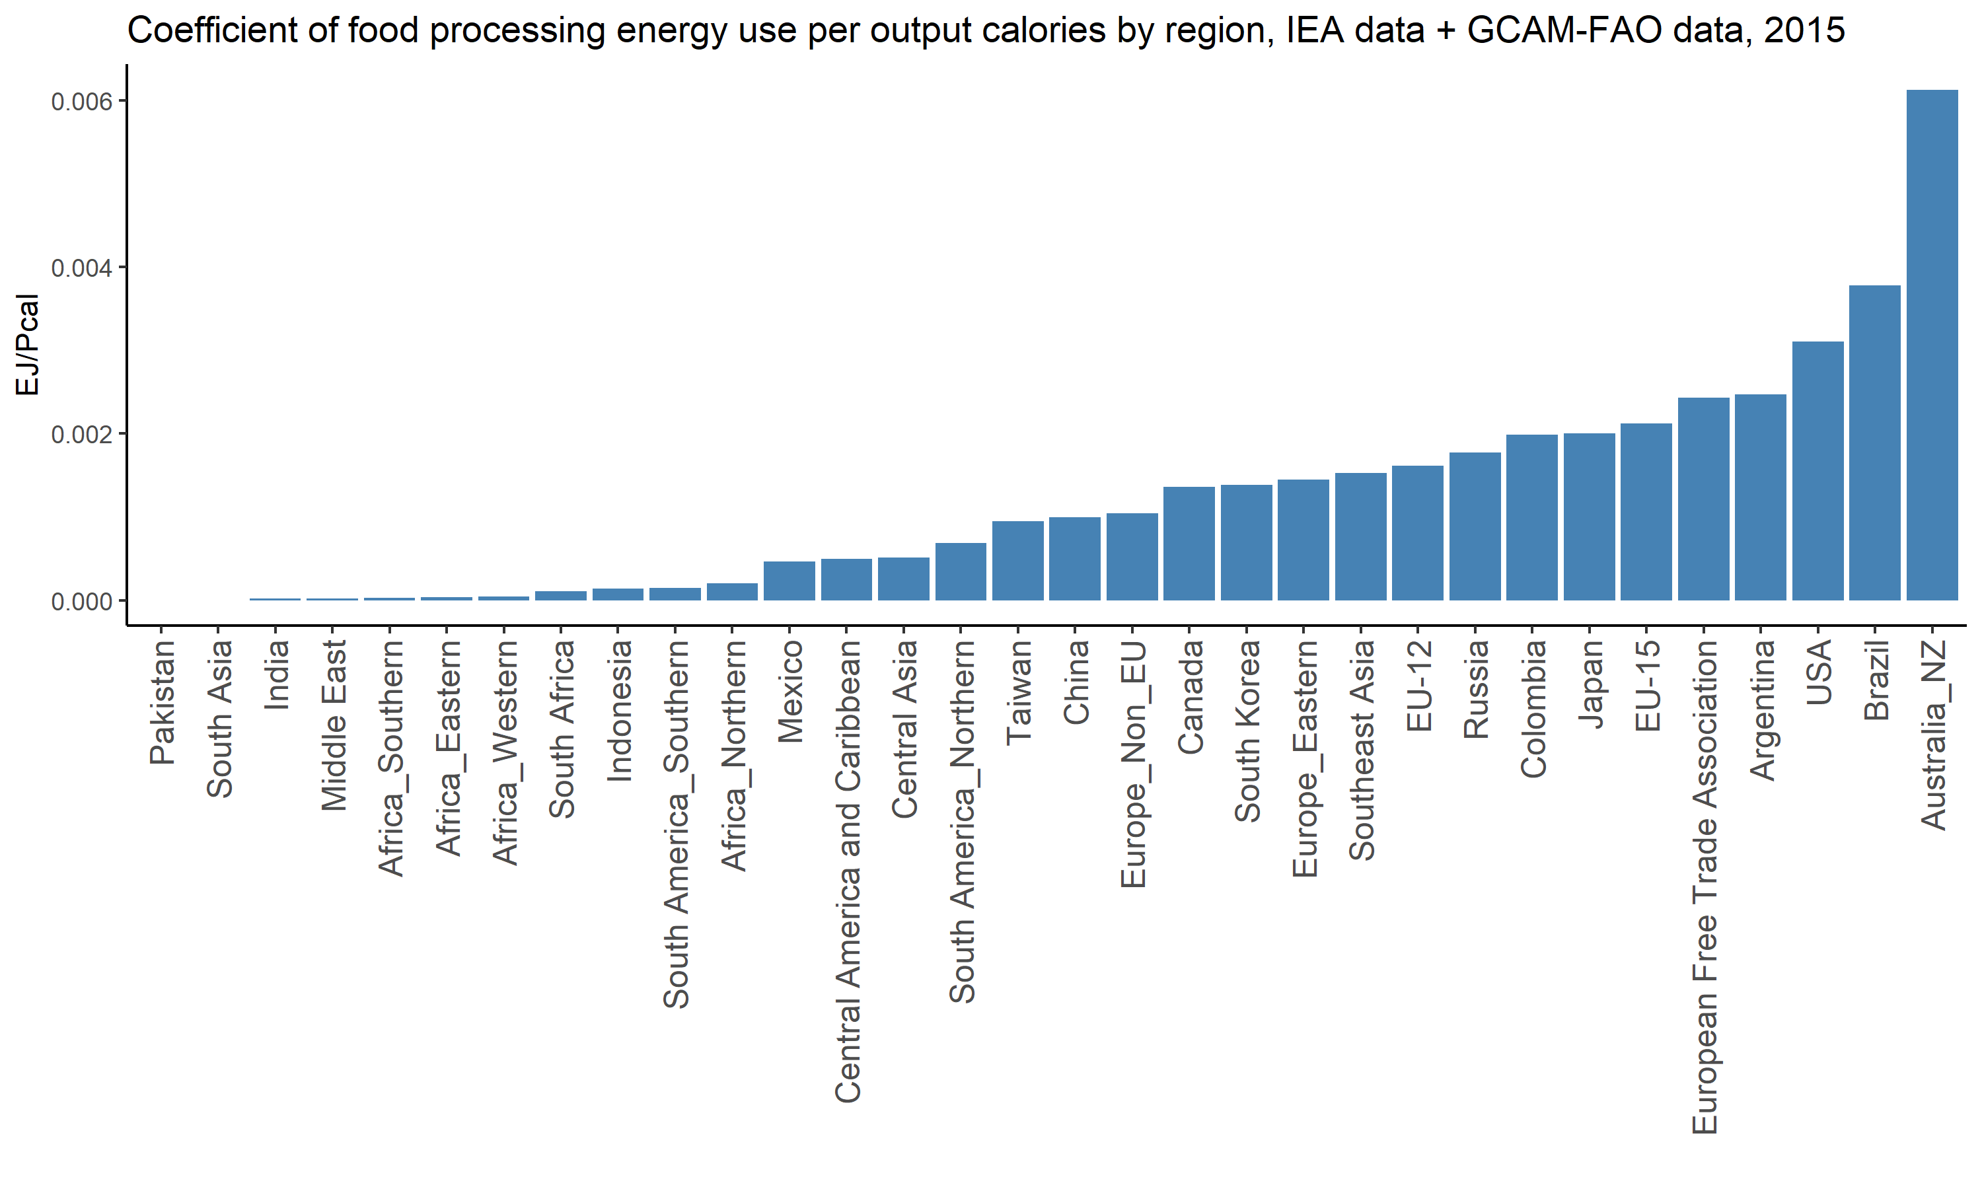
Food processing energy intensity

Slide 22
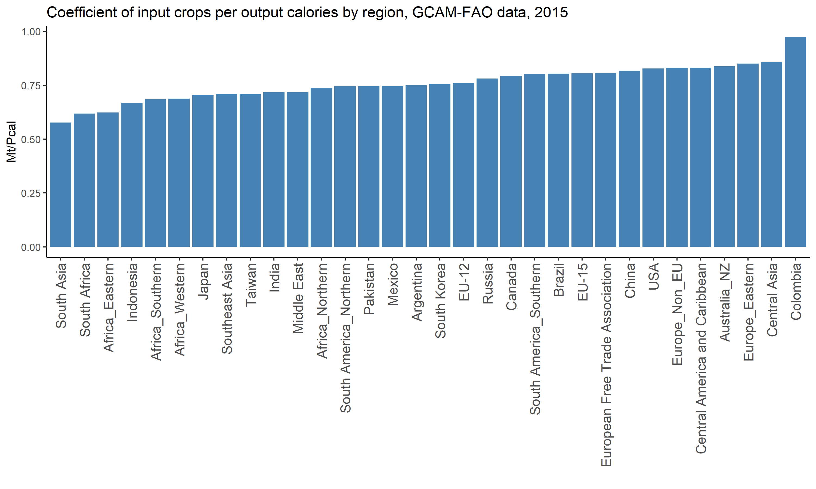
Food processing energy intensity and input crop intensity

Slide 23
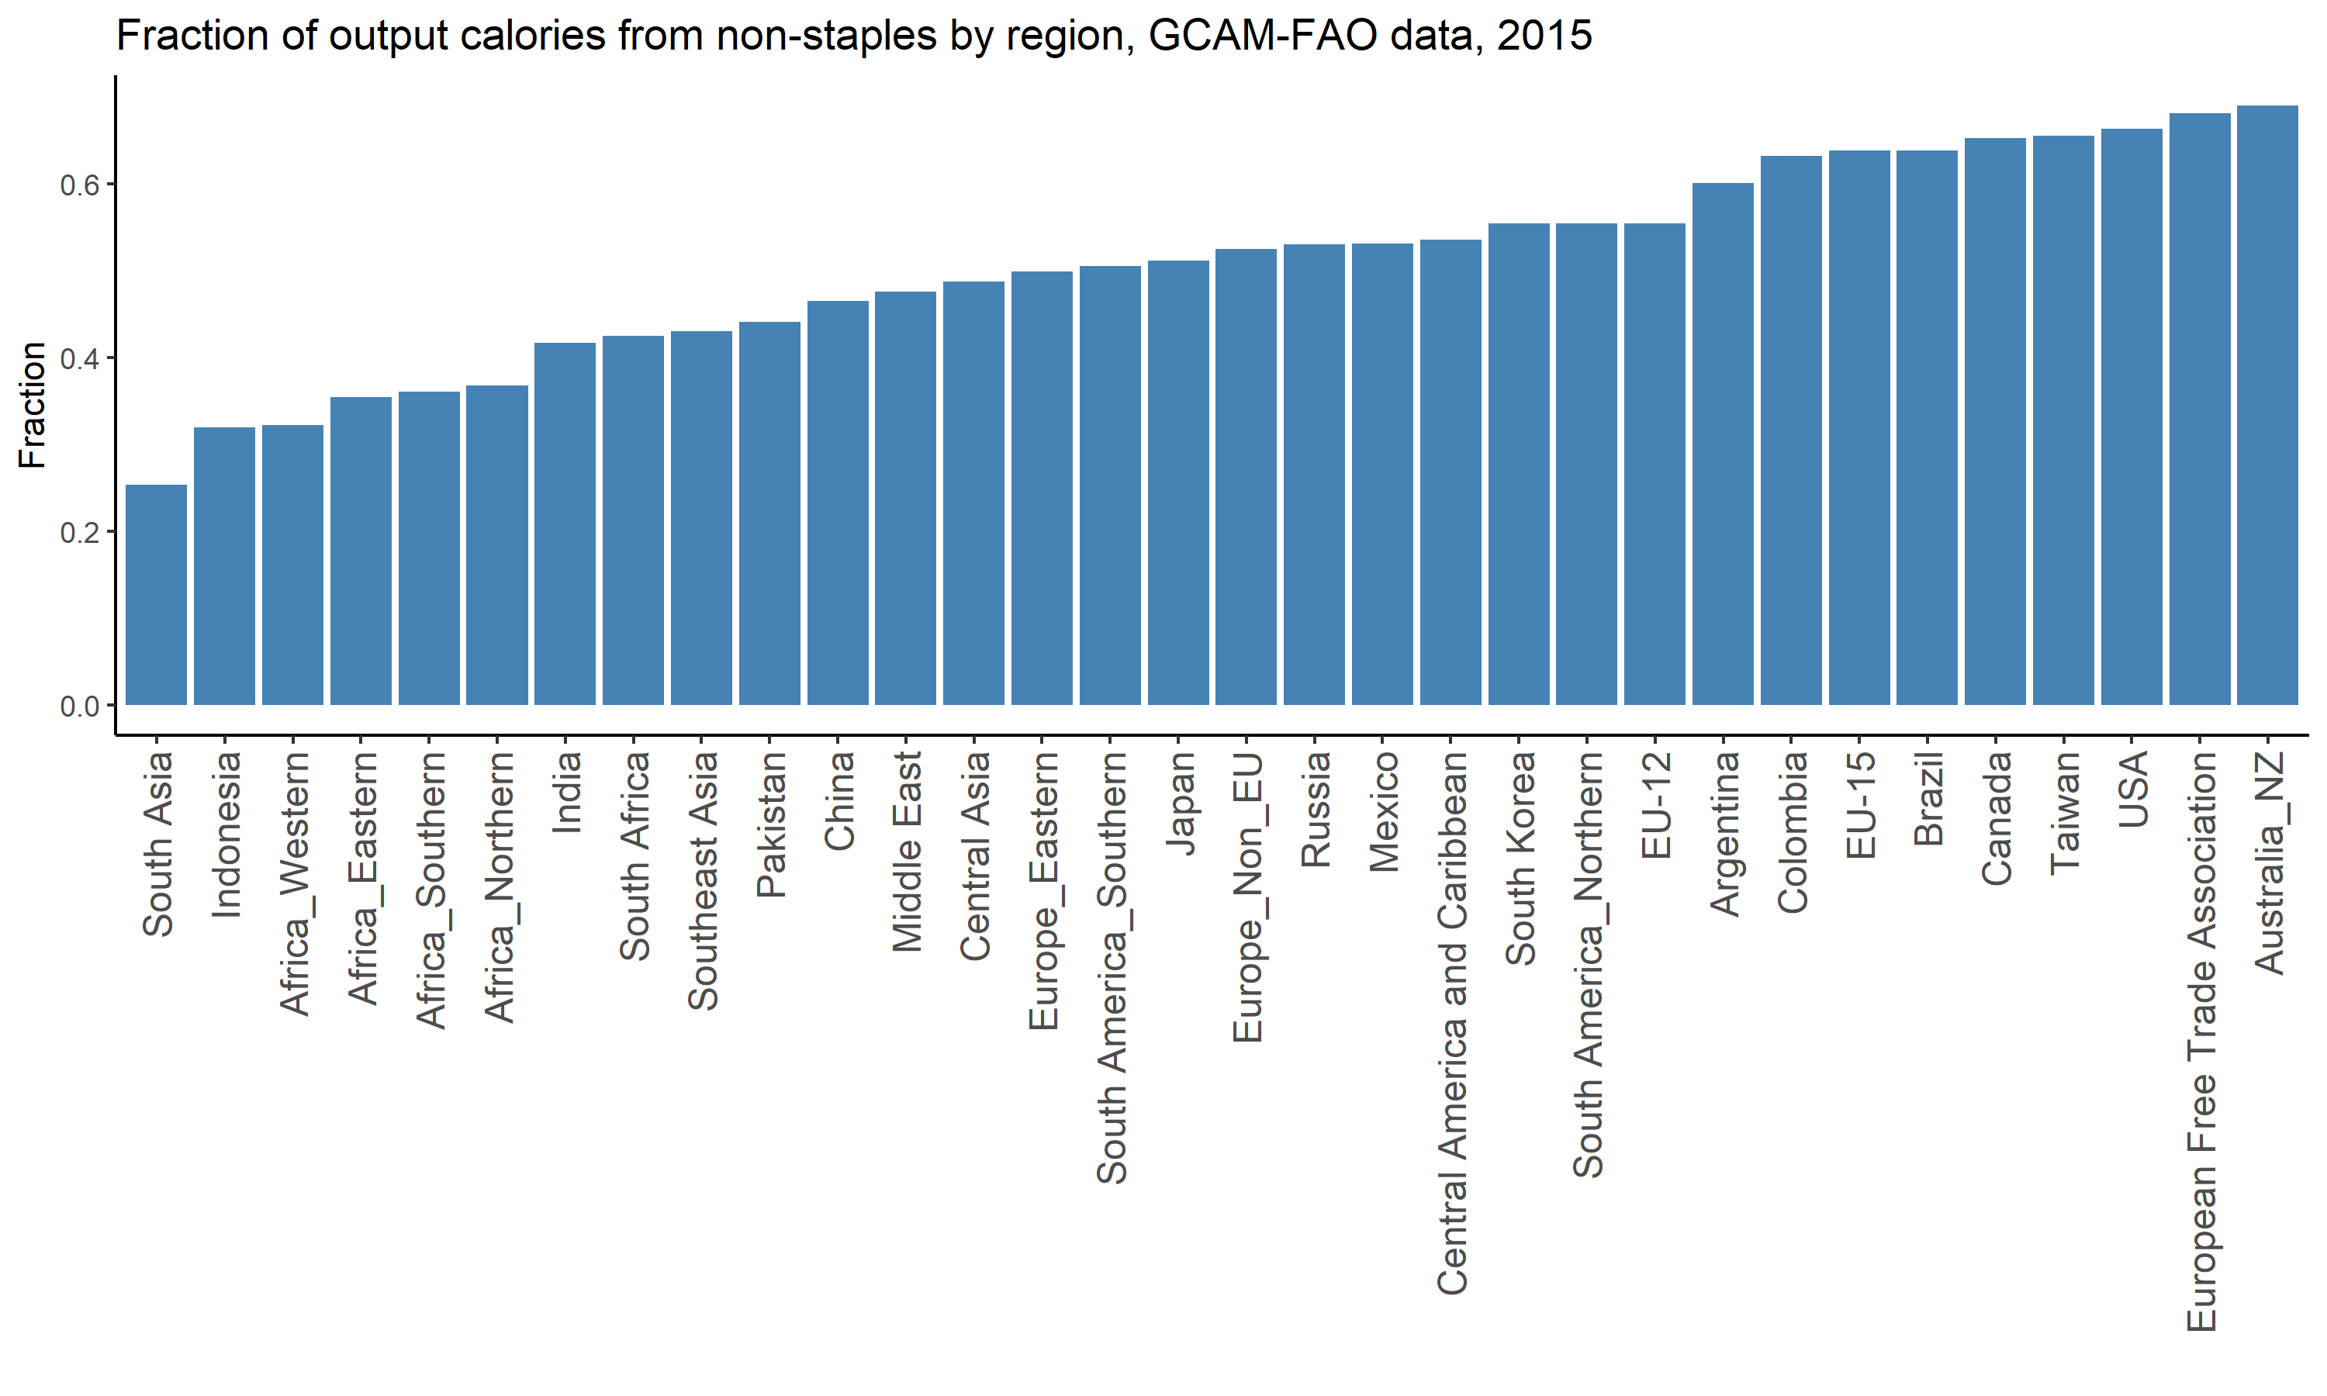
Food processing energy intensity and non-staples fraction

Slide 24
Questions
Calibrate food processing to domestically produced crops, or domestically consumed crops (accounting for exports and imports)?
Use the same fuel ratios for each food product/staples vs non-staples?
May be able to vary this based on literature

