Slide 1
Food processing discussion
Notes:
Stock image of cloud formations

Slide 2
Food processing sector overview
Main uses of energy in food processing, across all subsectors¹:
Process heating and drying (59%)
Cooling and refrigeration (16%)
Mechanical equipment (12%)
Infrastructure (HVAC and lighting) (8%)
Energy intensive processes include “materials reception and preparation; size reduction, mixing and forming; separation techniques; product processing technologies; heat processing; concentration by heat; chilling and freezing; post-processing operations; and utility processes”²
Wang, 2014, https://link.springer.com/article/10.1007/s12053-014-9256-8?utm_source=getftr&utm_medium=getftr&utm_campaign=getftr_pilot
UK Industrial Decarbonisation & Energy Efficiency Roadmaps to 2050 – Food and Drink, 2015, https://assets.publishing.service.gov.uk/government/uploads/system/uploads/attachment_data/file/416672/Food_and_Drink_Report.pdf

Slide 3
Food processing sector overview
Energy-saving and decarbonization options:
Energy efficiency measures, process optimization
Electrification of heat (heat pumps and electric boilers)
CHP/cogen
Fuel switching to renewables – biomass, solar thermal, geothermal heat pumps
Waste heat utilization
Food waste reduction, demand-side measures
(Note: CCS, hydrogen seem less likely to play a role for food processing)

Slide 4
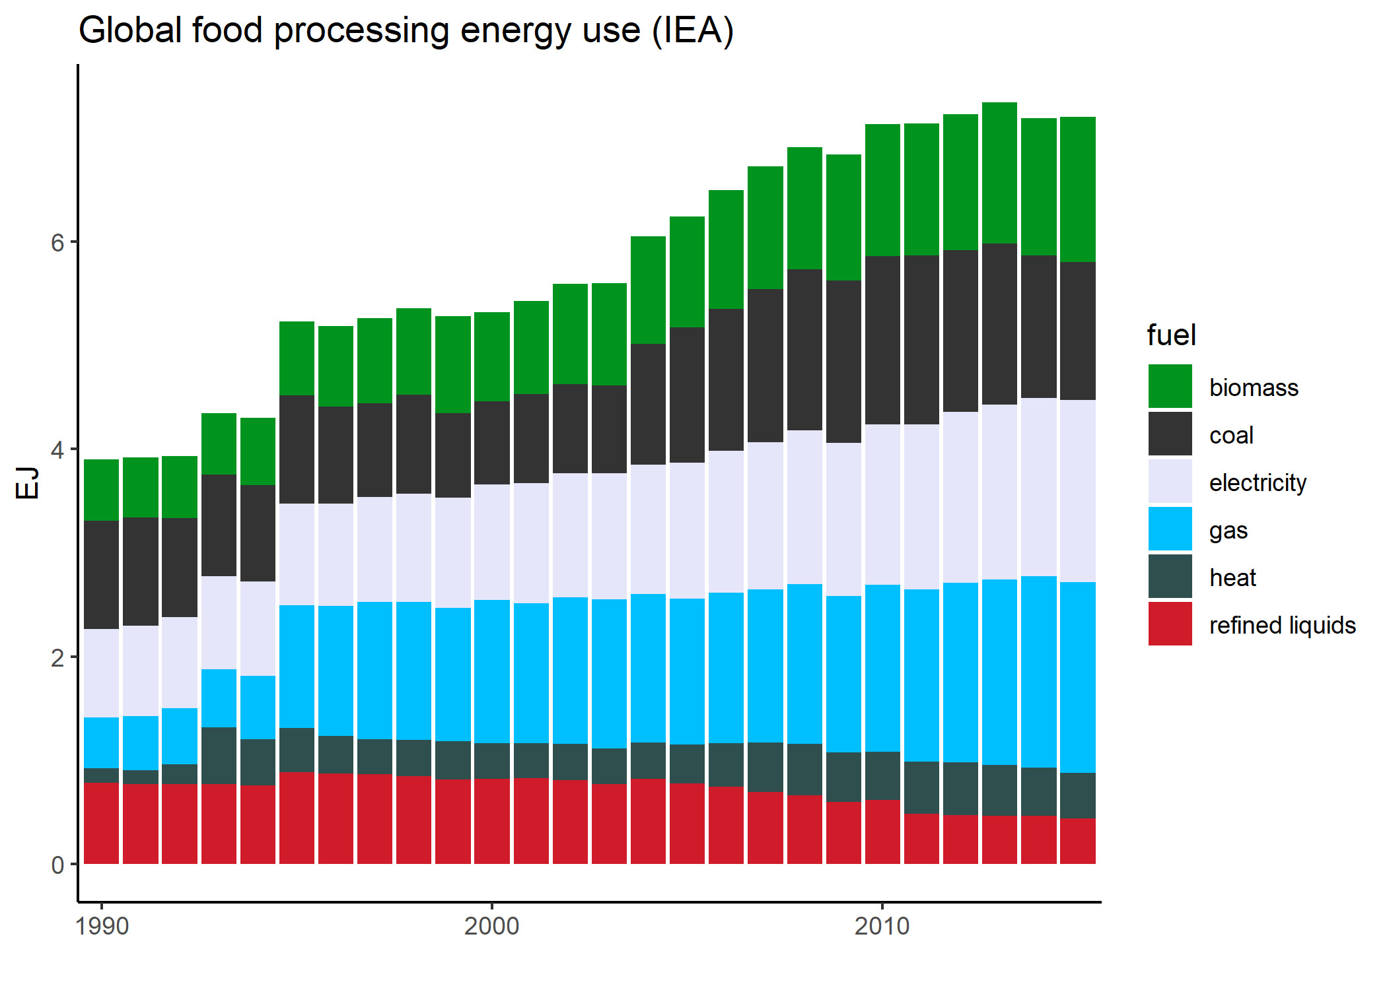
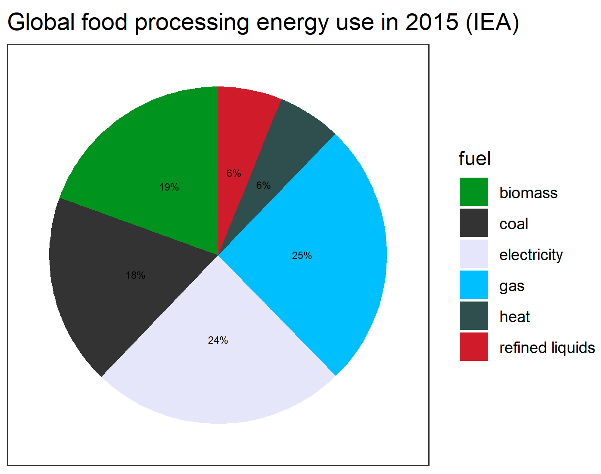
Food processing sector overview – IEA data

Slide 5
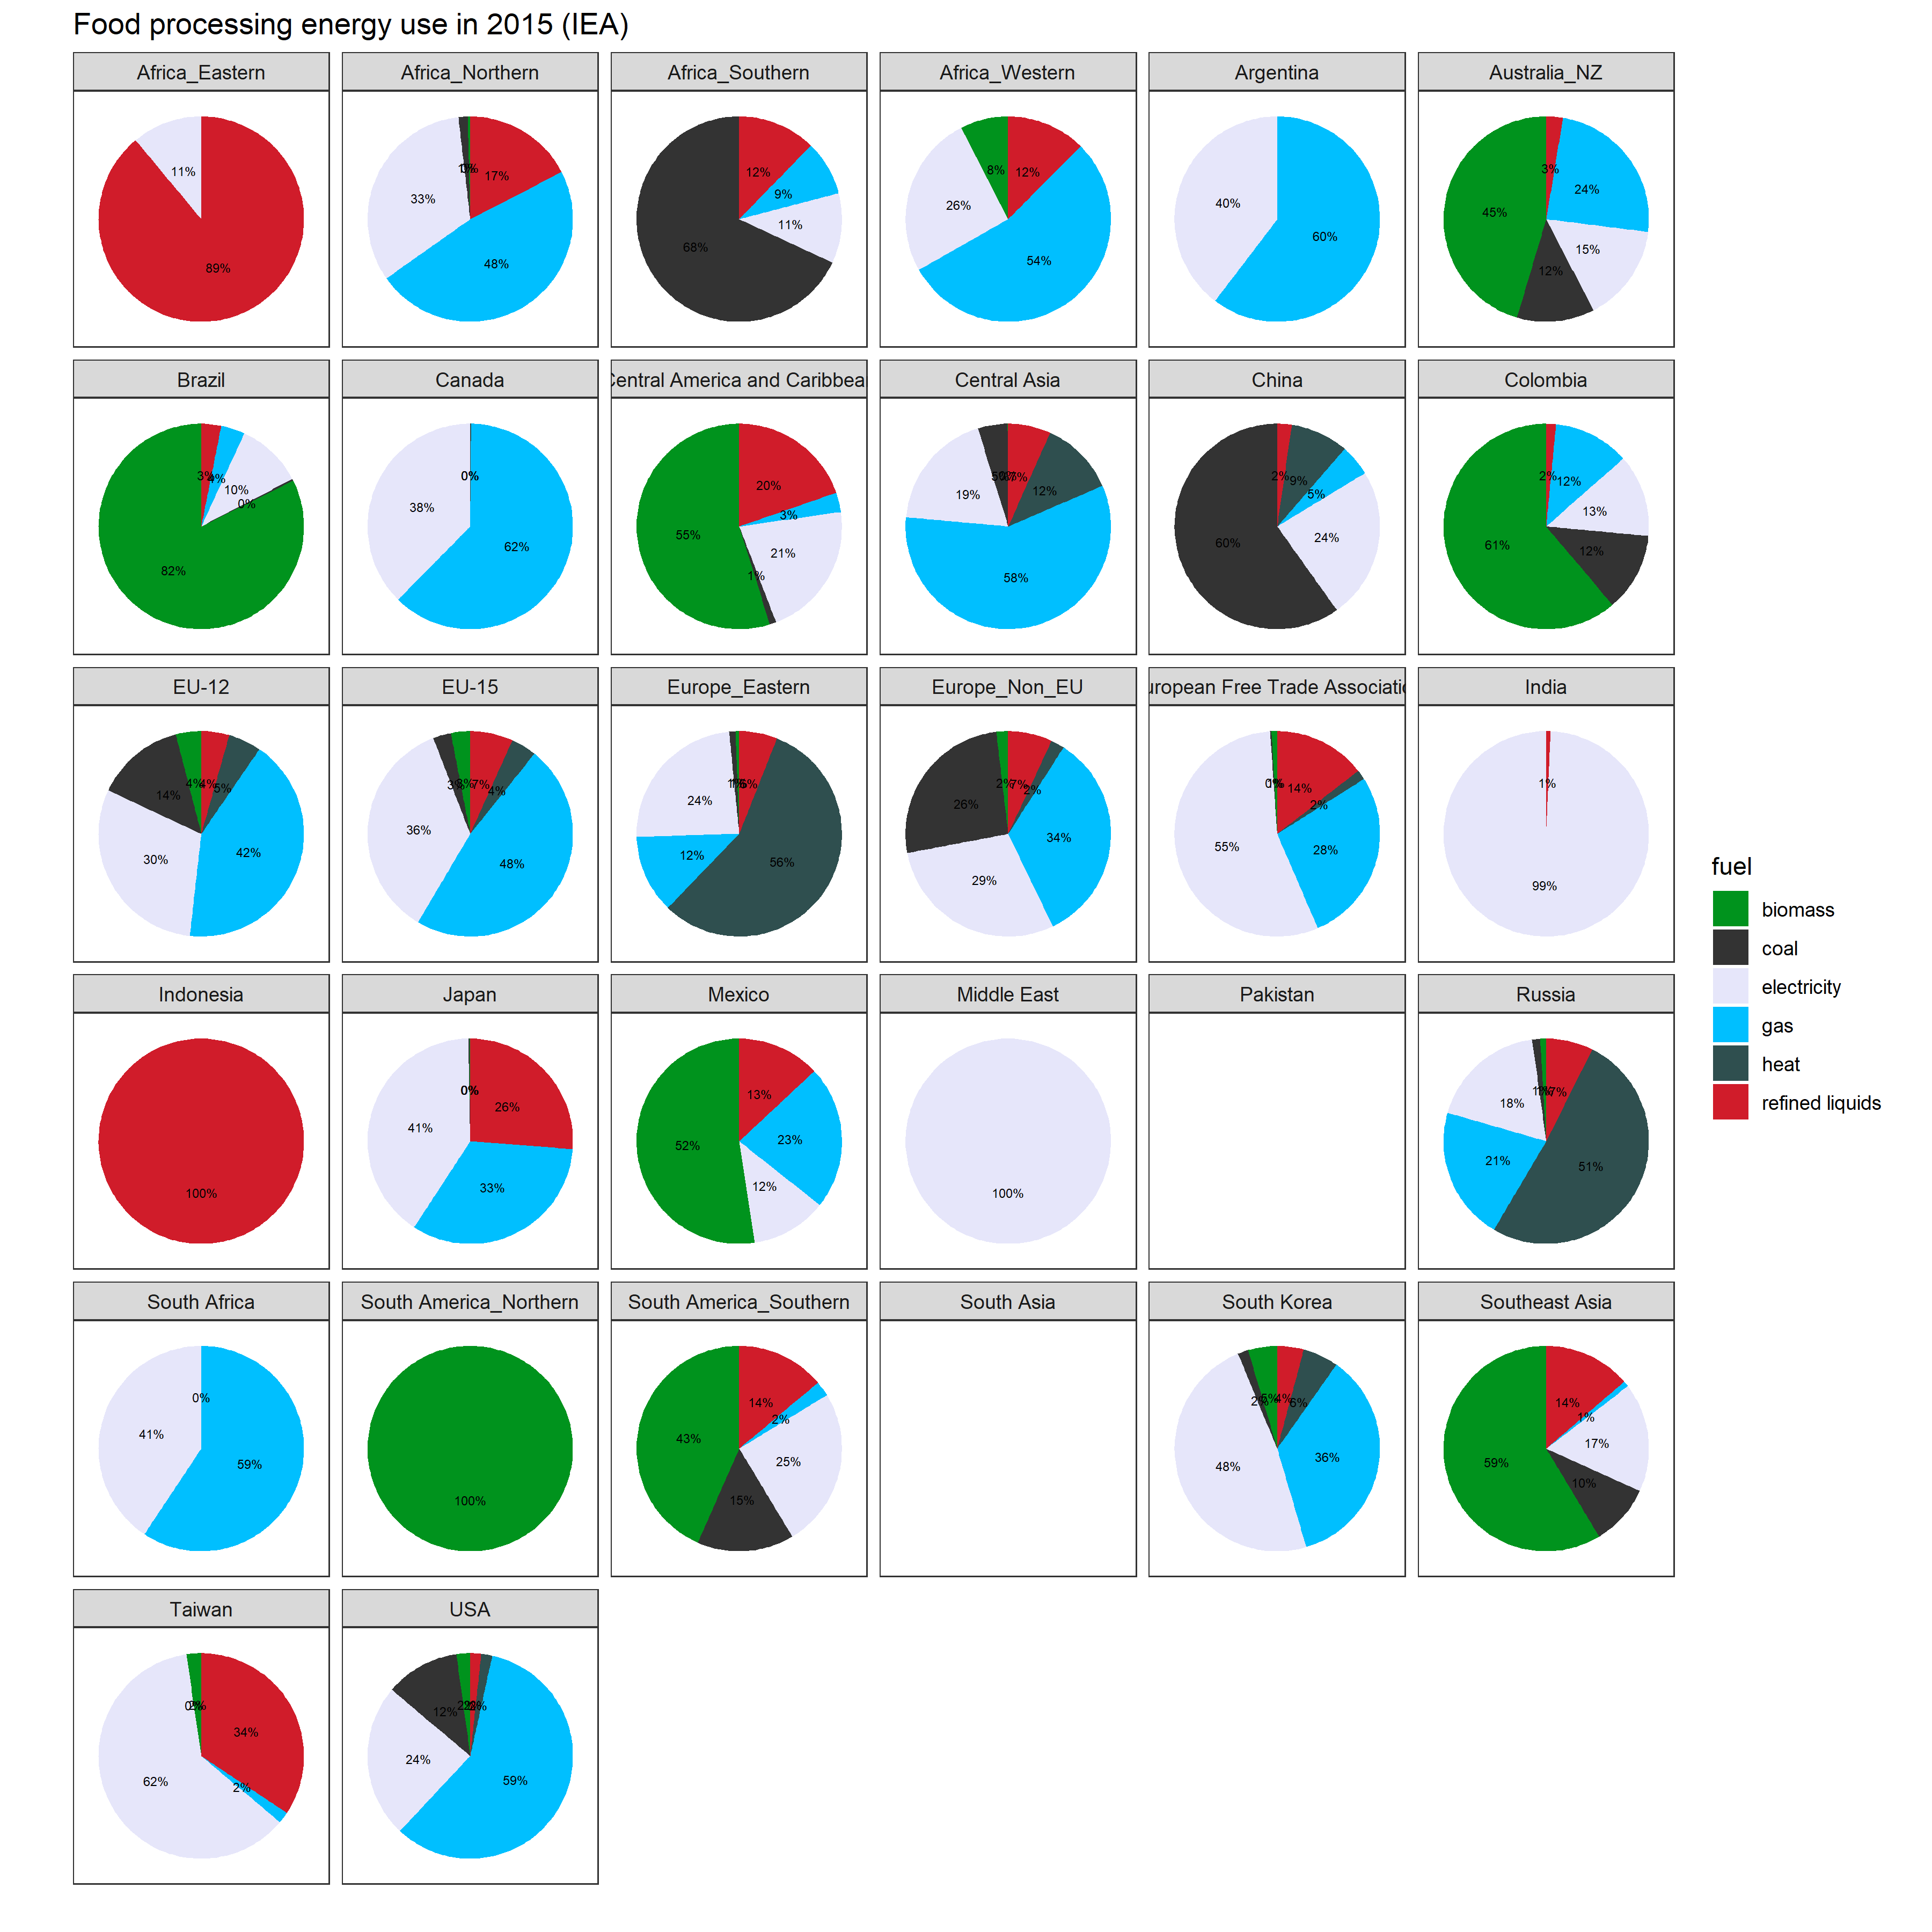
Food processing sector overview – IEA data
Notes:
Pakistan and South Asia do have food processing data in Comtrade, so this is likely missing in IEA

Slide 6
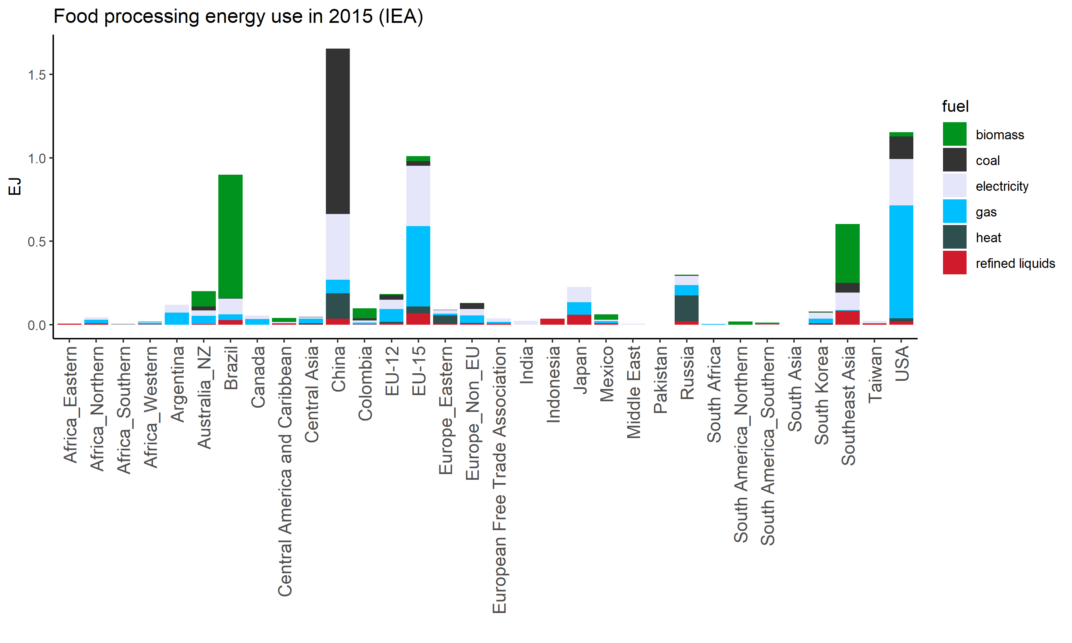
Food processing sector overview – IEA data

Slide 7
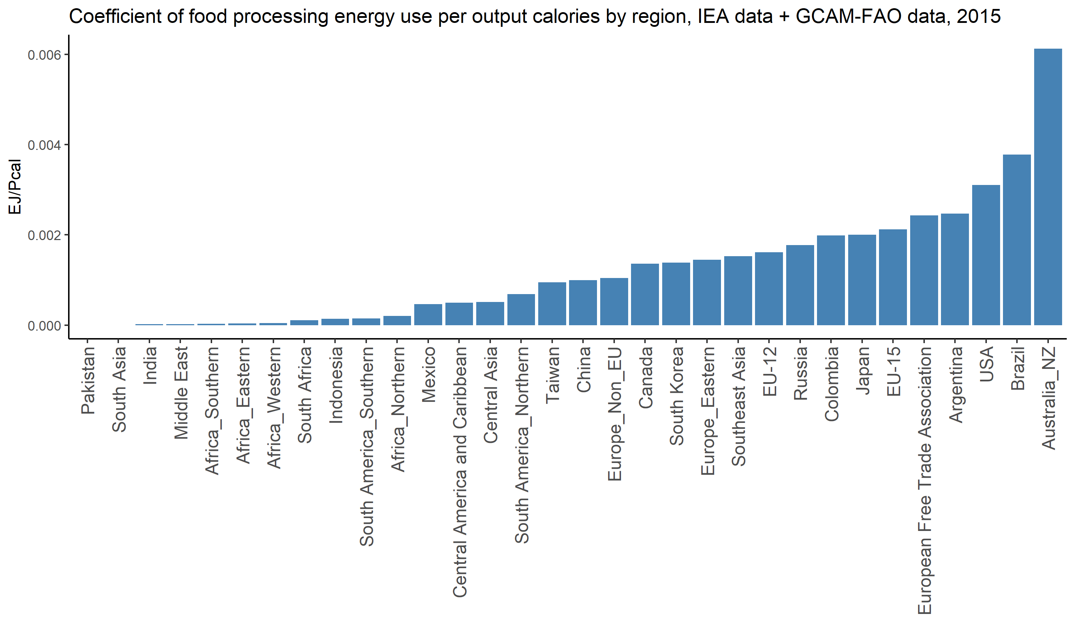
Food processing energy intensity
Note: output calories are calories for domestic consumption.

Slide 8
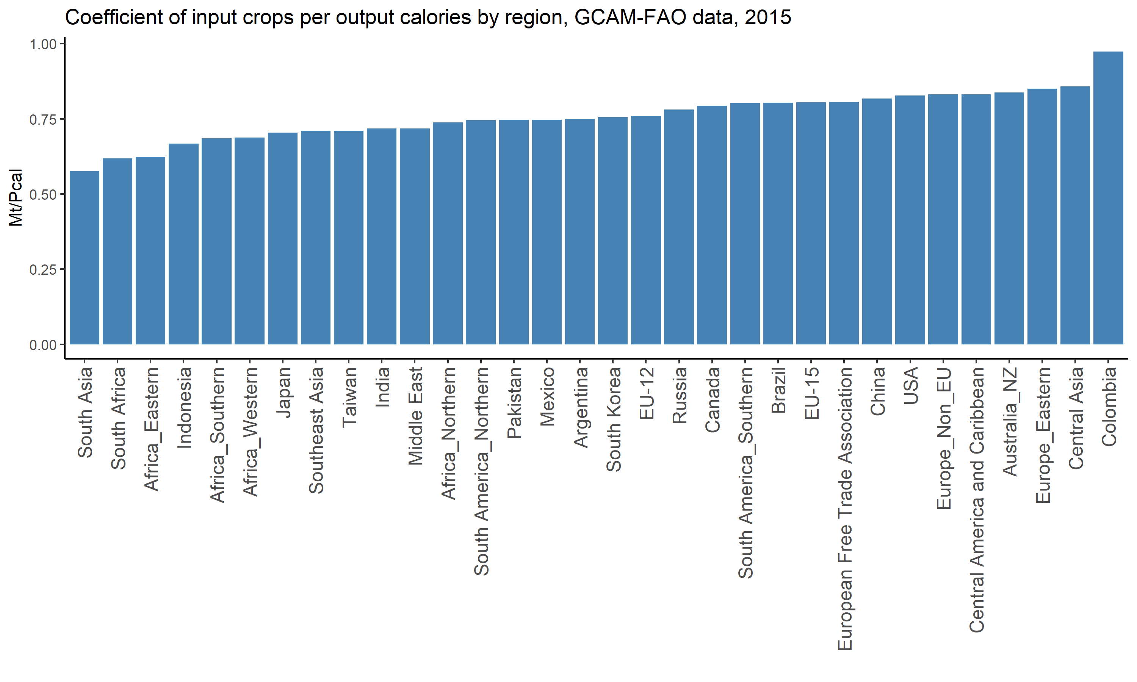
Food processing energy intensity and input crop intensity
Note: output calories are calories for domestic consumption.

Slide 9
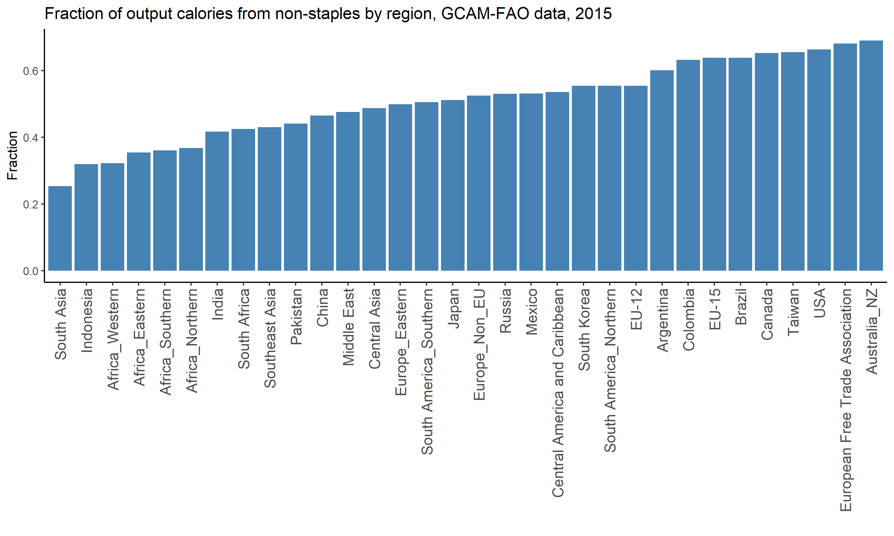
Food processing energy intensity and non-staples fraction
Note: output calories are calories for domestic consumption.

Slide 10
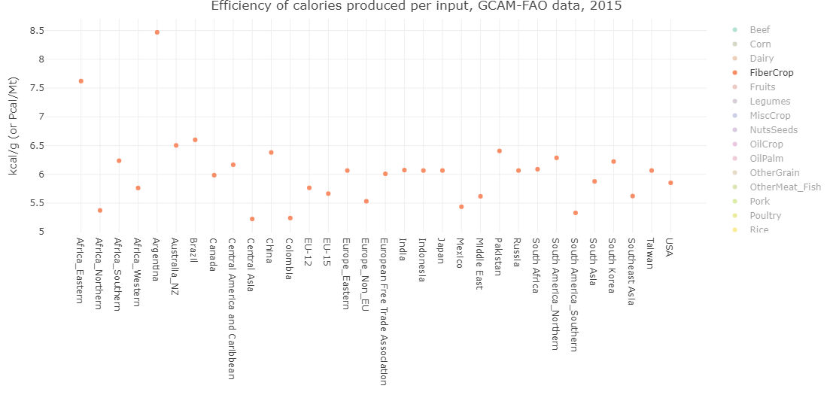
Variation in input crop coefficient by region

Slide 11
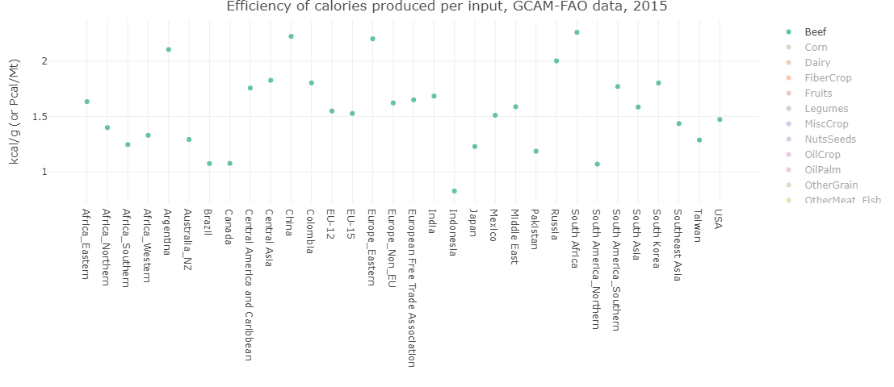
Variation in input crop coefficient by region

Slide 12
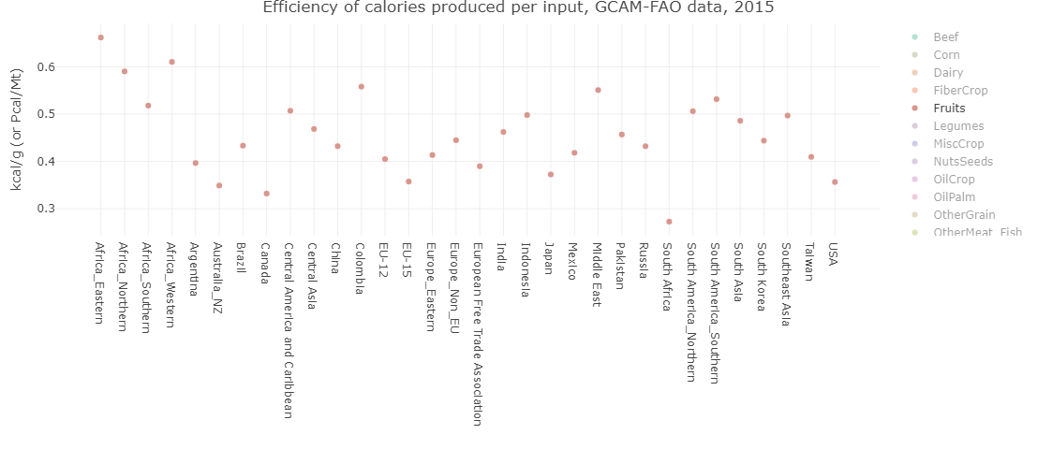
Variation in input crop coefficient by region

Slide 13
Proposed structure
Food processing
Total food demand (staples + non-staples)
Process heat
Electricity
Biomass
Coal
Gas
Refined liquids
Electricity
CHP (heat)
Solar thermal
Geothermal heat pumps
Electricity
CHP (electricity)
Challenges:
Less explicit processing level (though this could still be indicated with changes in energy coefficients with time)
Advantages:
More straightforward to implement

Slide 14
Potential strategies
Strategy 1:
Use IEA data to directly calculate coefficients
Challenge: disaggregating staples vs non-staples (or to finer categories)
Strategy 2:
Obtain coefficients of energy use for processing for different products from literature estimates
Challenge: high degree of variability in estimates, depending on location/sub-product type/etc.
Possibility: obtain breakdown of heat vs electricity for each product to disaggregate process heat vs electricity
Scale the theoretical coefficients so that the overall energy consumption matches IEA
Challenge: IEA regions with zero energy used in food processing
Assumption: relative level of processing is constant across crops in a given region

Slide 16
Structure possibilities
Advantages:
More explicit breakout of food types, matching their varied levels of processing required
Challenges:
Accurate calibration for all crops
Less explicit processing level (though this could still be indicated with changes in energy coefficients with time)
Food processing
Staples
Non-staples
Process heat
Electricity
Fruit/veg
Animal protein
All staples (rice, corn, wheat, other grain, root tuber)
Process heat
Electricity
Process heat
Electricity
Plant protein
Process heat
Electricity
Other*
Process heat
Electricity
*oil, fiber crops, sugar crops, misc.

Slide 17
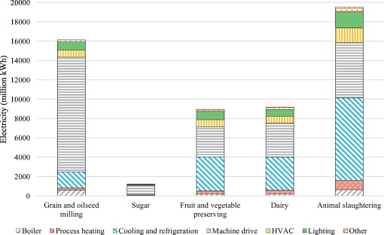
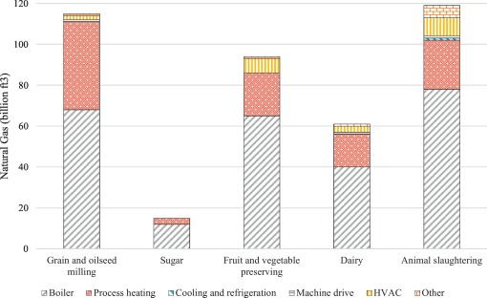
Food processing sector overview
US electricity and natural gas use in the food processing sector
Compton et al., 2018, https://www.sciencedirect.com/science/article/pii/S1466856418301917

Slide 18
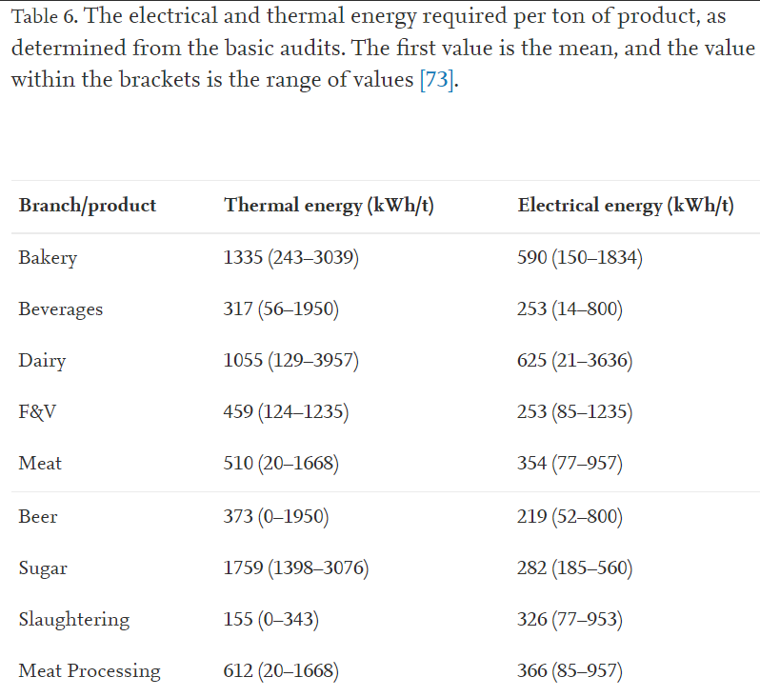
Food processing sector overview
From energy audits for small and medium-sized food and beverage companies in Austria, France, Germany, Poland, Spain, UK
Meyers et al., 2016, https://www.sciencedirect.com/science/article/pii/S0360544216303644

