Slide 1
Food processing discussion
Notes:
Stock image of cloud formations

Slide 2
Food processing work overview
Goal: break out food processing from “other industry”

Slide 3
Food processing work overview
Goal: break out food processing from “other industry”
Proposed plan:
Break out food processing simply, with a demand set by income and price elasticities, as typical for GCAM industries

Slide 4
Food processing work overview
Goal: break out food processing from “other industry”
Proposed plan:
Break out food processing simply, with a demand set by income and price elasticities, as typical for GCAM industries
Implement a one-directional linkage between food demand and food processing energy use, where food demand (output calories) sets the scale of food processing energy use

Slide 5
Food processing work overview
Goal: break out food processing from “other industry”
Proposed plan:
Break out food processing simply, with a demand set by income and price elasticities, as typical for GCAM industries
Implement a one-directional linkage between food demand and food processing energy use, where food demand (output calories) sets the scale of food processing energy use
Explore effect of food processing energy use on food (just check)

Slide 6
Proposed structure
Food processing
Process heat
Biomass
Coal
Gas
Refined liquids
Electricity
Solar thermal
Geothermal heat pumps
Electricity
Heat
Food
Food demand
Step 1

Slide 7
Proposed structure
Food processing
Process heat
Biomass
Coal
Gas
Refined liquids
Electricity
Solar thermal
Geothermal heat pumps
Electricity
Heat
Food demand
Food
Step 2

Slide 8
Proposed structure
Food processing
Process heat
Biomass
Coal
Gas
Refined liquids
Electricity
Solar thermal
Geothermal heat pumps
Electricity
Heat
Food demand
Food
Step 3
?

Slide 9
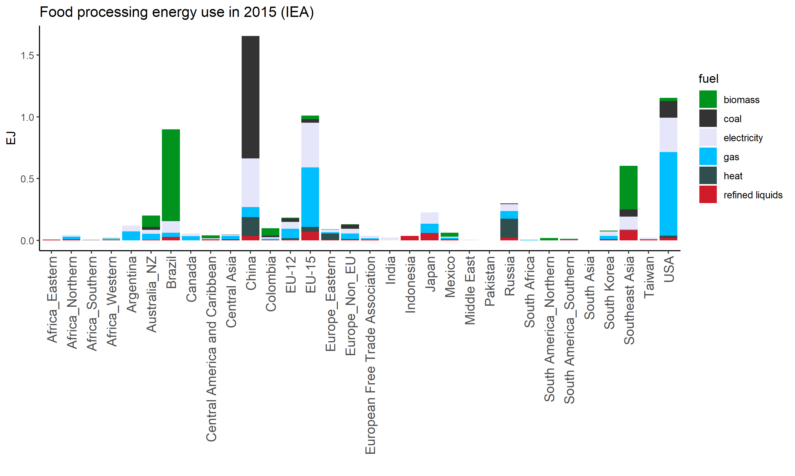
Initial breakout challenges
Regions with no (or very little) energy used in food processing in IEA data.
Notes:
This is where I am right now

Slide 10
Initial breakout challenges
Regions with no (or very little) energy used in food processing in IEA data.
Proposed solution: for regions with good data, calculate a relationship between food processing energy use, food production in calories, GDP, (input crops in Mt) → use this to fill in data for regions where it is missing
Notes:
This is where I am right now

Slide 11
Initial breakout challenges
Regions with no (or very little) energy used in food processing in IEA data.
Proposed solution: for regions with good data, calculate a relationship between food processing energy use, food production in calories, GDP, (input crops in Mt) → use this to fill in data for regions where it is missing
Initial testing at a GCAM region level and with just a few years → R squared 0.74
Notes:
This is where I am right now

Slide 12
Initial breakout challenges
Regions with no (or very little) energy used in food processing in IEA data.
Proposed solution: for regions with good data, calculate a relationship between food processing energy use, food production in calories, GDP, (input crops in Mt) → use this to fill in data for regions where it is missing
Initial testing at a GCAM region level and with just a few years → R squared 0.74
This relationship could also be used for the linkage between food demand and food processing later
Notes:
This is where I am right now

Slide 13
Initial breakout challenges
Regions with no (or very little) energy used in food processing in IEA data.
Allocating cogen to food processing
Notes:
This is where I am right now

Slide 14
Continued areas for thought
Linkage between food demand and food processing energy use:
Food processing energy use ~ calories + input crops (or conversion rate of crops to calories?) + GDP (per capita?) + ?
More heavily relying on the conversion rate of crops to calories
How to have feedback from food processing energy use (prices) on food prices and food demand
Non-energy costs
Notes:
This is where I am right now

Slide 15
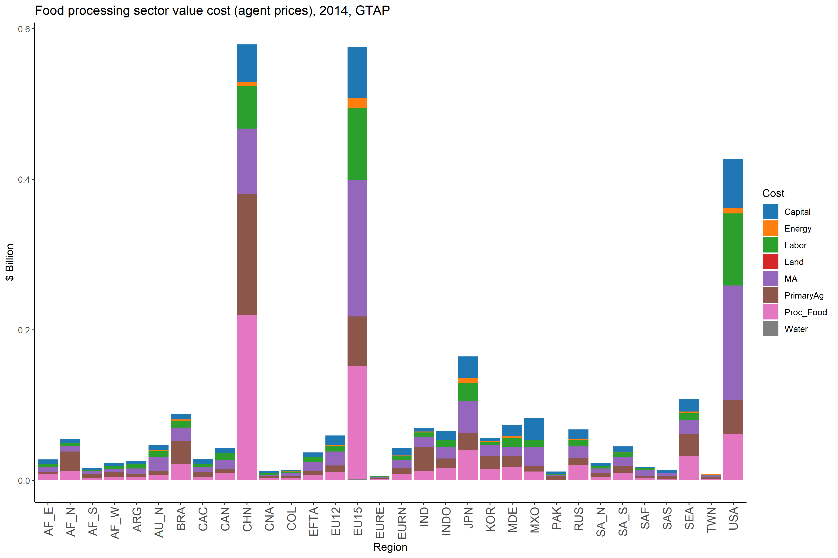
GTAP data
Notes:
This is where I am right now

Slide 16
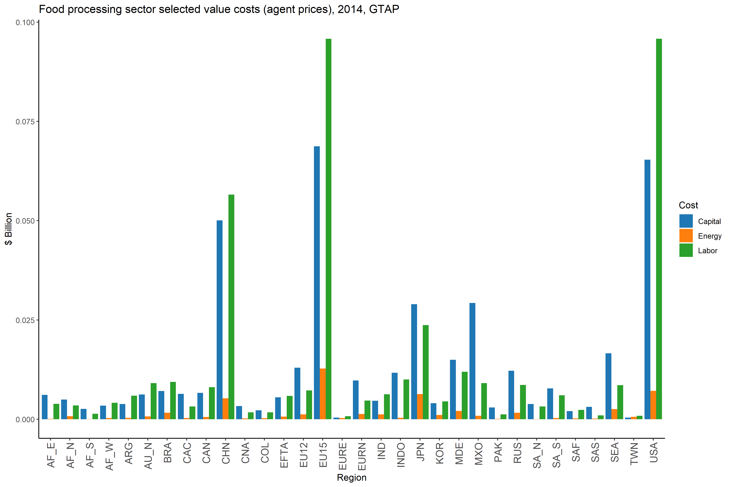
GTAP data
Notes:
This is where I am right now

