Slide 1
Food processing discussion
Notes:
Stock image of cloud formations

Slide 2
Food processing linkage structure
Food processing
Process heat
Biomass
Coal
Gas
Refined liquids
Electricity
Solar thermal
Geothermal heat pumps
Electricity
Heat
Food demand
Staples
Corn
Crop inputs
EJ per calorie
Non-staples
Fruits + veg
Crop inputs
EJ per calorie
…
…
Rice
Crop inputs
EJ per calorie
Fiber crop
Crop inputs
EJ per calorie
*No price for the energy inputs to crops
Food processing
Notes:
Obtain the coefficient of EJ of food processing energy use per calorie consumed for each region
Use those coefficients, and the consumption of food, to determine the energy used for food processing based on food demand
Initially, coefficients will be the same for all commodities, but this could be updated later
Coefficients will also be constant with time after 2015, but could be changed exogenously to reflect different scenarios

Slide 3
Updates since last meeting
deception seems to be working

Slide 4
Updates since last meeting
deception seems to be working
Functioning linkage between food demand and food processing energy use
→ scale of food processing energy use is set by food demand
No price feedback from food processing energy use on food demand (though structure allows this)

Slide 5
Updates since last meeting
deception seems to be working
Functioning linkage between food demand and food processing energy use
→ scale of food processing energy use is set by food demand
No price feedback from food processing energy use on food demand (though structure allows this)
Proposed methods for allocating some of the historical “other industry energy use” to food processing energy use in regions where food processing energy use is low/zero

Slide 6
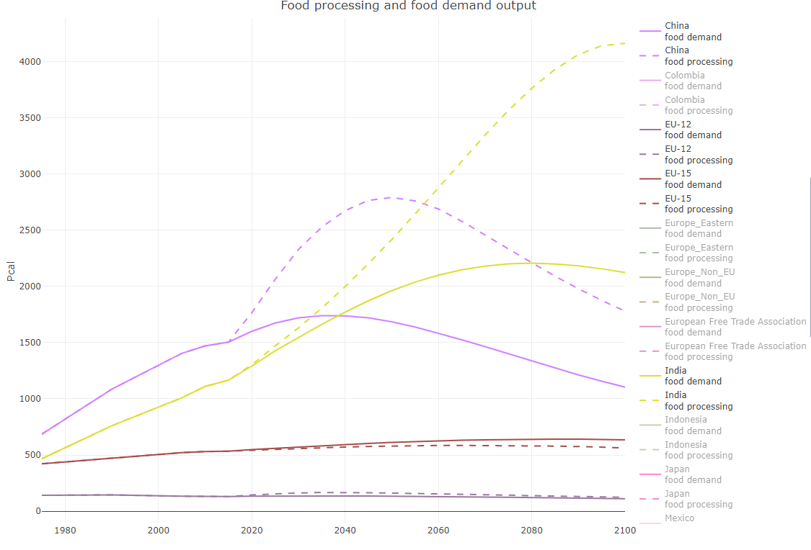
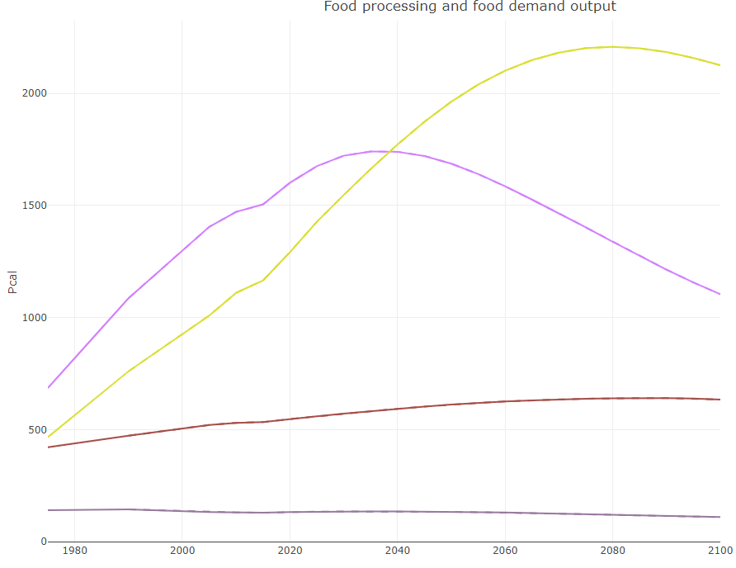
Food demand and food processing energy use linkage
Before:
After:

Slide 7
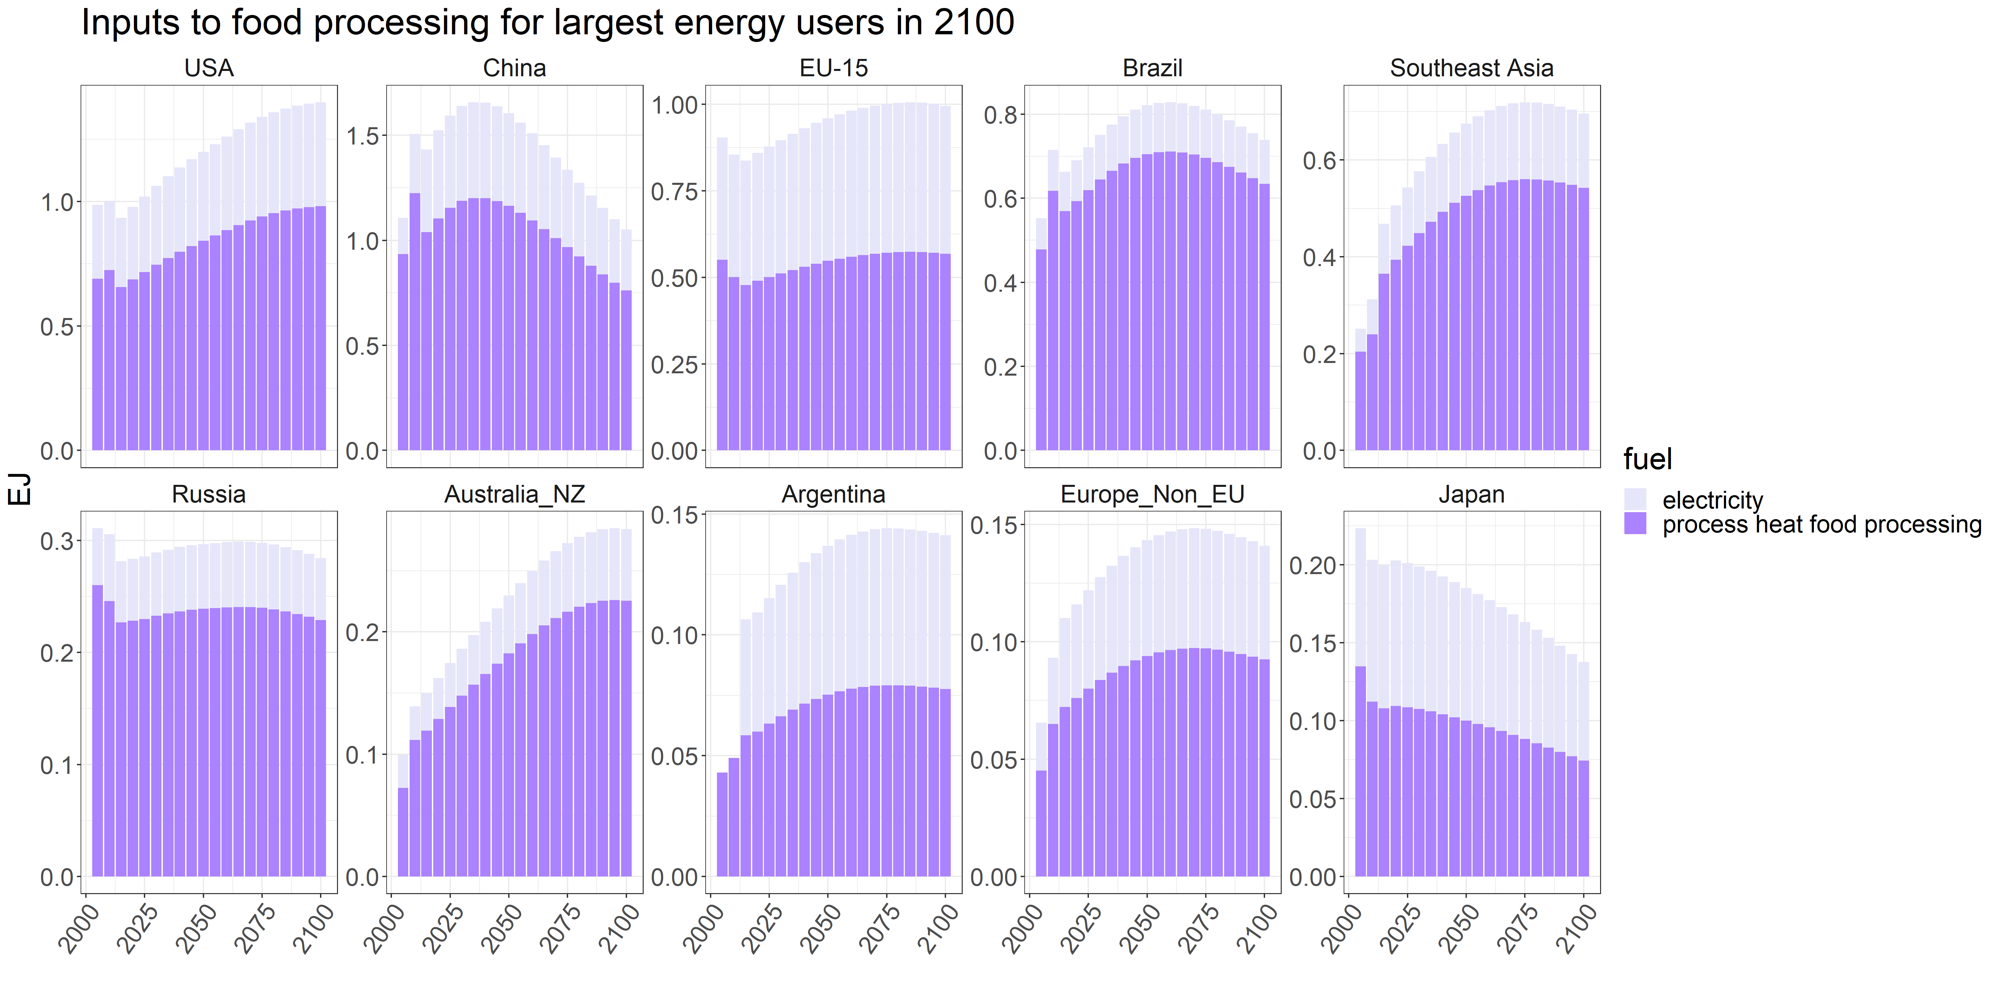
Food demand and food processing energy use linkage

Slide 8
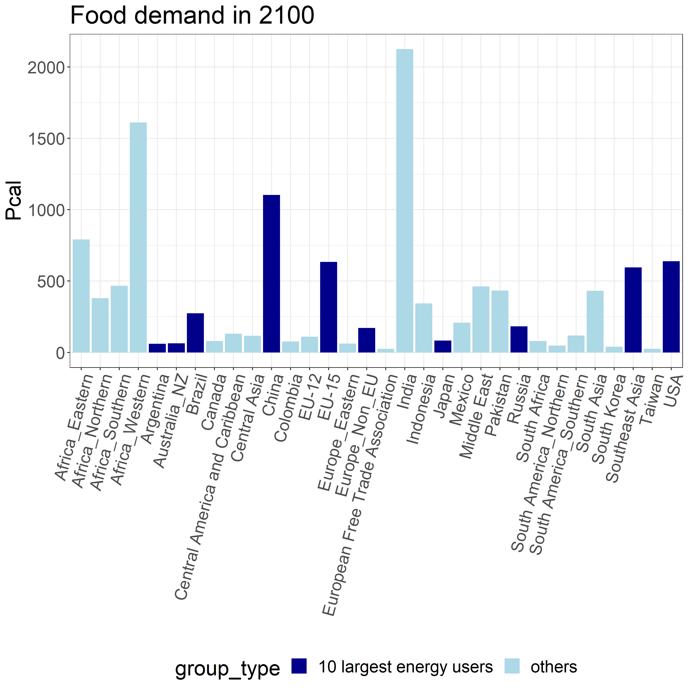
Food demand and food processing energy use linkage

Slide 9
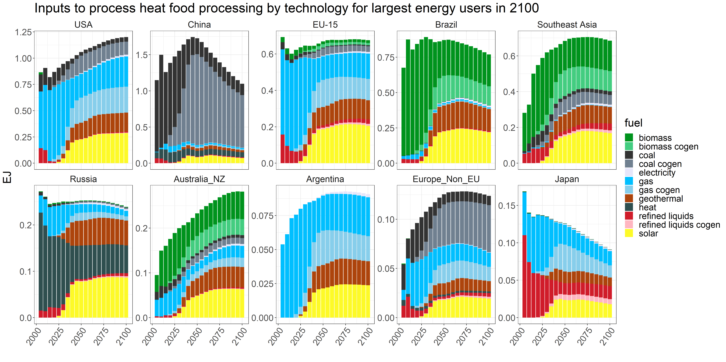
Food demand and food processing energy use linkage
Solar and geothermal come in very aggressively → need to adjust
Cogen

Slide 10
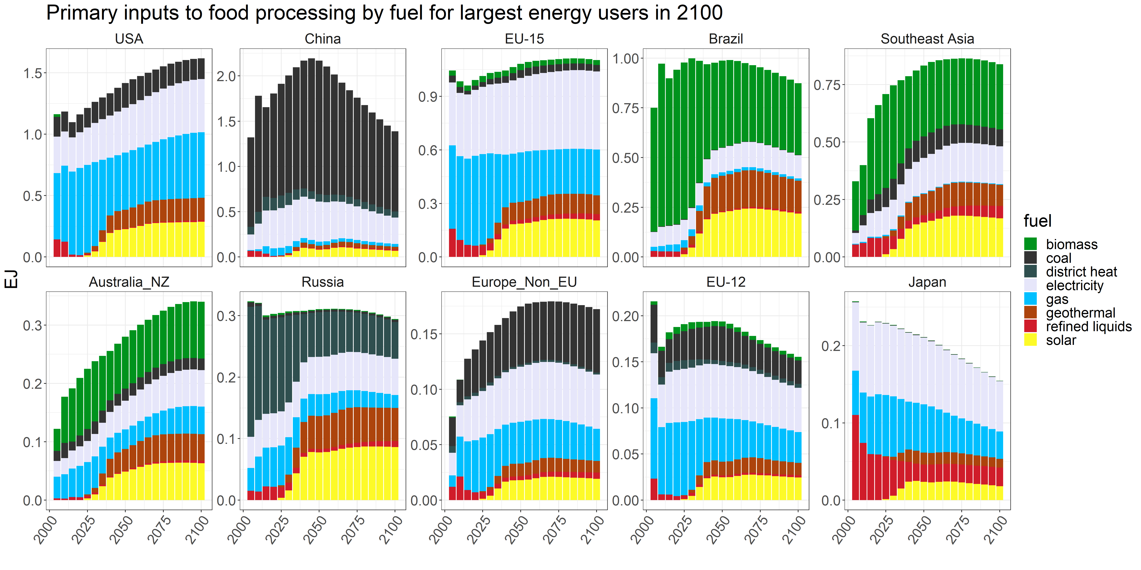
Food demand and food processing energy use linkage

Slide 11
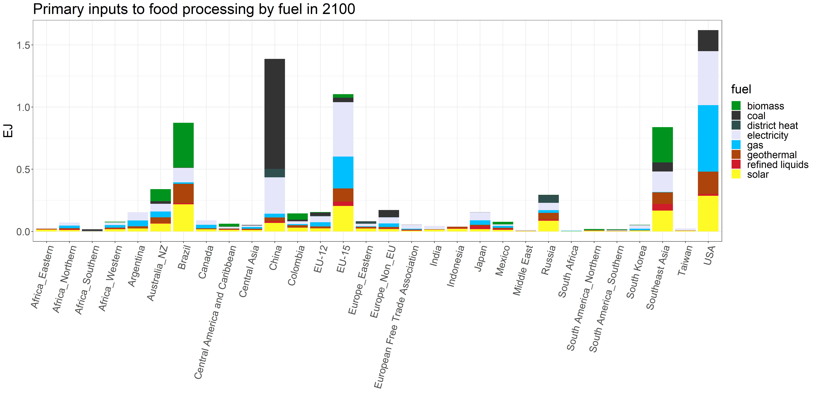
Food demand and food processing energy use linkage

Slide 12
Food demand and food processing energy use linkage

Slide 13
Relationship between food consumption and food processing energy use
Goal: allocate some of the “other industrial energy use” to food processing in regions where food processing energy use is low/zero

Slide 14
Relationship between food consumption and food processing energy use
Goal: allocate some of the “other industrial energy use” to food processing in regions where food processing energy use is low/zero
Tried including feed in the calculation (energy use ~ food + feed), but this yields a positive coefficient on feed and a negative coefficient on food

Slide 15
Relationship between food consumption and food processing energy use
Goal: allocate some of the “other industrial energy use” to food processing in regions where food processing energy use is low/zero
Tried including feed in the calculation (energy use ~ food + feed), but this yields a positive coefficient on feed and a negative coefficient on food
Potential strategies:
Linear model between food processing energy use coefficient (energy/calories) and GDP per capita and/or non-staples fraction
Grouping regions based on GDP per capita and using the group median (energy/calories) coefficient to infill for regions with limited data
Grouping regions based on non-staples fraction and using the group median (energy/calories) coefficient to infill for regions with limited data

Slide 16
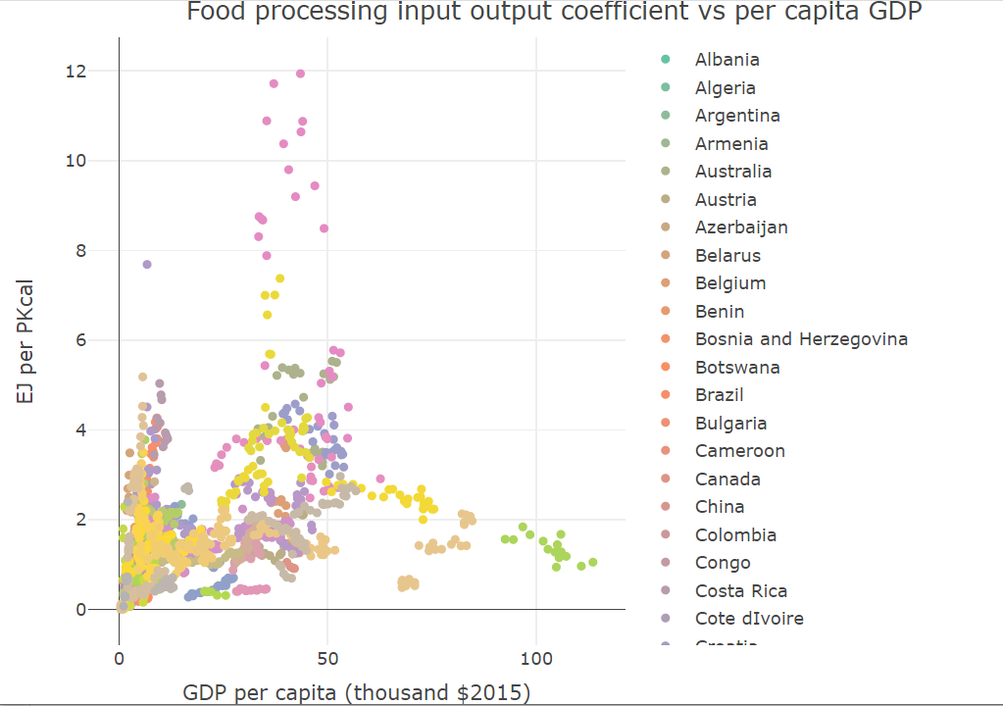
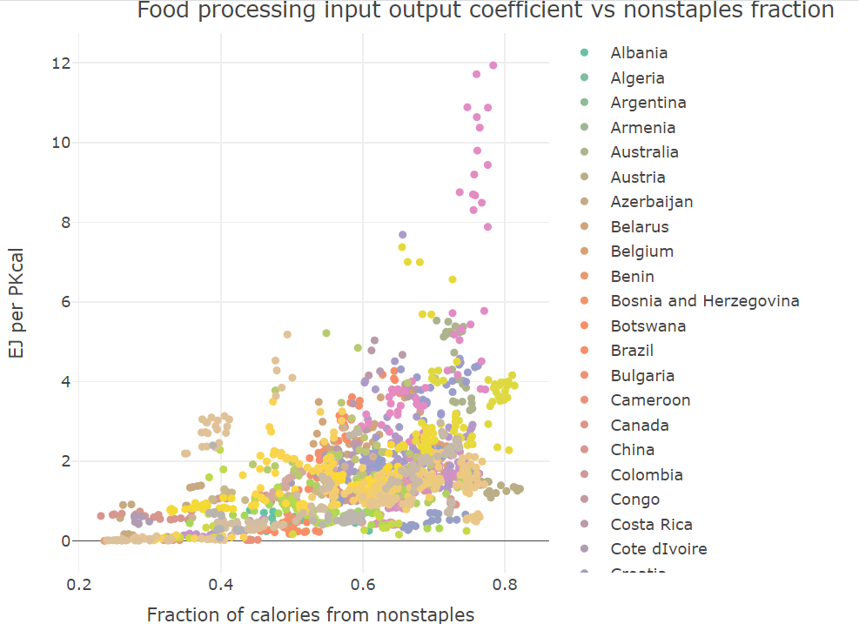
Relationship between food consumption and food processing energy use
Linear model between food processing energy use coefficient (energy/calories) and GDP per capita and/or non-staples fraction
*only using regions + years from 1990 onwards with < 50% of industry energy in non-specified industry, and > 1% of industry energy in food processing
EJ/PKcal = 0.011*(GDP per capita) + 2.65*(non-staples fraction)
R squared: 0.6882

Slide 17
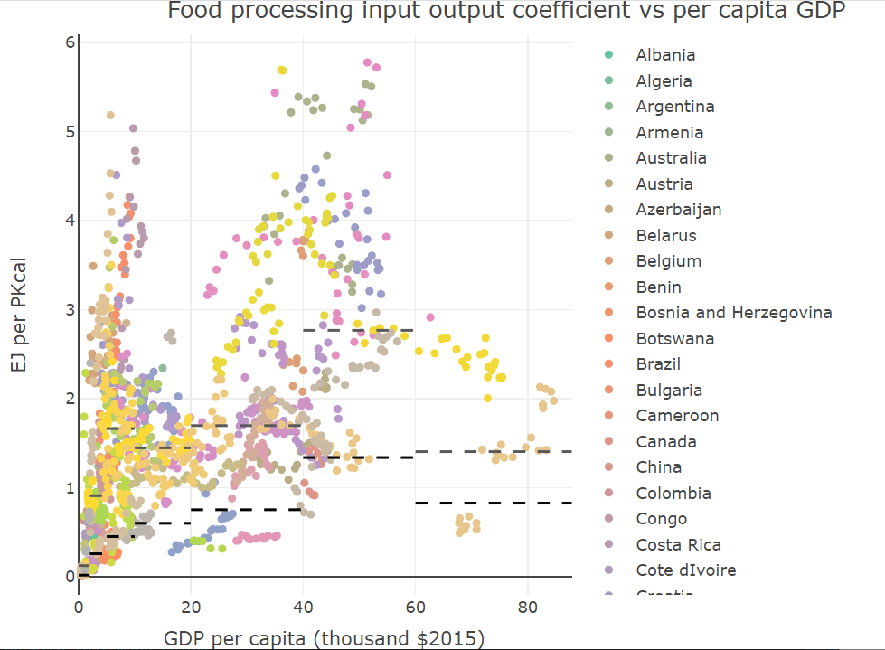
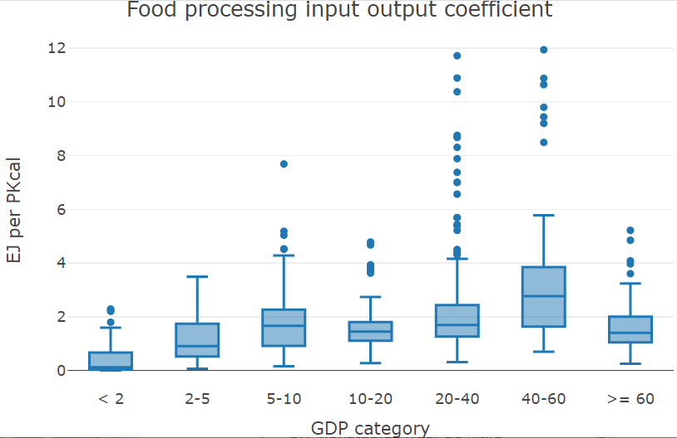
Relationship between food consumption and food processing energy use
Grouping regions based on GDP per capita and using the group median (energy/calories) coefficient to infill for regions with limited data
*only using regions + years from 1990 onwards with < 50% of industry energy in non-specified industry, and > 1% of industry energy in food processing
Note limited scale; 10th percentile = black dash; median = gray dash
Could use median or a lower percentile
Challenges with variation in the data; issues with data for low GDP regions

Slide 18
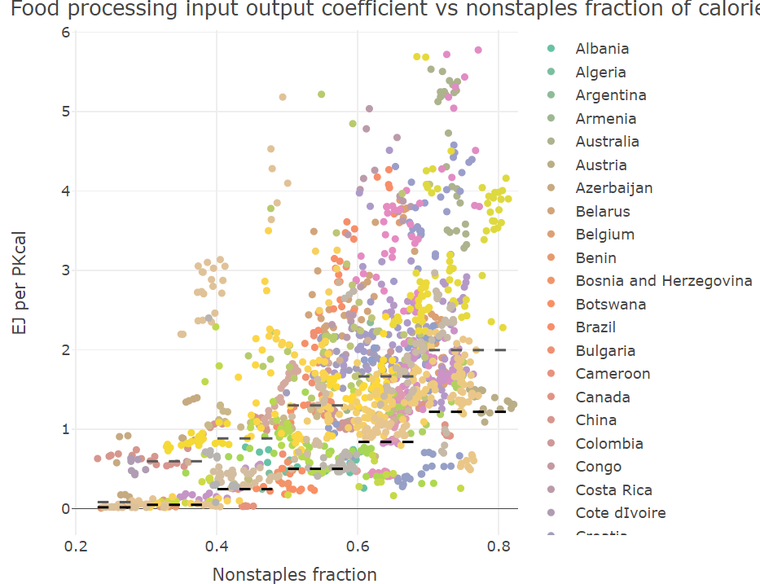
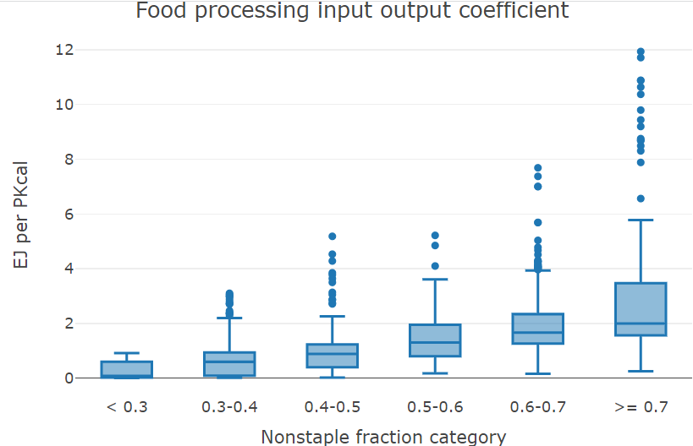
Relationship between food consumption and food processing energy use
Grouping regions based on non-staples fraction and using the group median (energy/calories) coefficient to infill for regions with limited data
*only using regions + years from 1990 onwards with < 50% of industry energy in non-specified industry, and > 1% of industry energy in food processing
Note limited scale; 10th percentile = black dash; median = gray dash
Could use median or a lower percentile
Challenges with variation in the data; issues with data for low non-staple fraction regions

Slide 19
Next steps
Refine the linkage between food demand and food processing energy use
Differentiate the coefficients between staples and non-staples?
Implement the allocation of historical “other industry energy use” to food processing energy use in regions where food processing energy use is low/zero
Allocate some (historical) cogen to food processing
Break out water consumption for food processing
Refine assumptions for food processing energy use (costs, coefficients, technology trajectories in future periods, technology lifetimes)

Slide 20
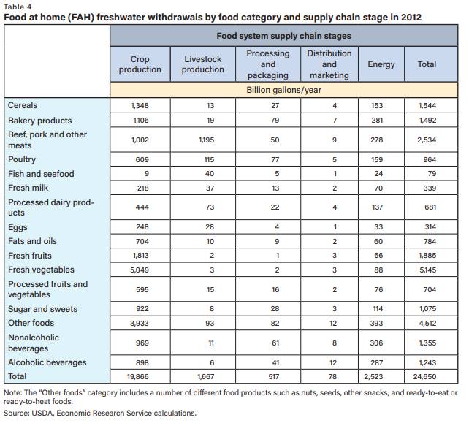
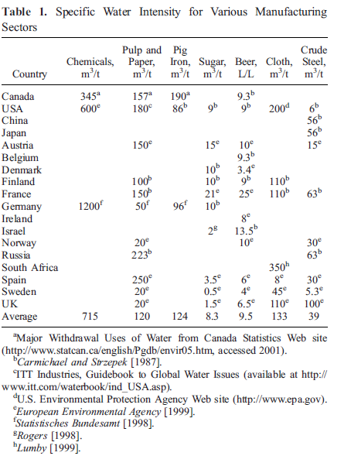
Water use in food processing
https://www.ers.usda.gov/webdocs/publications/101625/err-288.pdf?v=8878.3

Slide 22
Food processing linkage structure
Obtain the coefficient of EJ of food processing energy use per calorie consumed for each region
Use those coefficients, and the consumption of food, to determine the energy used for food processing based on food demand
Initially, coefficients will be the same for all commodities, but this could be updated later
Coefficients will also be constant with time after 2015, but could be changed exogenously to reflect different scenarios

Slide 23
Current breakout challenges
Allocating cogen to food processing
→ to do, likely based on share of overall fuel use
Allocating some of “other industrial energy use” to food processing
→ will be addressed using the derived relationship between food production and food processing energy use
Allocating some electricity consumption to process heat (rather than direct use)
→ currently implemented as allocating some electricity to process heat if, in all years, the fraction of food processing energy use that is supplied by electricity is > 0.6; could be refined (and may not be necessary once the reallocation of energy use is complete)

Slide 24
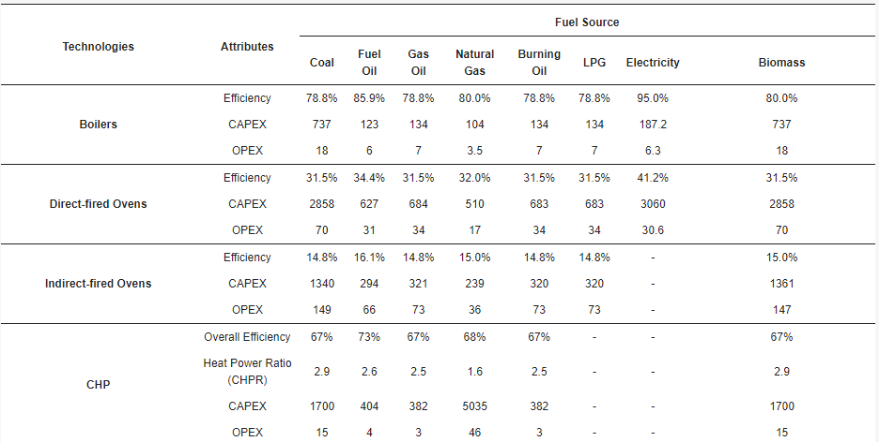
Non-energy costs
Potential sources:
GTAP data
Pro – includes capital vs labor vs other costs
Con – does not separate costs by technology/fuel (e.g., cost of gas-based techs vs coal-based techs)
Gowreesunker et al., 2018
Pro – separates costs by technology and fuel
Con – almost too much technology detail, would need to assume a capacity factor to convert capital costs to energy units
Sources for the overall costs per PKcal?
CAPEX: £m/GW_output, or £m/GWe_output for CHP systems
OPEX: £m/PJ_output, or £m/PJe_output

Slide 25
Food processing updates
Notes:
Stock image of cloud formations

Slide 26
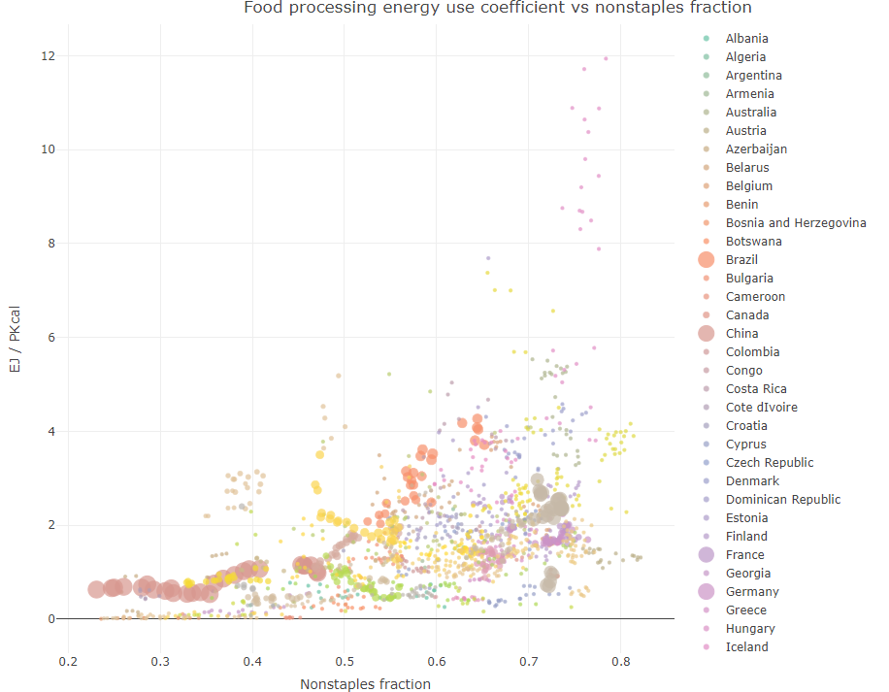
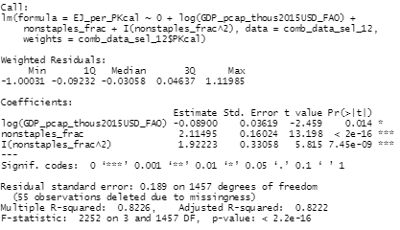
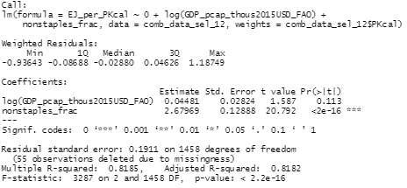
Relationship between food consumption and food processing energy use
Model between food processing energy use coefficient (energy/calories) and GDP per capita and/or non-staples fraction
*only using regions + years from 1990 onwards with < 50% of industry energy in non-specified industry, and > 1% of industry energy in food processing
Not much difference in fit when using weights, between quadratic and linear

Slide 27
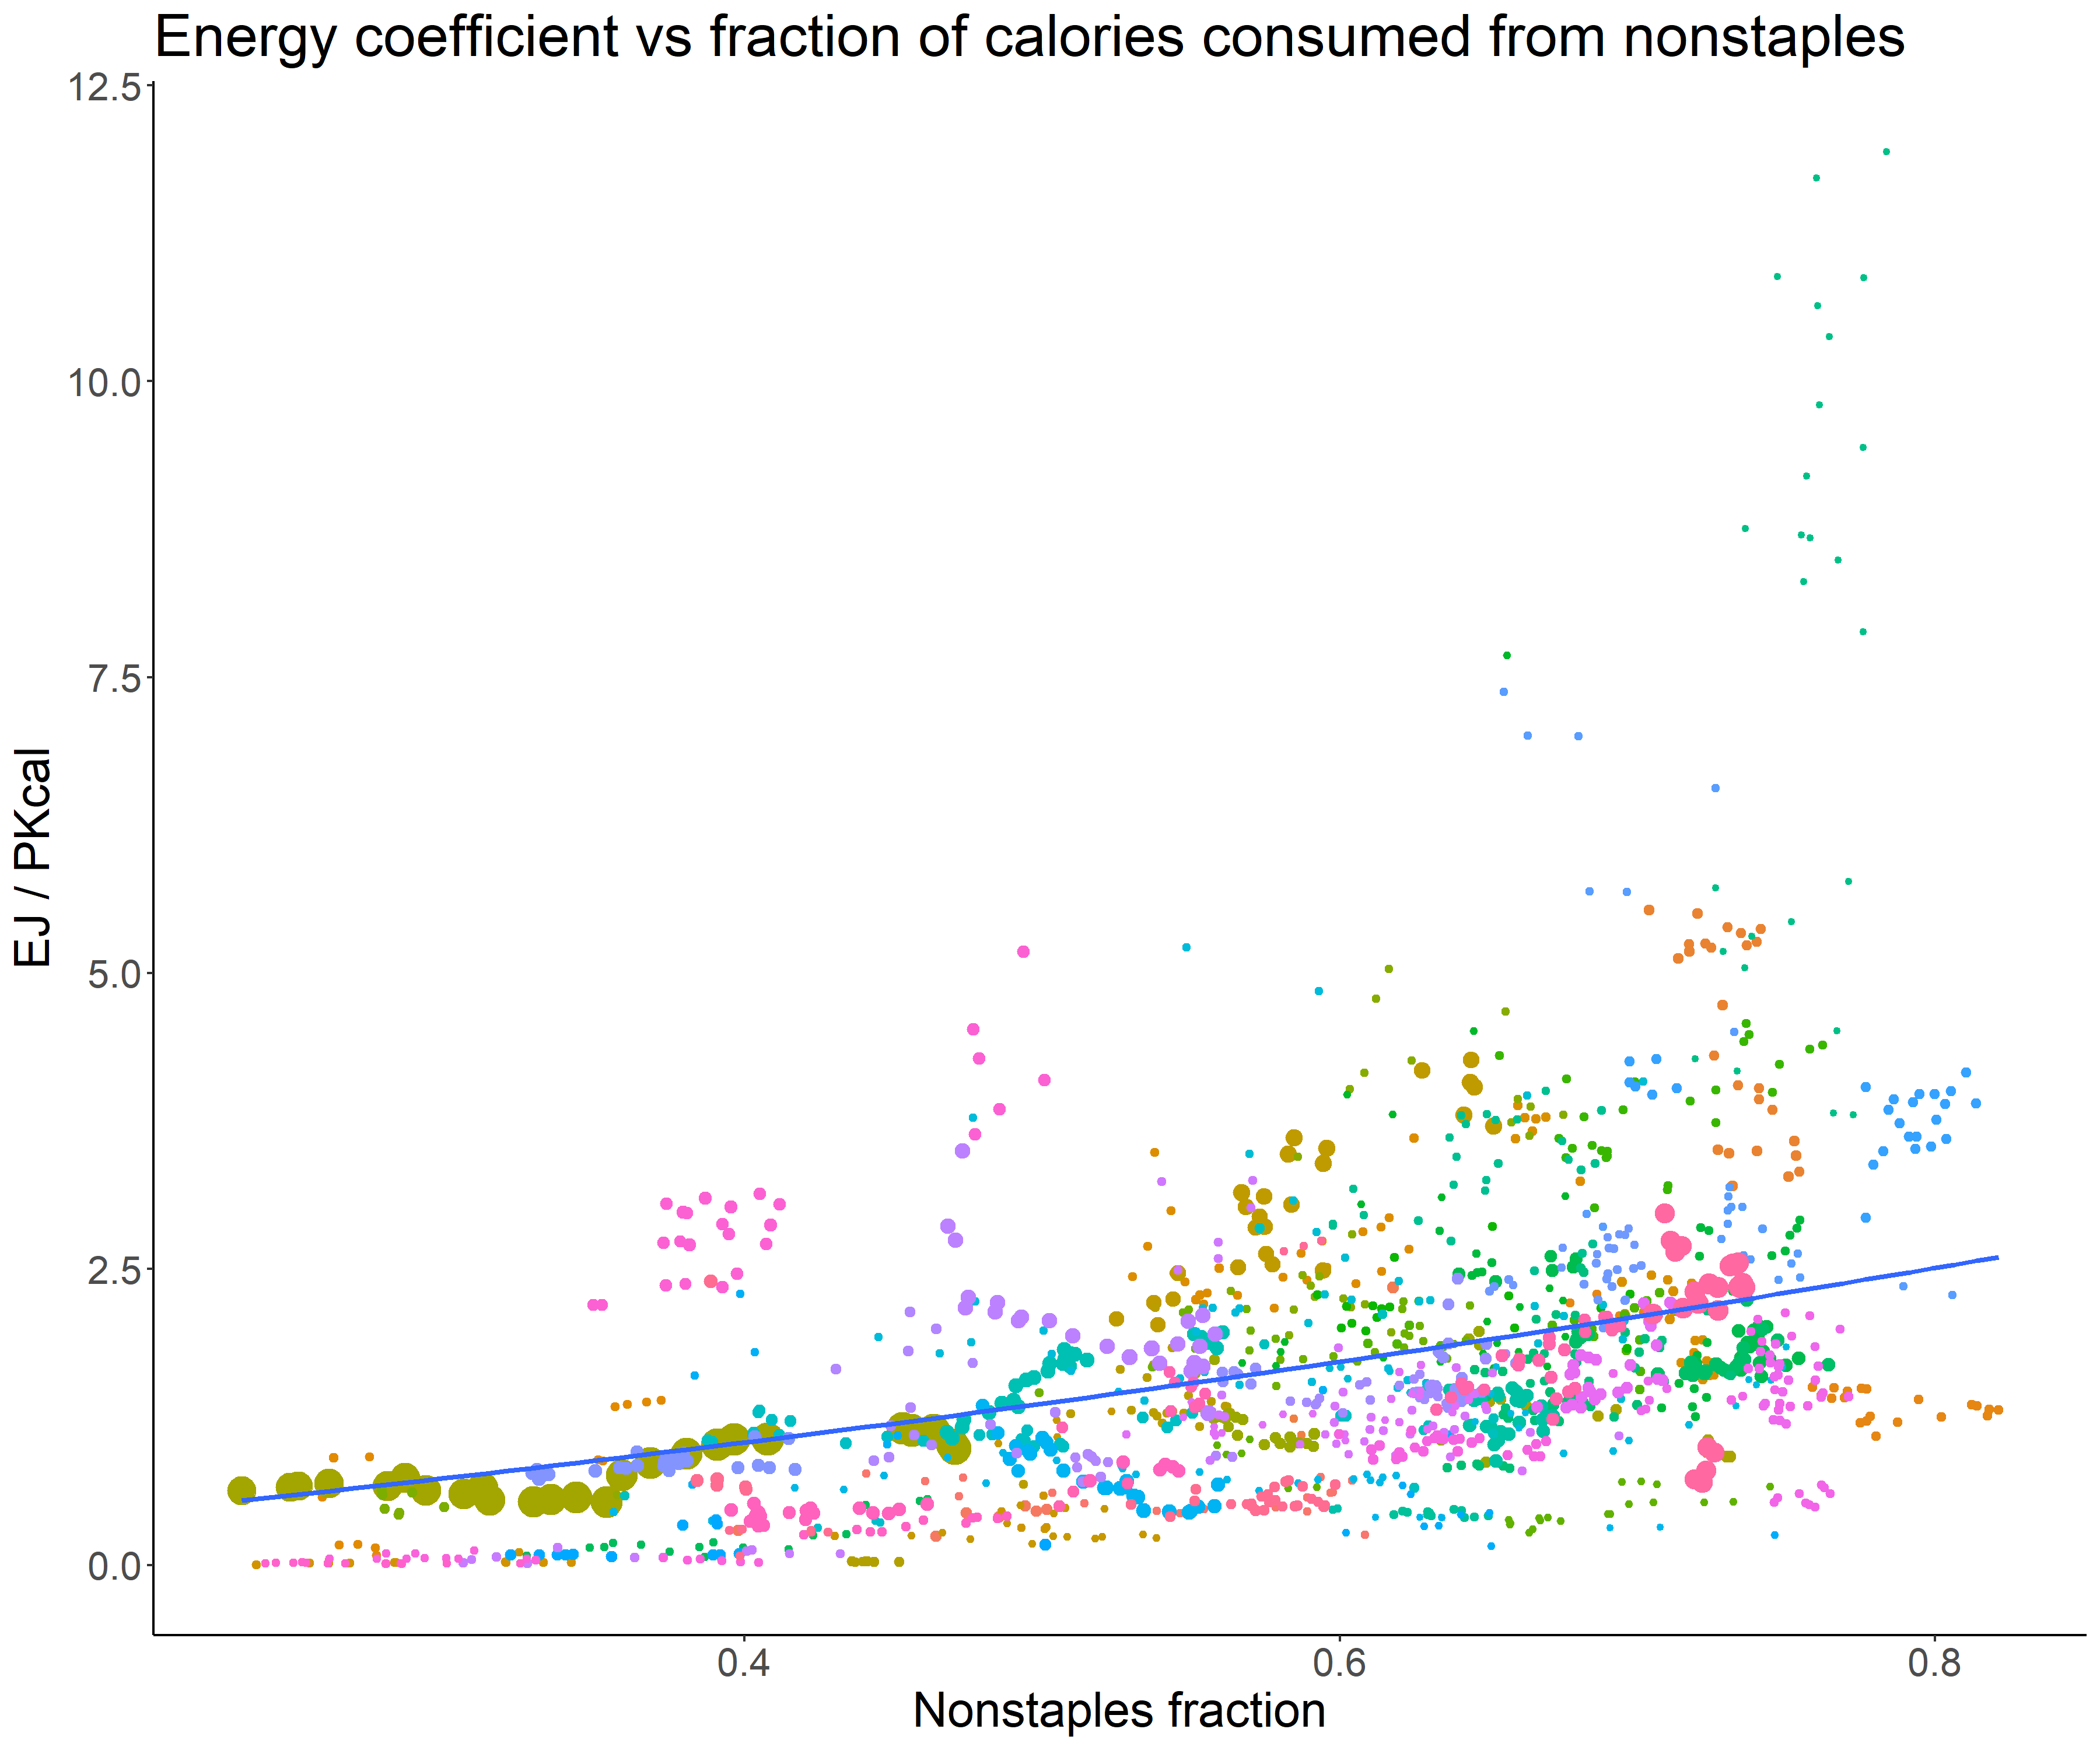
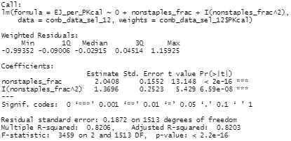
Relationship between food consumption and food processing energy use
Model between food processing energy use coefficient (energy/calories) and GDP per capita and/or non-staples fraction
*only using regions + years from 1990 onwards with < 50% of industry energy in non-specified industry, and > 1% of industry energy in food processing
Not much difference in fit when using weights, between quadratic and linear

Slide 28

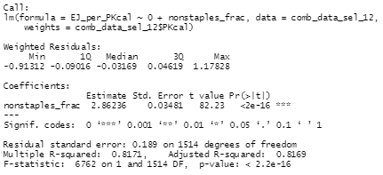
Relationship between food consumption and food processing energy use
Model between food processing energy use coefficient (energy/calories) and GDP per capita and/or non-staples fraction
*only using regions + years from 1990 onwards with < 50% of industry energy in non-specified industry, and > 1% of industry energy in food processing
Not much difference in fit when using weights, between quadratic and linear

Slide 29
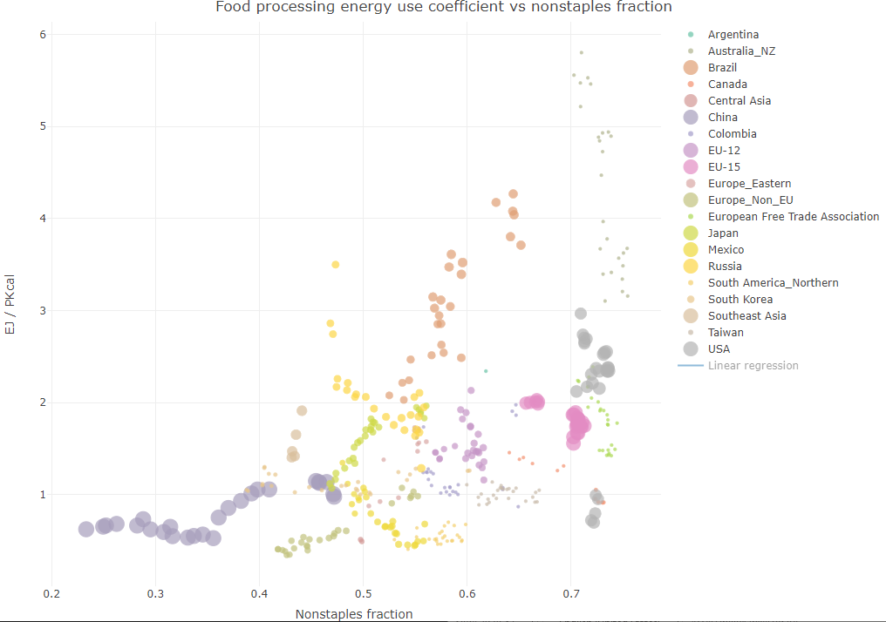
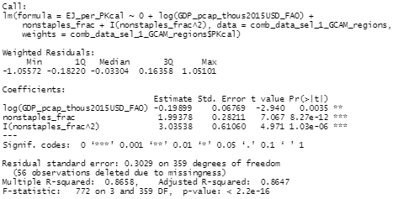
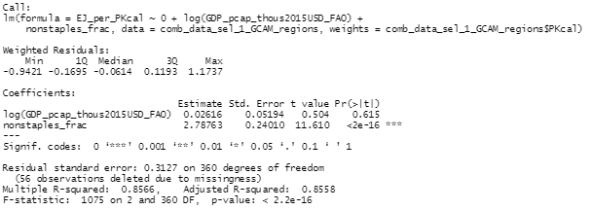
Relationship between food consumption and food processing energy use
Model between food processing energy use coefficient (energy/calories) and GDP per capita and/or non-staples fraction – derived at a GCAM region level!
*only using regions + years from 1990 onwards with < 50% of industry energy in non-specified industry, and > 1% of industry energy in food processing
Not much difference in fit when using weights, between quadratic and linear

Slide 30
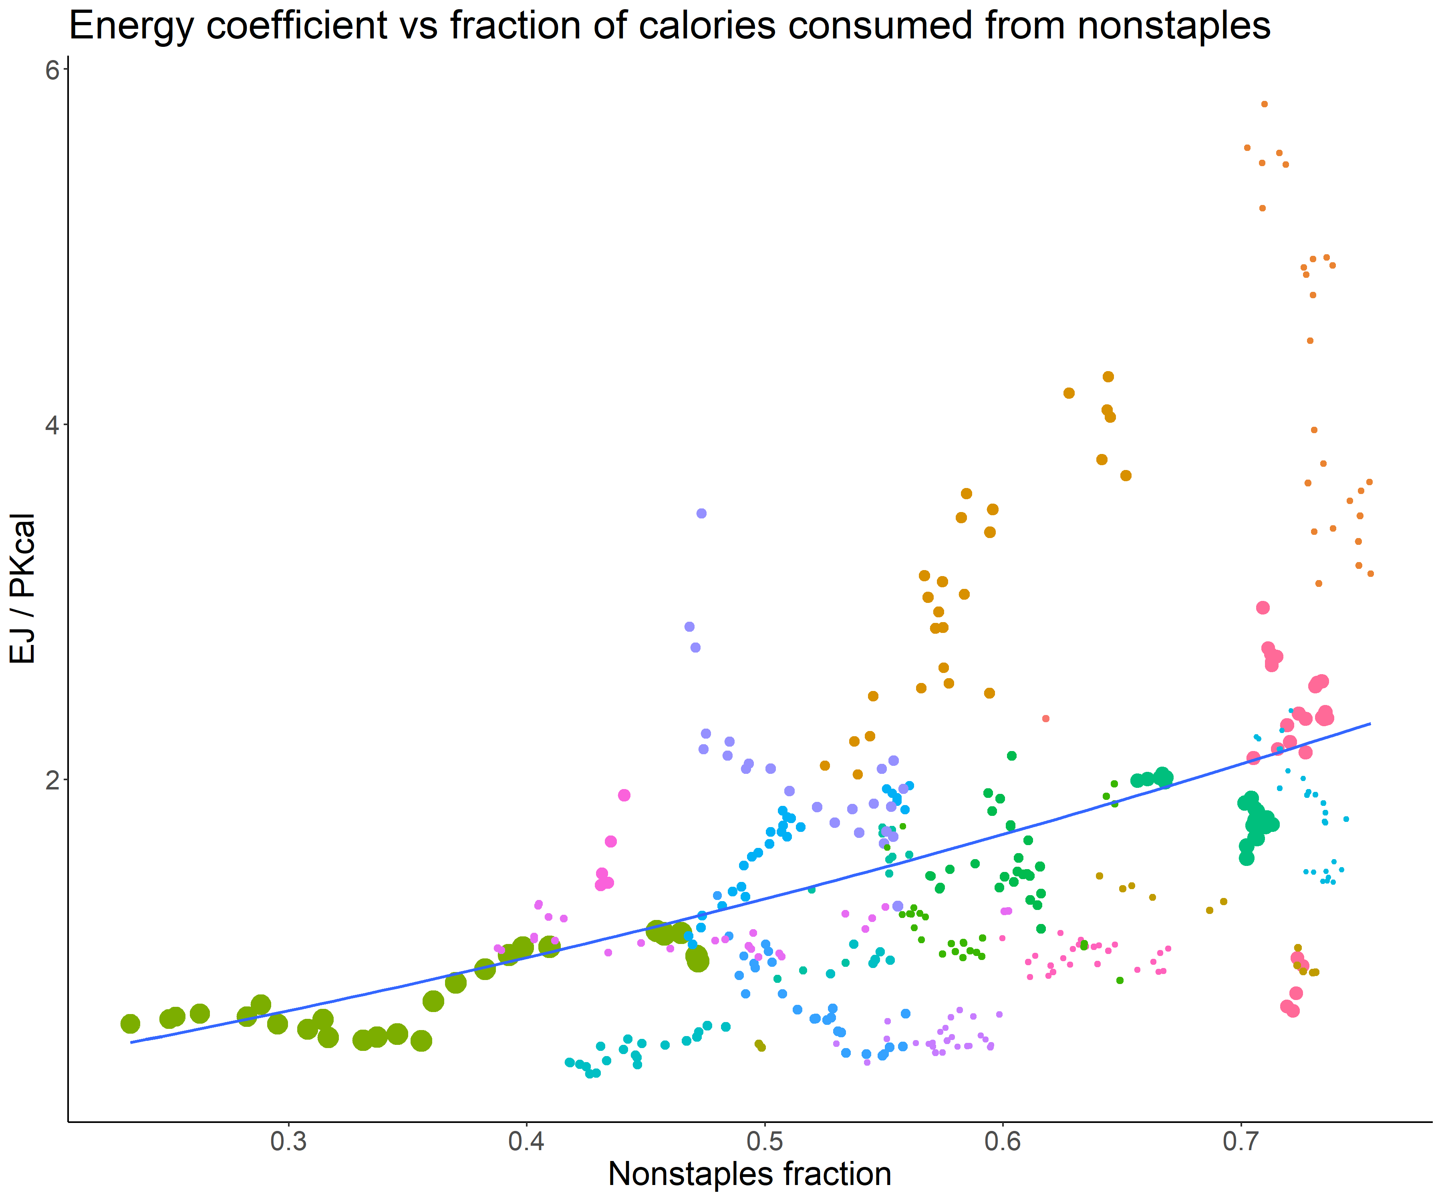
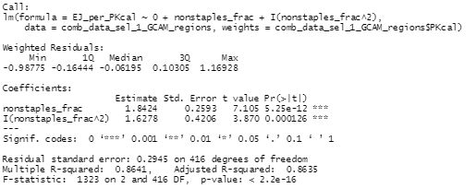
Relationship between food consumption and food processing energy use
Model between food processing energy use coefficient (energy/calories) and GDP per capita and/or non-staples fraction – derived at a GCAM region level!
*only using regions + years from 1990 onwards with < 50% of industry energy in non-specified industry, and > 1% of industry energy in food processing
Not much difference in fit when using weights, between quadratic and linear

Slide 31

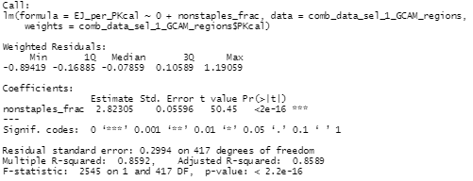
Relationship between food consumption and food processing energy use
Model between food processing energy use coefficient (energy/calories) and GDP per capita and/or non-staples fraction – derived at a GCAM region level!
*only using regions + years from 1990 onwards with < 50% of industry energy in non-specified industry, and > 1% of industry energy in food processing
Not much difference in fit when using weights, between quadratic and linear

Slide 32
Relationship between food consumption and food processing energy use
Comparison between models, and at a country vs GCAM region level. All use weights of the total calorie consumption.
*only using regions + years from 1990 onwards with < 50% of industry energy in non-specified industry, and > 1% of industry energy in food processing
Region level | Nonstaples frac coefficient | (Nonstaples frac)^2 coefficient | log(GDP per cap) coefficient | R squared | RSE
Countries | 2.11495 | 1.92223 | -0.08900 | 0.8222 | 0.189
Countries | 2.67969 | - | Not significant | 0.8182 | 0.1911
Countries | 2.0408 | 1.3696 | - | 0.8203 | 0.1872
Countries | 2.86236 | - | - | 0.8169 | 0.189
GCAM regions | 1.99378 | 3.03538 | -0.19899 | 0.8647 | 0.3029
GCAM regions | 2.78763 | - | Not significant | 0.8558 | 0.3127
GCAM regions | 1.8424 | 1.6278 | - | 0.8635 | 0.2945
GCAM regions | 2.82305 | - | - | 0.8589 | 0.2994
*with net import share: 1.7*(nonstaples frac)+2.4*(nonstaples frac squared)* -1.4*(net import share); not significant log GDP coefficient, 0.83 R squared, 0.19 RSE at country level
*does not add value at GCAM region level
Notes:
*with net import share: 1.7, 2.4, not significant, 0.83, 0.19, -1.4 on net import share for countries; does not add value at GCAM region level

Slide 33
Relationship between food consumption and food processing energy use
Comparison between models, and at a country vs GCAM region level. No weights.
*only using regions + years from 1990 onwards with < 50% of industry energy in non-specified industry, and > 1% of industry energy in food processing
Region level | Nonstaples frac coefficient | (Nonstaples frac)^2 coefficient | log(GDP per cap) coefficient | R squared | RSE
Countries | Not significant | 4.3423 | 0.1053 | 0.7013 | 1.235
Countries | 1.8215 | - | 0.2915 | 0.6914 | 1.255
Countries | Not significant | 4.9449 | - | 0.6979 | 1.233
Countries | 3.04833 | - | - | 0.6795 | 1.271
GCAM regions | Not significant | 4.10110 | Not significant | 0.7935 | 0.9096
GCAM regions | 2.62683 | - | Not significant | 0.7814 | 0.936
GCAM regions | Not significant | 3.9296 | - | 0.7848 | 0.8849
GCAM regions | 2.83424 | - | - | 0.7708 | 0.9132
*with net import share: 2.0*(nonstaples frac)+1.5*(nonstaples frac squared)* -1.1*(net import share); not significant log GDP coefficient, 0.79 R squared, 0.95 RSE at country level
*does not add value at GCAM region level
Notes:
*with net import share: 2.0, 1.5, not significant, 0.79, 0.95, -1.1 on net import share for countries; does not add value at GCAM region level

Slide 34
Relationship between food consumption and food processing energy use
Comparison between models, and at a country vs GCAM region level. All use weights of the total calorie consumption.
*only using regions + years from 1990 onwards with < 50% of industry energy in non-specified industry, and > 1% of industry energy in food processing
Using net import share from GTAP: (net import share = (imports – exports) / production)
1.7*(nonstaples frac)+2.4*(nonstaples frac squared)* -1.4*(net import share); not significant log GDP coefficient, 0.83 R squared, 0.19 RSE at country level
Does not add value at GCAM region level (coefficient of net import share is not significant)

Slide 35
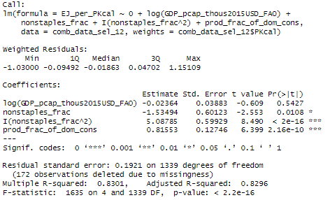
Relationship between food consumption and food processing energy use
Comparison between models, and at a country vs GCAM region level. All use weights of the total calorie consumption.
*only using regions + years from 1990 onwards with < 50% of industry energy in non-specified industry, and > 1% of industry energy in food processing

Slide 36
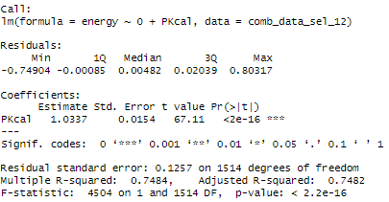
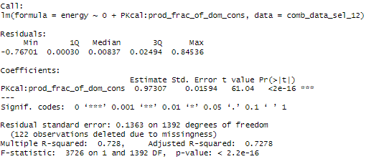
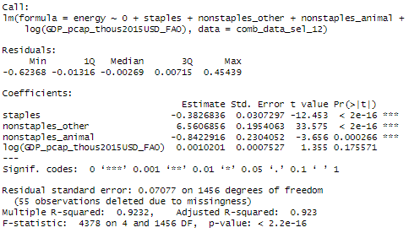
Relationship between food consumption and food processing energy use
Energy ~ calories relationship
*only using regions + years from 1990 onwards with < 50% of industry energy in non-specified industry, and > 1% of industry energy in food processing

