Slide 1
Food processing updates
Notes:
Stock image of cloud formations

Slide 2
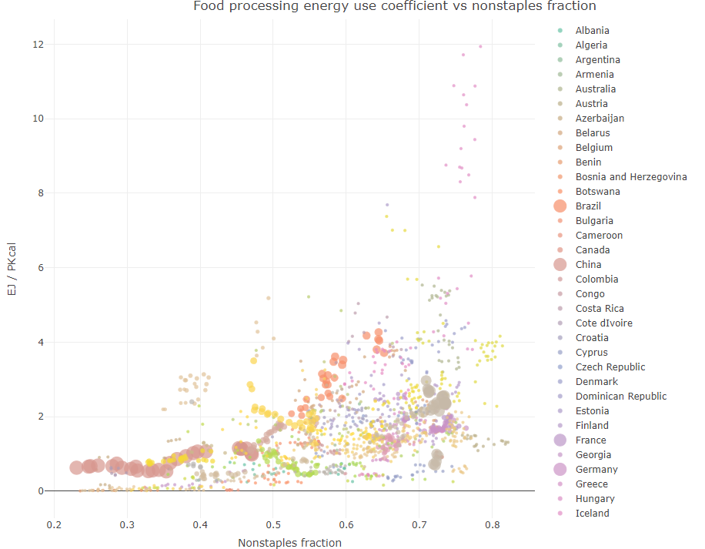
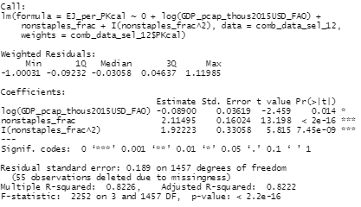
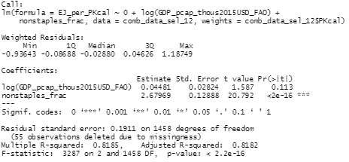
Relationship between food consumption and food processing energy use
Model between food processing energy use coefficient (energy/calories) and GDP per capita and/or non-staples fraction
*only using regions + years from 1990 onwards with < 50% of industry energy in non-specified industry, and > 1% of industry energy in food processing
Not much difference in fit when using weights, between quadratic and linear

Slide 3
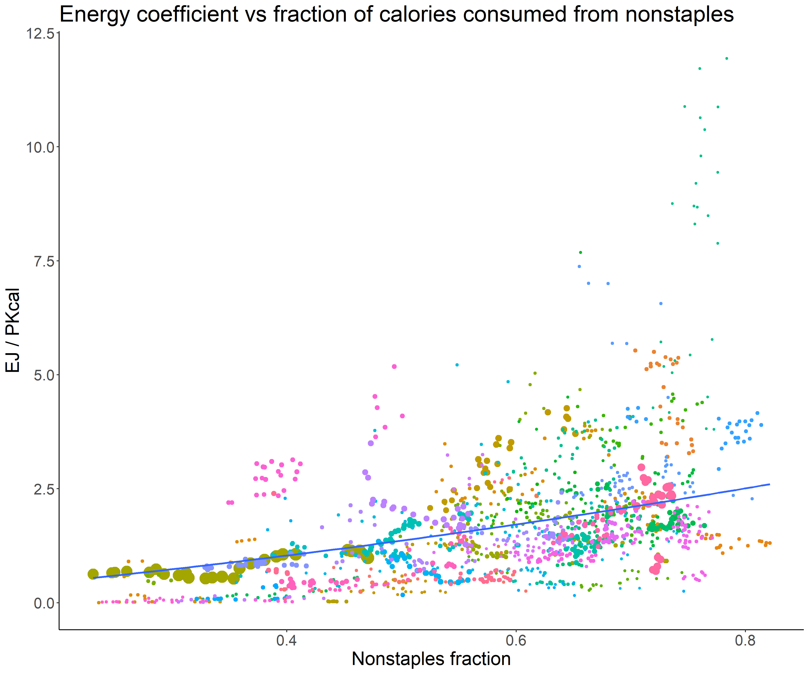
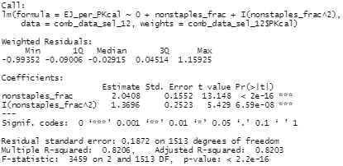
Relationship between food consumption and food processing energy use
Model between food processing energy use coefficient (energy/calories) and GDP per capita and/or non-staples fraction
*only using regions + years from 1990 onwards with < 50% of industry energy in non-specified industry, and > 1% of industry energy in food processing
Not much difference in fit when using weights, between quadratic and linear

Slide 4

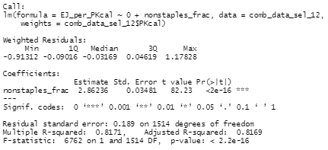
Relationship between food consumption and food processing energy use
Model between food processing energy use coefficient (energy/calories) and GDP per capita and/or non-staples fraction
*only using regions + years from 1990 onwards with < 50% of industry energy in non-specified industry, and > 1% of industry energy in food processing
Not much difference in fit when using weights, between quadratic and linear

Slide 5
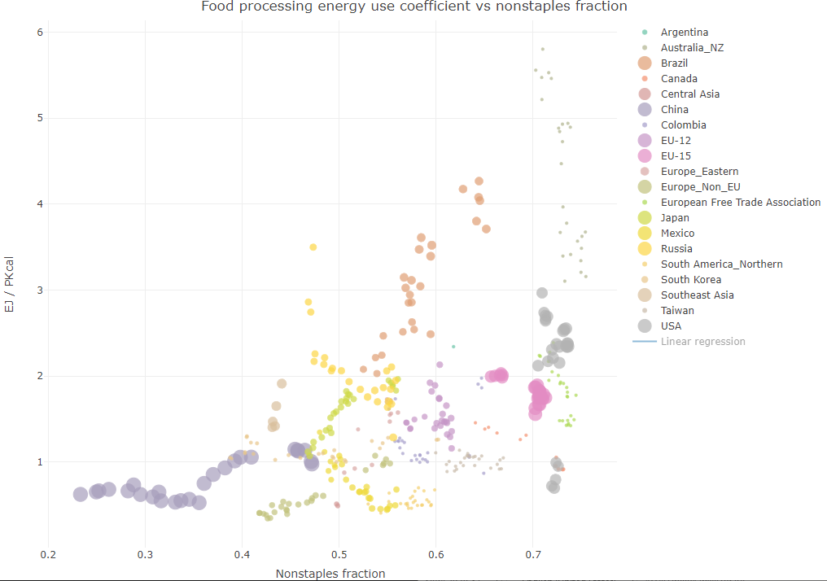
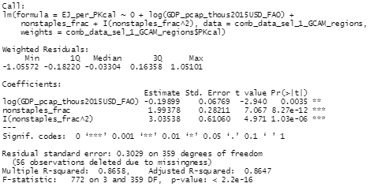
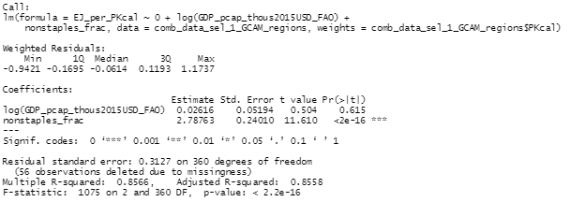
Relationship between food consumption and food processing energy use
Model between food processing energy use coefficient (energy/calories) and GDP per capita and/or non-staples fraction – derived at a GCAM region level!
*only using regions + years from 1990 onwards with < 50% of industry energy in non-specified industry, and > 1% of industry energy in food processing
Not much difference in fit when using weights, between quadratic and linear

Slide 6
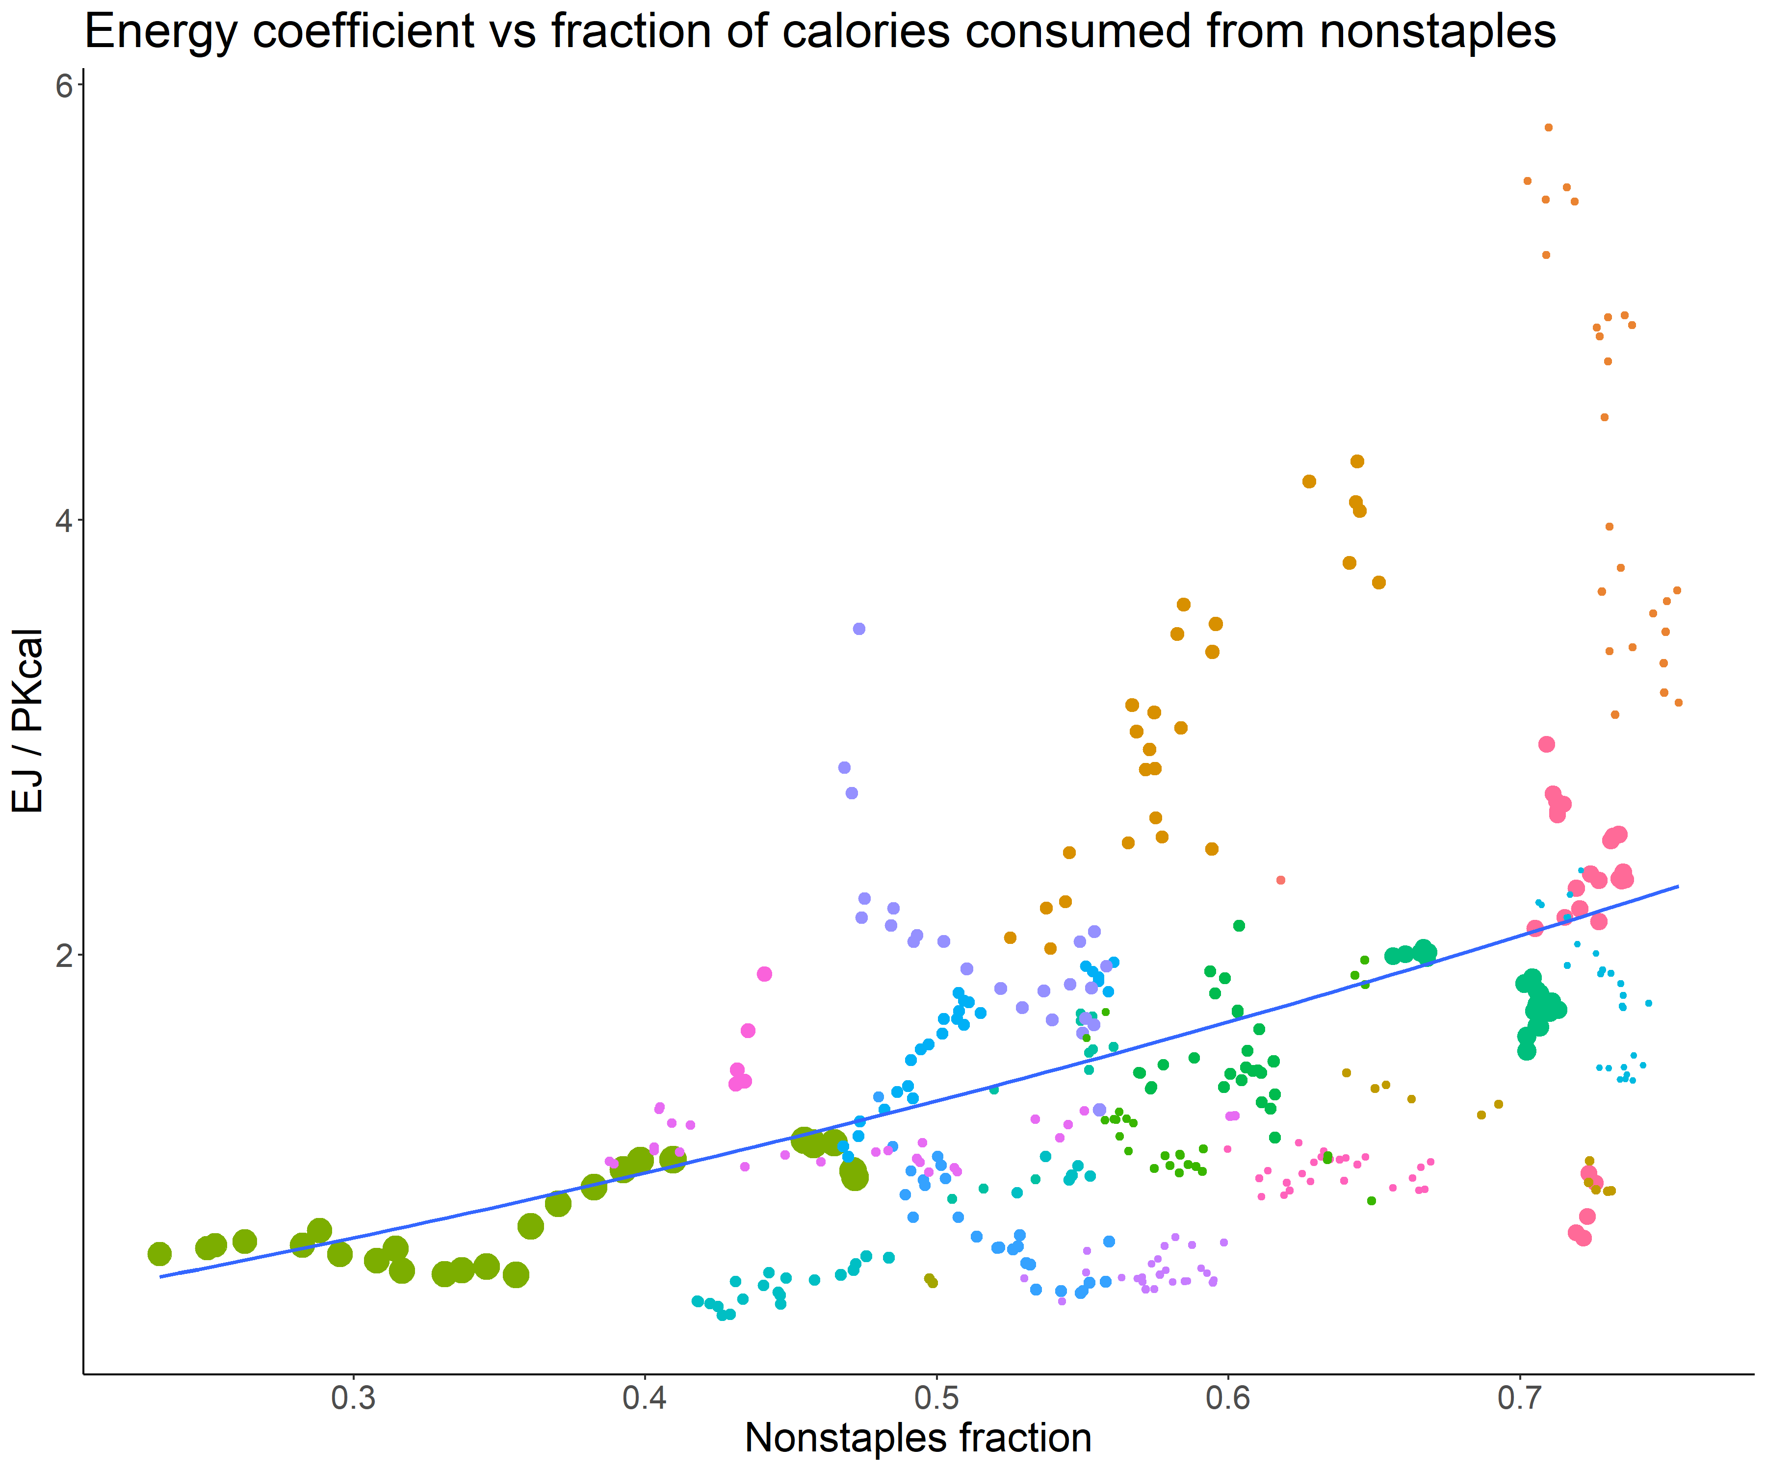
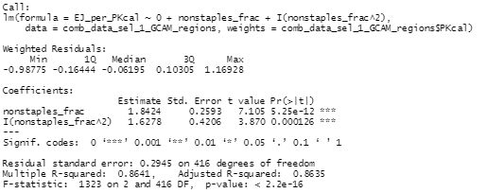
Relationship between food consumption and food processing energy use
Model between food processing energy use coefficient (energy/calories) and GDP per capita and/or non-staples fraction – derived at a GCAM region level!
*only using regions + years from 1990 onwards with < 50% of industry energy in non-specified industry, and > 1% of industry energy in food processing
Not much difference in fit when using weights, between quadratic and linear

Slide 7

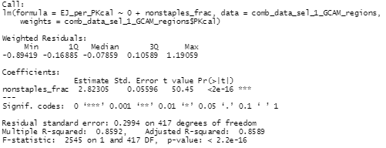
Relationship between food consumption and food processing energy use
Model between food processing energy use coefficient (energy/calories) and GDP per capita and/or non-staples fraction – derived at a GCAM region level!
*only using regions + years from 1990 onwards with < 50% of industry energy in non-specified industry, and > 1% of industry energy in food processing
Not much difference in fit when using weights, between quadratic and linear

Slide 8
Relationship between food consumption and food processing energy use
Comparison between models, and at a country vs GCAM region level. All use weights of the total calorie consumption.
*only using regions + years from 1990 onwards with < 50% of industry energy in non-specified industry, and > 1% of industry energy in food processing
Region level | Nonstaples frac coefficient | (Nonstaples frac)^2 coefficient | log(GDP per cap) coefficient | R squared | RSE
Countries | 2.11495 | 1.92223 | -0.08900 | 0.8222 | 0.189
Countries | 2.67969 | - | Not significant | 0.8182 | 0.1911
Countries | 2.0408 | 1.3696 | - | 0.8203 | 0.1872
Countries | 2.86236 | - | - | 0.8169 | 0.189
GCAM regions | 1.99378 | 3.03538 | -0.19899 | 0.8647 | 0.3029
GCAM regions | 2.78763 | - | Not significant | 0.8558 | 0.3127
GCAM regions | 1.8424 | 1.6278 | - | 0.8635 | 0.2945
GCAM regions | 2.82305 | - | - | 0.8589 | 0.2994
*with net import share: 1.7*(nonstaples frac)+2.4*(nonstaples frac squared)* -1.4*(net import share); not significant log GDP coefficient, 0.83 R squared, 0.19 RSE at country level
*does not add value at GCAM region level
Notes:
*with net import share: 1.7, 2.4, not significant, 0.83, 0.19, -1.4 on net import share for countries; does not add value at GCAM region level

Slide 9
Relationship between food consumption and food processing energy use
Comparison between models, and at a country vs GCAM region level. No weights.
*only using regions + years from 1990 onwards with < 50% of industry energy in non-specified industry, and > 1% of industry energy in food processing
Region level | Nonstaples frac coefficient | (Nonstaples frac)^2 coefficient | log(GDP per cap) coefficient | R squared | RSE
Countries | Not significant | 4.3423 | 0.1053 | 0.7013 | 1.235
Countries | 1.8215 | - | 0.2915 | 0.6914 | 1.255
Countries | Not significant | 4.9449 | - | 0.6979 | 1.233
Countries | 3.04833 | - | - | 0.6795 | 1.271
GCAM regions | Not significant | 4.10110 | Not significant | 0.7935 | 0.9096
GCAM regions | 2.62683 | - | Not significant | 0.7814 | 0.936
GCAM regions | Not significant | 3.9296 | - | 0.7848 | 0.8849
GCAM regions | 2.83424 | - | - | 0.7708 | 0.9132
*with net import share: 2.0*(nonstaples frac)+1.5*(nonstaples frac squared)* -1.1*(net import share); not significant log GDP coefficient, 0.79 R squared, 0.95 RSE at country level
*does not add value at GCAM region level
Notes:
*with net import share: 2.0, 1.5, not significant, 0.79, 0.95, -1.1 on net import share for countries; does not add value at GCAM region level

Slide 10
Relationship between food consumption and food processing energy use
Comparison between models, and at a country vs GCAM region level. All use weights of the total calorie consumption.
*only using regions + years from 1990 onwards with < 50% of industry energy in non-specified industry, and > 1% of industry energy in food processing
Using net import share from GTAP: (net import share = (imports – exports) / production)
1.7*(nonstaples frac)+2.4*(nonstaples frac squared)* -1.4*(net import share); not significant log GDP coefficient, 0.83 R squared, 0.19 RSE at country level
Does not add value at GCAM region level (coefficient of net import share is not significant)

Slide 11
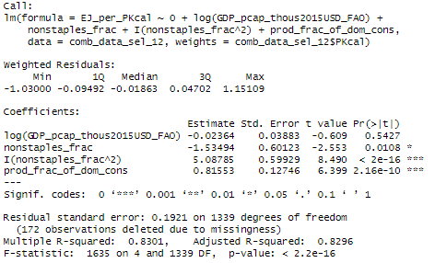
Relationship between food consumption and food processing energy use
Comparison between models, and at a country vs GCAM region level. All use weights of the total calorie consumption.
*only using regions + years from 1990 onwards with < 50% of industry energy in non-specified industry, and > 1% of industry energy in food processing
prod_frac_of_dom_cons = production / (production – exports + imports)

Slide 12
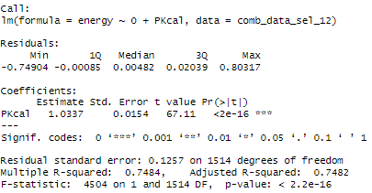
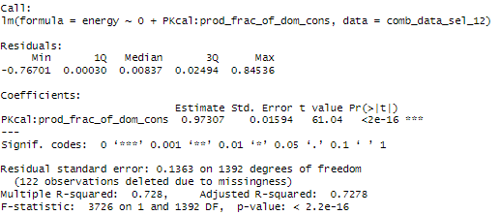
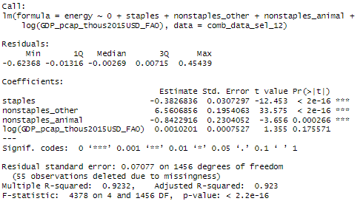
Relationship between food consumption and food processing energy use
Energy ~ calories relationship
*only using regions + years from 1990 onwards with < 50% of industry energy in non-specified industry, and > 1% of industry energy in food processing
prod_frac_of_dom_cons = production / (production – exports + imports)

Slide 13
Options for energy and food relationship
Possible dependent variables: energy, energy/calorie
Possible independent variables: total calories, staple calories, nonstaple calories, GDP per capita, nonstaple fraction of total calories, net import share, production fraction of domestic consumption

