Slide 1
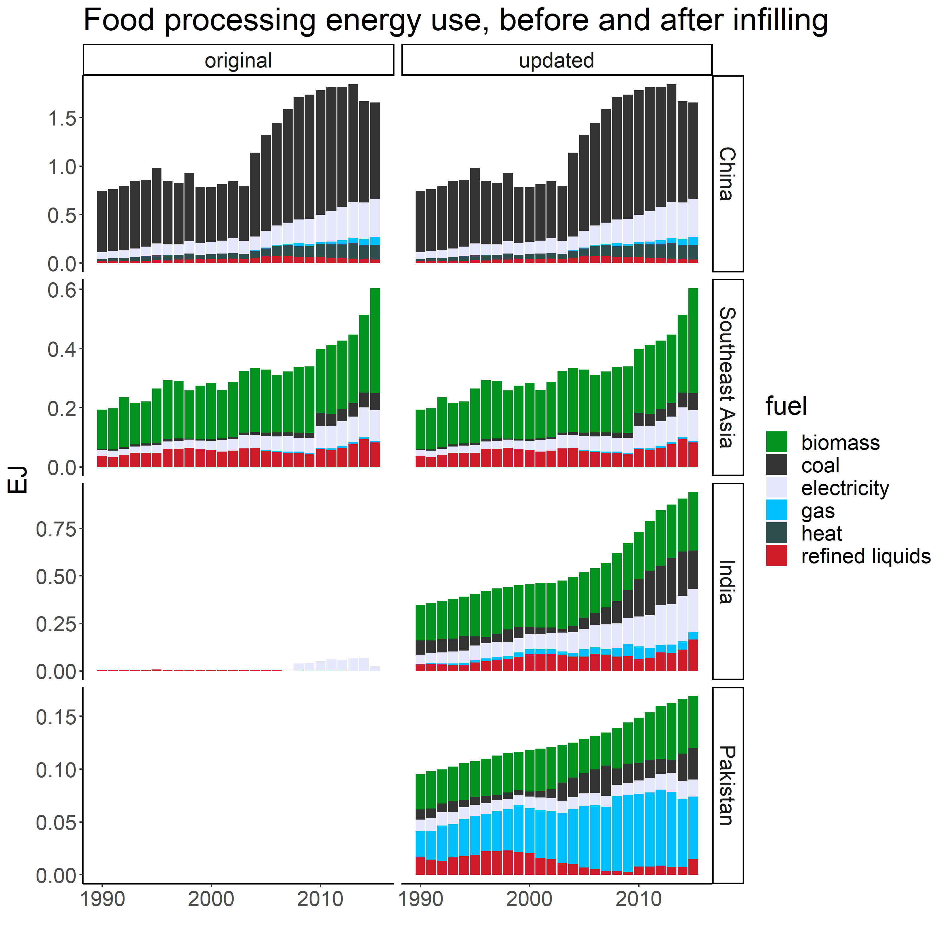
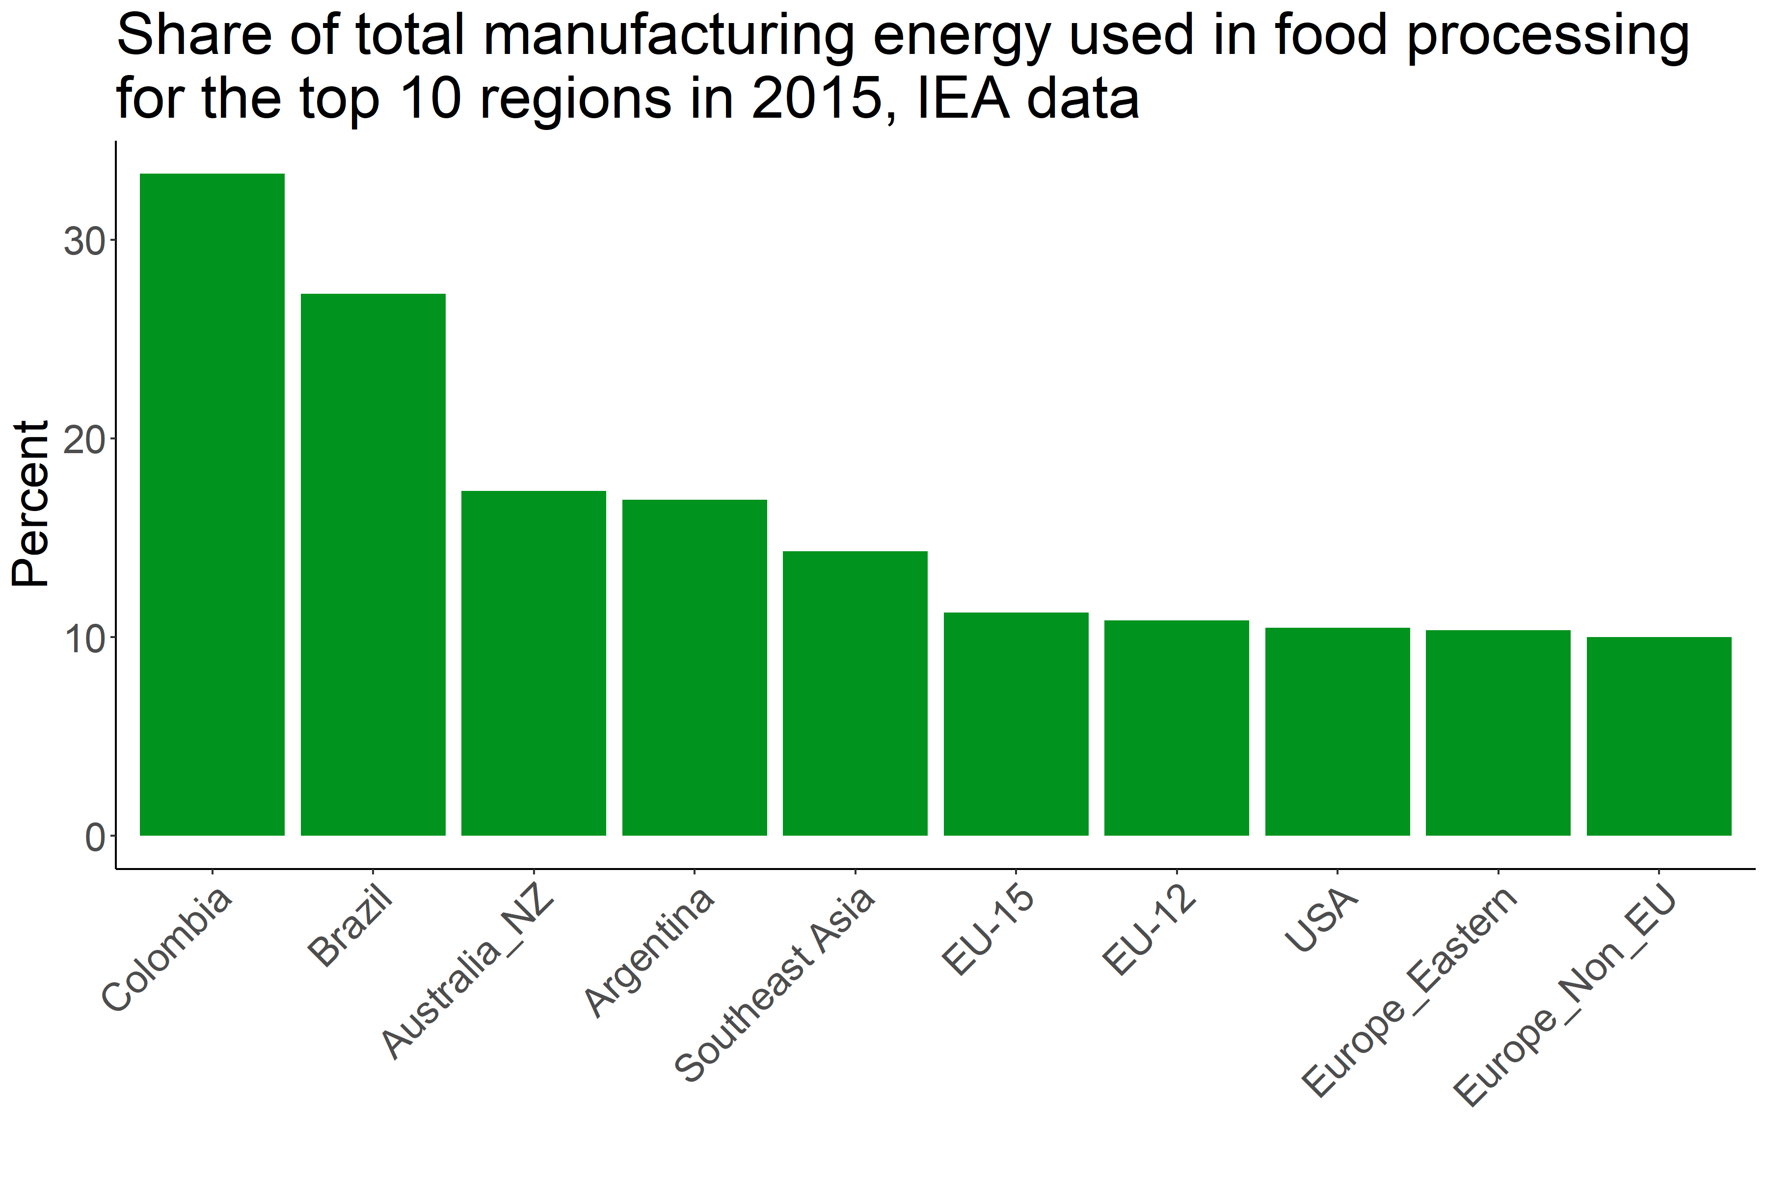
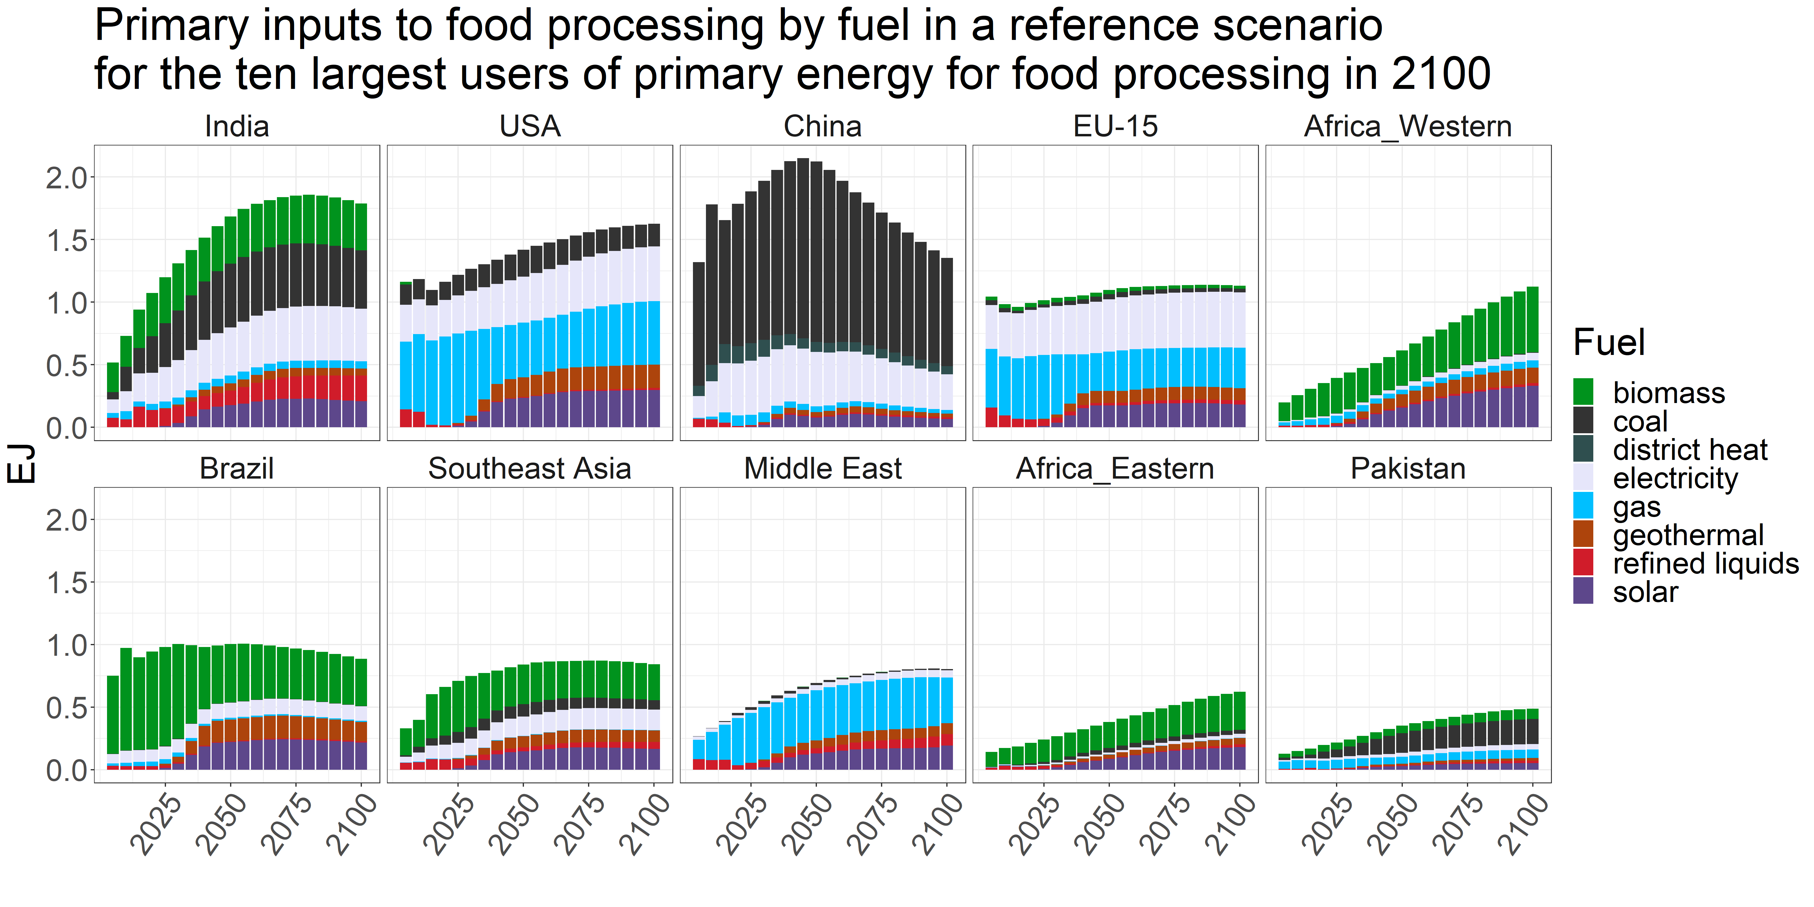
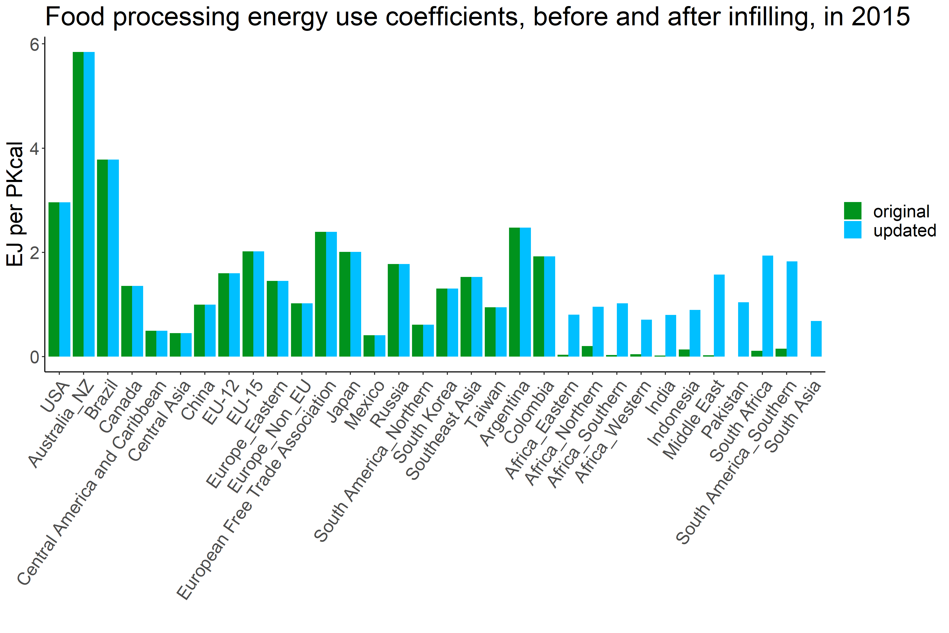
Incorporating food processing energy use into GCAM
The first effort to interconnect agriculture and land use, food demand, and food processing energy use in an integrated assessment model
Simone Speizer¹, Xin Zhao¹, Siddarth Durga¹, Stephanie Waldhoff¹, Jae Edmonds¹
¹Joint Global Change Research Institute, Pacific Northwest National Laboratory, College Park, USA
The food processing sector: challenges and opportunities
Linking food processing energy use to food demand in GCAM
Addressing limitations in IEA energy use data
The food processing sector is highly heterogeneous, generating outputs ranging from dairy products and canned fruits to baked goods and prepared meals using a wide range of processes
Though energy consumption per dollar value of product tends to be low, food processing is a large source of manufacturing energy demand in some regions
Food demand
Coefficient: energy demand per calorie consumed
Food processing
For some regions, IEA data on food processing energy use is incomplete, leading to unrealistically low coefficients of energy use per calorie consumed
Process heat
Electricity
We fit a linear model relating food processing energy use to GDP and calorie consumption of non-staple crops for regions with sufficient IEA energy use data and use this model to infill energy data for other regions
Biomass
Gas
Coal
Refined liquids
Heat
Electricity
Electric heat pumps
Geothermal heat pumps
Solar thermal
Food processing energy demand is set by food demand, with regionally varying coefficients of energy use per calorie consumed
Most energy use is for low temperature heat (process heating and drying)
Main emissions reductions strategies include energy efficiency improvements, heat recovery, combined heat and power systems, electrification of heat, and fuel switching to renewables
Understanding food processing energy use and its associated costs is important for accurately evaluating food prices
Note that these are exploratory results and refinement of technology details is in progress
Next steps and potential future directions
Refine the representation of food processing energy use technologies
Produce scenarios for future changes in the coefficient of food processing energy use per calorie consumed, reflecting different socioeconomic trajectories
Evaluate emissions reductions pathways for the sector
PNNL-SA-185712
simone.speizer@pnnl.gov
The views and opinions expressed in this poster are those of the authors alone and do not necessarily state or reflect those of the U.S. Government, and no official endorsement should be inferred. The authors acknowledge the U.S. Department of Energy, Office of Fossil Energy and Carbon Management for their generous support of this research.
Notes:
NOTE: This file must print at 100% SCALE to achieve a final print size of 36” wide x 24” tall.
• Contact Digital Duplicating (375-2969, http://digitalduplicating.pnl.gov) to order poster printing and finishing services for your completed poster design.
• Remember to have your poster cleared for public display/distribution through the Information Release system (https://informationrelease.pnl.gov). A text placeholder for your poster’s Clearance Number is included in the footer.

