Slide 1
A Warm Welcome To Careerera Family

Slide 2
LOGISTIC REGRESSION

Slide 3

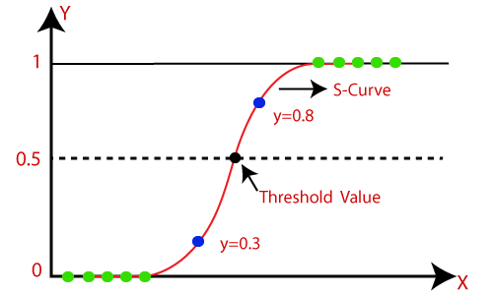
WHAT IS LOGISTIC REGRESSION ?
Logistic regression is a process of modeling the probability of a discrete outcome given an input variable. The most common logistic regression models a binary outcome; something that can take two values such as true/false, yes/no, and so on.

Slide 4
WHAT IS LOGISTIC REGRESSION?
It is used to model a binary outcome, that is a variable, which can have only two possible values: 0 or 1, yes or no, diseased or non-diseased.
The output of a logistic regression model is the probability of our input belonging to the class labeled with 1. And the complement of our model's output is the probability of our input belonging to the class labeled with 0.

Slide 5
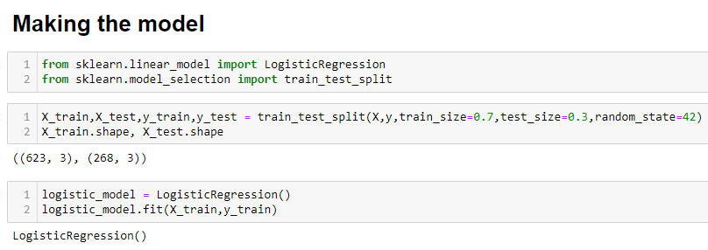
LOGISTIC REGRESSION

Slide 6
LOGISTIC REGRESSION – EXAMPLE
S – 1) Import Package, Functions and Classes
S – 2) Get Data
S – 3) Create a model and train it
S – 4) Evaluate the model
S – 5) Improve the model

Slide 7
WHAT IS UNIVARIANT LOGISTIC REGRESSION
Logistic regression is used to obtain odds ratio in the presence of more than one explanatory variable.
When there is one dependent variable, and one independent variable; both are categorical; generally produce Unadjusted model (crude odds ratio) by taking just one independent variable at a time
The result is the impact of each variable on the odds ratio of the observed event of interest.
Logistic regression analysis is valuable for predicting the likelihood of an event. It helps determine the probabilities between any two classes.

Slide 8
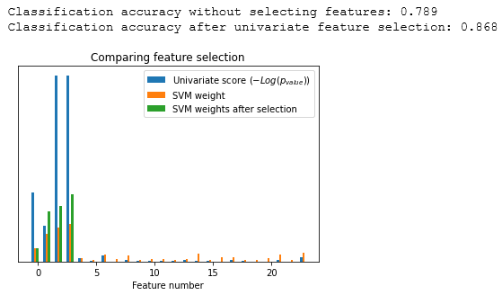
UNIVARIATE SELECTION EXAMPLE

Slide 9
WHAT IS MULTIVARIANT LOGISTIC REGRESSION?
When there is one dependent variable, and more than one independent variables; All are categorical; produce Adjusted model (adjusted odds ratio) by taking all the independent variables at a time.
Univariate logistic becomes multivariate when there are more than one independent variables at a model.

Slide 10
DEALING WITH CATEGORICAL INDEPENDENT VARIABLE
Machine learning models require all input and output variables to be numeric.
This means that if your data contains categorical data, you must encode it to numbers before you can fit and evaluate a model.
The two most popular techniques are an Ordinal Encoding and a One-Hot Encoding.
This means that categorical data must be converted to a numerical form. If the categorical variable is an output variable.

Slide 11
WHAT IS ENCODING CATEGORICAL DATA?
There are three common approaches for converting ordinal and categorical variables to numerical values. They are:
Ordinal Encoding
One-Hot Encoding
Dummy Variable Encoding
Ordinal Encoding:
In ordinal encoding, each unique category value is assigned an integer value.For example, “red” is 1, “green” is 2, and “blue” is 3.
This is called an ordinal encoding or an integer encoding and is easily reversible. Often, integer values starting at zero are used.

Slide 12
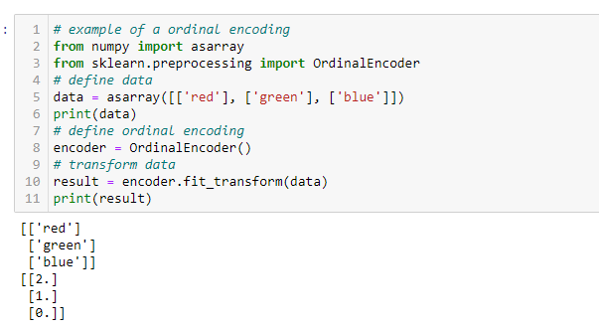
WHAT IS ORDINAL ENCODING?
Here,it is automatically generate some values for red=2,green=1 and blue=0.

Slide 13
WHAT IS ONE-HOT ENCODING?
This one-hot encoding transform is available in the scikit-learn Python machine learning library via the OneHotEncoder class.
Categories are sorted, in this case alphabetically because they are strings, then binary variables are created for each category in turn.
This means blue will be represented as [1, 0, 0] with a “1” in for the first binary variable, then green, then finally red.

Slide 14
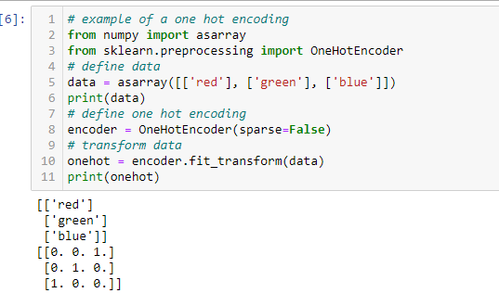
ONE-HOT ENCODING
Here, it divides red =[0,0,1] ,green =[0,1,0] and blue =[1,0,0] different encoding is present.

Slide 15
WHAT IS DUMMY VARIABLE ENCODING?
The problem is that one-hot encoding representation includes redundancy.
For example:
if we know that [1, 0, 0] represents “blue” and [0, 1, 0] represents “green” we don’t need another binary variable to represent “red“, instead we could use 0 values for both “blue” and “green” alone, e.g. [0, 0].
This is called a dummy variable encoding, and always represents C categories with C-1 binary variables.

Slide 16
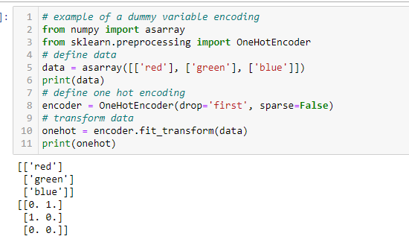
DUMMY VARIABLE ENCODING
Here,red = [0,1] ,green =[1,0] and blue =[0,0] it removes redundancy.

Slide 17
ONE-HOT VS DUMMY VARIABLE
We apply One-Hot Encoding when:
The categorical feature is not ordinal (like the countries above)
The number of categorical features is less so one-hot encoding can be effectively applied
We apply Label Encoding when:
The categorical feature is ordinal (like Jr. kg, Sr. kg, Primary school, high school)
The number of categories is quite large as one-hot encoding can lead to high memory consumption

Slide 18
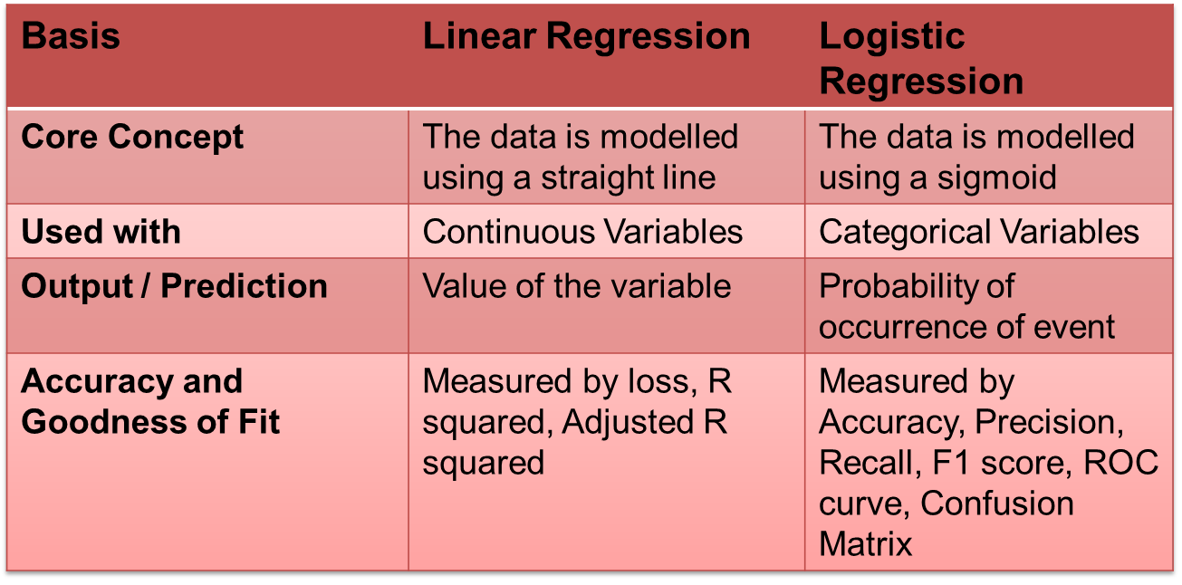
LINEAR REGRESSION VS LOGISTIC REGRESSION

Slide 19

THANK YOU !!!
(USA)
2-Industrial Park Drive, E-Waldorf, MD, 20602,
United States
(USA)
+1-844-889-4054
(Singapore)
3 Temasek Avenue, Singapore 039190
info@careerera.com www.careerera.com
(INDIA)
B-44, Sector-59, Noida Uttar Pradesh 201301
(INDIA)
+91-92-5000-4000

