Slide 1
A warm welcome to Careerera family

Slide 2
INTRODUCTION TO AI & DEEP LEARNING

Slide 3



Slide 4
CONTENT OF AI & DEEP LEARNING
Deep Neural Network & Tools
Deep Neural Net Optimization , Tuning & Interpretability
CNN
Famous CNN Architecture
RNN
Auto Encoders
Artificial Neural Network
Notes:
Careerera is one of the leading providers of Higher Education Professional Certification Training, Test Preparation, K -12 Education, Language Training, and other skill training for Adults and kids in the field of IT, Management, Software Development, Project Management, Quality Assurance and many more.
NEET, JEE Mains, AIEEE and more

Slide 5
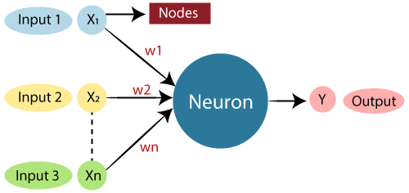
WHAT IS ARTIFICIAL NEURAL NETWORK(ANN) ?
The term "Artificial neural network" refers to a biologically inspired sub-field of artificial intelligence modeled after the brain.
An Artificial neural network is usually a computational network based on biological neural networks that construct the structure of the human brain.
Similar to a human brain has neurons interconnected to each other, artificial neural networks also have neurons that are linked to each other in various layers of the networks.
These neurons are known as nodes.

Slide 6
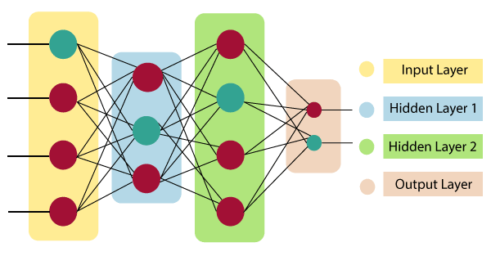
ARCHITECTURE OF ARTIFICIAL NEURAL NETWORK
In order to define a neural network that consists of a large number of artificial neurons, which are termed units arranged in a sequence of layers.
Artificial Neural Network primarily consists of three layers:

Slide 7

ARCHITECTURE OF ARTIFICIAL NEURAL NETWORK
Input Layer:
As the name suggests, it accepts inputs in several different formats provided by the programmer.
Hidden Layer:
The hidden layer presents in-between input and output layers. It performs all the calculations to find hidden features and patterns.
Output Layer:
The input goes through a series of transformations using the hidden layer, which finally results in output that is conveyed using this layer.
The artificial neural network takes input and computes the weighted sum of the inputs and includes a bias. This computation is represented in the form of a transfer function.
It determines weighted total is passed as an input to an activation function to produce the output. Activation functions choose whether a node should fire or not. Only those who are fired make it to the output layer. There are distinctive activation functions available that can be applied upon the sort of task we are performing.

Slide 8
WHAT ARE THE ADVANTAGES OF ANN ?
Parallel processing capability:
Artificial neural networks have a numerical value that can perform more than one task simultaneously.
Storing data on the entire network:
Data that is used in traditional programming is stored on the whole network, not on a database. The disappearance of a couple of pieces of data in one place doesn't prevent the network from working.
Capability to work with incomplete knowledge:
After ANN training, the information may produce output even with inadequate data. The loss of performance here relies upon the significance of missing data.
Having a memory distribution:
For ANN is to be able to adapt, it is important to determine the examples and to encourage the network according to the desired output by demonstrating these examples to the network. The succession of the network is directly proportional to the chosen instances, and if the event can't appear to the network in all its aspects, it can produce false output.
Having fault tolerance:
Extortion of one or more cells of ANN does not prohibit it from generating output, and this feature makes the network fault-tolerance.

Slide 9
WHAT ARE THE DISADVANTAGES OF ANN ?
Assurance of proper network structure:
There is no particular guideline for determining the structure of artificial neural networks. The appropriate network structure is accomplished through experience, trial, and error.
Unrecognized behavior of the network:
It is the most significant issue of ANN. When ANN produces a testing solution, it does not provide insight concerning why and how. It decreases trust in the network.
Hardware dependence:
Artificial neural networks need processors with parallel processing power, as per their structure. Therefore, the realization of the equipment is dependent.
Difficulty of showing the issue to the network:
ANNs can work with numerical data. Problems must be converted into numerical values before being introduced to ANN. The presentation mechanism to be resolved here will directly impact the performance of the network. It relies on the user's abilities.
The duration of the network is unknown:
The network is reduced to a specific value of the error, and this value does not give us optimum results.

Slide 10
HOW DO ARTIFICIAL NEURAL NETWORK WORKS?
Artificial Neural Network can be best represented as a weighted directed graph, where the artificial neurons form the nodes.
The association between the neurons outputs and neuron inputs can be viewed as the directed edges with weights.
The Artificial Neural Network receives the input signal from the external source in the form of a pattern and image in the form of a vector.
These inputs are then mathematically assigned by the notations x(n) for every n number of inputs.

Slide 11
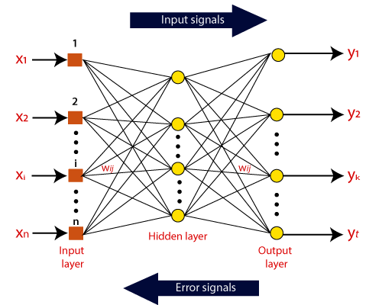
ANN WORKING

Slide 12
ANN WORKING
Afterward, each of the input is multiplied by its corresponding weights ( these weights are the details utilized by the artificial neural networks to solve a specific problem ).
In general terms, these weights normally represent the strength of the interconnection between neurons inside the artificial neural network.
All the weighted inputs are summarized inside the computing unit.
If the weighted sum is equal to zero, then bias is added to make the output non-zero or something else to scale up to the system's response.
Bias has the same input, and weight equals to 1.
Here the total of weighted inputs can be in the range of 0 to positive infinity.
Here, to keep the response in the limits of the desired value, a certain maximum value is benchmarked, and the total of weighted inputs is passed through the activation function.
The activation function refers to the set of transfer functions used to achieve the desired output.
There is a different kind of the activation function, but primarily either linear or non-linear sets of functions.
Some of the commonly used sets of activation functions are the Binary, linear, and Tan hyperbolic sigmoidal activation functions. Let us take a look at each of them in details:

Slide 13
ANN WORKING
Binary:
In binary activation function, the output is either a one or a 0. Here, to accomplish this, there is a threshold value set up. If the net weighted input of neurons is more than 1, then the final output of the activation function is returned as one or else the output is returned as 0.
Sigmoidal Hyperbolic:
The Sigmoidal Hyperbola function is generally seen as an "S" shaped curve. Here the tan hyperbolic function is used to approximate output from the actual net input. The function is defined as:
F(x) = (1/1 + exp(-????x))

Slide 14
WHAT ARE THE TYPES OF ANN ?
There are various types of Artificial Neural Networks (ANN) depending upon the human brain neuron and network functions, an artificial neural network similarly performs tasks.
The majority of the artificial neural networks will have some similarities with a more complex biological partner and are very effective at their expected tasks.
For example, segmentation or classification.
Feedback ANN:
In this type of ANN, the output returns into the network to accomplish the best-evolved results internally.
The feedback networks feed information back into itself and are well suited to solve optimization issues.
The Internal system error corrections utilize feedback ANNs.
Feed-Forward ANN:
A feed-forward network is a basic neural network comprising of an input layer, an output layer, and at least one layer of a neuron.
Through assessment of its output by reviewing its input, the intensity of the network can be noticed based on group behavior of the associated neurons, and the output is decided.
The primary advantage of this network is that it figures out how to evaluate and recognize input patterns.

Slide 15
WHAT ARE THE TOOLS FOR DEEP LEARNING ?
1. Torch:
The torch deep learning tools is an exceptionally effective open-source program.
This logical figuring system is supporting ML algorithms utilizing a Graphics Processing Unit.
It utilizes a powerful LuaJIT scripting language and a basic Compute Unified Device Architecture execution.
The light has a transposing, slicing, lots of routines for indexing, powerful N-dimensional array feature, and so on.
Has fantastic Graphics Processing Unit support and is embeddable so it can work with Android, iOS, and so on.

Slide 16
WHAT ARE THE TOOLS FOR DEEP LEARNING ?
2. Neural Designer:
Neural Designer is an expert application to find hidden designs, complicated connections, and anticipating genuine patterns from data indexes utilizing neural networks.
The Spain based new business Artelnics created Neural Designer, which has gotten quite possibly the most mainstream desktop applications for data mining.
It utilizes neural networks as numerical models imitating the human cerebrum work.
Neural Designer constructs computational models that work as the focal sensory system.

Slide 17
WHAT ARE THE TOOLS FOR DEEP LEARNING ?
3. TensorFlow:
Deep Learning Tools TensorFlow is regularly utilized across an assortment of undertakings yet includes a specific spend significant time in inference and training of deep neural networks.
It might be a representative mathematical library that upheld differentiable and dataflow programming.
It encourages the structure of both factual Machine Learning or ML arrangements just as profound deep learning through its broad interface of Compute Unified Device Architecture and Graphics Processing Unit.
It Offers help and capacities for different utilizations of Machine Learning like Reinforcement Learning, Natural Language Processing and Computer Vision.
TensorFlow is one of the must-know devices of ML for newcomers.

Slide 18
WHAT ARE THE TOOLS FOR DEEP LEARNING ?
4. Microsoft Cognitive Toolkit:
Microsoft Cognitive Toolkit deep learning tools is a monetarily utilized tool compartment that trains deep learning frameworks to adapt exactly like a human mind.
It is effortless and free open-source to utilize.
It furnishes excellent scaling abilities alongside enterprise-level quality, accuracy and speed.
It enables clients to bridle the knowledge inside huge datasets through data learning.
Microsoft Cognitive Toolkit deep learning tools depicts neural networks as an arrangement of computational strides through a coordinated diagram.

Slide 19
WHAT ARE THE TOOLS FOR DEEP LEARNING ?
5. Pytorch:
Pytorch is a deep learning tool.
It is exceptionally quick just as adaptable to utilize.
This is because Pytorch has a decent order over the Graphics Processing Unit.
It is quite possibly the main apparatuses of ML since it is utilized in the most indispensable parts of machine learning which incorporate constructing tensor calculations and deep neural networks.
Pytorch deep learning tool is founded on Python. Alongside this, it is the best option in contrast to NumPy.

Slide 20
WHAT ARE THE TOOLS FOR DEEP LEARNING ?
6. H20.ai:
H20’s deep learning tool gives a versatile multi-layer AI neural network.
H20’s possibly an entirely open-source, appropriated in-memory ML stage with direct adaptability.
H20’s backings the principal broadly utilized measurable and ML calculations including deep learning, generalized linear models, gradient boosted machines, and so on.
This artificial neural network includes a few parameters and components which can be modified likewise dependent on the data stored.
It likewise contains a rate-adaptive and annealing learning rate to output profoundly prescient yield.

Slide 21
WHAT ARE THE TOOLS FOR DEEP LEARNING ?
7. Keras:
Keras deep learning tool is a deep learning library that has negligible functionalities.
Keras deep learning tool was created with attention to empowering quick experimentation and works with TensorFlow and Theano.
The key advantage is that it can take you from thought to bring about a quick speed.
Keras deep learning tool is created in Python and fills in as an undeniable level neural networks library fit for running on top of either Theano or TensorFlow.
It takes into consideration simple and quick prototyping utilizing minimalism, extensibility, and total modularity.
Keras deep learning tool underpins recurrent networks, convolutional networks, a combination of both, and self-assertive availability plans like multi-output and multi-input training.

Slide 22
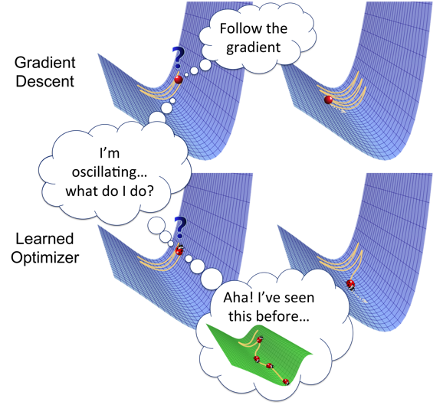
WHAT IS DEEP NEURAL NET OPTIMIZATION , TUNING & INTERPRETABILITY ?
Optimizers are algorithms or methods used to change the attributes of your neural network such as weights and learning rate in order to reduce the losses.
Optimizers help to get results faster.

Slide 23
TYPES OF OPTIMIZERS
OPTIMIZER
Gradient Descent
Adam
Stochastic Gradient Descent
Momentum
Nesterov Accelerated Gradient
Adagrad
AdaDelta
Mini-Batch Gradient Descent

Slide 24
WHAT ARE THE DIFFERENT TYPE OF OPTIMIZERS ?
1. GRADIENT DESCENT :-
Gradient Descent is the most basic but most used optimization algorithm.
It’s used heavily in linear regression and classification algorithms.
Backpropagation in neural networks also uses a gradient descent algorithm.
Gradient descent is a first-order optimization algorithm which is dependent on the first order derivative of a loss function.
It calculates that which way the weights should be altered so that the function can reach a minima.
Through backpropagation, the loss is transferred from one layer to another and the model’s parameters also known as weights are modified depending on the losses so that the loss can be minimized.

Slide 25
GRADIENT DESCENT
Algorithm: θ=θ−α⋅∇J(θ)
Advantages:
Easy computation.
Easy to implement.
Easy to understand.
Disadvantages:
May trap at local minima.
Weights are changed after calculating gradient on the whole dataset. So, if the dataset is too large than this may take years to converge to the minima.
Requires large memory to calculate gradient on the whole dataset.

Slide 26
WHAT ARE THE DIFFERENT TYPE OF OPTIMIZERS ?
2. Stochastic Gradient Descent
It’s a variant of Gradient Descent. It tries to update the model’s parameters more frequently. In this, the model parameters are altered after computation of loss on each training example. So, if the dataset contains 1000 rows SGD will update the model parameters 1000 times in one cycle of dataset instead of one time as in Gradient Descent.
θ=θ−α⋅∇J(θ;x(i);y(i)) , where {x(i) ,y(i)} are the training examples.
As the model parameters are frequently updated parameters have high variance and fluctuations in loss functions at different intensities.
Advantages:
Frequent updates of model parameters hence, converges in less time.
Requires less memory as no need to store values of loss functions.
May get new minima’s.
Disadvantages:
High variance in model parameters.
May shoot even after achieving global minima.
To get the same convergence as gradient descent needs to slowly reduce the value of learning rate.

Slide 27
WHAT ARE THE DIFFERENT TYPE OF OPTIMIZERS ?
3. Mini-Batch Gradient Descent
It’s best among all the variations of gradient descent algorithms. It is an improvement on both SGD and standard gradient descent. It updates the model parameters after every batch. So, the dataset is divided into various batches and after every batch, the parameters are updated.
θ=θ−α⋅∇J(θ; B(i)), where {B(i)} are the batches of training examples.
Advantages:
Frequently updates the model parameters and also has less variance.
Requires medium amount of memory.
All types of Gradient Descent have some challenges:
Choosing an optimum value of the learning rate. If the learning rate is too small than gradient descent may take ages to converge.
Have a constant learning rate for all the parameters. There may be some parameters which we may not want to change at the same rate.
May get trapped at local minima.

Slide 28
WHAT IS TUNING ?
The hyperparameters to tune are the number of neurons, activation function, optimizer, learning rate, batch size, and epochs. The second step is to tune the number of layers.

Slide 29
WHAT IS AUTO ENCODERS?
Autoencoders are a type of neural network that learns the data encodings from the dataset in an unsupervised way.
It basically contains two parts: the first one is an encoder which is similar to the convolution neural network except for the last layer.
The aim of the encoder to learn efficient data encoding from the dataset and pass it into a bottleneck architecture.
The other part of the Autoencoder is a decoder that uses latent space in the bottleneck layer to regenerate the images similar to the dataset.
These results backpropagate from the neural network in the form of the loss function.

Slide 30
WHAT IS VARIATIONAL AUTOENCODER ?
Variational AutoEncoder was proposed in 2013 by Knigma and Welling at Google and Qualcomm.
A variational AutoEncoder (VAE) provides a probabilistic manner for describing an observation in latent space.
Thus, rather than building an encoder that outputs a single value to describe each latent state attribute, we’ll formulate our encoder to describe a probability distribution for each latent attribute.
It has many applications such as data compression, synthetic data creation etc.

Slide 31
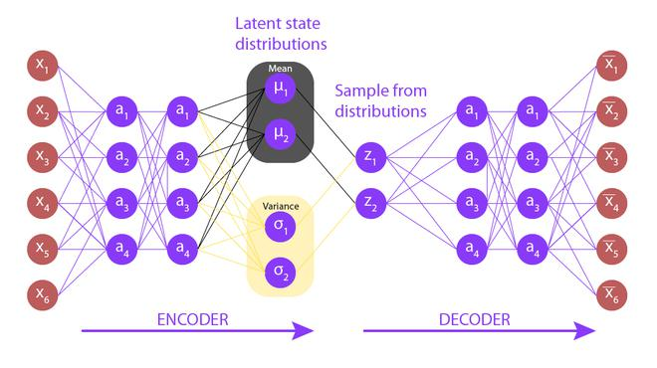
VARIATIONAL AUTOENCODER
Variational autoencoder is different from autoencoder in a way such that it provides a statistic manner for describing the samples of the dataset in latent space. Therefore, in variational autoencoder, the encoder outputs a probability distribution in the bottleneck layer instead of a single output value.

Slide 32
WHAT IS DEEP GENERATIVE MODELS ?
Generative models learn the distribution of the training data and help in generating new data points from the learned distribution by sampling those distribution.
In most cases, Gaussian distribution of the data are assumed.
Further, a deep generative model is an unsupervised learning technique that learns the distribution of the training data while optimizing the loss function of the model network.
There are several variants of the deep generative models and most of them are used to perform dual function viz. abstraction and generation.
These models are also classified depending on whether the network is learning an explicit or an implicit probability distribution.

Slide 33
WHAT ARE THE TYPES OF GENERATIVE MODELS ?
There are three types of deep generative models:
Variational AutoEncoder (VAE)
Generative Adversarial Nets (GANs).
Normalizing Flows (NFs).
VAEs :- VAEs are generative models consisting of an encoder and a decoder.
VAEs can perform both abstraction and generation and assume Gaussian distribution for the data.
Most commonly, a trained VAE can be used for generating new data samples from the learnt distribution space.
GANs :- GANs are generative models consisting of a generator and a discriminator.
GANs are trained using an adversarial learning technique, where the generator and the discriminator compete with each other.
During this process of training, the generator improves itself and tries to generate more realistic samples which the discriminator cannot distinguish with the real dataset.
NFs :- Normalizing Flows are generative models which produce tractable distributions where both sampling and density evaluation can be efficient and exact.

Slide 34
INTRODUCTION TO CONVOLUTIONAL NEURAL NETWORKS

Slide 35
WHAT IS CONVOLUTION ?
The convolutional layer is the core building block of a CNN, and it is where the majority of computation occurs.
It requires a few components, which are input data, a filter, and a feature map.
Let’s assume that the input will be a color image, which is made up of a matrix of pixels in 3D.
This means that the input will have three dimensions—a height, width, and depth—which correspond to RGB in an image.
We also have a feature detector, also known as a kernel or a filter, which will move across the receptive fields of the image, checking if the feature is present.
This process is known as a convolution.

Slide 36
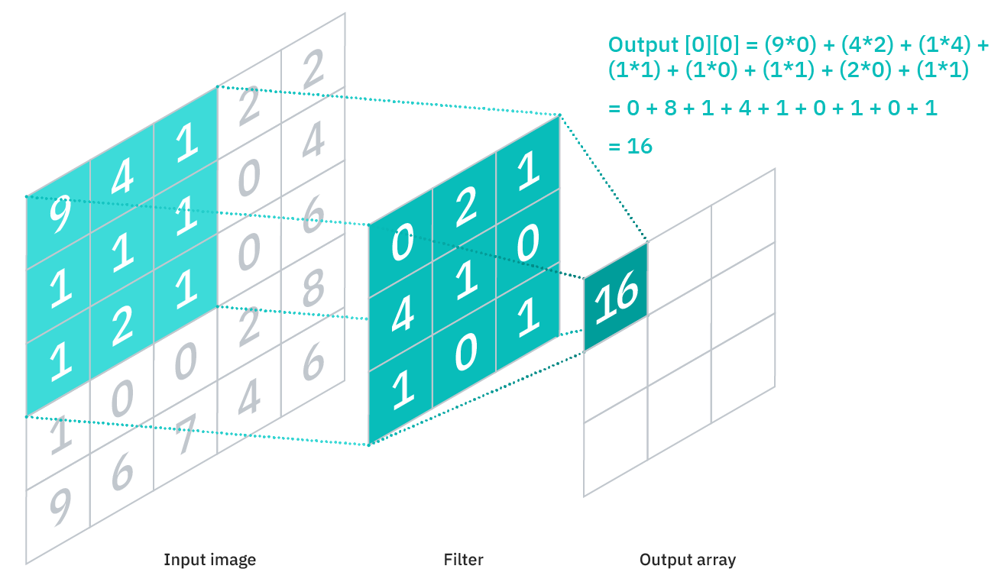
CONVOLUTION

Slide 37
WHAT IS CONVOLUTIONAL NEURAL NETWORKS ?
A Convolutional Neural Network (ConvNet/CNN) is a Deep Learning algorithm which can take in an input image, assign importance (learnable weights and biases) to various aspects/objects in the image and be able to differentiate one from the other.
The pre-processing required in a ConvNet is much lower as compared to other classification algorithms.
While in primitive methods filters are hand-engineered, with enough training, ConvNets have the ability to learn these filters/characteristics.

Slide 38
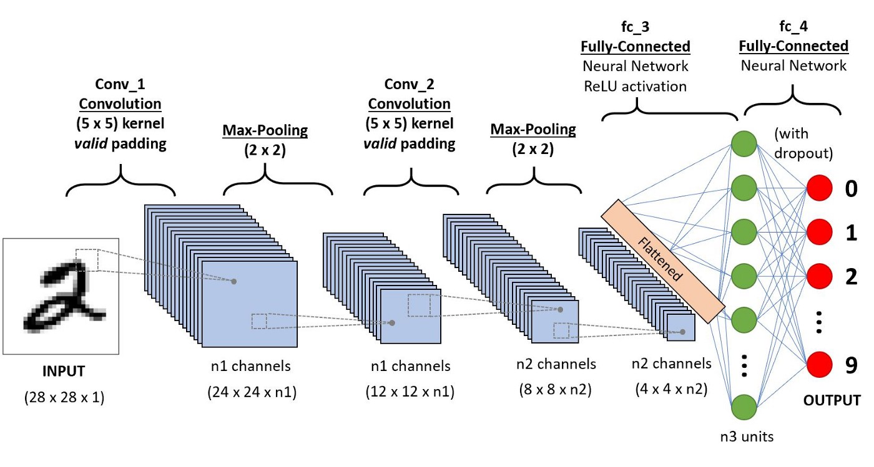
CONVOLUTIONAL NEURAL NETWORKS
The architecture of a ConvNet is analogous to that of the connectivity pattern of Neurons in the Human Brain and was inspired by the organization of the Visual Cortex.
Individual neurons respond to stimuli only in a restricted region of the visual field known as the Receptive Field.
A collection of such fields overlap to cover the entire visual area.

Slide 39
FORWARD PROPAGATION & BACKPROPAGATION FOR CNNS

Slide 40
WHAT IS FORWARD PROPAGATION ?
Forward propagation (or forward pass) refers to the calculation and storage of intermediate variables (including outputs) for a neural network in order from the input layer to the output layer.
We now work step-by-step through the mechanics of a neural network with one hidden layer.
This may seem tedious but in the eternal words of funk virtuoso James Brown, you must “pay the cost to be the boss”.
For the sake of simplicity, let us assume that the input example is x∈Rd and that our hidden layer does not include a bias term. Here the intermediate variable is:
z=W(1)x,

Slide 41
FORWARD PROPAGATION
where W(1)∈Rh×d is the weight parameter of the hidden layer. After running the intermediate variable z∈Rh through the activation function ϕ we obtain our hidden activation vector of length h ,
h=ϕ(z).
The hidden variable h is also an intermediate variable.
Assuming that the parameters of the output layer only possess a weight of W(2)∈Rq×h , we can obtain an output layer variable with a vector of length q :
o=W(2)h.

Slide 42
FORWARD PROPAGATION
Assuming that the loss function is l and the example label is y , we can then calculate the loss term for a single data example,
L=l(o , y).
According to the definition of L2 regularization, given the hyperparameter λ , the regularization term is
s=λ2(∥W(1)∥2F+∥W(2)∥2F),
where the Frobenius norm of the matrix is simply the L2 norm applied after flattening the matrix into a vector. Finally, the model’s regularized loss on a given data example is:
J=L+s.

Slide 43
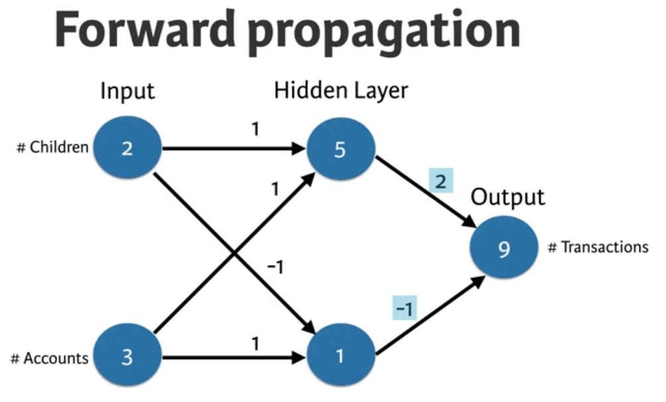
FORWARD PROPAGATION

Slide 44
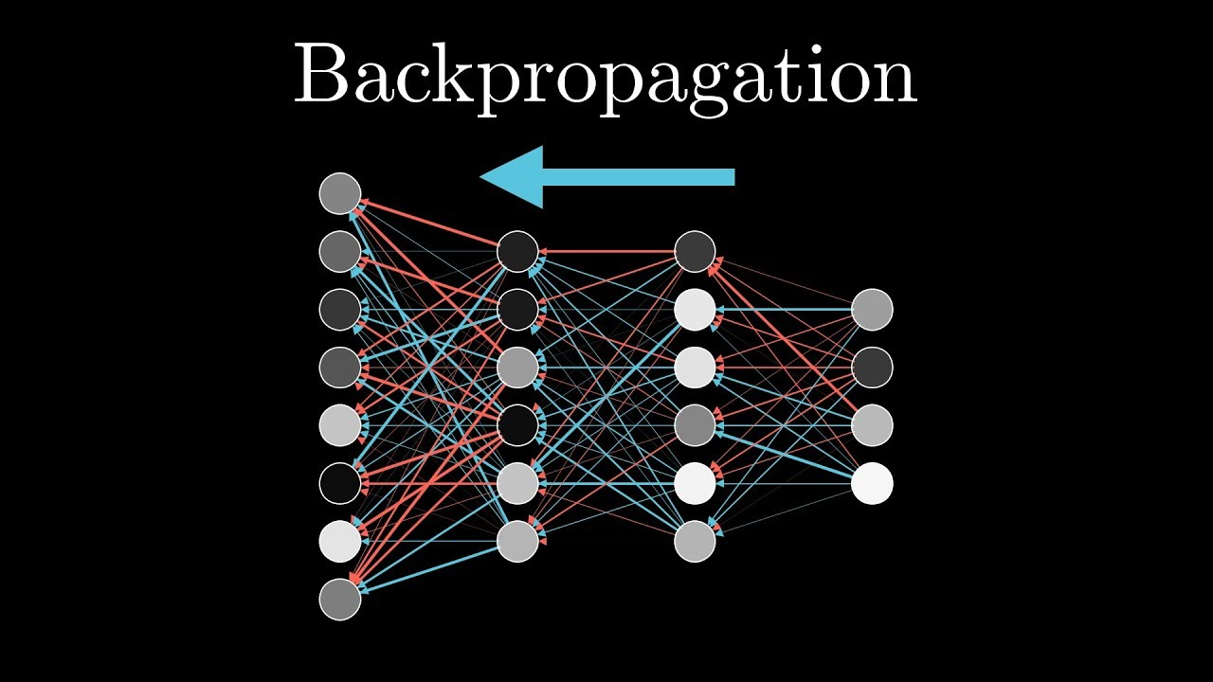
BACKPROPAGATION

Slide 45
WHAT IS BACKPROPAGATION ?
Backpropagation refers to the method of calculating the gradient of neural network parameters.
In short, the method traverses the network in reverse order, from the output to the input layer, according to the chain rule from calculus.
The algorithm stores any intermediate variables (partial derivatives) required while calculating the gradient with respect to some parameters.
Assume that we have functions Y=f(X) and Z=g(Y) , in which the input and the output X,Y,Z are tensors of arbitrary shapes.
By using the chain rule, we can compute the derivative of Z with respect to X via
∂Z∂X=prod(∂Z∂Y,∂Y∂X).

Slide 46
BACKPROPAGATION
we use the prod operator to multiply its arguments after the necessary operations, such as transposition and swapping input positions, have been carried out. For vectors, this is straightforward: it is simply matrix-matrix multiplication.
For higher dimensional tensors, we use the appropriate counterpart. The operator prod hides all the notation overhead.
the parameters of the simple network with one hidden layer, whose computational graph is in W(1) and W(2).
The objective of backpropagation is to calculate the gradients ∂J/∂W(1) and ∂J/∂W(2).
To accomplish this, we apply the chain rule and calculate, in turn, the gradient of each intermediate variable and parameter.

Slide 47
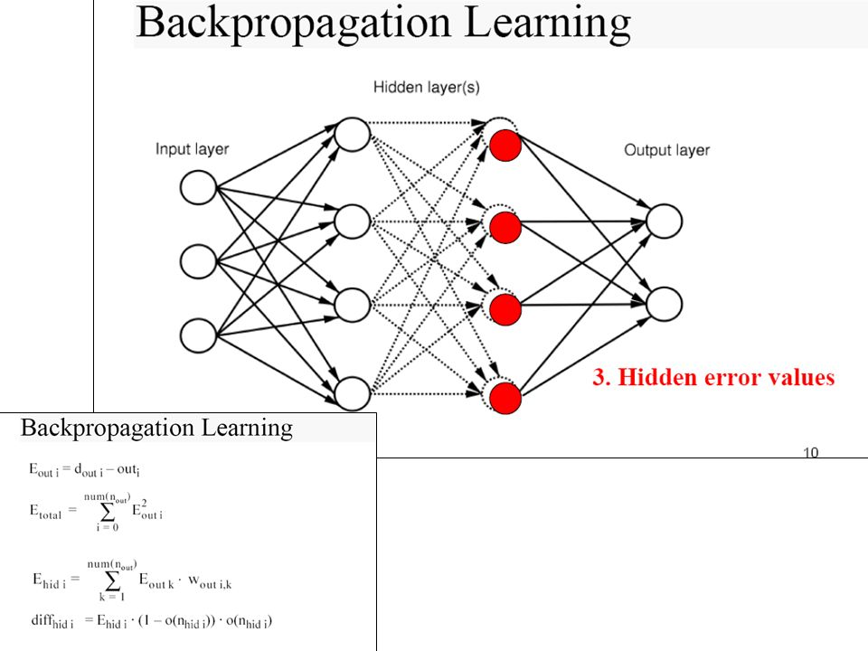
BACKPROPAGATION

Slide 48
CNN ARCHITECTURE

Slide 49
WHAT IS CNN ARCHITECTURE ?
The architecture of CNN is the most important factor that analyses the performance and determines accuracy.
An arrangement of layers in the network and the filters used in each layer impacts the performance of an algorithm a lot.
Through convolutional neural networks, machines can visualize the real world like humans and CNN will always be the go-to model to recognize the objects.
There are two main parts to a CNN architecture
A convolution tool that separates and identifies the various features of the image for analysis in a process called as Feature Extraction
A fully connected layer that utilizes the output from the convolution process and predicts the class of the image based on the features extracted in previous stages

Slide 50
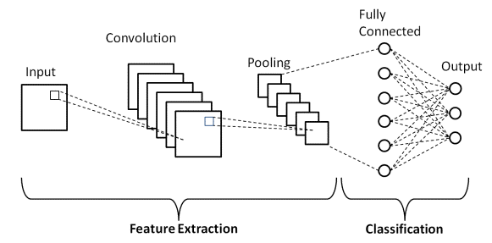
CNN ARCHITECTURE

Slide 51
WHAT ARE THE CONVOLUTION LAYERS?
There are three types of layers that make up the CNN which are the convolutional layers, pooling layers, and fully-connected (FC) layers.
When these layers are stacked, a CNN architecture will be formed.
In addition to these three layers, there are two more important parameters which are the dropout layer and the activation function which are defined below.

Slide 52
CONVOLUTION LAYERS
1. Convolutional Layer
This layer is the first layer that is used to extract the various features from the input images.
In this layer, the mathematical operation of convolution is performed between the input image and a filter of a particular size MxM.
By sliding the filter over the input image, the dot product is taken between the filter and the parts of the input image with respect to the size of the filter (MxM).
The output is termed as the Feature map which gives us information about the image such as the corners and edges.
Later, this feature map is fed to other layers to learn several other features of the input image.

Slide 53
CONVOLUTION LAYERS
2. Pooling Layer
In most cases, a Convolutional Layer is followed by a Pooling Layer.
The primary aim of this layer is to decrease the size of the convolved feature map to reduce the computational costs.
This is performed by decreasing the connections between layers and independently operates on each feature map.
Depending upon method used, there are several types of Pooling operations.
In Max Pooling, the largest element is taken from feature map.
Average Pooling calculates the average of the elements in a predefined sized Image section.
The total sum of the elements in the predefined section is computed in Sum Pooling.
The Pooling Layer usually serves as a bridge between the Convolutional Layer and the FC Layer

Slide 54
CONVOLUTION LAYERS
3. Fully Connected Layer
The Fully Connected (FC) layer consists of the weights and biases along with the neurons and is used to connect the neurons between two different layers.
These layers are usually placed before the output layer and form the last few layers of a CNN Architecture.
In this, the input image from the previous layers are flattened and fed to the FC layer.
The flattened vector then undergoes few more FC layers where the mathematical functions operations usually take place.
In this stage, the classification process begins to take place.

Slide 55
CONVOLUTION LAYERS
4. Dropout
Usually, when all the features are connected to the FC layer, it can cause overfitting in the training dataset.
Overfitting occurs when a particular model works so well on the training data causing a negative impact in the model’s performance when used on a new data.
To overcome this problem, a dropout layer is utilised wherein a few neurons are dropped from the neural network during training process resulting in reduced size of the model.
On passing a dropout of 0.3, 30% of the nodes are dropped out randomly from the neural network.

Slide 56
CONVOLUTION LAYERS
5. Activation Functions
Finally, one of the most important parameters of the CNN model is the activation function.
They are used to learn and approximate any kind of continuous and complex relationship between variables of the network.
In simple words, it decides which information of the model should fire in the forward direction and which ones should not at the end of the network.
It adds non-linearity to the network.
There are several commonly used activation functions such as the ReLU, Softmax, tanH and the Sigmoid functions.
Each of these functions have a specific usage.
For a binary classification CNN model, sigmoid and softmax functions are preferred an for a multi-class classification, generally softmax us used.

Slide 57
WHAT IS ALEXNET ?
LeNet performs well with the limited amount of data, but in real-world data will never be simple and consists of numerous variables.
AlexNet is the first large scale CNN architecture that can do well in ImageNet classification.
The architecture of AlexNet is quite similar to LeNet but is a bit deeper, larger and it uses continuous convolutional layers.
It has sixty million parameters and 650k neurons. This is very well-built that it is capable of achieving greater accuracies.
It has large applications in computer vision in artificial intelligence.

Slide 58
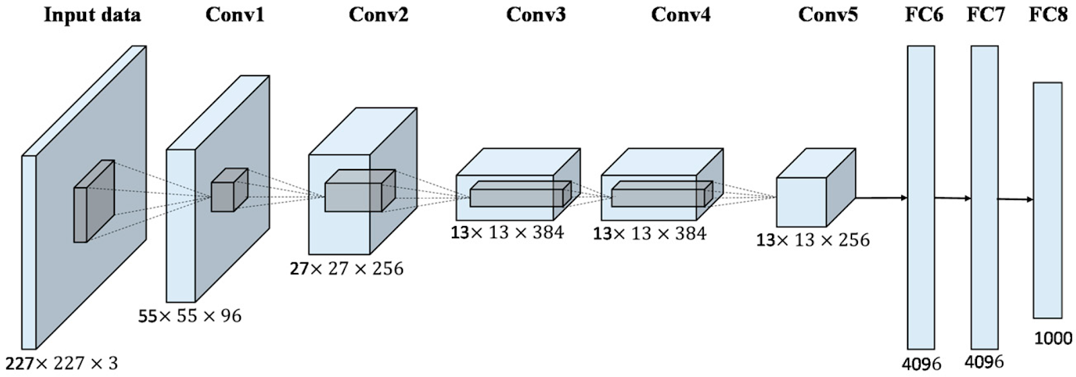
ALEXNET
This architecture has eight layers out of which five are convolutional layers, and the rest are fully-connected layers.

Slide 59
ALEXNET
AlexNet takes RGB image of size 256 x 256 as input. All images in the training dataset should be of the same size. Each convolutional layer consists of multiple kernels of the same size and extracts some prominent features.
The most important features of AlexNet are :-
ReLU Nonlinearity: Instead of tanh function AlexNet uses ReLU (Rectified linear units) as a function to train the dataset. The main advantage of using ReLU is it reduces the training time and makes the algorithm run almost six times faster. And using ReLU we can get a 25 percent training error
Overlapping Pooling: By using the overlapping of pooling, we can reduce the error by about 0.5 percent. And using this occurring chance of overfitting are very rare.

Slide 60
INTRODUCTION TO RECURRENT NEURAL NETWORK

Slide 61
WHAT IS RECURRENT NEURAL NETWORK?
Recurrent Neural Network(RNN) are a type of Neural Network where the output from previous step are fed as input to the current step.
In traditional neural networks, all the inputs and outputs are independent of each other, but in cases like when it is required to predict the next word of a sentence, the previous words are required and hence there is a need to remember the previous words.
Thus RNN came into existence, which solved this issue with the help of a Hidden Layer.
The main and most important feature of RNN is Hidden state, which remembers some information about a sequence.

Slide 62
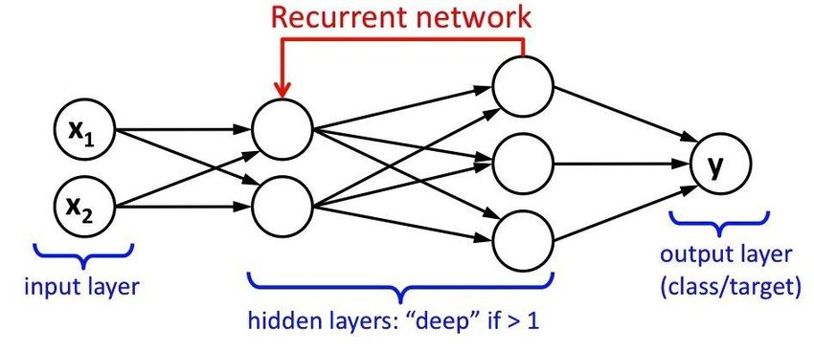
RECURRENT NEURAL NETWORK
RNN have a “memory” which remembers all information about what has been calculated.
It uses the same parameters for each input as it performs the same task on all the inputs or hidden layers to produce the output.
This reduces the complexity of parameters, unlike other neural networks.

Slide 63
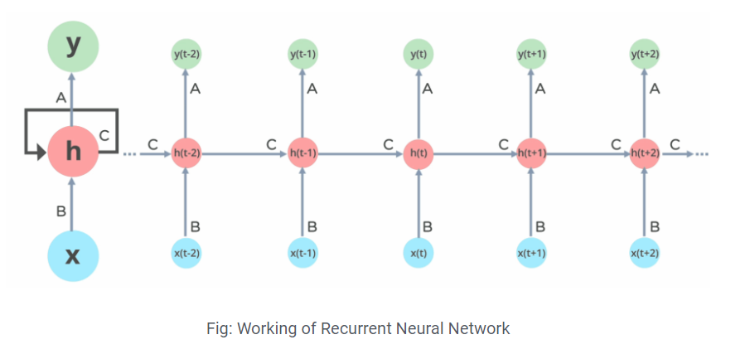
RECURRENT NEURAL NETWORK WORKING

Slide 64
HOW DOES RECURRENT NEURAL NETWORK WORKS?
In Recurrent Neural networks, the information cycles through a loop to the middle hidden layer.
The input layer ‘x’ takes in the input to the neural network and processes it and passes it onto the middle layer.
The middle layer ‘h’ can consist of multiple hidden layers, each with its own activation functions and weights and biases.
If you have a neural network where the various parameters of different hidden layers are not affected by the previous layer, ie: the neural network does not have memory, then you can use a recurrent neural network.
The Recurrent Neural Network will standardize the different activation functions and weights and biases so that each hidden layer has the same parameters.
Then, instead of creating multiple hidden layers, it will create one and loop over it as many times as required.

Slide 65
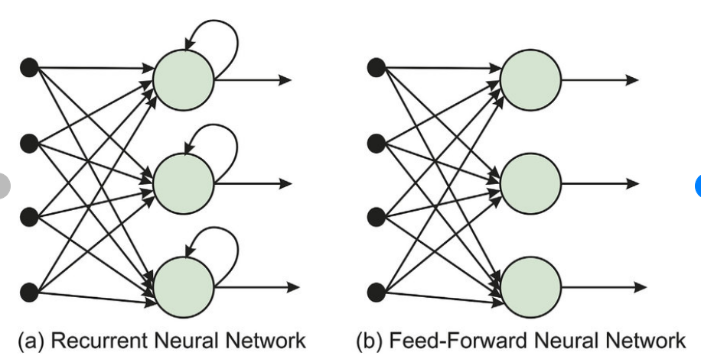
FEED FORWARD NEURAL NETWORK VS RECURRENT NEURAL NETWORK

Slide 66
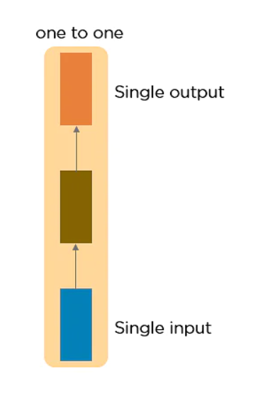
WHAT ARE THE DIFFERENT TYPES OF RNN ?
There are four types of Recurrent Neural Networks:
One to One
One to Many
Many to One
Many to Many
ONE TO ONE RNN :- This type of neural network is known
as the Vanilla Neural Network. It's used for general machine
learning problems, which has a single input and a single output.

Slide 67
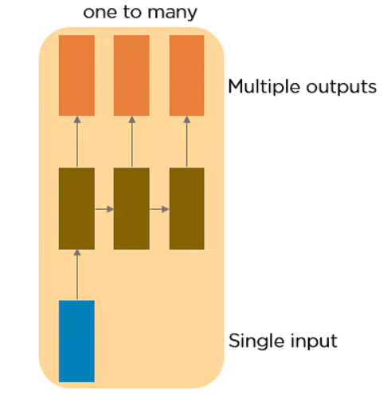
TYPES OF RNN
2. One to Many RNN:- This type of neural network has a single input and multiple outputs. An example of this is the image caption.

Slide 68
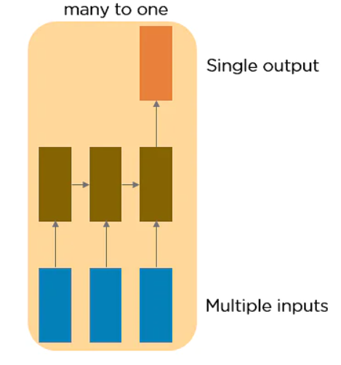
TYPES OF RNN
3. Many to One RNN :- This RNN takes a sequence of inputs and generates a single output. Sentiment analysis is a good example of this kind of network where a given sentence can be classified as expressing positive or negative sentiments.

Slide 69
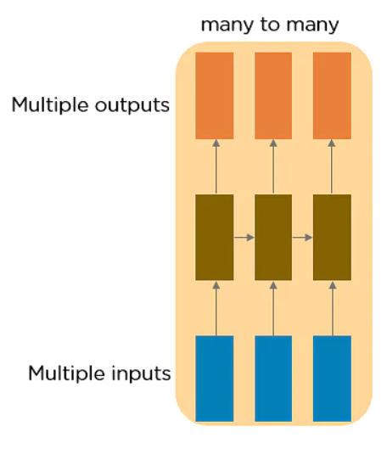
TYPES OF RNN
4. Many to Many RNN:- This RNN takes a sequence of inputs and generates a sequence of outputs. Machine translation is one of the examples.

Slide 70

THANK YOU !!!
(USA)
2-Industrial Park Drive, E-Waldorf, MD, 20602,
United States
(USA)
+1-844-889-4054
(Singapore)
3 Temasek Avenue, Singapore 039190
info@careerera.com www.careerera.com
(INDIA)
B-44, Sector-59, Noida Uttar Pradesh 201301
(INDIA)
+91-92-5000-4000

