Slide 1
A Warm Welcome To Careerera Family

Slide 2
INTRODUCTION TO NEURAL NETWORKS AND DEEP LEARNING

Slide 3

TABLE OF CONTENT
Introduction to Deep Learning
Neural Networks Basics
Shallow Neural Networks
Deep Neural Networks
Forward Propagation and Backpropagation.
How to Build and Train Deep Neural networks, and apply it to Computer Vision.
Introduction to Perceptron & Neural Networks
Activation and Loss functions
Gradient Descent
Hyper Parameter Tuning
Tensor Flow & Keras for Neural Networks
Introduction to Sequential data
RNNs and its mechanisms
Vanishing & Exploding gradients in RNNs
LSTMs - Long short-term memory
GRUs - Gated recurrent unit
LSTMs Applications
Time series analysis
LSTMs with attention mechanism
Neural Machine Translation
Advanced Language Models: Transformers, BERT, XLNet

Slide 4
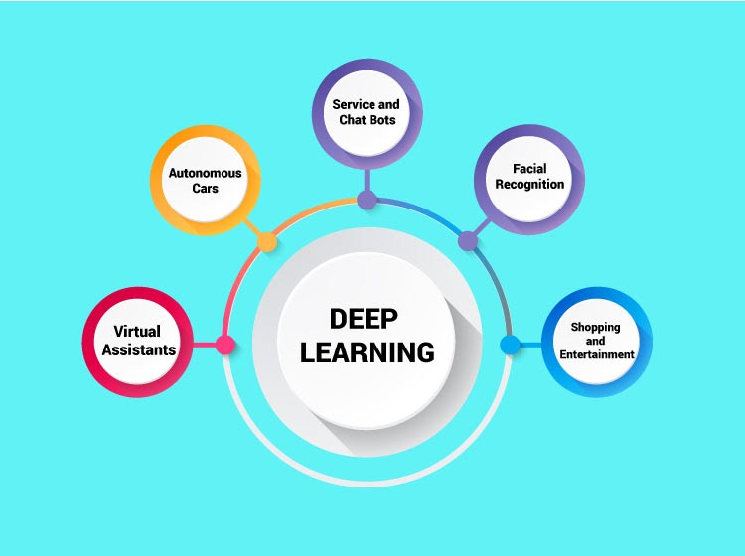
WHAT IS DEEP LEARNING?

Slide 5
INTRODUCTION TO DEEP LEARNING
Deep learning is a branch of machine learning which is completely based on artificial neural networks, as neural network is going to mimic the human brain so deep learning is also a kind of mimic of human brain.
In deep learning, we don’t need to explicitly program everything.
The concept of deep learning is not new.
It has been around for a couple of years now.
It’s on hype nowadays because earlier we did not have that much processing power and a lot of data.

Slide 6
DEFINITION OF DEEP LEARNING
Deep learning is a particular kind of machine learning that achieves great power and flexibility by learning to represent the world as a nested hierarchy of concepts, with each concept defined in relation to simpler concepts, and more abstract representations computed in terms of less abstract ones.

Slide 7
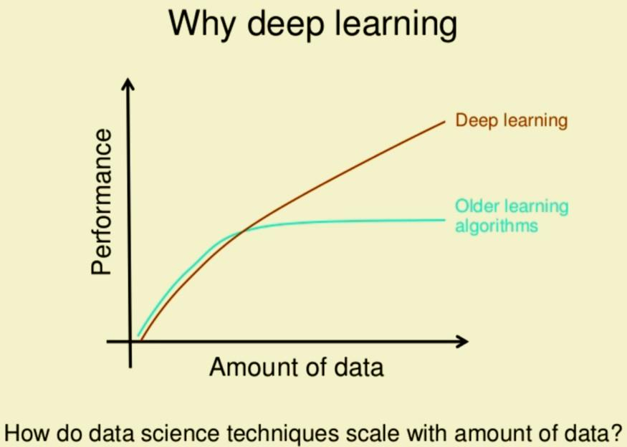
WHY IS DEEP LEARNING IMPORTANT?

Slide 8
WHY IS DEEP LEARNING IMPORTANT?
It contributes heavily towards making our daily lives more convenient, and this trend will grow in the future. Whether it is parking assistance through technology or face recognition at the airport, deep learning is fueling a lot of automation in today’s world.
Deep learning’s relevance can be linked most to the fact that our world is generating exponential amounts of data today, which needs structuring on a large scale.
Deep learning uses the growing volume and availability of data has been most aptly. All the information collected from these data is used to achieve accurate results through iterative learning models.
The repeated analysis of massive datasets eradicates errors and discrepancies in findings which eventually leads to a reliable conclusion.
Deep learning will continue to make an impact in both business and personal spaces and create a lot of job opportunities in the upcoming time.

Slide 9
DEEP LEARNING ARCHITECTURES :
Deep Neural Network – It is a neural network with a certain level of complexity (having multiple hidden layers in between input and output layers). They are capable of modeling and processing non-linear relationships.
Deep Belief Network(DBN) – It is a class of Deep Neural Network. It is multi-layer belief networks. Steps for performing DBN : a. Learn a layer of features from visible units using Contrastive Divergence algorithm. b. Treat activations of previously trained features as visible units and then learn features of features. c. Finally, the whole DBN is trained when the learning for the final hidden layer is achieved.
Recurrent (perform same task for every element of a sequence) Neural Network – Allows for parallel and sequential computation. Similar to the human brain (large feedback network of connected neurons). They are able to remember important things about the input they received and hence enables them to be more precise.

Slide 10
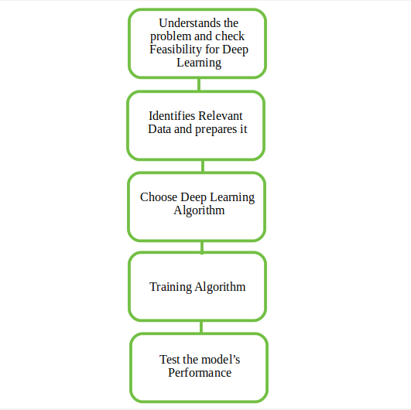
HOW A DEEP LEARNING WORKS?

Slide 11
HOW A DEEP LEARNING WORKS?
First, we need to identify the actual problem in order to get the right solution and it should be understood, the feasibility of the Deep Learning should also be checked (whether it should fit Deep Learning or not).
Second, we need to identify the relevant data which should correspond to the actual problem and should be prepared accordingly.
Third, Choose the Deep Learning Algorithm appropriately.
Fourth, Algorithm should be used while training the dataset.
Fifth, Final testing should be done on the dataset.

Slide 12
DEEP LEARNING APPLICATIONS :
Automatic Text Generation – Corpus of text is learned and from this model new text is generated, word-by-word or character-by-character. Then this model is capable of learning how to spell, punctuate, form sentences, or it may even capture the style.
Healthcare – Helps in diagnosing various diseases and treating it.
Automatic Machine Translation – Certain words, sentences or phrases in one language is transformed into another language (Deep Learning is achieving top results in the areas of text, images).
Image Recognition – Recognizes and identifies peoples and objects in images as well as to understand content and context. This area is already being used in Gaming, Retail, Tourism, etc.
Predicting Earthquakes – Teaches a computer to perform viscoelastic computations which are used in predicting earthquakes.

Slide 13
ADVANTAGES OF DEEP LEARNING
Ability to generate new features from the limited available training data sets.
Can work on unsupervised learning techniques helps in generating actionable and reliable task outcomes.
It reduces the time required for feature engineering, one of the tasks that requires major time in practicing machine learning.
With continuous training, its architecture has become adaptive to change and is able to work on diverse problems.

Slide 14
DISADVANTAGES OF DEEP LEARNING
The complete training process relies on the continuous flow of the data, which decreases the scope for improvement in the training process.
The cost of computational training significantly increases with an increase in the number of datasets.
Lack of transparency in fault revision. No intermediate steps to provide the arguments for a certain fault. In order to resolve the issue, a complete algorithm gets revised.
Need for expensive resources, high-speed processing units and powerful GPU’s for training the data sets.

Slide 15
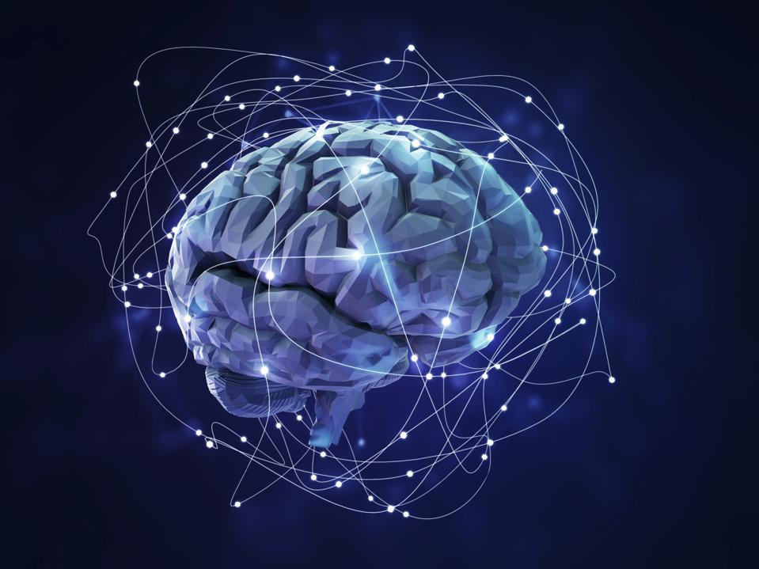
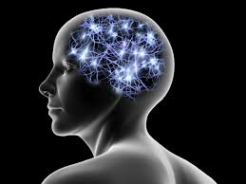
WHAT IS A NEURAL NETWORK?

Slide 16
WHAT IS A NEURAL NETWORK?
A neural network is a series of algorithms that endeavors to recognize underlying relationships in a set of data through a process that mimics the way the human brain operates.
In neural networks refer to systems of neurons, either organic or artificial in nature.
Neural networks can adapt to changing input; so the network generates the best possible result without needing to redesign the output criteria.
The concept of neural networks, which has its roots in artificial intelligence, is swiftly gaining popularity in the development of trading systems.

Slide 17
BASICS OF NEURAL NETWORKS
Neural networks, in the world of finance, assist in the development of such process as time-series forecasting, algorithmic trading, securities classification, credit risk modeling and constructing proprietary indicators and price derivatives.
A neural network works similarly to the human brain’s neural network. A “neuron” in a neural network is a mathematical function that collects and classifies information according to a specific architecture.
The network bears a strong resemblance to statistical methods such as curve fitting and regression analysis.
A neural network contains layers of interconnected nodes. Each node is a perceptron and is similar to a multiple linear regression.
The perceptron feeds the signal produced by a multiple linear regression into an activation function that may be nonlinear.

Slide 18
HOW A NEURAL NETWORK WORKS?
A neural network has many layers. Each layer performs a specific function, and the complex the network is, the more the layers are. That’s why a neural network is also called a multi-layer perceptron.
The purest form of a neural network has three layers:
The input layer
The hidden layer
The output layer

Slide 19
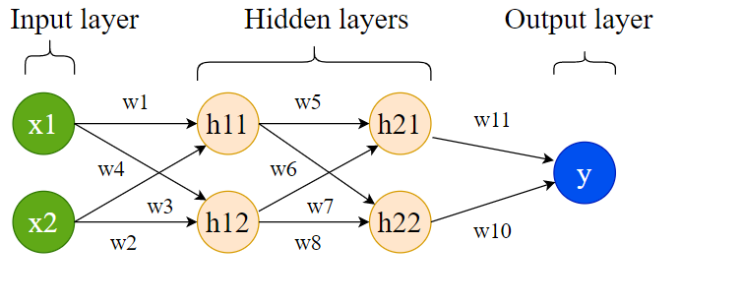
NEURAL NETWORK LAYERS

Slide 20
NEURAL NETWORK LAYERS
Input layer
This layer receives input data and passes it on to the next layer. The number of neurons in this layer depends on the number of dimensions of input data.
For example, if input data (matrix) is of size (500, 10), 500 rows (samples) and 10 columns (features), then the number of neurons in the input layer should be 10.
Each neuron in input layer is connected to all neurons in the next layer.
All these connections have a separate weight (denoted by w).

Slide 21
NEURAL NETWORK LAYERS
Hidden layer
The next two layers after the input layer are called hidden layers. In the first hidden layer too, all the neurons are connected to all other neurons in the adjacent (hidden) layer.
The number of hidden layers determines if the resulting neural network is deep (2 or more hidden layers) or shallow.
When the number of hidden layers is 2 or more, the structure or architecture of the neural network is deep and overall learning is called deep learning.
More the number of hidden layers, the more complex the architecture is.
A complex architecture is beneficial for learning unique patterns from big data.
But, complex architecture is prone to overfitting when a neural network starts memorizing data without learning unique and general patterns.

Slide 22
NEURAL NETWORK LAYERS
Output layer
This layer collects output computed using input data and weights which are optimized during learning.
An activation function is chosen to transform the combination of input and weight to an output.

Slide 23
NEURAL NETWORK APPLICATIONS
Pattern recognition
Investment analysis
Control system & monitoring
Mobile computing
Marketing and financial applications
Forecasting – sales ,market research , meteorology

Slide 24
ADVANTAGES OF NEURAL NETWORK
Neural Networks have the ability to learn by themselves and produce the output that is not limited to the input provided to them.
The input is stored in its own networks instead of a database, hence the loss of data does not affect its working.
These networks can learn from examples and apply them when a similar event arises, making them able to work through real-time events.
Even if a neuron is not responding or a piece of information is missing, the network can detect the fault and still produce the output.
They can perform multiple tasks in parallel without affecting the system performance.

Slide 25
DISADVANTAGES OF NEURAL NETWORK
The main disadvantages of neural networks are their black-box nature.
Sometimes you need more control over the details of the algorithm, although there are libraries like Keras that make the development of neural networks fairly simple.
Neural networks usually require much more data than traditional algorithms, as in at least thousands if not millions of labeled samples.
Neural networks are also more complex in computing terms than traditional algorithms.
The duration of the neural network is unknown.
Hardware dependence.
Unexplained behavior of the network.

Slide 26
SHALLOW NEURAL NETWORKS
Shallow neural networks give us basic idea about deep neural network which consist of only 1 or 2 hidden layers.
Understanding a shallow neural network gives us an understanding into what exactly is going on inside a deep neural network A neural network is built using various hidden layers.
Now that we know the computations that occur in a particular layer, let us understand how the whole neural network computes the output for a given input X.
These can also be called the forward propagation equations.

Slide 27
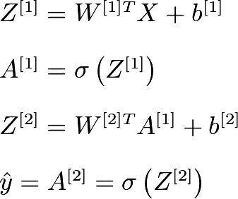
SHALLOW NEURAL NETWORKS
The first equation calculates the intermediate output Z[1]of the first hidden layer.
The second equation calculates the final output A[1]of the first hidden layer.
The third equation calculates the intermediate output Z[2]of the output layer.
The fourth equation calculates the final output A[2]of the output layer which is also the final output of the whole neural network.

Slide 28
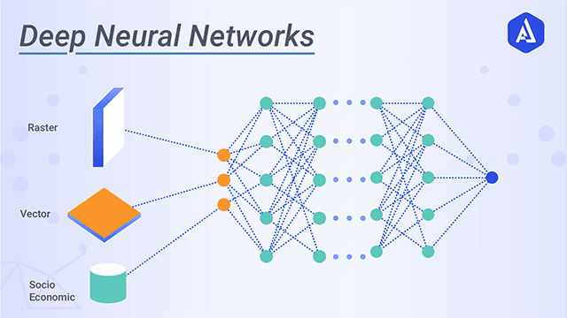
WHAT IS DEEP NEURAL NETWORKS?

Slide 29
WHAT IS DEEP NEURAL NETWORKS?
A neural network consists of several connected units called nodes.
These are the smallest part of the neural network and act as the neurons in the human brain.
When a neuron receives a signal, it triggers a process.
The signal is passed from one neuron to another based on input received.
A complex network is formed that learns from feedback.
The nodes are grouped into layers.
A task is solved by processing the various layers between the input and output layers.
The greater the number of layers to be processed, the deeper the network, therefore the term, deep learning.

Slide 30
DEEP NEURAL NETWORKS
CAP (Credit Assignment Path) sheds light on the number of layers required to solve a problem.
When the CAP index is more than two then the neural network is considered as deep.
Deep Neural Network applications are very efficient and useful in real-life scenarios.
Deep Neural Network AI-based robots like Alpha 2 can speak, execute voice commands, write messages, etc.

Slide 31
TYPES OF DEEP NEURAL NETWORK
Some of the types are:
ANN: Artificial Neural Networks
CNN: Convolution Neural Networks
RNN: Recurrent Neural Networks

Slide 32
WHAT IS ANN?
These Deep Neural Networks mostly act as the base for the pre-trained models in deep learning.
The ANN is a deep feed-forward neural network as it processes inputs in the forward direction only.
Artificial Neural Networks are capable of learning non-linear functions. The activation function of ANNs helps in learning any complex relationship between input and output.

Slide 33
WHAT IS CNN?
The CNN based models in Deep Neural Networks are used in video and image processing.
Filters or kernels are the building blocks of CNN.
By using conventional operations kernels extract relevant and correct features from the input data.

Slide 34
WHAT IS RNN?
RNN is designed to overcome the looping constraint of ANN in hidden layers.
Deep recurrent networks are capable of solving problems related to audio data, text data, and time-series data.
Recurrent neural networks capture sequential information available in the input data.
RNN works on parameter sharing.

Slide 35


FORWARD PROPAGATION
Forward propagation refers to the calculation and storage of intermediate variables (including outputs) for the neural network in order from the input layer to the output layer.
We now work step-by-step through the mechanics of a deep network with one hidden layer.
This may seem tedious but in the eternal words of funk virtuoso James Brown, you must “pay the cost to be the boss”.
For the sake of simplicity, let’s assume that the input example is x∈Rdx∈Rd and that our hidden layer does not include a bias term. Here the intermediate variable is:
where W(1)∈Rh×dW(1)∈Rh×d is the weight parameter of the hidden layer. After running the intermediate variable z∈Rhz∈Rh through the activation function ϕϕ we obtain our hidden activation vector of length hh,

Slide 36



FORWARD PROPAGATION
The hidden variable hh is also an intermediate variable. Assuming that the parameters of the output layer only possess a weight of W(2)∈Rq×hW(2)∈Rq×h, we can obtain an output layer variable with a vector of length qq:
Assuming that the loss function is ll and the example label is yy, we can then calculate the loss term for a single data example,
According to the definition of L2L2 regularization, given the hyperparameter λλ, the regularization term is

Slide 37
FORWARD PROPAGATION
where the Frobenius norm of the matrix is simply the L2L2 norm applied after flattening the matrix into a vector. Finally, the model’s regularized loss on a given data example is:
J=L+s.
We refer to JJ as the objective function in the following discussion.

Slide 38
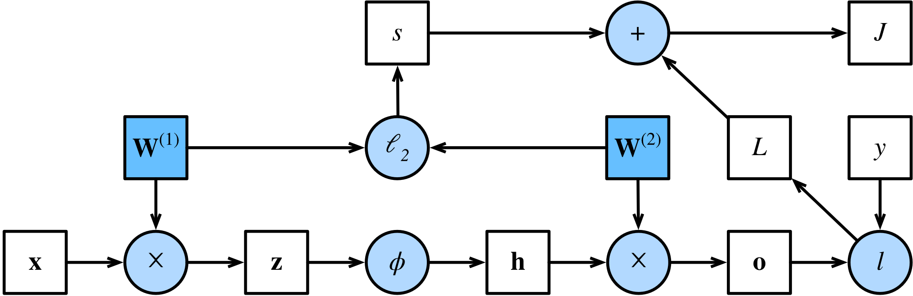
COMPUTATIONAL GRAPH OF FORWARD PROPAGATION
Plotting computational graphs helps us visualize the dependencies of operators and variables within the calculation.
contains the graph associated with the simple network described above, where squares denote variables and circles denote operators.
The lower-left corner signifies the input and the upper-right corner is the output.
Notice that the directions of the arrows (which illustrate data flow) are primarily rightward and upward.

Slide 39

BACKPROPAGATION
Backpropagation refers to the method of calculating the gradient of neural network parameters.
the method traverses the network in reverse order, from the output to the input layer, according to the chain rule from calculus.
The algorithm stores any intermediate variables (partial derivatives) required while calculating the gradient with respect to some parameters.
Assume that we have functions
in which the input and the output X,Y,Z are tensors of arbitrary shapes. By using the chain rule, we can compute the derivative of ZZ with respect to XX via

Slide 40


BACKPROPAGATION
Here we use the prodprod operator to multiply its arguments after the necessary operations, such as transposition and swapping input positions, have been carried out.
For vectors, this is straightforward: it is simply matrix-matrix multiplication.
For higher dimensional tensors, we use the appropriate counterpart.
The operator prodprod hides all the notation overhead.
Recall that the parameters of the simple network with one hidden layer, whose computational graph are W(1) and W(2) The objective of backpropagation is to calculate the gradients
To accomplish this, we apply the chain rule and calculate, in turn, the gradient of each intermediate variable and parameter.

Slide 41

BACKPROPAGATION
To accomplish this, we apply the chain rule and calculate, in turn, the gradient of each intermediate variable and parameter.
The order of calculations are reversed relative to those performed in forward propagation, since we need to start with the outcome of the computational graph and work our way towards the parameters.
The first step is to calculate the gradients of the objective function J=L+s with respect to the loss term L and the regularization term s.

Slide 42




BACKPROPAGATION
Next, we compute the gradient of the objective function with respect to variable of the output layer oo according to the chain rule:
Next, we calculate the gradients of the regularization term with respect to both parameters:
Now we are able to calculate the gradient of the model parameters closest to the output layer. Using the chain rule yields:

Slide 43



BACKPROPAGATION
To obtain the gradient with respect to W(1) we need to continue backpropagation along the output layer to the hidden layer. The gradient with respect to the hidden layer’s outputs is given by
Since the activation function ϕ applies elementwise, calculating the gradient
f the intermediate variable z requires that we use the elementwise multiplication operator, which we denote by ⊙:
Finally, we can obtain the gradient of the model parameters closest to the input layer. According to the chain rule, we get

Slide 44
HOW TO BUILD A DEEP NEURAL NETWORK
The output ŷ of a simple 2-layer Neural Network is:
the weights W and the biases b are the only variables that affects the output ŷ.
Naturally, the right values for the weights and biases determines the strength of the predictions. The process of fine-tuning the weights and biases from the input data is known as training the Neural Network.
Each iteration of the training process consists of the following steps:
Calculating the predicted output ŷ, known as feedforward
Updating the weights and biases, known as backpropagation

Slide 45
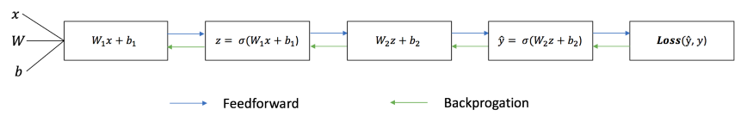
HOW TO BUILD A DEEP NEURAL NETWORK
The sequential graph below illustrates the process.

Slide 46
HOW TO BUILD A DEEP NEURAL NETWORK
Feedforward
As we’ve seen in the sequential graph above, feedforward is just simple calculus and for a basic 2-layer neural network, the output of the Neural Network is:
However, we still need a way to evaluate the “goodness” of our predictions (i.e. how far off are our predictions)? The Loss Function allows us to do exactly that.

Slide 47

HOW TO BUILD A DEEP NEURAL NETWORK
Loss Function
There are many available loss functions, and the nature of our problem should dictate our choice of loss function. In this tutorial, we’ll use a simple sum-of-sqaures error as our loss function.
That is, the sum-of-squares error is simply the sum of the difference between each predicted value and the actual value. The difference is squared so that we measure the absolute value of the difference.
Our goal in training is to find the best set of weights and biases that minimizes the loss function.

Slide 48
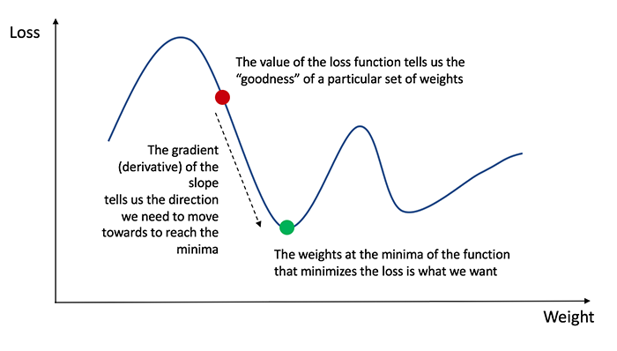
HOW TO BUILD A DEEP NEURAL NETWORK
Now that we’ve measured the error of our prediction (loss), we need to find a way to propagate the error back, and to update our weights and biases.
In order to know the appropriate amount to adjust the weights and biases by, we need to know the derivative of the loss function with respect to the weights and biases.
Recall from calculus that the derivative of a function is simply the slope of the function.

Slide 49
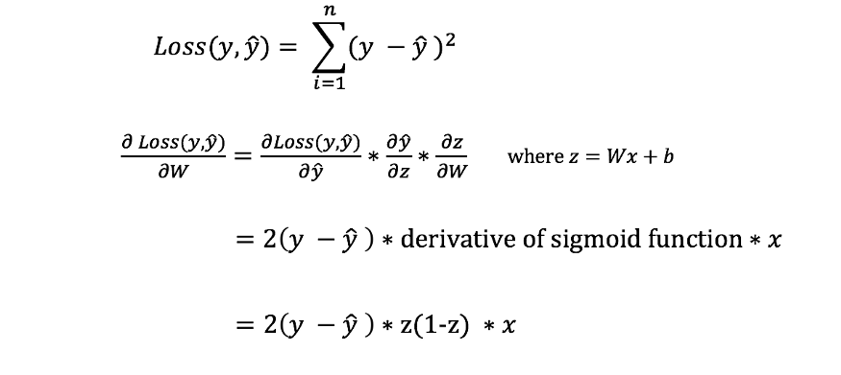
HOW TO BUILD A DEEP NEURAL NETWORK
If we have the derivative, we can simply update the weights and biases by increasing/reducing with it. This is known as gradient descent.
However, we can’t directly calculate the derivative of the loss function with respect to the weights and biases because the equation of the loss function does not contain the weights and biases. Therefore, we need the chain rule to help us calculate it.
That was ugly but it allows us to get what we needed — the derivative (slope) of the loss function with respect to the weights, so that we can adjust the weights accordingly.

Slide 50
TRAINING DEEP NEURAL NETWORKS
Deep neural networks are key break through in the field of computer vision and speech recognition.
For the past decade, deep networks have enabled the machines to recognize images, speech and even play games at accuracy nigh impossible for humans.
To achieve high level of accuracy, huge amount of data and henceforth computing power is needed to train these networks.
However, despite the computational complexity involved, we can follow certain guidelines to reduce the time for training and improve model accuracy.

Slide 51
TRAINING DEEP NEURAL NETWORKS
Data Pre processing
The importance of data pre-processing can only be emphasized by the fact that your neural network is only as good as the input data used to train it.
If important data inputs are missing, neural network may not be able to achieve desired level of accuracy.
On the other side, if data is not processed beforehand, it could effect the accuracy as well as performance of the network down the lane.

Slide 52
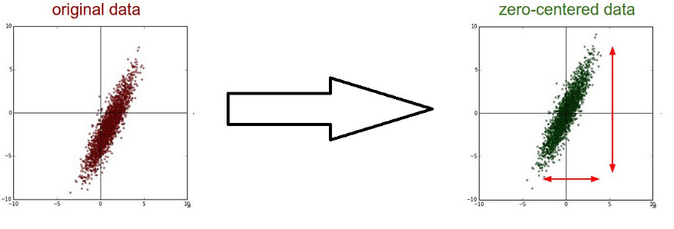
TRAINING DEEP NEURAL NETWORKS
Mean subtraction (Zero centering)
It’s the process of subtracting mean from each of the data point to make it zero-centered.
Consider a case where inputs to neuron (unit) are all positive or all negative.
In that case the gradient calculated during back propagation will either be positive or negative (same as sign of inputs).
And hence parameter updates are only restricted to specific directions which in turn will make it inefficient to converge.

Slide 53
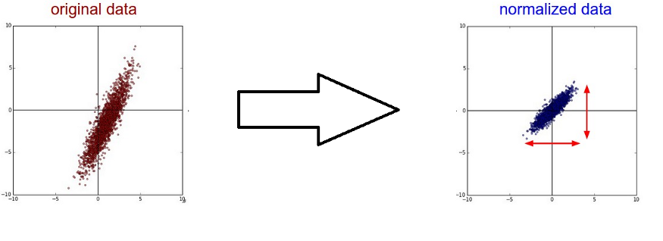
TRAINING DEEP NEURAL NETWORKS
Data Normalization
Normalization refers to normalizing the data to make it of same scale across all dimensions.
Common way to do that is to divide the data across each dimension by it’s standard deviation.
However, it only makes sense if you have a reason to believe that different input features have different scales but they have equal importance to the learning algorithm.

Slide 54
TRAINING DEEP NEURAL NETWORKS
Parameter Initialization
Deep neural networks are no stranger to millions or billions of parameters.
The way these parameters are initialized can determine how fast our learning algorithm would converge and how accurate it might end up.
The straightforward way is to initialize them all to zero.
However, if we initialize weights of a layer to all zero, the gradients calculated will be same for each unit in the layer and hence update to weights would be same for all units.
Consequently that layer is as good as a single logistic regression unit.

Slide 55
TRAINING DEEP NEURAL NETWORKS
Batch normalization
After learning the mapping from some input to output, we need to re-train the learning algorithm to learn the mapping from that same input to output in case data distribution of input changes.
However, the issue isn’t resolved there only as data distribution could vary in deeper layers as well. Activation at each layer could result in different data distribution. Hence, to increase the stability of deep neural networks we need to normalize the data fed at each layer by subtracting the mean and dividing by the standard deviation.

Slide 56
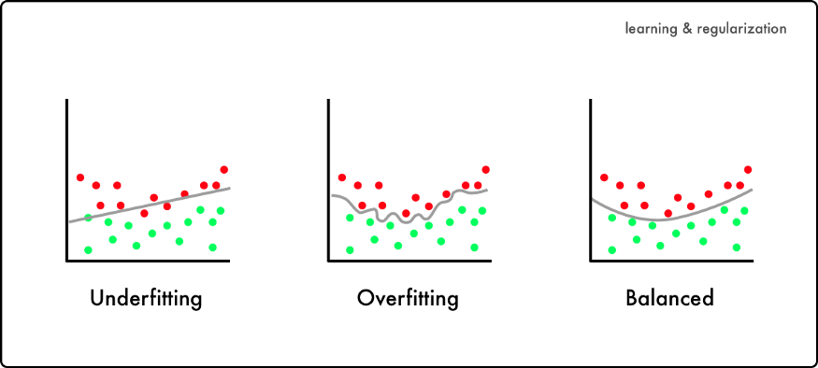
TRAINING DEEP NEURAL NETWORKS
Regularization
One of the most common problem in training deep neural network is over-fitting.
You’ll realize over-fitting in play when your network performed exceptionally well on the training data but poorly on test data.
This happens as our learning algorithm tries to fit every data point in the input even if they represent some randomly sampled noise as demonstrated in figure below.

Slide 57
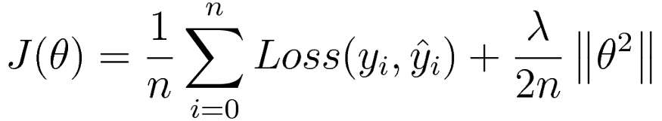
TRAINING DEEP NEURAL NETWORKS
Regularization helps avoid over-fitting by penalizing the weights of the network. To explain it further, consider a loss function defined for classification task over neural network as below :
J(theta) - Overall objective function to minimize. n - Number of training samples. y(i) - Actual label for ith training sample. y_hat(i) - Predicted label for ith training sample. Loss - Cross entropy loss. Theta - Weights of neural network. Lambda - Regularization parameter.

Slide 58
TRAINING DEEP NEURAL NETWORKS
Regularization
Regularization parameter (lambda) is used to control the effect of weights on final objective function.
So, in case lambda takes a very large value, weights of the network should be close to zero so as to minimize the objective function.
But as we let weights collapse to zero, we would nullify the effect of many units in the layer and hence network is no better than a single linear classifier with few logistic regression units.
And unexpectedly, this will throw us in the regime known as under-fitting which is not much better than over-fitting. C

Slide 59
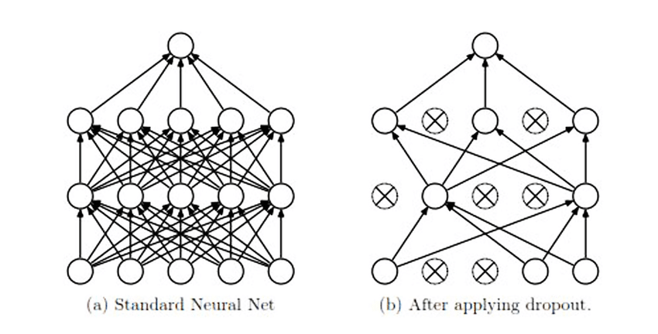
TRAINING DEEP NEURAL NETWORKS
Dropout Regularization
There’s one more powerful technique to reduce over-fitting in deep neural networks known as dropout regularization.
To randomly drop units while training the network so that we are working with smaller neural network at each iteration.
To drop a unit is same as to ignore those units during forward propagation or backward propagation.
In a sense this prevents the network from adapting to some specific set of features.

Slide 60
TRAINING DEEP NEURAL NETWORKS
Dropout Regularization
At each iteration we are randomly dropping some units from the network. And consequently, we are forcing each unit to not rely (not give high weights) on any specific set of units from previous layer as any of them could go off randomly.

Slide 61
WHAT IS COMPUTER VISION?
Computer Vision, or CV for short, is broadly defined as helping computers to “see” or extract meaning from digital images such as photographs and videos.
Researchers have been working on the problem of helping computers see for more than 50 years, and some great successes have been achieved, such as the face detection available in modern cameras and smartphones.
The problem of understanding images is not solved, and may never be. This is primarily because the world is complex and messy. There are few rules. And yet we can easily and effortlessly recognize objects, people, and context.

Slide 62
HOW COMPUTER VISION WORKS
Computer vision works in three basic steps:
Acquiring an image
Images, even large sets, can be acquired in real-time through video, photos or 3D technology for analysis.
Processing the image
Deep learning models automate much of this process, but the models are often trained by first being fed thousands of labeled or pre-identified images.
Understanding the image
The final step is the interpretative step, where an object is identified or classified.

Slide 63
TYPES OF COMPUTER VISION
Today’s AI systems can go a step further and take actions based on an understanding of the image. There are many types of computer vision that are used in different ways:
Image segmentation partitions an image into multiple regions or pieces to be examined separately.
Object detection identifies a specific object in an image. Advanced object detection recognizes many objects in a single image: a football field, an offensive player, a defensive player, a ball and so on. These models use an X,Y coordinate to create a bounding box and identify everything inside the box.
Facial recognition is an advanced type of object detection that not only recognizes a human face in an image, but identifies a specific individual.

Slide 64
TYPES OF COMPUTER VISION
Edge detection is a technique used to identify the outside edge of an object or landscape to better identify what is in the image.
Pattern detection is a process of recognizing repeated shapes, colors and other visual indicators in images.
Image classification groups images into different categories.
Feature matching is a type of pattern detection that matches similarities in images to help classify them.

Slide 65
WHAT IS A PERCEPTRON?
A Perceptron is a simple unit.
It takes in a numeric value along with its weights as input and in the core, it calculates the weighted sum and returns 1 if the sum is positive, else it returns 0. Here, 0 and 1 represents the labels of the two groups in a classification problem.
To elaborate, there are two steps that a perceptron does.
Summation
Application of activation function to the sum

Slide 66
PERCEPTRON
Like the nerve signals from the nearby neurons to the dendrite, the input to the perceptron in general, is an n-dimensional vector, say X. The summation process happens as follows. The inputs X, is multiplied with the corresponding weight, say W and added to a bias term b.
Z = WX + b = Wo.Xo + W1.X1 + ... + Wn-1.Xn-1 + 1.b

Slide 67
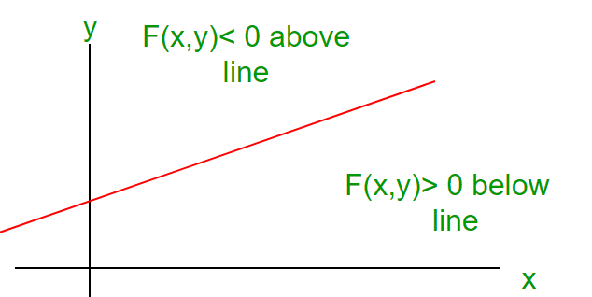
PERCEPTRON
The second part is the output for the binary classification problem. From the value of Z, we can understand whether a given vector X lies above or below the hyperplane.

Slide 68
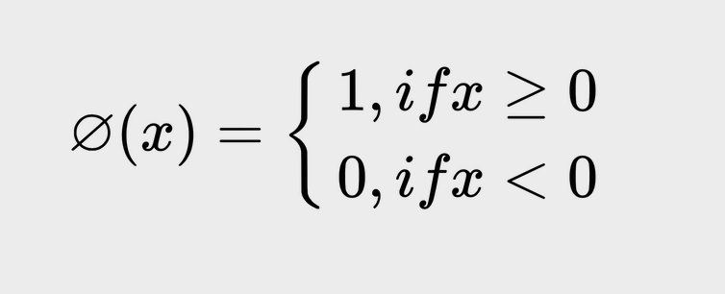
PERCEPTRON
For this, an activation function can be used on the summation, Z. In a simple perceptron, the activation function can be a step function (Heaviside step function).

Slide 69
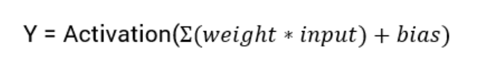
ACTIVATION FUNCTIONS
A neural network is basically a set of mathematical equations and weights.
Activation functions are an extremely important feature of the artificial neural networks.
They basically decide whether a neuron should be activated or not.
Whether the information that the neuron is receiving is relevant for the given information or should it be ignored.
The activation function is the non linear transformation that we do over the input signal. This transformed output is then seen to the next layer of neurons as input.

Slide 70
TYPES OF ACTIVATION FUNCTION
Linear Activation Function :-
The function is a line or linear. Therefore, the output of the functions will not be confined between any range.
2. Non Linear Activation Function:-
They make it easy for the model to generalize or adapt with variety of data and to differentiate between the output
The Nonlinear Activation Functions are mainly divided on the basis of their range or curves

Slide 71
TYPES OF NON LINER ACTIVATION FUNCTIONS
Threshold
Sigmoid
Tanh
ReLU
Leaky ReLU
SoftMax

Slide 72
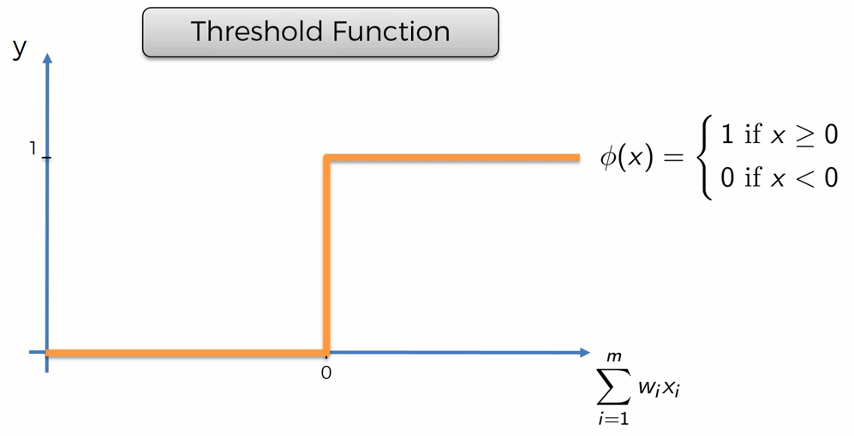
THRESHOLD ACTIVATION FUNCTION
The output is set at one of two levels, depending on whether the total input is greater than or less than some threshold value.
A threshold Activation function is sometimes used to quantify the output of a neuron in the output layer.
All possible connections between neurons are allowed. Since loops are present in this type of network, it becomes a non-linear dynamic system which changes continuously until it reaches a state of equilibrium.

Slide 73
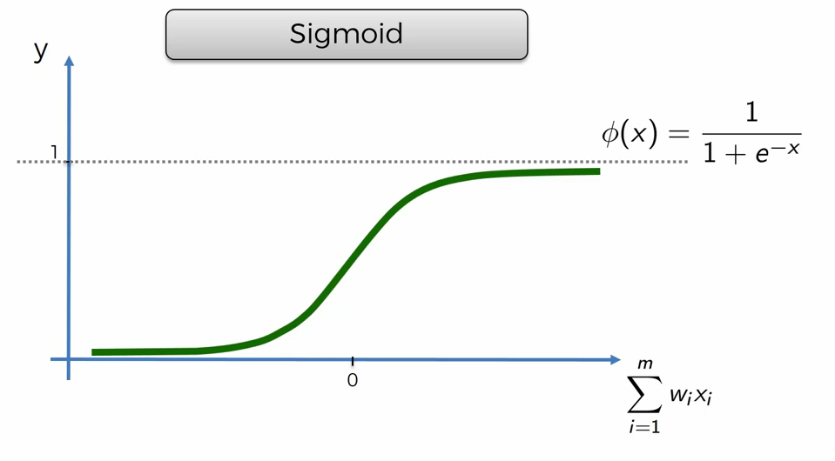
WHAT IS SIGMOID FUNCTION?
The Sigmoid Function curve looks like a S-shape
This function reduces extreme values or outliers in data without removing them.
It converts independent variables of near infinite range into simple probabilities between 0 and 1, and most of its output will be very close to 0 or 1.

Slide 74
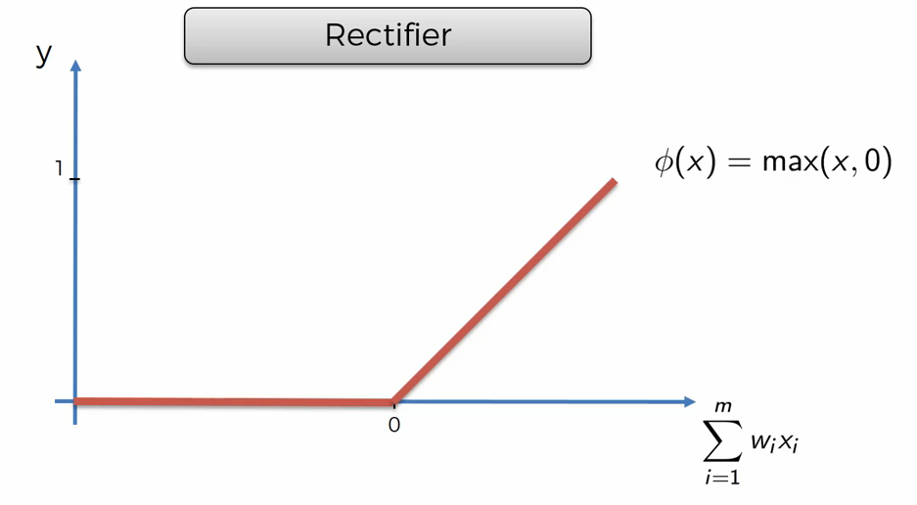
WHAT IS RECTIFIER (RELU) FUNCTION?
ReLU is the most widely used activation function while designing networks today. First things first, the ReLU function is non linear, which means we can easily backpropagate the errors and have multiple layers of neurons being activated by the ReLU function.

Slide 75
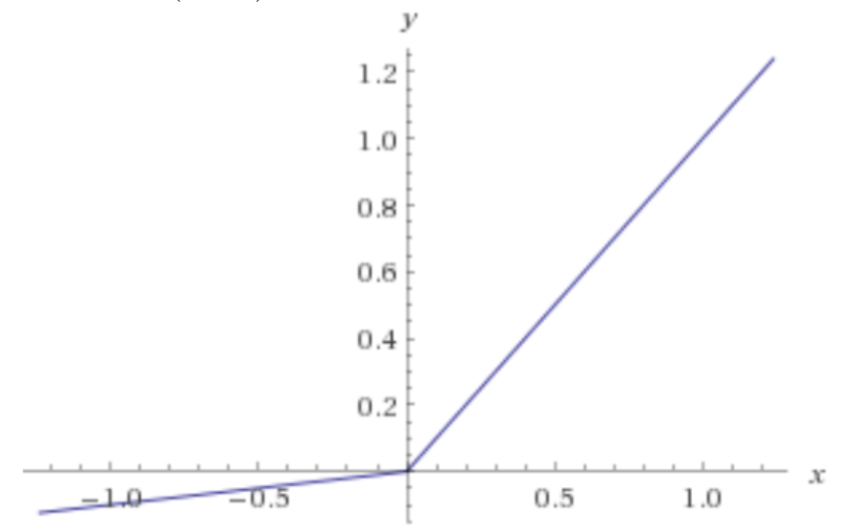
WHAT IS LEAKY RELU FUNCTION?
Leaky ReLU function is nothing but an improved version of the ReLU function. As we saw that for the ReLU function, the gradient is 0 for x<0, which made the neurons die for activations in that region. Leaky ReLU is defined to address this problem. Instead of defining the Relu function as 0 for x less than 0, we define it as a small linear component of x.
What we have done here is that we have simply replaced the horizontal line with a non-zero, non-horizontal line. Here a is a small value like 0.01 or so.

Slide 76
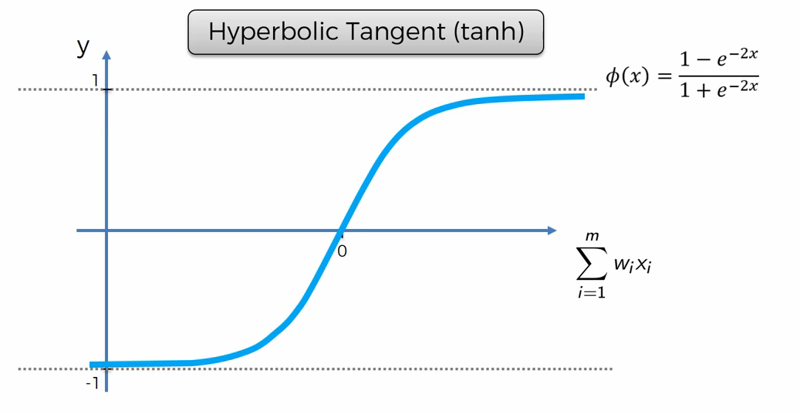
WHAT IS SIGMOID FUNCTION?
Pronounced “tanch,” tanh is a hyperbolic trigonometric function
The tangent represents a ratio between the opposite and adjacent sides of a right triangle, tanh represents the ratio of the hyperbolic sine to the hyperbolic cosine: tanh(x) = sinh(x) / cosh(x)
Unlike the Sigmoid function, the normalized range of tanh is –1 to 1 The advantage of tanh is that it can deal more easily with negative numbers

Slide 77
WHAT IS SOFTMAX FUNCTION (FOR MULTIPLE CLASSIFICATION)?
Softmax function calculates the probabilities distribution of the event over ‘n’ different events. In general way of saying, this function will calculate the probabilities of each target class over all possible target classes. Later the calculated probabilities will be helpful for determining the target class for the given inputs.
The main advantage of using Softmax is the output probabilities range. The range will 0 to 1, and the sum of all the probabilities will be equal to one. If the softmax function used for multi-classification model it returns the probabilities of each class and the target class will have the high probability.

Slide 78
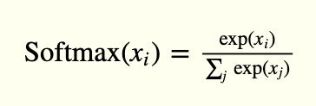
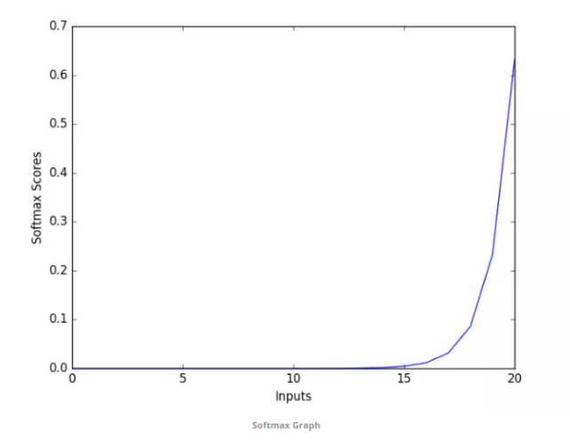
WHAT IS SOFTMAX FUNCTION (FOR MULTIPLE CLASSIFICATION)?
The formula computes the exponential (e-power) of the given input value and the sum of exponential values of all the values in the inputs. Then the ratio of the exponential of the input value and the sum of exponential values is the output of the softmax function.

Slide 79
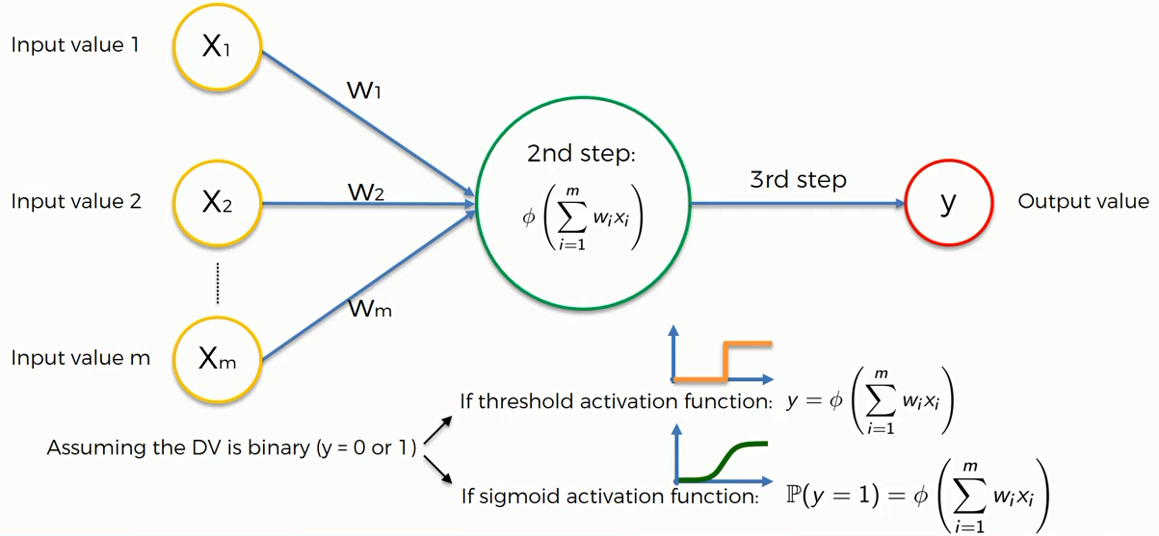
ACTIVATION FUNCTION EXAMPLE

Slide 80
WHAT ARE LOSS FUNCTIONS?
A loss function measures how good a neural network model is in performing a certain task, which in most cases is regression or classification.
We must minimize the value of the loss function during the backpropagation step in order to make the neural network better.
We only use the cross-entropy loss function in classification tasks when we want the neural network to predict probabilities.
For regression tasks, when we want the network to predict continuous numbers, we must use the mean squared error loss function.
We use mean absolute percentage error loss function during demand forecasting to keep an eye on the performance of the network during training time.

Slide 81
LOSS FUNCTIONS FOR REGRESSION
Regression involves predicting a specific value that is continuous in nature. Estimating the price of a house or predicting stock prices are examples of regression because one works towards building a model that would predict a real-valued quantity.
some loss functions which can be used for regression problems and try to draw comparisons among them.
Mean Absolute Error (MAE)
Mean Squared Error (MSE)
Mean Bias Error (MBE)
Mean Squared Logarithmic Error (MSLE)
Huber Loss

Slide 82
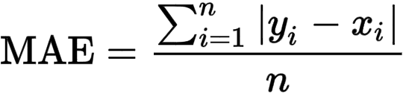
MEAN ABSOLUTE ERROR (MAE)
Mean Absolute Error (also called L1 loss) is one of the most simple yet robust loss functions used for regression models.
Regression problems may have variables that are not strictly Gaussian in nature due to the presence of outliers (values that are very different from the rest of the data). Mean Absolute Error would be an ideal option in such cases because it does not take into account the direction of the outliers (unrealistically high positive or negative values).
As the name suggests, MAE takes the average sum of the absolute differences between the actual and the predicted values. For a data point x_{i} and its predicted value y_{i}, n being the total number of data points in the dataset, the mean absolute error is defined as:

Slide 83
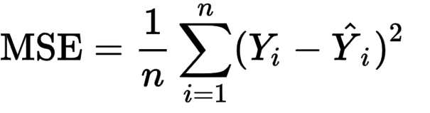
MEAN SQUARED ERROR (MSE)
Mean Squared Error (also called L2 loss) is almost every data scientist’s preference when it comes to loss functions for regression. This is because most variables can be modeled into a Gaussian distribution.
Mean Squared Error is the average of the squared differences between the actual and the predicted values. For a data point Y_{i} and its predicted value Ŷ_{i}, where n is the total number of data points in the dataset, the mean squared error is defined as:

Slide 84
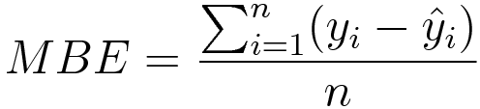
MEAN BIAS ERROR (MBE)
Mean Bias Error is used to calculate the average bias in the model. Bias, in a nutshell, is overestimating or underestimating a parameter. Corrective measures can be taken to reduce the bias post-evaluating the model using MBE.
Mean Bias Error takes the actual difference between the target and the predicted value, and not the absolute difference. One has to be cautious as the positive and the negative errors could cancel each other out, which is why it is one of the lesser-used loss functions.
Where y_{i} is the true value, ŷ_{i} is the predicted value and ‘n’ is the total number of data points in the dataset.

Slide 85
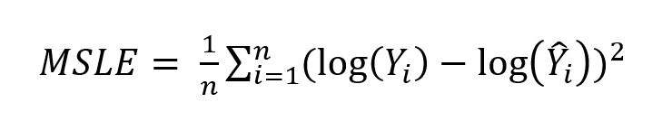
MEAN SQUARED LOGARITHMIC ERROR (MSLE)
Sometimes, one may not want to penalize the model too much for predicting unscaled quantities directly. Relaxing the penalty on huge differences can be done with the help of Mean Squared Logarithmic Error.
Calculating the Mean Squared Logarithmic Error is the same as Mean Squared Error, except the natural logarithm of the predicted values is used rather than the actual values.

Slide 86
HUBER LOSS
A comparison between L1 and L2 loss yields the following results:
L1 loss is more robust than its counterpart.
On taking a closer look at the formulas, one can observe that if the difference between the predicted and the actual value is high, L2 loss magnifies the effect when compared to L1. Since L2 succumbs to outliers, L1 loss function is the more robust loss function.
L1 loss is less stable than L2 loss.
Since L1 loss deals with the difference in distances, a small horizontal change can lead to the regression line jumping a large amount. Such an effect taking place across multiple iterations would lead to a significant change in the slope between iterations.

Slide 87
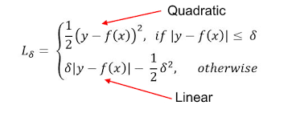
HUBER LOSS
On the other hand, MSE ensures the regression line moves lightly for a small adjustment in the data point.
Huber Loss combines the robustness of L1 with the stability of L2, essentially the best of L1 and L2 losses. For huge errors, it is linear and for small errors, it is quadratic in nature.
Huber Loss is characterized by the parameter delta (𝛿). For a prediction f(x) of the data point y, with the characterizing parameter 𝛿, Huber Loss is formulated as:

Slide 88
LOSS FUNCTIONS FOR CLASSIFICATION
Classification problems involve predicting a discrete class output. It involves dividing the dataset into different and unique classes based on different parameters so that a new and unseen record can be put into one of the classes.
A mail can be classified as a spam or not a spam and a person’s dietary preferences can be put in one of three categories - vegetarian, non-vegetarian and vegan. Let’s take a look at loss functions that can be used for classification problems.
Binary Cross Entropy Loss
Categorical Cross Entropy Loss
Hinge Loss
Kullback Leibler Divergence Loss (KL Loss)

Slide 89
BINARY CROSS ENTROPY LOSS
This is the most common loss function used for classification problems that have two classes. The word “entropy”, seemingly out-of-place, has a statistical interpretation.
Entropy is the measure of randomness in the information being processed, and cross entropy is a measure of the difference of the randomness between two random variables.
If the divergence of the predicted probability from the actual label increases, the cross-entropy loss increases. Going by this, predicting a probability of .011 when the actual observation label is 1 would result in a high loss value. In an ideal situation, a “perfect” model would have a log loss of 0. Looking at the loss function would make things even clearer -

Slide 90
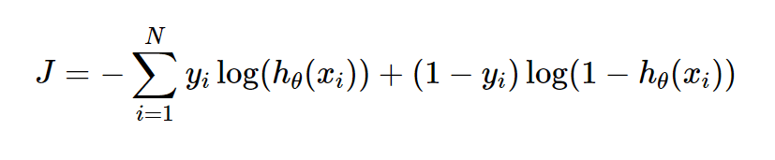
BINARY CROSS ENTROPY LOSS
Where y_{i} is the true label and h_{θ}(x_{i}) is the predicted value post hypothesis.
Since binary classification means the classes take either 0 or 1, if y_{i} = 0, that term ceases to exist and if y_{i} = 1, the (1-y_{i}) term becomes 0.

Slide 91
CATEGORICAL CROSS ENTROPY LOSS
Categorical Cross Entropy loss is essentially Binary Cross Entropy Loss expanded to multiple classes. One requirement when categorical cross entropy loss function is used is that the labels should be one-hot encoded.
This way, only one element will be non-zero as other elements in the vector would be multiplied by zero. This property is extended to an activation function called softmax,

Slide 92
HINGE LOSS
Another commonly used loss function for classification is the hinge loss. Hinge loss is primarily developed for support vector machines for calculating the maximum margin from the hyperplane to the classes.
Loss functions penalize wrong predictions and does not do so for the right predictions. So, the score of the target label should be greater than the sum of all the incorrect labels by a margin of (at the least) one.
This margin is the maximum margin from the hyperplane to the data points, which is why hinge loss is preferred for SVMs.
The following image clears the air on what a hyperplane and maximum margin is:

Slide 93
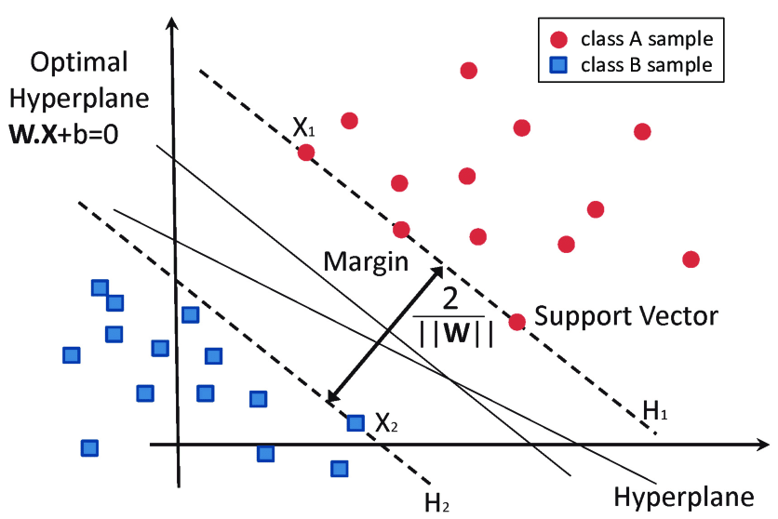
HINGE LOSS

Slide 94
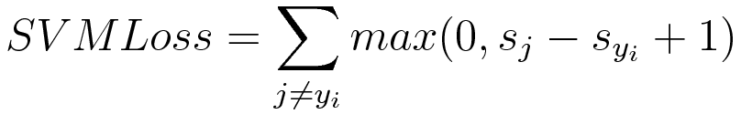
HINGE LOSS
The mathematical formulation of hinge loss is as follows:
Where s_{j} is the true value and s_{yi} is the predicted value.
Hinge Loss is also extended to Squared Hinge Loss Error and Categorical Hinge Loss Error.

Slide 95
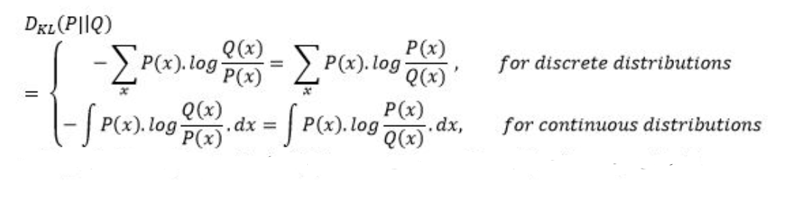
KULLBACK LEIBLER DIVERGENCE LOSS (KL LOSS)
Kullback Leibler Divergence Loss is a measure of how a distribution varies from a reference distribution (or a baseline distribution). A Kullback Leibler Divergence Loss of zero means that both the probability distributions are identical.
The number of information lost in the predicted distribution is used as a measure. The KL Divergence of a distribution P(x) from Q(x) is given by:

Slide 96
WHAT IS GRADIENT DESCENT?
Gradient descent is an optimization algorithm which is commonly-used to train machine learning models and neural networks.
Training data helps these models learn over time, and the cost function within gradient descent specifically acts as a barometer, gauging its accuracy with each iteration of parameter updates.
Until the function is close to or equal to zero, the model will continue to adjust its parameters to yield the smallest possible error.
Once machine learning models are optimized for accuracy, they can be powerful tools for artificial intelligence (AI) and computer science applications.

Slide 97
TYPES OF GRADIENT DESCENT
There are three types of gradient descent learning algorithms:
Batch gradient descent
Stochastic gradient descent
Mini-batch gradient descent.

Slide 98
BATCH GRADIENT DESCENT
Batch gradient descent sums the error for each point in a training set, updating the model only after all training examples have been evaluated.
This process referred to as a training epoch.
While this batching provides computation efficiency, it can still have a long processing time for large training datasets as it still needs to store all of the data into memory.
Batch gradient descent also usually produces a stable error gradient and convergence, but sometimes that convergence point isn’t the most ideal, finding the local minimum versus the global one.

Slide 99
STOCHASTIC GRADIENT DESCENT
Stochastic gradient descent (SGD) runs a training epoch for each example within the dataset and it updates each training example's parameters one at a time.
Since you only need to hold one training example, they are easier to store in memory.
While these frequent updates can offer more detail and speed, it can result in losses in computational efficiency when compared to batch gradient descent.
Its frequent updates can result in noisy gradients, but this can also be helpful in escaping the local minimum and finding the global one.

Slide 100
MINI-BATCH GRADIENT DESCENT
Mini-batch gradient descent combines concepts from both batch gradient descent and stochastic gradient descent.
It splits the training dataset into small batch sizes and performs updates on each of those batches.
This approach strikes a balance between the computational efficiency of batch gradient descent and the speed of stochastic gradient descent.

Slide 101
HYPER PARAMETER TUNING
A hyperparameter is a parameter whose value is used to control the learning process. By contrast, the values of other parameters (typically node weights) are derived via training.
Hyperparameters can be classified as model hyperparameters, that cannot be inferred while fitting the machine to the training set because they refer to the model selection task, or algorithm hyperparameters, that in principle have no influence on the performance of the model but affect the speed and quality of the learning process.
An example of a model hyperparameter is the topology and size of a neural network.
Examples of algorithm hyperparameters are learning rate and mini-batch size.

Slide 102
HYPER PARAMETER TUNING
Different model training algorithms require different hyperparameters, some simple algorithms (such as ordinary least squares regression) require none.
Given these hyperparameters, the training algorithm learns the parameters from the data.
For instance, LASSO is an algorithm that adds a regularization hyperparameter to ordinary least squares regression, which has to be set before estimating the parameters through the training algorithm.

Slide 103
HYPER PARAMETER TUNING
Tuning Strategies
We will explore two different methods for optimizing hyperparameters:
Grid Search
Random Search

Slide 104
HYPER PARAMETER TUNING
Grid Search
Grid search is a traditional way to perform hyperparameter optimization. It works by searching exhaustively through a specified subset of hyperparameters.
2. Random Search
Random search differs from grid search mainly in that it searches the specified subset of hyperparameters randomly instead of exhaustively. The major benefit being decreased processing time.
There is a tradeoff to decreased processing time, however. We aren’t guaranteed to find the optimal combination of hyperparameters.

Slide 105
WHAT IS KERAS?
Keras is a deep learning API written in Python, running on top of the machine learning platform TensorFlow.
It was developed with a focus on enabling fast experimentation. Being able to go from idea to result as fast as possible is key to doing good research.
Keras allows users to productize deep models on smartphones (iOS and Android), on the web, or on the Java Virtual Machine. It also allows use of distributed training of deep-learning models on clusters of Graphics processing units (GPU) and tensor processing units (TPU).

Slide 106
WHAT IS TENSOR FLOW?
TensorFlow is an end-to-end open source platform for machine learning.
It has a comprehensive, flexible ecosystem of tools, libraries and community resources that lets researchers push the state-of-the-art in ML and developers easily build and deploy ML powered applications.

Slide 107
INTRODUCTION TO SEQUENTIAL DATA
Sequential Data is any kind of data where the order matters as you said.
So we can assume that time series is a kind of sequential data, because the order matters.
A time series is a sequence taken at successive equally spaced points in time and it is not the only case of sequential data.
Examples of Sequence data
Examples of sequence data include DNA, protein, customer purchase history, web surfing history, and more.
Sequence Data Mining provides balanced coverage of the existing results on sequence data mining, as well as pattern types and associated pattern mining methods.

Slide 108
INTRODUCTION TO RECURRENT NEURAL NETWORKS (RNN)
Recurrent neural networks (RNN) are a class of neural networks that are helpful in modeling sequence data. Derived from feedforward networks, RNNs exhibit similar behavior to how human brains function. Simply put: recurrent neural networks produce predictive results in sequential data that other algorithms can’t.

Slide 109
RECURRENT MECHANISM
In feedforward networks (such as vanilla neural networks and CNNs), data moves one way, from the input layer to the output layer.
In recurring neural networks, the recurrent architecture allows data to circle back to the input layer.
This means that data is not limited to a feedforward direction.
Specifically, in a hidden layer of an RNN, the output from the previous time point will become part of the input for the current time point.
The following diagram illustrates how data flows in an RNN in general:

Slide 110
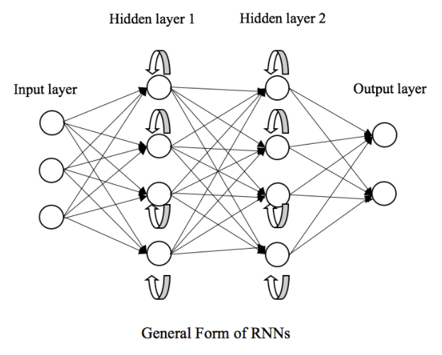
RECURRENT MECHANISM
Figure 1: The general form of an RNN

Slide 111
RECURRENT MECHANISM
Such a recurrent architecture makes RNNs work well with sequential data, including time series (such as daily temperatures, daily product sales, and clinical EEG recordings) and general consecutive data with order (such as words in a sentence, DNA sequences, and so on).
Take a financial fraud detector as an example; the output features from the previous transaction go into the training for the current transaction.
In the end, the prediction for one transaction depends on all of its previous transactions.
Let me explain the recurrent mechanism in a mathematical and visual way.

Slide 112
RECURRENT MECHANISM
Suppose we have some inputs, xt . Here, t represents a time step or a sequential order.
In a feedforward neural network, we simply assume that inputs at different t are independent of each other.
We denote the output of a hidden layer at a time step, t, as ht = f(xt ), where f is the abstract of the hidden layer.

Slide 113
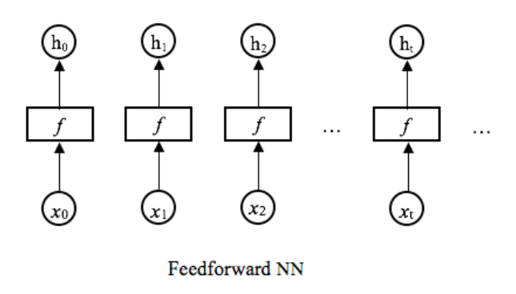
RECURRENT MECHANISM
This is depicted in the following diagram:
Figure 2: General form of a feedforward neural network

Slide 114
RECURRENT MECHANISM
On the contrary, the feedback loop in a recurring neural network feeds the information of the previous state to the current state.
The output of a hidden layer of an RNN at a time step, t, can be expressed as ht = f(ht−1, xt ).

Slide 115
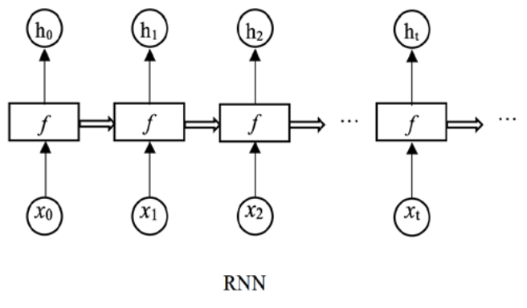
RECURRENT MECHANISM
This is depicted in the following diagram:
Figure 3: Unfolded recurrent layer over time steps

Slide 116
RECURRENT MECHANISM
The same task, f, is performed on each element of the sequence, and the output, ht, is dependent on the output that’s generated from previous computations, ht−1.
The chain-like architecture captures the “memory” that has been calculated so far.
This is what makes RNNs so successful in dealing with sequential data.

Slide 117
TYPES OF RNN
Different categories of rnns based on input and output
Many-to-one
One-to-many
Many-to-many (synced)
Many-to-many (unsynced)

Slide 118
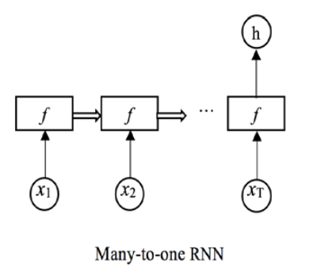
MANY-TO-ONE RNNS
The most intuitive type of RNN is probably many-to-one. A many-to-one RNN can have input sequences with as many time steps as you want, but it only produces one output after going through the entire sequence.
The following diagram depicts the general structure of a many-to-one RNN:

Slide 119
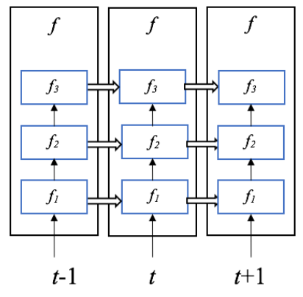
MANY-TO-ONE RNNS
f represents one or more recurrent hidden layers, where an individual layer takes in its own output from the previous time step. Here is an example of three hidden layers stacking up:
Example of three recurrent layers stacking up

Slide 120
MANY-TO-ONE RNNS
Many-to-one RNNs are widely used for classifying sequential data.
Sentiment analysis is a good example of this and is where the RNN reads the entire customer review, for instance, and assigns a sentiment score (positive, neutral, or negative sentiment).
Similarly, we can also use RNNs of this kind in the topic classification of news articles.
Identifying the genre of a song is another application as the model can read the entire audio stream.
We can also use many-to-one RNNs to determine whether a patient is having a seizure based on an EEG trace.

Slide 121
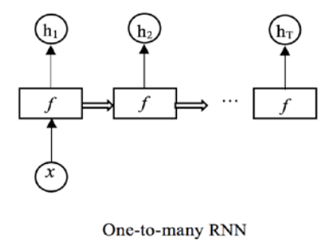
ONE-TO-MANY RNNS
One-to-many RNNs are the exact opposite of many-to-one RNNs.
They take in only one input (not a sequence) and generate a sequence of outputs.
A typical one-to many RNN is presented in the following diagram:
f represents one or more recurrent hidden layers.

Slide 122
ONE-TO-MANY RNNS
“one” here doesn’t mean that there is only one input feature. It means the input is from one time step, or it is time-independent.
One-to-many RNNs are commonly used as sequence generators.
For example, we can generate a piece of music given a starting note or/and a genre.
Similarly, we can write a movie script like a professional screenwriter using one-to-many RNNs with a starting word we specify.
Image captioning is another interesting application: the RNN takes in an image and outputs the description (a sentence of words) of the image.

Slide 123
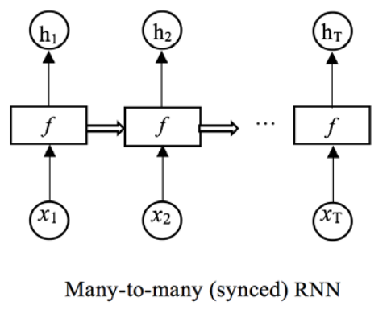
MANY-TO-MANY (SYNCED) RNNS
The third type of RNN, many-to-many (synced), allows each element in the input sequence to have an output.
Let us look at how data flows in the following many-to-many (synced) RNN:
General form of a many-to-many (synced) RNN
Each output is calculated based on its corresponding input and all the previous outputs.

Slide 124
MANY-TO-MANY (SYNCED) RNNS
One common use case for this type of RNN is time series forecasting, where we want to perform rolling prediction at every time step based on the current and previously observed data.
Here are some examples of time series forecasting where we can leverage synced many-to-many RNNs:
Product sales each day for a store
Daily closing price of a stock
Power consumption of a factory each hour
They are also widely used in solving NLP problems, including PoS tagging, named entity recognition, and real-time speech recognition.

Slide 125
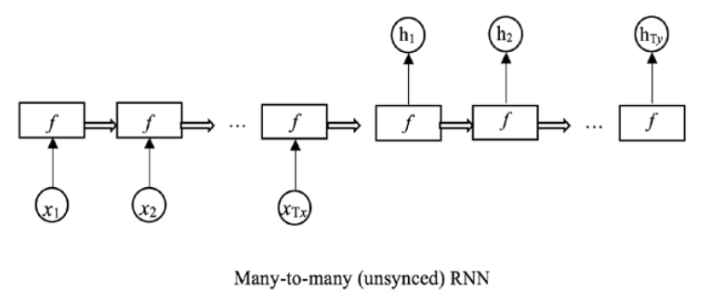
MANY-TO-MANY (UNSYNCED) RNNS
Sometimes, we only want to generate the output sequence after we’ve processed the entire input sequence.
This is the unsynced version of many-to-many rnn.
The following diagram for the general structure of a many-to-many (unsynced) rnn:
General form of a many-to-many (unsynced) RNN

Slide 126
MANY-TO-MANY (UNSYNCED) RNNS
Note that the length of the output sequence (Ty in the preceding diagram) can be different from that of the input sequence (Tx in the preceding diagram). This provides us with some flexibility.
This type of RNN is a go-to model for machine translation.
In French-English translation, for example, the model first reads a complete sentence in French and then produces a translated sentence in English.
Multi-step ahead forecasting is another popular example: sometimes, we are asked to predict sales for multiple days in the future when given data from the past month.

Slide 127
TWO ISSUES OF STANDARD RNN’S
There are two major obstacles RNN’s have had to deal with
EXPLODING GRADIENTS
Exploding gradients are when the algorithm, without much reason, assigns a stupidly high importance to the weights. Fortunately, this problem can be easily solved by truncating or squashing the gradients.
2. VANISHING GRADIENTS
Vanishing gradients occur when the values of a gradient are too small and the model stops learning or takes way too long as a result. This was a major problem in the 1990s and much harder to solve than the exploding gradients. Fortunately, it was solved through the concept of LSTM by Sepp Hochreiter and Juergen Schmidhuber.

Slide 128
ADVANTAGES OF RECURRENT NEURAL NETWORK
An RNN remembers each and every information through time. It is useful in time series prediction only because of the feature to remember previous inputs as well. This is called Long Short Term Memory.
Recurrent neural network are even used with convolutional layers to extend the effective pixel neighborhood.

Slide 129
DISADVANTAGES OF RECURRENT NEURAL NETWORK
Gradient vanishing and exploding problems.
Training an RNN is a very difficult task.
It cannot process very long sequences if using tanh or relu as an activation function.

Slide 130
WHAT IS LONG SHORT-TERM MEMORY (LTSM)?
Long Short-Term Memory (LTSM) networks are an extension of RNN that extend the memory.
LTSM are used as the building blocks for the layers of a RNN.
LTSMs assign data “weights” which helps RNNs to either let new information in, forget information or give it importance enough to impact the output.
LSTM was designed by Hochreiter & Schmidhuber.
It tackled the problem of long-term dependencies of RNN in which the RNN cannot predict the word stored in the long term memory but can give more accurate predictions from the recent information.
As the gap length increases RNN does not give efficient performance. LSTM can by default retain the information for long period of time.
It is used for processing, predicting and classifying on the basis of time series data.

Slide 131
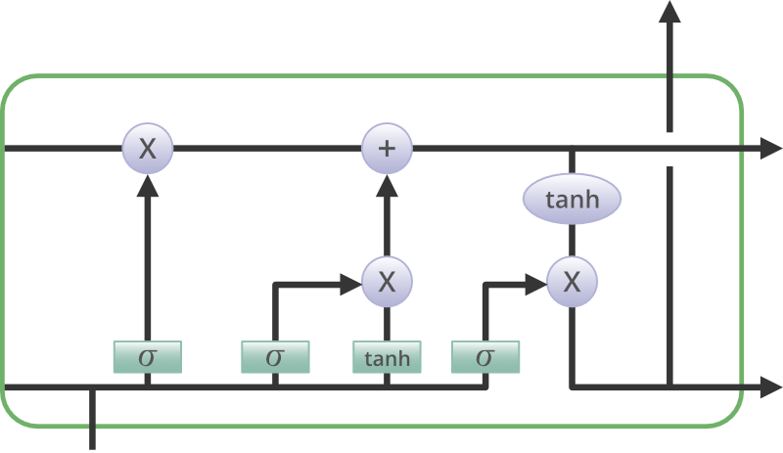
STRUCTURE OF LSTM:
LSTM has a chain structure that contains four neural networks and different memory blocks called cells.

Slide 132
STRUCTURE OF LSTM:
Information is retained by the cells and the memory manipulations are done by the gates. There are three gates –
Forget Gate:
The information that no longer useful in the cell state is removed with the forget gate.
Two inputs x_t (input at the particular time) and h_t-1 (previous cell output) are fed to the gate and multiplied with weight matrices followed by the addition of bias.
The resultant is passed through an activation function which gives a binary output.
If for a particular cell state the output is 0, the piece of information is forgotten and for the output 1, the information is retained for the future use.

Slide 133
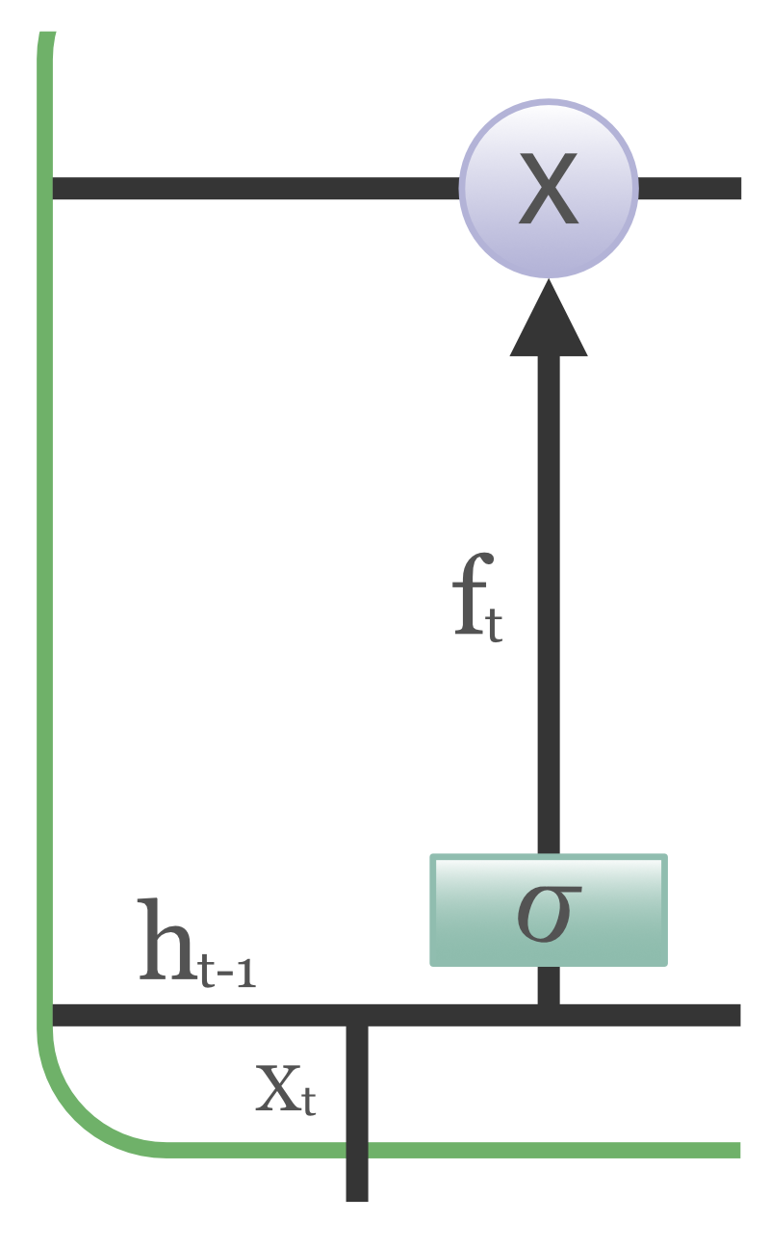
STRUCTURE OF LSTM:
Forget Gate:

Slide 134
STRUCTURE OF LSTM:
Input gate:
Addition of useful information to the cell state is done by input gate.
First, the information is regulated using the sigmoid function and filter the values to be remembered similar to the forget gate using inputs h_t-1 and x_t.
Then, a vector is created using tanh function that gives output from -1 to +1, which contains all the possible values from h_t-1 and x_t.
Atlast, the values of the vector and the regulated values are multiplied to obtain the useful information

Slide 135
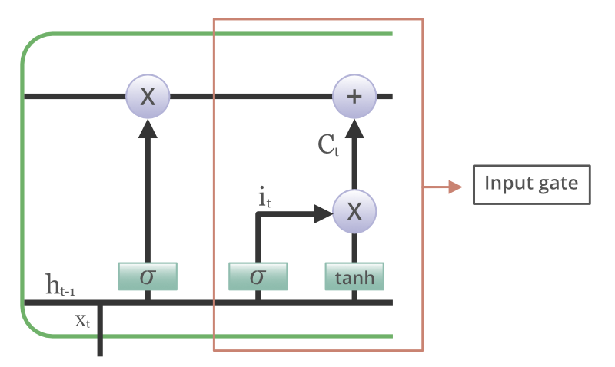
STRUCTURE OF LSTM:
Input gate:

Slide 136
STRUCTURE OF LSTM:
Output gate:
The task of extracting useful information from the current cell state to be presented as an output is done by output gate.
First, a vector is generated by applying tanh function on the cell.
Then, the information is regulated using the sigmoid function and filter the values to be remembered using inputs h_t-1 and x_t. Atlast, the values of the vector and the regulated values are multiplied to be sent as an output and input to the next cell.

Slide 137
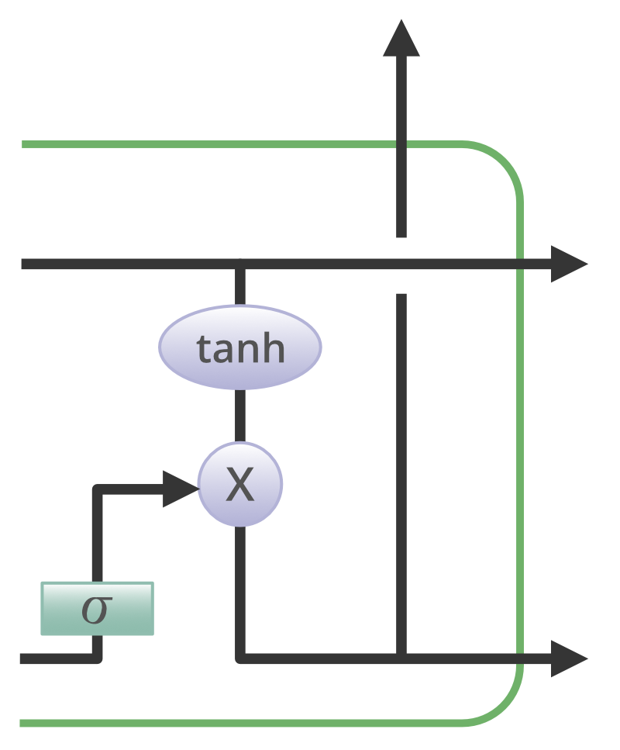
STRUCTURE OF LSTM:
Output gate:

Slide 138
APPLICATIONS OF LSTM
Some of the famous applications of LSTM includes:
Language Modelling
Machine Translation
Image Captioning
Handwriting generation
Question Answering Chatbots

Slide 139
GATED RECURRENT UNIT (GRU)
The GRU is a new generation of Recurrent Neural Networks and is very similar to an LSTM.
To solve the vanishing gradient problem of a standard RNN, GRU uses the update gate and reset gate.
These are two gates decide what information should be passed to the output.
These two gates can be trained to keep information from many time steps before the actual time step, without washing it through time, or to remove information which is irrelevant for the prediction.
If carefully trained, GRU can perform extremely well even in complex scenarios.

Slide 140
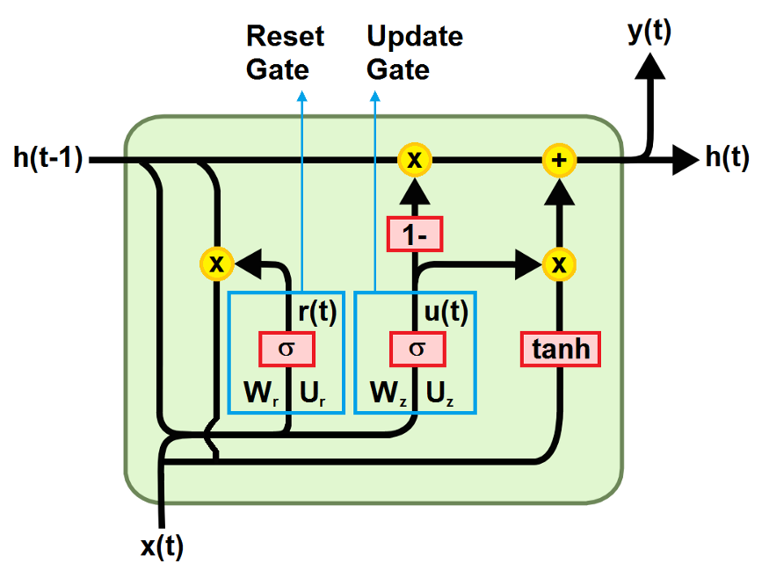
GATED RECURRENT UNIT (GRU)

Slide 141
STRUCTURE OF GRU:
Reset Gate
The first gate is the reset gate.
It determines how to combine the new input with the previous memory, deciding how much of the information from previous time steps can be forgotten.
First the weighted sum between the input x(t) and the memory h(t-1), which holds the information for the previous t-1 steps, is performed.
Then a sigmoid activation function is applied to squash the result between 0 and 1.

Slide 142

STRUCTURE OF GRU:
Update Gate
The second gate is the update gate.
It helps the model to determine how much of the information from previous time steps needs to be passed along to the future.
That is really powerful because the model can decide to copy all the information from the past and eliminate the risk of vanishing gradient problem.
The formula to calculate it is the analogous to the one for the reset gate, but the difference comes in the weights and the gate’s usage (it will be clear in the calculation of the memory).

Slide 143
STRUCTURE OF GRU:
Current memory
The memory content uses the reset gate to store the relevant information from the past.
To obtain it, first the multiplication element by element between the output of the reset gate r(t) and the final memory at the previous time step h(t-1) is computed, then the weighted sum between the result and the input x(t) is performed.
Finally, the nonlinear activation function tanh is applied.

Slide 144
STRUCTURE OF GRU:
Final Memory
As the last step, the network needs to calculate h(t), that is the vector which holds information for the current unit and passes it to the next time step.
It determines what to collect from the current memory content h~(t) and what from the previous steps h(t-1).
It is computed applying the element by element multiplication between the update gate z_t and h_(t-1), and between (1-z_t) and h~(t), and finally performing yhr weighted sum between the two results.

Slide 145
WHAT IS A TIME SERIES?
A time series is a data set that tracks a sample over time.
In particular, a time series allows one to see what factors influence certain variables from period to period.
Time series analysis can be useful to see how a given asset, security, or economic variable changes over time.
Forecasting methods using time series are used in both fundamental and technical analysis.
Although cross-sectional data is seen as the opposite of time series, the two are often used together in practice.

Slide 146
WHAT IS TIME SERIES ANALYSIS?
Time series analysis is a specific way of analyzing a sequence of data points collected over an interval of time.
In time series analysis, analysts record data points at consistent intervals over a set period of time rather than just recording the data points intermittently or randomly.
However, this type of analysis is not merely the act of collecting data over time.
What sets time series data apart from other data is that the analysis can show how variables change over time.
In other words, time is a crucial variable because it shows how the data adjusts over the course of the data points as well as the final results.

Slide 147
WHAT IS TIME SERIES ANALYSIS?
It provides an additional source of information and a set order of dependencies between the data.
Time series analysis typically requires a large number of data points to ensure consistency and reliability.
An extensive data set ensures you have a representative sample size and that analysis can cut through noisy data.
It also ensures that any trends or patterns discovered are not outliers and can account for seasonal variance.
Additionally, time series data can be used for forecasting—predicting future data based on historical data.

Slide 148
WHY ORGANIZATIONS USE TIME SERIES DATA ANALYSIS?
Time series analysis helps organizations understand the underlying causes of trends or systemic patterns over time.
Using data visualizations, business users can see seasonal trends and dig deeper into why these trends occur.
With modern analytics platforms, these visualizations can go far beyond line graphs.
When organizations analyze data over consistent intervals, they can also use time series forecasting to predict the likelihood of future events.

Slide 149
WHY ORGANIZATIONS USE TIME SERIES DATA ANALYSIS?
Time series forecasting is part of predictive analytics.
It can show likely changes in the data, like seasonality or cyclic behavior, which provides a better understanding of data variables and helps forecast better.
Today’s technology allows us to collect massive amounts of data every day and it’s easier than ever to gather enough consistent data for comprehensive analysis.

Slide 150
TYPES OF TIME SERIES ANALYSIS
Even within time series analysis, there are different types and models of analysis that will achieve different results.
Classification: Identifies and assigns categories to the data.
Curve fitting: Plots the data along a curve to study the relationships of variables within the data.
Descriptive analysis: Identifies patterns in time series data, like trends, cycles, or seasonal variation.
Explanative analysis: Attempts to understand the data and the relationships within it, as well as cause and effect.

Slide 151
TYPES OF TIME SERIES ANALYSIS
Exploratory analysis: Highlights the main characteristics of the time series data, usually in a visual format.
Forecasting: Predicts future data. This type is based on historical trends. It uses the historical data as a model for future data, predicting scenarios that could happen along future plot points.
Intervention analysis: Studies how an event can change the data.
Segmentation: Splits the data into segments to show the underlying properties of the source information.

Slide 152
PRIMARY TECHNIQUES AND TOOLS FOR TIME SERIES ANALYSIS
Just as there are many types and models, there are also a variety of methods to study data. Here are the three most common.
Box-Jenkins ARIMA models: These univariate models are used to better understand a single time-dependent variable, such as temperature over time, and to predict future data points of variables. These models work on the assumption that the data is stationary. Analysts have to account for and remove as many differences and seasonality in past data points as they can. Thankfully, the ARIMA model includes terms to account for moving averages, seasonal difference operators, and autoregressive terms within the model.
Box-Jenkins Multivariate Models: Multivariate models are used to analyze more than one time-dependent variable, such as temperature and humidity, over time.
Holt-Winters Method: The Holt-Winters method is an exponential smoothing technique. It is designed to predict outcomes, provided that the data points include seasonality.

Slide 153
WHAT IS ATTENTION?
A neural network is considered to be an effort to mimic human brain actions in a simplified manner. Attention Mechanism is also an attempt to implement the same action of selectively concentrating on a few relevant things, while ignoring others in deep neural networks.

Slide 154
HOW ATTENTION MECHANISM WAS INTRODUCED IN DEEP LEARNING
The attention mechanism emerged as an improvement over the encoder decoder-based neural machine translation system in natural language processing (NLP). Later, this mechanism, or its variants, was used in other applications, including computer vision, speech processing, etc.
Before Bahdanau et al proposed the first Attention model in 2015, neural machine translation was based on encoder-decoder RNNs/LSTMs. Both encoder and decoder are stacks of LSTM/RNN units. It works in the two following steps:
The encoder LSTM is used to process the entire input sentence and encode it into a context vector, which is the last hidden state of the LSTM/RNN. This is expected to be a good summary of the input sentence. All the intermediate states of the encoder are ignored, and the final state id supposed to be the initial hidden state of the decoder.
The decoder LSTM or RNN units produce the words in a sentence one after another

Slide 155
HOW ATTENTION MECHANISM WAS INTRODUCED IN DEEP LEARNING
there are two RNNs/LSTMs. One we call the encoder – this reads the input sentence and tries to make sense of it, before summarizing it. It passes the summary (context vector) to the decoder which translates the input sentence by just seeing it.
The main drawback of this approach is evident. If the encoder makes a bad summary, the translation will also be bad. And indeed it has been observed that the encoder creates a bad summary when it tries to understand longer sentences. It is called the long-range dependency problem of RNN/LSTMs.

Slide 156
HOW ATTENTION MECHANISM WAS INTRODUCED IN DEEP LEARNING
RNNs cannot remember longer sentences and sequences due to the vanishing/exploding gradient problem. It can remember the parts which it has just seen. Even Cho et al (2014), who proposed the encoder-decoder network, demonstrated that the performance of the encoder-decoder network degrades rapidly as the length of the input sentence increases.
Although an LSTM is supposed to capture the long-range dependency better than the RNN, it tends to become forgetful in specific cases. Another problem is that there is no way to give more importance to some of the input words compared to others while translating the sentence.

Slide 157
WHAT IS NEURAL MACHINE TRANSLATION?
Neural Machine Translation is a machine translation approach that applies a large artificial neural network toward predicting the likelihood of a sequence of words, often in the form of whole sentences.
Unlike statistical machine translation, which consumes more memory and time, neural machine translation, NMT, trains its parts end-to-end to maximize performance.
NMT systems are quickly moving to the forefront of machine translation, recently outcompeting traditional forms of translation systems.

Slide 158
HOW DOES NEURAL MACHINE TRANSLATION WORK?
Unlike Traditional Methods Of Machine Translation That Involve Separately Engineered Components, Nmt Works Cohesively To Maximize Its Performance.
Additionally, Nmt Employs The Use Of Vector Representations For Words And Internal State.
This Means That Words Are Transcribed Into A Vector Defined By A Unique Magnitude And Direction.
Compared To Phrase-based Models, This Framework Is Much Simpler.
Rather Than Separate Component Like The Language Model And Translation Model, Nmt Uses A Single Sequence Model That Produces One Word At A Time.

Slide 159

HOW DOES NEURAL MACHINE TRANSLATION WORK?

Slide 160
HOW DOES NEURAL MACHINE TRANSLATION WORK?
The NMT uses a bidirectional recurrent neural network, also called an encoder, to process a source sentence into vectors for a second recurrent neural network, called the decoder, to predict words in the target language.
This process, while differing from phrase-based models in method, prove to be comparable in speed and accuracy.

Slide 161
APPLICATIONS OF NEURAL NETWORK TRANSLATION
One of the most popular translation machines in the world is Google Translate.
The system uses Google Neural Machine Translation to increase its fluency and accuracy.
The system not only applies a large data set for training its algorithms, its end-to-end design allows the system to learn over time and create better, more natural translations.
Google Neural Machine Translation can even process what are called "zero-shot translations.
" For example, the translation from French to Spanish is a zero-shot translation because it is a direct translation.
Previously, Google Translate would translate the initial language into English, and then translate that English to the target language.

Slide 162
TRANSFORMERS
Transformers provides thousands of pretrained models to perform tasks on texts such as classification, information extraction, question answering, summarization, translation, text generation and more in over 100 languages. Its aim is to make cutting-edge NLP easier to use for everyone.
Transformers provides APIs to quickly download and use those pretrained models on a given text, fine-tune them on your own datasets and then share them with the community on our model hub. At the same time, each python module defining an architecture is fully standalone and can be modified to enable quick research experiments.
Transformers is backed by the three most popular deep learning libraries — Jax, PyTorch and TensorFlow — with a seamless integration between them. It's straightforward to train your models with one before loading them for inference with the other.

Slide 163
WHY USE TRANSFORMERS?
Easy-to-use state-of-the-art models:
High performance on NLU and NLG tasks.
Low barrier to entry for educators and practitioners.
Few user-facing abstractions with just three classes to learn.
A unified API for using all our pretrained models.
Lower compute costs, smaller carbon footprint:
Researchers can share trained models instead of always retraining.
Practitioners can reduce compute time and production costs.
Dozens of architectures with over 2,000 pretrained models, some in more than 100 languages.

Slide 164
WHY USE TRANSFORMERS?
Choose the right framework for every part of a model's lifetime:
Train state-of-the-art models in 3 lines of code.
Move a single model between TF2.0/PyTorch frameworks at will.
Seamlessly pick the right framework for training, evaluation and production.
Easily customize a model or an example to your needs:
We provide examples for each architecture to reproduce the results published by its original authors.
Model internals are exposed as consistently as possible.
Model files can be used independently of the library for quick experiments.

Slide 165
BERT
Bidirectional Encoder Representations from Transformers — BERT, is a pre-trained NLP model developed by Google in 2018.
With this, anyone in the world can train their own question answering models in about 30 minutes on a single Cloud TPU, or in a few hours using a single GPU.
The company, with the release, has showcased its performance on 11 NLP tasks including the very competitive Stanford questions dataset.
Unlike other language models, BERT has only been pre-trained on 2,500 million words of Wikipedia and 800 million words of Book Corpus and has been successfully used to pre-train a deep neural network.
According to researchers, BERT has achieved 93.2% accuracy, which surpasses previous results of accuracy.

Slide 166
XLNET
XLNet by Google is an extension of the Transformer-XL model, which has been pre-trained using an autoregressive method to learn the functions from bidirectional contexts.
Not only it can perform NLP tasks such as text classification, analyzing sentiments, answering questions, along with the essential GLUE benchmark for English, but also many a time has outperformed BERT in many NLP tasks.
According to researchers, XLNet has surpassed BERT in 20 tasks such as SQUAD, GLUE, and RACE.
Also, this model does not undergo the pre-train fine-tune discrepancy that BERT has been subjected to, eliminating the independence assumption.

Slide 167

THANK YOU !!!
(USA)
2-Industrial Park Drive, E-Waldorf, MD, 20602,
United States
(USA)
+1-844-889-4054
(Singapore)
3 Temasek Avenue, Singapore 039190
info@careerera.com www.careerera.com
(INDIA)
B-44, Sector-59, Noida Uttar Pradesh 201301
(INDIA)
+91-92-5000-4000

