Slide 1
A Warm Welcome To Careerera Family

Slide 2

DECISION TREE

Slide 3
WHAT IS DECISION TREE?
It is a graphical representation for getting all the possible solutions to a problem/decision based on given conditions.
It is called a decision tree because, similar to a tree, it starts with the root node, which expands on further branches and constructs a tree-like structure.
Decision Tree is a Supervised learning technique that can be used for both classification and Regression problems, but mostly it is preferred for solving Classification problems.
In a Decision tree, there are two nodes, which are the Decision Node and Leaf Node.

Slide 4
DECISION TREE
A decision tree consists of three types of nodes: –
Decision nodes – typically represented by squares.
Chance nodes – typically represented by circles.
End nodes – typically represented by triangles.
Decision trees are commonly used in operations research and operations management. If, in practice, decisions have to be taken online with no recall under incomplete knowledge, a decision tree should be paralleled by a probability model as a best choice model or online selection model algorithm. Another use of decision trees is as a descriptive means for calculating conditional probabilities
Decision trees, influence diagrams, utility functions, and other decision analysis tools and methods are taught to undergraduate students in schools of business, health economics, and public health, and are examples of operations research or management science methods

Slide 5
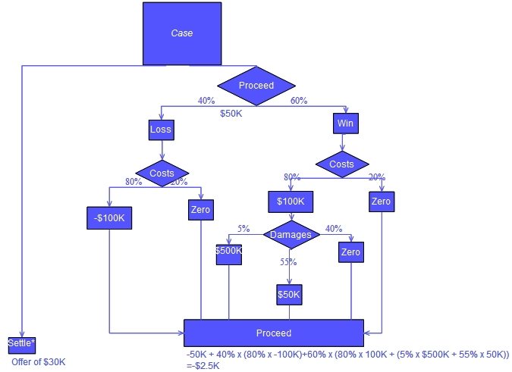
DECISION TREE USING FLOWCHART SYMBOLS

Slide 6

WHAT IS DECISION TREE?

Slide 7
DECISION TREE TERMINOLOGY
Root Node: Root node is from where the decision tree starts. It represents the entire dataset, which further gets divided into two or more homogeneous sets.
Leaf Node: Leaf nodes are the final output node, and the tree cannot be segregated further after getting a leaf node.
Splitting: Splitting is the process of dividing the decision node/root node into sub-nodes according to the given conditions.
Branch/Sub Tree: A tree formed by splitting the tree.
Pruning: Pruning is the process of removing the unwanted branches from the tree.
Parent/Child node: The root node of the tree is called the parent node, and other nodes are called the child nodes.

Slide 8
BASIC TERMS IN DECISION TREE
Solve such problems there is a technique which is called as Attribute selection measure or ASM.
By this measurement, we can easily select the best attribute for the nodes of the tree.
There are two popular techniques for ASM, which are:
Gini Index
Information Gain

Slide 9
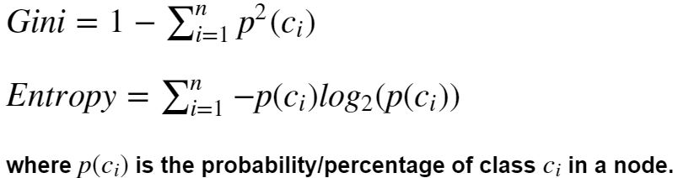
WHAT IS GINI INDEX AND ENTROPY?
Gini index and entropy are the criteria for calculating information gain.
Decision tree algorithms use information gain to split a node
Both gini and entropy are measures of impurity of a node
A node having multiple classes is impure whereas a node having only one class is pure.
Entropy in statistics is analogous to entropy in thermodynamics where it signifies disorder
If there are multiple classes in a node, there is disorder in that node

Slide 10
WHAT IS INFORMATION GAIN?
Information Gain, or IG for short, measures the reduction in entropy or surprise by splitting a dataset according to a given value of a random variable.
A larger information gain suggests a lower entropy group or groups of samples, and hence less surprise.
You might recall that information quantifies how surprising an event is in bits.
Lower probability events have more information, higher probability events have less information.
Entropy quantifies how much information there is in a random variable, or more specifically its probability distribution. A skewed distribution has a low entropy, whereas a distribution where events have equal probability has a larger entropy.

Slide 11
WHAT IS INFORMATION GAIN?
In information theory, we like to describe the “surprise” of an event.
Low probability events are more surprising therefore have a larger amount of information.
Whereas probability distributions where the events are equally likely are more surprising and have larger entropy.
Skewed Probability Distribution (unsurprising) : Low entropy
Balanced Probability Distribution (surprising) : High entropy

Slide 12
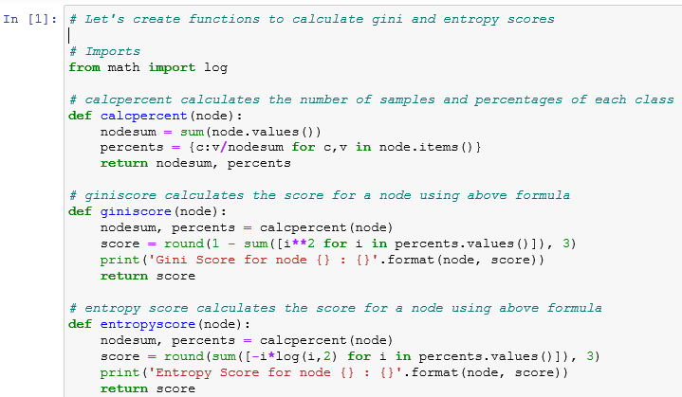
GINNI, ENTROPY AND INFORMATION GAIN [EXAMPLE]

Slide 13
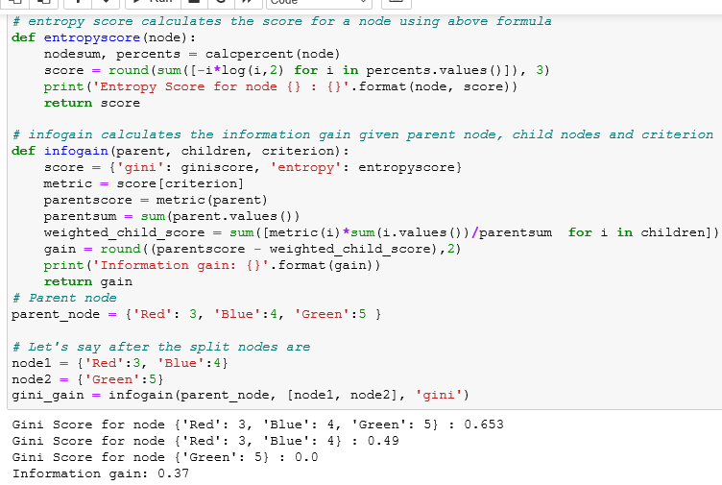
GINNI, ENTROPY AND INFORMATION GAIN – EXAMPLE

Slide 14
How does the Decision Tree algorithm Work?
Step-1: Begin the tree with the root node, says S, which contains the complete dataset.
Step-2: Find the best attribute in the dataset using Attribute Selection Measure (ASM).
Step-3: Divide the S into subsets that contains possible values for the best attributes.
Step-4: Generate the decision tree node, which contains the best attribute.
Step-5: Recursively make new decision trees using the subsets of the dataset created in step -3. Continue this process until a stage is reached where you cannot further classify the nodes and called the final node as a leaf node.

Slide 15
EVALUATING DECISION TREES MODELS: ‘CONFUSION MATRIX’
A confusion matrix is a table that is often used to describe the performance of a classification model (or "classifier") on a set of test data for which the true values are known.
Confusion Matrix is a useful machine learning method which allows you to measure Recall, Precision, Accuracy, and AUC-ROC curve.
Example to know the terms :
True Positive, True Negative, False Negative, and True Negative. True Positive: You projected positive and its turn out to be true.

Slide 16
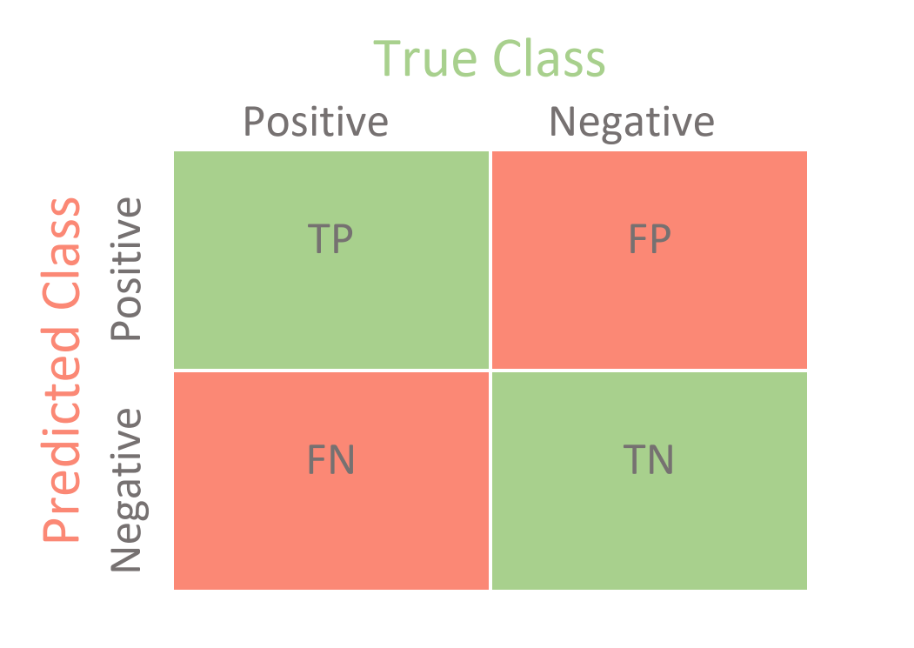
EVALUATING DECISION TREES MODELS: ‘CONFUSION MATRIX’

Slide 17
EVALUATING DECISION TREES MODELS: ‘CONFUSION MATRIX’
True Positives (TP): These are cases in which we predicted yes (they have the disease), and they do have the disease.
True Negatives (TN): We predicted no, and they don't have the disease.
False Positives (FP): We predicted yes, but they don't actually have the disease. (Also known as a "Type I error.")
False Negatives (FN): We predicted no, but they actually do have the disease. (Also known as a "Type II error.")

Slide 18
EVALUATING DECISION TREES MODELS:
Accuracy: Accuracy is a metric used in classification problems used to tell the percentage of accurate predictions. We calculate it by dividing the number of correct predictions by the total number of predictions.
Accuracy=(TP+TN)/(TP+TN+FP+FN)
Precision : Precision is the ratio of correctly predicted positive observations to the total predicted positive observations.
Precision Score = TP / (FP + TP)
Recall : recall is calculated as the ratio between the numbers of Positive samples correctly classified as Positive to the total number of Positive samples.
Recall = TP / (TP+ FN)

Slide 19
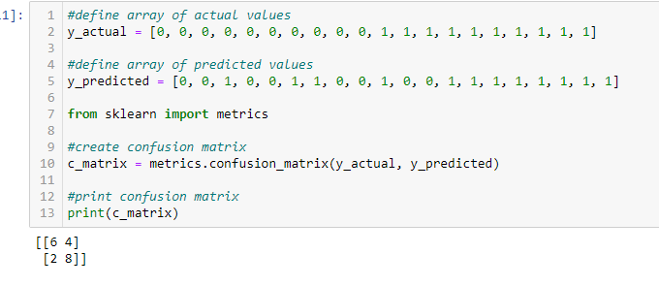
EVALUATING DECISION TREES MODELS: ‘CONFUSION MATRIX’

Slide 20
WHAT IS TYPE 1 ERROR ?
Type 1 error, in statistical hypothesis testing, is the error caused by rejecting a null hypothesis when it is true.
Type I error is denoted by α (alpha) known as an error, also called the level of significance of the test.
Type 1 error occurs when the null hypothesis is rejected even when there is no relationship between the variables.

Slide 21
WHAT IS TYPE II ERROR ?
Type II error is the error that occurs when the null hypothesis is accepted when it is not true.
The type II error results in a false negative result.
The Type II error is denoted by β (beta) and is also termed as the beta error.
The null hypothesis is set to state that there is no relationship between two variables and the cause-effect relationship between two variables, if present, is caused by chance.

Slide 22
WHAT ARE THE ADVANTAGE OF DECISION TREE ?
It is simple to understand as it follows the same process which a human follow while making any decision in real-life.
It can be very useful for solving decision-related problems.
It helps to think about all the possible outcomes for a problem.
There is less requirement of data cleaning compared to other algorithms.

Slide 23
WHAT ARE THE DISADVANTAGE OF DECISION TREE ?
The decision tree contains lots of layers, which makes it complex.
It may have an overfitting issue, which can be resolved using the Random Forest algorithm.
For more class labels, the computational complexity of the decision tree may increase.

Slide 24

THANK YOU !!!
(USA)
2-Industrial Park Drive, E-Waldorf, MD, 20602,
United States
(USA)
+1-844-889-4054
(Singapore)
3 Temasek Avenue, Singapore 039190
info@careerera.com www.careerera.com
(INDIA)
B-44, Sector-59, Noida Uttar Pradesh 201301
(INDIA)
+91-92-5000-4000

