Slide 1
Classification
A Warm Welcome To Careerera Family

Slide 2

CLASSIFICATION TECHNIQUES(CART)

Slide 3
WHAT IS CLASSIFICATION?
The Classification algorithm is a Supervised Learning technique that is used to identify the category of new observations on the basis of training data.
In Classification, a program learns from the given dataset or observations and then classifies new observation into a number of classes or groups.
Such as, Yes or No, 0 or 1, Spam or Not Spam, cat or dog, etc. Classes can be called as targets/labels or categories.

Slide 4
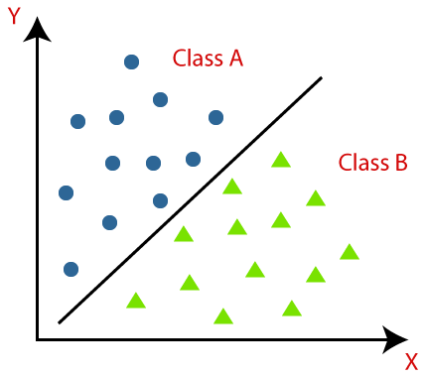
WHAT IS CLASSIFICATION?
Classification algorithms can be better understood using the below diagram. In the below diagram, there are two classes, class A and Class B. These classes have features that are similar to each other and dissimilar to other classes.

Slide 5
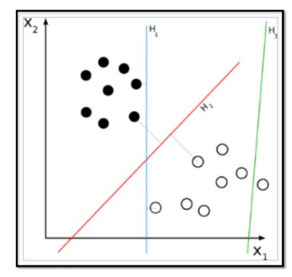
CLASSIFICATION EXAMPLE
Social media sentiment analysis has two potential outcomes, positive or negative

Slide 6
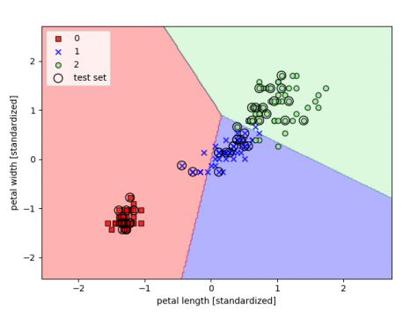
CLASSIFICATION EXAMPLE
Classification of the Iris flower dataset into its three sub-species indicated by codes 0, 1, and 2

Slide 7
TYPES OF ML CLASSIFICATION MODEL
Classification Algorithms can be further divided into the Mainly two category:
1. Linear Models
Logistic Regression.
Support Vector Machines.
2. Non-linear Models
K-Nearest Neighbours.
Kernel SVM.
Naïve Bayes.
Decision Tree Classification.
Random Forest Classification.

Slide 8
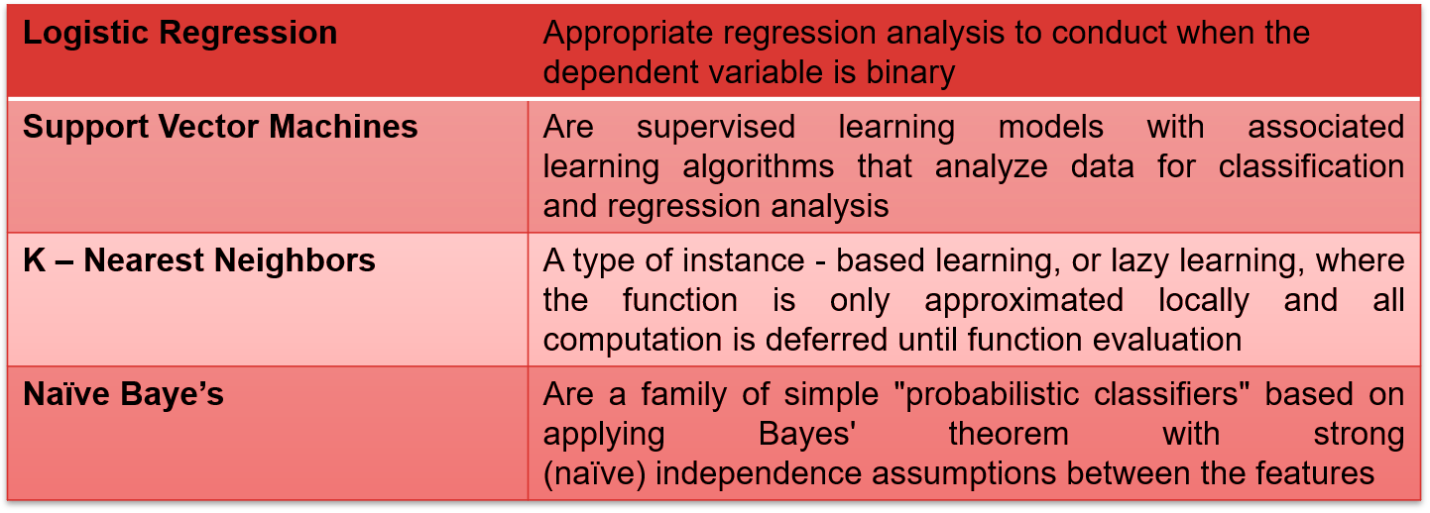
BRIEF INTRODUCTION TO CLASSIFICATION TECHNIQUES

Slide 9
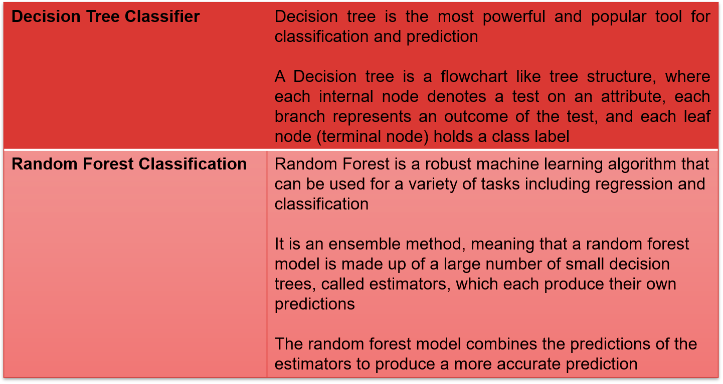
BRIEF INTRODUCTION TO CLASSIFICATION TECHNIQUES

Slide 10
USE CASES OF CLASSIFICATION ALGORITHMS
Classification algorithms can be used in different places. Below are some popular use cases of Classification Algorithms:
Email Spam Detection
Speech Recognition
Identifications of Cancer tumor cells.
Drugs Classification
Biometric Identification, etc.

Slide 11
ADVANTAGES OF CART (CLASSIFICATION AND REGRESSION TREE)
CART allows one to utilize the same variables many times in various regions of the tree. This skill is capable of revealing intricate interdependencies between groups of variables.
Outliers in the input variables have no meaningful effect on CART.
One can loosen halting restrictions to allow decision trees to overgrow and then trim the tree down to its ideal size. This method reduces the likelihood of missing essential structure in the data set by terminating too soon.
To choose the input set of variables, CART can be used in combination with other prediction algorithms.

Slide 12
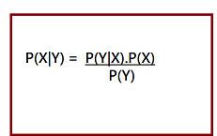
THE BAYES THEOREM
Bayes theorem is one of the most popular machine learning concepts that helps to calculate the probability of occurring one event with uncertain knowledge while other one has already occurred.
Here, both events X and Y are independent events which means probability of outcome of both events does not depends one another.
The equation is called as Bayes Rule or Bayes Theorem.

Slide 13
THE BAYES THEOREM
P(X|Y) is called as posterior, which we need to calculate. It is defined as updated probability after considering the evidence.
P(Y|X) is called the likelihood. It is the probability of evidence when hypothesis is true.
P(X) is called the prior probability, probability of hypothesis before considering the evidence
P(Y) is called marginal probability. It is defined as the probability of evidence under any consideration.

Slide 14
KNN CLASSIFIER
K-Nearest Neighbour is one of the simplest Machine Learning algorithms based on Supervised Learning technique.
K-NN algorithm assumes the similarity between the new case/data and available cases and put the new case into the category that is most similar to the available categories.
K-NN algorithm stores all the available data and classifies a new data point based on the similarity. This means when new data appears then it can be easily classified into a well suite category by using K- NN algorithm.
K-NN algorithm can be used for Regression as well as for Classification but mostly it is used for the Classification problems.

Slide 15
KNN CLASSIFIER
K-NN is a non-parametric algorithm, which means it does not make any assumption on underlying data.
It is also called a lazy learner algorithm because it does not learn from the training set immediately instead it stores the dataset and at the time of classification, it performs an action on the dataset..
KNN algorithm at the training phase just stores the dataset and when it gets new data, then it classifies that data into a category that is much similar to the new data.

Slide 16
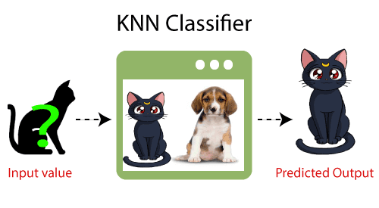
KNN CLASSIFIER
Example: we have an image of a creature that looks similar to cat and dog, but we want to know either it is a cat or dog. So for this identification, we can use the KNN algorithm, as it works on a similarity measure. Our KNN model will find the similar features of the new data set to the cats and dogs images and based on the most similar features it will put it in either cat or dog category.

Slide 17
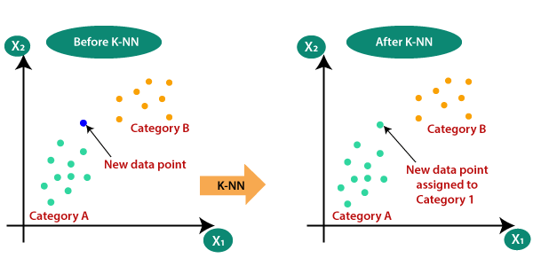
WHY DO WE NEED A KNN ALGORITHM?
With the help of K-NN, we can easily identify the category or class of a particular dataset. Consider the below diagram:

Slide 18
HOW DOES KNN CLASSIFIER WORK?
The K-NN working can be explained on the basis of the below algorithm:
Step-1: Select the number K of the neighbors
Step-2: Calculate the Euclidean distance of K number of neighbors
Step-3: Take the K nearest neighbors as per the calculated Euclidean distance.
Step-4: Among these k neighbors, count the number of the data points in each category.
Step-5: Assign the new data points to that category for which the number of the neighbor is maximum.
Step-6: Our model is ready.

Slide 19
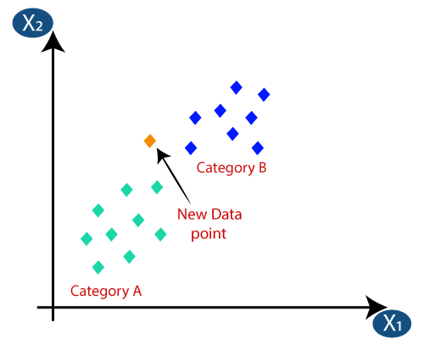
WORKING
Suppose we have a new data point and we need to put it in the required category. Consider the below image:

Slide 20
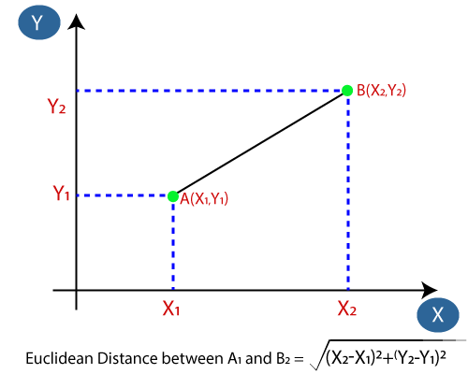
WORKING
Firstly, we will choose the number of neighbors, so we will choose the k=5.
Next, we will calculate the Euclidean distance between the data points. The Euclidean distance is the distance between two points, which we have already studied in geometry. It can be calculated as:

Slide 21
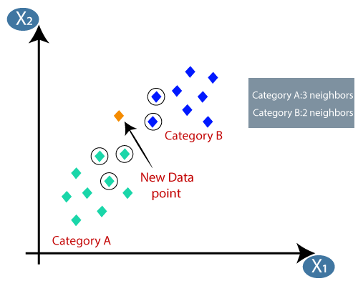
WORKING
By calculating the Euclidean distance we got the nearest neighbors, as three nearest neighbors in category A and two nearest neighbors in category B. Consider the below image:
As we can see the 3 nearest neighbors are from category A, hence this new data point must belong to category A.

Slide 22
HOW TO SELECT THE VALUE OF K?
There is no particular way to determine the best value for "K", so we need to try some values to find the best out of them. The most preferred value for K is 5.
A very low value for K such as K=1 or K=2, can be noisy and lead to the effects of outliers in the model.
Large values for K are good, but it may find some difficulties.

Slide 23
ADVANTAGES OF KNN ALGORITHM
It is simple to implement.
It is robust to the noisy training data
It can be more effective if the training data is large.
DISADVANTAGES OF KNN ALGORITHM
Always needs to determine the value of K which may be complex some time.
The computation cost is high because of calculating the distance between the data points for all the training samples.

Slide 24
GUASSIAN NAÏVE’S BAYES CLASSIFIER

Slide 25
NAÏVE BAYES CLASSIFIER ALGORITHM
Naïve Bayes algorithm is a supervised learning algorithm, which is based on Bayes theorem and used for solving classification problems.
It is mainly used in text classification that includes a high-dimensional training dataset.
Naïve Bayes Classifier is one of the simple and most effective Classification algorithms which helps in building the fast machine learning models that can make quick predictions.
It is a probabilistic classifier, which means it predicts on the basis of the probability of an object.
Some popular examples of Naïve Bayes Algorithm are spam filtration, Sentimental analysis, and classifying articles.

Slide 26
WHY IT IS CALLED NAÏVE BAYES
The Naïve Bayes algorithm is comprised of two words Naïve and Bayes, Which can be described as:
Naïve: It is called Naïve because it assumes that the occurrence of a certain feature is independent of the occurrence of other features. Such as if the fruit is identified on the bases of color, shape, and taste, then red, spherical, and sweet fruit is recognized as an apple. Hence each feature individually contributes to identify that it is an apple without depending on each other.
Bayes: It is called Bayes because it depends on the principle of Bayes' Theorem

Slide 27

BAYES’ THEOREM
Bayes' theorem is also known as Bayes' Rule or Bayes' law, which is used to determine the probability of a hypothesis with prior knowledge. It depends on the conditional probability.
The formula for Bayes' theorem is given as:
Where,
P(A|B) is Posterior probability: Probability of hypothesis A on the observed event B.
P(B|A) is Likelihood probability: Probability of the evidence given that the probability of a hypothesis is true.
P(A) is Prior Probability: Probability of hypothesis before observing the evidence.
P(B) is Marginal Probability: Probability of Evidence.

Slide 28
ADVANTAGES OF NAÏVE BAYES’ THEOREM
Naïve Bayes is one of the fast and easy ML algorithms to predict a class of datasets.
It can be used for Binary as well as Multi-class Classifications.
It performs well in Multi-class predictions as compared to the other Algorithms.
It is the most popular choice for text classification problems.
DISADVANTAGE OF NAÏVE BAYES’ THEOREM
Naive Bayes assumes that all features are independent or unrelated, so it cannot learn the relationship between features.

Slide 29
APPLICATIONS OF NAÏVE BAYES’ THEOREM
It is used for Credit Scoring.
It is used in medical data classification.
It can be used in real-time predictions because Naïve Bayes Classifier is an eager learner.
It is used in Text classification such as Spam filtering and Sentiment analysis.

Slide 30
TYPES OF NAÏVE BAYES’ THEOREM
There are three types of Naive Bayes Model, which are given below:
Gaussian: The Gaussian model assumes that features follow a normal distribution. This means if predictors take continuous values instead of discrete, then the model assumes that these values are sampled from the Gaussian distribution.
Multinomial: The Multinomial Naïve Bayes classifier is used when the data is multinomial distributed. It is primarily used for document classification problems, it means a particular document belongs to which category such as Sports, Politics, education, etc. The classifier uses the frequency of words for the predictors.
Bernoulli: The Bernoulli classifier works similar to the Multinomial classifier, but the predictor variables are the independent Booleans variables. Such as if a particular word is present or not in a document. This model is also famous for document classification tasks.

Slide 31
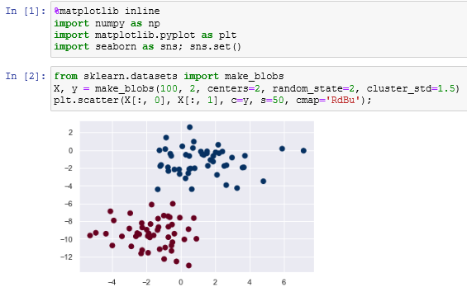
NAÏVE BAYE’S – EXAMPLE

Slide 32
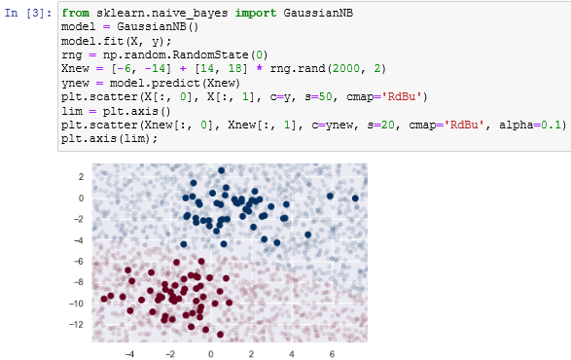
NAÏVE BAYE’S – EXAMPLE

Slide 33
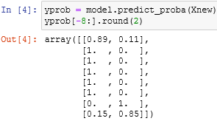
NAÏVE BAYE’S – EXAMPLE

Slide 34

THANK YOU !!!
(USA)
2-Industrial Park Drive, E-Waldorf, MD, 20602,
United States
(USA)
+1-844-889-4054
(Singapore)
3 Temasek Avenue, Singapore 039190
info@careerera.com www.careerera.com
(INDIA)
B-44, Sector-59, Noida Uttar Pradesh 201301
(INDIA)
+91-92-5000-4000

