Slide 1
A warm welcome to Careerera family

Slide 2
TEXT MINING AND SENTIMENT ANALYSIS

Slide 3

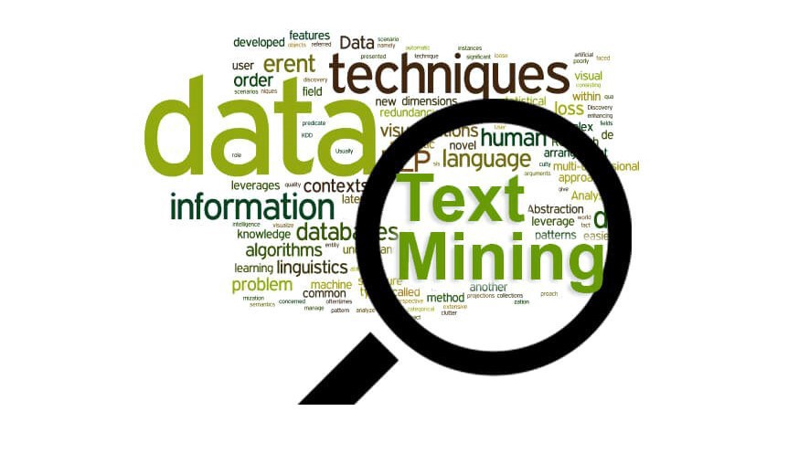
WHAT IS TEXT MINING ?
Text Mining is the process of deriving meaningful information from natural language text.

Slide 4
WHAT IS TEXT CLEANING ?
Text cleaning is task-specific and one needs to have a strong idea about what they want their end result to be and even review the data to see what exactly they can achieve.
Use of Text Cleaning Because :-
Having too many typos or spelling mistakes in the text
Having too many numbers and punctuations (E.g. Love!!!!)
Text is full of emojis and emoticons and username and links too. (If the text is from Twitter or Facebook)
Some of the text parts are not in the English language. Data is having a mixture of more than one language
Some of the words are combined with the hyphen or data having contractions words. (E.g. text-processing)
Repetitions of words (E.g. Data)

Slide 5
HOW TO CLEAN THE TEXT?
We will see how to code and clean the textual data for the following methods.
Lowecasing the data
Removing Punctuations
Removing Numbers
Removing extra space
Replacing the repetitions of punctations
Removing Emojis
Removing emoticons
Removing Contractions

Slide 6
WHAT IS REGEX ?
Regular expressions or RegEx is defined as a sequence of characters that are mainly used to find or replace patterns present in the text.
In simple words, we can say that a regular expression is a set of characters or a pattern that is used to find substrings in a given string.
A regular expression (RE) is a language for specifying text search strings. It helps us to match or extract other strings or sets of strings, with the help of a specialized syntax present in a pattern.
For Example, extracting all hashtags from a tweet, getting email iD or phone numbers, etc from large unstructured text content.

Slide 7
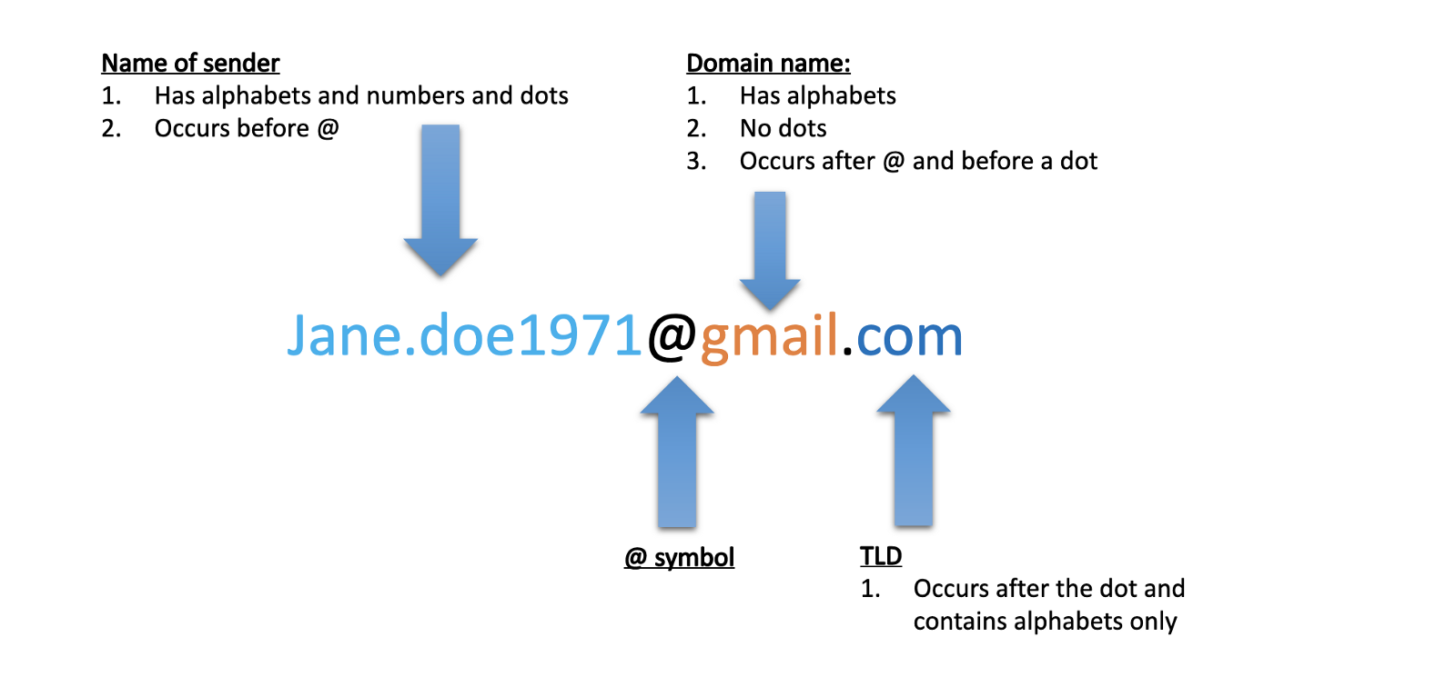
Identify the different components of an email address.

Slide 8
WHAT ARE THE USE CASES OF REGEX?
Regular Expressions (REGEX) are used in various tasks such as,
Data pre-processing,
Rule-based information Mining systems,
Pattern Matching,
Text feature Engineering,
Web scraping,
Data Extraction, etc.

Slide 9
WHAT ARE THE COMMON REGEX FUNCTION IN NLP ?
To work with Regular Expressions, Python has a built-in module known as “re”. Some common functions from this module are as follows:
re.search()
re.match()
re.sub()
re.compile()
re.findall()

Slide 10
WHAT ARE THE REGEX FUNCTIONS ?
1. re. search( )
This function helps us to detect whether the given regular expression pattern is present in the given input string. It matches the first occurrence of a pattern in the entire string and not just at the beginning. It returns a Regex Object if the pattern is found in the string, else it returns a None object.
Syntax: re.search(patterns, string)
2. re.match( )
This function will only match the string if the pattern is present at the very start of the string.
Syntax: re.match(patterns, string)

Slide 11
REGEX FUNCTIONS
3. re.sub( )
This function is used to substitute a substring with another substring.
Syntax: re.sub(patterns, Substitute, Input text)
4. re.compile( )
This function stores the regular expression pattern in the cache memory for faster searches. So, we have to pass the regex pattern to re.compile() function.
Syntax: re.compile(patterns, repl, string)
5. re.findall( )
This function will return all the occurrences of the pattern from the string. I would recommend you to always use re.findall(). It can work like both re.search() and re.match(). Therefore, the result of the findall() function is a list of all the matches
Syntax: re.findall(patterns, string)

Slide 12
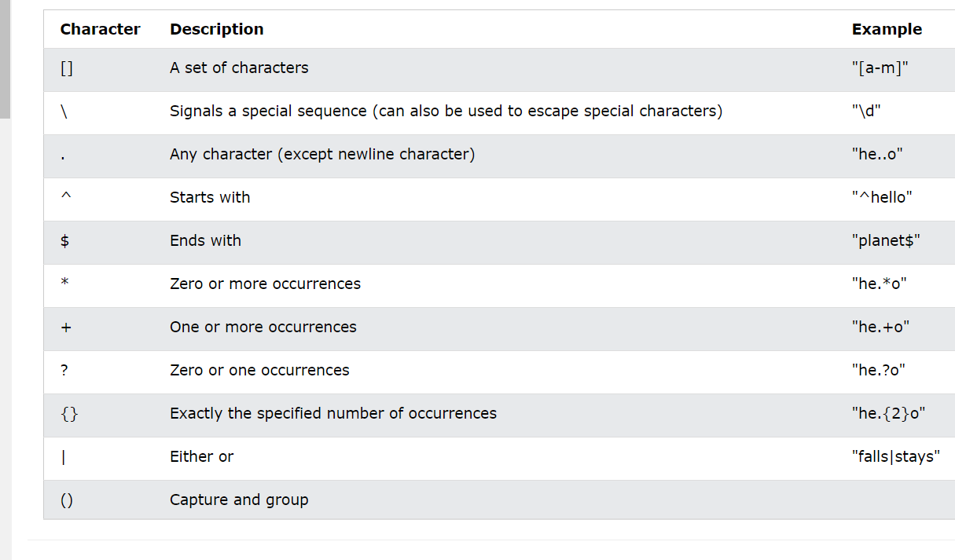
WHAT ARE THE BASICS IN REGEX ?

Slide 13
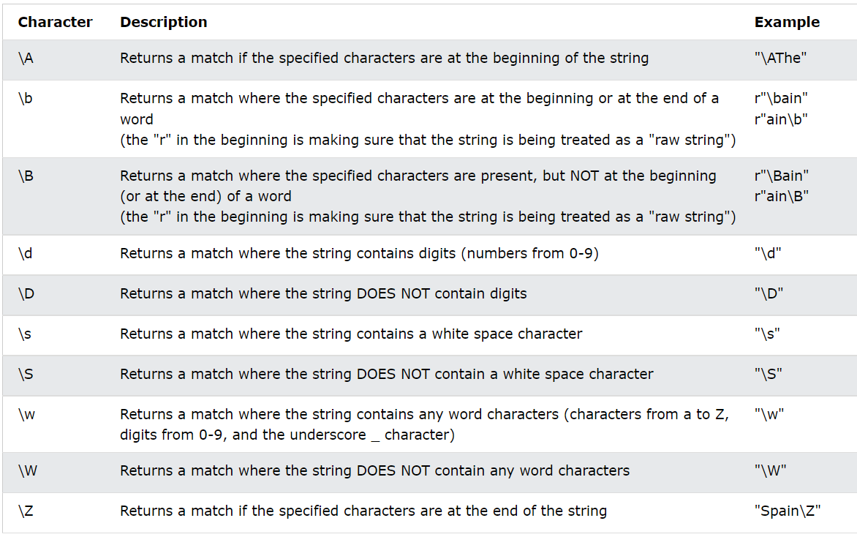
WHAT ARE THE META SEQUENCES IN REGEX ?
Basically, Meta Sequences are a shorthand way to write commonly used character sets in the form of regular expressions. The commonly used meta-sequences are as follows:

Slide 14
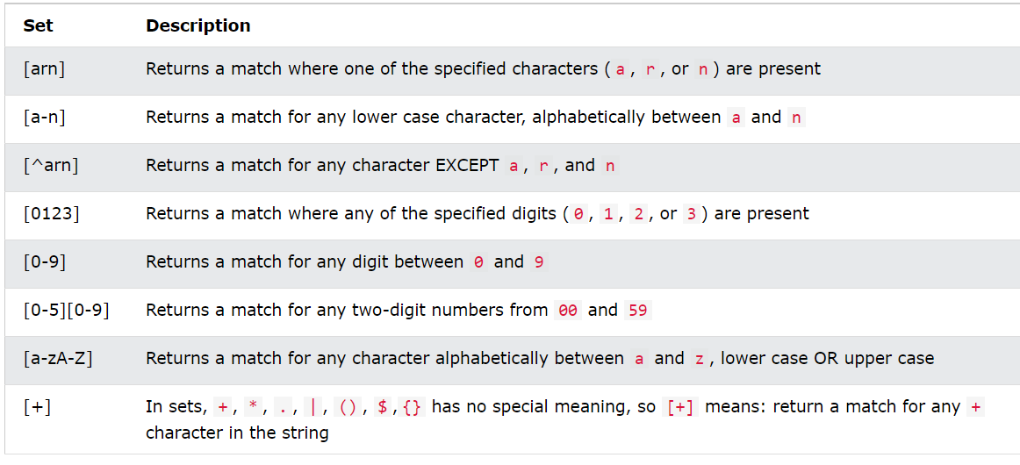
WHAT ARE CHARACTER SETS IN REGEX?
1. Character sets provide a lot more flexibility than just typing a wildcard or the literal characters. These are groups of characters specified inside square brackets.
2. Character sets can be specified with or without the help of a quantifier.
3. When no quantifier succeeds the character set, it matches only one character and the match is successful only if the character in the string is one of the characters present inside the character set.

Slide 15
WHAT IS STEMMING ?
Stemming is a technique used to extract the base form of the words by removing affixes from them.
It is just like cutting down the branches of a tree to its stems. For example, the stem of the words eating, eats, eaten is eat.
Stemming is the process of producing morphological variants of a root/base word.
Stemming programs are commonly referred to as stemming algorithms or stemmers.
A stemming algorithm reduces the words “chocolates”, “chocolatey”, “choco” to the root word, “chocolate” and “retrieval”, “retrieved”, “retrieves” reduce to the stem “retrieve”.
Stemming is an important part of the pipelining process in Natural language processing.
Tokenization involves breaking down the document into different words.

Slide 16
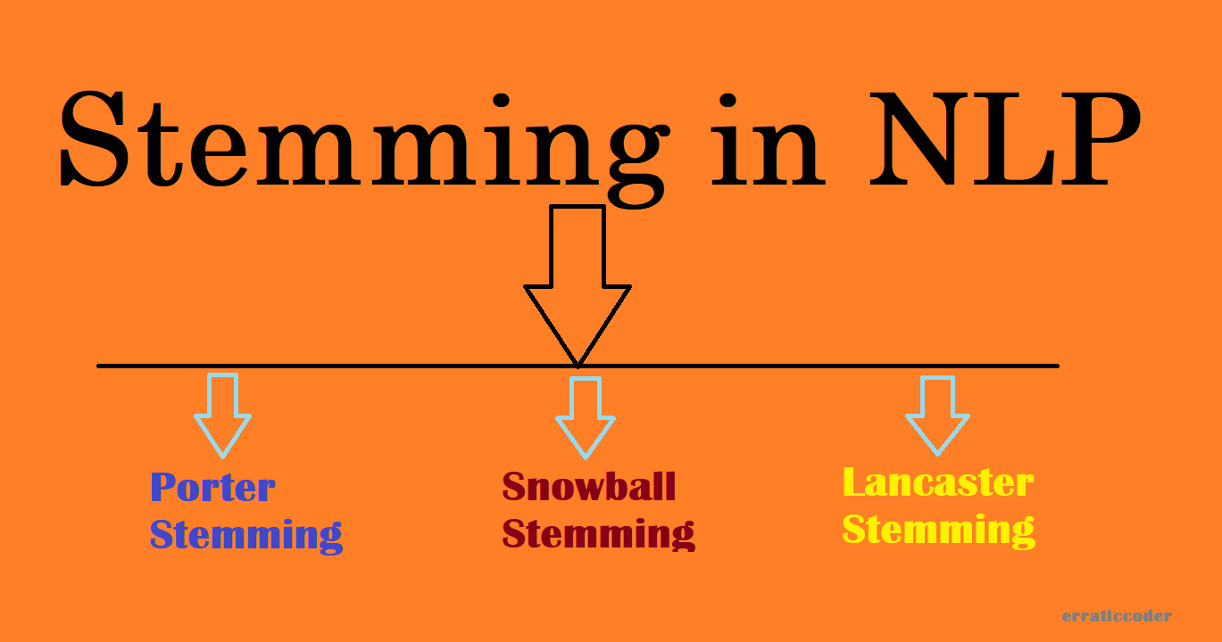
WHAT ARE THE STEMMER IN NLTK LIBRARY?
1. Porter Stemmer – PorterStemmer()
2. Snowball Stemmer – SnowballStemmer()
3. Lancaster Stemmer – LancasterStemmer()

Slide 17
PORTER STEMMER
Martin Porter invented the Porter Stemmer or Porter algorithm in 1980.
Five steps of word reduction are used in the method, each with its own set of mapping rules.
Porter Stemmer is the original stemmer and is renowned for its ease of use and rapidity.
Frequently, the resultant stem is a shorter word with the same root meaning.
PorterStemmer() is a module in NLTK that implements the Porter Stemming technique.

Slide 18
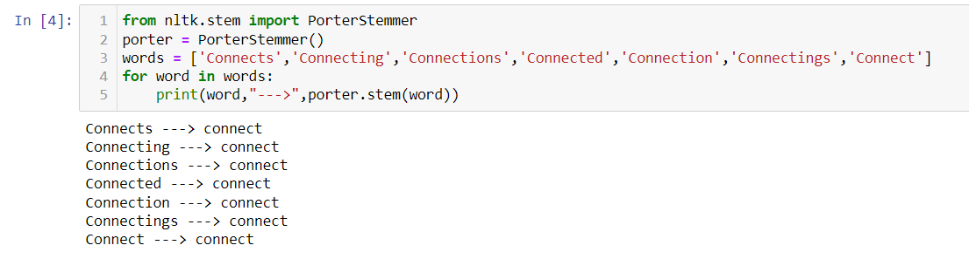
Example of PorterStemmer()

Slide 19
SNOWBALL STEMMER
When compared to the Porter Stemmer, the Snowball Stemmer can map non-English words too. Since it supports other languages the Snowball Stemmers can be called a multi-lingual stemmer.
The Snowball stemmers are also imported from the nltk package.
This stemmer is based on a programming language called ‘Snowball’ that processes small strings and is the most widely used stemmer.
The Snowball stemmer is way more aggressive than Porter Stemmer and is also referred to as Porter2 Stemmer. Because of the improvements added when compared to the Porter Stemmer, the Snowball stemmer is having greater computational speed.
SnowballStemmer() is a module in NLTK that implements the Snowball stemming technique.

Slide 20
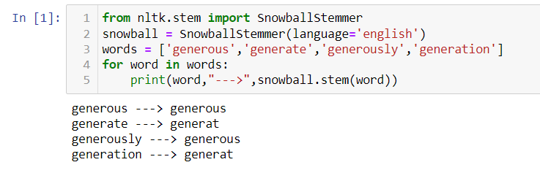
Example of SnowballStemmer()

Slide 21
LANCASTER STEMMER
The Lancaster stemmers are more aggressive and dynamic compared to the other two stemmers.
The stemmer is really faster, but the algorithm is really confusing when dealing with small words.
But they are not as efficient as Snowball Stemmers.
The Lancaster stemmers save the rules externally and basically uses an iterative algorithm.
LancasterStemmer() is a module in NLTK that implements the Lancaster stemming technique.

Slide 22
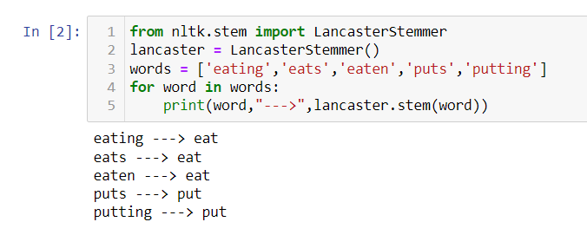
Example of LancasterStemmer()

Slide 23
WHAT IS LEMMATIZATION?
Lemmatization is the process of grouping together the different inflected forms of a word so they can be analyzed as a single item.
Lemmatization is similar to stemming but it brings context to the words. So it links words with similar meanings to one word.
Text preprocessing includes both Stemming as well as Lemmatization.
Many times people find these two terms confusing. Some treat these two as the same.
Actually, lemmatization is preferred over Stemming because lemmatization does morphological analysis of the words.
Examples of lemmatization:
-> rocks : rock
-> corpora : corpus
-> better : good

Slide 24
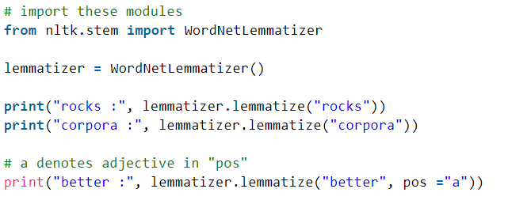
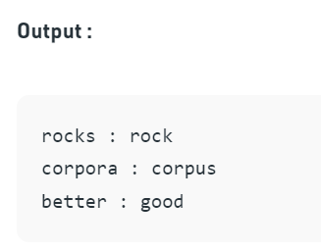
EXAMPLE OF LEMMATIZATION

Slide 25
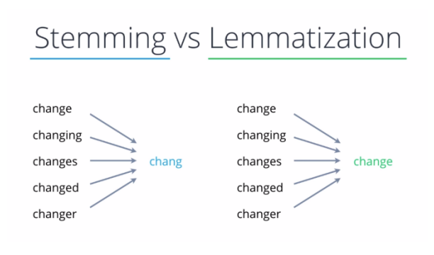
STEMMING VS LEMMATIZATION

Slide 26
WHAT IS WORD CLOUD ?
Word Cloud or Tag Clouds is a visualization technique for texts that are natively used for visualizing the tags or keywords from the websites.
These keywords typically are single words that depict the context of the webpage the word cloud is being made from.
These words are clustered together to form a Word Cloud.
Each word in this cloud has a variable font size and color tone. Thus, this representation helps to determine words of prominence.
A bigger font size of a word portrays its prominence more relative to other words in the cluster.
Word Cloud can be built in varying shapes and sizes based on the creators’ vision.
The number of words plays an important role while creating a Word Cloud.
More number of words does not always mean a better Word Cloud as it becomes cluttery and difficult to read.
A Word Cloud must always be semantically meaningful and must represent what it is meant for.
Although, there are different ways by which Word Clouds can be created but the most widely used type is by using the Frequency of Words in our corpus. And thus, we will be creating our Word Cloud by using the Frequency type.

Slide 27
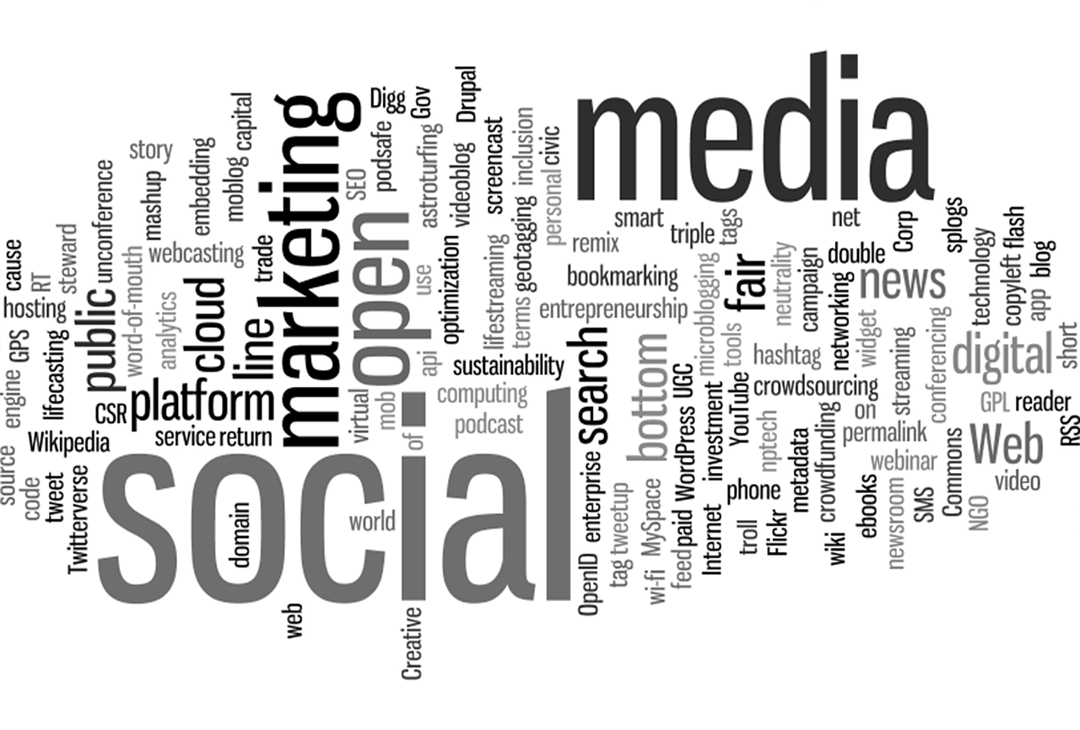
WORD CLOUD

Slide 28
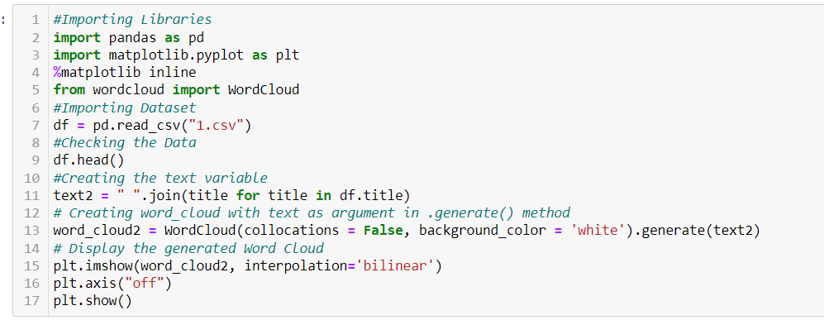
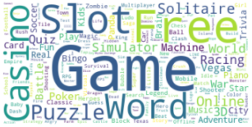
WORD CLOUD

Slide 29
WHAT IS PRINCIPAL COMPONENT ANALYSIS ?
Principal Component Analysis is an unsupervised learning algorithm that is used for the dimensionality reduction in machine learning.
It is a statistical process that converts the observations of correlated features into a set of linearly uncorrelated features with the help of orthogonal transformation.
These new transformed features are called the Principal Components.
It is one of the popular tools that is used for exploratory data analysis and predictive modeling.
It is a technique to draw strong patterns from the given dataset by reducing the variances.
PCA generally tries to find the lower-dimensional surface to project the high-dimensional data.
PCA works by considering the variance of each attribute because the high attribute shows the good split between the classes, and hence it reduces the dimensionality.
Some real-world applications of PCA are image processing, movie recommendation system, optimizing the power allocation in various communication channels.
It is a feature extraction technique, so it contains the important variables and drops the least important variable.

Slide 30
PRINCIPAL COMPONENT ANALYSIS
PCA is mainly used as the dimensionality reduction technique in various AI applications such as computer vision, image compression, etc.
It can also be used for finding hidden patterns if data has high dimensions. Some fields where PCA is used are Finance, data mining, Psychology, etc.
The PCA algorithm is based on some mathematical concepts such as:
Variance and Covariance
Eigenvalues and Eigen factors
Principal Components in PCA
The principal component must be the linear combination of the original features.
These components are orthogonal, i.e., the correlation between a pair of variables is zero.
The importance of each component decreases when going to 1 to n, it means the 1 PC has the most importance, and n PC will have the least importance.

Slide 31
TF-IDF
TF-IDF in NLP stands for Term Frequency – Inverse document frequency.
It is a very popular topic in Natural Language Processing which generally deals with human languages.
During any text processing, cleaning the text (preprocessing) is vital. Further, the cleaned data needs to be converted into a numerical format where each word is represented by a matrix (word vectors). This is also known as word embedding.
Term Frequency (TF) = (Frequency of a term in the document)/(Total number of terms in documents) Inverse Document Frequency(IDF) = log( (total number of documents)/(number of documents with term t)) TF.IDF = (TF).(IDF)

Slide 32
BIGRAMS & TRIGRAMS
Bigrams: Bigram is 2 consecutive words in a sentence. E.g. “The boy is playing football”. The bigrams here are:
The boy
Boy is
Is playing
Playing football
Trigrams: Trigram is 3 consecutive words in a sentence. For the above example trigrams will be:
The boy is
Boy is playing Is
playing football

Slide 33
WHAT IS WEB SCRAPPING ?
Web scraping is an automatic method to obtain large amounts of data from websites.
Most of this data is unstructured data in an HTML format which is then converted into structured data in a spreadsheet or a database so that it can be used in various applications.
There are many different ways to perform web scraping to obtain data from websites. These include using online services, particular API’s or even creating your code for web scraping from scratch.
Many large websites, like Google, Twitter, Facebook, StackOverflow, etc. have API’s that allow you to access their data in a structured format.
This is the best option, but there are other sites that don’t allow users to access large amounts of data in a structured form or they are simply not that technologically advanced. In that situation, it’s best to use Web Scraping to scrape the website for data.
Web scraping requires two parts, namely the crawler and the scraper.
The crawler is an artificial intelligence algorithm that browses the web to search for the particular data required by following the links across the internet.
The scraper, on the other hand, is a specific tool created to extract data from the website. The design of the scraper can vary greatly according to the complexity and scope of the project so that it can quickly and accurately extract the data.

Slide 34
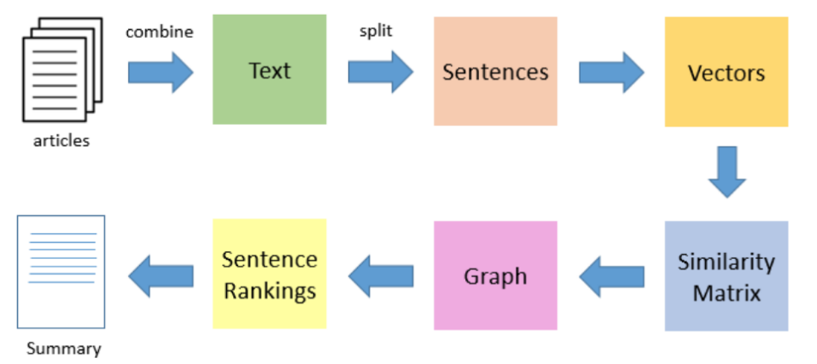
WHAT IS TEXT SUMMARIZATION ?
In this approach we build algorithms or programs which will reduce the text size and create a summary of our text data.
This is called automatic text summarization in machine learning.
Text summarization is the process of creating shorter text without removing the semantic structure of text.

Slide 35
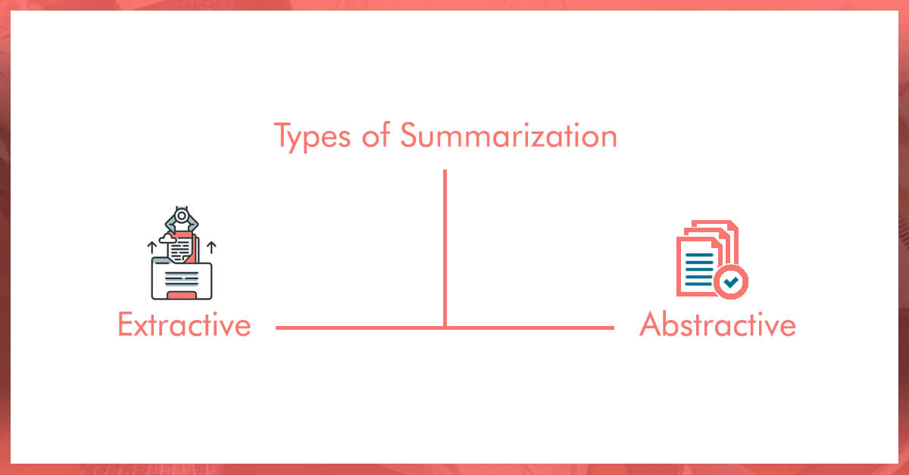
TYPES OF TEXT SUMMARIZATION

Slide 36
EXTRACTIVE APPROCHES
Extractive Approaches:
Using an extractive approach we summarize our text on the basis of simple and traditional algorithms.
For example, when we want to summarize our text on the basis of the frequency method, we store all the important words and frequency of all those words in the dictionary.
On the basis of high frequency words, we store the sentences containing that word in our final summary.
This means the words which are in our summary confirm that they are part of the given text.

Slide 37
ABSTRACTIVE APPROCHES
Abstractive Approaches:
An abstractive approach is more advanced. On the basis of time requirements we exchange some sentences for smaller sentences with the same semantic approaches of our text data.
The approach is to identify the important sections, interpret the context and reproduce in a new way.
This ensures that the core information is conveyed through shortest text possible.
Note that here, the sentences in summary are generated, not just extracted from original text.

Slide 38
WHAT IS LEX RANK ALGORITHM?
LexRank is an unsupervised approach to text summarization based on graph-based centrality scoring of sentences.
The main idea is that sentences "recommend" other similar sentences to the reader.
Thus, if one sentence is very similar to many others, it will likely be a sentence of great importance.
The importance of this sentence also stems from the importance of the sentences "recommending" it.
Thus, to get ranked highly and placed in a summary, a sentence must be similar to many sentences that are in turn also similar to many other sentences.
This makes intuitive sense and allows the algorithms to be applied to any arbitrary new text.

Slide 39
WHAT IS LATENT DIRICHLET ALLOCATION(LDA) TECHNIQUE ?
It is one of the most popular topic modeling methods.
Each document is made up of various words, and each topic also has various words belonging to it.
The aim of LDA is to find topics a document belongs to, based on the words in it.
A tool and technique for Topic Modeling, Latent Dirichlet Allocation (LDA) classifies or categorizes the text into a document and the words per topic, these are modeled based on the Dirichlet distributions and processes.
The LDA makes two key assumptions:
Documents are a mixture of topics, and
Topics are a mixture of tokens (or words)
And, these topics using the probability distribution generate the words.
In statistical language, the documents are known as the probability density (or distribution) of topics and the topics are the probability density (or distribution) of words.

Slide 40
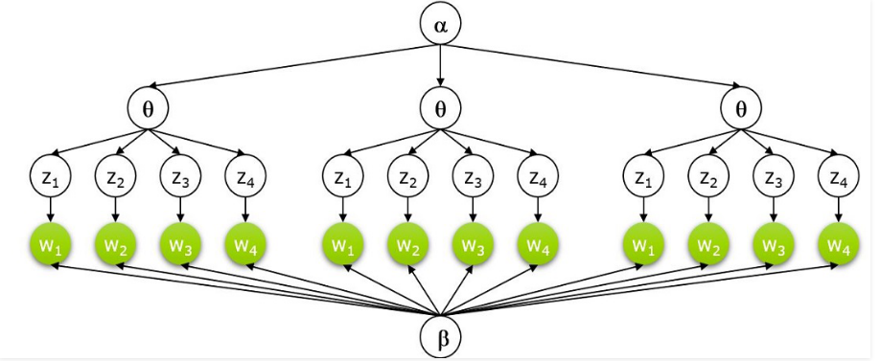
LATENT DIRICHLET ALLOCATION(LDA)
Latent Dirichlet allocation is one of the most popular methods for performing topic modeling.
Each document consists of various words and each topic can be associated with some words.
The aim behind the LDA to find topics that the document belongs to, on the basis of words contains in it.
It assumes that documents with similar topics will use a similar group of words.
This enables the documents to map the probability distribution over latent topics and topics are probability distribution.
Setting up Generative Model:

Slide 41
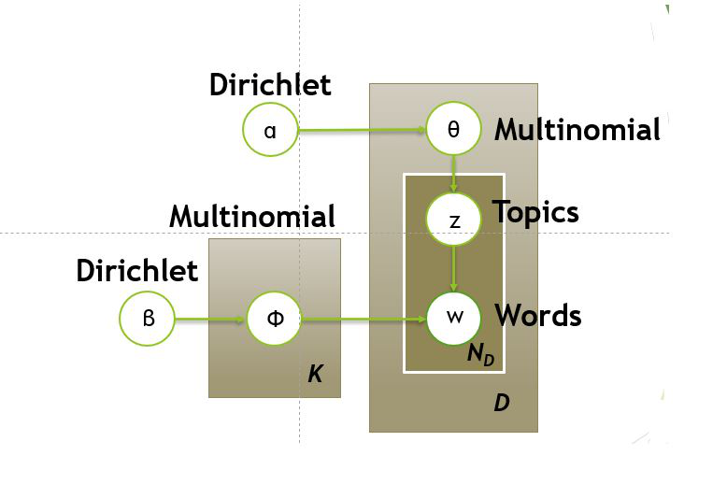
GRAPHIC REPRESENTATION OF LDA

Slide 42
WHAT IS WORD2VEC ARCHITECTURE (SKIP GRAMS VS CBOW) ?
Word2Vec is a shallow, two-layer neural networks which is trained to reconstruct linguistic contexts of words.
It takes as its input a large corpus of words and produces a vector space, typically of several hundred dimensions, with each unique word in the corpus being assigned a corresponding vector in the space.
Word vectors are positioned in the vector space such that words that share common contexts in the corpus are located in close proximity to one another in the space.
Word2Vec is a particularly computationally-efficient predictive model for learning word embeddings from raw text.
It comes in two flavors, the Continuous Bag-of-Words (CBOW) model and the Skip-Gram model.
Algorithmically, these models are similar.

Slide 43
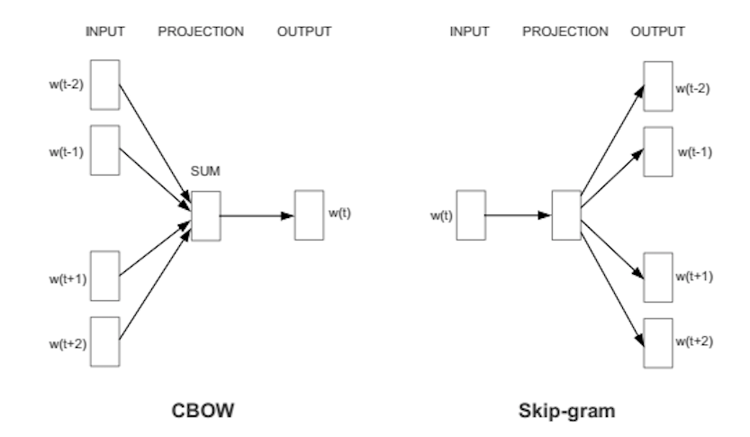
CBOW VS SKIP GRAMS

Slide 44
CBOW & SKIP GRAMS
Continuous Bag-of-Words (CBOW)
CBOW predicts target words (e.g. ‘mat’) from the surrounding context words (‘the cat sits on the’).
Statistically, it has the effect that CBOW smoothes over a lot of the distributional information (by treating an entire context as one observation).
For the most part, this turns out to be a useful thing for smaller datasets.
Skip-Gram
Skip-gram predicts surrounding context words from the target words (inverse of CBOW).
Statistically, skip-gram treats each context-target pair as a new observation, and this tends to do better when we have larger datasets.

Slide 45
WORD2VEC ARCHITECTURE
The architecture is similar to an autoencoder’s one, you take a large input vector, compress it down to a smaller dense vector and then instead of decompressing it back to the original input vector as you do with autoencoders, you output probabilities of target words.
First of all, we cannot feed a word as string into a neural network.
Instead, we feed words as one-hot vectors, which is basically a vector of the same length as the vocabulary, filled with zeros except at the index that represents the word we want to represent, which is assigned “1”.
The hidden layer is a standard fully-connected (Dense) layer whose weights are the word embeddings.
The output layer outputs probabilities for the target words from the vocabulary.

Slide 46
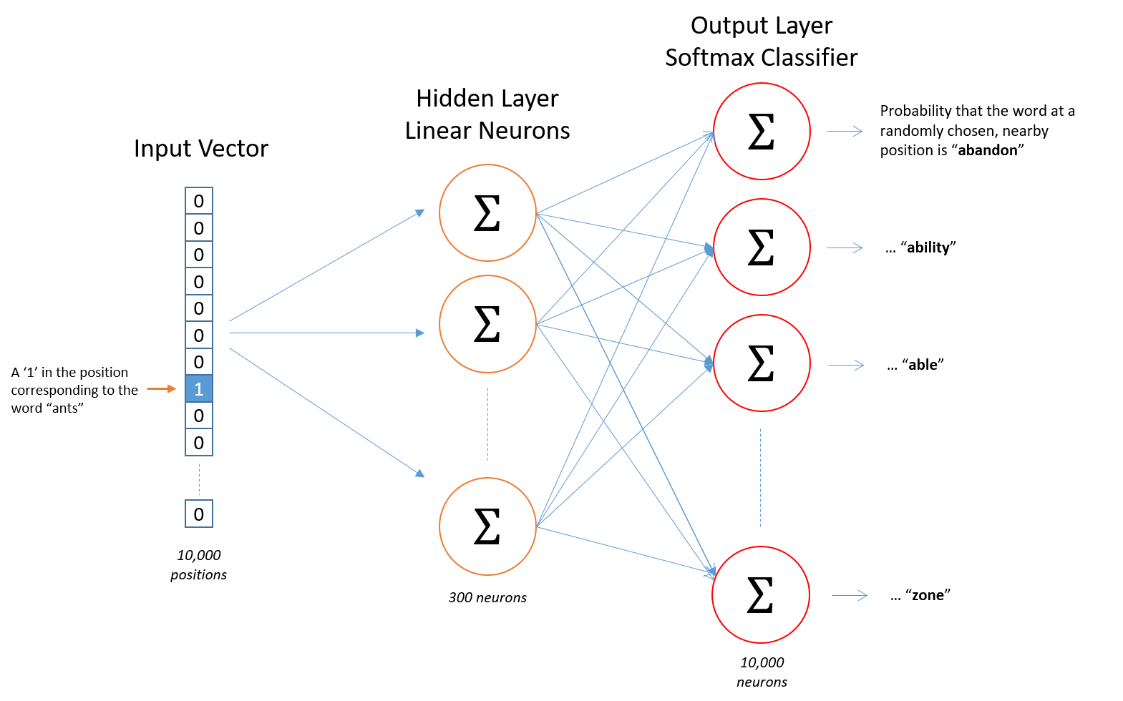
WORD2VEC ARCHITECTURE

Slide 47
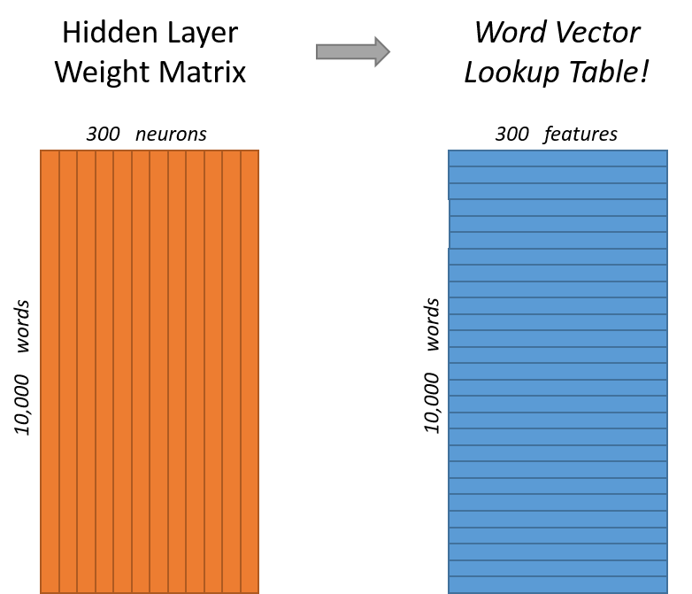
The rows of the hidden layer weight matrix, are actually the word vectors (word embeddings)

Slide 48
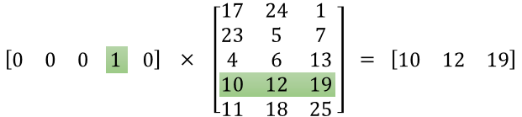
WORD2VEC
The hidden layer operates as a lookup table. The output of the hidden layer is just the “word vector” for the input word. More concretely, if you multiply a 1 x 10,000 one-hot vector by a 10,000 x 300 matrix, it will effectively just select the matrix row corresponding to the ‘1’.

Slide 49
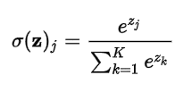
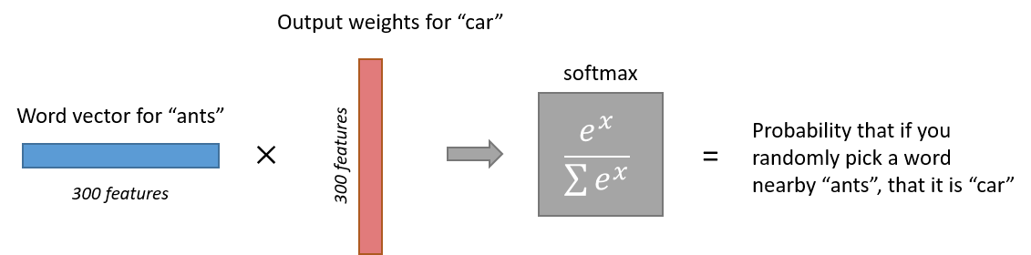
WORD2VEC
The end goal of all of this is to learn this hidden layer weight matrix and then toss the output layer when we’re done!
The output layer is simply a softmax activation function:
Here is a high-level illustration of the architecture:

Slide 50
WHAT IS TEXT CLASSIFICATION ?
Text classification is a machine learning technique that assigns a set of predefined categories to open-ended text.
Text classifiers can be used to organize, structure, and categorize pretty much any kind of text – from documents, medical studies and files, and all over the web.
For example, new articles can be organized by topics; support tickets can be organized by urgency; chat conversations can be organized by language; brand mentions can be organized by sentiment and so on.
Text classification is one of the fundamental tasks in natural language processing with broad applications such as sentiment analysis, topic labeling, spam detection, and intent detection.

Slide 51
TEXT CLASSIFICATION
Text claification is the process of categorizing the text into a group of words.
By using NLP, text classification can automatically analyze text and then assign a set of predefined tags or categories based on its context.
NLP is used for sentiment analysis, topic detection, and language detection. There is mainly three text classification approach-
Rule-based System,
Machine System
Hybrid System.

Slide 52
TEXT CLASSIFICATION USING DOC2VEC
The Doc2Vec approach is an extended version of Word2Vec and this will generate the vector space for each document.
And similar documents will be having vectors close to each other.
In this implementation we will be creating two classes. one for label the documents for training and the other one for the preprocessing.
For Doc2Vec we can use gensim’s model.
Implementation
Three main parts involved for this are as follows:
Loading and preparing the text data
Getting the feature vector using doc2vec model
Training the Classifier

Slide 53


Thank You !!!
(USA)
2-Industrial Park Drive, E-Waldorf, MD, 20602,
United States
(USA)
+1-844-889-4054
(Singapore)
3 Temasek Avenue, Singapore 039190
info@careerera.com www.careerera.com
(INDIA)
B-44, Sector-59, Noida Uttar Pradesh 201301
(INDIA)
+91-92-5000-4000

