Slide 1
A warm welcome to Careerera family

Slide 2
NATURAL LANGUAGE PROCESSING

Slide 3

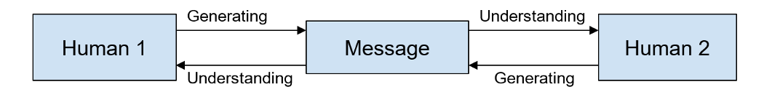
WHAT IS NATURAL LANGUAGE PROCESSING?
Natural language processing (NLP) is a field of artificial intelligence in which computers analyze, understand, process and generates meaning from human language in a smart and intelligent way.
It focuses on the interactions between human language and computers .
NLP is all about making computers understand and generate human language.

Slide 4
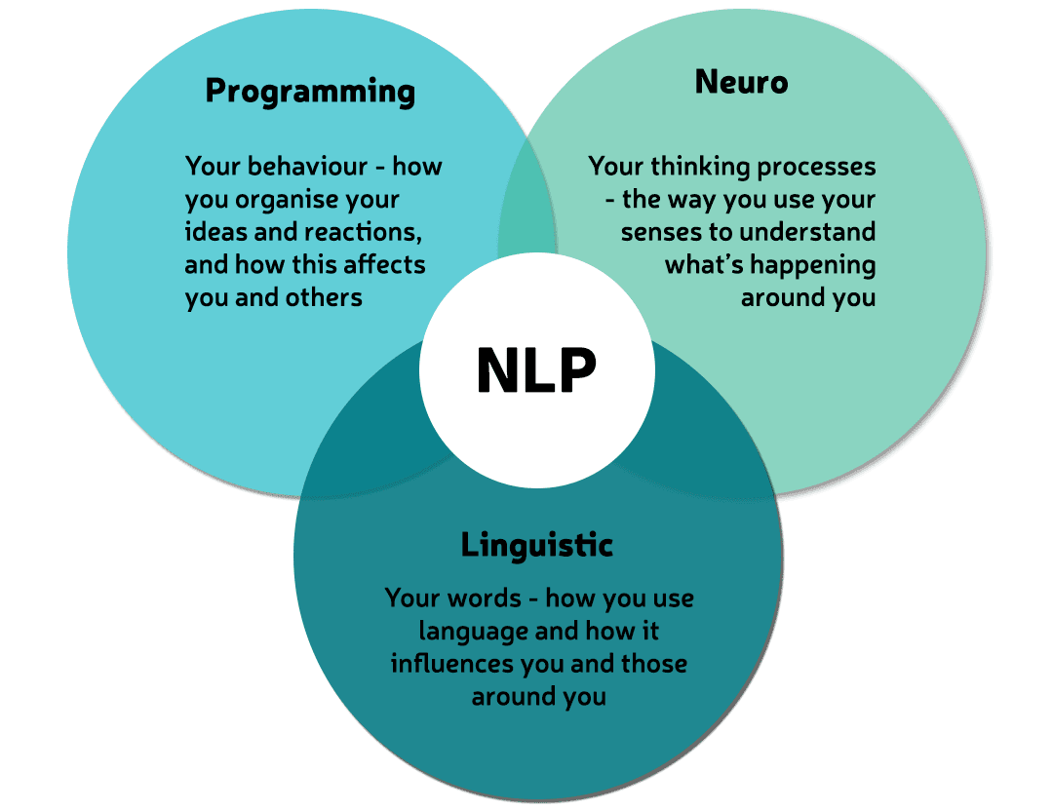
WHAT ARE THE SUBPARTS OF NATURAL LANGUAGE PROCESSING ?

Slide 5
WHAT ARE THE APPLICATIONS OF NATURAL LANGUAGE PROCESSING ?
Search Autocomplete
When we search for something on Google, after typing 2-3 letters, it shows you all the possible search words.
Search Autocorrect
When we search for something with spell mistakes, it corrects them and still finds relevant and correct results.
Search autocomplete and autocorrect both help us in finding accurate results much efficiently.

Slide 6
WHAT ARE THE APPLICATIONS OF NATURAL LANGUAGE PROCESSING ?
Grammar Checkers
This is one of the most widely used applications of natural language processing. These tools can correct grammar, spellings, suggest better synonyms, and help in delivering content with better clarity and engagement.
Chatbots
Interacting with every customer manually, and resolving the problems becomes a tedious task. This is where Chatbots come into the picture, which solves basic queries of a customer.
Some more applications of NLP are Amazon's Alexa ,Apple's Siri, things like machine translation and text-filtering.

Slide 7
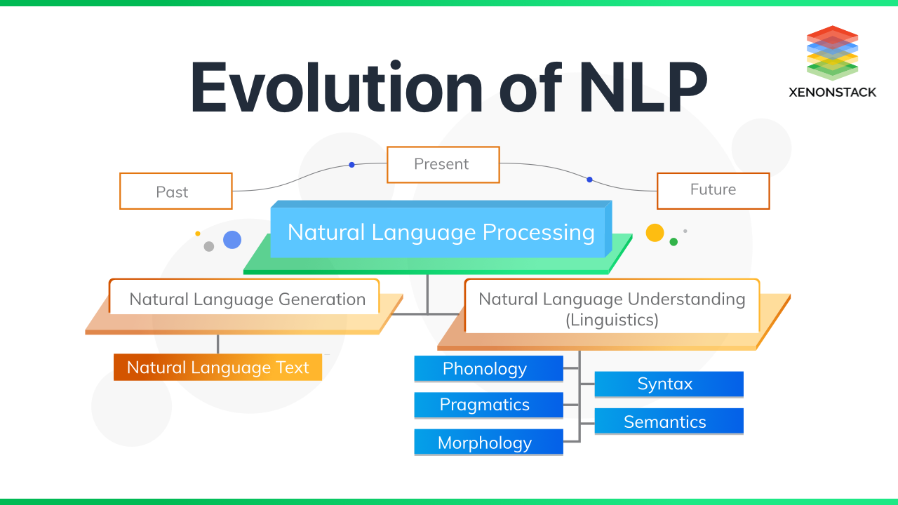

Slide 8
WHAT ARE THE ADVANTAGES OF NATURAL LANGUAGE PROCESSING ?
NLP provide user’s with an advantage of solving their queries related to any subjects within a second.
NLP offers exact answers to their queries, means it does not provide irrelevant information.
NLP helps machine to communicate with humans in their languages.
Most of the companies nowadays make use of NLP to improve the efficiency of documentation processes.

Slide 9
WHAT IS REGEX ?
Regular expressions or RegEx is defined as a sequence of characters that are mainly used to find or replace patterns present in the text.
In simple words, we can say that a regular expression is a set of characters or a pattern that is used to find substrings in a given string.
A regular expression (RE) is a language for specifying text search strings. It helps us to match or extract other strings or sets of strings, with the help of a specialized syntax present in a pattern.
For Example, extracting all hashtags from a tweet, getting email iD or phone numbers, etc from large unstructured text content.

Slide 10
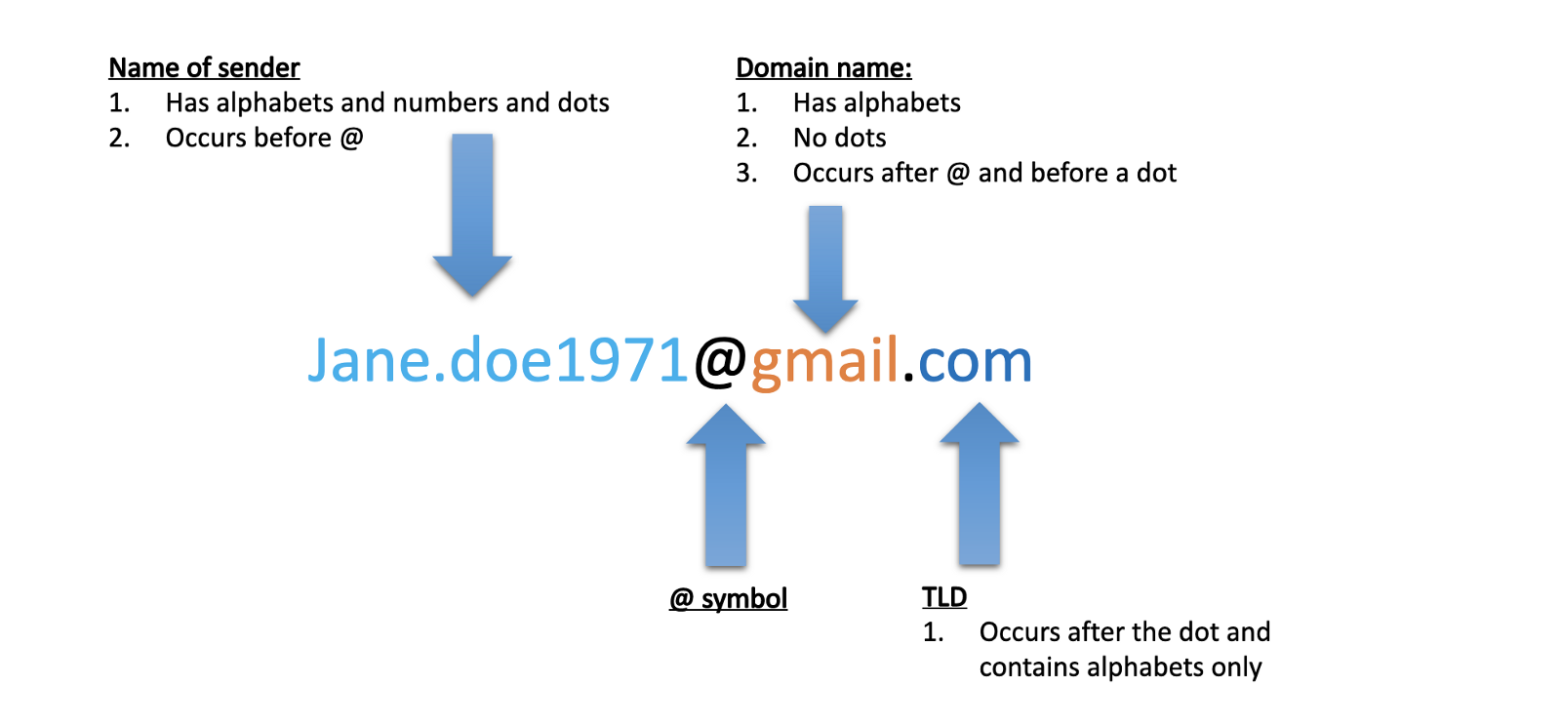
Identify the different components of an email address.

Slide 11
WHAT ARE THE USE CASES OF REGEX?
Regular Expressions (REGEX) are used in various tasks such as,
Data pre-processing,
Rule-based information Mining systems,
Pattern Matching,
Text feature Engineering,
Web scraping,
Data Extraction, etc.

Slide 12
WHAT ARE THE COMMON REGEX FUNCTION IN NLP ?
To work with Regular Expressions, Python has a built-in module known as “re”. Some common functions from this module are as follows:
re.search()
re.match()
re.sub()
re.compile()
re.findall()

Slide 13
WHAT ARE THE REGEX FUNCTIONS ?
1. re. search( )
This function helps us to detect whether the given regular expression pattern is present in the given input string. It matches the first occurrence of a pattern in the entire string and not just at the beginning. It returns a Regex Object if the pattern is found in the string, else it returns a None object.
Syntax: re.search(patterns, string)
2. re.match( )
This function will only match the string if the pattern is present at the very start of the string.
Syntax: re.match(patterns, string)

Slide 14
REGEX FUNCTIONS
3. re.sub( )
This function is used to substitute a substring with another substring.
Syntax: re.sub(patterns, Substitute, Input text)
4. re.compile( )
This function stores the regular expression pattern in the cache memory for faster searches. So, we have to pass the regex pattern to re.compile() function.
Syntax: re.compile(patterns, repl, string)
5. re.findall( )
This function will return all the occurrences of the pattern from the string. I would recommend you to always use re.findall(). It can work like both re.search() and re.match(). Therefore, the result of the findall() function is a list of all the matches
Syntax: re.findall(patterns, string)

Slide 15
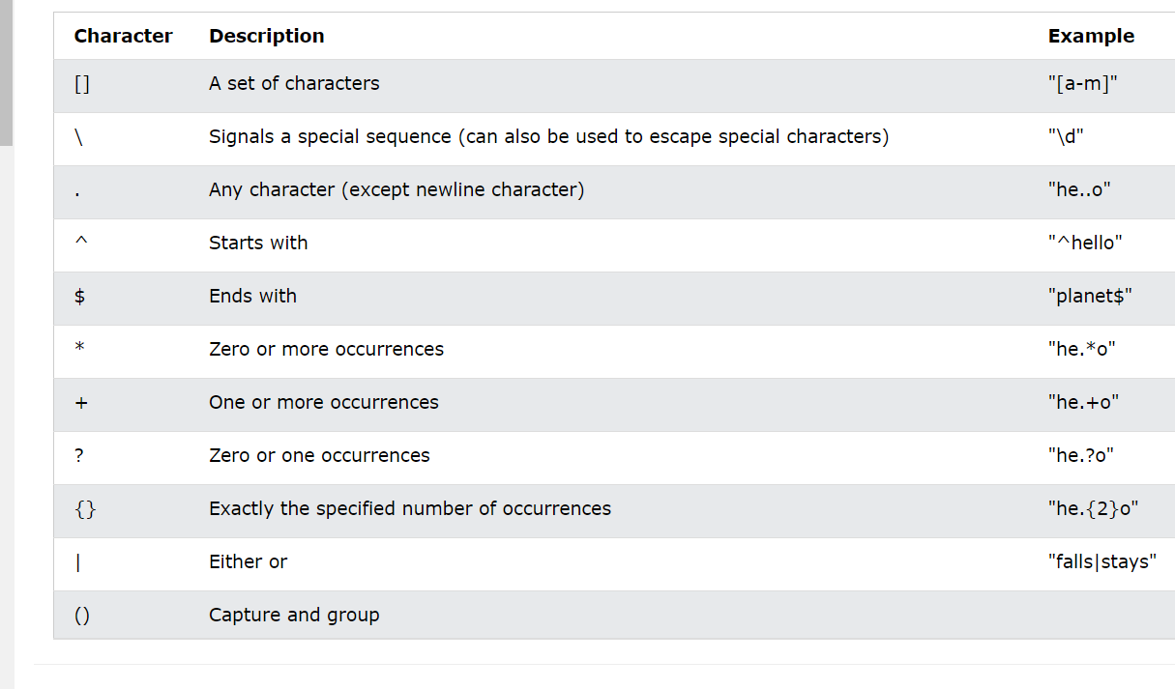
WHAT ARE THE BASICS IN REGEX ?

Slide 16
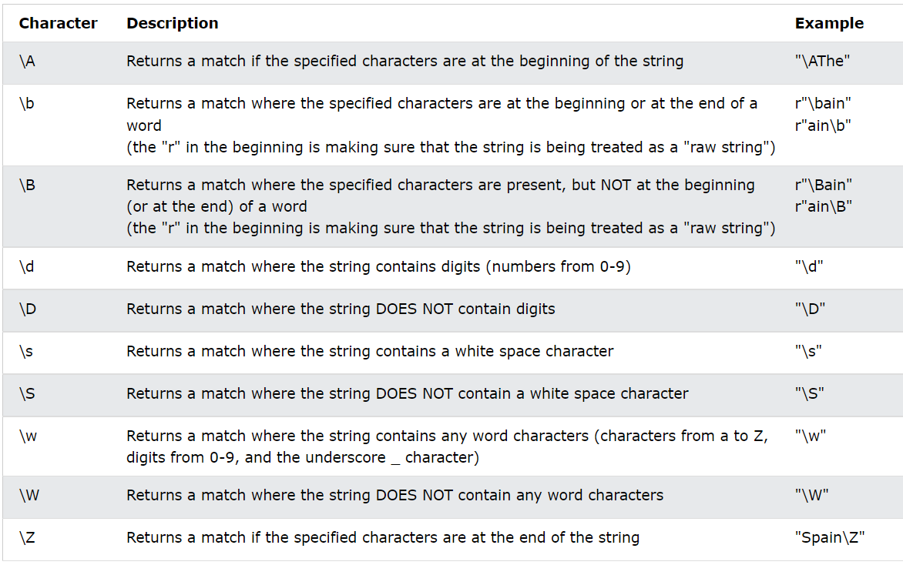
WHAT ARE THE META SEQUENCES IN REGEX ?
Basically, Meta Sequences are a shorthand way to write commonly used character sets in the form of regular expressions. The commonly used meta-sequences are as follows:

Slide 17
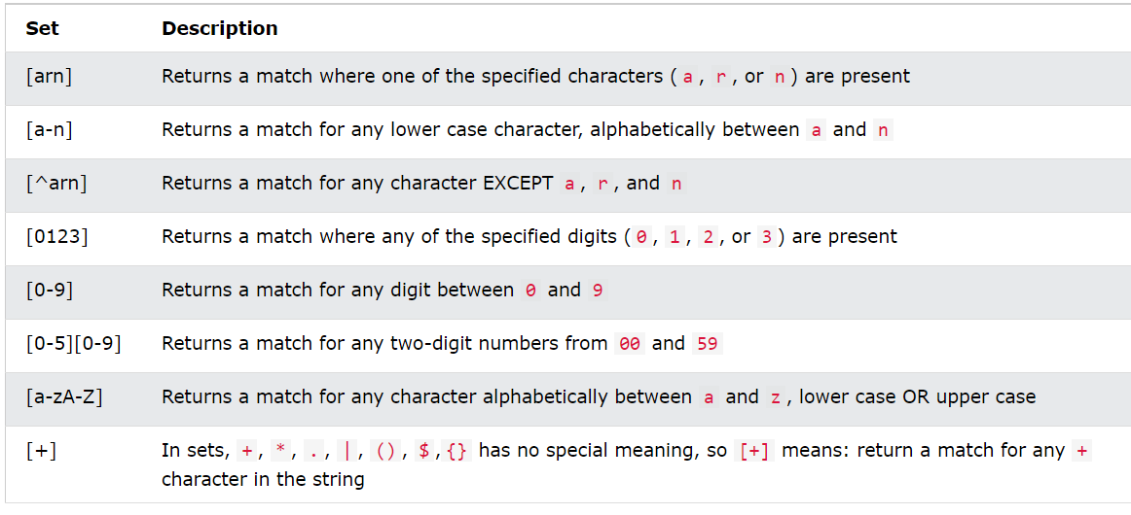
WHAT ARE CHARACTER SETS IN REGEX?
1. Character sets provide a lot more flexibility than just typing a wildcard or the literal characters. These are groups of characters specified inside square brackets.
2. Character sets can be specified with or without the help of a quantifier.
3. When no quantifier succeeds the character set, it matches only one character and the match is successful only if the character in the string is one of the characters present inside the character set.

Slide 18
NATURAL LANGUAGE UNDERSTANDING (NLU)
It is a subfield of natural language processing (NLP), which involves transforming human language into a machine-readable format.
It focuses on a machine’s ability to understand the human language. It refers to how unstructured data is rearranged so that machines may “understand” and analyze it.
Natural language understanding (NLU) uses the power of machine learning to convert speech to text and determine the user’s intent as well.

Slide 19
NATURAL LANGUAGE UNDERSTANDING EXAMPLES
Machine Translation:
It is automated translation by computer software. Users input text in their source language and select their target language. The MT engine then generates the desired translation. Machine translation can be used to translate large volumes of text quickly
Question Answering :
It is a subfield of NLP and speech recognition that uses NLU to help computers automatically understand natural language questions.
The goal of question answering is to give the user response in their natural language so that user can understand.

Slide 20
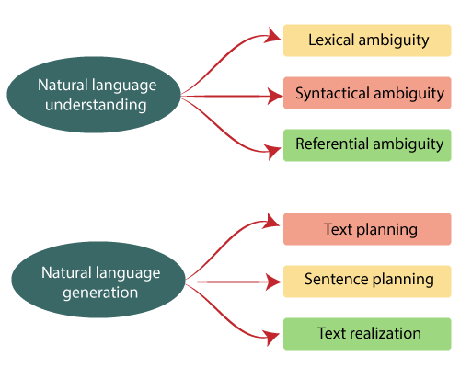
STEPS OF NATURAL LANGUAGE UNDERSTANDING

Slide 21
WHAT ARE THE STEPS OF NATURAL LANGUAGE UNDERSTANDING ?
Lexical ambiguity
Lexical ambiguity arises when there is presence of two or more possible meanings for a single word.
Syntactical ambiguity
Syntactic ambiguity arises whenever a sentence can be understood as having more than one distinct meanings in a sequence of words. . It is also termed as grammatical ambiguity.
Referential ambiguity
Referential ambiguity arises whenever readers or listeners are unable understand whom they are actually referring to out of multiple candidates.

Slide 22
WHAT IS NATURAL LANGUAGE GENERATION (NLG) ?
Natural Language Generation is a branch of Artificial Intelligence (AI) that generates language as an output on the basis of input data.
NLG is one of the fastest growing technologies.
It transforms structured data into natural language.

Slide 23
NATURAL LANGUAGE GENERATION EXAMPLES
Content Creation at Scale
One familiar example of this is Google smart compose, which suggests words as you write sentences .
In 2020, online children’s clothing dealer Baby shop used NLG service to generate its product descriptions.
Testing has prove that NLG Content drives more traffic at a faster rate.

Slide 24
NATURAL LANGUAGE GENERATION EXAMPLES
Conversational AI
Natural language generation is a part of conversational AI application’s like chatbots, voice user interfaces, and smart assistants—and these voice technologies are an essential tool for business.
In 2021, nearly 90 % of marketer’s considered voice assistants as an “important” marketing channel, and almost 30% considered as “extremely” important.

Slide 25
STEPS OF NATURAL LANGUAGE GENERATION

Slide 26
WHAT ARE THE STEPS OF NATURAL LANGUAGE GENERATION ?
Text planning
Here we retrieve the relevant content from a knowledge base.
Sentence planning
We have to choose the required words for setting a tone of the sentence.
Text Realization
Basically, it’s process of mapping sentence plan into sentence structure.

Slide 27
WHAT ARE THE FEATURE ENGINEERING STRATEGIES ?
Before we talk about feature engineering, we need to do some data pre-processing or wrangling to remove unnecessary characters, symbols and tokens.
Text pre-processing
It is a method to clean the text data and make it ready to feed data to the model as well helps in building a Machine Learning model and depending on how well the data has been preprocessed; the results are seen.

Slide 28
WHAT ARE THE STEPS TO PRE-PROCESSED DATA ?
There can be multiple ways of cleaning and pre-processing textual data such as
Removing tags.
Expanding contractions.
Stemming and lemmatization.
Tokenization.
Text lower casing.

Slide 29
STEPS TO PRE-PROCESSED DATA
Removing tags
Removal of HTML tags from your dataset.
Expanding contractions
To shortened words or syllables such as do not to don’t and I would to I’d.
Stemming
Stemming is removing the suffix from a word and reduce it to its root word.

Slide 30
STEPS TO PRE-PROCESSED DATA
For example: “Crying” is a word and its suffix is “ing”, if we remove “ing” from “ Crying” then we will get base word i.e., “Cry”. We uses these suffix to create a new word from original stem word.
Lemmatization
Lemmatization considers the context and converts the word to its meaningful base form.
Tokenization
Tokenization is the process of breaking down the given text into a smallest unit called tokens.
Text lower casing
Converting a word to lower case such as NLP to nlp.

Slide 31
NLU vs NLG
NLU | NLG
NLU is the process of reading and interpreting language. | NLG is the process of writing or generating language.
It produces non-linguistic outputs from natural language inputs. | It produces constructing natural language outputs from non-linguistic inputs.

Slide 32
WHAT ARE THE NATURAL LANGUAGE PROCESSING LIBRARIES ?
Scikit-learn
It is the most widely used libraries as it provides a wide range of algorithms for building machine learning models. It has an excellent documentation that helps data scientists in making their task more easier.
Natural language Toolkit (NLTK)
NLTK is a complete toolkit for all NLP techniques.
SpaCy
SpaCy is an open-source NLP library which is used for Data Extraction, Data Analysis, Sentiment Analysis, and Text Summarization. It is way faster than other libraries

Slide 33
NATURAL LANGUAGE PROCESSING LIBRARIES
Gensim
Gensim works with large datasets and processes data streams. The main uses of Gensim include Data Analysis, Text generation applications (chatbots) and Semantic search applications.
TextBlob
It provides an easy interface to help beginners and has all the basic NLP functionalities such as sentiment analysis, phrase extraction, parsing and many more. TextBlob is an open-source Natural Language Processing library.

Slide 34
NATURAL LANGUAGE PROCESSING WITH MACHINE LEARNING
Machine learning (ML) for natural language processing (NLP) and text analytics involves using machine learning algorithms and “narrow” artificial intelligence (AI) to understand the meaning of text documents.
Machine learning for NLP and text analytics involves a set of statistical techniques for identifying Parts of speech, entities, sentiment and other aspects of text.

Slide 35
WHAT IS THE ROLE OF MACHINE LEARNING IN NATURAL LANGUAGE PROCESSING ?
Machine Learning and Natural Language Processing are important subfields of Artificial Intelligence.
Machine Learning gives the system the ability to learn from past experiences and examples. Algorithms perform a fixed set of executions according to what it has been programmed to do so and they do not have the ability to solve unknown problems.
A machine learning algorithm is far better equipped to handle such unknown problems.

Slide 36
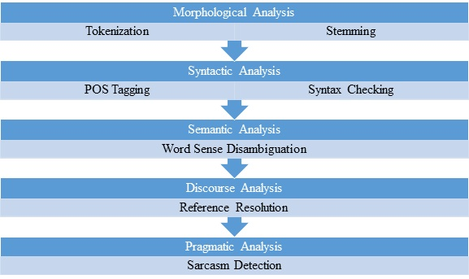
STEPS OF NATURAL LANGUAGE PROCESSING

Slide 37
STEPS OF NATURAL LANGUAGE PROCESSING
Morphological analysis
Morphology is the study of words and their structure. Morphemes, like prefixes, suffixes and base words, are defined as the smallest meaningful units of meaning.
Syntactic analysis
Syntactic analysis is the process of analyzing natural language that checks whether the given sentence follows rules of a formal grammar.
Semantic analysis
The most important task of semantic analysis is to get the exact meaning of the sentence and to analyze the text for meaningfulness.

Slide 38
STEPS OF NATURAL LANGUAGE PROCESSING
Discourse Analysis
Discourse analysis may be defined as the process of performing text , determining contextual information or language analysis, which involves text interpretation and knowing the social interactions.
Pragmatic Analysis
It is part of the process of extracting information from text. Specifically, it's the portion that focuses on taking structures set of text and figuring out what the actual meaning was.

Slide 39
WHAT IS LEXICAL PROCESSING ?
Lexical analysis is the process of trying to understand what words mean, intuit their context, and note the relationship of one word to others.
It is often the entry point to many NLP data pipelines.
Lexical analysis can come in many forms and varieties.
It is used as the first step of a compiler, for example, and takes a source code file and breaks down the lines of code to a series of "tokens", removing any whitespace or comments.
In other types of analysis, lexical analysis might preserve multiple words together as an "n-gram" (or a sequence of items).

Slide 40
WHAT IS SPEECH RECOGNITION?
Speech recognition, also known as automatic speech recognition (ASR), computer speech recognition, or speech-to-text, is a capability which enables a program to process human speech into a written format.
While it’s commonly confused with voice recognition, speech recognition focuses on the translation of speech from a verbal format to a text one whereas voice recognition just seeks to identify an individual user’s voice.

Slide 41
WHAT ARE THE KEY FEATURES OF EFFECTIVE SPEECH RECOGNITION?
Many speech recognition applications and devices are available, but the more advanced solutions use AI and machine learning. They integrate grammar, syntax, structure, and composition of audio and voice signals to understand and process human speech. Ideally, they learn as they go — evolving responses with each interaction.
The best kind of systems also allow organizations to customize and adapt the technology to their specific requirements — everything from language and nuances of speech to brand recognition. For example:
Language weighting: Improve precision by weighting specific words that are spoken frequently (such as product names or industry jargon), beyond terms already in the base vocabulary.
Speaker labeling: Output a transcription that cites or tags each speaker’s contributions to a multi-participant conversation.
Acoustics training: Attend to the acoustical side of the business. Train the system to adapt to an acoustic environment (like the ambient noise in a call center) and speaker styles (like voice pitch, volume and pace).
Profanity filtering: Use filters to identify certain words or phrases and sanitize speech output.

Slide 42
HOW SPEECH RECOGNITION WORKS ?
Speech recognition systems use computer algorithms to process and interpret spoken words and convert them into text.
A software program turns the sound a microphone records into written language that computers and humans can understand, following these four steps:
analyze the audio;
break it into parts;
digitize it into a computer-readable format; and
use an algorithm to match it to the most suitable text representation.

Slide 43
SPEECH RECOGNITION
Speech recognition software must adapt to the highly variable and context-specific nature of human speech. The software algorithms that process and organize audio into text are trained on different speech patterns, speaking styles, languages, dialects, accents and phrasings. The software also separates spoken audio from background noise that often accompanies the signal.
To meet these requirements, speech recognition systems use two types of models:
Acoustic models. These represent the relationship between linguistic units of speech and audio signals.
Language models. Here, sounds are matched with word sequences to distinguish between words that sound similar.

Slide 44
WHAT APPLICATION IS SPEECH RECOGNITION USED FOR ?
Speech recognition systems have quite a few applications.
Mobile Devices
Education
Customer service
Healthcare application
Disability assistance
Court reporting
Emotion recognition
Hands free communication

Slide 45
APPLICATIONS OF SPEECH RECOGNITION
Mobile devices:- Smartphones use voice commands for call routing, speech-to-text processing, voice dialing and voice search.
Users can respond to a text without looking at their devices.
On Apple iPhones, speech recognition powers the keyboard and Siri, the virtual assistant.
Functionality is available in secondary languages, too.
Speech recognition can also be found in word processing applications like Microsoft Word, where users can dictate words to be turned into text.
Education. Speech recognition software is used in language instruction. The software hears the user's speech and offers help with pronunciation.
Customer service. Automated voice assistants listen to customer queries and provides helpful resources.
Healthcare applications. Doctors can use speech recognition software to transcribe notes in real time into healthcare records.

Slide 46
APPLICATIONS OF SPEECH RECOGNITION
Disability assistance. Speech recognition software can translate spoken words into text using closed captions to enable a person with hearing loss to understand what others are saying. Speech recognition can also enable those with limited use of their hands to work with computers, using voice commands instead of typing.
Court reporting. Software can be used to transcribe courtroom proceedings, precluding the need for human transcribers . Emotion recognition. This technology can analyze certain vocal characteristics to determine what emotion the speaker is feeling. Paired with sentiment analysis, this can reveal how someone feels about a product or service.
Hands-free communication. Drivers use voice control for hands-free communication, controlling phones, radios and global positioning systems, for instance.

Slide 47
WHAT ARE THE DIFFERENT SPEECH RECOGNITION ALGORITHMS?
The power behind speech recognition features comes from a set of algorithms and technologies. They include the following:
Hidden Markov model. HMMs are used in autonomous systems where a state is partially observable or when all of the information necessary to make a decision is not immediately available to the sensor (in speech recognition's case, a microphone). An example of this is in acoustic modeling, where a program must match linguistic units to audio signals using statistical probability.
Natural language processing. NLP eases and accelerates the speech recognition process.
N-grams. This simple approach to language models creates a probability distribution for a sequence. An example would be an algorithm that looks at the last few words spoken, approximates the history of the sample of speech and uses that to determine the probability of the next word or phrase that will be spoken.
Artificial intelligence. AI and machine learning methods like deep learning and neural networks are common in advanced speech recognition software. These systems use grammar, structure, syntax and composition of audio and voice signals to process speech. Machine learning systems gain knowledge with each use, making them well suited for nuances like accents.

Slide 48
WHAT IS SIGNAL PROCESSING ?
Signal processing is a discipline of applied mathematics, using the tools of information theory, probability and statistics, vector spaces, harmonic analysis, optimization, and machine learning.
AUDIO SIGNAL:- When an object vibrates, the air molecules oscillate to and fro from their rest position and transmits its energy to neighboring molecules. This results in the transmission of energy from one molecule to another which in turn produces a sound wave.

Slide 49
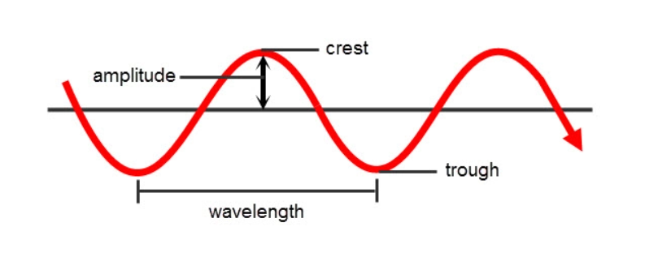
PARAMETER OF AUDIO SIGNAL
Amplitude: Amplitude refers to the maximum displacement of the air molecules from the rest position
Crest and Trough: The crest is the highest point in the wave whereas trough is the lowest point
Wavelength: The distance between 2 successive crests or troughs is known as a wavelength
Cycle: Every audio signal traverses in the form of cycles. One complete upward movement and downward movement of the signal form a cycle
Frequency: Frequency refers to how fast a signal is changing over a period of time

Slide 50
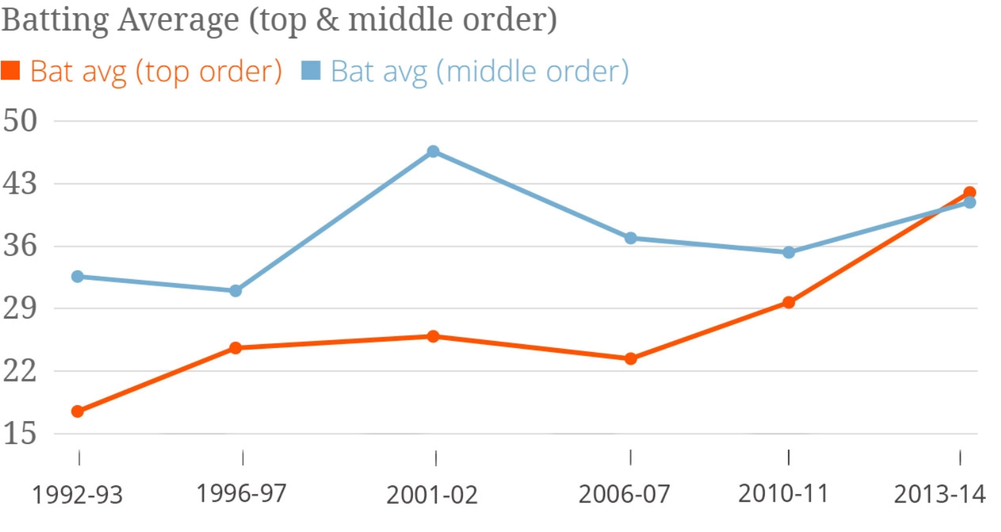
TYPES OF SIGNAL
1. Digital Signal :- A digital signal is a discrete representation of a signal over a period of time. Here, the finite number of samples exists between any two-time intervals.
For example, the batting average of top and middle-order batsmen year-wise forms a digital signal since it results in a finite number of samples.

Slide 51
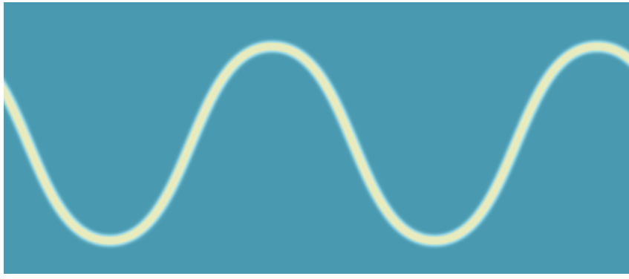
TYPES OF SIGNAL
2. Analog signal
An analog signal is a continuous representation of a signal over a period of time. In an analog signal, an infinite number of samples exist between any two-time intervals.
For example, an audio signal is an analog one since it is a continuous representation of the signal.

Slide 52
WHAT ARE THE SPEECH RECOGNITION MODELS ?
Speech recognition systems use two types of models:
Acoustic models. These represent the relationship between linguistic units of speech and audio signals.
Language models. Here, sounds are matched with word sequences to distinguish between words that sound similar.

Slide 53
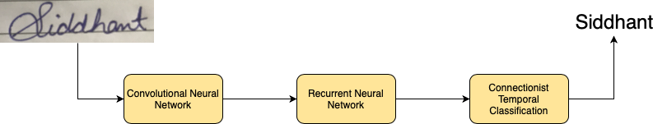
WHAT ARE THE TYPES OF SPEECH RECOGNITION MODEL ?
1. Connectionist Temporal Classification
2. Listen, Attend, Spell
3. Convolutional Architectures
Connectionist Temporal Classification:- Connectionist Temporal Classification (CTC) is a type of Neural Network output helpful in tackling sequence problems like handwriting and speech recognition where the timing varies. Using CTC ensures that one does not need an aligned dataset, which makes the training process more straightforward.

Slide 54
Listen, Attend, Spell
Listen, Attend, Spell:- The Listen, Attend and Spell (LAS) model and other attention-based automatic speech recognition (ASR) models have known limitations when operated in a fully online mode.
Listen, Attend and Spell (LAS), a neural network that learns to transcribe speech utterances to characters.
Unlike traditional DNN-HMM models, this model learns all the components of a speech recognizer jointly.
Our system has two components: a listener and a speller.
The listener is a pyramidal recurrent network encoder that accepts filter bank spectra as inputs.
The speller is an attention-based recurrent network decoder that emits characters as outputs.
The network produces character sequences without making any independence assumptions between the characters.
This is the key improvement of LAS over previous end-to-end CTC models.
On a subset of the Google voice search task, LAS achieves a word error rate (WER) of 14.1% without a dictionary or a language model, and 10.3% with language model rescoring over the top 32 beams.
By comparison, the state-of-the-art CLDNN-HMM model achieves a WER of 8.0%.

Slide 55
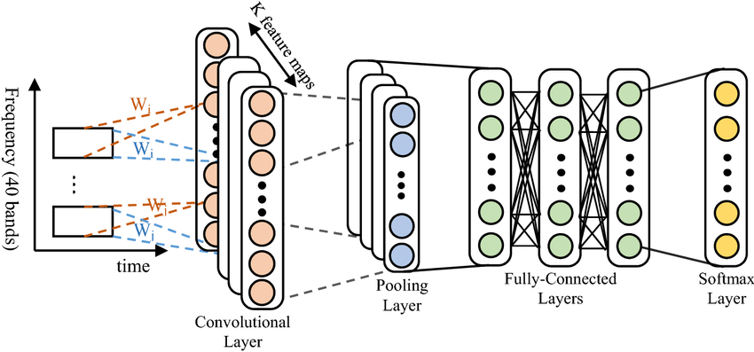
Convolutional Architectures

Slide 56
CONVOLUTIONAL NEURAL NETWORK
Convolutional Neural Network (CNN) is applied as advanced deep neural networks to classify each word from our pooled data set as a multi-class classification task.
The proposed deep neural network returned 97.06% as word classification accuracy with a completely unknown speech sample.
CNN is used to train and test our data.
CNNs are a type of deep learning algorithm that are used to process data with a grid-like topology.
CNNs are a type of deep learning algorithm that is used to process data that has a spatial or temporal relationship.
CNNs are similar to other neural networks, but they have an added layer of complexity due to the fact that they use a series of convolutional layers.
Convolutional layers are an essential component of Convolutional Neural Networks (CNNs).

Slide 57
SPEECH TO TEXT
Speech-to-Text has three main methods to perform speech recognition. These are listed below:
Synchronous Recognition (REST and gRPC) sends audio data to the Speech-to-Text API, performs recognition on that data, and returns results after all audio has been processed. Synchronous recognition requests are limited to audio data of 1 minute or less in duration.
Asynchronous Recognition (REST and gRPC) sends audio data to the Speech-to-Text API and initiates a Long Running Operation. Using this operation, you can periodically poll for recognition results. Use asynchronous requests for audio data of any duration up to 480 minutes.
Streaming Recognition (gRPC only) performs recognition on audio data provided within a gRPC bi-directional stream. Streaming requests are designed for real-time recognition purposes, such as capturing live audio from a microphone. Streaming recognition provides interim results while audio is being captured, allowing result to appear, for example, while a user is still speaking.

Slide 58
TEXT TO SPEECH
TTS(Text to Speech) interface that allows the computer to read a text like a human. this is also called read-aloud technology.
In the real world, we can see numerous applications of the TTS system. this is widely used to make smart devices that can interact with humans.
There are some major applications of the TTS system:
Devices for blind people who can’t see but can listen. A device that can read text using OCR (Optical Character Recognition) and using text to speech it can read aloud.
Smart Devices and Voice Assistants
Text to Speech comes very useful for physically disabled people, i.e it can be used in mobile phones, computers to guide blind people.
There could be multiple ways to perform Text2Speech but the easiest and most efficient way is to use Google’s API using the gTTS library

Slide 59
VOICE ASSISTANT DEVICE
Voice assistants are the great innovation in the field of AI that can change the way of living of the people in a different manner.
The voice assistant was first introduced on smartphones and after the popularity it got.
It was widely accepted by all. Initially, the voice assistant was mostly being used in smartphones and laptops but now it is also coming as home automation and smart speakers.
Many devices are becoming smarter in their own way to interact with human in an easy language.
The Desktop based voice assistant are the programs that can recognize human voices and can respond via integrated voice system.
This paper will define the working of a voice assistants, their main problems and limitations.
In this paper it is described that the method of creating a voice assistant without using cloud services, which will allow the expansion of such devices in the future.

Slide 60


Thank You !!!
(USA)
2-Industrial Park Drive, E-Waldorf, MD, 20602,
United States
(USA)
+1-844-889-4054
(Singapore)
3 Temasek Avenue, Singapore 039190
info@careerera.com www.careerera.com
(INDIA)
B-44, Sector-59, Noida Uttar Pradesh 201301
(INDIA)
+91-92-5000-4000

