Slide 1
A warm welcome to Careerera family

Slide 2
TIME SERIES FORECASTING

Slide 3



Slide 4
CONTENT OF :- TIME SERIES FORECASTING.
Regression vs Time Series
Examples of Time Series Data
Trend, Seasonality, Noise and Stationarity.
Time Series Operations.
Detrending
Successive Differences
Moving Average and Smoothing
Exponentially weighted forecasting model
Lagging
Correlation and Auto-correlation
Holt Winters Methods
Single Exponential smoothing
Holt’s linear trend method
Holt’s Winter seasonal method
ARIMA and SARIMA
What is Time Series ?
Notes:
Careerera is one of the leading providers of Higher Education Professional Certification Training, Test Preparation, K -12 Education, Language Training, and other skill training for Adults and kids in the field of IT, Management, Software Development, Project Management, Quality Assurance and many more.
NEET, JEE Mains, AIEEE and more

Slide 5
WHAT IS TIME SERIES FORECASTING

Slide 6
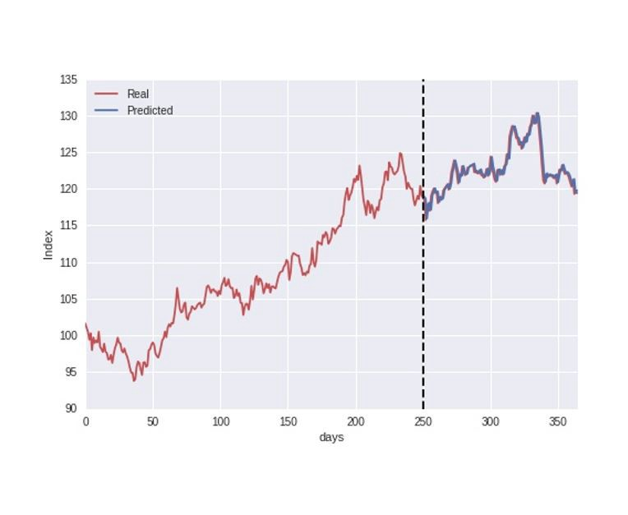
WHAT IS TIME SERIES FORECASTING ?
Time series forecasting is a techniques for the prediction of events through a sequence of time.
The techniques predict future events by analyzing the trends of the past, on the assumption that future trends will hold similar to historical trends.
“The purpose of time series analysis is generally twofold: to understand or model the stochastic mechanisms that gives rise to an observed series and to predict or forecast the future values of a series based on the history of that series.”

Slide 7
WHAT ARE THE APPLICATION IN WHICH TIME SERIES FORECASTING IS PERFORMED?
Weather Forecasting
Climate Forecasting
Economic Forecasting
Health care Forecasting
Engineering Forecasting
Finance Forecasting
Business Forecasting
Environmental studies Forecasting
Social Studies Forecasting
Earthquake Forecasting

Slide 8
WHAT ARE THE APPLICATION IN WHICH TIME SERIES FORECASTING IS PERFORMED?
Time series forecasting is something just the analysis if experts studying a filled offering their predictions.
In many modern applications, however, time series forecasting uses computer technologies, including:
Machine learning
Artificial Neural Networks
Support Vector machines
Fuzzy logic
Gaussian processes
Hidden markov models

Slide 9
WHAT IS TIME SERIES ANALYSIS ?
Time series analysis is a specific way of analyzing a sequence of data points collected over an interval of time.
In time series analysis, analysts record data points at consistent intervals over a set period of time rather than just recording the data points intermittently or randomly.
Time series analysis is a statistical technique that deals with time series data, or trend analysis.
Time series data means that data is in a series of particular time periods or intervals.

Slide 10
WHEN WE SHOULD USE TIME SERIES ANALYSIS FORECASTING ?
Time series forecasting occurs when your predictions based on historical time stamped data.
It involves building models through historical analysis and using the to make observations and drive future strategic decision-making.
Examples of time series are the number of units sold or the closing value of Nasdaq.
The demand of one of your products and the exchange rate of the British Pound Sterling vs the American Dollar are two more examples of time series.

Slide 11
REGRESSION VS TIME SERIES

Slide 12
REGRESSION VS TIME SERIES
Time series as an extension. Time series uses terms such as autocorrelation and moving average to summarize historical information of the y variable with the hope the these features better predict future y.
In time series forecasting , prediction is the primary goal.
Regression uses independent variables, while time series usually uses the target variable itself.
Look at the underlying assumptions for a time series and linear regression models.
If you have continuous target variable, then it is a regression problem. For instance, in bigmart sales we have the sales to predict, which is continuous.
Hence this becomes a regression problem.

Slide 13
EXAMPLES OF TIME SERIES DATA

Slide 14
EXAMPLE OF TIME SERIES DATA
There are several Examples from a range of industries to make the notations of time series analysis and forecasting more concrete:
Forecasting the Closing price of a stock each Day.
Forecasting product sales in units sold each day for a Store.
Forecasting unemployment for a state each quarter.
Forecasting the average price of gasoline each Day.
Forecasting utilization demand on a server each hour.
Forecasting the number of passengers through a train station each Day.
Forecasting the corn yield in tons by state each Year.

Slide 15
WHAT IS LEVEL, TREND, SEASONALITY, NOISE AND STATIONARITY ?
Level: The base value for the series if it were a straight line.
Trend: The linear increasing or decreasing behavior of the series over time.
Seasonality: The repeating patterns or cycles of behavior over time.
Noise: The variability in the observations that cannot be explained by the model.
Stationarity: A time series has stationarity if a shift in time doesn't cause a change in the shape of the distribution.

Slide 16
TIME SERIES COMPONENTS

Slide 17
WHAT ARE THE COMPONENTS OF TIME SERIES ?
A useful abstraction for selecting forecasting methods is to break a time series down into Systematic and Unsystematic components.
Systematic:- Components of the time series that have consistency or recurrence and can be described and modeled.
Non – Systematic: -Components of the Time Series that cannot be directly modeled.
A given time series is through to consist of three Systematic Components including Level , Trend , Seasonality , and one non – Systematic Components called noise.
These Components are Defined Follows:
1. Level :The average value in the series
2. Trend : The increasing or decreasing value in the series.
3. Seasonality : The repeating short – term cycle in the series.
4. Noise : The random variation in the series.

Slide 18
TIME SERIES OPERATIONS

Slide 19
WHAT ARE THE OPERATIONS IN TIME SERIES?
Time series is a sequence of time-based data points collected at specific intervals of a given phenomenon that undergoes changes over time.
It is indexed according to time.
The four variations to time series are:
Seasonal variations
Trend Variations
Cyclic Variations
rabdom Variations

Slide 20
DETRENDING

Slide 21
WHAT IS A DETREND ?
A detrend involves removing the effect of trend from a data set to show only the difference in values from the trend it allows cyclical and other patterns to be identified.
Detrending can be done using regression analysis and other statistical techniques.
Detrending shows a different aspect of time series data by removing deterministic and stochastic trends.
When you detrend data, you remove an aspect from the data that you think is causing some kind of distortion.
There are two common methods used to detrend time series data:
METHOD 1:- Detrend by Differencing
METHOD 2:- Detrend by Model Fitting

Slide 22
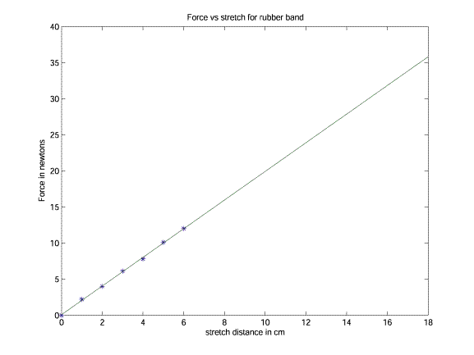
DETREND

Slide 23
HOW DETRENDING WORKS ?
To “Detrend” Time series data means to remove an underlying trend in the data.
The main reason we would want to do this is to more easily see subtends in the data that are seasonal or cyclical.
For Example, consider the following time series data that represent the total series for some company during 20 consecutive periods:

Slide 24
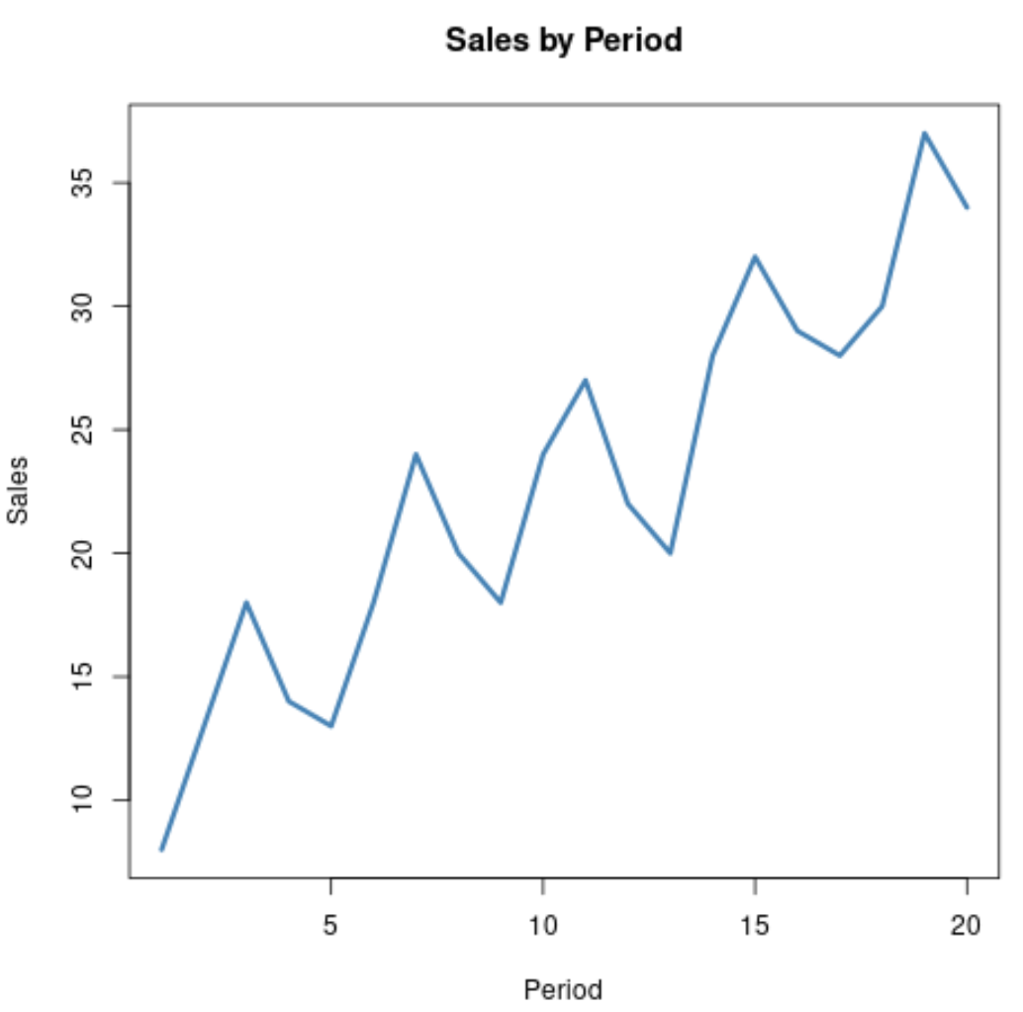
DETREND WORKING

Slide 25
HOW DETRENDING WORKS ?
Clearly the sales is trending upwards over time, but there also appears to be a cyclical or seasonal trend in the data, which can be seen by the tiny “hills” that occur over time.
To gain a better view of this cyclical trend, we can detrend the data.
In this case, this would involve removing the overall upward trend over time so that the resulting data represents just the cyclical trend.

Slide 26
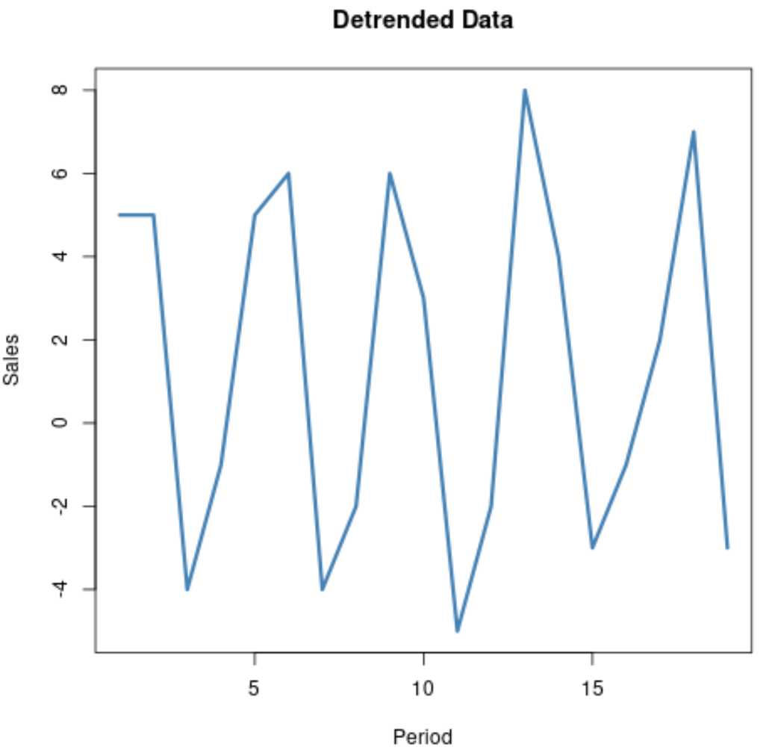
DETREND WORKING

Slide 27
METHOD 1 : DETREND BY DIFFERENCING
One way to detrend time series data is to simply create a new dataset where each observation is the difference between itself and the previous observation.
For example, the following image shows how to use differencing to detrend a data series.
To obtain the first value of the detrended time series data, we calculate 13 – 8 = 5. Then to obtain the next value we calculate 18-13 = 5, and so on.

Slide 28
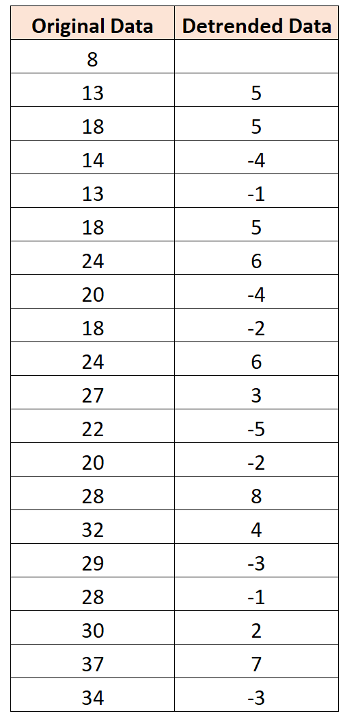
METHOD 1 : DETREND BY DIFFERENCING

Slide 29
METHOD 1 : DETREND BY DIFFERENCING
And this plot shows the detrended data:

Slide 30
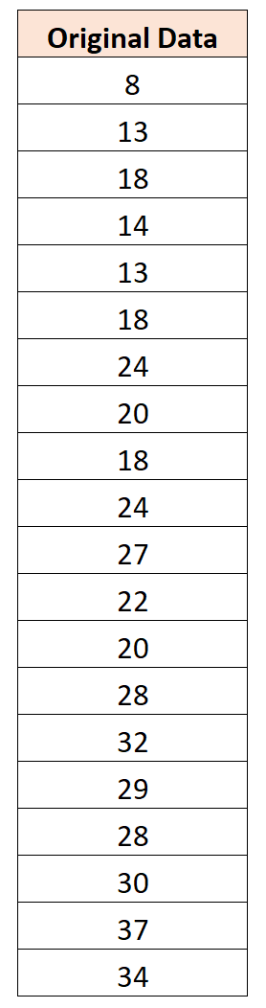
METHOD 2: DETREND BY MODEL FITTING
Another way to detrend time series data is to fit a regression model to the data and then calculate the difference between the observed values and the predicted values from the model.
For example, suppose we have the same dataset:

Slide 31
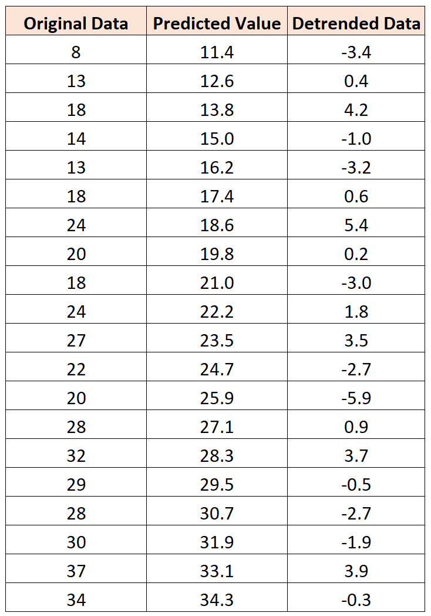
METHOD 2: DETREND BY MODEL FITTING
If we fit a simple linear regression model to the data, we can obtain a predicted value for each observation in the dataset.
We can then find the difference between the actual value and the predicted value for each observation. These differences represent the detrended data.

Slide 32
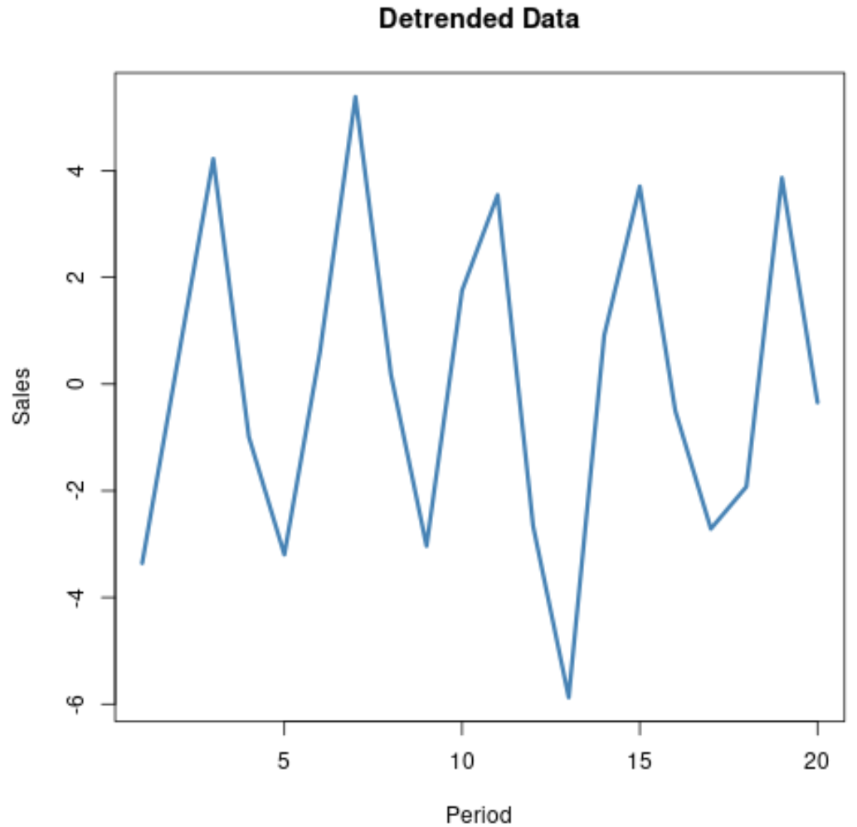
METHOD 2: DETREND BY MODEL FITTING
If we create a plot of the detrended data, we can visualize the seasonal or cyclical trend in the data much more easily:

Slide 33
SUCCESSIVE DIFFERENCES
If you want to use successive difference, your first difference sequence should be 10 , 24 , 44 , 70 , 102 – was it ?
Then Repeating two more items you should (in this case) get a constant third difference…
If you want a polynomial , constant difference identify your pattern as cubic. Divide the constant by 3 !

Slide 34
MOVING AVERAGE AND SMOOTHING

Slide 35
WHAT IS MOVING AVERAGE SMOOTHING ?
Moving averages can smooth time series data, reveal underlying trends, and identify components for use in statistical modeling.
Smoothing is the process of removing random variations that appear as coarseness in a plot of raw time series data.
It reduces the noise to emphasize the signal that can contain trends and cycles. Analysts also refer to the smoothing process as filtering the data.

Slide 36
WHAT IS MOVING AVERAGE SMOOTHING ?
Calculating a moving average involves creating a new series where the values are comprised of the average of raw observations in the original time series.
A moving average require that you specify a window size called the window width.
This defines the number of raw observations used to calculate the moving average value.
The “moving” part in the moving average that are used:
Centered moving Average.
Trailing moving Average.

Slide 37
WHAT IS CENTERED MOVING AVERAGE ?
1.Centered Moving Average:-
The value at time(t) is calculated as the average of raw observations at, before, and after time (t).
For Examples, a center moving average with a window of 3 would be calculated as:
This method require knowledge of future values, and as such is used on time series analysis to better understand the dataset.
A center moving average can be used as a general method to remove trend and seasonal components from a time series, a method that we often cannot use when forecasting.
center_ma(t) = mean(obs(t-1), obs(t),obs(t+1))

Slide 38
WHAT IS TRAILING MOVING AVERAGE?
2. Trailing Moving Average:-
The Value at time(t) is calculated as the average of the raw observations at and before the time (t)
For example, a trailing moving average with a window of 3 would be calculated as:
Trailing moving average only uses historical observations and is used on Time series forecasting.
trail_ma(t) = mean(obs(t-2), obs(t-1),obs(t))

Slide 39
EXPONENTIALLY WEIGHTED FORECASTING MODEL

Slide 40
WHAT IS EXPONENTIAL SMOOTHING ?
Exponential smoothing is a time series forecasting method for univariate data.
Time series methods like the Box-Jenkins ARIMA family of methods develop a model where the prediction is a weighted linear sum of recent past observations or lags.
Exponential smoothing methods may be considered as peers and an alternative to the popular Box-Jenkins ARIMA class of methods for time series forecasting.
Collectively, the methods are something referred to as ETS models, referring to the explicit modeling of Error, Trend and Seasonality.

Slide 41
TYPES OF EXPONENTIAL SMOOTHING
There are three main types of Exponential smoothing time series forecasting methods.
A Simple method that assumes no systematic structure, an extension that explicitly handles trends, and the most advanced approach that add support for seasonality.
1. Single Exponential Smoothing
2. Double Exponential Smoothing
3. Triple Exponential Smoothing

Slide 42
WHAT IS SINGLE EXPONENTIAL SMOOTHING ?
Single Exponential Smoothing, SES for short, also called Simple Exponential Smoothing, is a time series forecasting methods for univariate data without a trend or seasonality.
It requires a single parameter, called alpha (a), also called the smoothing factor or smoothing coefficient.
Hyperparameters:
Alpha : Smoothing factor for the level.

Slide 43
WHAT IS DOUBLE EXPONENTIAL SMOOTHING ?
Double Exponential Smoothing is an extension to Exponential Smoothing that explicitly adds support for trends in the univariate time series.
In addition to the alpha parameter for controlling smoothing factor for the level, an additional smoothing factor is added to control the decay of the influence of the change in trend called beta (b).
The method supports trend that change in different ways: an additive and a multiplicative, depending on whether the trend is linear or exponential respectively.
Double Exponential Smoothing with an additive trend is classically referred to as Holt’s linear trend model, named for the developer of the method Charles Holt.

Slide 44
WHAT IS DOUBLE EXPONENTIAL SMOOTHING ?
Additive Trend: Double Exponential Smoothing with a linear trend.
Multiplicative Trend: Double Exponential Smoothing with an exponential trend.
Hyperparameteres:
Alpha: Smoothing factor for the level.
Beta: Smoothing factor for the trend.
Trend Type: Additive or multiplicative.
Dampen Type: Additive or Multiplicative.
Phi: Damping coefficient.

Slide 45
WHAT IS TRIPLE EXPONENTIAL SMOOTHING ?
Triple Exponential Smoothing is an extension of Exponential Smoothing that explicitly adds support for seasonality to the univariate time series.
This method is something called Holt-Winter Exponential Smoothing, named for two contributors to the method: Charles Holt and Peter Winters.
In Additional to the alpha and beta smoothing factor, a new parameter is added called gamma (g) that control the influence on the seasonal component.

Slide 46
WHAT IS TRIPLE EXPONENTIAL SMOOTHING ?
Additive Seasonality: Triple Exponential Smoothing with a linear seasonality.
Multiplicative Seasonality: Triple Exponential Smoothing with an exponential seasonality.
Hyperparameters:
Alpha: Smoothing factor for the level
Beta: Smoothing factor for the trend
Gamma: Smoothing factor for the seasonality.
Trend Type: Additive or Multiplicative.
Dampen Type: Additive or Multiplicative.
Phi: Damping coefficient.
Seasonality Type: Additive or Multiplicative.
Period: Time steps in seasonal period.

Slide 47
LAGGING

Slide 48
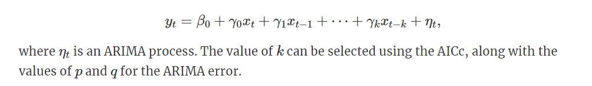
WHAT IS LAGGING ?
Sometimes, the impact of a predictor which is included in a regression model will not be simple and immediate.
In these situations, we need to allow for lagged effects of the predictor. Suppose that we have only one predictor in our model. Then a model which allows for lagged effects can be written as

Slide 49
CORRELATION AND AUTO - CORRELATION

Slide 50
WHAT IS CORRELATION AND AUTO – CORRELATION ?
Just as correlation measures the extent of a linear relationship between two variables, autocorrelation measures the linear relationship between lagged values of a time series.
There are several autocorrelation coefficients, corresponding to each panel in the lag plot.
For example:-
r1r1 measures the relationship between ytyt and yt−1yt−1
r2r2 measures the relationship between ytyt and yt−2yt−2, and so on.

Slide 51
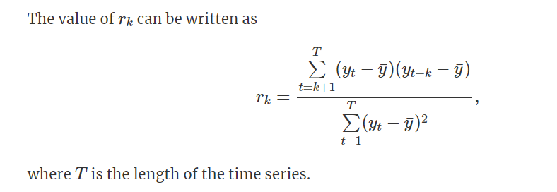
FORMULA OF CORRELATION AND AUTO-CORRELATION

Slide 52
HOLT WINTERS METHODS

Slide 53
WHAT IS HOLT WINTERS FORECASTING ?
The Holt Winter method – also known as triple exponential smoothing – is an incredibly popular and relatively simple methods for times series forecasting.
This article will be a somewhat through introduction into the math and theory of the Holt-Winter methods, complete with a python implementation from scratch.
A Holt-Winters model is defined by its three order parameters, alpha, beta, gamma.
Alpha specifies the coefficient for the level smoothing.
Beta specifies the coefficient for the trend smoothing.

Slide 54
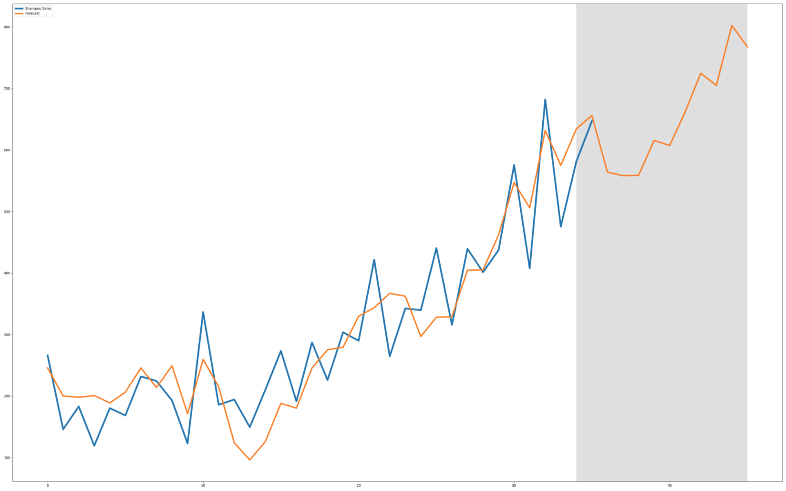
HOLT WINTERS FORECASTING

Slide 55
WHAT IS HOLT – WINTERS METHODS?
Holt (1957) and Winters (1960) extended Holt’s method to capture seasonality.
Charles Holt and Peter Winter’s is one of the oldest time series analysis techniques which takes into account the trend and seasonality while doing the forecasting.
The Holt-Winters seasonal method comprises the forecast equation and three smoothing equations — one for the level ℓt, one for the trend bt , and one for the seasonal component st , with corresponding smoothing parameters α,β∗ and γ.
The three aspects are 3 types of exponential smoothing and hence the hold winter’s method is also known as triple exponential smoothing.

Slide 56
WHAT IS HOLT – WINTERS METHODS?
Simple Exponential Smoothing (SES):- Simple exponential smoothing assumes that the time series has no change in level. Thus, it can not be used with series that contain trend, seasonality, or both.
Holt’s Exponential Smoothing (HES):- Holt’s exponential smoothing is one step above simple exponential smoothing, as it allows the time series data to have a trend component. Holt’s exponential smoothing is still incapable of cope with seasonal data.
Winter’s Exponential Smoothing (WES):- Winter’s exponential smoothing is an extension to Holt’s exponential smoothing that finally allows for the inclusion of seasonality. Winter’s exponential smoothing is what is referred to as the Holt-winter methods.

Slide 57
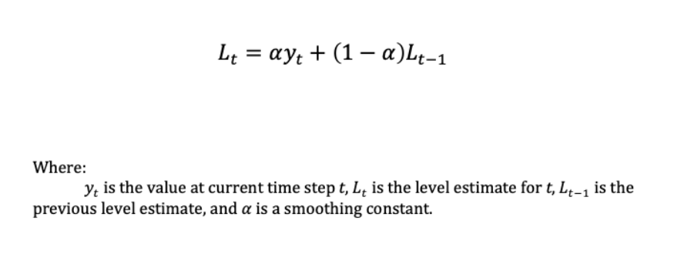
WHAT IS SIMPLE EXPONENTIAL SMOOTHING ?
The Simple Exponential smoothing method does not take into account any trend or seasonality. Rather, it assumes that the time series data only has a level, L.
UPDATE EQUATION
We can define the simple exponential smoothing method as:

Slide 58
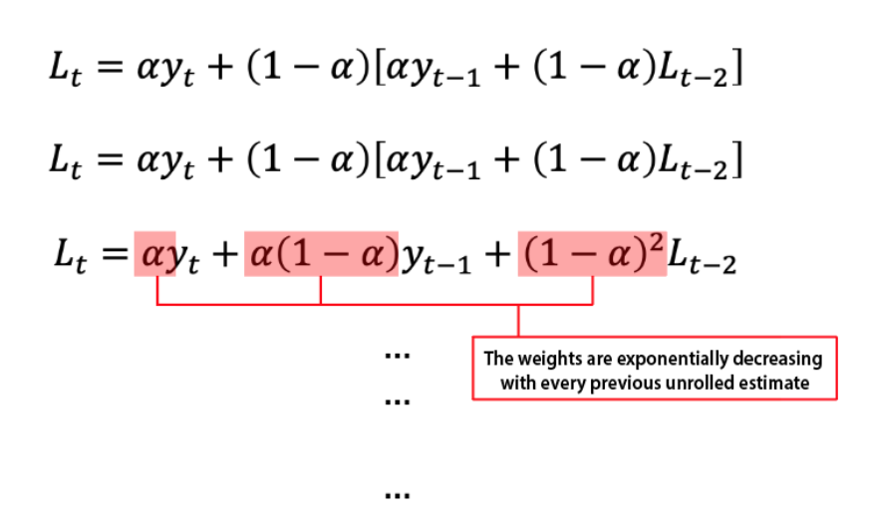
WHAT IS SIMPLE EXPONENTIAL SMOOTHING ?
This equation is known as the level update equation, as it updates the level of the current time step bases on the previous level estimate. The equation is therefore recursive, since every level estimate must be computed using every estimate before it.

Slide 59
IMPLEMENTATION OF SIMPLE EXPONENTIAL SMOOTHING
We will implementation simple exponential smoothing in python, and see some examples.
Recalling the equation, simple exponential smoothing can be implemented as:
From typing import List
def simple_es(series: List, alpha:float) -> float:
if len(series) <2:
return series[0]
return (alpha*series[-1]) + ((1 - alpha) * ses(series[: -1],alpha) )

Slide 60
FORECASTING
When forecasting with the SES method, the future time steps is just the level of the current time step. Therefore, the forecast is the level L at time step t.
As an example, we will apply our python SES implementation to some real world data:

Slide 61
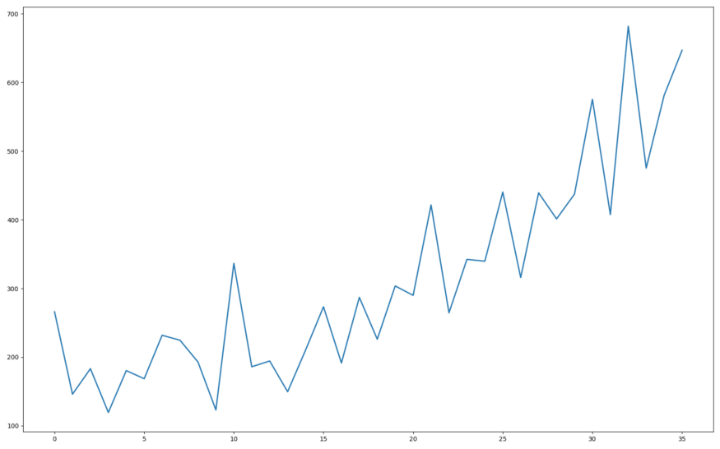
FORECASTING

Slide 62
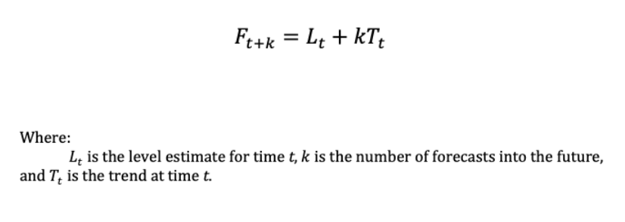
WHAT IS HOLT’S EXPONENTIAL SMOOTHING ?
A Step up from simple exponential smoothing, Holt’s exponential smoothing method is capable of taking into account a trend component. Holt’s method is often referred to as double exponential smoothing.
Holt’s method extends simple exponential smoothing by assuming that the time series has both a level and a trend. A forecast with Holt’s method can therefore be defined as:

Slide 63
WHAT IS HOLT’S EXPONENTIAL SMOOTHING ?
As we can see, it is literally just a simple extenuation of original SES method, just with the inclusion of the trend, T, component.
However it is important to note that are two types of time series, each with their own slightly different forecasting equation:
Additive:- In an additive time series, the time series is the sum of its components.
Multiplicative:- In a multiplicative time series, the time series is the product of its components.

Slide 64
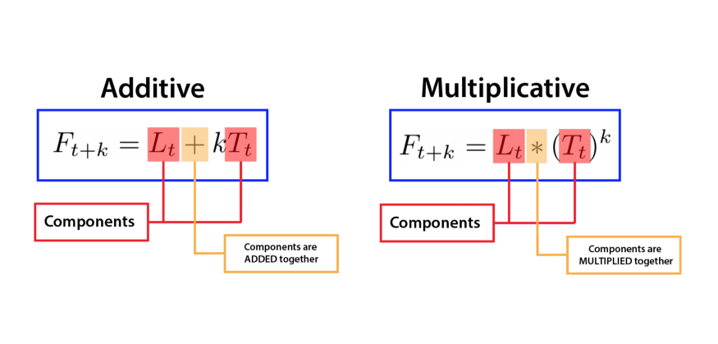
WHAT IS HOLT’S EXPONENTIAL SMOOTHING ?
The forecasting equation must correspond to the particular type of time series:

Slide 65

WHAT IS HOLT’S EXPONENTIAL SMOOTHING ?
UPDATE EQUATION
The trend estimate for a given t can be computed as:
This equation is known as the trend update equation, as it updates the trend estimate of the current time step based on the difference between previous level estimates.
Beta also has the domain 0 ≤ β ≤ 1, and it dedicates how fast a given trend estimate should be adjusted.

Slide 66
IMPLEMENTATION
Recalling the trend update equation, Holt’s exponential smoothing can be implemented as:
def holt_es(series: List,alpha: float, beta: float,initial_trend: float) -> float:
if len(series) < 2:
return initial_trend
l_t = ses(series , alpha)
l_t_prev = ses(series[: -1], alpha)
trend_t_prev = ses(series[: -1],alpha,beta,initial_trend)
return (beta * (l_t - l_t_prev)) + ((1-beta) * trend_t_prev)

Slide 67
FORECASTING
When forecasting with the HES method, we must remember the different types of forecasts-Additive and Multiplicative – and choose the forecasting equation accordingly.

Slide 68
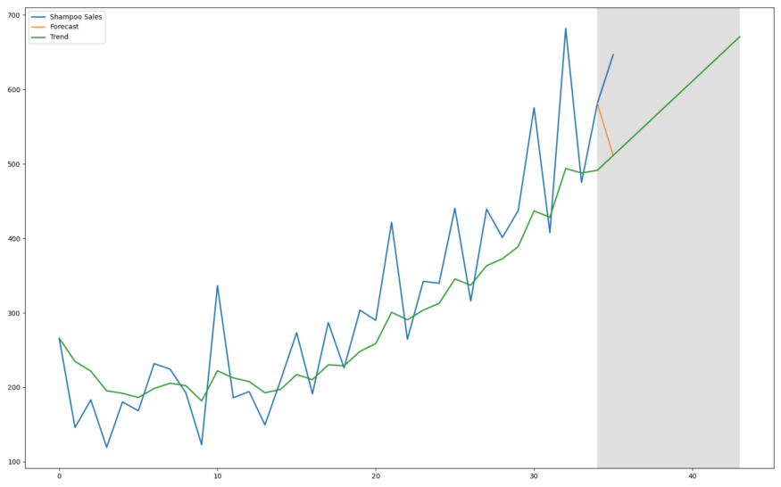
FORECASTING

Slide 69
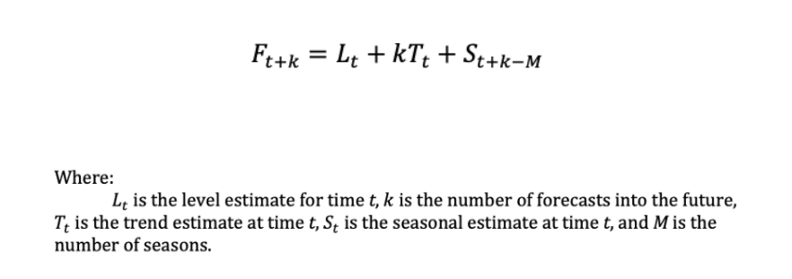
WHAT IS WINTER’S EXPONENTIAL SMOOTHING ?
Winter’s exponential smoothing method is an extension to Holt’s method that finally allows for the capturing of a seasonal component.
Since winter’s exponential smoothing is built on top of both single and double exponential smoothing, winter’s method is thus also known as triple exponential smoothing.
Winter method assumes that the time series has a level, trend and seasonal component.
A forecast with winter’s exponential smoothing can be expressed as:

Slide 70
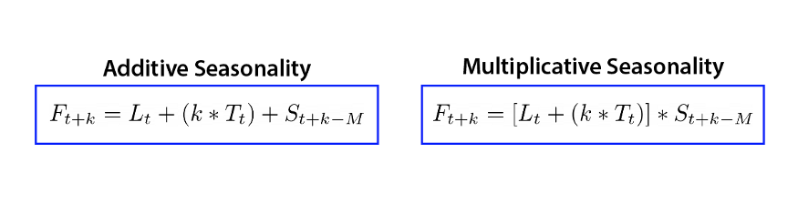
WHAT IS WINTER’S EXPONENTIAL SMOOTHING ?
The forecast equation is the extenuation of both the SES and HES methods, finally augmented with the inclusion of the Seasonal, S, component.
Just like Holt’s method, the forecasting equation has multiple variation for each of the types of time series:

Slide 71
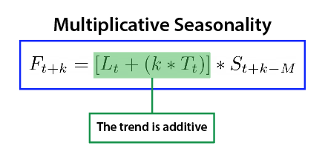
WHAT IS WINTER’S EXPONENTIAL SMOOTHING ?
It is important to notice that each of the time series components do not need to exhibit the same behavior. For instance, the multiplicative seasonality formula does – obviously – have multiplicative seasonality, however the trend portion is additive:

Slide 72
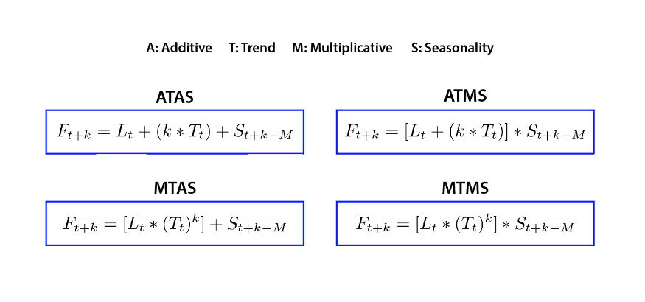
WHAT IS WINTER’S EXPONENTIAL SMOOTHING ?
This independence allows the mixing and matching of different behaviors to model many different types of time series:

Slide 73
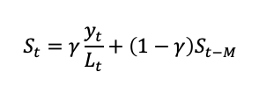

WHAT IS WINTER’S EXPONENTIAL SMOOTHING ?
UPDATE EQUATION
The inclusion of the seasonality component now adds the third update equation:
There is the introduction of another smoothing constant: Y. The gamma smoothing constant also has the domain 0≤γ≤1. This specific update equation is for a time series with multiplicative level. For an additive level, use the seasonal update equation below:

Slide 74

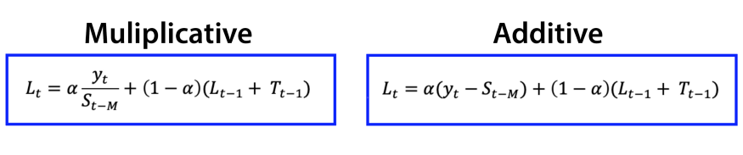
WHAT IS WINTER’S EXPONENTIAL SMOOTHING ?
The new level update equation can be expressed as:
This specific update equation is for additive seasonality and additive trend. The update equations for each type of seasonality can be seen below:

Slide 75
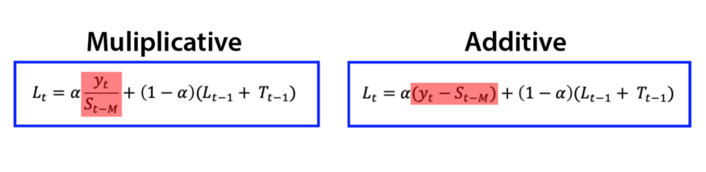
WHAT IS WINTER’S EXPONENTIAL SMOOTHING ?
We can see the specific deseasonalization effect here :

Slide 76
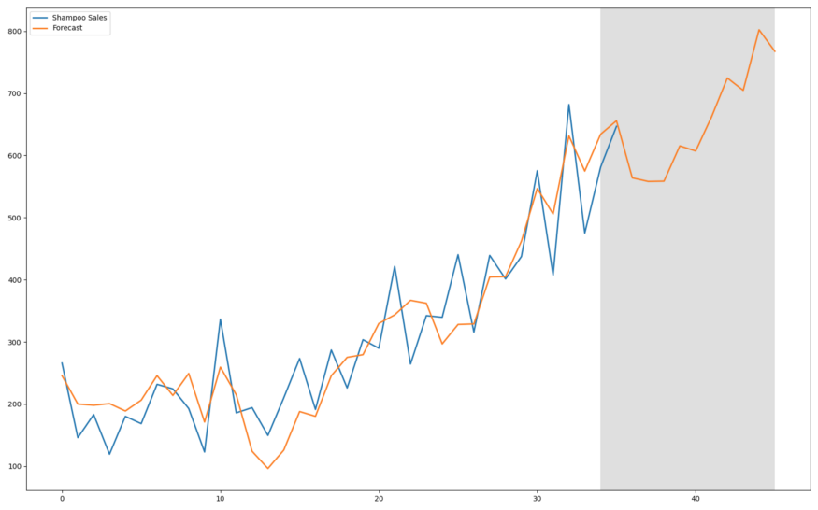
Forecasting

Slide 77
SINGLE EXPONENTIAL SMOOTHING

Slide 78
WHAT IS SINGLE EXPONENTIAL SMOOTHING ?
Single Exponential Smoothing, SES for short, also called Simple Exponential Smoothing, is a time series forecasting method for univariate data without a trend or seasonality.
It require a single parameter, called alpha (a), also called the smoothing factor or smoothing coefficient.
Hyperparameters:
Alpha : - Smoothing factor for the level.

Slide 79
HOLT’S LINEAR TREND METHOD

Slide 80
WHAT IS HOLT’S LINEAR TREND METHOD ?
Holt (1957) extended simple exponential smoothing to allow the forecasting of data with a trend. This method involves a forecast equation and two smoothing equations(one for the level and one for the trend) :
Forecast equation ^yt+h|t=ℓt+hbtLevel
Equations ℓt=αyt+(1−α)(ℓt−1+bt−1)
Trend Equation bt=β∗(ℓt−ℓt−1)+(1−β∗)bt−1,

Slide 81
WHAT IS HOLT’S LINEAR TREND METHOD ?
Where ℓt denotes an estimate of the level of the series at time t , b_{t} denotes an estimate of the trend (slope) of the series at time t , α is the smoothing parameter for the level , 0 ≤ α ≤ 10 ≤ α ≤ 1, and β∗ is the smoothing parameter for the trend , 0 ≤ β ∗ ≤ 10 ≤ β ∗ ≤ 1.
The forecast function is no longer flat but trending. The h – step – ahead forecast is equal to the last estimated level plus h times the last estimated trend value.
Hence the forecasts are a linear function of h.

Slide 82
HOLT’S WINTER SEASONAL METHOD

Slide 83
WHAT IS HOLT’S WINTER SEASONAL METHOD?
Holt(1957) and Winters(1960) extended Holt’s method to capture seasonality.
The Holt-Winters seasonal method comprises the forecast equation and three smoothing equations – one for the level ℓt, one for the trend bt, and one for the seasonal component st, with corresponding smoothing parameters α, β∗ and γ.
We use m to denote the frequency of the seasonality, i.e., the number of seasons in a year. For example, for quarterly data m = 4 , and for monthly data m = 12 .

Slide 84
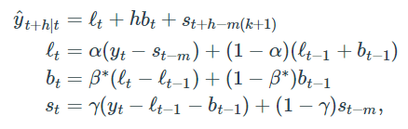
HOLT – WINTER’S ADDITIVE METHOD
The components form for the additive methods is :

Slide 85
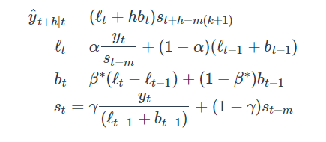
HOLT-WINTER’S MULTIPLICATIVE METHOD
The Component form for the Multiplicative method is :

Slide 86
AN APPLICATION : INTERNATIONAL TOURIST VISITORS IN AUSTRALIA
Holt winter’s method with both additive and multiplicative seasonality forecast quarterly visitors in Australia spent by international tourists.
Figure 1 shows the data from 1999 to 2013, and the forecast for 2014 – 2015.
Note that the data shown an obvious seasonal pattern, with peaks observed in the March quarter of each year, corresponding to the Australian summer.

Slide 87
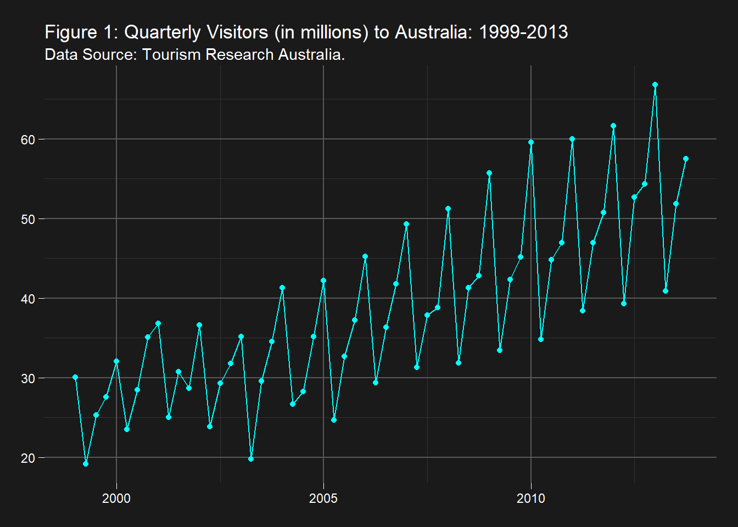
AN APPLICATION : INTERNATIONAL TOURIST VISITORS IN AUSTRALIA (CONT…..)

Slide 88
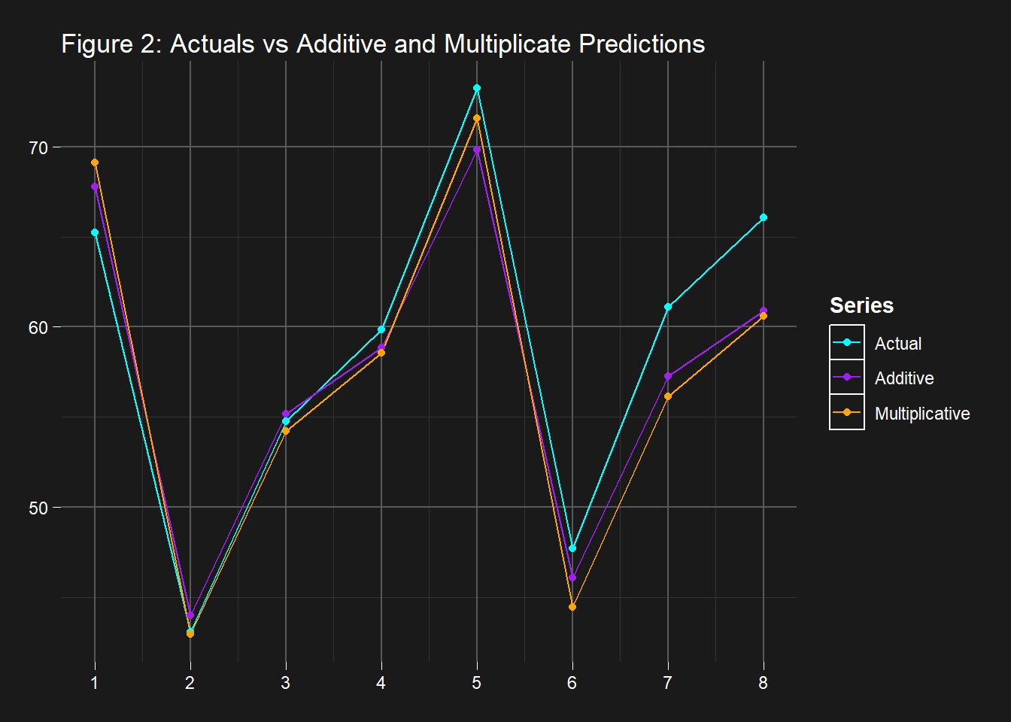
AN APPLICATION : INTERNATIONAL TOURIST VISITORS IN AUSTRALIA (CONT…..)

Slide 89
ARIMA AND SARIMA MODEL

Slide 90
WHAT IS ARIMA AND SARIMA MODEL?
Time series is a series of data points measured at consistent time intervals such as yearly, daily ,monthly , hourly and so on.
It is time –dependent & the progress of time is an important aspect of the data set.
One of the most Common methods used in time series forecasting is known as the ARIMA model, which stands for auto regressive Integrated Moving Average.
ARIMA is a model that can be fitted to time series data to predict future points in the series.

Slide 91
WHAT IS ARIMA AND SARIMA MODEL?
We can split the ARIMA term into three terms , AR , I , MA:
AR(p) stands for the autoregressive model, the p parameter is an integer that confirms how many lagged series are going to be used to forecast periods ahead.
I(d) is the differencing part, the d parameter tells how many differencing orders are going to be used to make the series stationary.
MA(q) stands for moving average model, the q is the number of lagged forecast error terms in the prediction equation.
SARIMA is seasonal ARIMA and it is used with time series with seasonality.

Slide 92
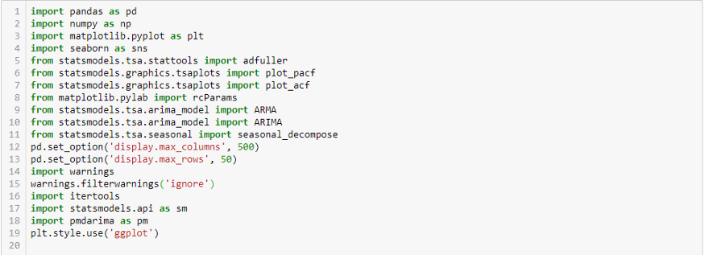
STEPS TO BUILD ARIMA AND SARIMA MODEL
1. Load the data & Import the necessary libraries: The first step for model building is to load the data set & import libraries.

Slide 93
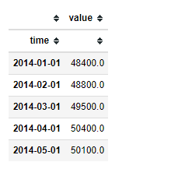
STEPS TO BUILD ARIMA AND SARIMA MODEL
2. Data Processing : While working with time series data in python, it’s important to always ensure that dates are used as index values and are understood by python as a true “date” object. We can do this by using pandas datestamp or to_datetime method.

Slide 94
STEPS TO BUILD ARIMA AND SARIMA MODEL
3. Check for Stationarity: Most time series models require the data to be stationary. A time series is said to be stationary if its statistical properties such as mean, variance &covariance remain constant over time . The formal way to check for this are plotting the data and do a visual analysis and use a statistical test.
Visual: We can use the decomposition method which allows us to separately view seasonality(which could be daily, weekly, annual, etc.), trend and random which is the variability in the data set after removing the effects of the seasonality and trend.

Slide 95
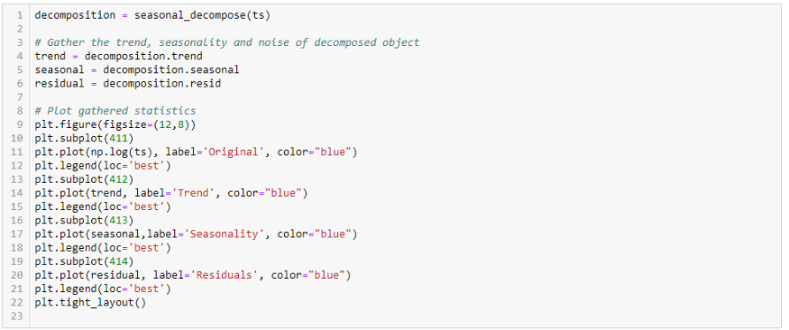
STEPS TO BUILD ARIMA AND SARIMA MODEL

Slide 96
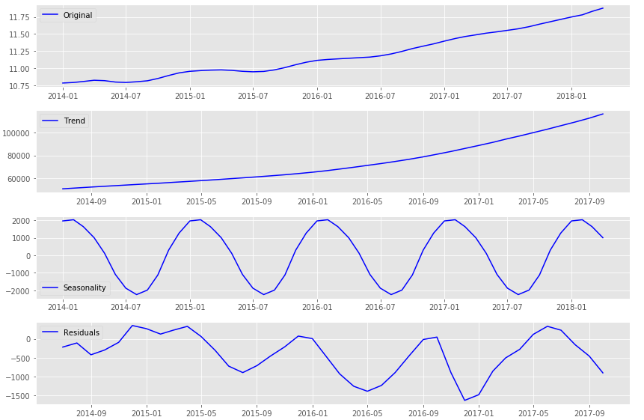
STEPS TO BUILD ARIMA AND SARIMA MODEL

Slide 97
STEPS TO BUILD ARIMA AND SARIMA MODEL
The plot shows that the data has both trend & seasonality. That means it is not stationary.
Statistical test: To confirm our visual observation on the above plot, we will use the Dicky-Fuller Hypothesis testing.
Null Hypothesis: The series is not stationarity.
Alternate Hypothesis: The series is stationary.

Slide 98
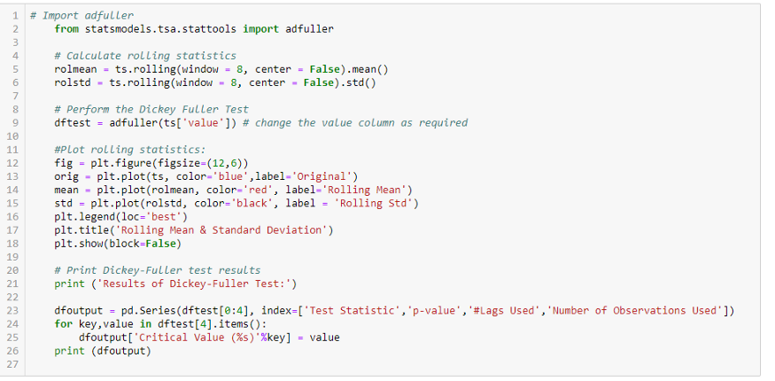
STEPS TO BUILD ARIMA AND SARIMA MODEL

Slide 99
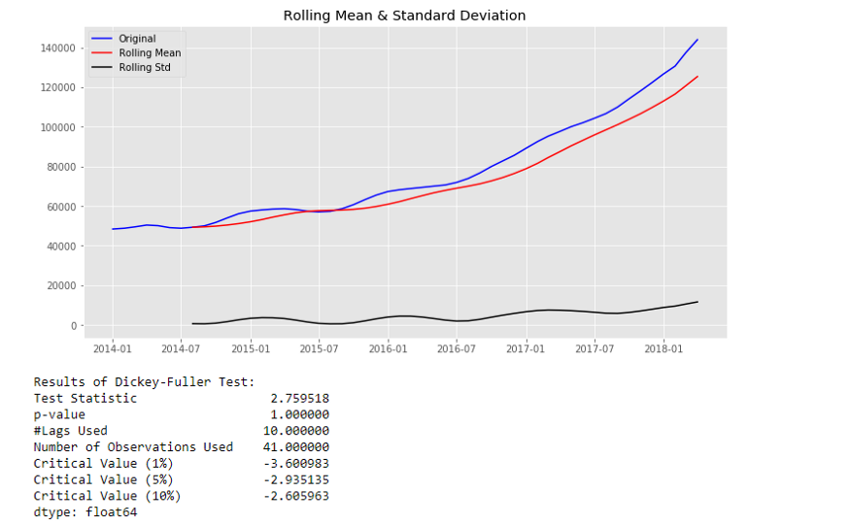
STEPS TO BUILD ARIMA AND SARIMA MODEL
With the p-value 1 which is greater than 0.05, we fail to reject the null hypothesis & it confirms that the series is not stationary.

Slide 100
STEPS TO BUILD ARIMA AND SARIMA MODEL
4. Make series stationery & determine the d value: After the statistical test confirmed that the series is not stationary, the next step is to remove the trend and make the series stationary.
One of the most common methods of dealing with removing both the trend and seasonality is differencing and the number of times the differencing was performed to make the series stationary is the d value.
After a couple of differencing the test confirms that the data is stationary. That means the d value is 2.

Slide 101
STEPS TO BUILD ARIMA AND SARIMA MODEL
5. Create ACF and PACF Plots & determine the p and q values: The Partial Autocorrelation Function (PACF) gives the partial correlation of a time series with its own lagged values, controlling for the values of the time series at all shorter lags. The Autocorrelation Function gives the correlation of a time series with its own lagged values but without controlling the other lags.
The ACF plot for the AR(p) time series would be strong to a lag of p and remain stagnant for subsequent lag values, trailing off at some point as the effect is weakened. The PACF, on the other hand, describes the direct relationship between an observation and its lag. This generally leads to no correlation for lag values beyond p.
The ACF for the MA(q) process would show a strong correlation with recent values up to the lag of q, then an immediate decline to minimal or no correlation. For the PACF, the plot shows a strong relationship to the lag and then a tailing off to no correlation from the lag onwards. Below is the ACF & PACFplot for our stationary data.

Slide 102
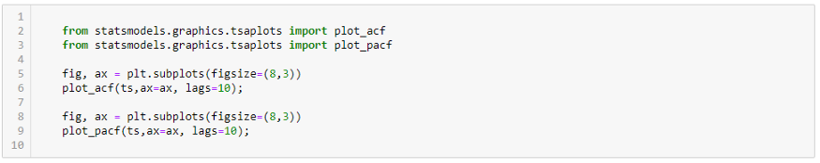
STEPS TO BUILD ARIMA AND SARIMA MODEL

Slide 103
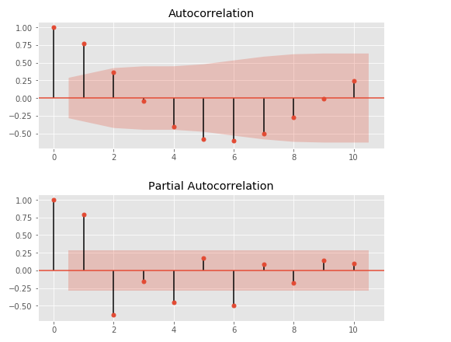
STEPS TO BUILD ARIMA AND SARIMA MODEL
PACF & ACF suggested that AR(2) & MA(2), the next step is to run the ARIMA model using the range of values estimated by the ACF & PACF. Information criterion like AIC (Akaike Information Criterion) or BIC(Bayesian Information Criterion) will be used to choose among correctly fitted models.

Slide 104
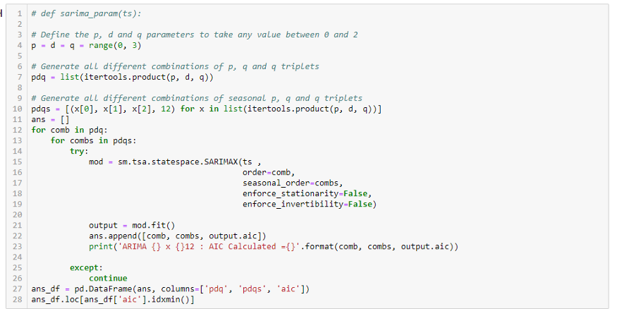
STEPS TO BUILD ARIMA AND SARIMA MODEL
6. Fit ARIMA Model:

Slide 105

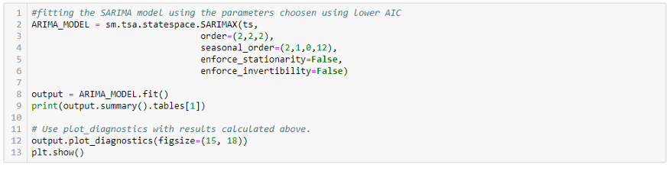
STEPS TO BUILD ARIMA AND SARIMA MODEL

Slide 106
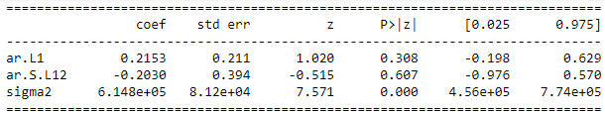
STEPS TO BUILD ARIMA AND SARIMA MODEL

Slide 107
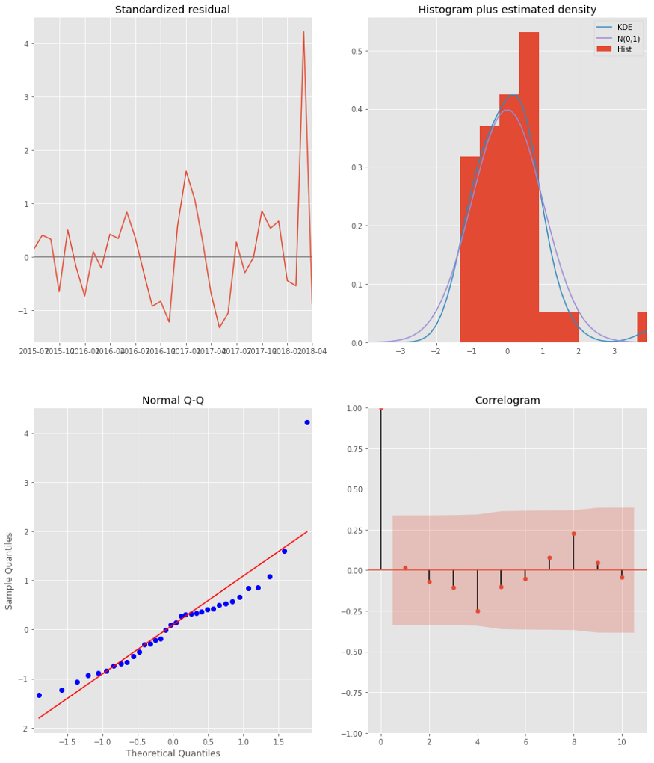
STEPS TO BUILD ARIMA AND SARIMA MODEL

Slide 108
WHAT IS Auto ARIMA MODEL ?
Auto ARIMA model: The Advantage of using Auto over the ARIMA model is that after data preprocessing step we can skip the next steps & directly fit our model.
It uses the AIC (Akaike Information Criterion) & BIC (Bayesian Information Criterion) Values generated by trying different combinations of p,q & d values to fit the model.

Slide 109
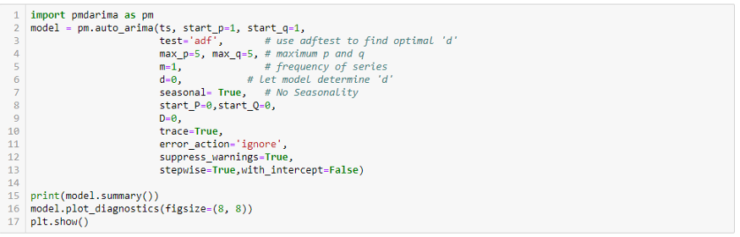
Auto-ARIMA MODEL

Slide 110
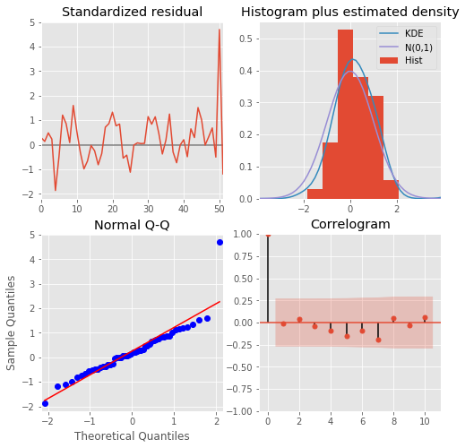
Auto-ARIMA MODEL

Slide 111
Auto-ARIMA MODEL
The residual plots for the auto ARIMA model look pretty good.
Histogram Plus estimated density plot: The red KDE line follows closely with the N(0,1) line. This is good indication that the residual are normally distributed.
The Q-Q-Plot: Shows that the ordered distribution of residuals (blue dots) follows the linear trend of the samples taken from a standard normal distribution with N(0, 1). This is an indication that the residuals are normally distributed.
The Standardize residual plot: The residuals over time don’t display any obvious seasonality and appear to be white noise.

Slide 112
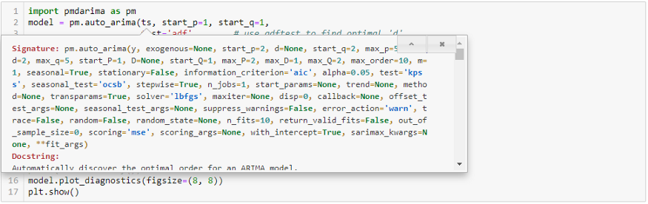
Auto-ARIMA MODEL
The Correlogram plot: Shows that the time series residuals have low correlation with lagged versions of itself.

Slide 113

Thank You !!!
(USA)
2-Industrial Park Drive, E-Waldorf, MD, 20602,
United States
(USA)
+1-844-889-4054
(Singapore)
3 Temasek Avenue, Singapore 039190
info@careerera.com www.careerera.com
(INDIA)
B-44, Sector-59, Noida Uttar Pradesh 201301
(INDIA)
+91-92-5000-4000

