Slide 1

“Never assume you can't do something. Push yourself to redefine the boundaries.”
Brian Chesky, CEO of Airbnb

Slide 2
Agenda
Problem Statement
Data Analysis & Visualization.
Proposed Solution
Solution Details
Challenges
Model Creation
Insights
Conclusion

Slide 3
Problem Statement
Airbnb is an online marketplace which allows users to post lisings on their website and it earns commissions from every booking
At present when someone wants to list an Airbnb rental, they have to manually analyze similar properties near their location and decide the price themselves
Idea of our project is to form a model to estimate what the correct price of their rental should be given the features of their property.
Dataset: 77000+ records and has 97 columns.
Dataset source: http://insideairbnb.com/get-the-data.html

Slide 4
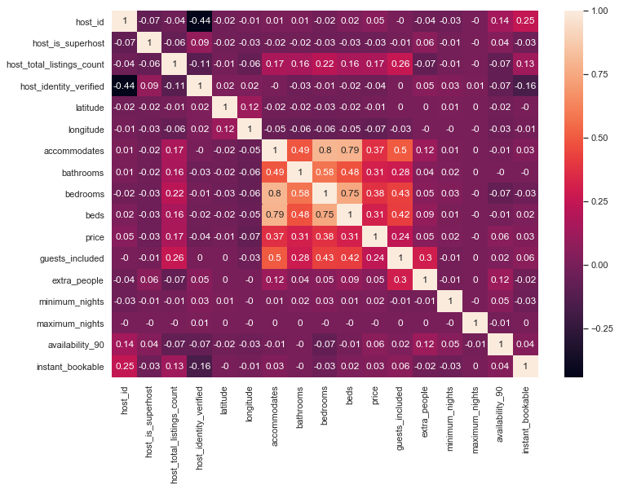
Data Analysis & Visualization.
Correlation Matrix:
After visualization of correlation between different features, 'beds' column is having strong correlation with accommodation.
'beds' column is removed.

Slide 5
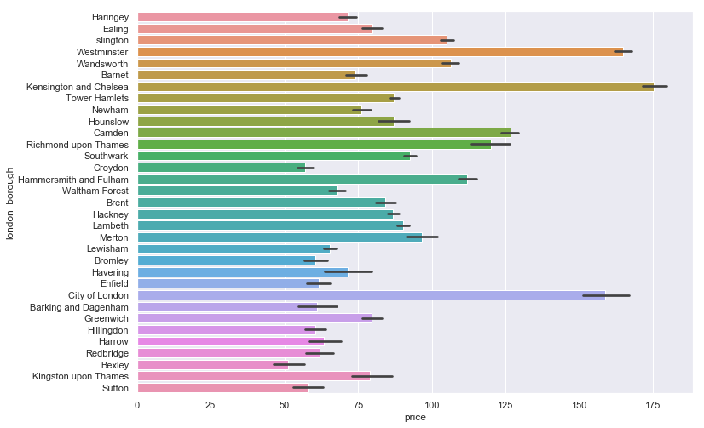
London-borough vs price
This plot shows relationship of london_borough and price in data using barplot().
From this plot Westminister, Kensington and Chelsea, City of London has higher prices where the black lines are the error bars that shows uncertainty in values which is highest for Enfield.

Slide 6
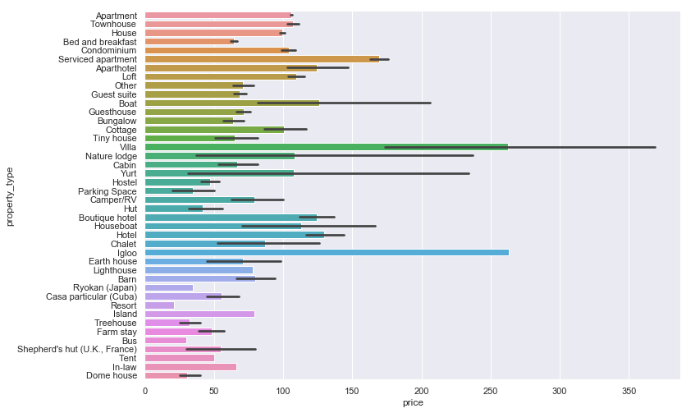
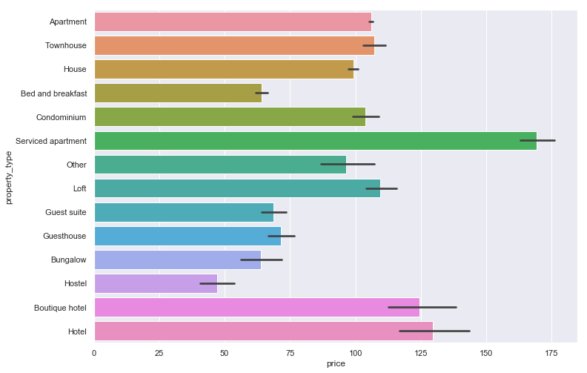
Property-types vs price.
This plot shows relationship of property_type and price in data using barplot().
From this plot, we can see that there are some property types which are present in very few listings. So such categories were clubbed together into ‘Other’.

Slide 7
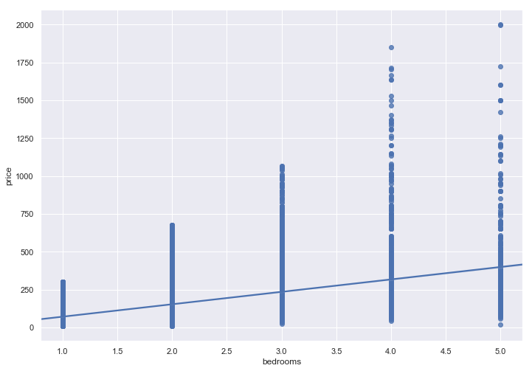
Bedrooms vs price
This visualization shows how spread out the bedrooms and price in data are.
We can see from the plot that the lower bound price of each bedrooms are overlapping.
This shows that the users are free to post any price for their listings without any moderation from Airbnb which makes our task more challenging

Slide 8
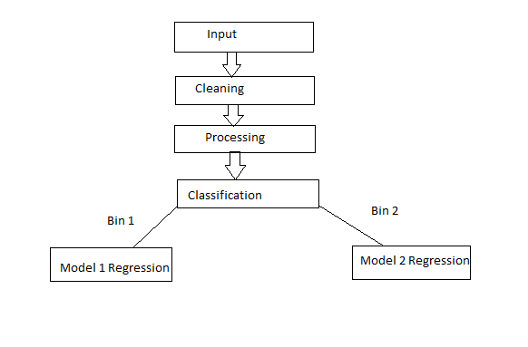
Proposed Solution

Slide 9
Solution Details: Cleaning & Preprocessing Phase
Removed the unwanted features from our dataset.
Removed the features which could leak information(Reviews)
Performed Exploratory Data Analysis (EDA) in order to remove categorical columns which had unbalanced data
Performed Data Cleaning to standardize the columns and remove noise which improves the quality of the training data for analytics and gives better decision-making.
Developed a common function which could identify category wise outliers in the feature passed to it and give flexibility to either remove or replace that value with threshold
Handled the misleading information in our data.
E.g.: Some listings mentioned the room type as Shared room and the price mentioned was for 1 person but the features of the house specifies how many people in total it can accommodate.

Slide 10
Feature Selection & Feature Engineering
After performing data cleaning and removing the unwanted features from our data we have selected feature like 'amenities' for feature engineering.
Sample value from Amenities columns:
{TV,"Cable TV",Internet,Wifi,Breakfast,"Pets live on this property",Dog(s),Heating,"Family/kid friendly","Fire extinguisher",Shampoo}
We transformed it into individual features using the MultiLabelBinarizer
We then checked the correlation between each amenity and discarded the amenities having very high correlation.
For eg: bathroom essentials, Bath towel and cooking basics, Dishes and silverware etc.
Removed amenities which are most common or most uncommon from the data.
The data also has different property type values, so we are replacing those values with “Others” where count is below or equal to 100.

Slide 11
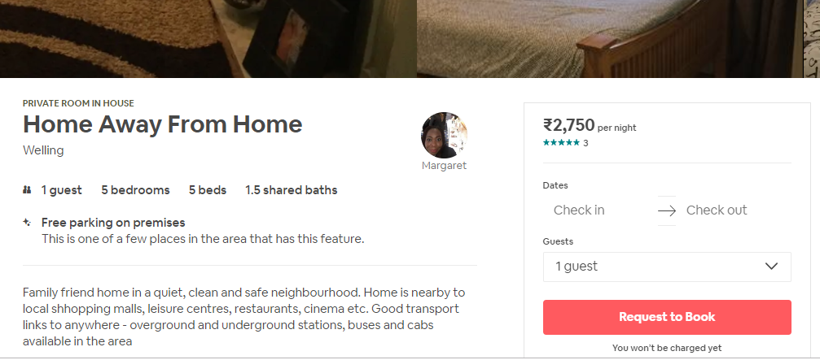
Challenges:
After Exploratory Data Analysis(EDA) on our data we found that some records in 'price' column were suspicious that could lead to incorrect model.
On careful analysis, we found out that there was a problem in Airbnb website which resulted in traditional web scrappers which relied on tools like Beautifulsoup to fetch incorrect prices.
So we used selenium package which is capable of scraping JS rendered pages to get the correct price for such listings.
Data also had many listings with misleading information.
For eg: Host wants to give private room for rent for one guest but has mentioned the total number of bedrooms in her house

Slide 12
Model Selection and Creation
After feature engineering step we have created 2 bins for 'price' from 0-100 & 101-2001.
Splitting the data into Train and Test set(70-30).
Before performing Regression we have first done Classification to predict Price_bins.
We chose Random Forest and Logistic Regression because we wanted a algorithm which would allow to assign class weights to handle class imbalance problem
Classification Models | Accuracy |  | Precision | Recall
 | Train | Test
Random Forest Classifier | 0.8873 | 0.8688 | 0.88 | 0.87
Logistic Regression | 0.8683 | 0.8633 | 0.87 | 0.86
Vote Classifier | 0.8788 | 0.8668 | 0.87 | 0.87

Slide 13
After performing Classification on price_bins we have built XGBRegressor model for each price bin.
We have trained the model on log transformed Target variable as price is a relative term.
We have used L1 regularization to prevent overfitting
Regression Models |  | Median Absolute Error Train | Median Absolute Error Test
XGBRegressor | For Price_bin 1 | 4.9123 | 7.8473
XGBRegressor | For Price_bin 2 | 16.73 | 22.54

Slide 14
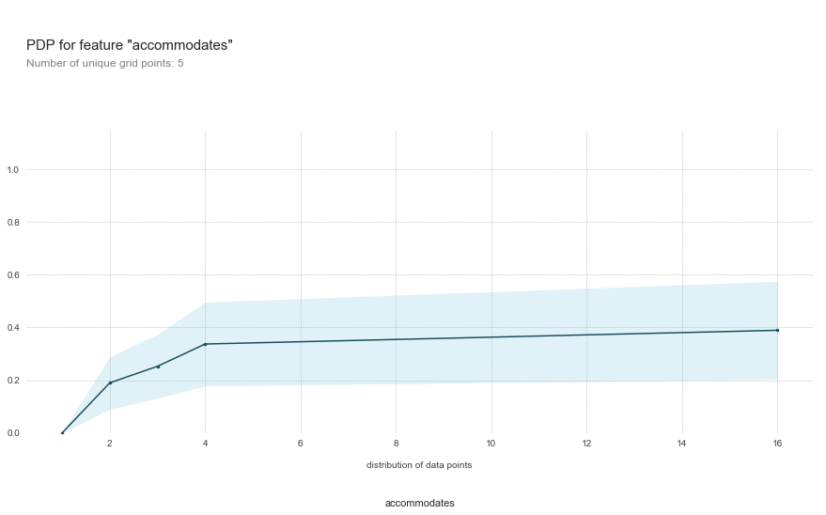
Insights
Importance of Accommodates in the model
The predicted price increases as accommodates increases

Slide 15
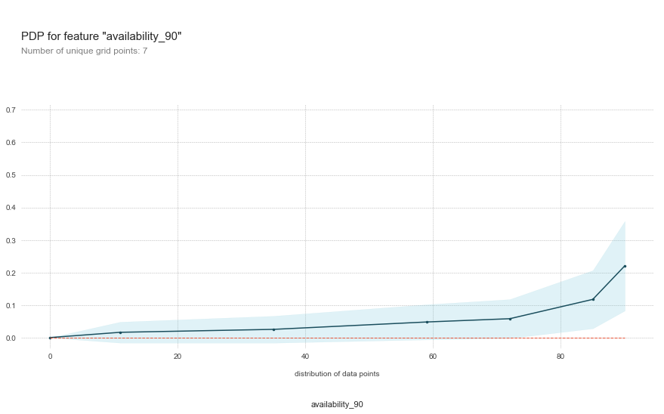
Importance of Availability in the model
There is steady increase in predicted price as the availability increases

Slide 16
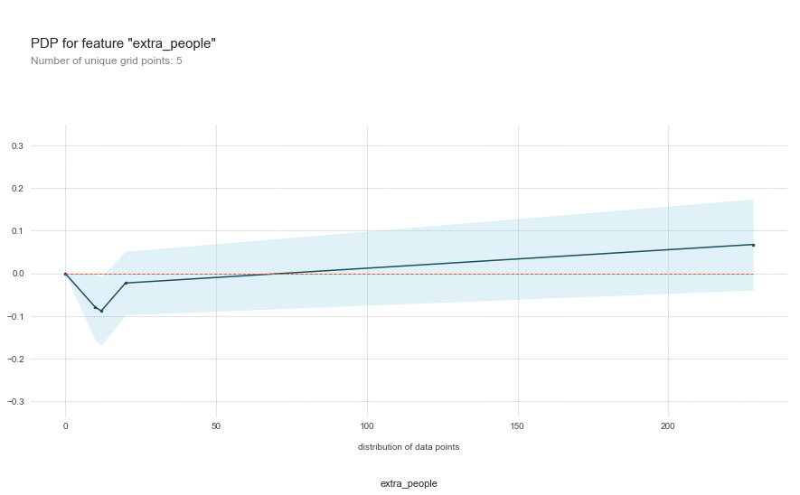
Importance of extra_people in the model
There is decline is in predicted price as the listings start charging more for extra people

Slide 17
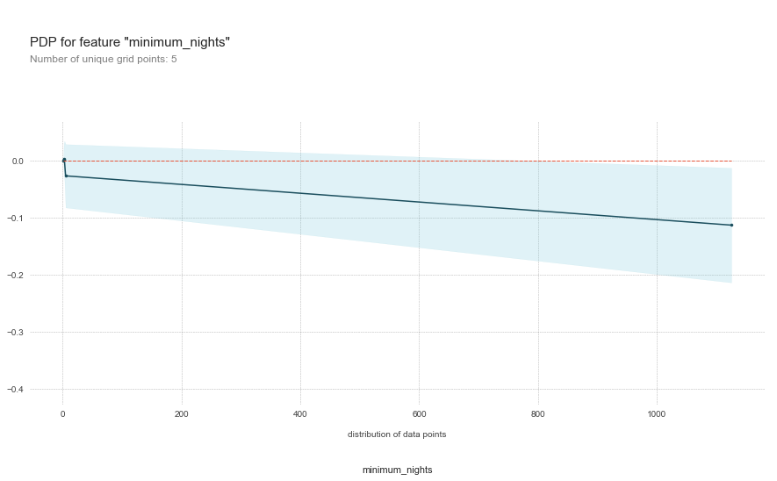
Importance of minimum_nights in the model
There is decline is in predicted price as the host start increasing the minimum nights

Slide 18
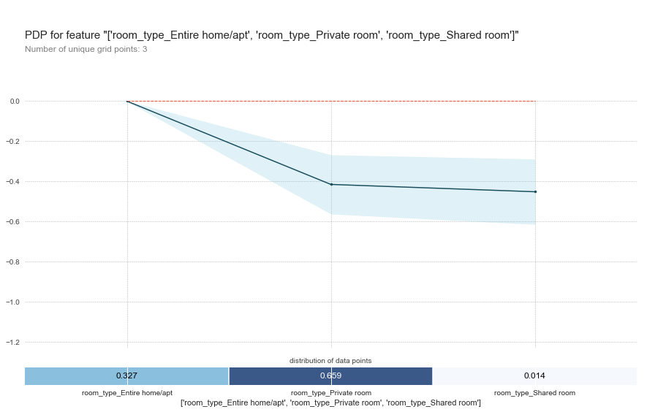
Importance of room_type in the model
Entire home can fetch the maximum price whereas shared room fetches minimum price

Slide 19
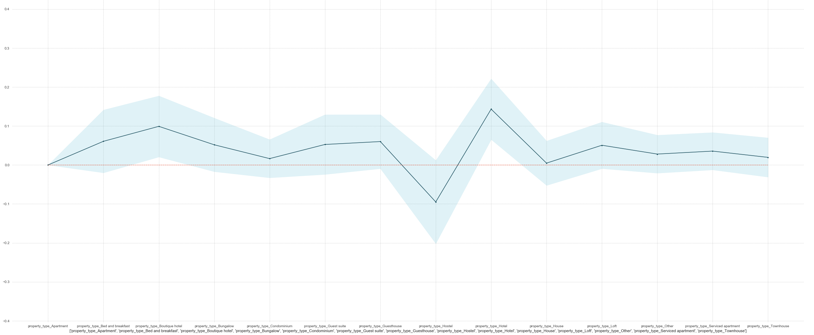
Importance of property_type in the model
A hotel can fetch the maximum price whereas an hostel fetches the minimum price

Slide 20
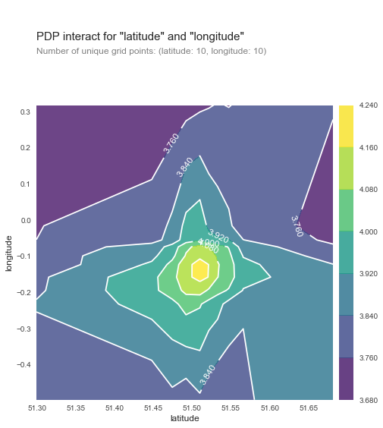
Importance of location in the model
The model is accurately able to predict that maximum rental price predicted is in centre London.
The lat, long combination is near Buckingham Palace

Slide 21
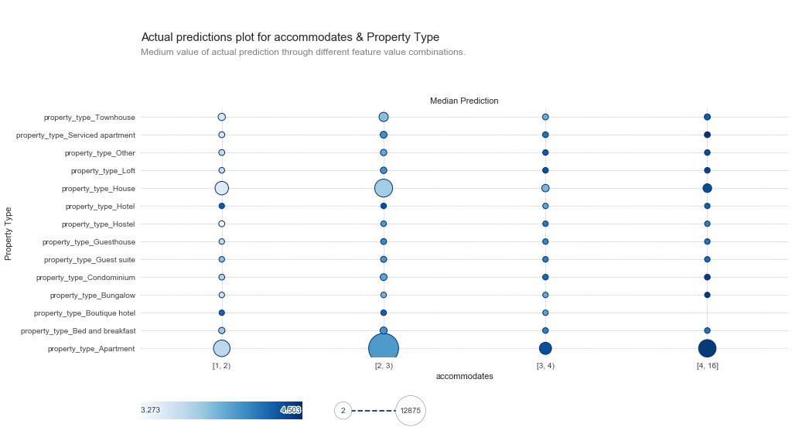

Slide 22
Conclusion
There are a variety of ways that UK residents can choose to host on Airbnb. Just over half of the hosts on the platform choose to rent out their entire home.
This may be their primary residence that they make available to Airbnb guests when they themselves go on holiday, or it may be a second home in a city .
A large proportion of hosts on Airbnb share their home by listing a private bedroom in their primary residence. This allows hosts the flexibility to maximise space in their home, benefiting from the additional income, and social interaction, without having to commit to a full-time tenant.
What makes predicting the rental price most challenging is that Airbnb gives the host complete flexibility to choose their rental price. So a 5 bedroom house can range anywhere between 25$ to 2000$+
We chose this Dataset over any Kaggle dataset because we wanted to analyse a real world usecase instead of just creating a model on pre-cleaned data.

Slide 23
Honour Code & Team Contribution
We hereby declare that solution developed by us is entirely our work and not plagiarized by any means.
Vrushank Gude-30%
Shehzada Alam-20%
Sagar Bhutada-15%
Sameer Pophali-20%
Shreyas Wankhede-15%

Slide 24
Thank You

