Slide 1

Platforma Java i potporne tehnologije otvorenog koda u poslovnom okruženju - vježba 4
FER 2017/2018
Simon Šporer
Serengeti
Notes:
Ch. Sw. Arh. Spec. Ing. Inf. Simon Šporer

Slide 2


spring-boot
Notes:
Omogučava izradu Enterprise aplikacija
prati SOLID standard
sastoji se od CORE tehnologije i Spring obitelji projekata (plug-in-ovi)

Slide 3
Spring
https://docs.spring.io/spring/docs/current/spring-framework-reference/overview.html

Slide 4
Spring
Servlet API (JSR 340)
WebSocket API (JSR 356)
Concurrency Utilities (JSR 236)
JSON Binding API (JSR 367)
Bean Validation (JSR 303)
JPA (JSR 338)
JMS (JSR 914)
Dependency Injection (JSR 330)
Common Annotations (JSR 250)
...

Slide 5
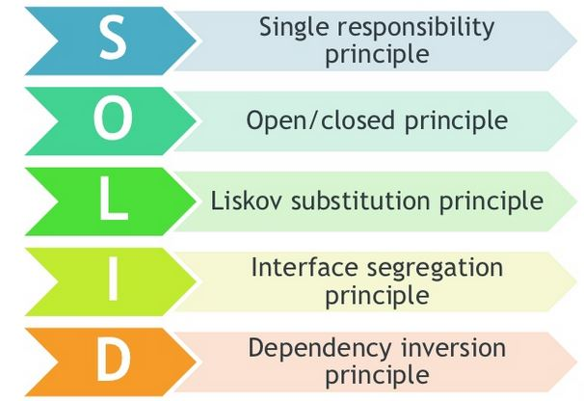
Spring
Notes:
KISS, ACID, WYSIVYG
Single responsibility principle^{[4]}
a class should have only a single responsibility (i.e. changes to only one part of the software's specification should be able to affect the specification of the class)
Open/closed principle^{[5]}
“software entities … should be open for extension, but closed for modification.”
Liskov substitution principle^{[6]}
“objects in a program should be replaceable with instances of their subtypes without altering the correctness of that program.” See also design by contract.
Interface segregation principle^{[7]}
“many client-specific interfaces are better than one general-purpose interface.”^{[8]}
Dependency inversion principle^{[9]}
one should “depend upon abstractions, [not] concretions.”^{[8]}

Slide 6
Spring
IoC
Beans
Context
Lifecycle
Dependencies
Environment
i18n
Validation, conversion, binding
SpEL
AoP
Null-safety
...

Slide 7
Zadatak 1
U direktoriju Vjezbe04 na svom branch-u napraviti “Hello-world” spring-boot aplikaciju i pusha-ti na zajenički repozitorij.

Slide 8
Spring - XML config
<?xml version="1.0" encoding="UTF-8"?> <!DOCTYPE beans PUBLIC "-//SPRING//DTD BEAN 2.0//EN" "http://www.springframework.org/dtd/spring-beans-2.0.dtd"> <beans> <bean id="someBean" class="hr.package.SomeBean"> <property name="isolation"> <bean id="java.sql.Connection.TRANSACTION_SERIALIZABLE" class="org.springframework.beans.factory.config.FieldRetrievingFactoryBean" /> </property>
<property name=”anotherBean” ref=”anotherBean”/>
<property name="entityManagerFactory" ref="entityManagerFactory" /> </bean>
<bean id=”anotherBean” class=”hr.package.AnotherBean”>
<jee:jndi-lookup id="dataSource" jndi-name="jdbc/dataSource"
cache="true" resource-ref="true" lookup-on-startup="false"
proxy-interface="javax.sql.DataSource" expected-type="javax.sql.DataSource" />
</beans>

Slide 9
Spring - annotation config
@Configuration
@PropertySource("classpath:/app.properties")
@Profile("development") public class AppConfig {
@Autowired Environment env;
@Bean public MyBean myBean() { // instantiate, configure and return bean ... } }

Slide 10
spring-boot
package com.example.myproject; import org.springframework.boot.SpringApplication; import org.springframework.boot.autoconfigure.SpringBootApplication; @SpringBootApplication // isto kao @Configuration
// @EnableAutoConfiguration
// @ComponentScan public class Application { public static void main(String[] args) { SpringApplication.run(Application.class, args); } }

Slide 11
Arhitektura
WEB
Controller, servlet… itd
DTO
Service
Component
Service
ClientImpl: WS, Email, Worker...
Domain
Repository
DAO impl.
DB

Slide 12
Struktura
src/main/java
+- hr.fer.vjezbe
+- mainApp.java
+- web/controller
+- service
+- component
| component.java
| clientInterface.java
| +- impl
| +- clientImpl.java
+- domain
| +- daoInterface.java
| +- jpaImpl(ili hibernate ili mybatis)
| +- daoImpl.java
| +- entity
| +- repository
+- model
+- dto.java
+- enum
+- util

Slide 13
Zadatak 2
Napraviti komponentu koja svake dvije sekunde ispisuje “Hello world” u log.

Slide 14
Zadatak 3
Napraviti komponentu koja svaki puta u zasebnom threadu ispisuje log sa generiranim UUID-em 10 puta koristeći pool od 4 threada.
Napraviti primjer sa pozivom iz JUnit-a koji poziva tu metodu u navedenoj komponenti 8 puta.

Slide 15
Platforma Java i potporne tehnologije otvorenog koda u poslovnom okruženju - vježba 4
FER 2017/2018
Simon Šporer
Serengeti
Notes:
Ch. Sw. Arh. Spec. Ing. Inf. Simon Šporer

