Slide 1
CALL CENTRE PERFORMANCE ANALYSIS
ASTROSAGE
Optimising a ₹1 Crore investment for efficiency, satisfaction & profit
₹2.14 L
Net revenue
54%
Gross margin
2.9/10
Avg satisfaction
81%
Repeat volume
131
Active agents
Spreadsheet Analytics Project · 28,027 consultations · Dec 2023 – Jan 2024

Slide 2
THE PROBLEM
Context · why this analysis
Business Problem & Objective
Business & Challenge
Objective
AstroSage is a digital astrology platform where customers consult expert astrologers — its ‘gurus’ — over Call and Chat, across the App and Gurucool brands. Demand is strong and loyal: just 48.9% of customers are repeat callers, yet they drive ~81% of all consultations.
Turn the raw consultation records into a clear, evidence-based story — measuring where the business loses efficiency, satisfaction and profit, then recommending exactly where a ₹1 crore investment will deliver the highest, fastest return.
But rapid growth has outpaced service quality and profit. Only 28% of chats complete and ~34% of calls go unanswered, satisfaction averages just 2.9/10, and it swings widely guru to guru (ratings 0.10–5.95) — so revenue and goodwill leak where customers decide to stay or go.
It sets out to answer three questions:
Where is revenue leaking?
Why is customer satisfaction low?
The upshot: a strong, loyal demand base held back by reliability, consistency and weak monetisation.
Who needs coaching — and where is capacity short?
AstroSage · Call Centre Performance Analysis
02

Slide 3
OVERVIEW
The dataset at a glance · headline KPIs
Dataset Overview
☎
♥
☺
▲
◆
28,027
10,344
131
~824
34 days
Consultations
Unique customers
Agents & gurus
Consultations / day
Dec 23 – Jan 24
₹
▲
◆
⚙
★
₹2.14 L
₹1.15 L
~54%
₹0.99 L
2.9 / 10
Net revenue
Gross profit
Gross margin
Agent payout
Avg satisfaction
↻
⇄
≫
✆
✔
81.2%
48.9%
8.5×
66%
28%
Repeat volume
Repeat customers
Call vs Chat ₹/consult
Call answer rate
Chat completion
AstroSage · Call Centre Performance Analysis
03

Slide 4
AGENDA
A guided tour of the analysis
What this deck covers
01
Dataset & data cleaning
02
Headline KPIs
03
Demand & volume
04
Peak-period handling
05
Revenue & channel economics
06
Platform: App vs Gurucool
07
Customers & loyalty
08
Service quality
09
Satisfaction drivers
10
Agent performance & workload
11
Guru quality spread
12
Weekly rhythm
13
Strategic recommendations
14
₹1 crore investment plan
AstroSage · Call Centre Performance Analysis
04

Slide 5
FOUNDATION
Objective questions 1–3 & 14
Dataset & Data Cleaning
28,027
35 + 13
~16
CLEANING APPROACH
Rows analysed
Raw + derived cols
Categorical fields
0
Field / issue
Raw state
Action
blank cells remain across 28,027 rows after cleaning.
amount / earnings
blank for free calls
Filled → 0
chatStatus
8,512 blanks (calls)
Filled → N/A
▸ Consistency standardised text; trimmed 151 name variants.
▸ Completeness missing numerics → 0, text → N/A.
▸ Enrichment 13 derived cols: Month, Hour, Revenue, Repeat…
durations
8,513 blanks
Unified field
guruName
double spaces, emojis
TRIM + CLEAN
Duplicates
0 dup IDs / rows
Verified clean
AstroSage · Call Centre Performance Analysis
05

Slide 6
DEMAND
Objective questions 4–5
Demand & Volume
KEY INSIGHTS
~824 / day
26,488 in Dec
Peak 1,324
average across the 34-day window.
the only full month (Jan partial 1,539).
on 15 Dec; low 325 on New-Year day.
AstroSage · Call Centre Performance Analysis
06

Slide 7
PEAK PERIODS
Subjective question 4
Peak-Period Handling
KEY INSIGHTS
06–10 & 15–16
Night dip ~1.7
Roster to peaks
twin demand peaks (busiest 1,875 at 08:00).
ratings fall in thinly-staffed 00–01h & 21h.
add trained evening / night cover.
AstroSage · Call Centre Performance Analysis
07

Slide 8
ECONOMICS
Objective question 9 + channel view
Revenue & Channel Economics
Call vs Chat economics
Channel
Consults
Revenue
/consult
Call
8,508
₹1.68 L
₹19.8
Chat
19,514
₹45.5 K
₹2.33
Other
5
₹51
₹10.1
8.5×
more revenue per Call than Chat (₹19.8 vs ₹2.33). Scale Calls; fix Chat reliability before growing it.
AstroSage · Call Centre Performance Analysis
08

Slide 9
CHANNELS
Subjective question 3 · channel benchmark
Platform: App vs Gurucool
KEY INSIGHTS
App = ₹1.25 L
Gurucool = 20,225
Play to strengths
monetises best despite 7,800 consults.
higher volume, lower rating (2.69 vs 3.50).
bring App's monetisation to Gurucool.
AstroSage · Call Centre Performance Analysis
09

Slide 10
LOYALTY
Objective questions 8 & 10
Customers & Loyalty
KEY INSIGHTS
10,344 customers
81% of volume
158 max
48.9% are repeat callers.
comes from repeat callers — retention wins.
consultations by a single power user.
AstroSage · Call Centre Performance Analysis
10

Slide 11
QUALITY
Objective 14 · satisfaction distribution
Service Quality
KEY INSIGHTS
39%
of rated consultations score Low (1–3) — the clearest signal to lift.
▸ Not rated 26% left no score (7,256).
▸ High (6–8) only 20% delight customers.
▸ So quality & consistency are the gap.
AstroSage · Call Centre Performance Analysis
11

Slide 12
DRIVERS
Objective 11 & Subjective 6
Satisfaction Drivers
KEY INSIGHTS
r ≈ 0.53
moderate positive correlation between call duration and rating.
▸ Completion completed sessions ~7.0 vs ~2.0 incomplete.
▸ Sweet spot 3–5 min rates best (6.68).
▸ So fix connection quality to lift satisfaction.
AstroSage · Call Centre Performance Analysis
12

Slide 13
PEOPLE
Objective 7 & Subjective 7
Agent Performance & Workload
KEY INSIGHTS
37%
of all volume handled by just the top 10 of 131 agents.
▸ Top load Astro Krishaa — 1,580 consults.
▸ Imbalance busiest 1,580 vs median ~67.
▸ Balance skill-based routing + per-agent caps.
AstroSage · Call Centre Performance Analysis
13

Slide 14
QUALITY SPREAD
Objective 12 · best vs worst
Guru Quality Spread
KEY INSIGHTS
0.10→5.95
the rating gap between the worst and best gurus (≥50 consults).
▸ Best Daljit Kaur 5.95 — codify what she does.
▸ Worst Astro K Ojha 0.10 — targeted coaching.
▸ Route send high-value callers to top gurus.
AstroSage · Call Centre Performance Analysis
14

Slide 15
RHYTHM
Subjective 5 · demand & satisfaction by weekday
Weekly Rhythm
KEY INSIGHTS
Weekends busiest
Midweek dip
Rating stable
Sunday 4,592 & Friday 4,515 lead volume.
Wed / Thu lightest (~3,350).
2.7–3.2 all week (Tuesday best).
AstroSage · Call Centre Performance Analysis
15

Slide 16
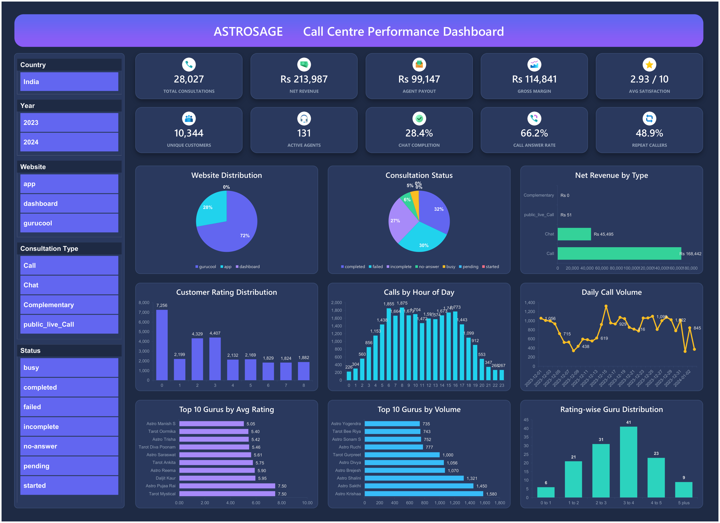
DASHBOARD
Pivot-driven · slicer-filtered · built in Excel
Interactive Excel Dashboard
WHAT IT REVEALS
Every KPI and chart is pivot-driven — slice by channel, platform or hour and the story behind the headline numbers appears at once:
▸ Reliability gap only ~28% of chats complete vs ~66% of calls — connection is the real bottleneck.
▸ Channel & platform Calls earn ~8.5× more revenue per consult; App monetises better than Gurucool.
▸ Quality spread guru ratings fan out from 0.10 to 5.95; ratings climb with session completion.
▸ Demand rhythm clear hourly & weekday peaks show exactly when to add staff.
AstroSage · Call Centre Performance Analysis
16

Slide 17
THE ANSWER
Subjective question 10
₹1 Crore Investment Allocation
THE PLAN
Technology
₹45 L
Technology (CRM, routing)
₹20 L
Repeat-caller retention
Repeat-caller Retention
₹1 Cr
₹20 L
Training & quality
Training & Quality
total
₹10 L
Peak & evening staffing
Peak & Evening Staffing
₹5 L
Analytics & monitoring
Analytics
Why? capacity is fine — connection reliability is the constraint.
AstroSage · Call Centre Performance Analysis
17

Slide 18
IN SUMMARY
From 28,027 consultations to a ₹1 Cr plan
Conclusion & Recommendations
1
Fix connection reliability first
THE BOTTOM LINE
Only 28% of chats complete and ~34% of calls go unanswered; failed sessions score 0/10 vs 7.0/10 once they connect — the biggest, fastest win.
37%
2
Protect & grow the repeat base
of chats never connect — fixing this one gap lifts satisfaction and unlocks the most revenue, fast.
48.9% of 10,344 customers are repeat callers, yet they drive 81% of volume and ~98% of net revenue. Fund CRM and loyalty to defend the core.
3
Close the guru quality gap
▸ Small base, big impact 48.9% repeat callers = 81% of volume and ~98% of revenue.
Ratings average just 2.9/10 and span 0.10 → 5.95. Coach the bottom with QA scorecards, codify the top gurus’ habits, and route premium callers to them.
▸ Uneven delivery ratings span 0.10–5.95; 19 of 131 agents do ~60% of the work.
4
Balance a lopsided workload
19 of 131 agents carry ~60% of volume (top 10 alone = 37%). Skill-based routing plus per-agent caps cut queues and prevent burnout.
▸ The ₹1 Cr plan reliability-first: ₹45L tech, ₹40L retention & training, ₹15L ops.
5
Staff the peaks, scale Calls
Fix connection reliability first — the rest compounds from there.
Demand peaks at 06–10 and 15–16 while night ratings fall to 1.7. Calls monetise 8.5× better than Chat (₹19.8 vs ₹2.33) — add cover, grow Calls.
AstroSage · Call Centre Performance Analysis
18

Slide 19
Thank You
Capacity is adequate — quality, consistency and monetisation are the real constraints.
Lead with training + technology, protect the 81% repeat base, and profit compounds.
₹2.14 L
revenue
54%
gross margin
81%
repeat volume
₹1 Cr
data-backed plan
AstroSage · Call Centre Performance Analysis

