Slide 1
ANALYTICAL CRM · CAPSTONE
Reducing Customer
Churn with Data
20.37%
OVERALL CHURN
2,037
CUSTOMERS LOST
Who is leaving, why, and how to keep them — from 10,000 customer records.
5
SEGMENTS TO FIX
SQL + Excel + Power BI | 10,000 customers | 26 objective + 14 subjective answers, data-verified
Prepared by the Data & CRM Analytics team

Slide 2
The story in one slide
CHURN CRM
▲
◆
●
★
%
82.7%
32.4%
26.9%
44.7%
20.4%
3-product churn
Germany churn
Inactive churn
Over-50 churn
Overall churn
vs 7.6% at two
2× France & Spain
vs 14.3% active
steepest of all ages
2,037 of 10,000
So what? Churn concentrates in a handful of segments — multi-product, Germany, the inactive and the over-50s. Fix those and the bank keeps its most valuable customers with far less spend.
Bank Customer Churn · Analytical CRM · 2016–2019
01

Slide 3
The portfolio at a glance
CHURN CRM
●
▲
✓
10,000
20.37%
7,963
Total customers
Churn rate
Retained
the full book
2,037 lost
79.6% of base
€
●
◆
€76,486
51.5%
70.6%
Avg balance
Active members
Card holders
€764M on deposit
half are engaged
little churn effect
Bank Customer Churn · Analytical CRM · 2016–2019
02

Slide 4
How these numbers were built
CHURN CRM
Objective Question 14, 24, 26
The data
The cleaning
The toolchain
10,000
735 rows
SQL · BI
customer records, consolidated from 7 source tables into one model.
impossible active-yet-exited records fixed; no missing values remain.
queried in MySQL, modelled in Excel, visualised in Power BI.
Reproducible. Every figure in this deck traces back to the SQL queries and the consolidated data model.
Bank Customer Churn · Analytical CRM · 2016–2019
03

Slide 5
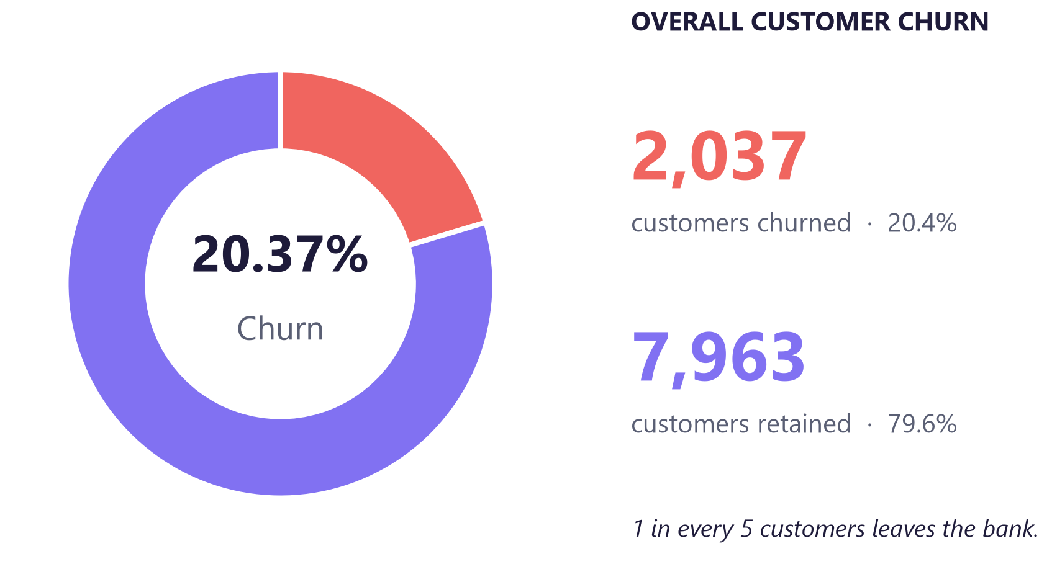
One in five customers walks out
CHURN CRM
Subjective Question 11
WHAT IT MEANS
◆ 1 in 5 is gone. 2,037 of 10,000 customers left — a 20.4% hole in the book.
◆ That's real money. leavers walked out with their balances and fee income.
◆ Most still stay. 7,963 customers (79.6%) remain and are worth defending.
◆ It's not random. churn clusters in a handful of segments we can name.
◆ So it's fixable. target those segments and the rate comes down.
Bank Customer Churn · Analytical CRM · 2016–2019
04

Slide 6
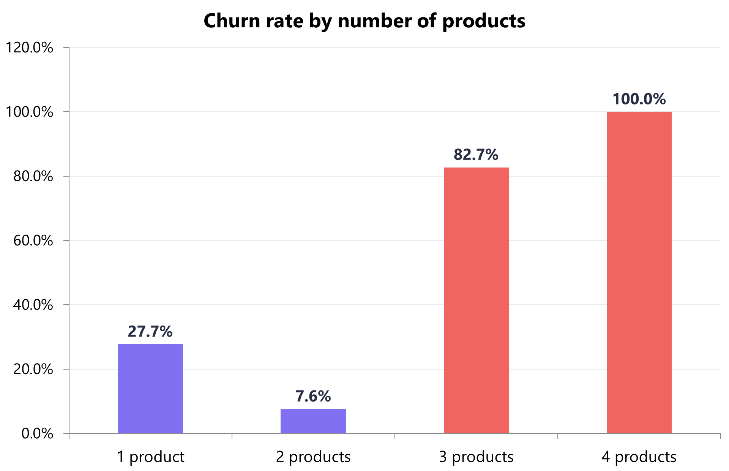
Product holding is the biggest signal
CHURN CRM
Objective Question 10, 12 | Subjective Question 2
WHAT IT MEANS
◆ Two is the sweet spot. just 7.6% churn when customers hold two products.
◆ Three or four is fatal. 82.7% then 100% walk out — effectively everyone.
◆ Not loyalty — friction. it reads like mis-selling on multi-product ties.
◆ Pause the push. stop aggressive 3rd/4th-product selling now.
◆ Rescue the 326. the customers already stuck at 3–4 products.
Bank Customer Churn · Analytical CRM · 2016–2019
05

Slide 7
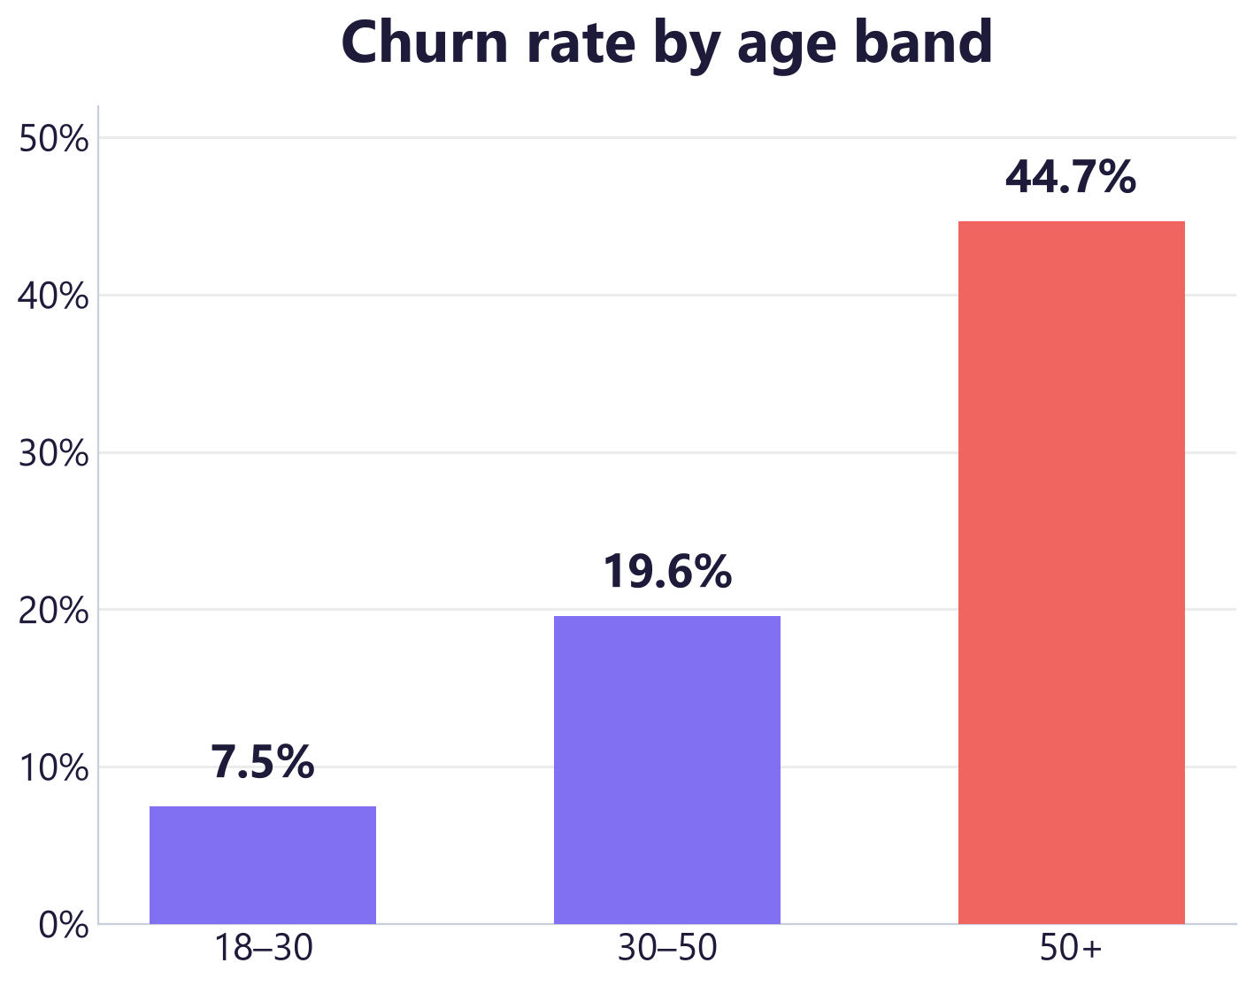
Churn climbs steeply with age
CHURN CRM
Objective Question 16 | Subjective Question 9
WHAT IT MEANS
◆ Youth stay. only 7.5% of 18–30s leave — barely a problem.
◆ Over-50s are the risk. 44.7% walk out — six times the youngest band.
◆ The middle is the volume. 30–50s are the largest group (6,771) at 19.6%.
◆ Service is the gap. our offer clearly isn't landing with older customers.
◆ Fix older first. biggest rate, clearest opportunity to act.
Bank Customer Churn · Analytical CRM · 2016–2019
06

Slide 8
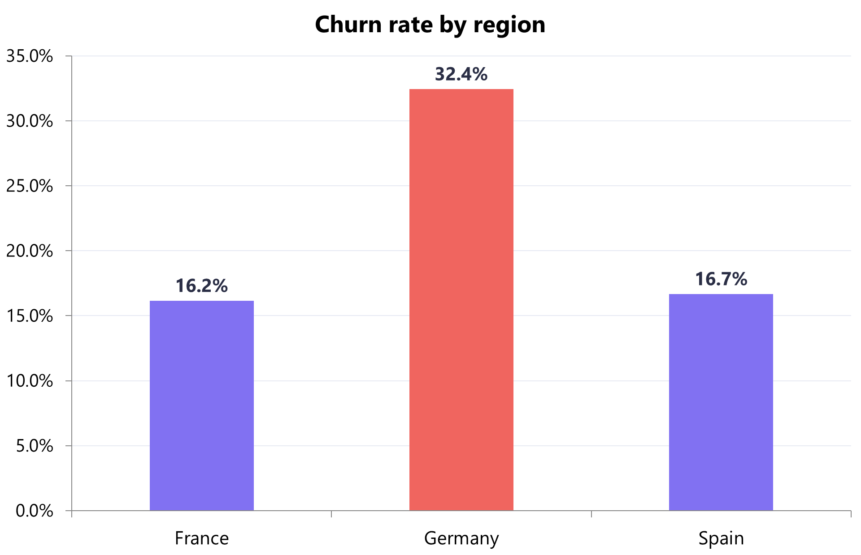
Germany loses the richest accounts
CHURN CRM
Objective Question 1, 21 | Subjective Question 3
WHAT IT MEANS
◆ Worst market by far. 32.4% churn — double France and Spain.
◆ Highest value too. German customers carry our biggest balances.
◆ So the pain doubles. we lose more customers and more money each.
◆ It needs its own play. review pricing, product fit and service.
◆ Call the big balances. proactive outreach to high-value Germans.
Bank Customer Churn · Analytical CRM · 2016–2019
07

Slide 9
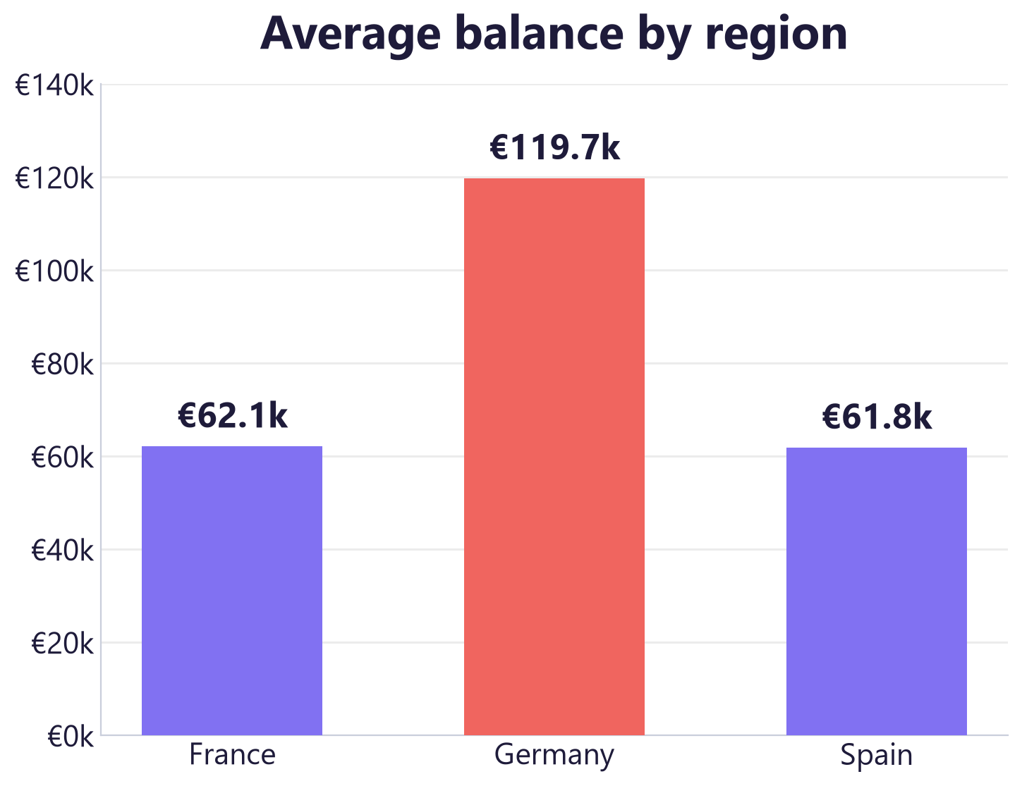
Germany holds the richest balances
CHURN CRM
Objective Question 1 | Subjective Question 3
WHAT IT MEANS
◆ Germany is the money. €119.7k average balance — nearly double France & Spain.
◆ Huge concentration. about €300M sits with just 2,509 customers.
◆ And it leaks fastest. Germany also churns at 32.4% — the worst market.
◆ Double the damage. each German loss costs roughly two French ones.
◆ Defend it now. a German retention play protects the richest book.
Bank Customer Churn · Analytical CRM · 2016–2019
08

Slide 10
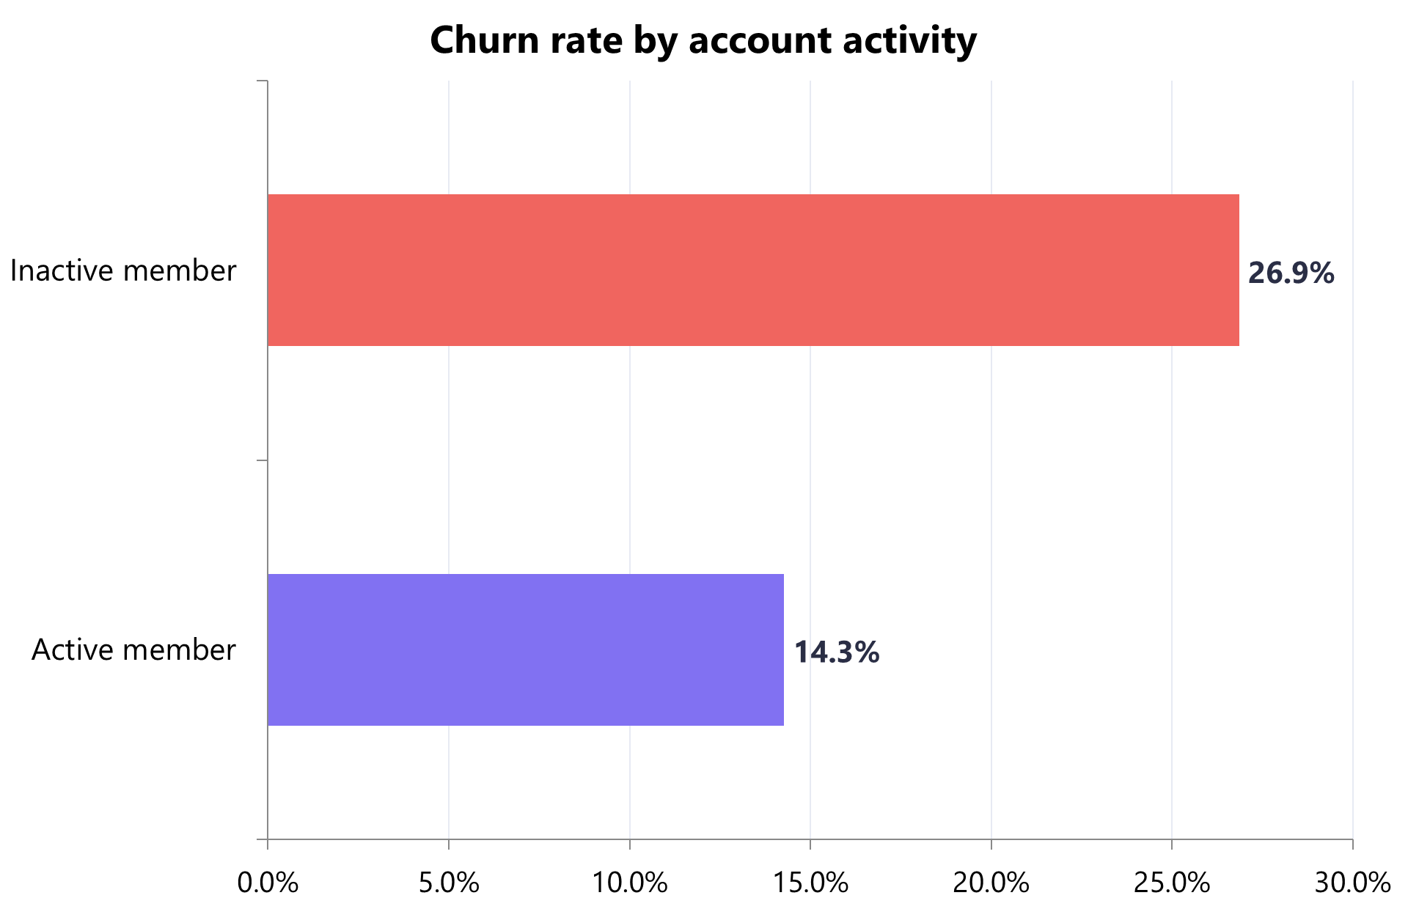
Inactive & older customers leave most
CHURN CRM
Subjective Question 7, 8
WHAT IT MEANS
◆ Inactivity is a red flag. 26.9% churn vs 14.3% for active members.
◆ Age compounds it. over-50s leave at 44.7% — the steepest band.
◆ Together they're lethal. an inactive over-50 is our highest-risk customer.
◆ Re-engage the dormant. a programme for the 4,849 inactive customers.
◆ Older ones first. they carry the steepest rate of all.
Bank Customer Churn · Analytical CRM · 2016–2019
09

Slide 11
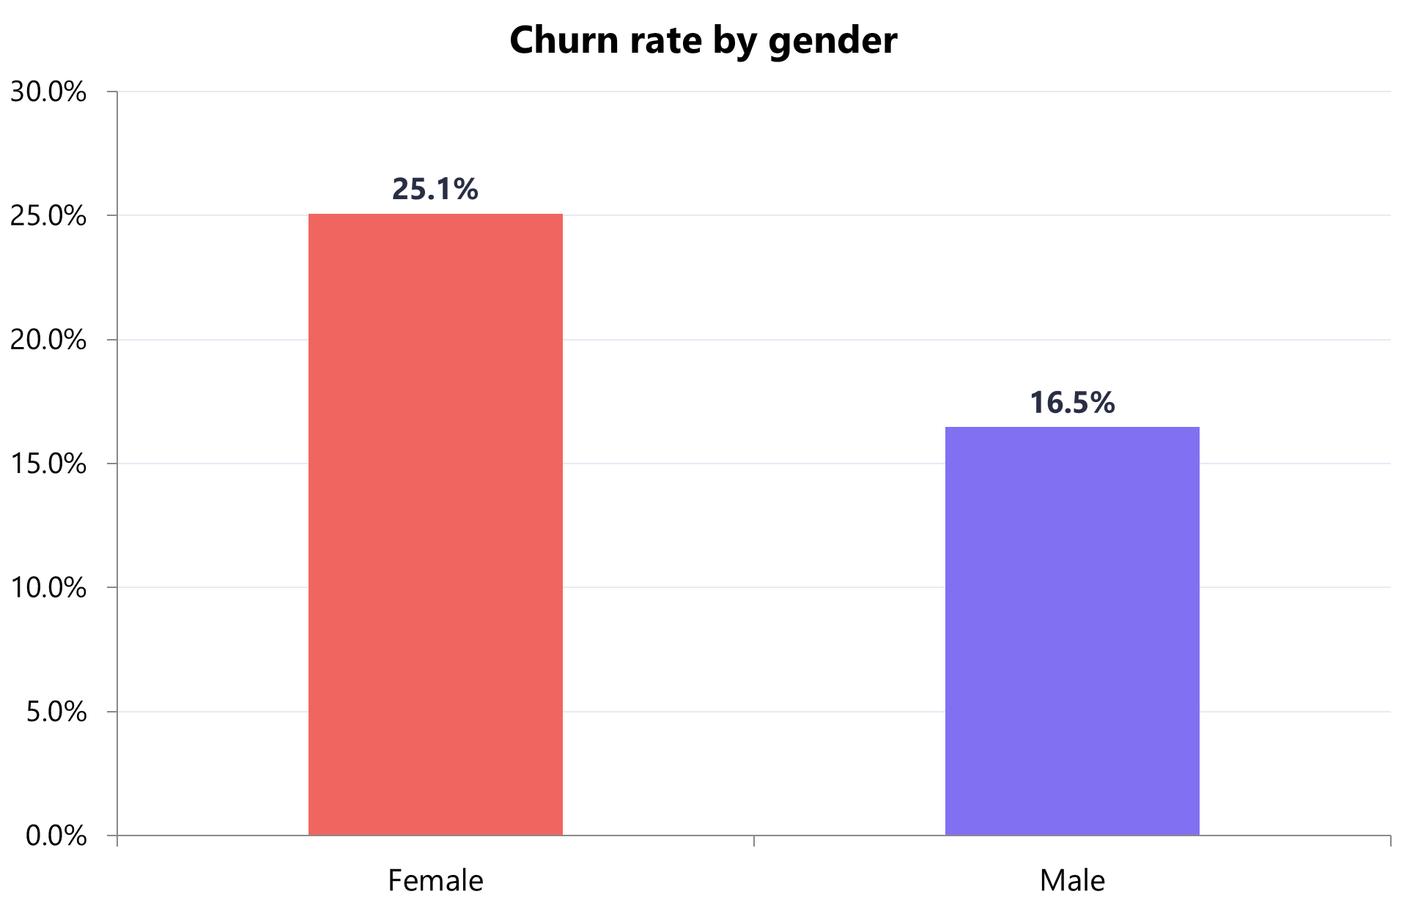
Women churn more than men
CHURN CRM
Objective Question 4 | Subjective Question 7
WHAT IT MEANS
◆ A clear gap. 25.1% of women leave vs 16.5% of men.
◆ It's consistent. the gap holds across age and region.
◆ Something's off. the product or service fits women less well.
◆ Review the journey. map exactly where women drop out.
◆ Pair the fixes. combine with the age and inactivity plays.
Bank Customer Churn · Analytical CRM · 2016–2019
10

Slide 12
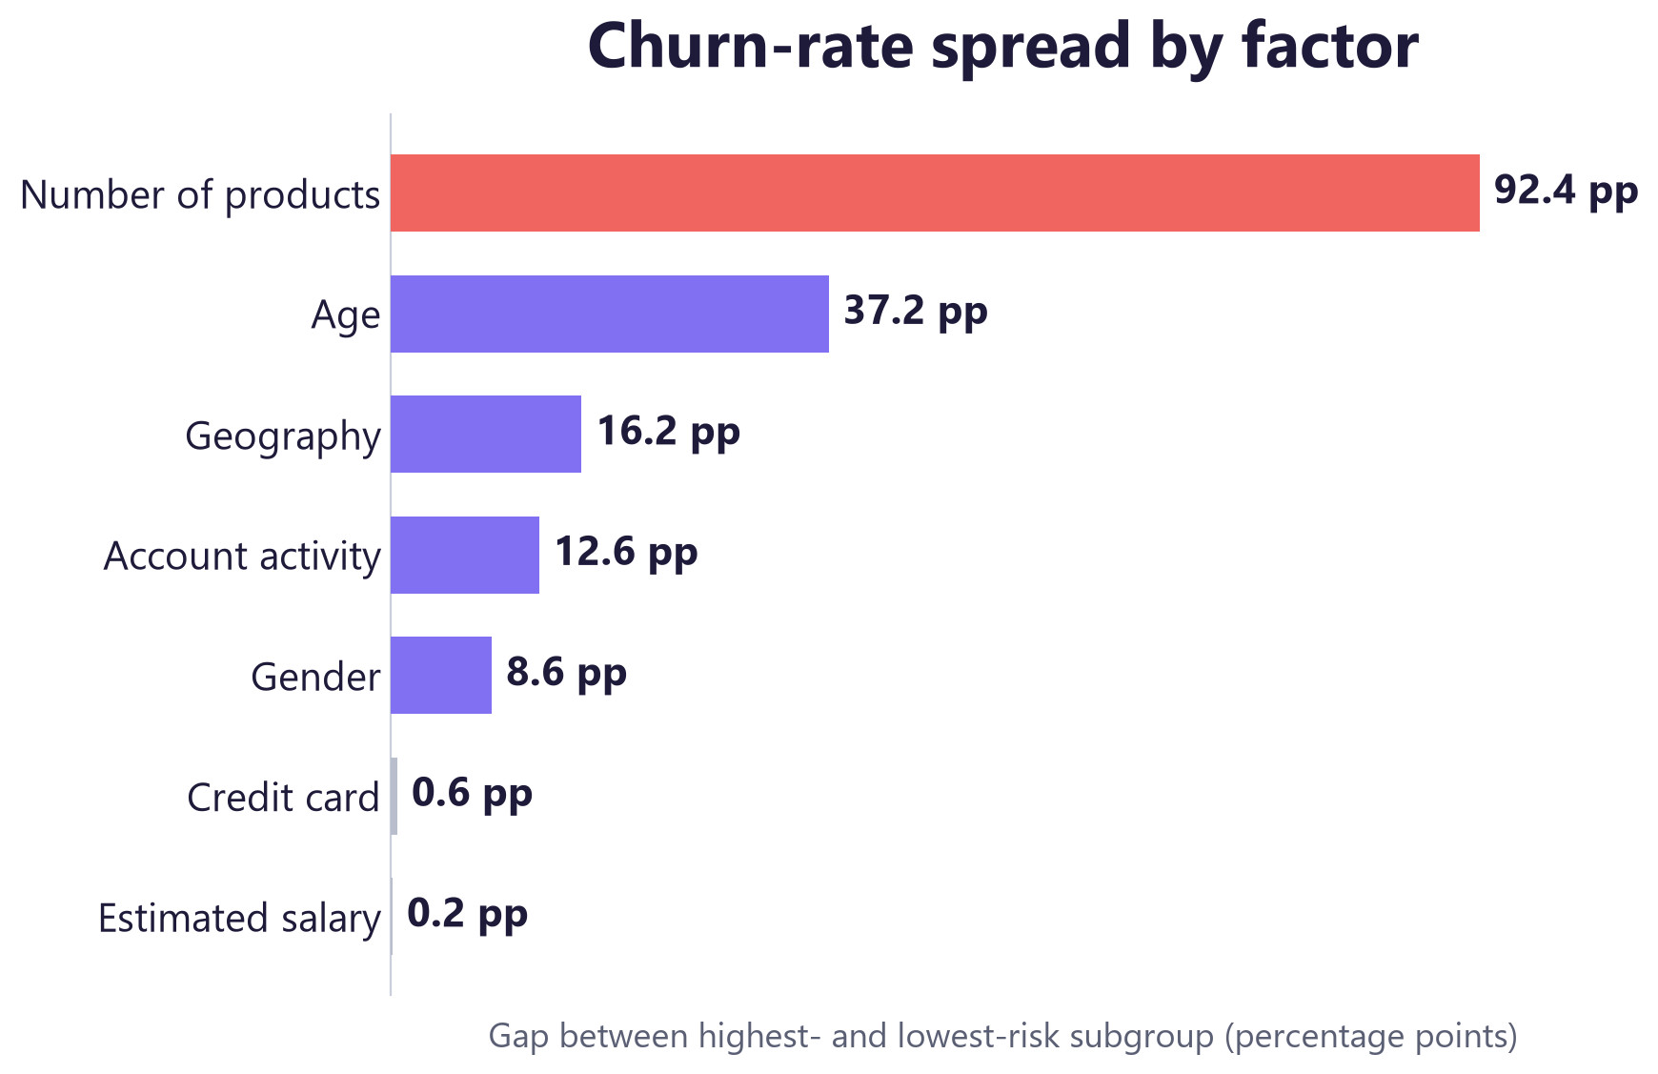
What drives churn — and what doesn't
CHURN CRM
Subjective Question 7, 8
WHAT IT MEANS
◆ Products are everything. a 92-point swing dwarfs every other factor.
◆ Age & geography matter. 37 and 16 points of spread — worth acting on.
◆ Activity & gender help. 13 and 9 points — useful for targeting.
◆ Card & salary don't. under 1 point of difference — stop spending there.
◆ Focus wins. fix the top three drivers, ignore the rest.
Bank Customer Churn · Analytical CRM · 2016–2019
11

Slide 13
Where NOT to spend
CHURN CRM
Objective Question 5, 9, 17
Credit card
Credit score
Estimated salary
20.2% vs 20.8%
645 vs 652
r ≈ 0.00
Holding a card barely changes churn (0.6 pt).
Leavers and stayers score almost the same.
No link to churn, balance or credit score.
Bottom line. Skip credit-card incentives and salary/score targeting for churn. Put the money into products, activity, geography and age.
Bank Customer Churn · Analytical CRM · 2016–2019
12

Slide 14
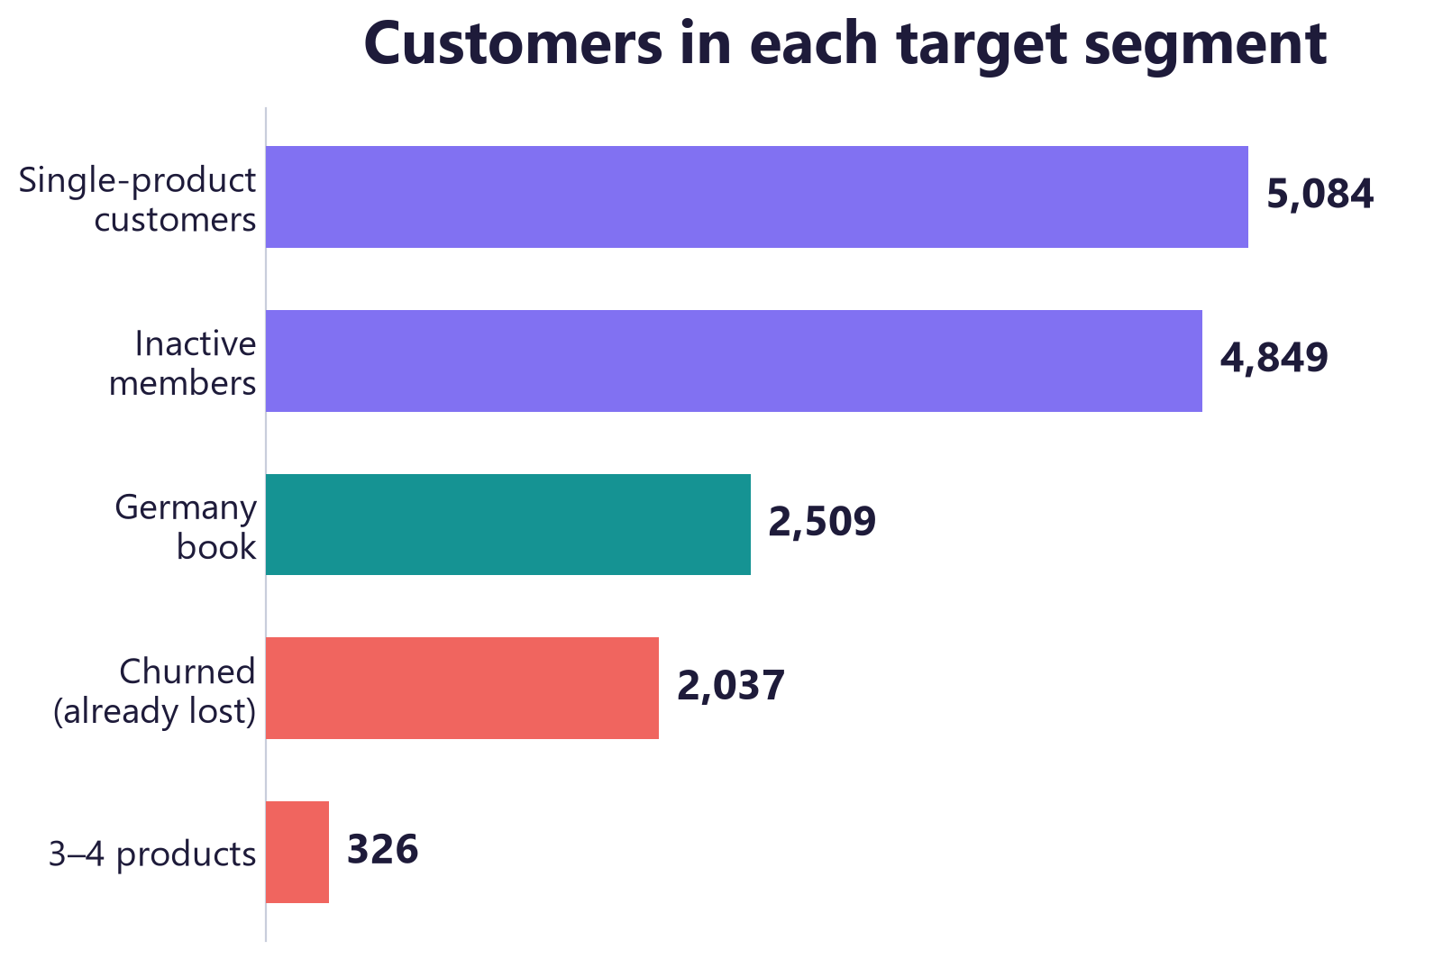
The opportunity, sized
CHURN CRM
Subjective Question 4
WHAT IT MEANS
◆ Biggest pool: singles. 5,084 one-product customers to move up to two.
◆ Fastest win: inactive. 4,849 dormant members churning at 26.9%.
◆ Richest to defend: Germany. 2,509 high-value accounts in the worst market.
◆ Small but certain. 326 at 3–4 products churn almost completely.
◆ Clear order of play. singles, then inactive, then Germany.
Bank Customer Churn · Analytical CRM · 2016–2019
13

Slide 15
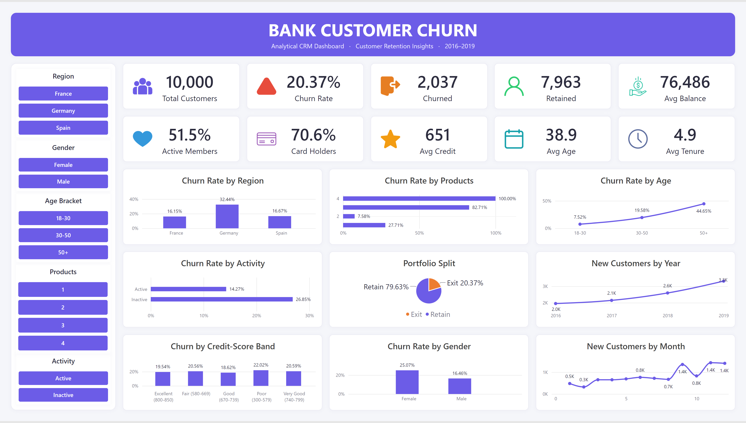
One interactive view for management
CHURN CRM
◆ 10 KPIs at a glance: churn, balance, activity and tenure.
◆ 9 churn break-down: region product, age, activity, gender and credit.
◆ Fully interactive - Region, Gender, Age & Products slicers filter every visual.
◆ A clean, centered title layout, built for easy reading by management.
Bank Customer Churn · Analytical CRM · 2016–2019
14

Slide 16
Recommendations
CHURN CRM
Subjective Question 4, 7
1
Fix the multi-product experience
Pause aggressive 3rd/4th-product selling; save the 326 at-risk customers.
2
Stand up a Germany retention play
Review pricing, product fit and service; call high-balance German customers.
3
Activate the inactive
Re-engagement programme for the 4,849 inactive customers (26.9% churn).
4
Convert single-product to two
Move the 5,084 single-product customers into the safe 7.6% band.
5
Look after older & female customers
Dedicated service review for over-50s (44.7%) and women (25.1%).
Bank Customer Churn · Analytical CRM · 2016–2019
15

Slide 17
Churn is concentrated — and therefore fixable.
Target the five segments and the bank protects its most valuable customers with far less spend than a broad campaign would need.
Thank you — questions welcome.

