Slide 1

Winning the
Mega-Auction with Data
Who to buy, how to play, and why RCB haven't won — from four seasons of ball-by-ball data.
SQL + Excel analytics | 60,223 deliveries | 15 objective answers, data-verified

Slide 2
Top-performers, value-for-money players
THE BRIEF
◆ The goal. Win a first title — sign reliable, high-impact players and spend smart at the 2017 mega-auction.
◆ The method. Answer all 15 objective questions with verified SQL, then turn the evidence into a buying plan.
◆ The proof. Every KPI is computed from ball-by-ball data and cross-checked in Excel — SQL, tables and charts agree.
60,223
deliveries analysed
255
matches
20
linked tables
14
charts built
Royal Challengers Bangalore · Mega-Auction Analytics · 2013–2016
01

Slide 3
Five findings that shape the strategy
▲
▼
⌂
★
»
8.37
RCB run-rate
Fastest identity (lg 7.70)
9.76
Death economy
The one clear weakness
59%
Home win-rate
Fortress vs 45% away
90%
Win posting 200+
First-innings runs decide
55.6%
Chase win-rate
Fielding first beats 43%
So what? RCB out-bat the league but keep losing the death overs. Fix the bowling, keep the batting — and the title math changes.
Royal Challengers Bangalore · Mega-Auction Analytics · 2013–2016
02

Slide 4
The database schema
PK primary key FK foreign key → arrow points from a foreign key to the table it references
■ fact ■ match / dimension ■ reference
Extra_Runs
Ball_by_Ball
Wicket_Taken
PK Match · Over · Ball · Innings
FK Extra_Type_Id
Extra_Runs (value)
PK Match · Over · Ball · Innings
FK Striker · Non_Striker · Bowler · Teams
Runs_Scored
PK Match · Over · Ball · Innings
FK Player_Out · Kind_Out
Fielders
Matches
Player
Team
PK Match_Id
FK Teams · Season · Venue · Toss
Match_Date · Win_Margin
PK Player_Id
FK Batting_hand · Bowling_skill · Country
Player_Name · DOB
PK Team_Id
Team_Name · 8 franchises
Season
Venue
Player_Match
City
Country
PK Season_Id
Season_Year · Caps
PK Venue_Id
FK City_Id
Venue_Name
PK Match_Id + Player_Id
FK Role_Id · Team_Id
PK City_Id
FK Country_id
City_Name
PK Country_Id
Country_Name
REFERENCE / LOOKUP TABLES
Batting_Style
Bowling_Style
Toss_Decision
Win_By
Outcome
Out_Type
Extra_Type
Rolee
Umpire
PK Batting_Id
PK Bowling_Id
PK Toss_Id
PK Win_Id
PK Outcome_Id
PK Out_Id
PK Extra_Id
PK Role_Id
PK Umpire_Id
Royal Challengers Bangalore · Mega-Auction Analytics · 2013–2016
03

Slide 5
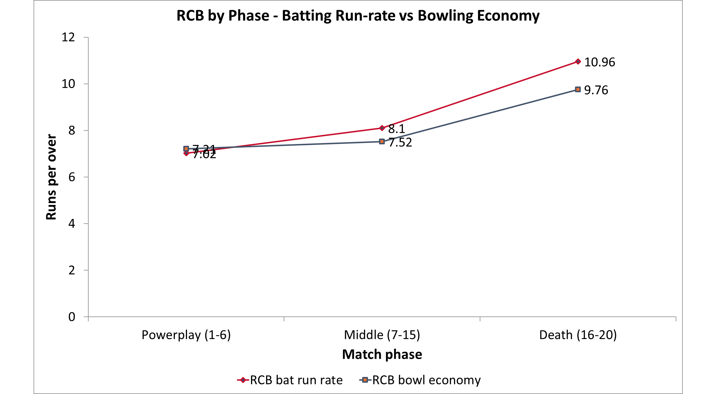
Firepower up front, leakage at the death
WHAT IT MEANS
◆ Elite finishers. RCB score 10.96 runs/over in the death overs — among the best.
◆ But they leak. They concede 9.76/over at the death; games slip away here.
◆ Highest-leverage fix. Buying death bowling is the single biggest improvement available.
Royal Challengers Bangalore · Mega-Auction Analytics · 2013–2016
04

Slide 6
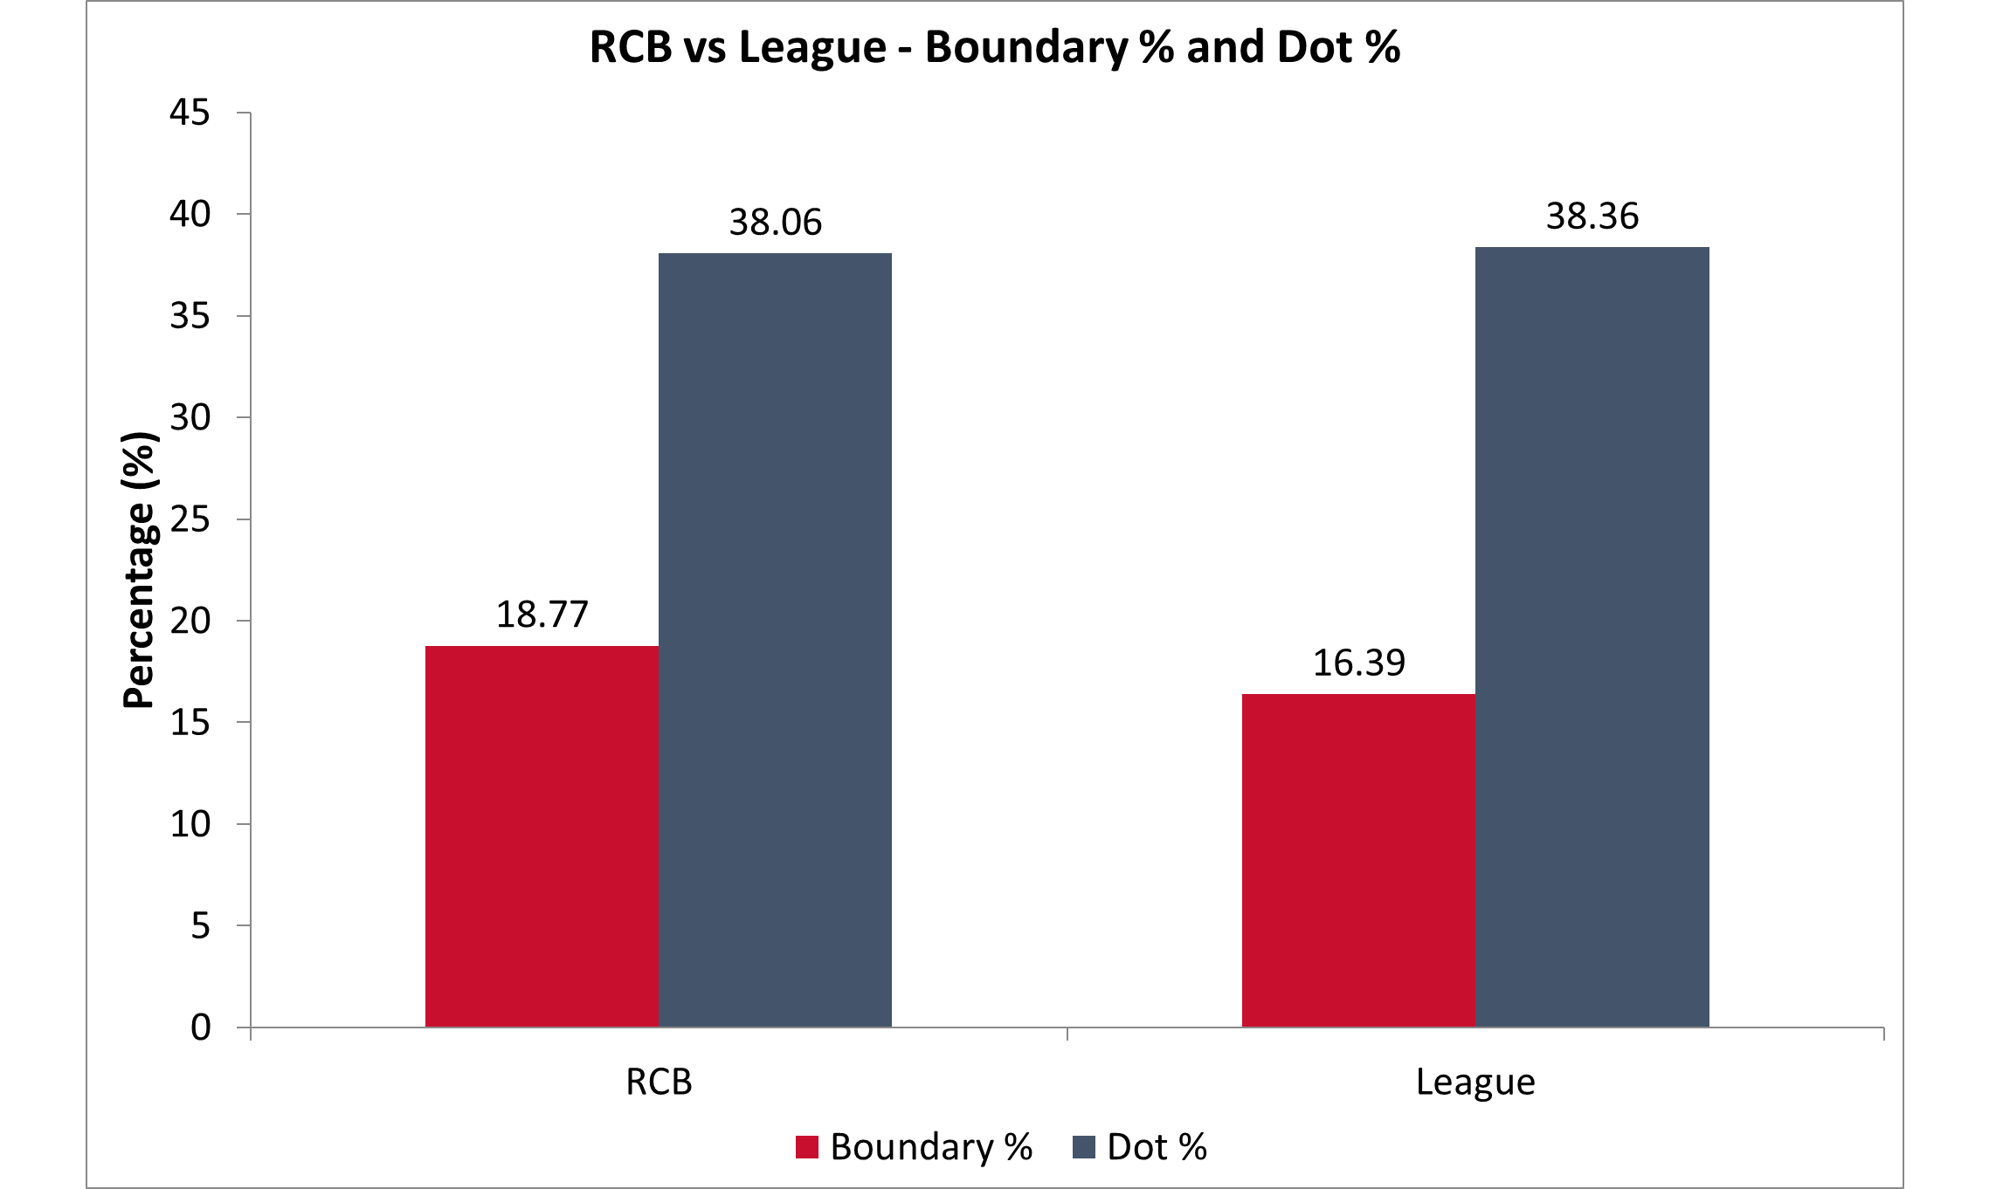
RCB out-hit the league
WHAT IT MEANS
◆ More boundaries. 18.8% of balls find the rope vs 16.4% league-wide.
◆ Same risk. Dot-ball rate is in line with the league — aggression without extra danger.
◆ Recruit to sustain it. Target stroke-makers who keep this up on a fast outfield.
Royal Challengers Bangalore · Mega-Auction Analytics · 2013–2016
05

Slide 7
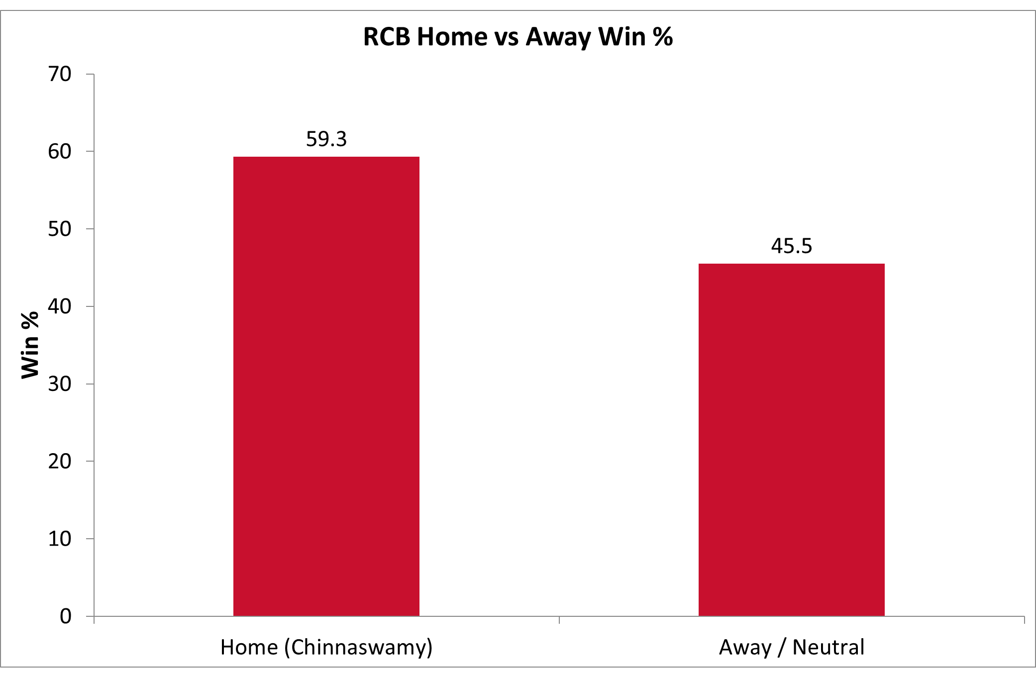
Chinnaswamy is a fortress
WHAT IT MEANS
◆ Big home edge. RCB win 59.3% at Chinnaswamy vs 45.5% away.
◆ Attack the deck. It's a flat, high-scoring ground made for stroke-play.
◆ Recruit for it. Favour players with a strong record at home.
Royal Challengers Bangalore · Mega-Auction Analytics · 2013–2016
06

Slide 8
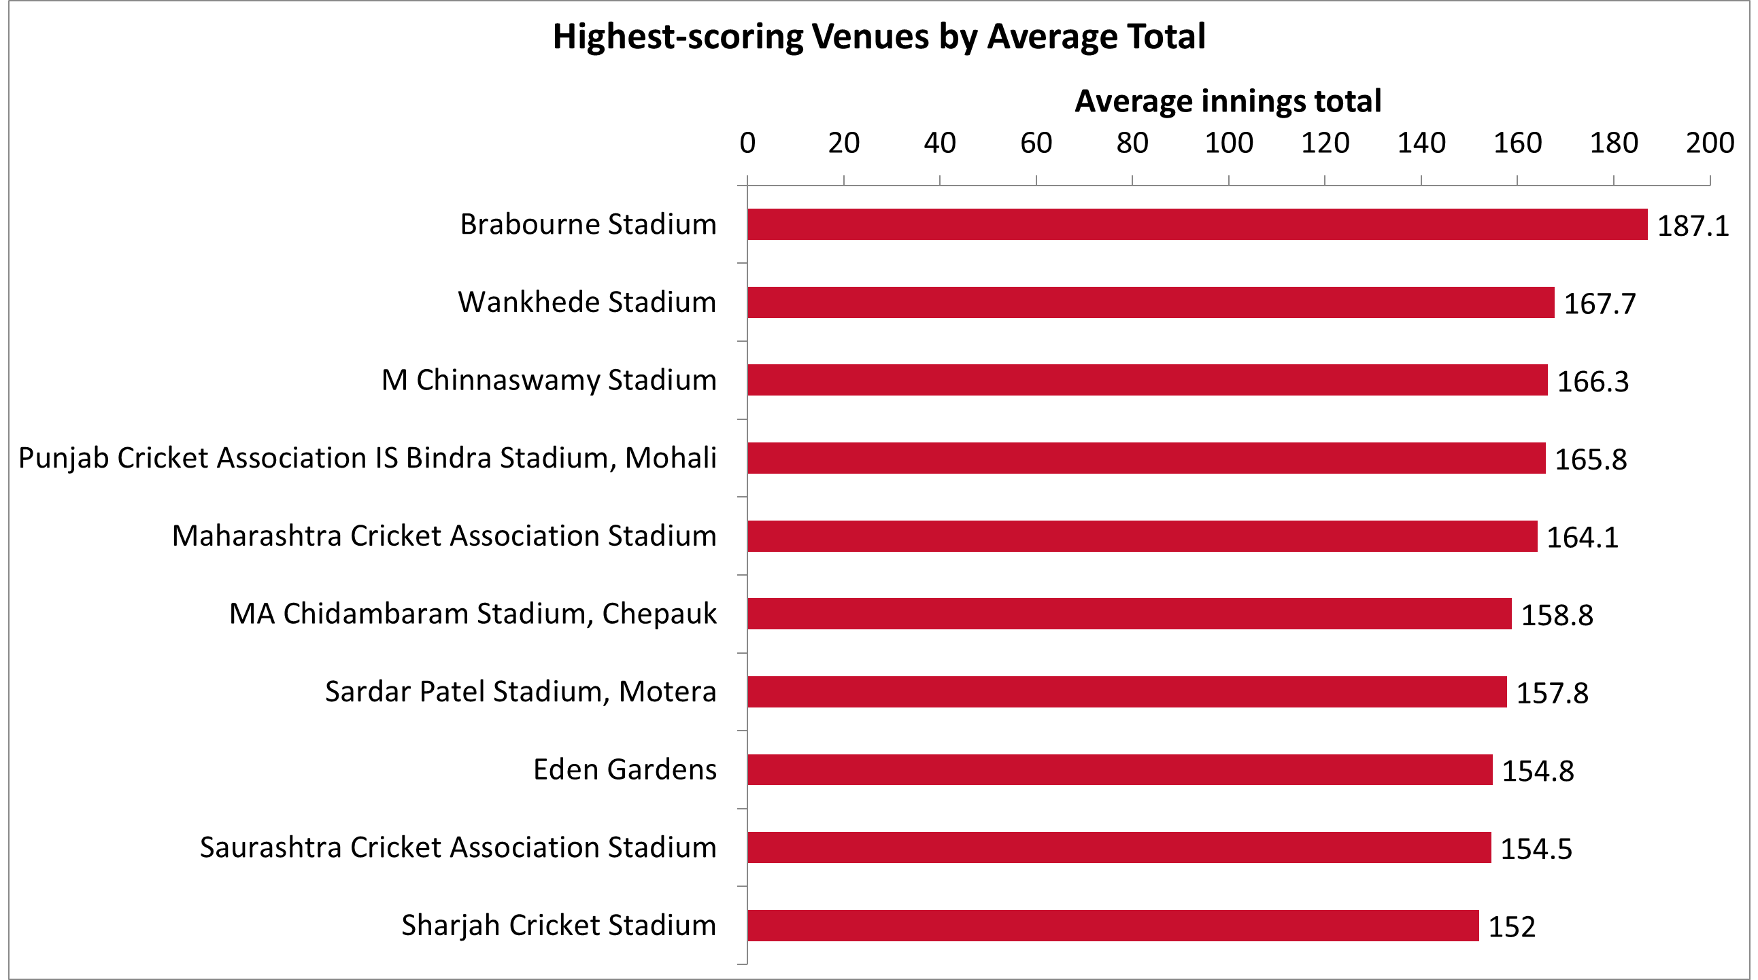
Recruit for high-scoring grounds
WHAT IT MEANS
◆ Runs galore. Chinnaswamy is among the league's highest-scoring venues.
◆ Do not leak. Flat decks reward big hitters and punish costly bowling.
◆ Buy accordingly. Prioritise power hitters and economical death bowlers.
Royal Challengers Bangalore · Mega-Auction Analytics · 2013–2016
07

Slide 9
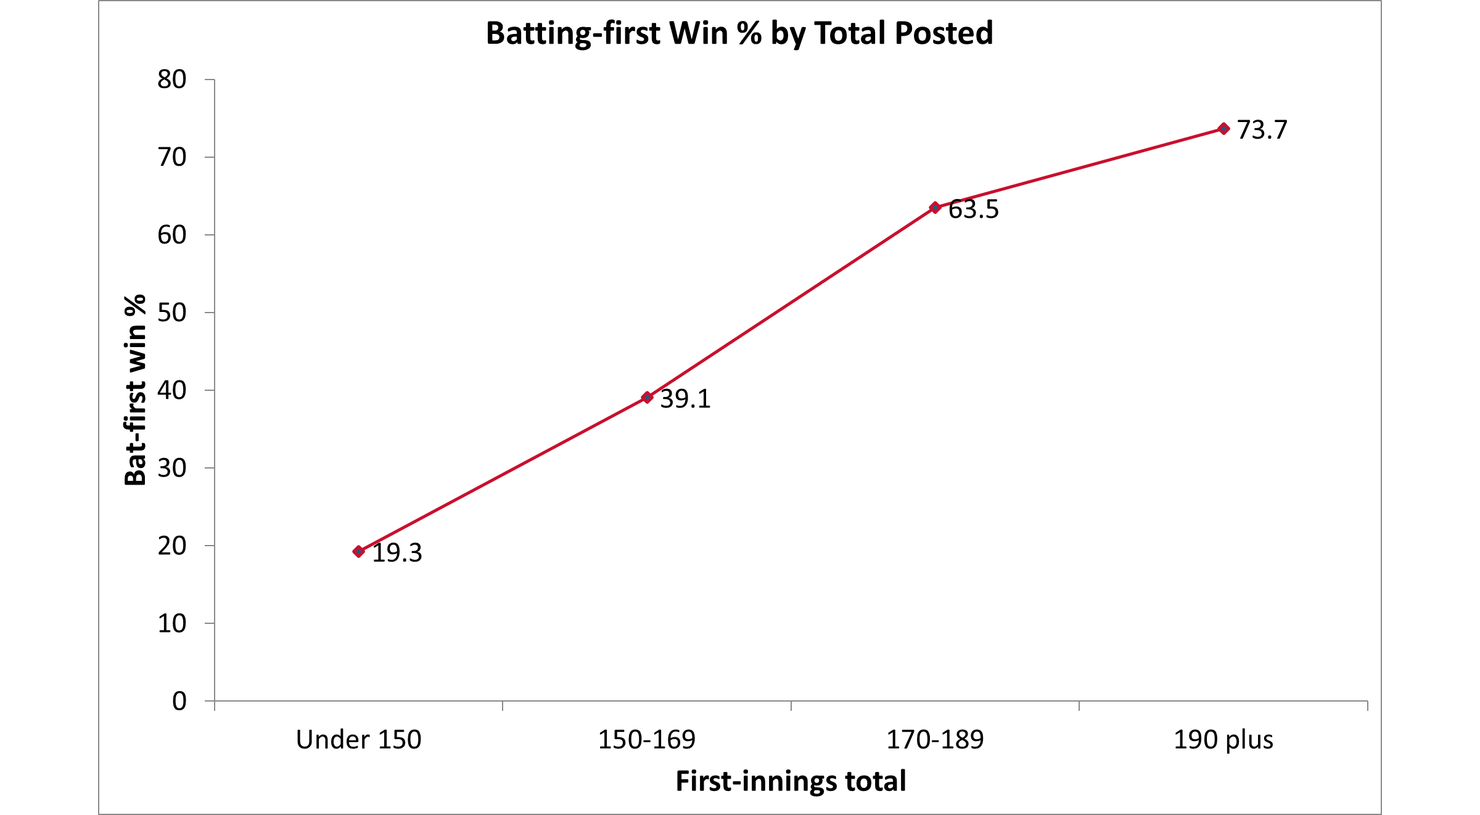
Set a big total, win the match
WHAT IT MEANS
◆ Runs are gold. Posting 180+ wins ~60%; 200+ wins 90% of the time.
◆ Dots are fatal. Totals under 140 are defended just 18% of the time.
◆ Plan, not luxury. At this venue power-hitting depth is the game plan.
Royal Challengers Bangalore · Mega-Auction Analytics · 2013–2016
08

Slide 10
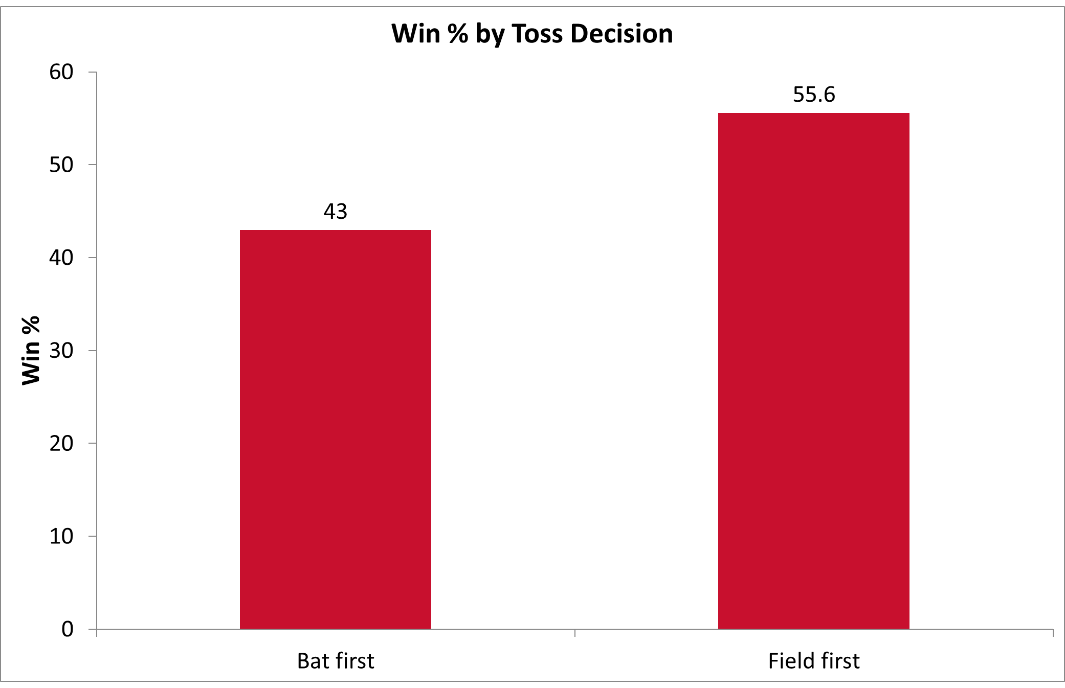
Default to bowling
WHAT IT MEANS
◆ Chasing wins. Fielding first wins 55.6% of matches vs 43.0% batting first.
◆ Win toss, bowl. Make chasing the default plan at the toss.
◆ Stay flexible. Override where a venue clearly rewards batting first.
Royal Challengers Bangalore · Mega-Auction Analytics · 2013–2016
09

Slide 11
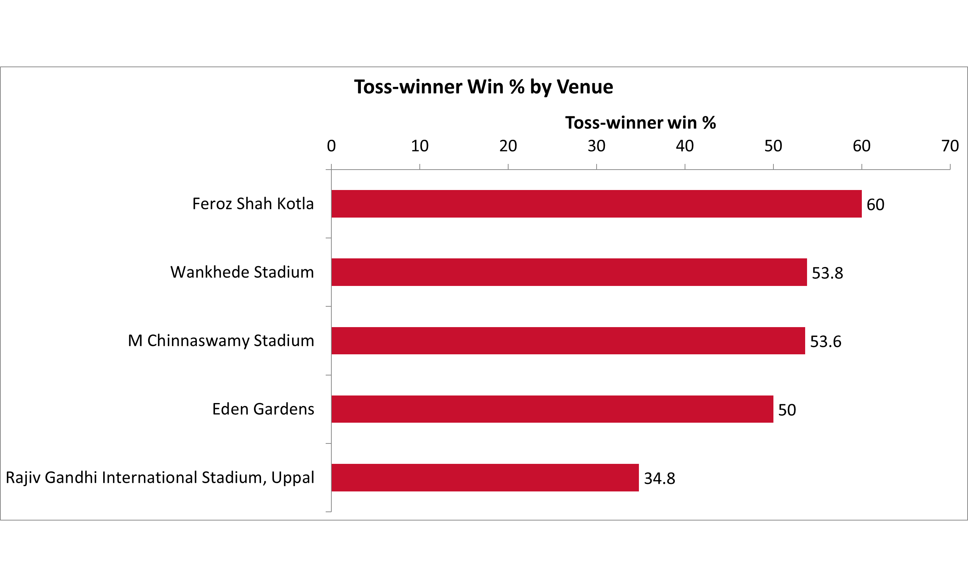
But read the venue
WHAT IT MEANS
◆ It flips by ground. The toss edge swings from ~35% to ~60% across venues.
◆ No blanket rule. The right call depends on the specific stadium.
◆ Plan per venue. Set the toss decision ground-by-ground.
Royal Challengers Bangalore · Mega-Auction Analytics · 2013–2016
10

Slide 12
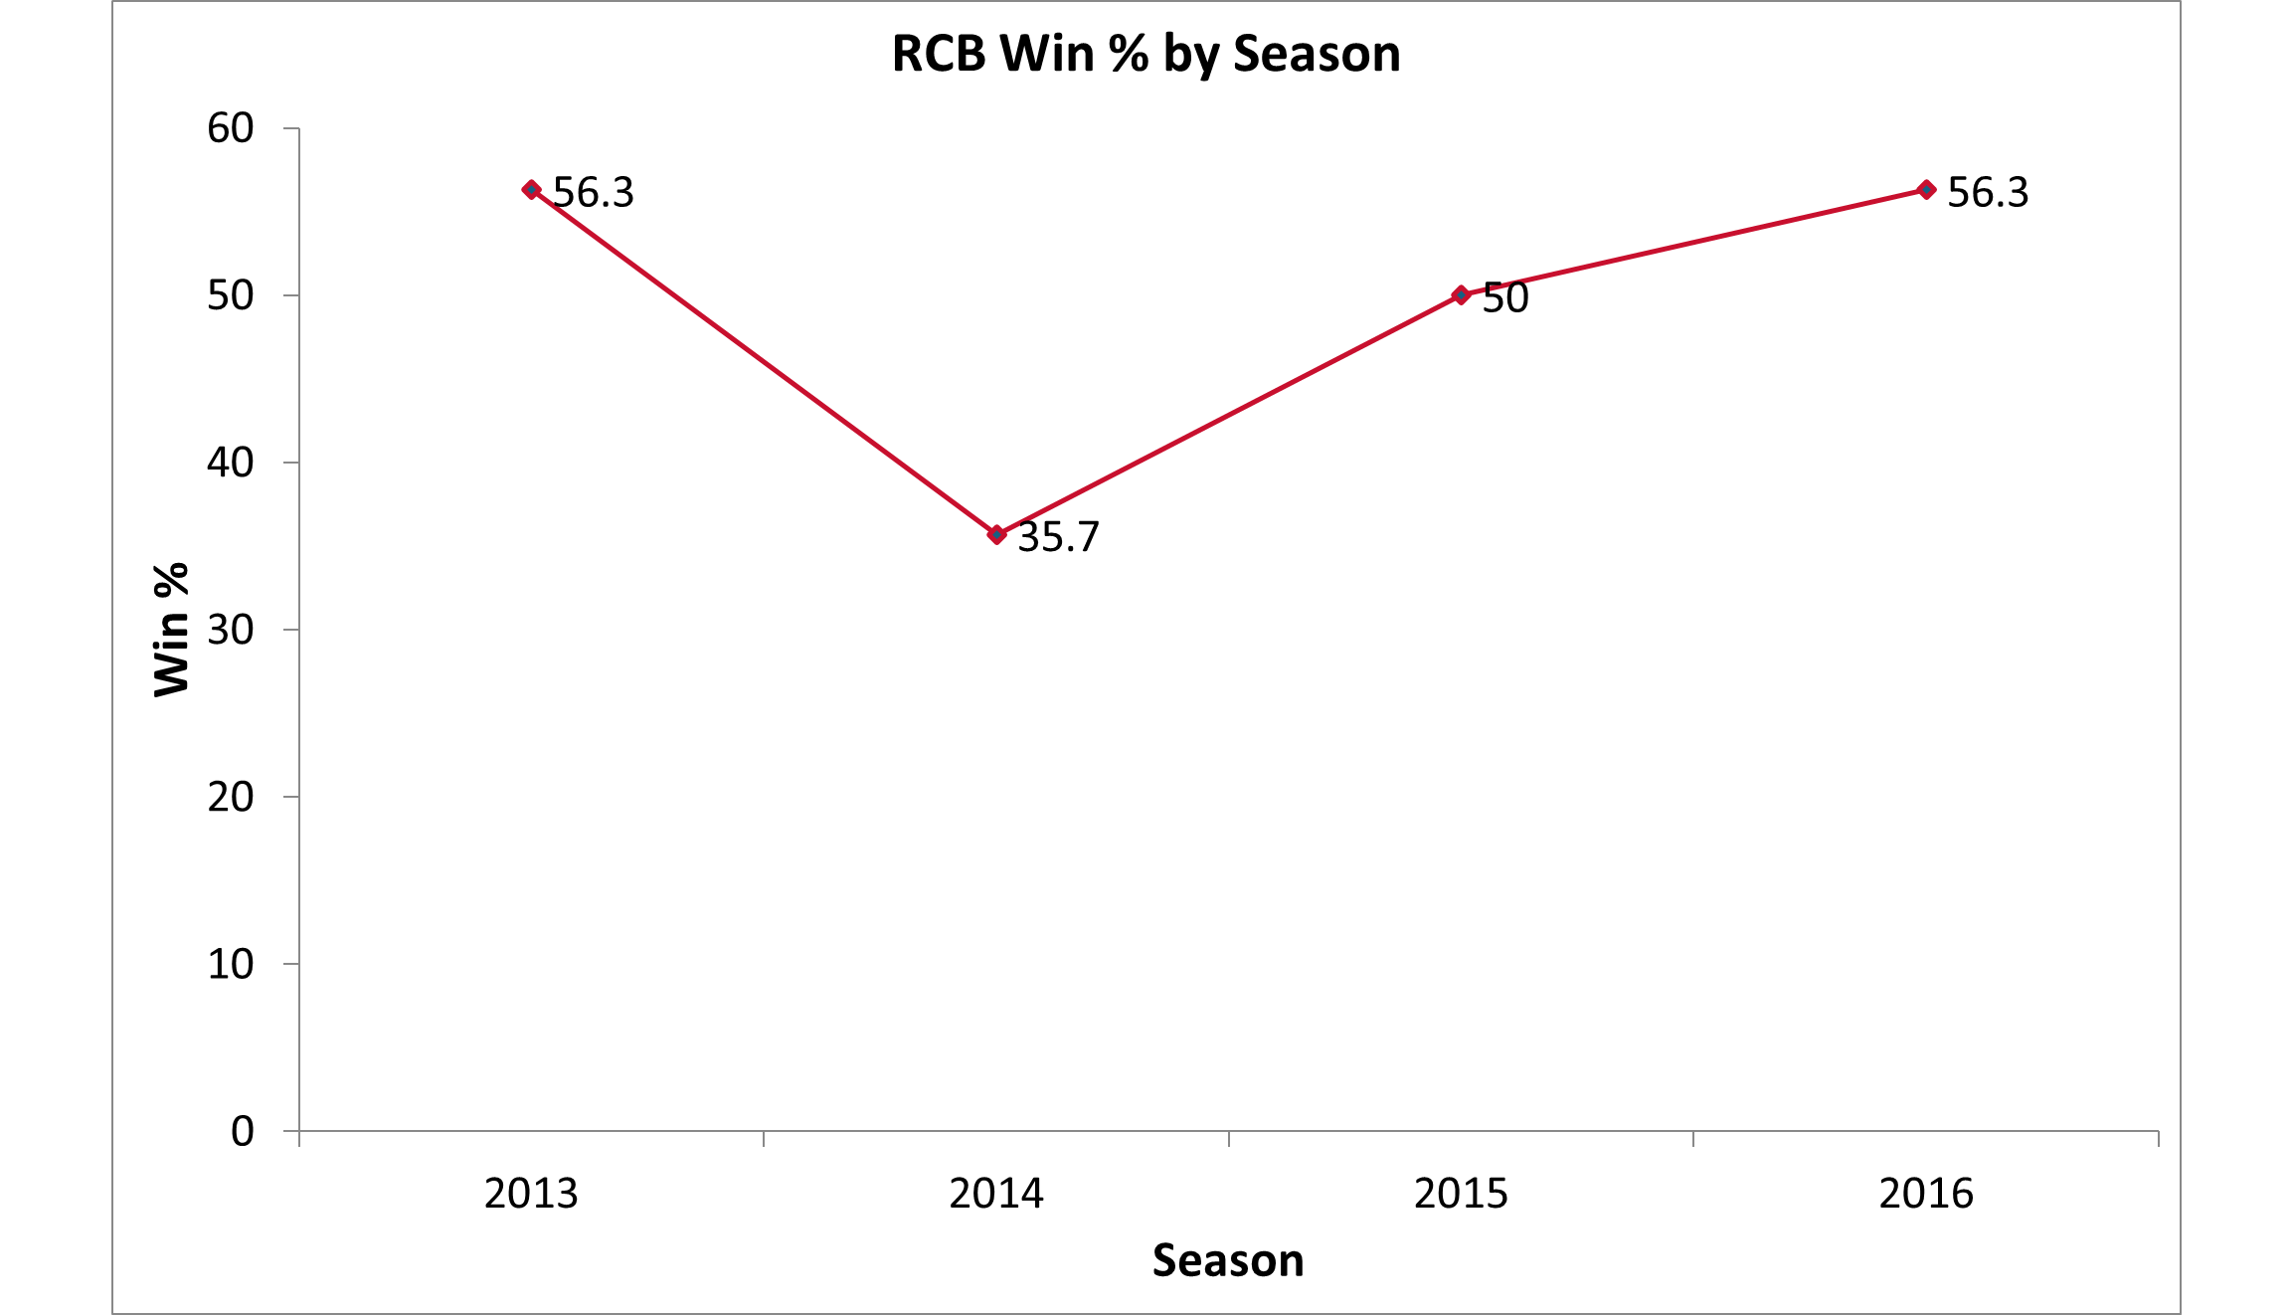
Competitive, never dominant
WHAT IT MEANS
◆ Stuck mid-table. Win-rate sits in a 36–56% band — never the league's best side.
◆ Batting carries them. Elite batting is undercut by bowling that can't close games.
◆ Balance wins titles. Buy the bowling and add an all-rounder to break the drought.
Royal Challengers Bangalore · Mega-Auction Analytics · 2013–2016
11

Slide 13
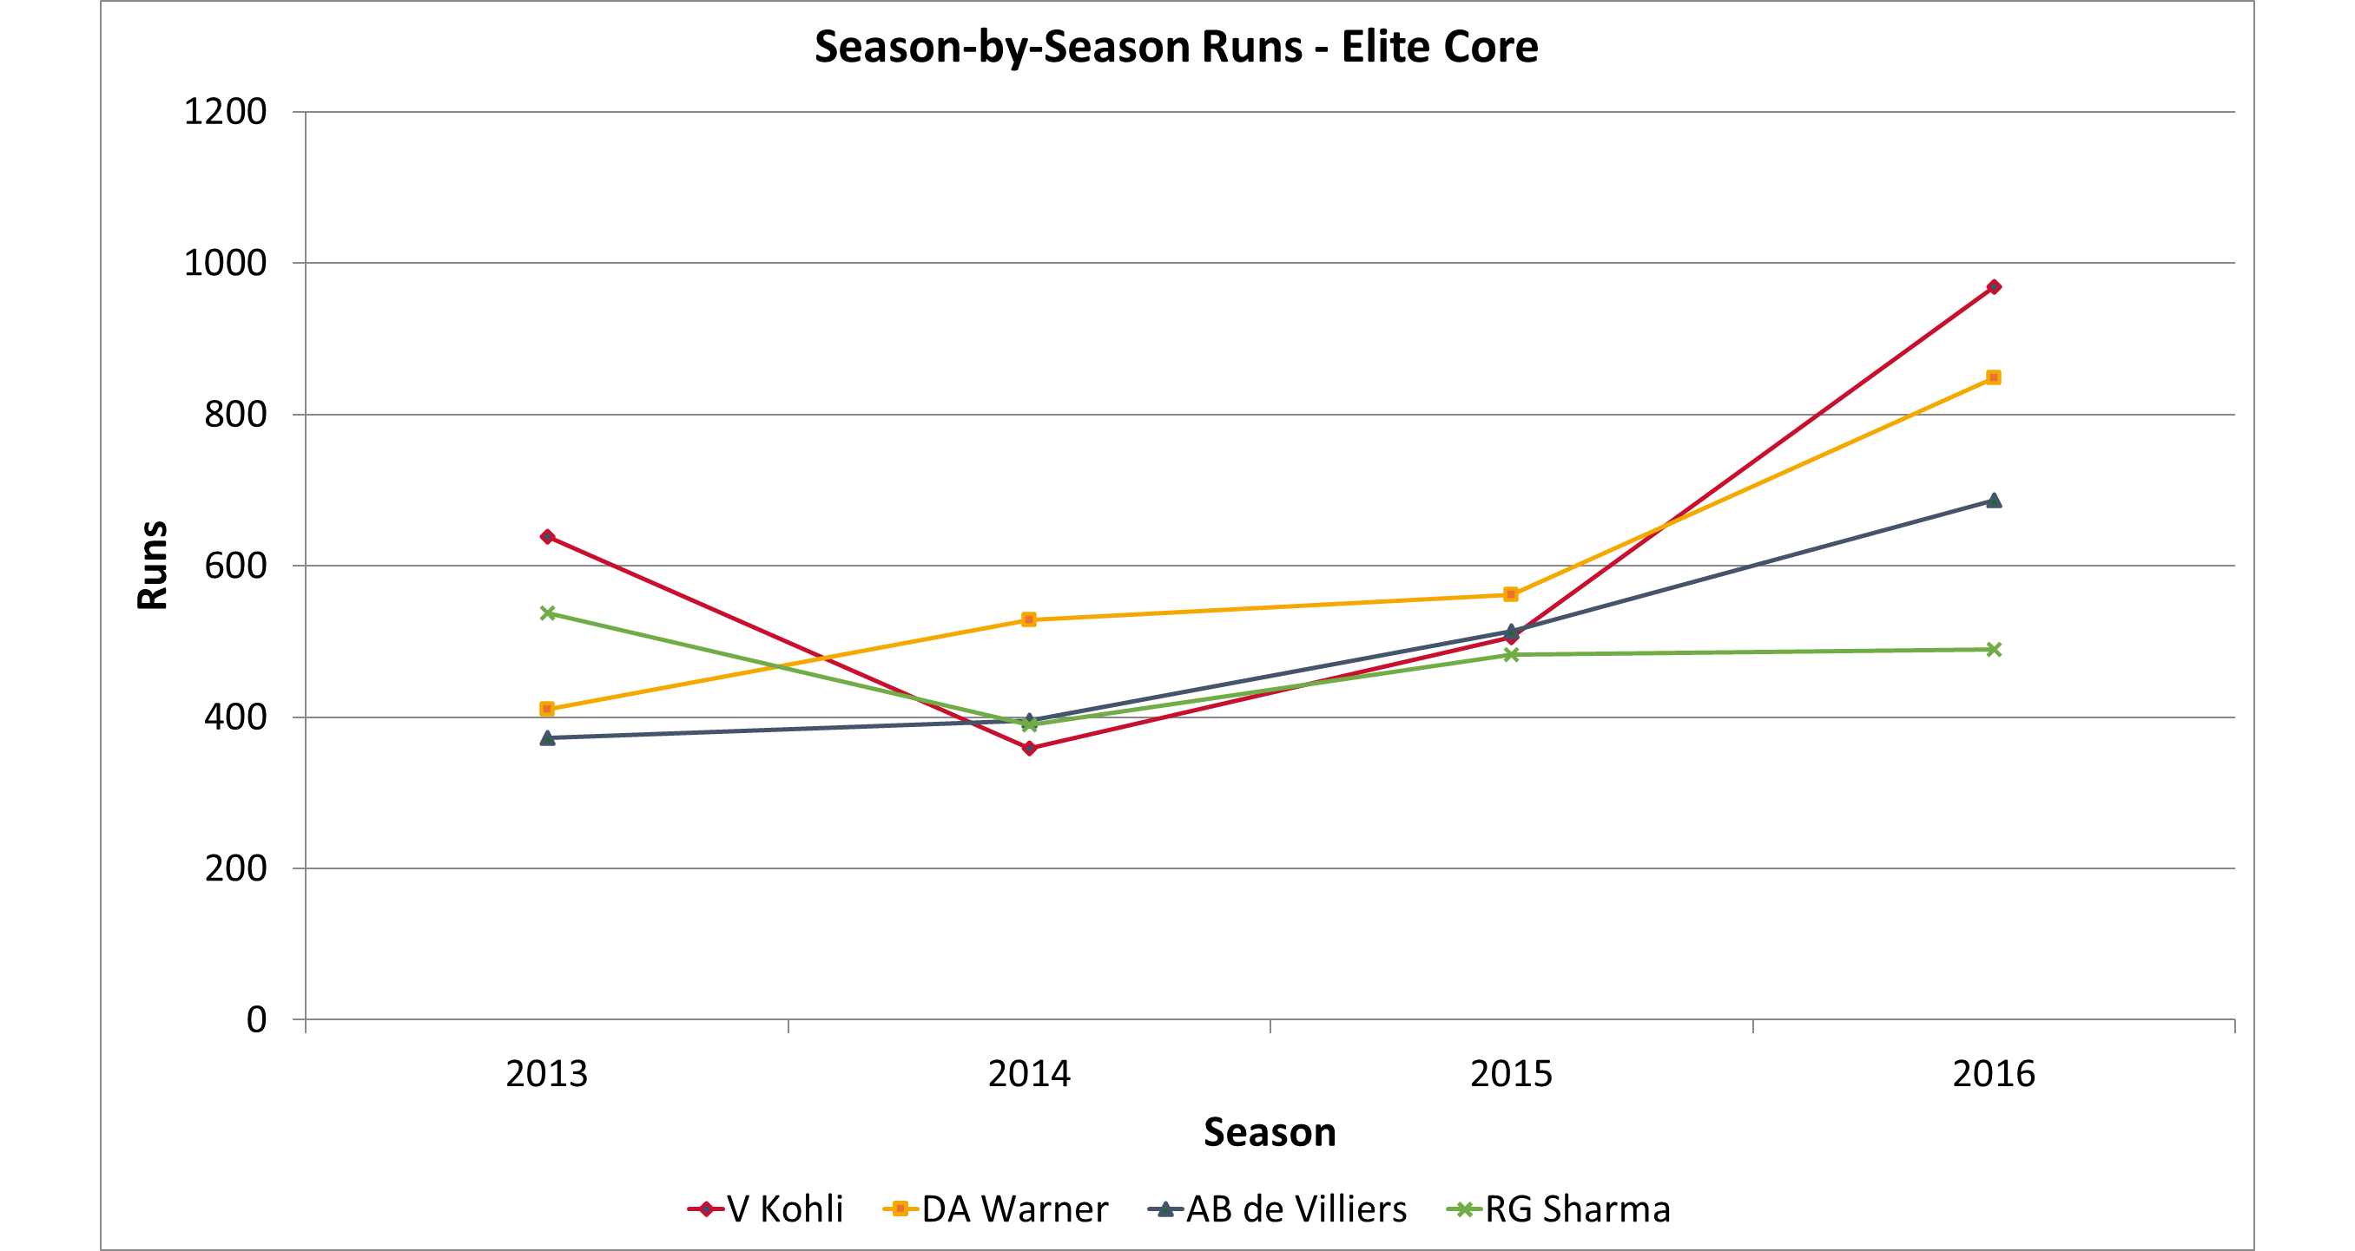
The consistent core to build around
WHAT IT MEANS
◆ Repeat performers. Kohli, Warner & de Villiers post 400+ almost every season.
◆ Metronomic. Rohit Sharma has the lowest year-to-year spread of the group.
◆ Retain the spine. Consistency — not one hot year — is the retention signal.
Royal Challengers Bangalore · Mega-Auction Analytics · 2013–2016
12

Slide 14
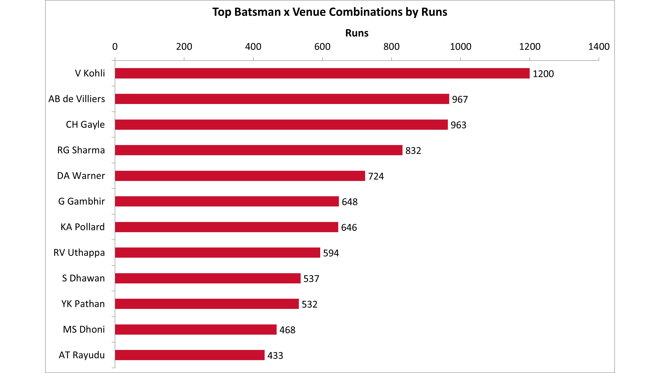
Recruit for the home track
WHAT IT MEANS
◆ Home specialists. Kohli (1200) and de Villiers (967) torch Chinnaswamy.
◆ Condition edge. Some players clearly thrive on flat, high-scoring pitches.
◆ Buy for the ground. Weight recruitment toward proven Chinnaswamy scorers.
Royal Challengers Bangalore · Mega-Auction Analytics · 2013–2016
13

Slide 15
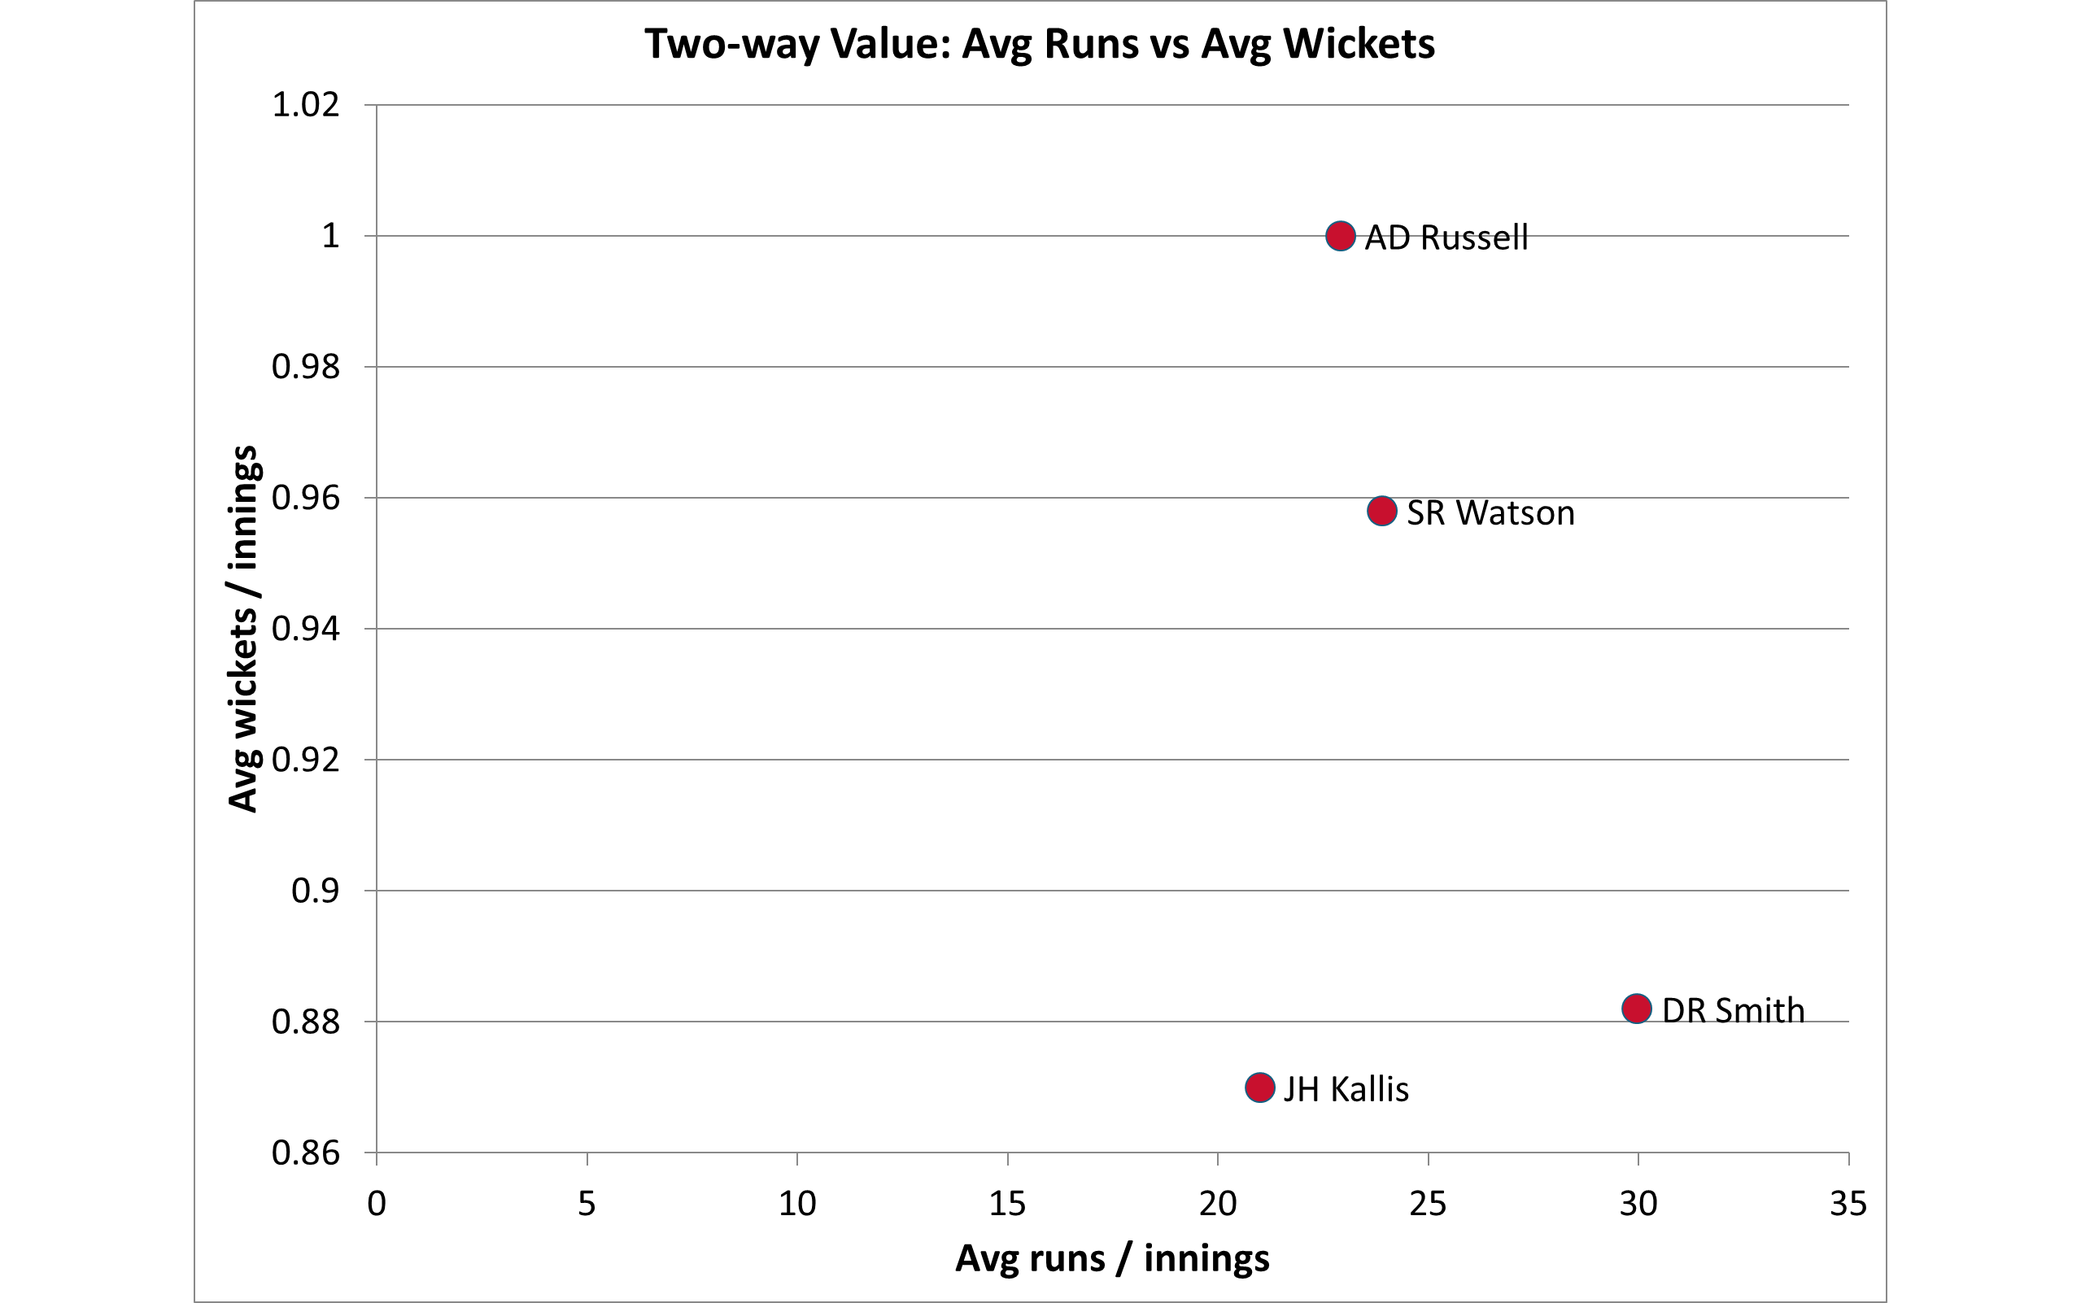
Two-way value wins T20s
WHAT IT MEANS
◆ Rare and vital. Watson, Russell, Jadeja & Henriques give bat and ball in one slot.
◆ Lengthen the XI. An elite all-rounder adds a sixth bowling option and batting depth.
◆ Prioritise it. Two-way value is scarce — pay up for it at the auction.
Royal Challengers Bangalore · Mega-Auction Analytics · 2013–2016
14

Slide 16
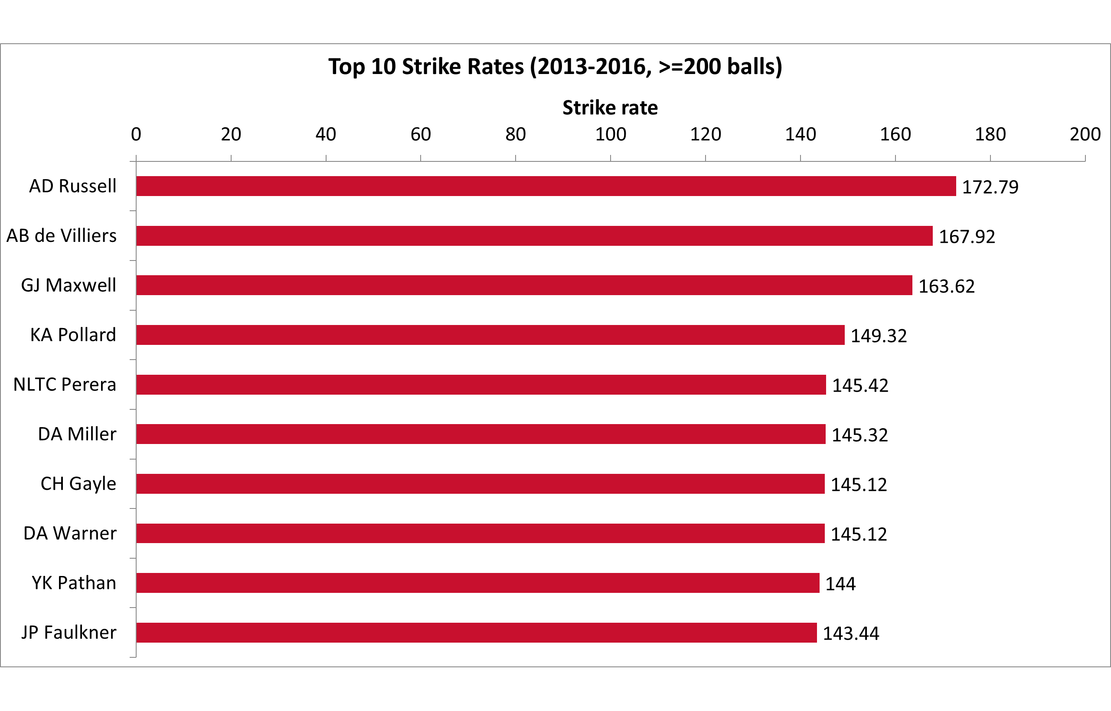
Buy impact, not depth
WHAT IT MEANS
◆ Explosive top order. High-SR strikers — de Villiers, Gayle, Maxwell, Warner.
◆ Two death bowlers. Yorker specialists with low 16–20 economy (Malinga, Steyn, Bhuvneshwar).
◆ Concentrate spend. Back 3–4 match-winners; fill the rest with value picks.
Royal Challengers Bangalore · Mega-Auction Analytics · 2013–2016
15

Slide 17
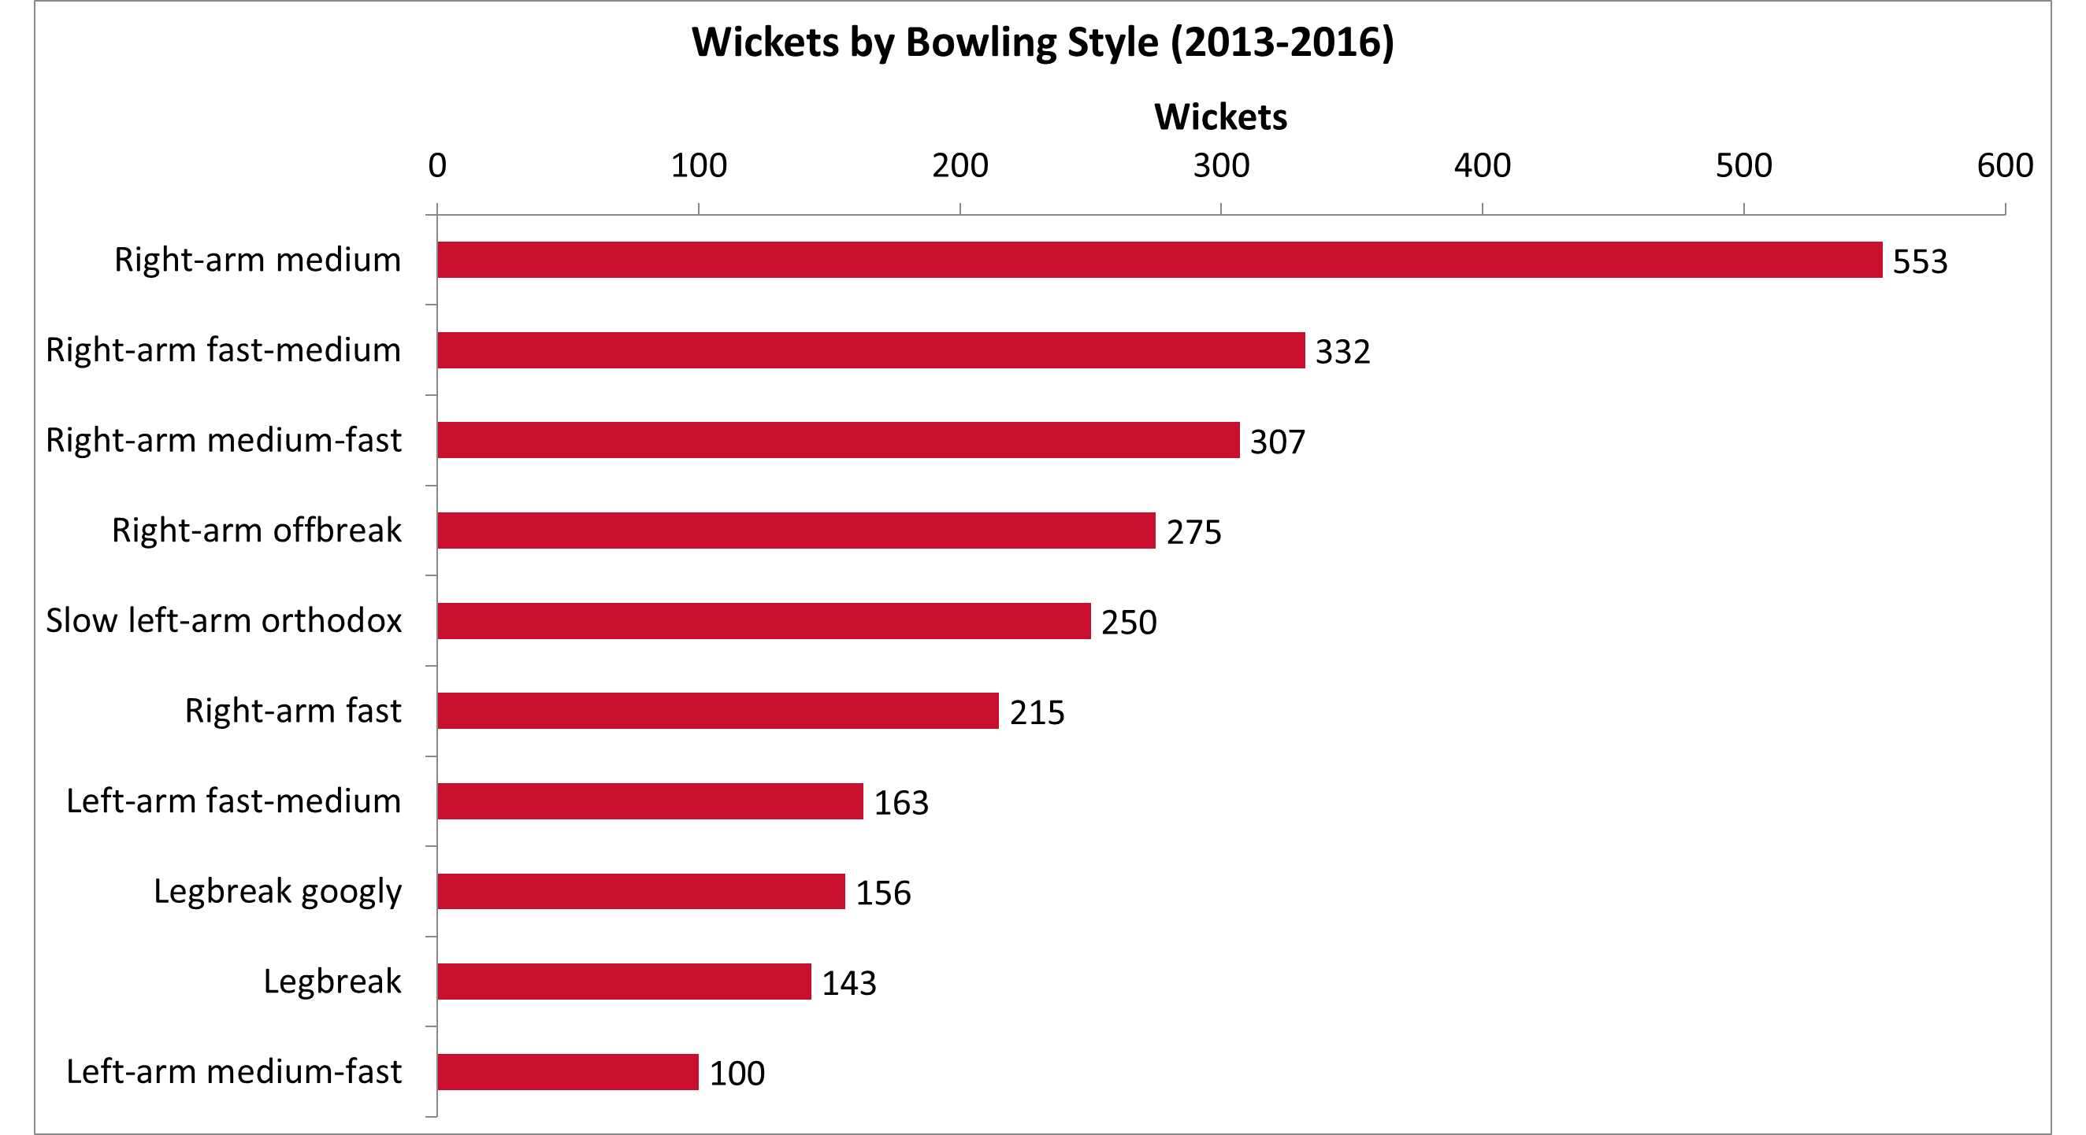
Pace takes the wickets
WHAT IT MEANS
◆ Seam dominates. Right-arm medium and fast styles take the most wickets in the data.
◆ Spin still matters. Off-break and left-arm orthodox add vital middle-overs control.
◆ Buy accordingly. Two reliable seamers plus a quality spinner balance the attack.
Royal Challengers Bangalore · Mega-Auction Analytics · 2013–2016
16

Slide 18
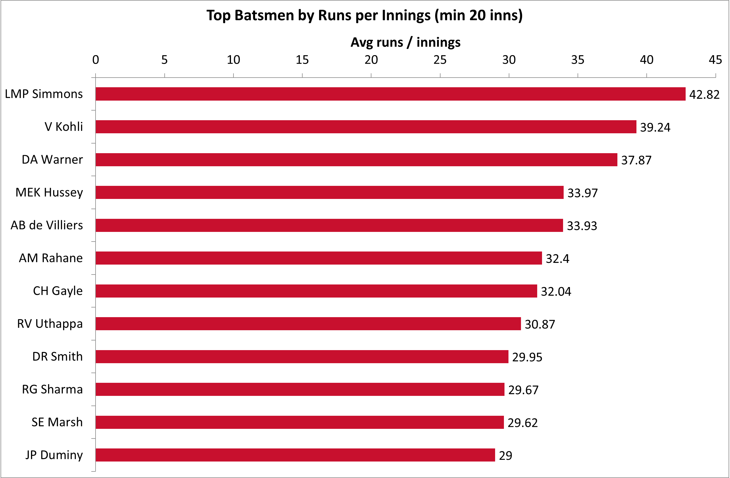
The batters to build around
WHAT IT MEANS
◆ Per-innings leaders. Simmons, Kohli, Warner and de Villiers top the list.
◆ Proven, not lucky. All qualified at 20+ innings, so no small samples.
◆ The batting core. Anchor the top order around these names.
Royal Challengers Bangalore · Mega-Auction Analytics · 2013–2016
17

Slide 19
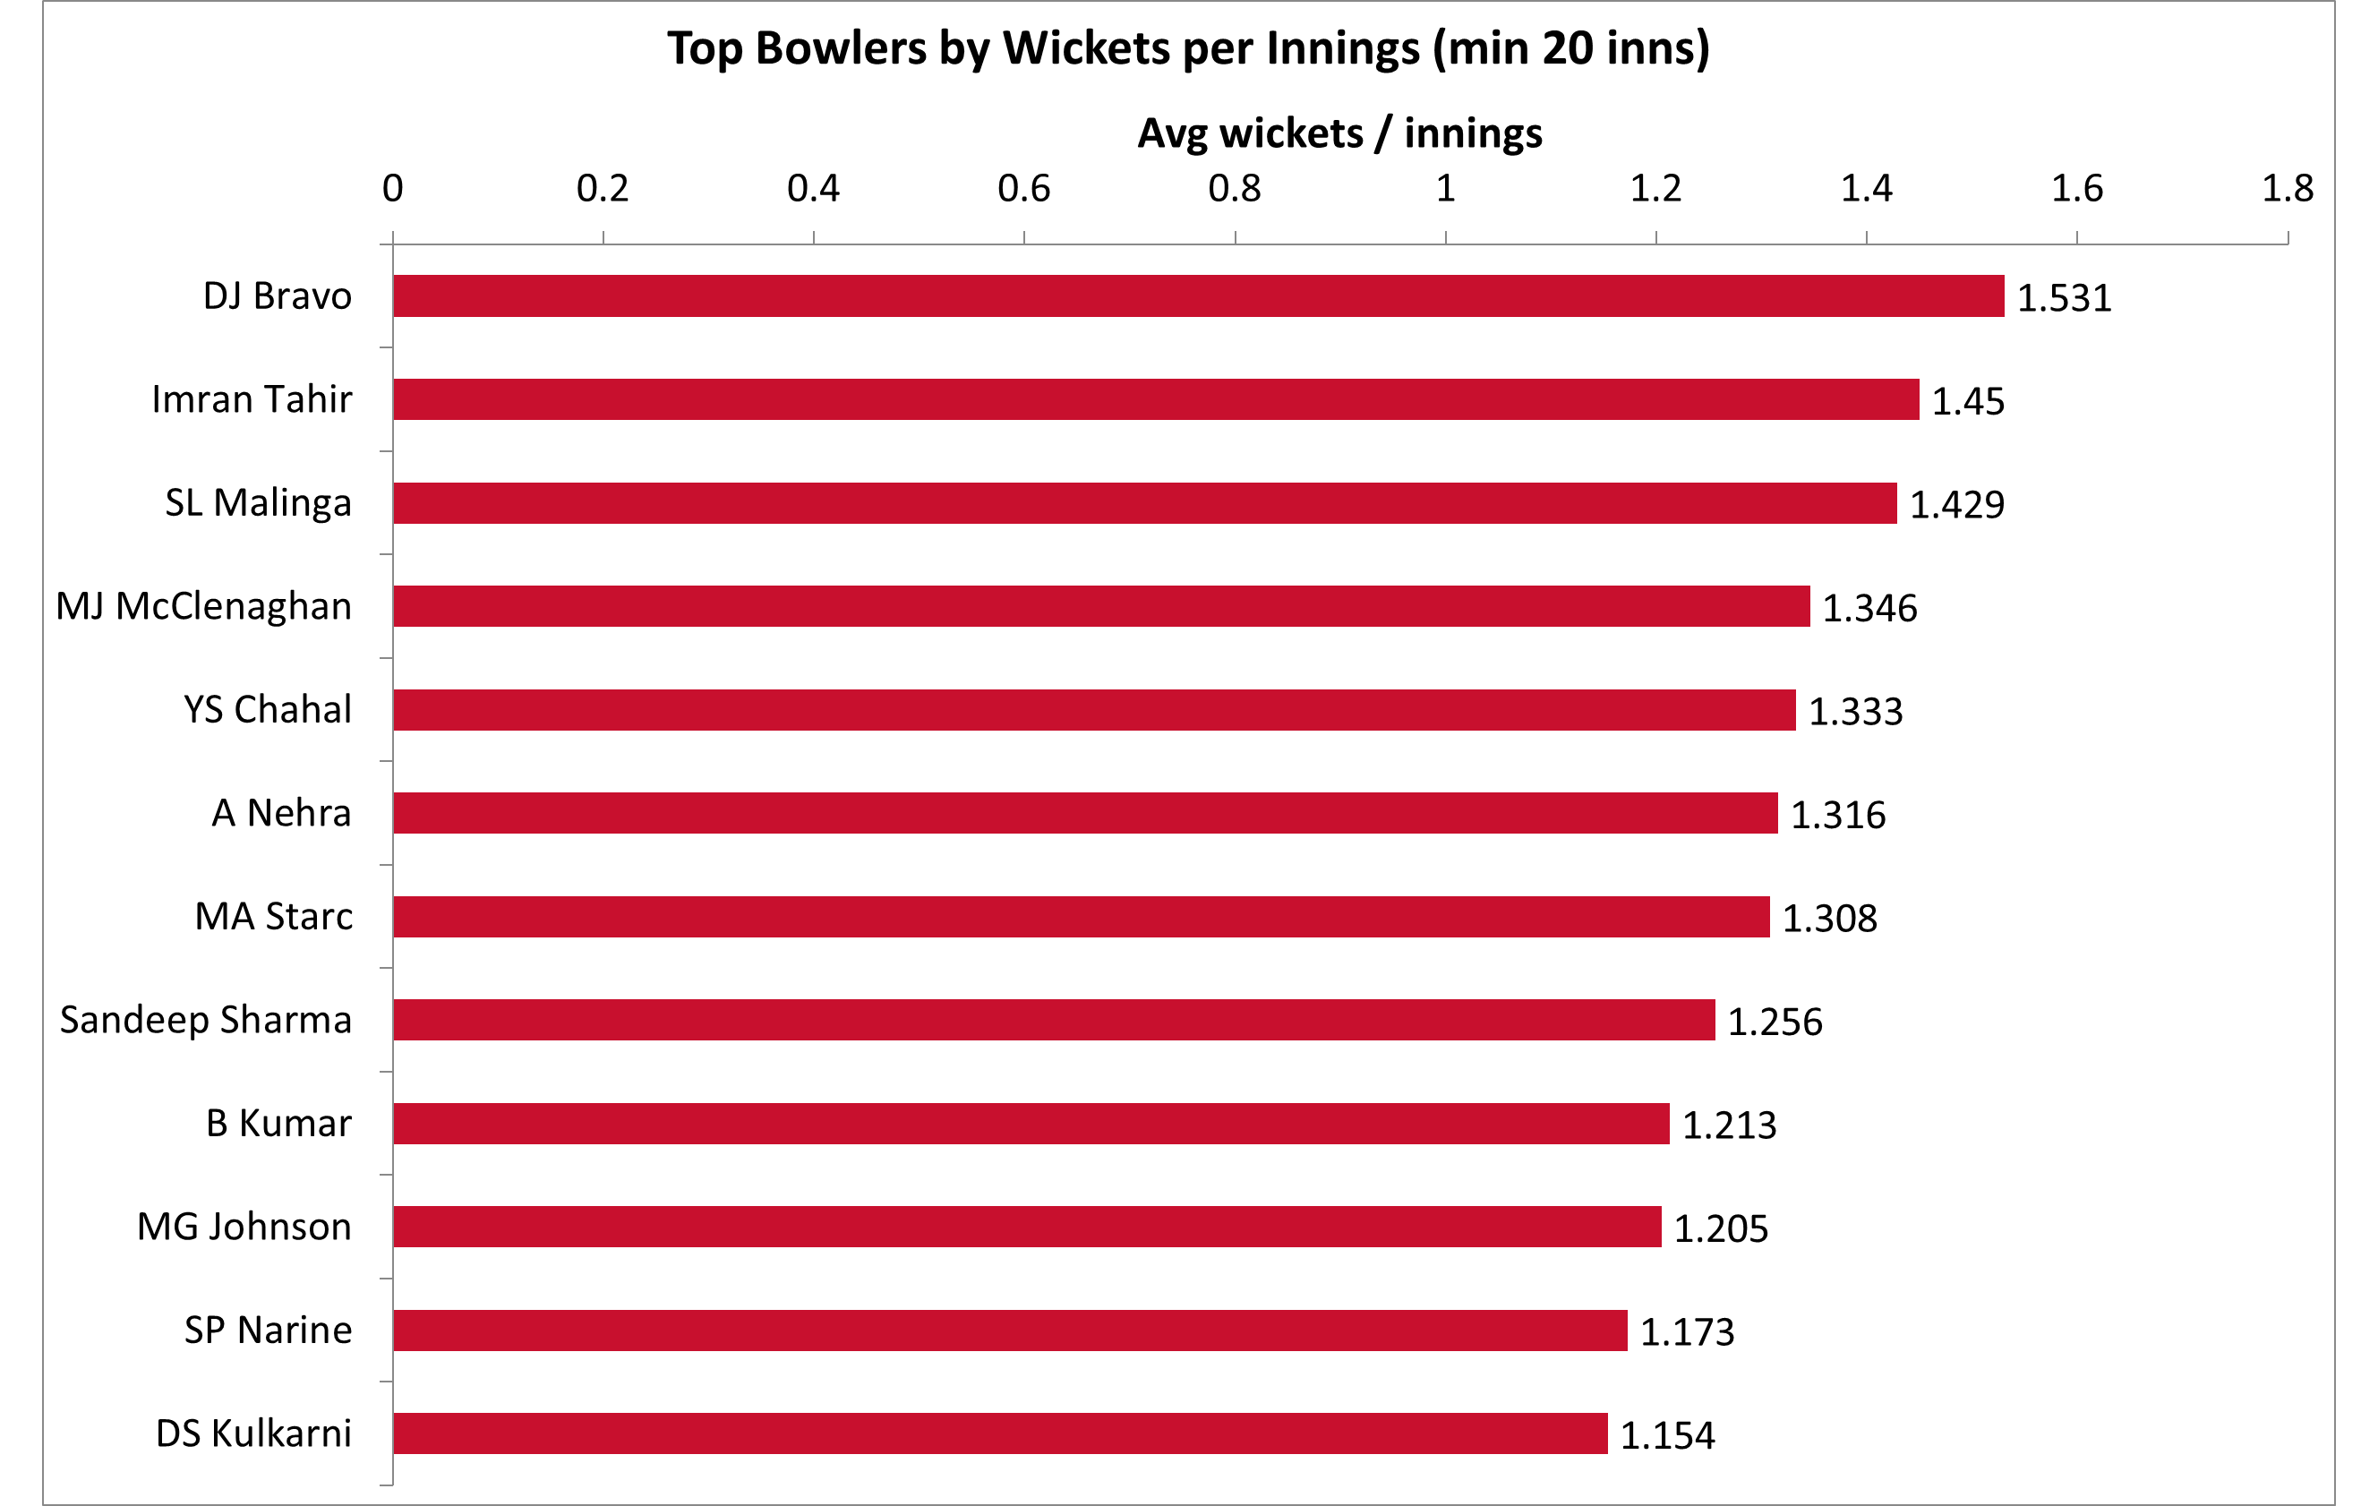
The bowlers to build around
WHAT IT MEANS
◆ Strike bowlers win T20s. Bravo, Tahir and Malinga lead wickets per innings.
◆ Pace and death. Specialist strike bowlers are the scarce asset.
◆ Highest-value buys. Spend here to fix RCB's bowling.
Royal Challengers Bangalore · Mega-Auction Analytics · 2013–2016
18

Slide 20
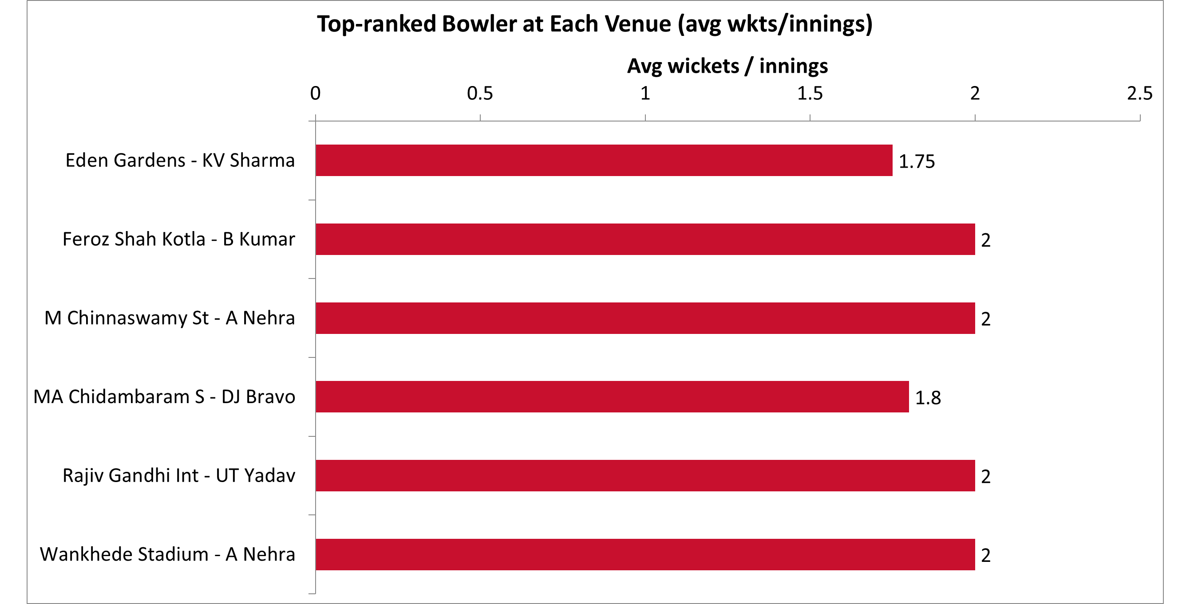
Bowling specialists by venue
WHAT IT MEANS
◆ Ground-specific edges. Some bowlers dominate particular venues (RANK 1 per ground).
◆ Home cover. Target seamers who can control high-scoring Chinnaswamy conditions.
◆ Match the fixture. Pick bowlers with proven records at RCB's key away grounds.
Royal Challengers Bangalore · Mega-Auction Analytics · 2013–2016
19

Slide 21
The RCB Auction Blueprint
Fix the death overs first
Build batting on power + consistency
1
2
Two specialist death bowlers — the highest-leverage spend.
Keep the Kohli–de Villiers core; add an SR-150 finisher.
Buy one balancing all-rounder
Exploit the fortress
3
4
Lengthen the batting, add a sixth bowling option.
Recruit for flat, high-scoring Chinnaswamy pitches.
Make the toss call venue-specific
Spend on match-winners
5
6
Default to chasing; override where batting first wins.
Value = performance per rupee; back 3–4 game-changers.
Royal Challengers Bangalore · Mega-Auction Analytics · 2013–2016
20

Slide 22
RCB don't need to score more.
They need to concede less when it matters.
Pair the league's best batting with even average death bowling — and the title math changes.
Thank you · RCB Sports-Analytics Desk · SQL + Excel

