Slide 1

Fantasy Stock
Presented by:
Shaheryar and zimin lu

Slide 2
RSI - Relative strength index
Momentum indicator – measuring magnitude of recent price charges
Displayed as an oscillating line graph and it’s reading range from 0 to 100.
Widely accepted indicator is that an oversold reading in an uptrend is higher than 30% (bullish) and an overbought reading on an RSI during a downtrend is lower than 70% (bearish).
During uptrends, the RSI tends to remain more static than it does during downtrends. This makes sense because the RSI is measuring gains versus losses. In an uptrend, there will be more gains, keeping the RSI at higher levels. In a downtrend, the RSI will tend to stay at lower levels.

Slide 3
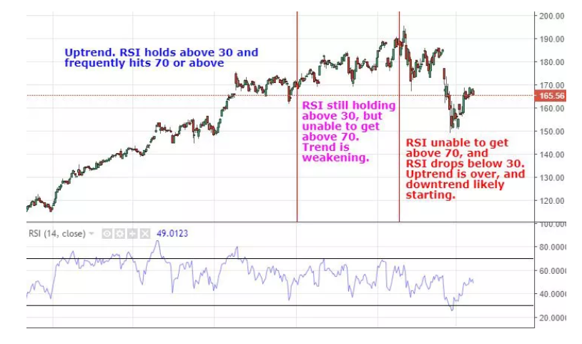
RSI - Relative strength index

Slide 4
Exponential Moving Average
EMA Crossover trading strategy, more responsive to changing data.
Our bread and butter, simple but robust.
Used a 30 day and 100 day moving average for opening prices.
For hyper traders such as us the shorter the ema the more signals we get.
20-EMA - the last stop on the bus for short-term traders.
50-EMA - used by traders to gauge mid-term trends.
200-EMA - welcome to the world of long-term trend followers.

Slide 5
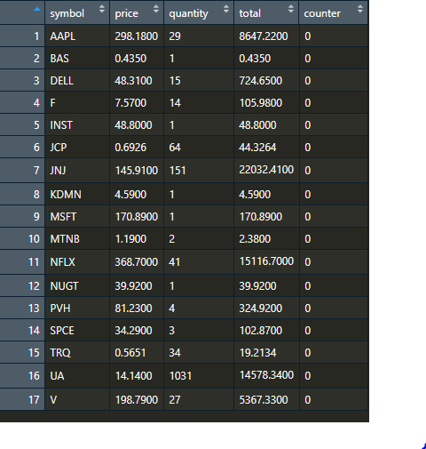
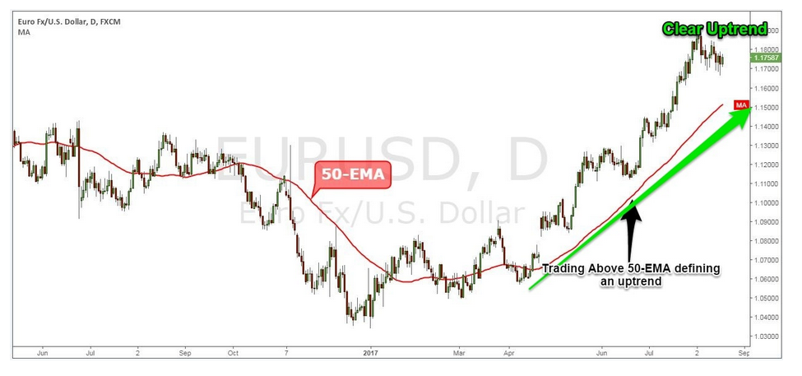
Profile Table

Slide 6
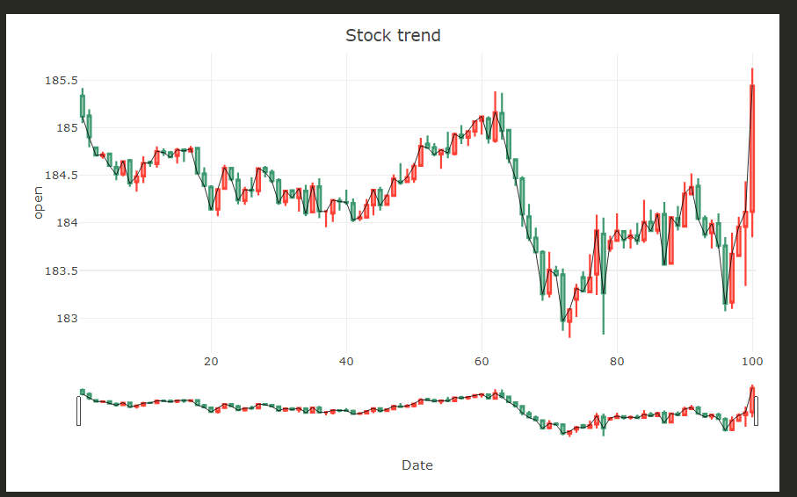
Time Series Forecasting

