Slide 1

Google Play store App Analysis
Supervisor:
Dr. Sean Mondesire
Assistant Professor
Program Director
Computer Science
St. Thomas University.

Slide 2
GROUP MEMBERS
Gabriella Bongiovanni
Syed Shaheryar Qadir

Slide 3
CONTENTS
Problem Statement
Project Objective
Purpose and Motivation
Variable Description
Phase – I : Acquiring and Cleaning Data
Acquiring Data
Tidying Procedure

Slide 4
CONTENTS
Phase – II : Modeling
Visualizing the Data
Table
Summary
Conclusion
References

Slide 5
PROBLEM STATEMENT
PROBLEM STATEMENT

Slide 6
PROBLEM STATEMENT
Problem Statement
Based on past trends what price tier should an app be placed in, to maximize its number of installs?

Slide 7
PROJECT OBJECTIVES
PROJECT OBJECTIVES

Slide 8
PROJECT OBJECTIVE
Project Objective
The goal is to increase the number of installs of a google app by altering the price of said app based on past data acquired from Kaggle. Monetization and sales would serve as motivation for us.

Slide 9
PURPOSE AND MOTIVATION
PURPOSE AND MOTIVATION

Slide 10
PURPOSE AND MOTIVATION
Purpose and Motivation
Today, apps are almost essential to everyday living. An average of 2.6 billion people own smart phones. In 2012, 35.4 percent of Black Friday sales last year were completed on mobile devices. (2012 IBM Holiday Benchmark Reports) Imagine today! Companies who invest in apps are able to connect better with customers, create a more simplified web-based customer experience, allowing for increased profit. Monetization and sales would serve as motivation for us.

Slide 11
VARIABLE DESCRIPTION
Variable Description

Slide 12
INDEPENDENT VARIABLES
Price
Describes the cost of an app.
Numeric data type

Slide 13
DEPENDENT VARIABLES
Installs
Describes the amount of times each app has been downloaded.
Numeric data type

Slide 14
PHASE – I
PHASE – I : ACQUIRING AND CLEANING DATA

Slide 15
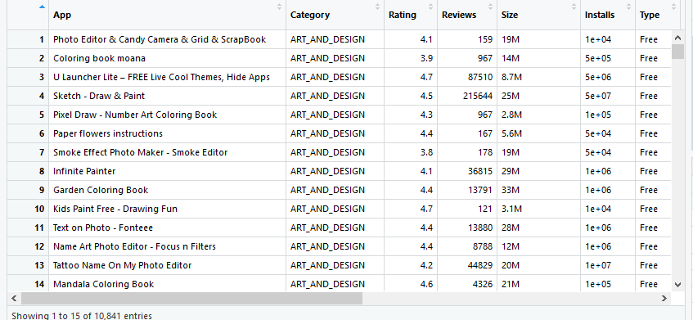
PHASE – I : ACQUIRING DATA

Slide 16
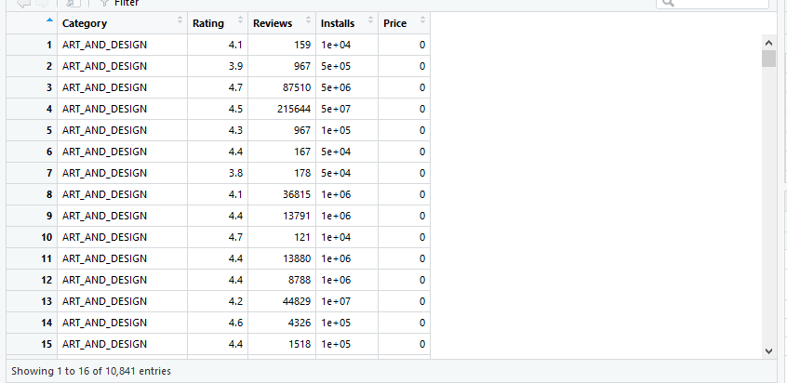
PHASE – I : TIDYING PROCEDURE
Tidying Procedure
Rows with n/a were deleted and only olny columns with price and installs were kept.

Slide 17
PHASE – II
PHASE – II : MODELING

Slide 18
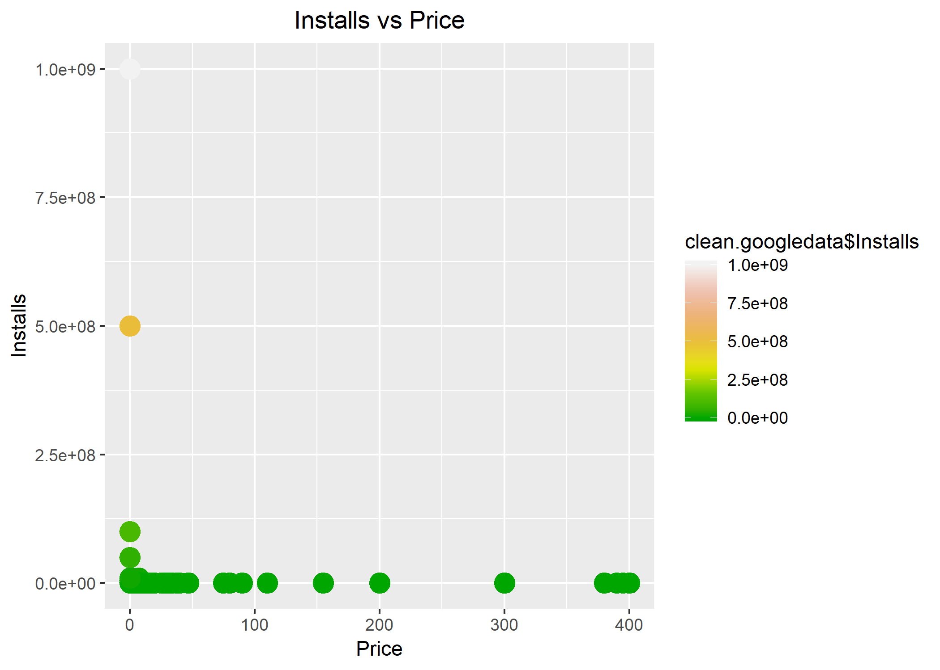
PHASE – II : VISUALIZING THE DATA

Slide 19
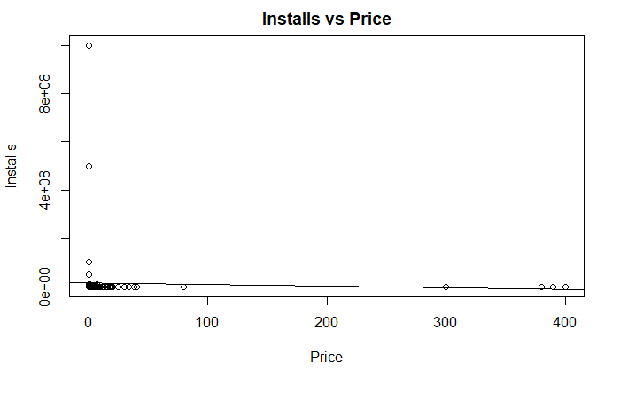
PHASE – II : VISUALIZING THE DATA

Slide 20
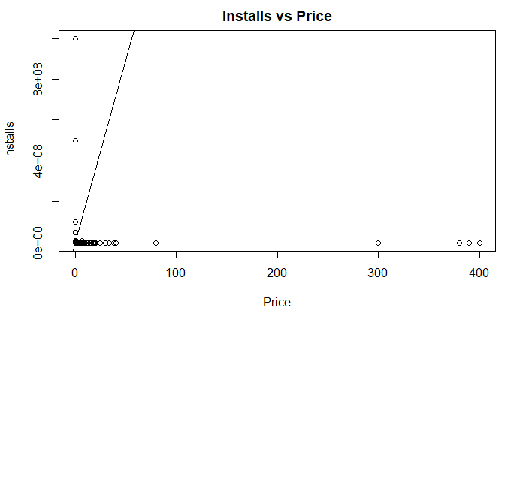
PHASE – II : VISUALIZING THE DATA

Slide 21
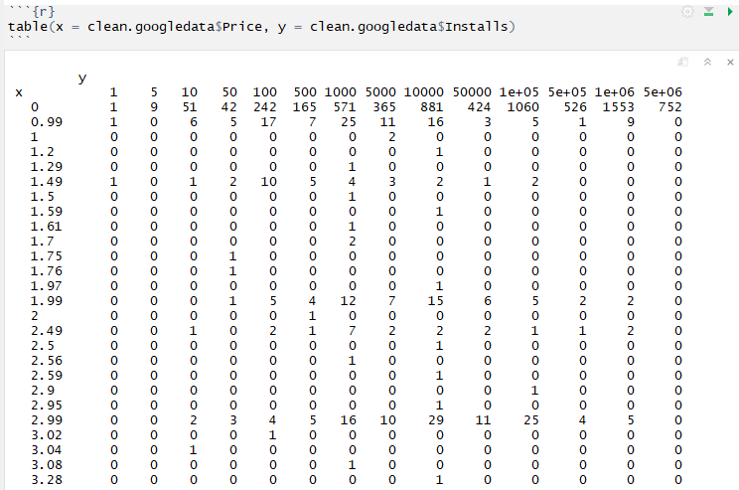
PHASE – II : TABLE

Slide 22
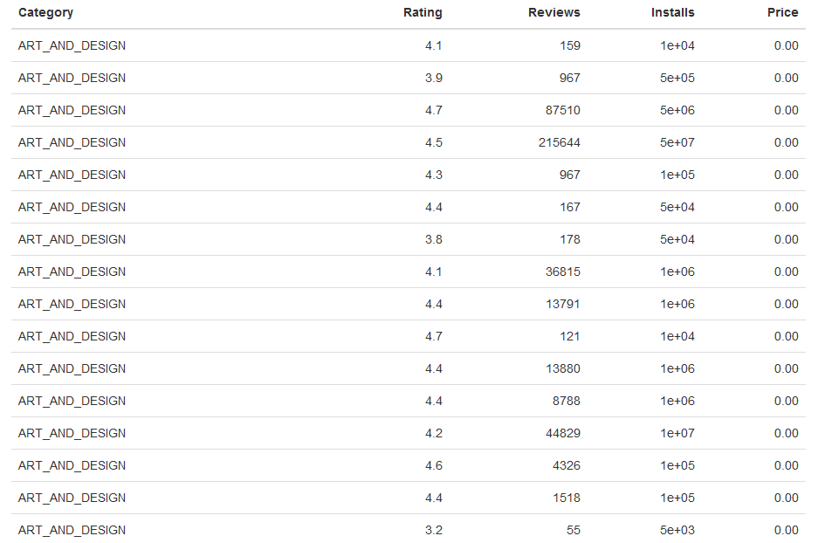
PHASE – II : TABLE

Slide 23
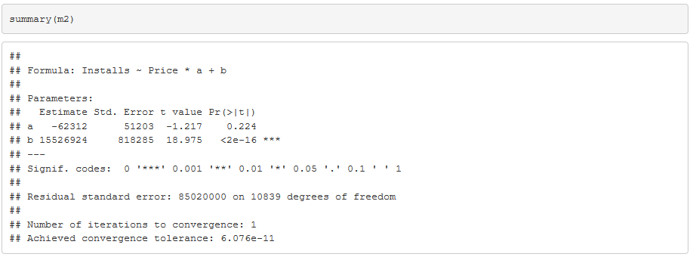
PHASE – II : SUMMARY

Slide 24
PHASE – I & II
CONCLUSION

Slide 25
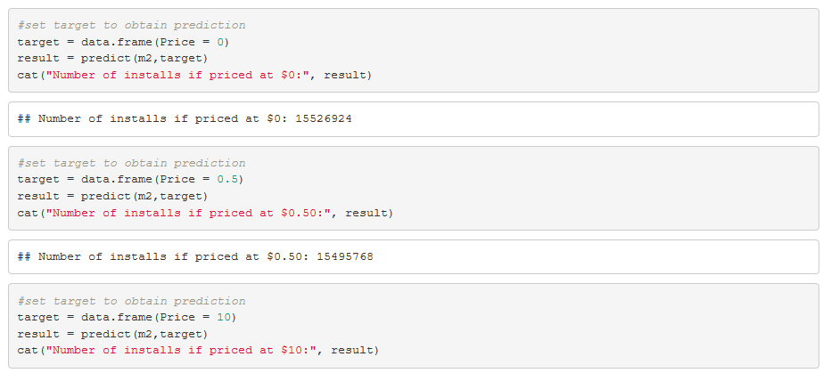
PHASE – I & II: CONCLUSION

Slide 26
REFERENCES
Lavanya Gupta. (2019, February 3). Google Play Store Apps. [Kaggle Post]. Retrieved from https://www.kaggle.com/lava18/google-play-store-apps
Viswanathan, P. (2011, December 13). Mobile app development trends for 2012. About.com Mobile Devices. Retrieved March 16, 2012, from http://mobiledevices.about.com/od/kindattentiondevelopers/tp/Mobile-AppDevelopment-Trends-For-2012.htm
Racoma, J. A. (2011, June 30). Mobile app market US$36.7b industry by 2015 with 182.7b downloads; but is more better? CMSWire.com. Retrieved February 12, 2012, from http://www.cmswire.com/cms/mobile/mobile-app-market-us367b-industry-by-2015-with1827b-downloads-but-is-more-better-011867.php
Google/IPSOS, & OTX MediaCT. (2011, April). The mobile movement. Think with Google. Retrieved from http://www.thinkwithgoogle.com/insights/library/studies/the-mobilemovement/

Slide 27
REFERENCES
Thomas L. Rakestraw. (2013). The mobile app industry: a case study. Retrieved from https://pdfs.semanticscholar.org/b4fd/972d8f34de5d8c5eeec805b94642b1610223.pdf
Ramanthan. (2018, July 13) [Statsdirect Post]. Retrieved from https://www.statsdirect.com/help/basics/p_values.htm

Slide 28
