Slide 1

Abstract Slide 1

Slide 2
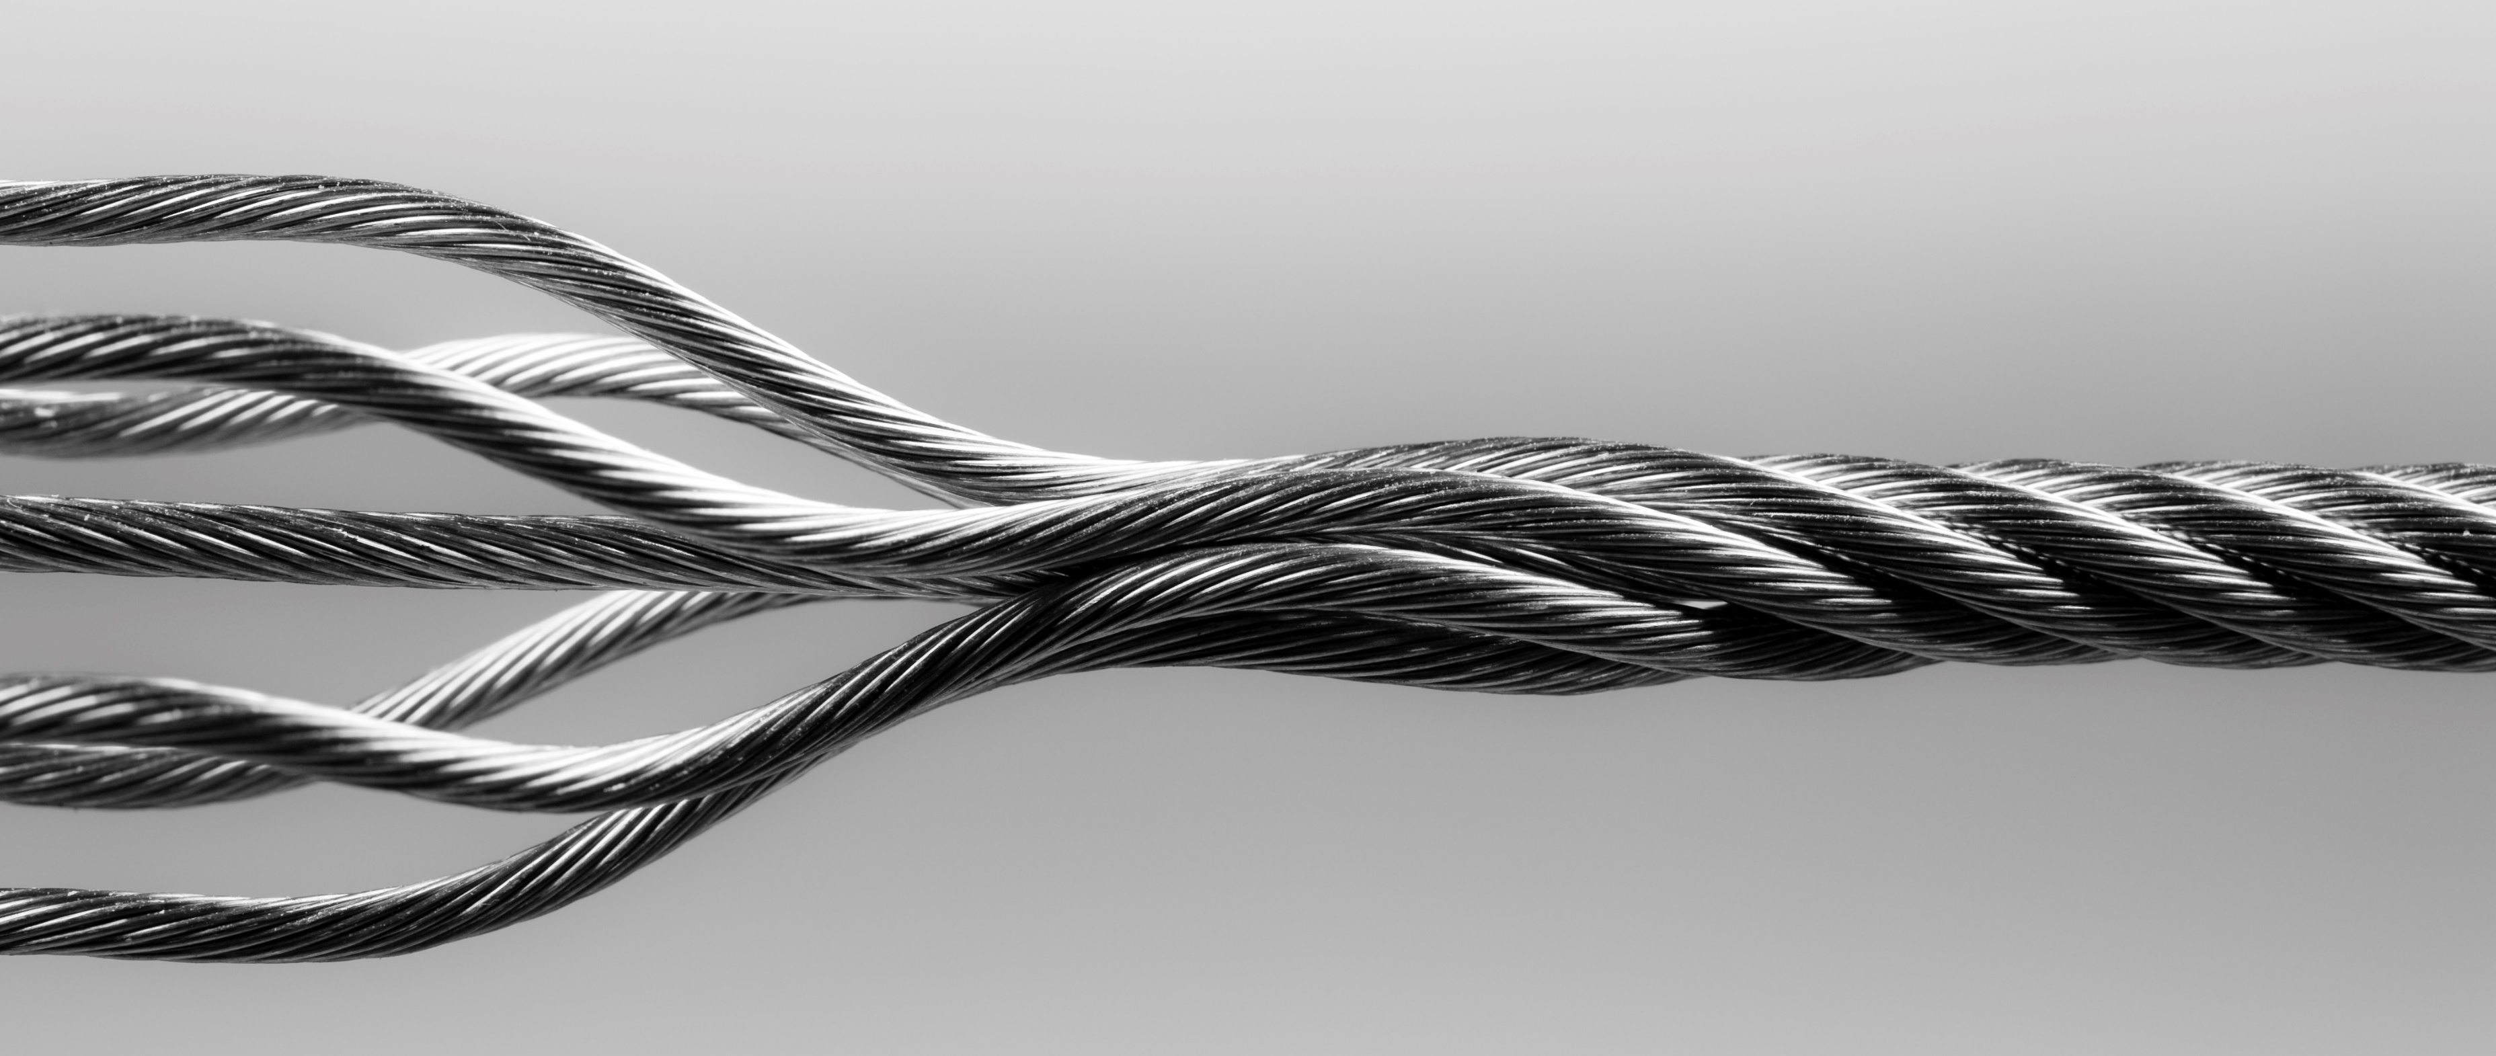
Abstract Slide 2

Slide 3

Abstract Slide 3

Slide 4
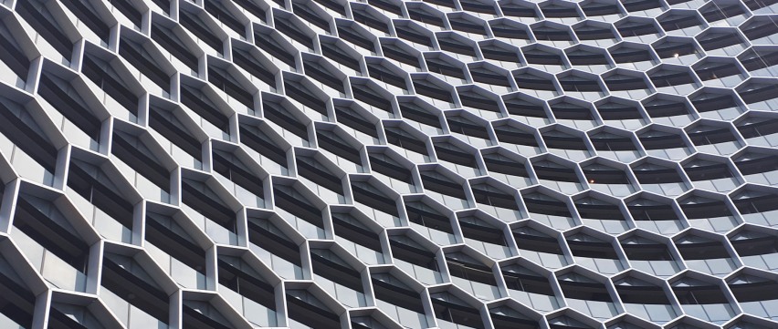
Abstract Slide 4

Slide 5

Abstract Slide 5

Slide 6

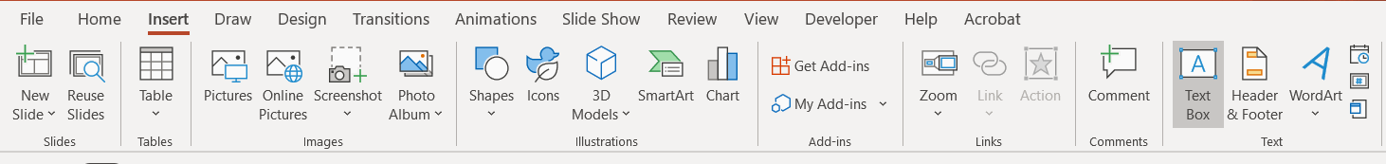
Instructional Slide
Facebook Full Banner view – Maintain main graphics within this line to best work on desktop view
Grey area is where text must fit to ensure best results.
TO ADD YOUR OWN IMAGE:
Delete image on slide
Click the image icon to insert your image
Best image option: 851 (8.86) x 360 (3.75) jpg / png
TO SAVE AS AN IMAGE FOR FACEBOOK:
Click on the File tab
Click Save as
From the File Type list, choose one of the following options:
Copy and paste squares onto your slide to make sure your graphics look great. Don’t forget to delete the squares before saving.
TO ADD TEXT:
Click on the insert tab
Click Text box
Draw Text Box
Format text as required
Facebook Mobile view – Maintain main graphics & text within this line to best work on mobile view

