Slide 1
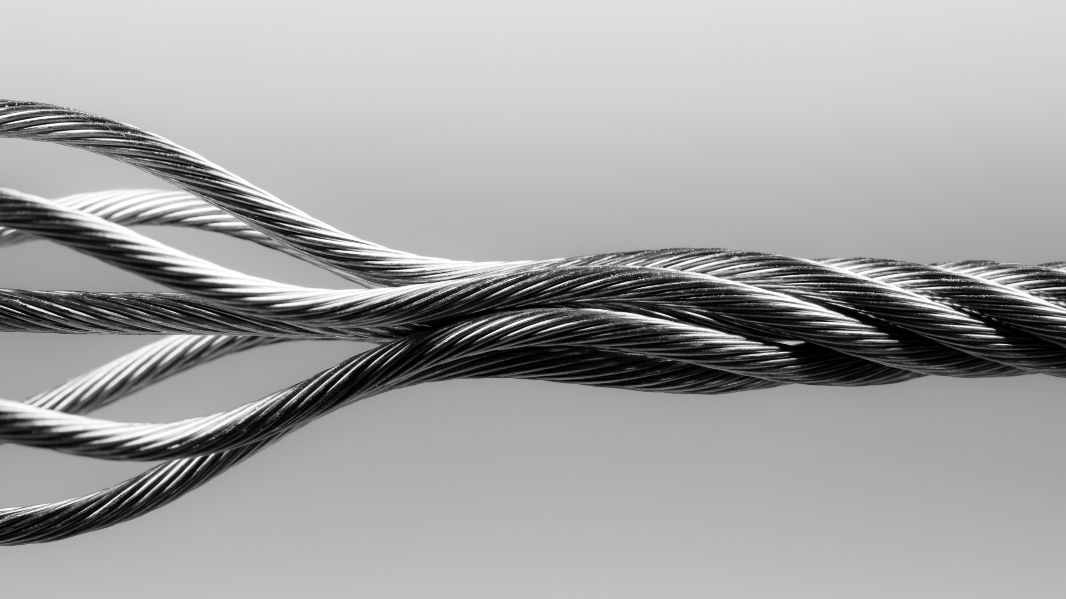
Abstract Slide 2
Image Classification in R
Presented by:
Shaheryar and Zimin Lu
Supervised by:
Dr. Sean Mondesire

Slide 2
Contents
Introduction
Data Set
Image Classifier Model
Reporting (Hypothesis testing, Accuracy, Recall, Precision, Overfitting (AuC) )
Conclusion

Slide 3
INTRODUCTION
The goal of this project is to build four image classifiers using
Naïve Bayes
Random Forest
Deep Learning
Support Vector Machine

Slide 4
dataset
The dataset was obtained through Kaggle which involves two folders of cat and dog images.
The imager package serves as the major breakthrough for image processing in R.
https://dahtah.github.io/imager/imager.html

Slide 5
imager
The dataset was obtained through Kaggle which involves two folders of cat and dog images.
The imager package serves as the major breakthrough for image processing in R.
https://dahtah.github.io/imager/imager.html

Slide 6
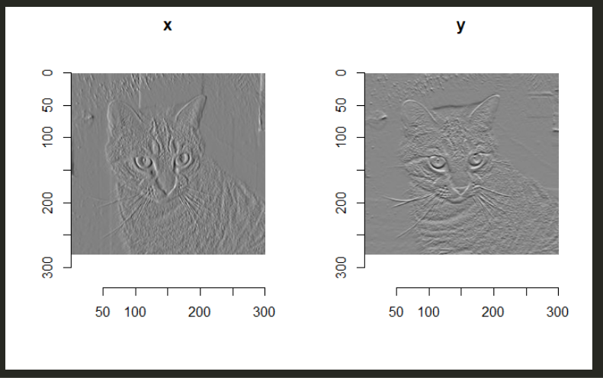
Imager uses edge detection
The dataset was obtained through Kaggle which involves two folders of cat and dog images.
The imager package serves as the major breakthrough for image processing in R.
https://dahtah.github.io/imager/imager.html

Slide 7
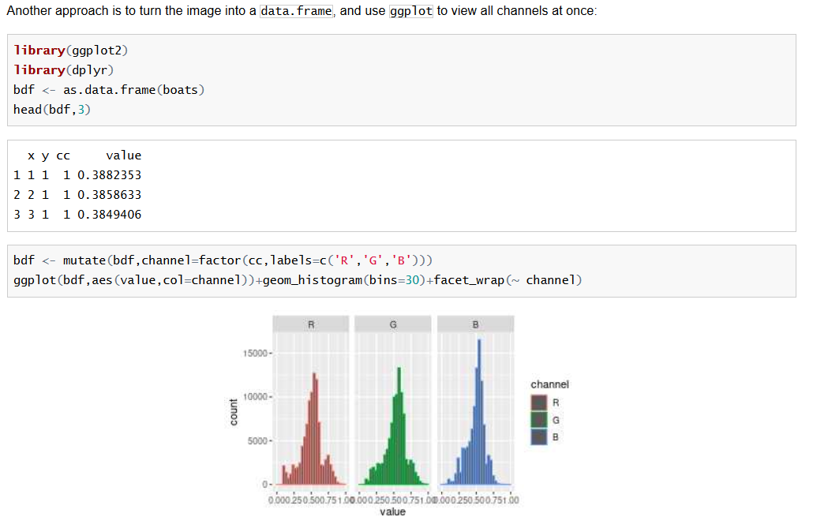
imager
The dataset was obtained through Kaggle which involves two folders of cat and dog images.
The imager package serves as the major breakthrough for image processing in R.
https://dahtah.github.io/imager/imager.html
Width, height
depth & spectrum

Slide 8
Naïve bayes
Naive Bayes Accuracy: 58.93246 % Naive Bayes Precision: 21.96508 % Naive Bayes Recall: 44.12724 % Naive Bayes AuC: 61.67882 %

Slide 9
Random forest
Random Forest Accuracy: 86.79245 % Random Forest Precision: 1.867641 % Random Forest Recall: 3.752039 % Random Forest AuC: 65.09849 %

Slide 10
Deep learning
Deep Learning Accuracy: 55.69106 % Deep Learning Precision: 16.68697 % Deep Learning Recall: 33.52365 % Deep Learning AuC: 55.85439 %

Slide 11
Support vector machine
Gaussian RBF Kernel Accuracy: 57.1169 % Gaussian RBF Kernel Precision: 38.28664 % Gaussian RBF Kernel Recall: 75.25938 %

