Slide 1
Distributed Tracing for Micro Services using Jaeger

Slide 2



Why Distributed Tracing?
Some questions:
How to find root cause/performance issue in API requests spanning multiple services in multiple hosts?
How to benchmark different drivers/tools and identify the performance bottleneck?
Some solutions:
We might think about: Logging, Monitoring or Profiling
However, they may not fit into our case or may not scale well
Tracing focuses on workflow
Tracing will be an additional tool for us beside above existing solutions

Slide 3

Why Jaeger ?
As on-the-ground microservice practitioners are quickly realizing, the majority of operational problems that arise when moving to a distributed architecture are ultimately grounded in two areas: networking and observability.
Problems Addressed
Distributed transaction monitoring
Service dependency analysis
Root cause analysis
Distributed transaction monitoring
Distributed context propagation

Slide 4
Jaeger Terminology
Span
A span represents a logical unit of work in Jaeger that has an operation name, the start time of the operation, and the duration. Spans may be nested and ordered to model causal relationships.
Trace
A trace is a data/execution path through the system, and can be thought of as a directed acyclic graph of spans.

Slide 5
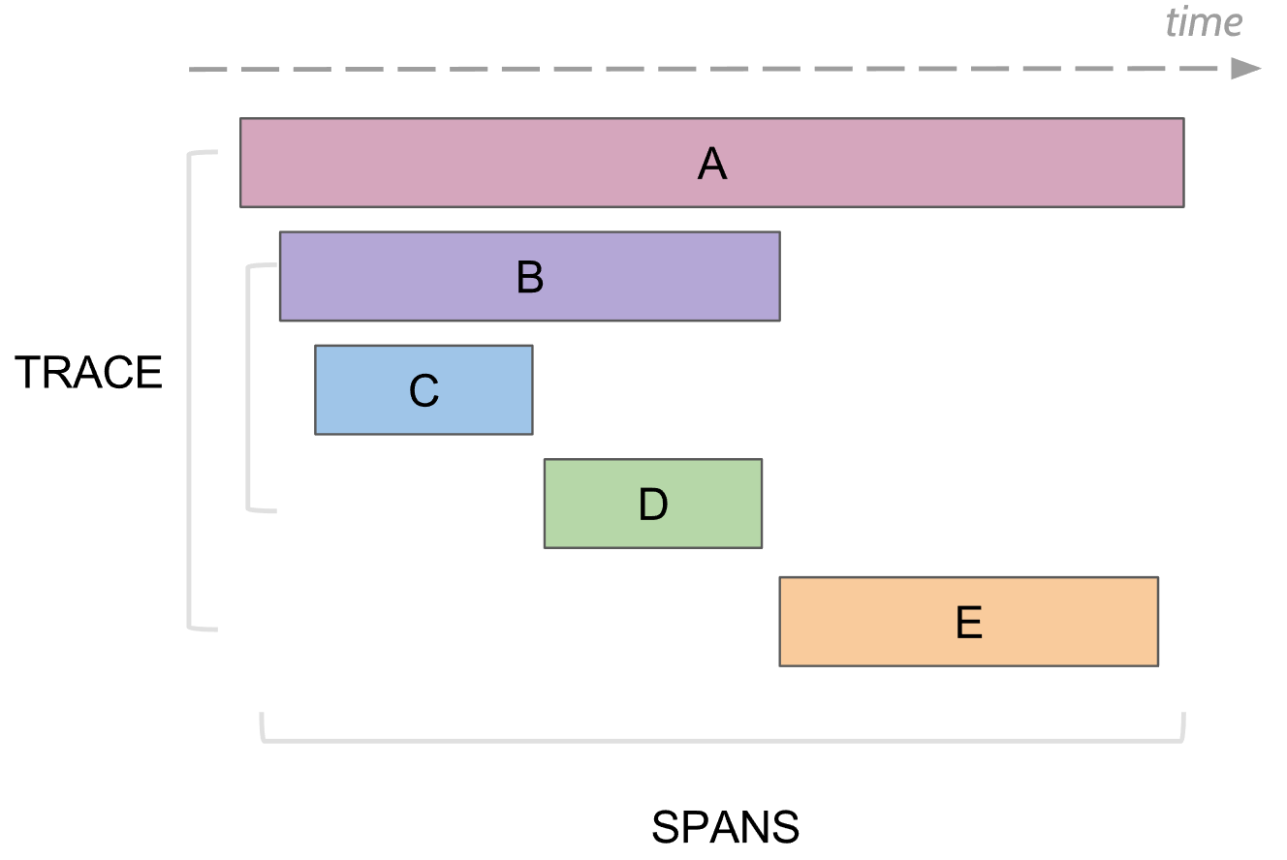

Slide 6
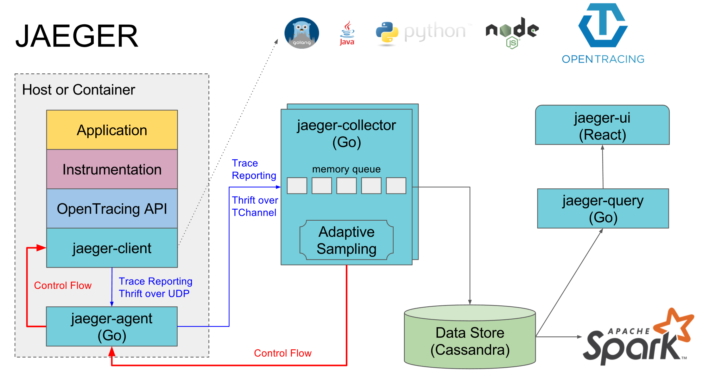
Architecture

Slide 7
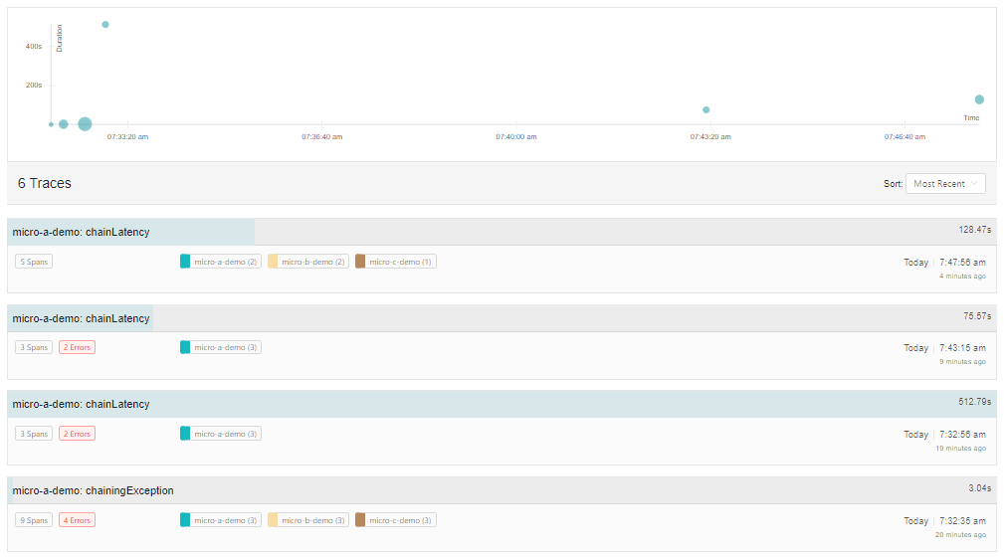
Snapshot - Traces

Slide 8
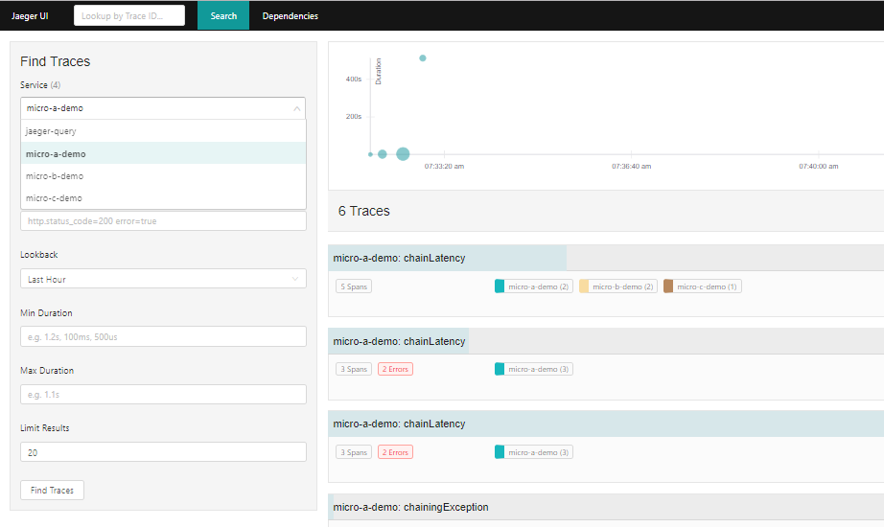
Snapshot - Services

Slide 9
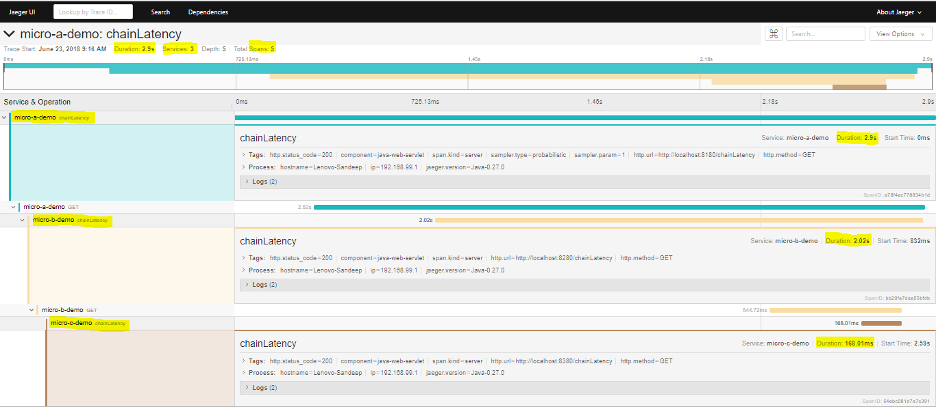
Snapshot - Span

Slide 10
References
https://www.jaegertracing.io/
https://github.com/jaegertracing/jaeger/releases
https://github.com/jaegertracing/

