Slide 1
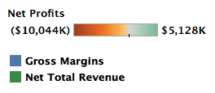
Profitability by College FY21 Projections

Slide 2
Chemistry
Text Goes Here

