Slide 1
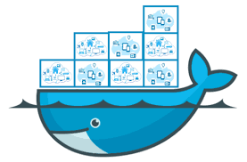
Docker
By: Saeid Rasouli

Slide 2

Table of content
Docker is a tool that allows developers, sys-dmins etc. to easily deploy their applications in a sandbox (called containers) to run on the host operating system i.e. Linux.
The key benefit of Docker is that it allows users to package an application with all of its dependencies into a standardized unit for software development

Slide 3
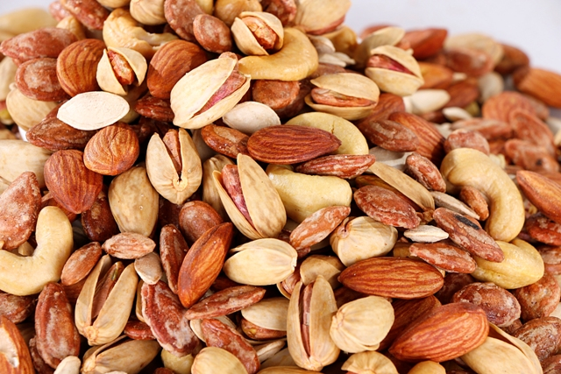
Mix
Difficult separating
Difficult removing moving disabling
Trustable?
Difficult managing
Bad impact on others

Slide 4
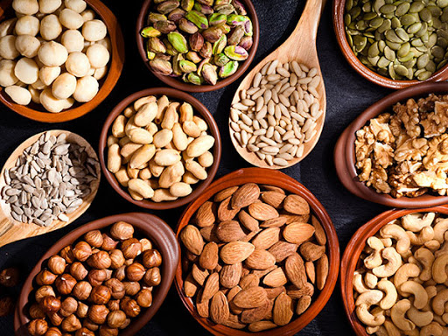
Separate
Trustable
Easy to manage
Easy to remove move disable
Sandbox
Multi instance

Slide 5
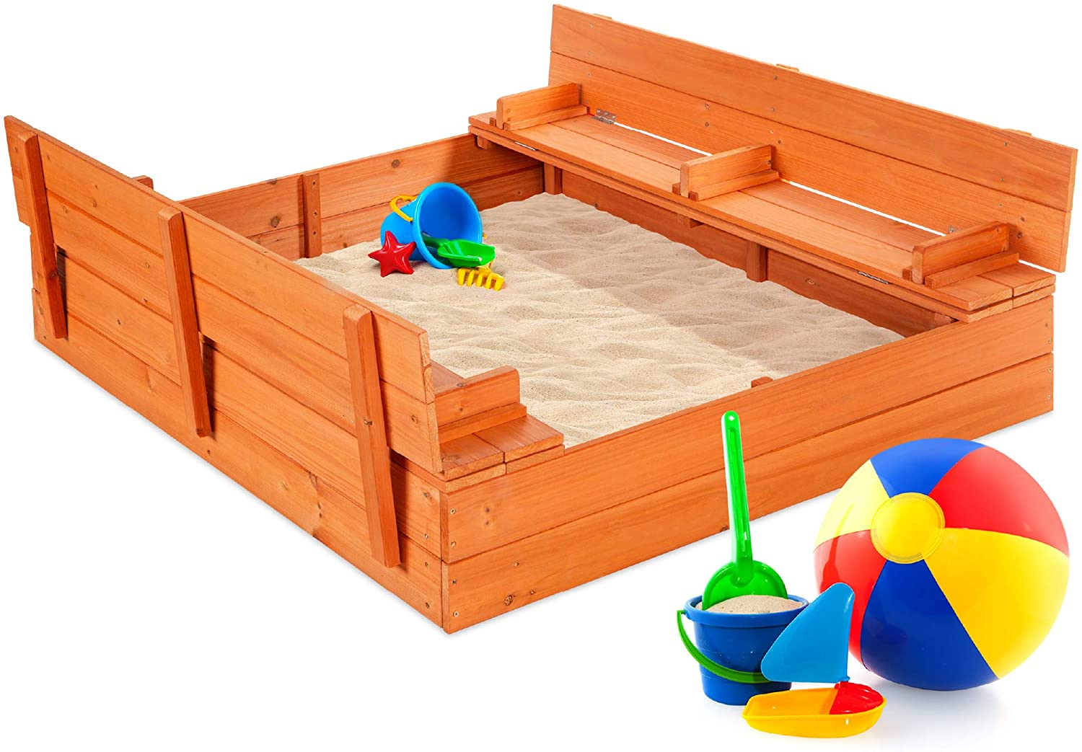
Sandbox
A testing environment in a computer system in which new or untested software can be run securely.

Slide 6
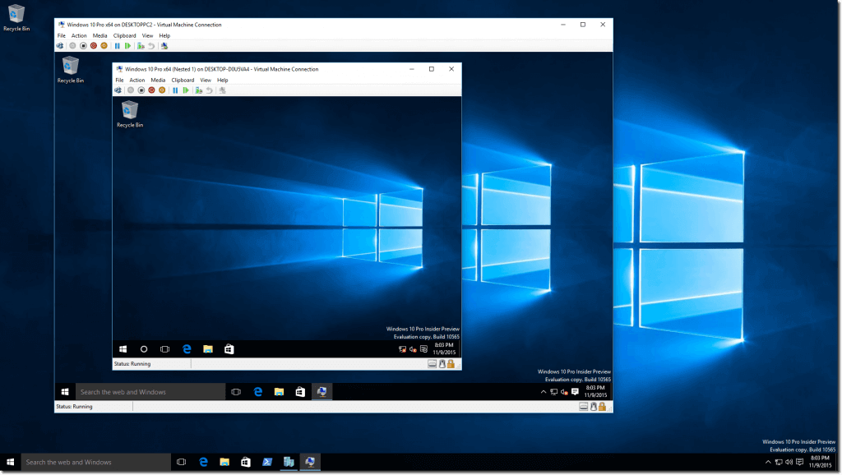
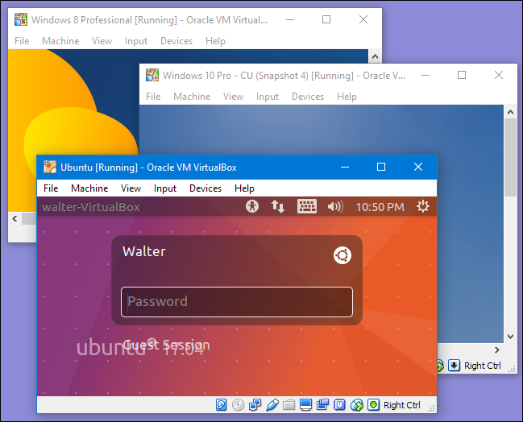
Multiple sandbox

Slide 7
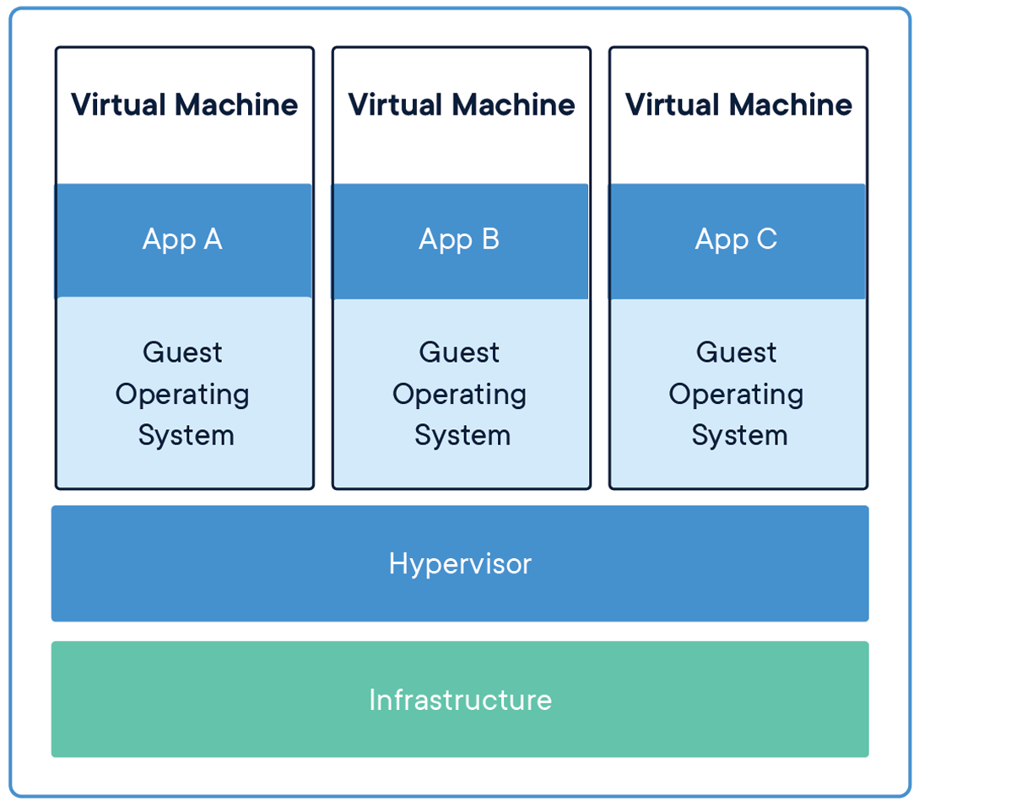
Virtualization
Separate environment → sandbox
Reduce resource usage → reduce price
Academic use
Testing untrustable apps
Platform virtualization software:
Vmware workstation
Vmware server
Virtualbox
proxmox VE
Hyper-V

Slide 8
Virtualization
Install Guest OS
Wasting resource
Performance?
Portable?
Developer target?
SysAdmin target?

Slide 9
Container
Containers are a form of operating system virtualization. A single container might be used to run anything from a small microservice or software process to a larger application. Inside a container are all the necessary executables, binary code, libraries, and configuration files
containers do not contain operating system images.
more lightweight and portable, with significantly less overhead.

Slide 10
Container
Less overhead
Increased portability
More consistent operation: DevOps teams know applications in containers will run the same, regardless of where they are deployed.
Greater efficiency: Containers allow applications to be more rapidly deployed, patched, or scaled.
Better application development: Containers support agile and DevOps efforts to accelerate development, test, and production cycles.

Slide 11
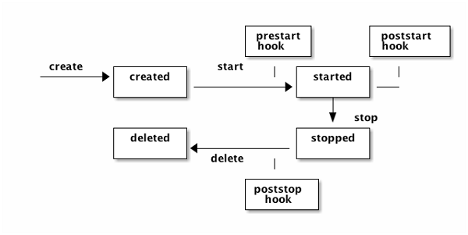
Container

Slide 12
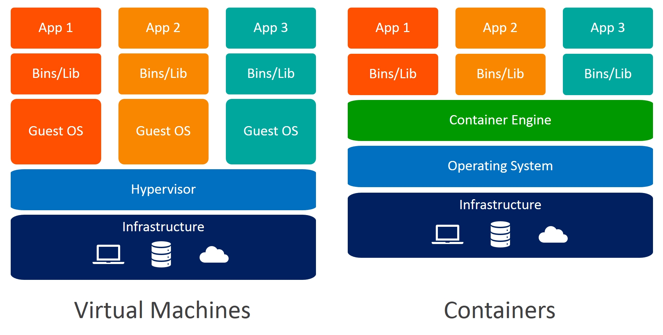
Virtual machine vs Container

Slide 13
Containers VS Virtual machine
VMs are great at providing full process isolation for applications: there are very few ways a problem in the host operating system can affect the software running in the guest operating system, and vice-versa. But this isolation comes at great cost — the computational overhead spent virtualizing hardware for a guest OS to use is substantial.
Containers take a different approach: by leveraging the low-level mechanics of the host operating system, containers provide most of the isolation of virtual machines at a fraction of the computing power.

Slide 14
Container
Docker: container engine
PodMan: is an open-source container engine, which performs much the same role as the Docker engine .
Hyper-V: Windows Containers, which take a similar abstraction approach to Docker, and Hyper-V Containers. Hyper-V offer greater portability than traditional containers, as applications running within them don’t rely on compatibility with the host system.
LXC is a set of low-level container management tools that form part of open-source project LinuxContainers.org .
rkt (CoreOS Rocket):
runC: is a lightweight universal OS container runtime. It was originally a low-level Docker component
Containerd: is basically a daemon, supported by both Linux and Windows, that acts as an interface between your container engine and container runtimes.
https://jfrog.com/knowledge-base/7-alternatives-to-docker-all-in-one-solutions-and-standalone-container-tools/

Slide 15
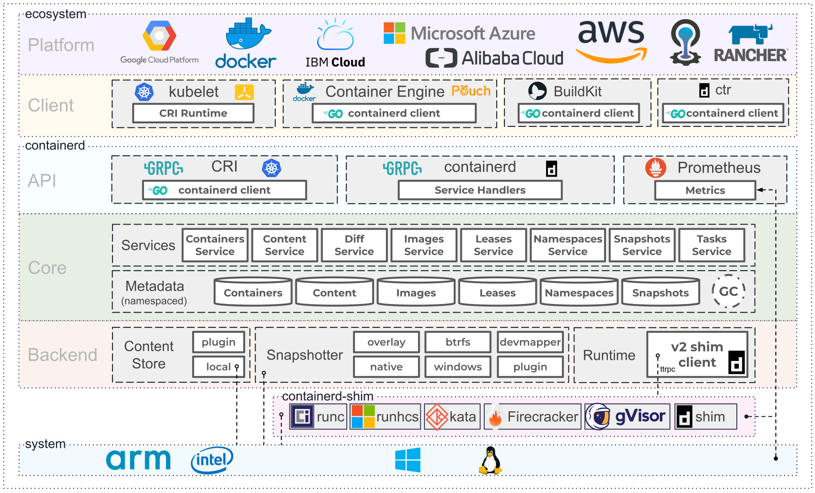
Containerd

Slide 16
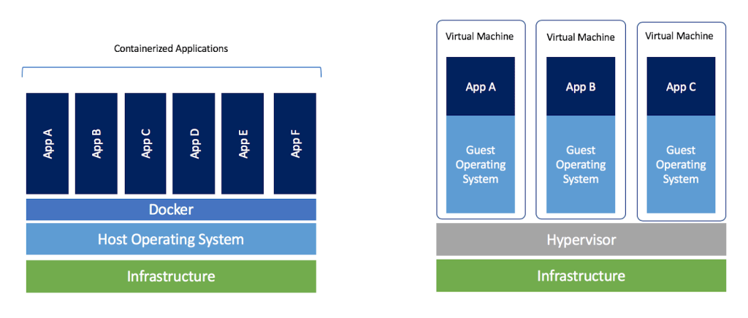
OS-level virtualization
OS-level virtualization is an operating system paradigm in which the kernel allows the existence of multiple isolated user space instances.
https://en.wikipedia.org/wiki/OS-level_virtualization
Depend on Kernel: https://blog.hypriot.com/post/verify-kernel-container-compatibility

Slide 17
What is Docker?
Docker is a tool that allows developers, sys-dmins etc. to easily deploy their applications in a sandbox (called containers) to run on the host operating system i.e. Linux.
The key benefit of Docker is that it allows users to package an application with all of its dependencies into a standardized unit for software development
Docker: a person who works at a port, putting goods onto and taking them off ships
Container: a hollow object, such as a box or a bottle, that can be used for holding something, especially to carry or store it. a very large metal box used for transporting goods

Slide 18
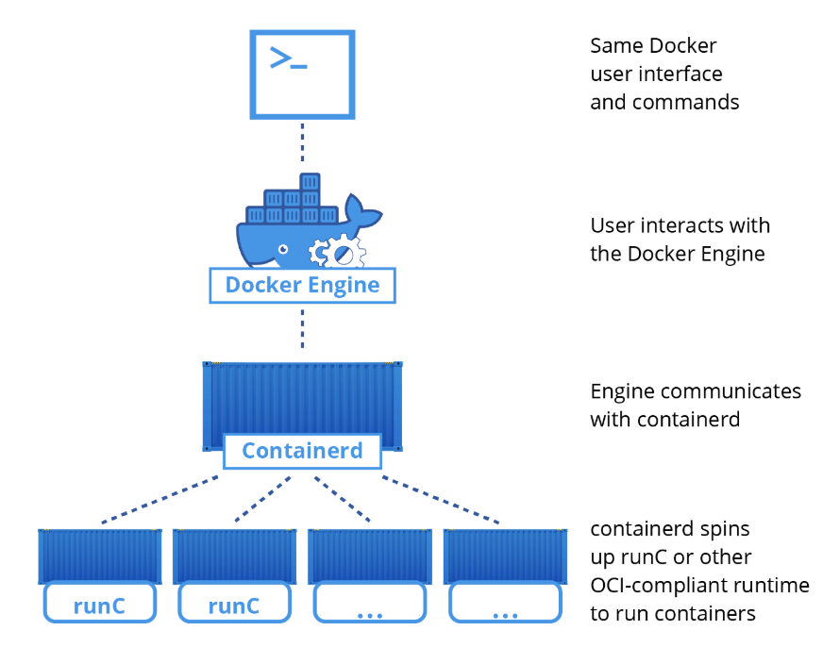
What is Docker?

Slide 19
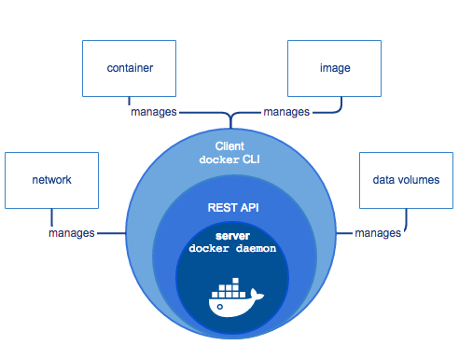
What is Docker?

Slide 20
Features of Docker
Docker has the ability to reduce the size of development by providing a smaller footprint of the operating system via containers.
With containers, it becomes easier for teams across different units, such as development, QA and Operations to work seamlessly across applications.
You can deploy Docker containers anywhere, on any physical and virtual machines and even on the cloud.
Since Docker containers are pretty lightweight, they are very easily scalable.

Slide 21
Terminology
Images - The blueprints of our application which form the basis of containers.
Containers - Created from Docker images and run the actual application.
Docker Daemon - The background service running on the host that manages building, running and distributing Docker containers
Docker Client - The command line tool( or other tools) that allows the user to interact with the daemon.
Docker Hub - A registry of Docker images.

Slide 22
How to work?
Depend on Linux Kernel
Isolation:
Cgroups( share and also limit the resources each process or container)
namespaces(Process ID,Mount,IPC,User,Network)
union file systems(UFS) sush as AUFS, overlay, overlay2
Run limited process instead of full process.
https://medium.com/@kasunmaduraeng/docker-namespace-and-cgroups-dece27c209c7
https://dockerlabs.collabnix.com/beginners/understanding-docker-underlying-technology/README.html
https://dker.ru/docs/docker-engine/user-guide/docker-storage-drivers/overlayfs-storage-in-practice/

Slide 23
AUFS
apt-get install aufs-tools
mkdir /tmp/dir1
mkdir /tmp/aufs-root
mount -t aufs -o br=/tmp/dir1:/home/user2 none /tmp/aufs-root/
By default, if no permissions are specified, first branch will be mounted as writable, and the remaining branches will be mounted as readonly.
So when you create any file inside ‘/tmp/aufs-root/’, physically it will be created under “/tmp/dir1”, since it is the only writable branch

Slide 24
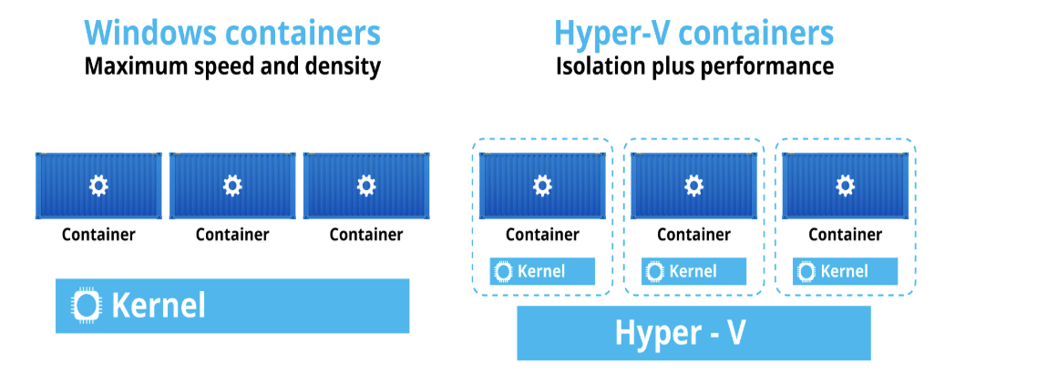
Windows container and Hyper-V
https://hub.docker.com/publishers/microsoftowner
https://docs.microsoft.com/en-us/virtualization/windowscontainers/manage-containers/hyperv-container

Slide 25
Installation
Docker CE (Community Edition) is the simple classical OSS (Open Source Software) Docker Engine.
Docker EE (Enterprise Edition) is Docker CE with certification on some systems and support by Docker Inc.
https://docs.docker.com/engine/install/centos/

Slide 26
Install in CentOS
sudo yum remove docker \
docker-client \
docker-client-latest \
docker-common \
docker-latest \
docker-latest-logrotate \
docker-logrotate \
docker-engine
$ sudo yum install -y yum-utils
$ sudo yum-config-manager \
--add-repo \
https://download.docker.com/linux/centos/docker-ce.repo
$ sudo yum install docker-ce docker-ce-cli containerd.io
$ sudo systemctl enable docker
$ sudo systemctl start docker

Slide 27
Install in Windows
Windows 7/8/10 Home
Install Docker toolbox and run docker
Windows server 2016 and Windows 10 Pro, Enterprise and Education:
Using windows container and Windows HyperV
Windows 10 Home edition
WSL 2 is a new version of Windows Subsystem for Linux (WSL) for Windows based developers to run Linux environment without the overhead of a VM
https://medium.com/@wuedward/docker-on-wsl-2-317d8623a180
https://devconnected.com/how-to-install-docker-on-windows-7-8-10-home-and-pro/
https://stackoverflow.com/questions/48251703/if-docker-runs-natively-on-windows-then-why-does-it-need-hyper-v

Slide 28
Docker pull , push
Docker Registry
Docker pull: Get image from docker registry
Docker push: Push image into docker registry
docker pull hello-world
docker pull nginx
docker run busybox

Slide 29
Docker RUN
Run a container from a image
RUN permanent or non-permanent
RUN with tty
RUN in detach mode
RUN in Interactive
docker run [OPTIONS] IMAGE[:TAG|@DIGEST] [COMMAND] [ARG…]
docker run busybox
docker run busybox echo “Hello world”
docker run -dt busybox echo “Hello world”
-d, --detach Run container in background and print container ID
-t, --tty Allocate a pseudo-TT
-i, --interactive Keep STDIN open even if not attached

Slide 30
Docker exec
Execute a command into container
docker exec <container_name> echo "echo"
docker exec <container_name> ls -l /
Run in interactive mode with tty terminal
docker exec -it <container_name> / bin/bash
-i, --interactive Keep STDIN open even if not attached
-t, --tty Allocate a pseudo-TTY

Slide 31
Docker single service
Single service:
#!/bin/bash
while (true)
do
echo “Hello: “
sleep 3
done

Slide 32
Docker environments
docker run -e firstname=ali -e lastname=rezaei myimage /root/run.sh
-e, --env list Set environment variables

Slide 33
Docker publish
docker run -p 8080:80 nginx:latest
-p, --publish list Publish a container's port(s) to the host

Slide 34
Docker switch
docker run –-host-name=mail.test.io …
docker run –- dns1=127.0.0.1 –-dns2=8.8.8.8
docker run –-rm nginx:latest /root/run.sh
docker top <container-name>
docker logs -f <container-name>
Docker run --label a=1 myimage:latest
docker run –-host-name=mail.test.io …
docker run –- dns1=127.0.0.1 –-dns2=8.8.8.8
docker run –-rm nginx:latest /root/run.sh

Slide 35
Docker inspect
docker inspect <image-id>
docker inspect <container-id>
docker <object> inspect <object-id>

Slide 36
Docker stop/start/pause
docker start <container-name>
docker stop <container-name>
docker restart <container-name>
docker pause <container-name>

Slide 37
Docker commit
docker commit <container-name> <new-image-name>

Slide 38
Docker image
docker images
Docker image tag <image-name:tag> <new-name:new-tag>
Docker image rmi <image-name>
Docker image save <images-name> > file.tar
Docker image load -i file.tar
Docker image prune

Slide 39
Docker container
docker container ls
Docker container create
Docker container cp
Docker container top

Slide 40
Docker network
Network drivers:
bridge: The default network driver. Bridge networks are usually used when your applications run in standalone containers that need to communicate.
host: For standalone containers, remove network isolation between the container and the Docker host, and use the host’s networking directly.
overlay: Overlay networks connect multiple Docker daemons together and enable swarm services to communicate with each other.
macvlan: Macvlan networks allow you to assign a MAC address to a container, making it appear as a physical device on your network. The Docker daemon routes traffic to containers by their MAC addresses.
none: For this container, disable all networking. Usually used in conjunction with a custom network driver.
Network plugins: You can install and use third-party network plugins with Docker.

Slide 41
Docker network
docker run -d --network bridge --name my_nginx nginx
docker run -d --network host --name my_nginx2 nginx

Slide 42
Docker network
Create bridge network
- docker network create --driver bridge my-net
docker run -d --network my-net -p 192.168.1.100:8080:80 --name my_nginx nginx
docker run -d --network my-net –ip 172.17.0.10 --name my_nginx nginx
docker netwrok ls
docker network rm my-net
docker network disconnect my-net my-nginx
Attach network card to exist container
docker network connect my-net my_nginx2

Slide 43
Docker volume
Volumes are the preferred mechanism for persisting data generated by and used by Docker containers.
Volumes and bind mounts let you share files between the host machine and container so that you can persist data even after the container is stopped.
Volumes are easier to back up or migrate than bind mounts.
You can manage volumes using Docker CLI commands or the Docker API.
Volumes work on both Linux and Windows containers.
Volumes can be more safely shared among multiple containers.
Volume drivers let you store volumes on remote hosts or cloud providers, to encrypt the contents of volumes, or to add other functionality.
New volumes can have their content pre-populated by a container.
Volumes on Docker Desktop have much higher performance than bind mounts from Mac and Windows hosts.

Slide 44
Docker volume
docker create volume nginx-vol
docker run -d --name=nginxtest --mount source=nginx-vol,destination=/usr/share/nginx/html nginx:latest
docker run -d --name=nginxtest -v nginx-vol:/usr/share/nginx/html nginx:latest
docker volume rm nginx-vol
Use Read-only
docker run -d --name=nginxtest --mount source=nginx-vol,destination=/usr/share/nginx/html,readonly nginx:latest
docker run -d --name=nginxtest -v nginx-vol:/usr/share/nginx/html:ro nginx:latest
docker plugin install --grant-all-permissions vieux/sshfs : https://docs.docker.com/storage/volumes/#use-a-volume-driver

Slide 45
Docker volume
Create Data-Only Containers
docker run -v /dbdata --name dbstore ubuntu /bin/bash
docker run –name=app --rm --volumes-from dbstore ubuntu
Backup
docker run --rm --volumes-from dbstore -v $(pwd):/backup ubuntu tar cvf /backup/backup.tar /dbdata
Restore
docker run -v /dbdata --name dbstore2 ubuntu /bin/bash
docker run --rm --volumes-from dbstore2 -v $(pwd):/backup ubuntu bash -c "cd /dbdata && tar xvf /backup/backup.tar --strip 1"
Remove volumes
Named volumes have a specific source from outside the container,
Anonymous volumes have no specific source so when the container is deleted, instruct the Docker Engine daemon to remove them.

Slide 46
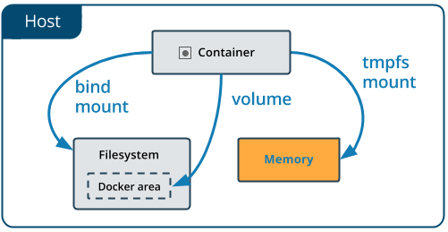
Docker Volume
Use tmpfs mounts
Save container data in tmpfs
Increase performance
Limitation:
you can’t share tmpfs mounts between containers.
Only available Docker on Linux.

Slide 47
Docker Volume
docker run -d -it --name tmptest --mount type=tmpfs,destination=/app nginx:latest
docker run -d -it --name tmptest --tmpfs /app nginx:latest
https://docs.docker.com/storage/tmpfs/

Slide 48
Docker restart policy
Docker provides restart policies to control whether your containers start automatically when they exit, or when Docker restarts.
Use a restart policy
No: Do not automatically restart the container. (the default)
On-failure: Restart the container if it exits due to an error, which manifests as a non-zero exit code.
Always: Always restart the container if it stops. If it is manually stopped, it is restarted only when Docker daemon restarts or the container itself is manually restarted.
Unless-stopped: Similar to always, except that when the container is stopped (manually or otherwise), it is not restarted even after Docker daemon restarts.
docker run -d --restart unless-stopped redis
docker update --restart unless-stopped redis

Slide 49
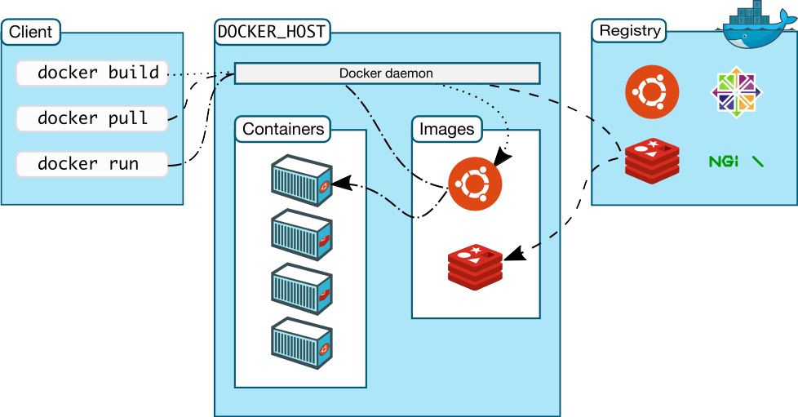
Docker architecture

Slide 50
Dockerfile
Build a image automatically
Docker can build images automatically by reading the instructions from a Dockerfile
A Dockerfile is a text document that contains all the commands a user could call on the command line to assemble an image

Slide 51
Dockerfile
FROM MY-IMAGE:latest
MAINTAINER s.rasouli@arissystem.com
ENV main=3.7 buildnumber=1234
ENV version=$main.$buildnumber
WORKDIR /opt
RUN rm /opt/test/data/ldap/mdb/db/data.mdb -f
COPY ./data.mdb /opt/test/data/ldap/mdb/db/
RUN chown test:test /opt/test/data/ldap/mdb/db/data.mdb
COPY ./start.sh /root
VOLUME ["/var/lib/","/var/log/","/opt" ]
EXPOSE 389 25 7071 8080 443 80 22 7072 9071 110 143 993 995 587 465 8443
CMD ["/root/start.sh"]

Slide 52
Dockerfile Instructions
ADD
COPY: copy file from context to image
ENV: set environments
EXPOSE: set expose port
FROM: set base image name
LABEL: add metadata to image
STOPSIGNAL
USER
VOLUME: set volume
WORKDIR: work directory
CMD
ENTRYPOINT
https://hub.docker.com/_/alpine?tab=description&page=1&ordering=last_updated

Slide 53
Dockerfile FROM
The FROM instruction initializes a new build stage and sets the Base Image for subsequent instructions.
As such, a valid Dockerfile must start with a FROM instruction.
FROM [--platform=<platform>] <image> [AS <name>]
FROM [--platform=<platform>] <image>[:<tag>] [AS <name>]
FROM [--platform=<platform>] <image>[@<digest>] [AS <name>]

Slide 54
Dockerfile ARG
ARG CODE_VERSION=latest
FROM NGINX:${CODE_VERSION}
ARG VERSION=latest
FROM busybox:$VERSION
ARG VERSION
RUN echo $VERSION > image_version

Slide 55
Dockerfile RUN
RUN has 2 forms:
- RUN <command> (shell form, the command is run in a shell, which by default is /bin/sh -c on Linux or cmd /S /C on Windows)
RUN /bin/bash -c 'source $HOME/.bashrc; \ echo $HOME'
RUN /bin/bash -c 'source $HOME/.bashrc; echo $HOME'
- RUN ["executable", "param1", "param2"] (exec form)
RUN ["/bin/bash", "-c", "echo hello"]
The RUN instruction will execute any commands in a new layer on top of the current image and commit the results.
https://docs.docker.com/engine/reference/builder/#run

Slide 56
Dockerfile LABEL
LABEL "com.example.vendor"="ACME Incorporated"
LABEL com.example.label-with-value="foo"
LABEL version="1.0"
LABEL description="This text illustrates \
that label-values can span multiple lines."

Slide 57
Dockerfile EXPOSE
By default, EXPOSE assumes TCP
EXPOSE 80/tcp
EXPOSE 80/udp
EXPOSE 7071

Slide 58
Dockerfile ARG
using ARG, which is not persisted in the final image:
ARG DEBIAN_FRONTEND=noninteractive
RUN apt-get update && apt-get install -y ...

Slide 59
Dockerfile CMD
The main purpose of a CMD is to provide defaults for an executing container.
The CMD instruction has three forms
CMD ["executable","param1","param2"] (exec form, this is the preferred form)
CMD ["param1","param2"] (as default parameters to ENTRYPOINT)
CMD command param1 param2 (shell form)

Slide 60
Dockerfile CMD
FROM ubuntu
CMD echo "This is a test." | wc -
If you use the shell form of the CMD, then the <command> will execute in /bin/sh -c:
CMD [“/usr/bin/tail” , “-f” ,”/dev/null”]

Slide 61
Docker ENTRYPOINT
ENTRYPOINT instruction allows you to configure a container that will run as an executable. It looks similar to CMD, because it also allows you to specify a command with parameters. The difference is ENTRYPOINT command and parameters are not ignored when Docker container runs with command line parameters. (There is a way to ignore ENTTRYPOINT, but it is unlikely that you will do it.)
Shell form of ENTRYPOINT ignores any CMD or docker run command line arguments.
ENTRYPOINT has two forms:
ENTRYPOINT ["executable", "param1", "param2"] (exec form, preferred)
ENTRYPOINT command param1 param2 (shell form)

Slide 62
Docker ENTRYPOINT
Exec form
Exec form of ENTRYPOINT allows you to set commands and parameters and then use either form of CMD to set additional parameters that are more likely to be changed. ENTRYPOINT arguments are always used, while CMD ones can be overwritten by command line arguments provided when Docker container runs. For example, the following snippet in Dockerfile
ENTRYPOINT ["/bin/echo", "Hello"]
CMD ["world"]
when container runs as docker run -it <image> will produce output
Hello world
but when container runs as docker run -it <image> John will result in
Hello John
Shell form
Shell form of ENTRYPOINT ignores any CMD or docker run command line arguments.

Slide 63
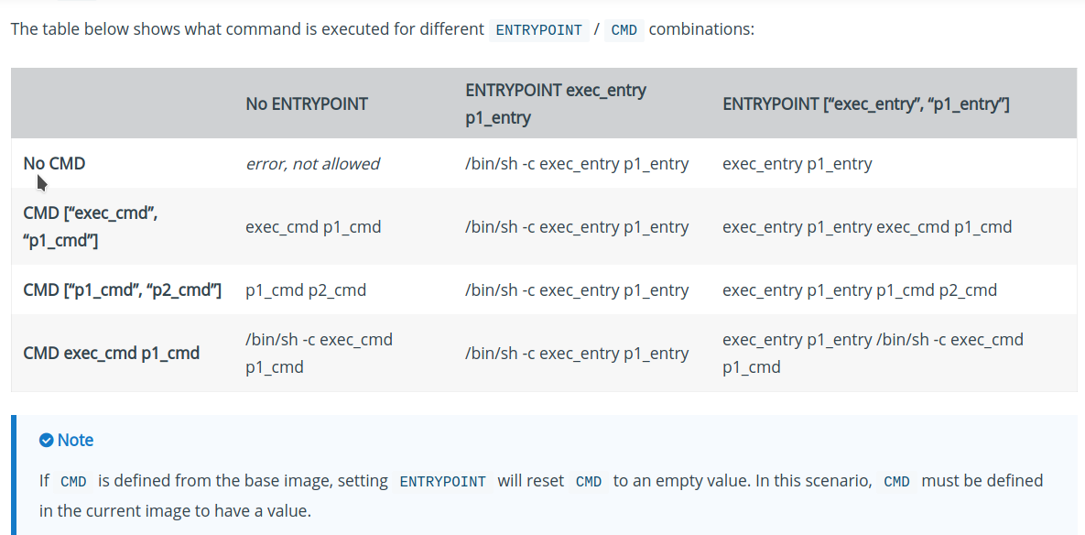
Dockerfile CMD vs ENTRYPOINT

Slide 64
Dockerfile CMD vs ENTRYPOINT
Use RUN instructions to build your image by adding layers on top of initial image.
Prefer ENTRYPOINT to CMD when building executable Docker image and you need a command always to be executed. Additionally use CMD if you need to provide extra default arguments that could be overwritten from command line when docker container runs.
Choose CMD if you need to provide a default command and/or arguments that can be overwritten from command line when docker container runs.

Slide 65
Docker build
When you issue a docker build command, the current working directory is called the build context.
mkdir myproject && cd myproject
echo "hello" > hello
echo -e "FROM busybox\nCOPY /hello /\nRUN cat /hello" > Dockerfile
docker build -t helloapp:v1 .
mkdir -p dockerfiles context
mv Dockerfile dockerfiles && mv hello context
docker build --no-cache -t helloapp:v2 -f dockerfiles/Dockerfile context
No files are sent as build context to the daemon: Omitting the build context can be useful in situations where your Dockerfile does not require files to be copied into the image, and improves the build-speed
echo -e 'FROM busybox\nRUN echo "hello world"' | docker build -t myimage:latest -
docker build -t myimage:latest -<<EOF
FROM busybox
RUN echo "hello world"
EOF

Slide 66
Docker build
If you want to improve the build-speed by excluding some files from the build- context, refer to exclude with .dockerignore.
Build from remote
https://docs.docker.com/develop/develop-images/dockerfile_best-practices/
docker build -t myimage:latest -f- https://github.com/docker-library/hello-world.git
Dokcer build -t testimage:latest - <<EOF
FROM busybox
COPY hello.c .
EOF

Slide 67
Dockerfile COPY vs ADD
ADD /source/file/path /destination/path
ADD http://source.file/url /destination/path
ADD source.file.tar.gz /temp → Automatically decompress[just locally]
COPY /source/file/path /destination/path
The fact that ADD had so many functionalities proved to be problematic in practice, as it behaved extremely unpredictable.
The Docker team also strongly discourages using ADD to download and copy a package from a URL
RUN curl http://source.file/package.file.tar.gz \
| tar -xjC /tmp/ package.file.tar.gz \
&& make -C /tmp/ package.file.tar.gz
https://phoenixnap.com/kb/docker-add-vs-copy
COPY go /usr/local/ → copy content of `go` directory
COPY go /usr/local/go → copy `go` directory itself

Slide 68
VOLUME
The VOLUME instruction creates a mount point with the specified name and marks it as holding externally mounted volumes from native host or other containers.
The value can be a JSON array, VOLUME ["/var/log/" ,”/app”]
plain string with multiple arguments, such as VOLUME /var/log or VOLUME /var/log /var/db

Slide 69
Dokcerfile USER
The USER instruction sets the user name (or UID) and optionally the user group (or GID) to use when running the image and for any RUN, CMD and ENTRYPOINT instructions that follow it in the Dockerfile.
FROM microsoft/windowsservercore
# Create Windows user in the container
RUN net user /add patrick
# Set it for subsequent commands
USER patrick

Slide 70
Docker build history
docker history --no-trunc <Image-ID> | tac | tr -s ' ' | cut -d " " -f 5- | sed 's,^/bin/sh -c #(nop) ,,g' | sed 's,^/bin/sh -c,RUN,g' | sed 's, && ,\n & ,g' | sed 's,\s*[0-9]*[\.]*[0-9]*\s*[kMG]*B\s*$,,g' | head -n -1

Slide 71
Docker Scratch
Most Dockerfiles start from a parent image. If you need to completely control the contents of your image, you might need to create a base image instead. Here’s the difference:
A parent image is the image that your image is based on. It refers to the contents of the FROM directive in the Dockerfile. Each subsequent declaration in the Dockerfile modifies this parent image. Most Dockerfiles start from a parent image, rather than a base image. However, the terms are sometimes used interchangeably.
A base image has FROM scratch in its Dockerfile..
It can be as simple as this to create an Ubuntu parent image:
$ sudo debootstrap xenial xenial > /dev/null
$ sudo tar -C xenial -c . | docker import - xenial
FROM scratch
ADD hello /
CMD ["/hello"]

Slide 72
docker-compose
Manage multiple service: build, run, stop ,…
Scale switch: run multiple service
Easy to use
Yaml format
https://www.educative.io/blog/docker-compose-tutorial
https://www.baeldung.com/docker-compose

Slide 73
docker-compose
version: '3'
services:
web:
build: ./web
image: web:1.2
container_name: web-dev
db:
image: mysql:latest
container_name: db-dev
command: --default-authentication-plugin=mysql_native_password
environment:
- MYSQL_ROOT_PASSWORD=mypass
- MYSQL_DATABASE=webdb
- MYSQL_USER= webuser
- MYSQL_PASSWORD= webpass
volumes:
- ./db/init-db:/docker-entrypoint-initdb.d

Slide 74
docker-compose commands
Start service:
docker-compose up <service-name>
Start all service
docker-compose up
Start in detach mode
docker-compose up -d
Check docker-compose
docker-compose config

Slide 75
docker-compose commands
Stop service
docker-compose stop <service-name>
Start service (already exist)
docker-compose start <service-name>
docker-compose ps
Remove service (container): (remove container and network)
docker-compose down → all services that exist in docker-compose file
Remove service (container): (remove container and network and volume)
docker-compose down -v → all services that exist in docker-compose file

Slide 76
docker-compose down
Stops containers and removes containers, networks, volumes, and images
created by `up`.
By default, the only things removed are:
- Containers for services defined in the Compose file
- Networks defined in the `networks` section of the Compose file
- The default network, if one is used
Networks and volumes defined as `external` are never removed.
Usage: down [options]
Options:
--rmi type Remove images. Type must be one of:
'all': Remove all images used by any service.
'local': Remove only images that don't have a
custom tag set by the `image` field.
-v, --volumes Remove named volumes declared in the `volumes`
section of the Compose file and anonymous volumes
attached to containers.
--remove-orphans Remove containers for services not defined in the
Compose file
-t, --timeout TIMEOUT Specify a shutdown timeout in seconds.
(default: 10)

Slide 77
Docker-compose build , --build
Build service (image)
docker-compose build [service-name]
Build before start
docker-compose up –-build
No build
docker-compose up --no-build

Slide 78
docker-compose --scale
version: '3'
services:
web:
build: ./web
image: web:1.2
environment:
- COMPANY_NAME="MICROSOFT"
- TELEPHONE_NUMBER="001253568714"
- DISCRIPTION="TEST COMPANY .2"
- VERSION="1.5"
ports:
- "8080-8085:8080"
dokcer-compose up -d –-scale web=4

Slide 79
Docker-compose file
YAML Basic Rules
YAML files should end in .yaml whenever possible in Grav.
YAML is case sensitive.
YAML does not allow the use of tabs.
Basic Data Types
Scalars They are the strings and numbers that make up the data on the page.
Sequences
Mappings
https://learn.getgrav.org/16/advanced/yaml

Slide 80
Docker-compose file
<?xml version="1.0" encoding="UTF-8" ?>
<root>
<0>
<martin>
<name>Martin D'vloper</name>
<job>Developer</job>
<skills>python</skills>
<skills>perl</skills>
<skills>pascal</skills>
</martin>
</0>
<1>
<tabitha>
<name>Tabitha Bitumen</name>
<job>Developer</job>
<skills>lisp</skills>
<skills>fortran</skills>
<skills>erlang</skills>
</tabitha>
</1>
</root>
# Employee records
- martin:
name: Martin D'vloper
job: Developer
skills:
- python
- perl
- pascal
- tabitha:
name: Tabitha Bitumen
job: Developer
skills:
- lisp
- fortran
- erlang
[
{
"martin": {
"name": "Martin D'vloper",
"job": "Developer",
"skills": [
"python",
"perl",
"pascal"
]
}
},
{
"tabitha": {
"name": "Tabitha Bitumen",
"job": "Developer",
"skills": [
"lisp",
"fortran",
"erlang"
]
}
}
]

Slide 81
Docker-compose file
version: define version of docker-compose
services: define all service that each service has a name
Image:
Define image name (that exists in docker-hub): image: ubuntu:latest
Set image name for build: image: myapp:1.2
build:
build: /path/to/dockerfile/
build: https://github.com/my-company/my-project.git

Slide 82
Docker-compose file
Ports: define port mapping
ports:
- "80:80"
ports: → static port in scale mode
- "8080-8085:80"
ports: → random port in scale mode
- "80"

Slide 83
docker-compose file
Environment
web:
environment:
- DEBUG=1
web:
env_file:
- web-variables.env
docker-compose run -e DEBUG=1 web python console.py

Slide 84
docker-compose file
Network
networks:
front-network:
ipv4_address: 172.21.0.10
networks:
front-network:
ipam:
config:
- subnet: 172.21.0.0/16

Slide 85
docker-compose file
Join to exist network
networks:
default:
external:
name: my-pre-existing-network

Slide 86
docker-compose file
Volumes
Named-volume
Service1:
volumes:
- db-vol:/data
- db-log:/var/log
volumes:
db-vol:
db-log
Path volume
Service1:
volumes:
- /home/database/data:/data

Slide 87
docker-compose file
Entrypoint: Override the default entrypoint.
entrypoint: /code/entrypoint.sh
entrypoint: ["php", "-d", "memory_limit=-1", "vendor/bin/phpunit"]
Command: Override the default command.
command: bundle exec thin -p 3000
command: ["bundle", "exec", "thin", "-p", "3000"]

Slide 88
docker-compose extra commands
docker-compose exec
https://docs.doc1ker.com/compose/reference/exec/
docker-compose create
https://docs.docker.com/compose/reference/create/
docker-compose file
https://docs.docker.com/compose/compose-file/

Slide 89
docker-compose run vs up
Run:
The command passed by run overrides the command defined in the service configuration.
The second difference is the docker-compose run command does not create any of the ports specified in the service configuration.
docker-compose run is made to run one-off commands for your services: if you already did a docker-compose up, all your containers are already running on their specified ports from docker-compose.yml

Slide 90
Docker-compose .env
echo “MYSQL_WS_PASSWORD_ROOT=root123” >.env
Use in docker-compose: - environment:
- MYSQL_ROOT_PASSWORD=${MYSQL_WS_PASSWORD_ROOT}
cat .env
TAG=v1.5
$ cat docker-compose.yml
version: '3'
services:
web:
image: "webapp:${TAG}"

Slide 91
Docker-compose multi project
docker-compose -f docker-compose.yml -f docker-compose.prod.yml up -d
https://docs.docker.com/compose/extends/

Slide 92
docker --link
Access container to another container in default bridge
User-defined network has own access and there is no need to use –link
https://docs.docker.com/network/bridge/#differences-between-user-defined-bridges-and-the-default-bridge

