Slide 1
Beyond Forest Loss
Identifying Deforestation Archetypes
Deforestation is not random — events leave repeatable spatial and temporal signatures.
Akash Sagi · Sakethram Naidu
Notes:
Most existing systems can tell us where forests are being lost. But our key question is — can we go beyond that?
Can we actually understand what kind of deforestation is happening, just from the patterns we observe?
Our work explores whether deforestation events leave repeatable signatures, and whether we can discover those patterns automatically.

Slide 2
The Problem: Current Monitoring Tells Us Where — Not What
What we already have
Linear / corridor-like
Global systems (Hansen/GFW) reliably detect where & when forest loss occurred
30m annual maps at planetary scale — remarkable coverage
Roads, tracks — elongated
Blocky / compact
What's missing
Agriculture — uniform patch
Outputs are binary: loss vs. no loss
Morphology, recurrence, and process are invisible
Can't distinguish agriculture from roads from logging
Fragmented / mosaic
Logging — broken edges
Do different deforestation events leave repeatable spatial signatures
discoverable without labels?
Notes:
Right now, global monitoring systems like Hansen or Global Forest Watch are extremely powerful.
They give us high-resolution maps showing exactly where and when forest loss occurs. But there’s a big limitation.
These outputs are essentially binary — loss or no loss. They don’t tell us what caused the loss. For example, a road, a farm, and logging activity all look the same in these maps.
But visually, they are very different:
Roads are linear
Agriculture is blocky
Logging is fragmented
So the core question is — Are these patterns consistent enough that we can discover them automatically?

Slide 3
Our Core Idea
Event shape encodes the
underlying deforestation process.
🌿
🔍
🎯
Different drivers leave different geometric fingerprints
Those fingerprints are discoverable without labels
Archetypes turn detection into interpretable action
Notes:
The shape of a deforestation event encodes the process behind it.
And importantly, we don’t rely on labeled data.

Slide 4
Our Approach: Unsupervised Archetype Discovery
detect → describe → interpret
1
2
3
Extract Events
Compute Features
Cluster with HDBSCAN
Group annual loss pixels by spatial connectivity into contiguous event patches. One patch = one event.
Measure geometry: area, perimeter, compactness, eccentricity, aspect ratio, edge density, mask fraction.
Discover recurring archetypes without predefining cluster count. Genuine outliers stay as noise.
Hansen GFW (30m) + Sentinel-2 (10–20m)
8 morphological descriptors per event
No labels required — fully unsupervised
Key insight: reason over event morphology rather than individual pixels — shape reveals process.
Notes:
First, we extract events. Instead of looking at individual pixels, we group connected loss pixels into event patches.
Second, we compute features. We measure the shape of each event using things like: Finally, we cluster these events using HDBSCAN. This lets us discover natural groupings without predefining how many clusters exist.

Slide 5
Data & Unit of Analysis
Data Sources
Unit of Analysis
Hansen Global Forest Change
Annual Loss Map
1
Annual forest-loss detections from Landsat time series · 30m resolution
Multiple disturbed pixels across the landscape
Sentinel-2
2
Connected Component
10–20m imagery for finer local geometry and spatial context
Spatially contiguous pixels grouped together
Landsat archive (fallback)
3
Event Patch
Continuity when Sentinel-2 is unavailable
One deforestation event — ready for feature extraction
This framing lets the model reason over event morphology rather than treating each changed pixel independently.
Notes:
We use data from:
Hansen Global Forest Change
Sentinel-2 imagery
The important part is how we define our unit of analysis.
We start with:
An annual loss map
Group pixels into connected components
Treat each group as a single event
This allows the model to reason about entire deforestation events, rather than isolated pixels — which is critical for capturing shape.”

Slide 6
Results: 14 Distinct Archetypes Discovered
14
5.6%
Cluster Summary
Feature
Distinguishes
clusters discovered
events as noise
Area
Small vs. large events
What this means
Compactness
Compact vs. sprawling
14 meaningful clusters emerged with zero predefined labels
HDBSCAN kept 5.6% as noise — genuine outliers, not forced into categories
Clusters separate along size, compactness, elongation, and edge complexity
Clean separation signals real morphological structure, not coincidence
Eccentricity
Round vs. elongated
Aspect ratio
Square vs. linear
Edge density
Smooth vs. fragmented
Mask fraction
Dense vs. sparse patches
Notes:
“When we apply our clustering approach, we discover 14 distinct archetypes of deforestation events.
Importantly, this is done without any predefined labels.
Only about 5.6% of events are classified as noise, which means most events fall into meaningful groups.
These clusters separate along interpretable dimensions like size, compactness, elongation, and edge complexity.
This indicates that the patterns we observe reflect real morphological structure, not random variation.”

Slide 7
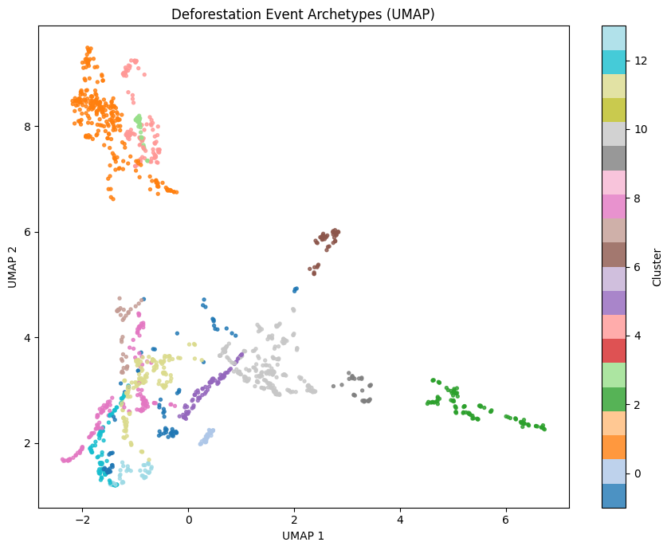
Results: Archetypes Separate in Feature Space
UMAP projection of all deforestation events
How to read this
Each dot = one deforestation event
Color = archetype cluster assigned by HDBSCAN
Distance reflects feature similarity — closer = more similar shape
Distinct blobs = real separation, not overlap
If clusters were random, dots would blend together. They don't — the archetypes are real.
Notes:
“This slide shows a UMAP projection of all deforestation events in feature space.
Each point represents a single event, and the color indicates the cluster assigned by HDBSCAN.
Points that are closer together have more similar shapes.
What we observe is that events form distinct groups rather than blending together, which shows that the archetypes are well-separated and reflect real structure in the data.”
🔍 2. What this plot actually is
You took:
High-dimensional feature space (6–8 features)
And reduced it to:
2D using UMAP
Important:
UMAP preserves:
local similarity (similar points stay close)

Slide 8
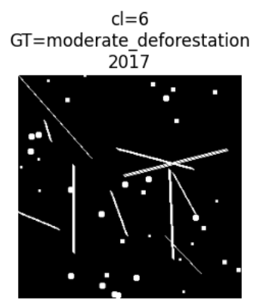
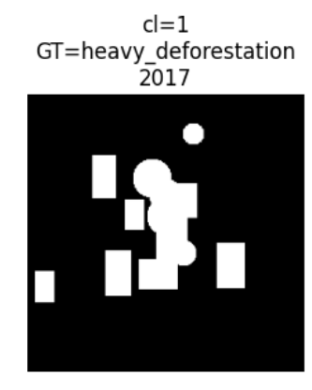
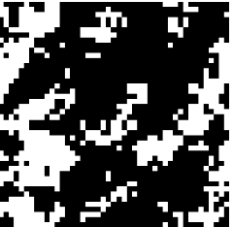
What the Archetypes Tell Us
Geometry → Process
LINEAR
→
Roads & Infrastructure
Thin elongated corridors with branching — classic road-building and infrastructure expansion signature
BLOCKY
→
Agricultural Clearing
Localized compact footprint — deliberate bulk clearance for cropland or plantation establishment
FRAGMENTED
→
Selective Logging
High edge complexity and broken shape — partial canopy removal leaving scattered residual patches
Archetypes can be interpreted before driver labels are available — that's the power of morphology-first discovery.
Notes:
“This slide shows how we interpret the discovered archetypes.
We find that different geometric patterns correspond to different real-world deforestation processes.
For example, linear patterns align with roads and infrastructure expansion, compact blocky patterns align with agricultural clearing, and fragmented patterns align with selective logging.
The key point is that these interpretations emerge from geometry alone, without using labels.”
You are doing:
Unsupervised clusters → Human interpretation → Real-world processes

Slide 9
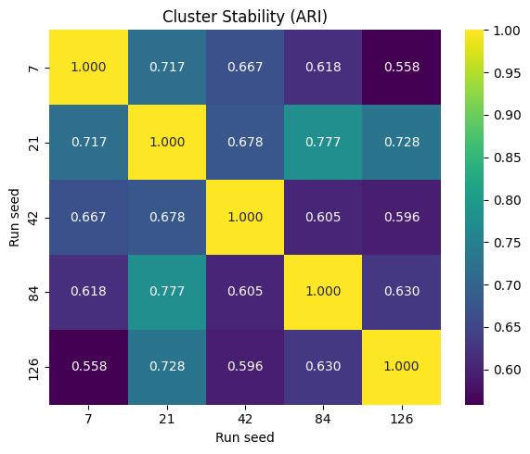
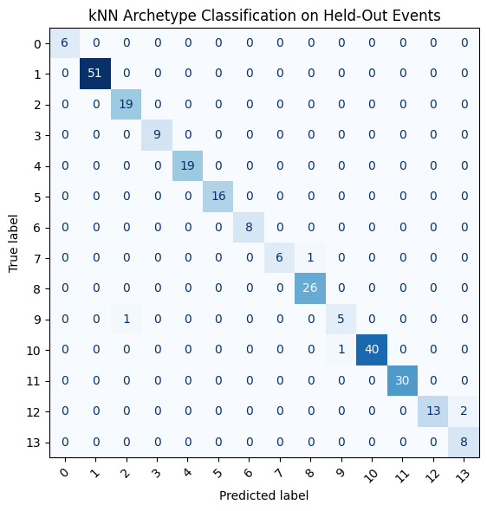
Are the Archetypes Stable and Learnable?
Held-out kNN classification
0.658
98.24%
5-fold cross-validation on held-out events
Near-diagonal confusion matrix — almost no misclassification
mean ARI across seeds
5-fold CV accuracy
Stability across random seeds (ARI range 0.56–0.78)
ARI heatmap — yellow = high agreement across 5 seeds
kNN confusion matrix — strong diagonal confirms archetypes are learnable
Notes:
“To validate our archetypes, we evaluate both stability and learnability.
First, we test stability by running the clustering multiple times with different random seeds and measuring agreement using the Adjusted Rand Index. We observe a mean ARI of about 0.66, which indicates consistent clustering structure.
Second, we test learnability by training a k-nearest neighbors classifier on held-out data. We achieve about 98% accuracy with a near-diagonal confusion matrix, showing that the archetypes are well-separated and can be reliably assigned to new events.
Together, this shows that the patterns we discover are both stable and learnable.”

Slide 10
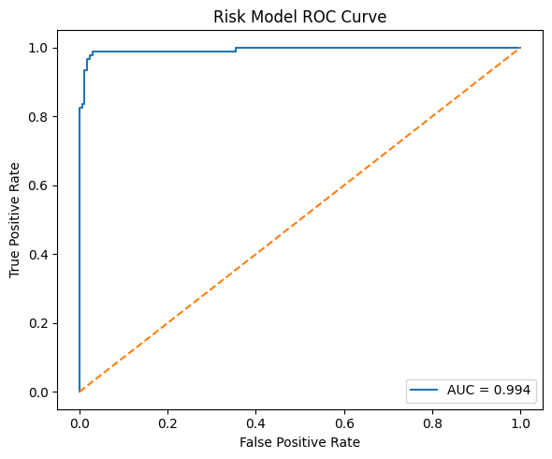
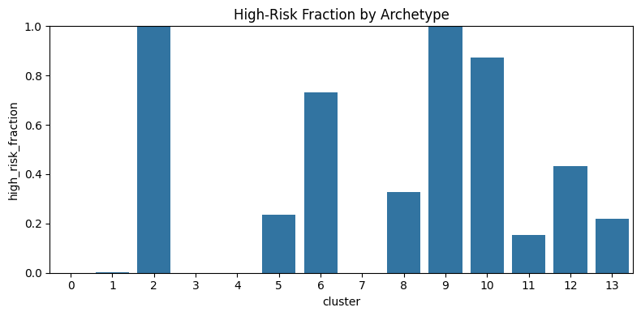
Exploratory Proxy Risk Model
Some archetypes are systematically higher risk
0.994
ROC-AUC on held-out split
What the model shows
Highest proxy-risk clusters: 2, 9, 10, and 6
Top predictive features: perimeter, mask fraction, bounding box area, compactness
Some archetypes are consistently 100% high-risk; others near zero
ROC Curve (AUC = 0.994)
High-risk fraction by archetype
Interpretation
Some archetypes appear systematically more hazardous than others — exactly the kind of signal we want to test against real longitudinal driver labels in future work.
Notes:
“As an exploratory step, we test whether certain archetypes are associated with higher risk.
We train a simple model using the same geometric features and observe a very high ROC-AUC of 0.994.
We also find that some clusters are consistently high-risk, while others are near zero.
However, it’s important to note that this is not independent validation, since the labels are derived from the same geometry used for clustering.
So this result should be interpreted as a signal, not as a causal or deployable model.”

Slide 11
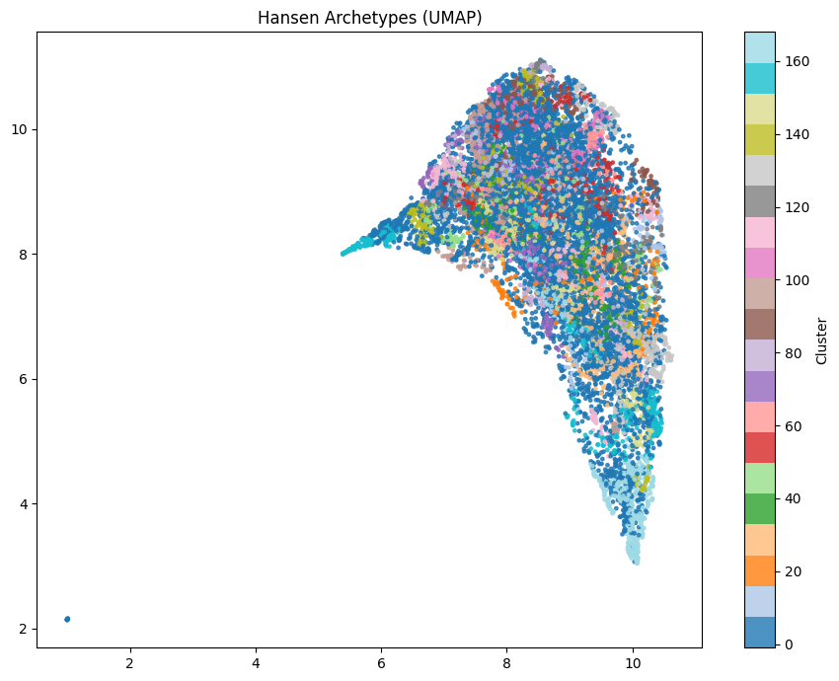
Generalization: Does It Hold at Scale?
15,000-event Hansen Global Forest Change sample
What we tested
Same morphology-first pipeline on a 15,000-event Hansen sample
Much broader geographic diversity than the development set
No modifications — pure transfer test
What we found
Cluster structure still emerges — the idea transfers
Global heterogeneity makes clusters noisier (expected)
Validates morphology archetypes aren't just a local artifact
The morphology-first idea survives at broader geographic scale.
Hansen UMAP — 15,000 events; structure persists despite noisier global diversity
Notes:
“Here we test whether our approach generalizes to larger and more diverse data.
We apply the same morphology-first pipeline to a 15,000-event global Hansen dataset, with no modifications.
What we observe is that cluster structure still emerges, although it becomes noisier due to greater geographic diversity.
This suggests that the patterns we discovered are not specific to one dataset, but reflect a more general property of deforestation.”

Slide 12
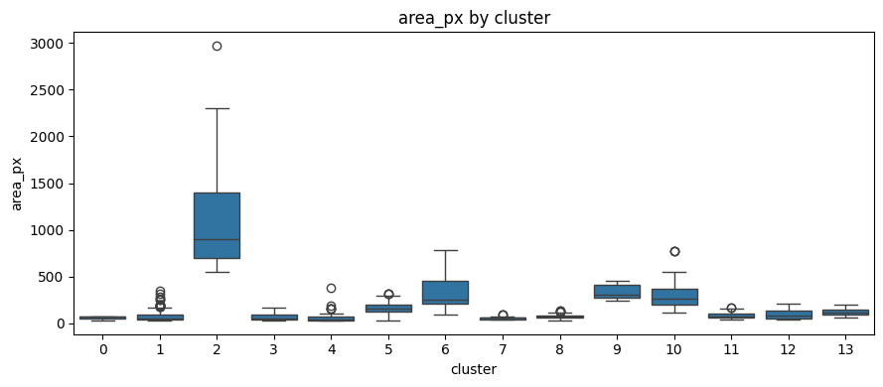
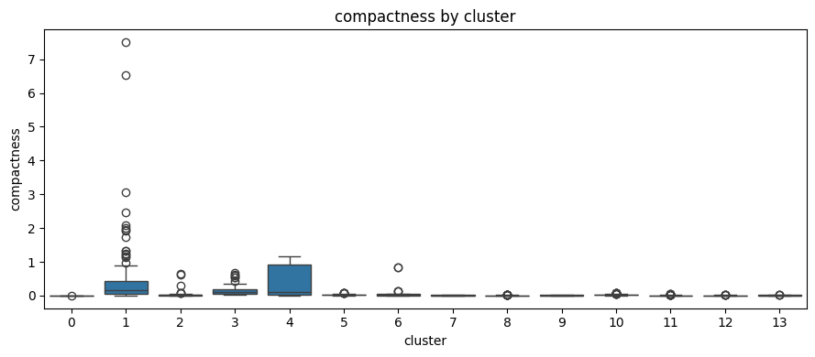
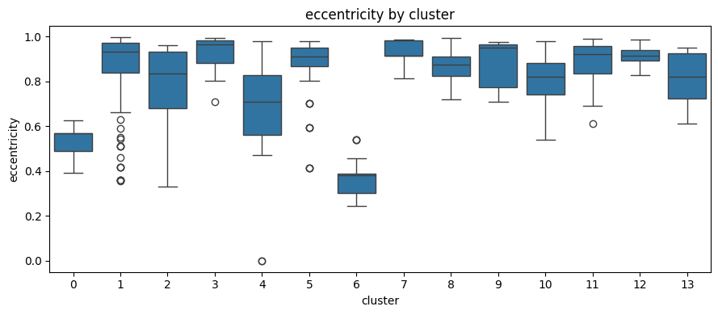
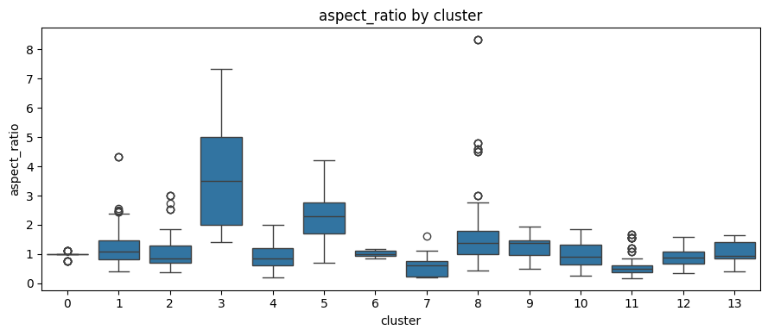
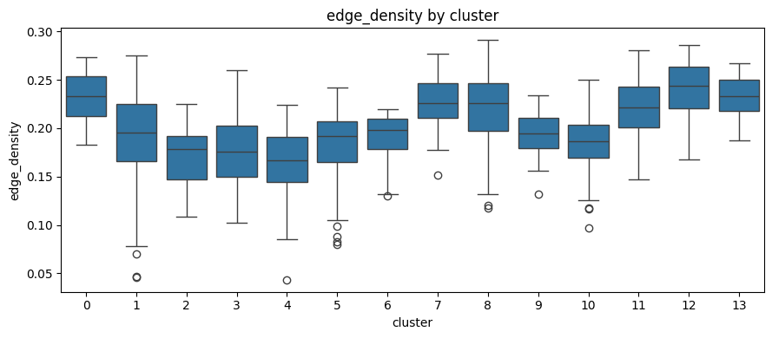
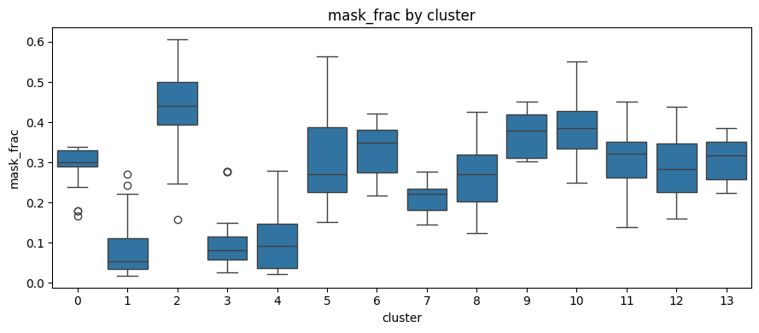
Results Gallery — Feature Distributions by Archetype
Boxplots showing how each morphological feature varies across the 14 clusters
Area (px)
Compactness
Eccentricity
Aspect Ratio
Edge Density
Mask Fraction
Notes:
“These boxplots show how each feature varies across the 14 clusters. What we see is that each cluster has a distinct signature — for example, some clusters are large and compact, others are small and elongated, and some are highly fragmented.
This confirms that the clustering is capturing real morphological differences, not random groupings. Each archetype is defined by a combination of size, shape, and boundary complexity.”

Slide 13
Takeaways
01
02
Deforestation has learnable event-level structure
Unsupervised archetypes add interpretability
Morphology is not arbitrary — different processes leave distinct geometric fingerprints that emerge consistently across random seeds.
Moving from binary detection to pattern categories makes forest loss more actionable. Archetypes can be interpreted before driver labels are available.
03
04
The framework is stable and generalizes
Driver validation is the critical next step
98.24% held-out classification accuracy and consistent ARI across seeds. Initial Hansen tests show it survives geographic transfer.
The key open question: do our geometric archetypes align with known ecological drivers? A labeled benchmark will answer this.
From "forest lost" → "what kind of loss, why, and where to act next"

Slide 14
Questions
& Discussion
Akash Sagi · Sakethram Naidu

