Slide 1
DATA SCIENCE
PROJECT - 1

Slide 2
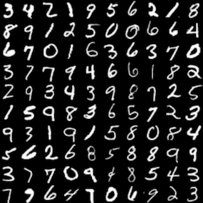
HANDWRITTEN DIGITS CLASSIFICATION
- MNIST DATASET

Slide 3
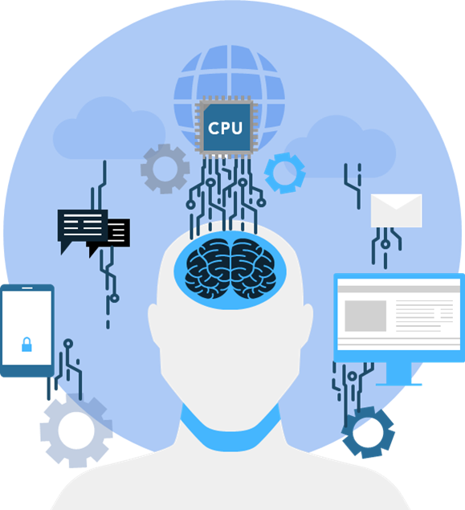
COMPUTER VISION
ARTIFICIAL NEURAL NETWORKS

Slide 4
TABLE OF CONTENTS
01
02
03
04
TOOLS & LIBRARIES
WHAT IS NEURAL NETWORKS ?
05
DATA FLATTENING
BUILDING MODEL
OUTCOMES
ACCURACY

Slide 5
TOOLS USED

Slide 6
TENSORFLOW MATPLOTLIB NUMPY

Slide 7
TENSORFLOW
TensorFlow is a Python library for fast numerical computing created and released by Google.
It is used for implementing machine learning and deep learning applications.
Google team created TensorFlow.
TensorFlow is designed in Python programming language.
Specifically designed for the types of operations required to develop and evaluate large deep learning models.
TensorFlow offers multiple data tools to help you consolidate, clean and preprocess data at scale.

Slide 8
MATPLOTLIB
Matplotlib is a visualization library in Python for 2D plots of arrays.
Matplotlib is a multi-platform data visualization library built on NumPy arrays and designed to work with the broader SciPy stack.
One of the greatest benefits of visualization is that it allows us visual access to huge amounts of data in easily digestible visuals.
Matplotlib consists of several plots like line, bar, scatter, histogram etc.

Slide 9
NUMPY
NumPy is a Python library used for working with arrays.
It also has functions for working in domain of linear algebra, fourier transform, and matrices.
NumPy stands for Numerical Python.
NumPy aims to provide an array object that is up to 50x faster than traditional Python lists.
The array object in NumPy is called ndarray, it provides a lot of supporting functions that make working with ndarray very easy.

Slide 10
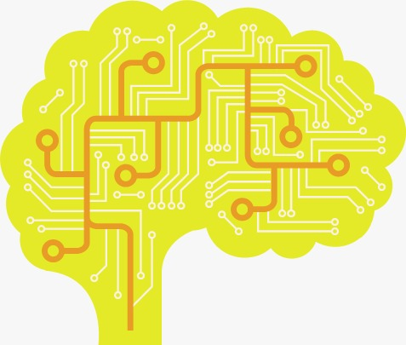
WHAT IS A NEURAL NETWORK ?

Slide 11
NEURAL NETWORK
A neural network is a method in artificial intelligence that teaches computers to process data in a way that is inspired by the human brain.
It is a type of machine learning process, called deep learning, that uses interconnected nodes or neurons in a layered structure that resembles the human brain.

Slide 12
LAYERS OF A NETWORK
01
02
03
INPUT LAYER
HIDDEN LAYER
NUMBERS IN
MATRIX FORM
OUTPUT LAYER
NUMBERS FROM 1-10

Slide 13
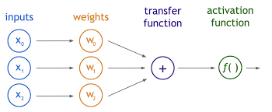

Slide 14
NEURAL NETWORK OF OUR DATASET

Slide 15
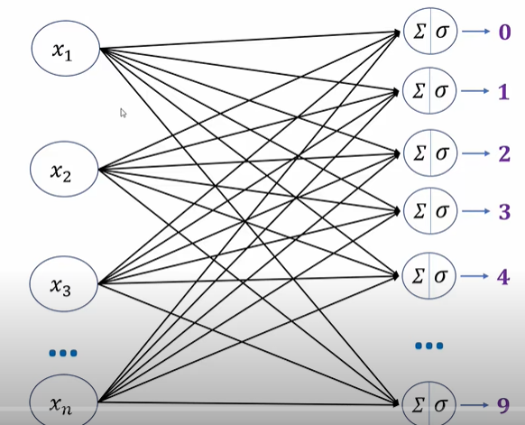
NEURAL NETWORK OF OUR DATASET

Slide 16
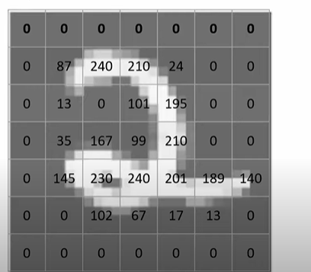
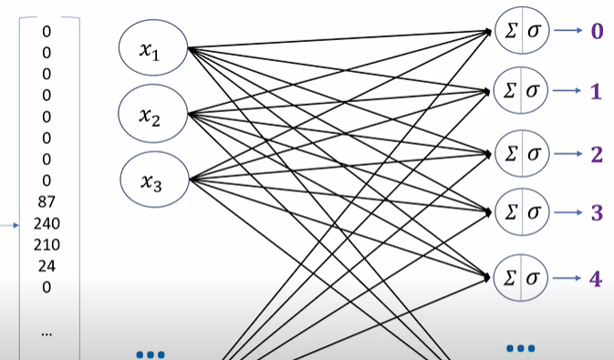

Slide 17
SCALING AND FLATTENING OF THE DATASET

Slide 18
Contents:
Image Conversion
Scaling of Dataset
Flattening Dataset

Slide 19

IMAGE CONVERSION
Images are converted from RGB to Grayscale

Slide 20
SCALING OF DATASET:
Scaling is basically used for making data points generalized,so that the distance between data points will be minimized
The are two methods for scaling the data:
1)Normalization
2)Standardization
Normalization:
(X-min(X))/max(X)-min(X)
Standardization:
(X-mean(X))/standard deviation(X)

Slide 21
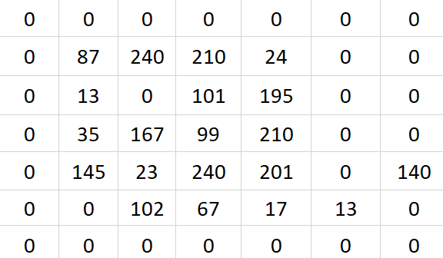
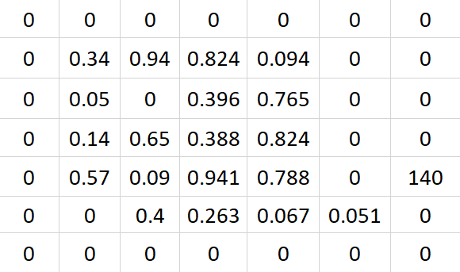


Slide 22
FLATTENING OF DATASET:
It is a technique used to convert multi-dimensional array into 1-D array
It is basically done to reduce the space occupied by the data and also to reduce the computational time
This can be done by using the reshape() method

Slide 23
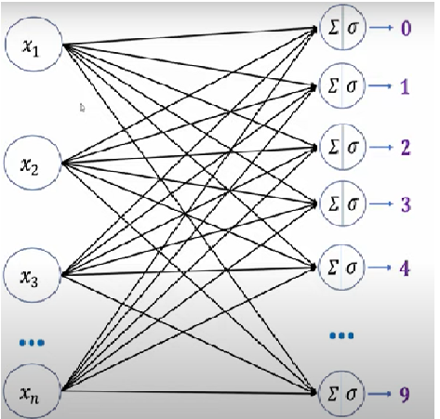
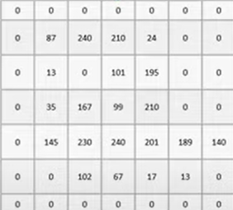

Slide 24
BUILDING MODEL

Slide 25
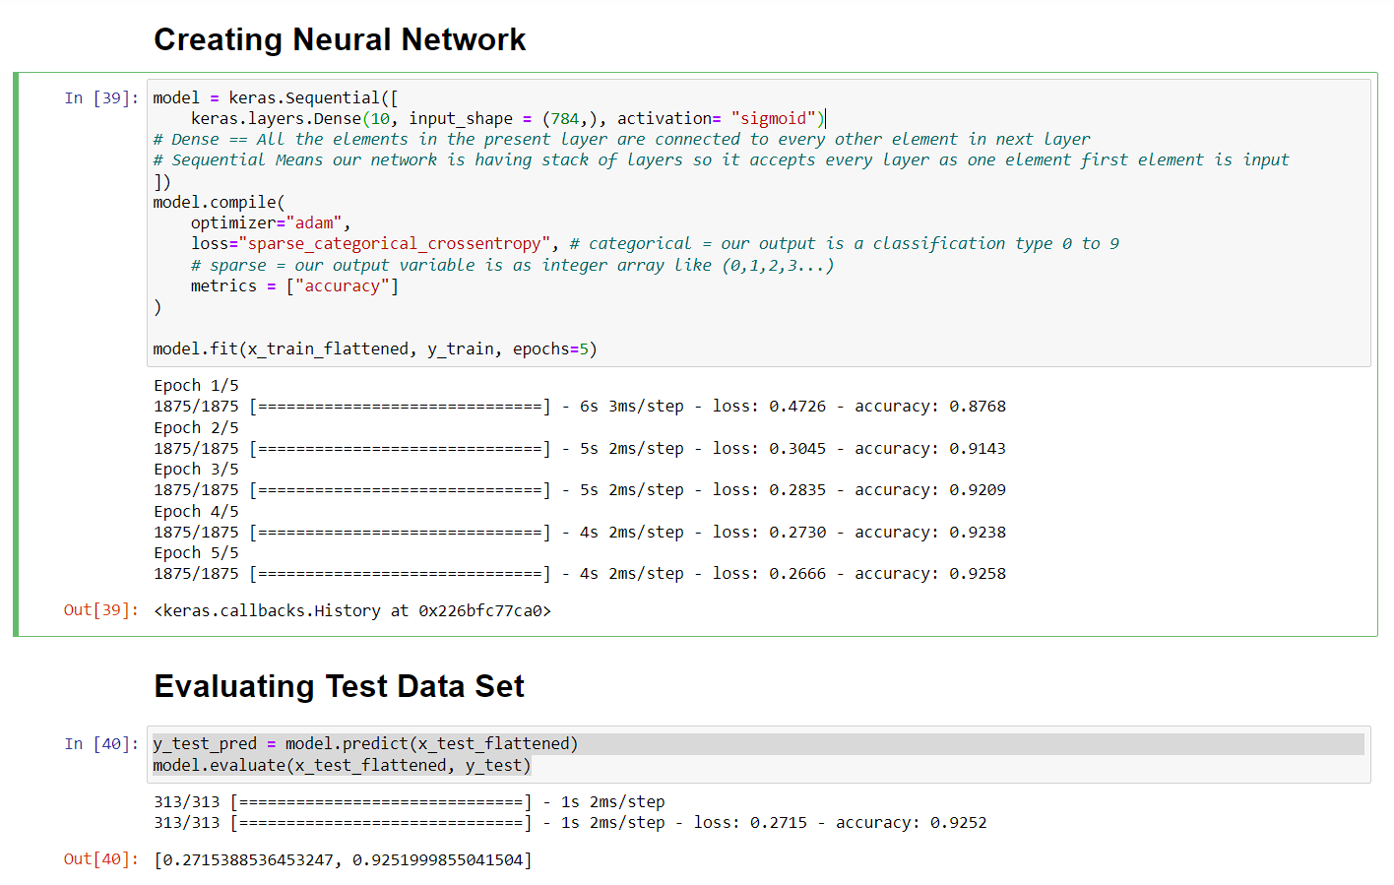

Slide 26
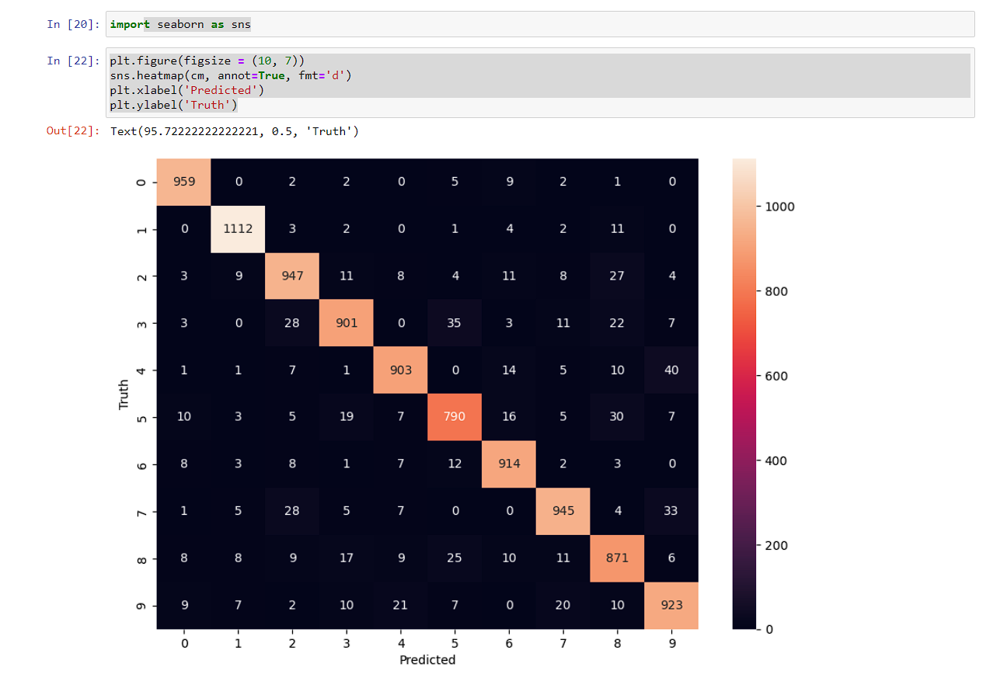

Slide 27
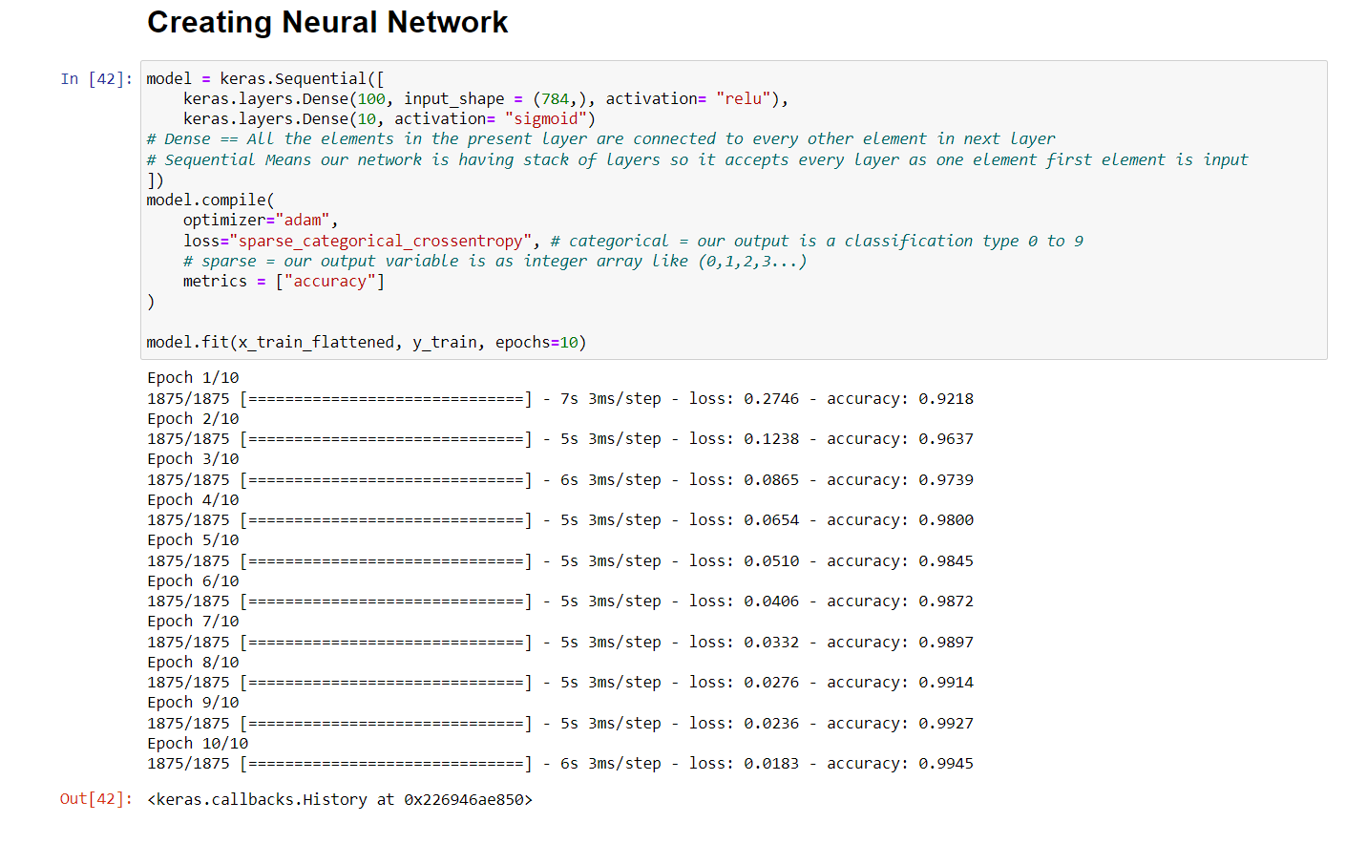
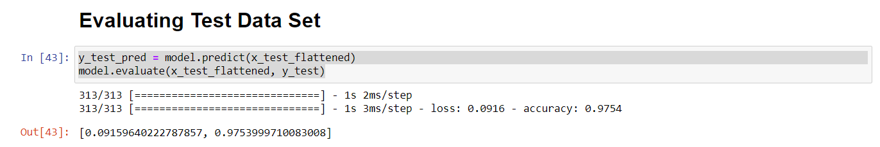

Slide 28
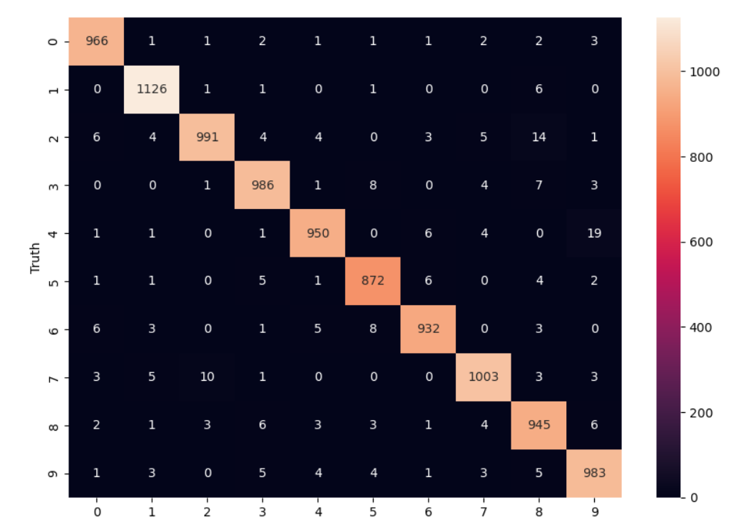

Slide 29
THANK YOU
HEMANTH – 20EG112142 SRAVAN – 20EG112152 MURALI – 20EG112154 SWAMY – 21EG512106

