Slide 1
Read-Log-Update A Lightweight Synchronization Mechanism for Concurrent Programming
Alexander Matveev (MIT)
Nir Shavit (MIT and TAU) Pascal Felber (UNINE)
Patrick Marlier (UNINE)

Slide 2
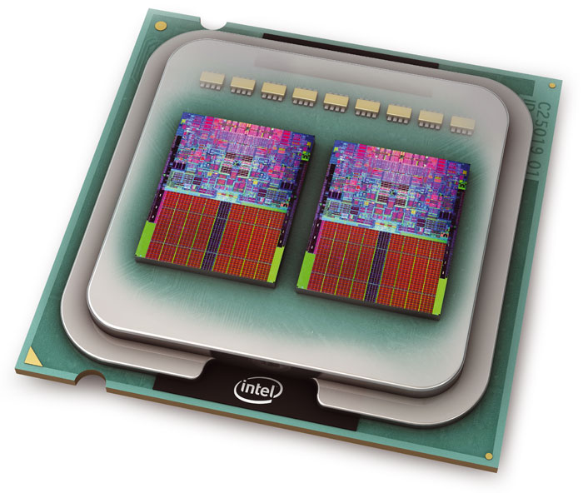
Multicore Revolution
Need concurrent data-structures
New programming frameworks for concurrency
Notes:
So, now-days, multicore processors are everywhere: servers, desktops and even mobile phones.
Because of that the way we write software must change: we need concurrent software. In particular, we need concurrent data-structures.
However, it is hard to design and implement concurrent DSs, even for expert programmers, and therefore, we need new programming frameworks that can help us in this task (and make it easy).

Slide 3
The Key to Performance in Concurrent Data-Structures
Unsynchronized traversals: sequences of reads without locks, memory fences or writes
90% of the time is spent traversing data
Multi-location atomic updates
Hide race conditions from programmers
Notes:
Our experience of years of work on concurrent data-structures shows us the key to performance in many use-cases is based on the following 2 components: unsync-trav and multi-location atomic updates.
The first component, Unsync-Traversals, is simply based on the fact that 90% of the time you spend traversing or reading the data. Whenether you have a list, you traverse the list to find target nodes, or whenether you have a graph, you traverse the graph to find the target nodes that you want to modify. So, most of the time you perform traversals that read data, so you need to make these reads as efficient as possible, without any locks, memory fences or even writes. Because the gain speed is significant.
The second component is multi-location atomic updates. Here, we do not mean large atomic updates that wrap the whole operation and provide atomicity for the whole operation. Instead, our intention is for short atomic updates that are applied to small and problematic parts of the data-structure, that experience complex race conditions that programmers would like to hide and automate. This provides simplicity and also provides efficiency, since it allows to avoid using global locks on code sections that experience complex race conditions that are complex to detect and code.
So the question is how we can provide a programming framework for concurrency that will provide support for both components.

Slide 4
RCU
Read-Copy-Update (RCU), introduced by McKenney, is a programming framework that provides built-in support for unsynchronized traversals
Notes:
Paul Mckenney realized this problem (memrec+unsync reads) and the importance of unsynchronized traversals, and introduced the beautiful RCU framework, that provides both unsync-traversals and memory reclamation.
RCU is not a trivial result and it solve a complex problem of unsync-tra interacting with memory management.
Let see why

Slide 5
RCU
Pros:
Very efficient (no overhead for readers)
Popular, Linux kernel has 6,500+ RCU calls
Cons:
Hard to program (in non-trivial cases)
Allows only single pointer updates
Supports unsynchronized traversals
but not multi-location atomic updates
Notes:
RCU is very efficient: has no overheads for readers at all.
Because of that it is popular in the Linux Kernel,
But it has a significant limitation.
As a result, RCU solves the first component of unsync traversals, but does not provide solution for the second component of atomic-seq.
Because of that applying RCU to complex DS is hard and usually results in a publication.
And actually the RCU linux calls are 6500 variations on a linked-list.

Slide 6
This Paper — RLU
Read-Log-Update (RLU), an extension to RCU that provides both unsynchronized traversals and multi-location atomic updates within a single framework
Key benefit: Simplifies RCU programming
Key challenge: Preserves RCU efficiency
Notes:
1. I would like to present you read-log-update, an extension to RCU that allows RCU to be general and applicable to complex data-structures.
2. It provides both (1) and (2)
3. One might think why not to use STM to do this? But STM overheads are high so it will make RCU slow.
4. Also, one might thing why not to use HTM that is fast? But if you use HTM to provide atomicity for writes, you will need to make transactional reads, which eliminates the benefit of unsync-traversals.
6. There is no easy way to use existing techniques to provide both (1) and (2), and we need a new algorithmic approach, which is what I’m going to show you in this work.

Slide 7
RCU Overview Key Idea
To modify objects: Duplicate them and modify copies
Provides unsynchronized traversals
To commit: Use a single pointer update to make new copies reachable and old copies unreachable
➔ Must happen all at once!
Notes:
RLU uses RCU so let me first explain RCU

Slide 8
RCU Key Idea
Duplicate C
(2) Single pointer update: make C’ reachable and C unreachable
Update(C)
P
P
P
P
P
C’
C’
Writer-Lock
A
B
C
D
Q
Q
Q
Q
How to deallocate C?
Lookup(C)
Notes:
Add register / unregister -> memory fences -> Kernel contex switch
Simple and fast -> works great for a unidirectional list

Slide 9
How to free objects?
RCU-Epoch: a time interval after which it is safe to deallocate objects
Waits for all current read operations to finish
RCU-Duplication + RCU-Epoch provide:
Unsynchronized traversals AND
Memory reclamation
This makes RCU efficient and practical
But, RCU allows only single pointer updates
Notes:
Paul Mckenney realized this problem (memrec+unsync reads) and the importance of unsynchronized traversals, and introduced the beautiful RCU framework, that provides both unsync-traversals and memory reclamation.
RCU is not a trivial result and it solve a complex problem of unsync-tra interacting with memory management.
Let see why

Slide 10
The Problem RCU Single Pointer Updates
Update(even nodes)
P
B’
D’
A
B
C
D
E
Q
Q
Q
Q
Lookup(even nodes)
Q sees B’ but not D’:
an inconsistent mix
Notes:
Add register / unregister -> memory fences -> Kernel contex switch
Simple and fast -> works great for a unidirectional list

Slide 11
RCU is Complex
Applying RCU beyond a linked list is worth a paper in a top conference:
RCU resizable hash tables (Triplett, McKenney, Walpole => USENIX ATC-11)
RCU balanced trees (Clements, Kaashoek, Zeldovich => ASPLOS-12)
RCU citrus trees (Arbel, Attiya => PODC-14, Arbel, Morrison => PPoPP-15)
Notes:
Designing RCU DS requires ingenious to either manipulate multiple locations consistently or deal with the inconsistencies of using a single pointer.
Anyone of you have dealt with RCU DS in the kernel knows this.

Slide 12
Our Work
Read-Log-Update (RLU), an extension to RCU that adds support for multi-pointer atomic updates
Key Idea: Use a global clock + per thread logs
Notes:
We present read-log-update …
Its key idea
These ideas are inspired by software transactional memory algorithms, but are used in a new way that preserves the efficiency of RCU. If you would use TM as is, you would the efficiency of RCU.

Slide 13
RLU Clocks and Logs
Global Clock (22)
A log/buffer to store copies (per-thread)
Write Clock
(∞)
P
Log
Used on
commit
RLU header
B’
D’
A
B
C
D
E
Read on start
Q
Local Clock
(22)
Notes:
It appends a header to each object, that includes a pointer to a copy.
Then, when a thread wants to modify objects, it generates copies and stores these copies in a per thread log or buffer.
In addition, it installs copy pointers to object headers.
Next, it has a global clock that is read on start by each operation, in this case Q
Operations use their local clocks to determine whenether to read the actual objects or copies (to preserve consistency)
For this to work properly, read-log-update also has a local per thread write clock, that is initially is infinity, and is used during the commit.
So how the commit works and preserves consistency of reads…
10 minutes to get here

Slide 14
RLU Commit – Phase 1
Global Clock (23)
1. P updates clocks
2. P executes RCU-epoch
Waits for Q to finish
Write Clock
(23)
Global Clock (22)
Write Clock
(∞)
P
Steal copy when:
Local Clock >=
Write Clock
B’
D’
C’
A
B
C
D
E
Z
Local Clock
(23)
Q
Local Clock
(22)
Z will read only new objects
Q will read only old objects
Notes:
First, P updates the clocks: it updates the write-clock and then the global clock to the next clock (23)
This global clock update makes the new copies reachable by new threads that start after the global clock increment, while old threads, that started before the global clock increment, continue to read old copies.
Here is an example of two reader threads, Q, an old thread, and Z, a new thread. Both check whenether their local clocks >= write clock of the thread that generated the copies, and this ensures that both correct: Z reads only new, while Q reads only old, but not a mix.
Next, P executes RCU-Epoch to re-use old copies, that waits for old threads (in this case for Q). After this step is done, old copies can be reused…

Slide 15
RLU Commit – Phase 2
3. P writes back log
4. P resets write clock
5. P swaps logs
(current log is safe for
re-use after next commit)
Write Clock
(23)
Global Clock (23)
Write Clock
(∞)
P
B’
D’
B’
D’
C’
A
B’
B
C
D’
D
E
Notes:
Now old copies are safe for re-use, since no-one is reading them, so P overwrites old copies with new ones.
Then, it updates the clocks again, to disable reading from the per-thread login order to to disable access to the per-thread log

Slide 16
RLU Programming
RLU API extends the RCU API:
rcu_dereference(..) / rlu_dereference(..)
rcu_assign_pointer(..) / rlu_assign_pointer(..)
…
RLU adds a new call: rlu_try_lock(..)
To modify object => Lock it
Provides multi-location atomic updates
Hides object duplications and manipulations
Notes:
We build-on and extend the API of RCU, and introduce a locking function to automate the object duplication and manipulation process.
All programmers need to do is just to lock objects before they modify them.
5 minutes

Slide 17
Programming Example List Delete with a Mutex
void RLU_list_delete(list_t *list, int val) {
spin_lock(&writer_lock);
rlu_reader_lock();
prev = rlu_dereference(list->head);
curr = rlu_dereference(prev->next);
while (curr->val < val) {
prev = curr;
curr = rlu_dereference(prev->next);
}
next = rlu_dereference(curr->next);
rlu_try_lock(&prev)
rlu_assign_ptr(&(prev->next) , next);
rlu_free(curr);
rlu_reader_unlock();
spin_lock(&writer_lock);
}
Acquire mutex
and start
Find node
Delete node
Finish and release mutex
How can we eliminate the mutex?

Slide 18
RCU + Fine-Grained Locks
Locking “prev” and “curr” is not enough: Thread Q may delete or insert new nodes concurrently
Insert(D)
P
P
P
P
P
A
B
C
E
Q
Q
Q
Q
Programmers need to add custom post-lock validations.
In this case, we need:
C.next == E
C is reachable from the head
Delete(C)

Slide 19
List Delete without a Mutex
void RCU_list_delete(list_t *list, int val) { restart: rcu_reader_lock(); … find “prev” and “curr” …
if (!try_lock(prev) ||
!try_lock(curr))
{ rcu_reader_unlock(); goto restart; } // Validate “prev“ and “curr”
if ((curr->is_invalid == 1) ||
(prev->is_invalid == 1) ||
(rcu_dereference(prev->next) != curr))
{ rcu_reader_unlock(); goto restart; } next = rcu_dereference(curr->next); rcu_assign_ptr(&(prev->next) , next); curr->is_invalid = 1; memory_fence(); unlock(prev); unlock(curr); rcu_reader_unlock(); rcu_free(curr); }
void RLU_list_delete(list_t *list, int val) { restart: rlu_reader_lock(); … find “prev” and “curr” …
if (!rlu_try_lock(prev) ||
!rlu_try_lock(curr))
{ rlu_reader_unlock(); goto restart; } next = rlu_dereference(curr->next); rlu_assign_ptr(&(prev->next) , next);
rlu_free(curr);
rlu_reader_unlock(); }
Find “prev” and “curr”
Find “prev” and “curr”
Lock “prev” and “curr”
Lock “prev” and “curr”
Delete “curr” and finish.
No post-lock validations necessary!
Custom post-lock validations
Delete “curr” and finish

Slide 20
Performance
RLU is optimized for read-dominated workloads (like RCU):
RLU object lock checks are fast because:
Locks are co-located with the objects
Stealing is usually rare
RLU writers are more expensive than RCU writers:
Not significant for read-dominated workloads
Tested in userspace and kernel
Notes:
5 minutes

Slide 21
Userspace Hash Table and Linked-List (Kernel is similar)
Notes:
Expalin in words that this is best case for RCU

Slide 22
Applying RLU to Kyoto CacheDB
Kyoto CacheDB uses:
A reader-writer lock
A per slot lock (DB is broken into slots)
➔ The reader-writer lock is a serial bottleneck
Use RLU to eliminate this lock
It was easy to apply:
Use slot locks to serialize writers to the same slot
Simply lock each object before modification

Slide 23
RLU and Original Kyoto CacheDB

Slide 24
Conclusion
RLU adds multi-pointer atomic updates to RCU while maintaining efficiency both in userspace and kernel
Much more in the paper
Optimizations (deferral)
Benchmarks (kernel, Citrus, resizable hash table)
RLU is available as open source (MIT license):
https://github.com/rlu-sync
Notes:
5 minutes

Slide 25
Thank You

Slide 26
Appendix
RLU-Defer
Kernel Tests
RCU vs RLU resizable hash table

Slide 27
RLU-Defer
RLU writers are slower since they need to execute wait-for-readers.
RLU-Defer reduces these costs (by 10x).
Note that wait-for-readers write-backs and unlocks objects.
But unlocking is only needed for a write-write conflict, so RLU-Defer executes wait-for-readers only when a write-write conflict occurs.

Slide 28
RLU-Defer
RLU-Defer is significant for many threads

Slide 29
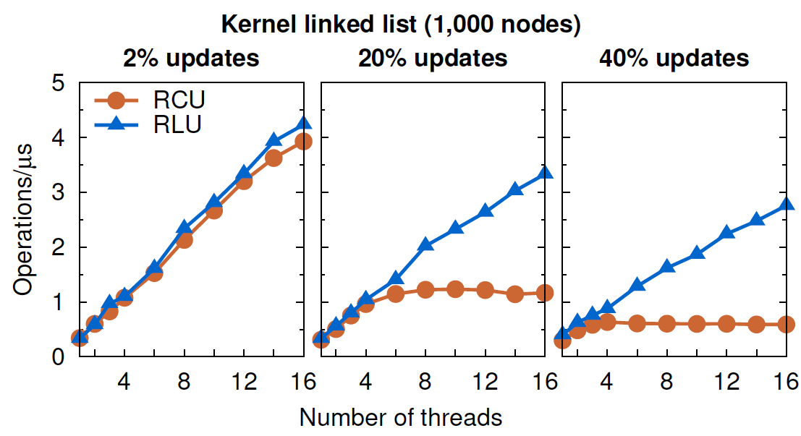
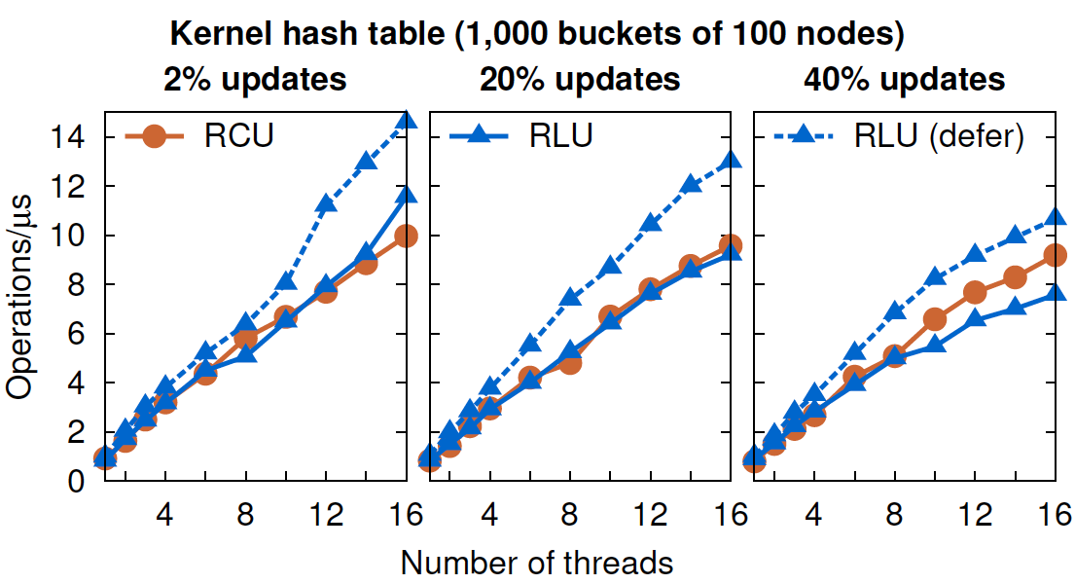
Kernel Tests

Slide 30
Resizable Hash Table Code Comparison

Slide 31
Resizable Hash Table Performance

