Slide 1
Dynamic Performance Tuning of Word-Based Software Transactional Memory
Pascal Felber
University of Neuchatel
Pascal.Felber@unine.ch
Christof Fetzer, Torvald Riegel
Dresden University of Technology
PPoPP 2008

Slide 2
STM in a nutshell
Multicores and MPs will be everywhere
The “free ride” is over
  Concurrent programming necessary for speedup
  Hard to get right, impact on many developers
STM can simplify concurrent programming
  Sequence of instructions executed atomically
    BEGIN … LOAD / STORE … COMMIT
  Optimistic execution, abort and retry on conflict
  A “universal” synchronization construct
  Transactions are composable

Slide 3
Agenda
Motivations
TINYSTM: a lightweight STM design
Dynamic tuning in TINYSTM
Experimental evaluation
Conclusions

Slide 4
Motivations
Performance of TM depends on many factors
  TM design choices, e.g., word-based vs. object-based, visible vs. invisible reads, lock-based vs. non-blocking, write-through vs. write-back, encounter-time vs. commit-time locking, etc.
  TM configuration parameters, e.g., number of locks and hash function, CM strategy and parameters, etc.
…which in turn depends on runtime factors
  CPU type, size of cache lines, etc.

Slide 5
Motivations
Most importantly it depends on the workload
  E.g., ratio of update to read-only transactions, number of locations read or written, contention on shared memory locations, etc.
There is no “one-size-fits-all” STM
We could benefit from
dynamic tuning mechanisms

Slide 6
TINYSTM: a lightweight design
Word-based lock-based STM implementation
  Written in portable C, 32/64-bit
  Small code base (<1000 LOC), GPL
  Memory management operations
Time-based algorithm like LSA [DISC06] & TL2 [DISC06]
  Versioned locks used to build consistent snapshot
“Classical” word-based STM design
  Per-stripe locks, encounter-time locking (ETL)
  Write-through and write-back versions
Used as underlying STM in TANGER [TRANSACT07]
Notes:
Shared clock with roll-over
Encounter-time locking
First, our empirical observations appear to indicate that detecting conflicts early often increases the transaction throughput because transactions do not perform useless work. Commit-time locking may help avoid some read-write conflicts, but in general conflicts discovered at commit time cannot be solved without aborting at least one transaction.
Second, encounter-time locking allows us to efficiently handle reads-after-writes without requiring expensive or complex mechanisms. This feature is especially valuable when write sets have non-negligible size.

Slide 7
Basic data structures
LOAD(addr) by transaction tx
Find lock for addr and read lock, value, lock
If lock is owned by tx, return latest value
If lock is free and version ≤ tx.ts, return latest value
If lock is free and version > tx.ts, can try to “extend” snapshot (requires validation)
Otherwise, abort (or defer to CM)
STORE(addr) by transaction tx
Find lock for addr and read lock
If lock is owned by tx, write new value
If lock is free, try to acquire it atomically (CAS)
Otherwise, abort (or defer to CM)
COMMIT by transaction tx
Acquire unique timestamp from clock
If tx is not read-only and time has advanced, validate read set
Write values and release locks
tx descriptor
timestamp
shared clock
memory
read-set
…
write-set
lock bit
…
lock array
…
0
&p->next
&n->val
address
1
version
0
stm_start(tx);
…
n = stm_load(tx, &p->next);
v = stm_load(tx, &n->val);
…
stm_store(tx, &p->next, n);
…
stm_commit(tx);
L-1
one-to-many
mapping
siezof(word)
…
locks[(addr >> #shifts) % L]

Slide 8
Write-through vs. write-back
Write-through (ETL)
Writes to memory (undo log)
Uses incarnation numbers on versions (ABA problem)
Write-back (ETL)
Buffered writes
(redo log)
Locks point directly to entries in redo log
Faster commit
Faster RW-after-write, enables compiler optimizations
Faster abort
Version numbers don’t change on abort (no ABA problem)

Slide 9
On validation costs
Observation: long update transaction may have large validation overhead (e.g., LL)
  Reducing the # of locks increases false sharing
Our approach: “hierarchical locking”
  Smaller array of H << L counters mapped to locks
  H partitions in read set, read and write masks
  Counters are atomically updated on first write of transaction to partition (keep track of progress)
  Validation of partition skipped if counter did not change or only updated by current transaction
  Efficient with large read sets and few writes

Slide 10
Hierarchical locking
tx descriptor
timestamp
shared clock
memory
read-set[H]
…
write-set
lock bit
read-mask:H
lock array
write-mask:H
0
&p->next
counters[H]
…
&n->val
…
address
1
version
0
hierarchical array
0
counter
L-1
one-to-many
mapping
one-to-many
mapping
H-1
siezof(word)
…
siezof(word)
counters[(addr >> #shifts) % H]
locks[(addr >> #shifts) % L]

Slide 11
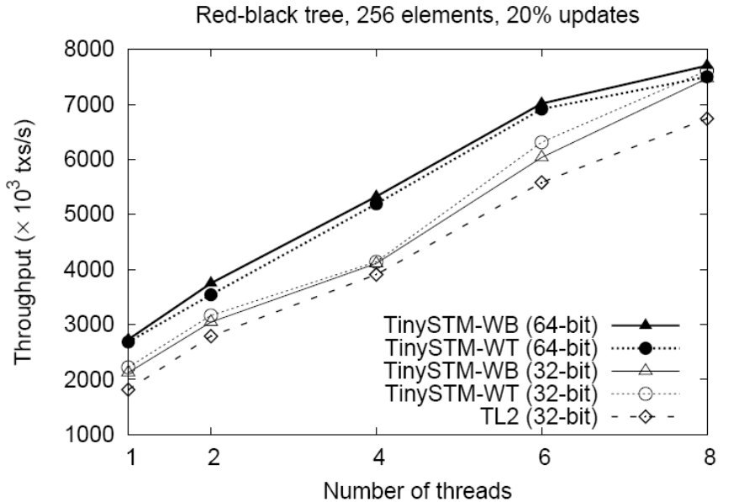
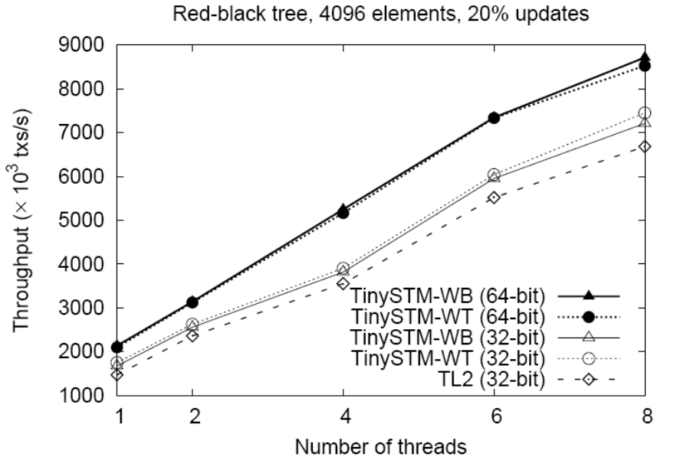
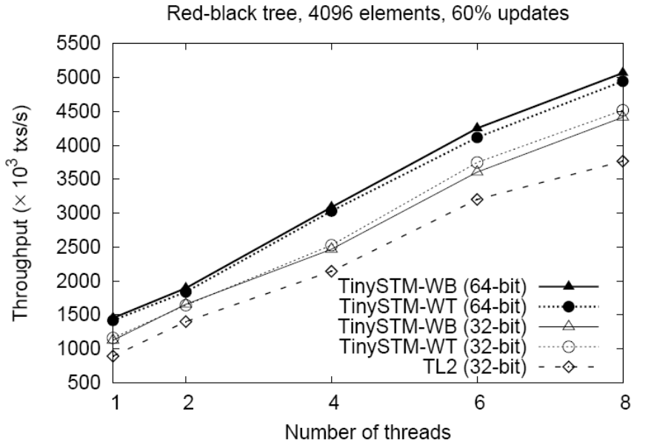
Throughput
(red-black tree)
8-core Intel Xeon at 2 GHz, Linux 2.6.18-4 (64-bit)
L=2²⁰, #shifts=2/3
All designs scale well.
64-bit version noticeably faster.
Performance of CTL and ETL is comparable (little contention).

Slide 12
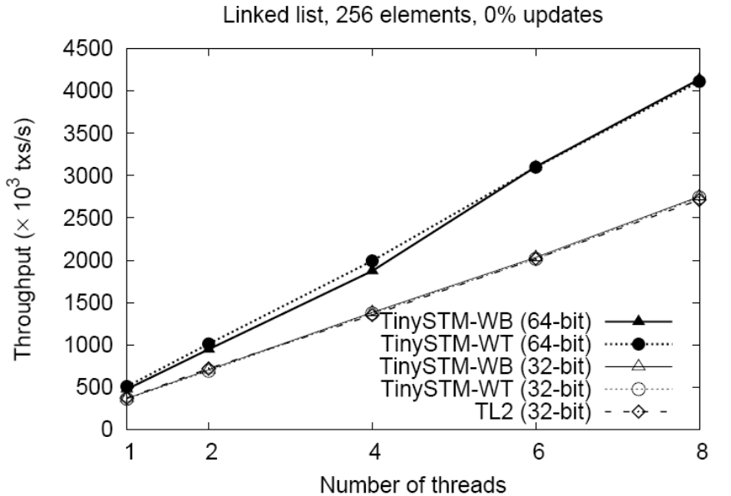
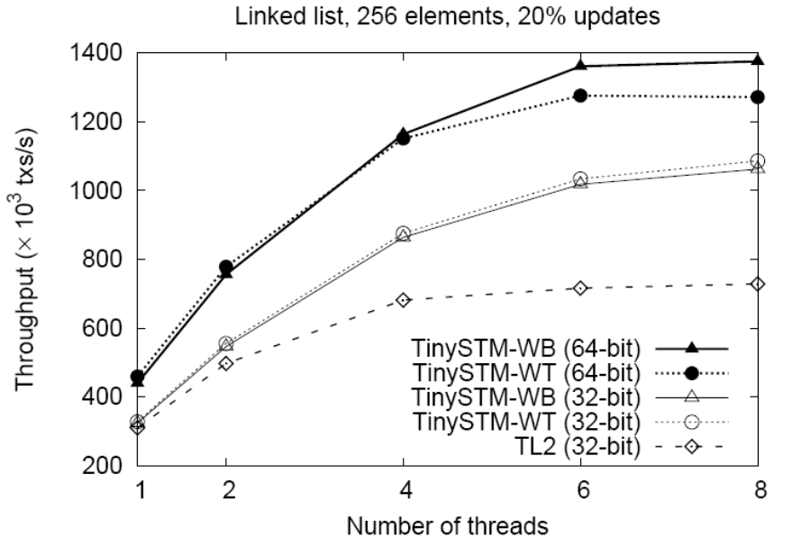
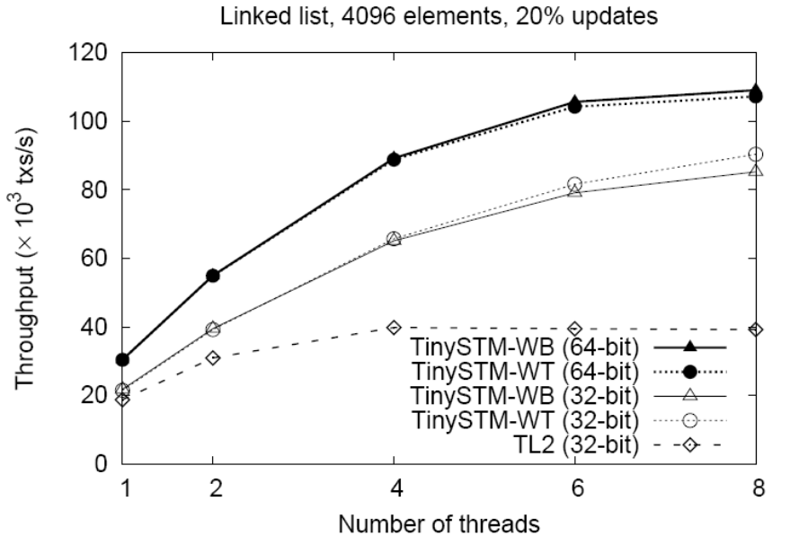
Throughput
(linked list)
8-core Intel Xeon at 2 GHz, Linux 2.6.18-4 (64-bit)
L=2²⁰, #shifts=2/3
All designs scale well.
64-bit version noticeably faster.
CTL suffers more from long transaction (no CM).

Slide 13
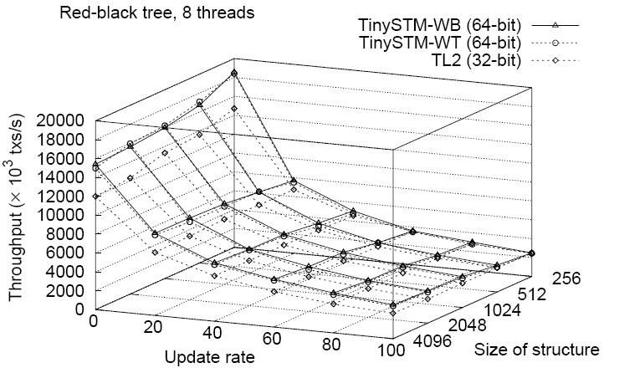
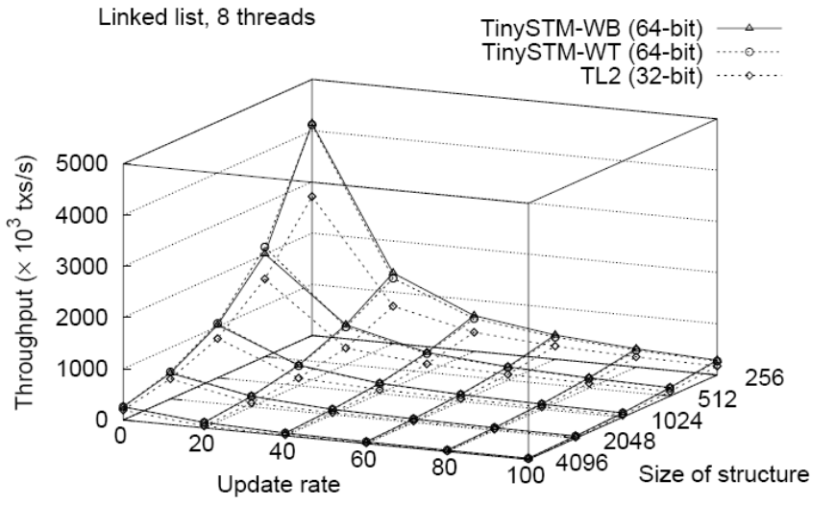
Size and update rates
8-core Intel Xeon at 2 GHz, Linux 2.6.18-4 (64-bit)
L=2²⁰, #shifts=2/3
Linked list more sensitive to size than red-black tree (linear vs. logarithmic).
Read-only much faster.

Slide 14
Dynamic tuning
Three main tuning parameters in TINYSTM
  Mapping of addresses to locks (#shifts + 2/3)
  Size of lock array (L, #locks)
  Size of hierarchical array (H)
Goal: find a good combination of these parameters for the workload at runtime
…but, do they really have much impact?
Notes:
More parameters to come

Slide 15
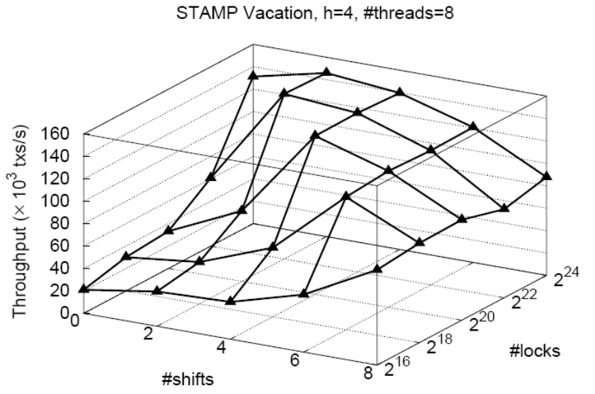
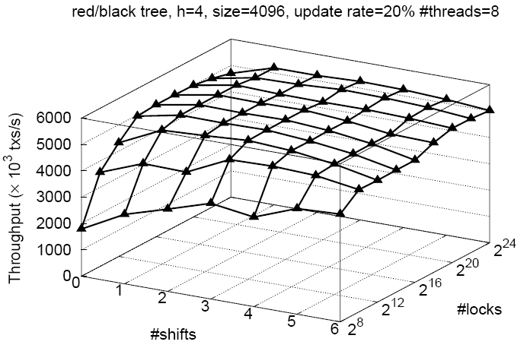
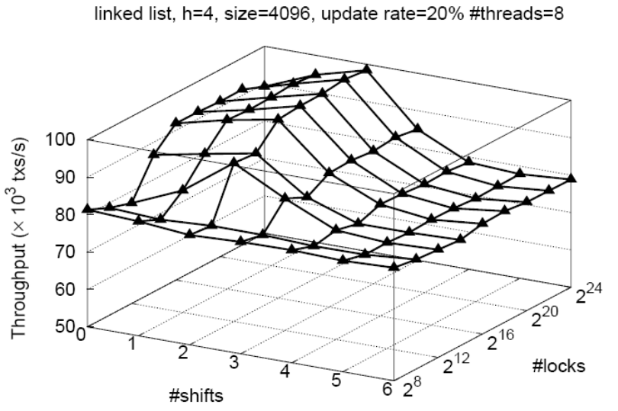
Impact of
#shifts and #locks
8-core Intel Xeon at 2 GHz, Linux 2.6.18-4 (64-bit)
The number of shifts and locks have impact on throughput.
The “sweet spots” are not the same for all workloads.

Slide 16
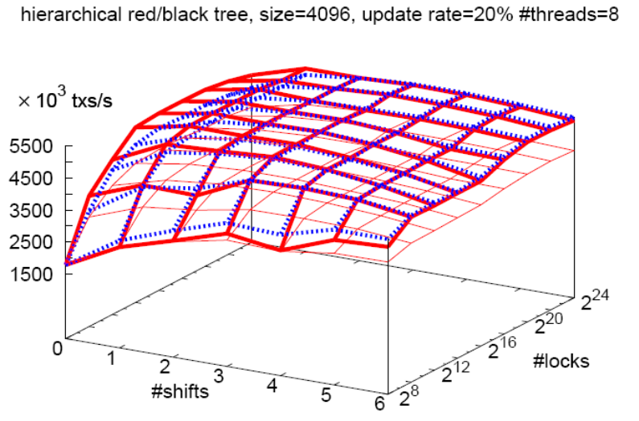
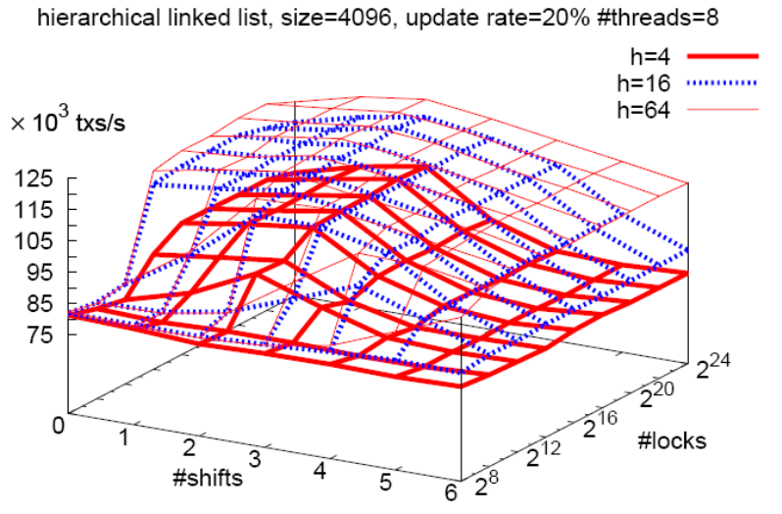
Impact of H
8-core Intel Xeon at 2 GHz, Linux 2.6.18-4 (64-bit)
The hierarchical array helps much for large read sets.
The best value for H is not the same for all workloads.

Slide 17
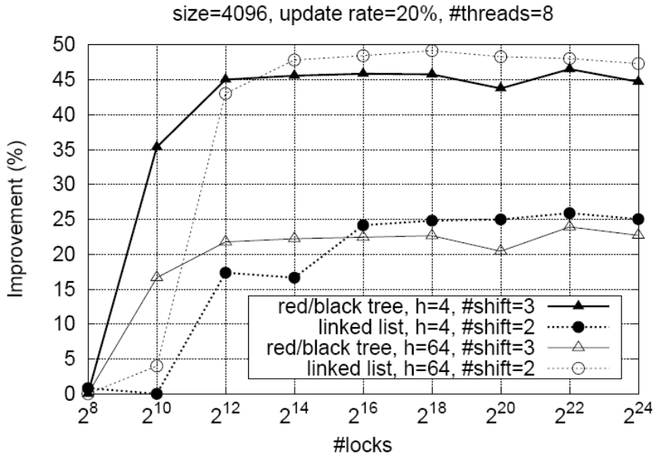
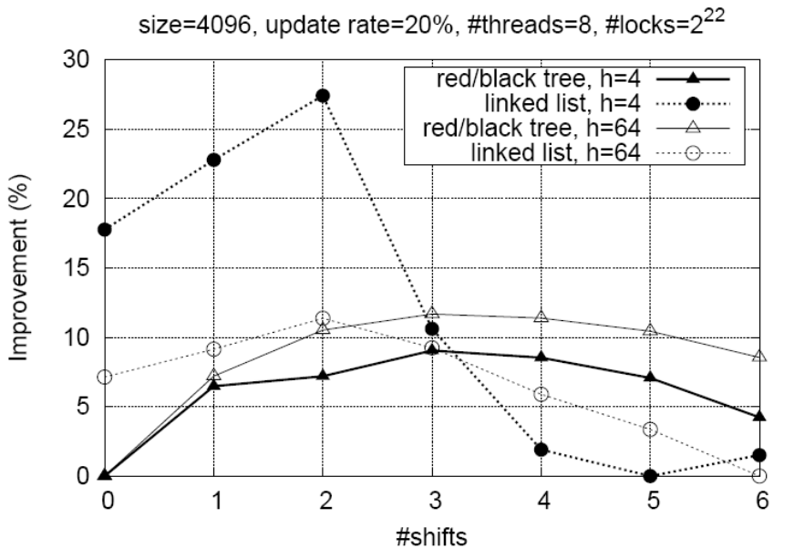
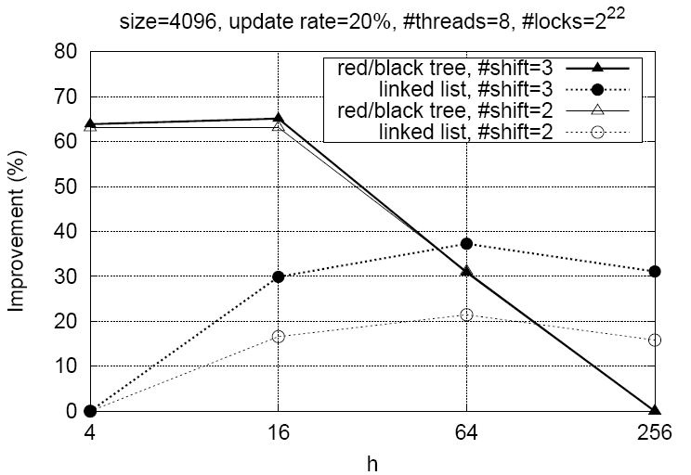
Throughput improvement
8-core Intel Xeon at 2 GHz, Linux 2.6.18-4 (64-bit)
Larger #locks help initially but then throughput flattens.
Best #shifts depends on spatial locality of shared structure.
Best H depends on size of transaction’s read set.
Notes:
H: too small => full validation anyhow; too large => overhead from atomic operations on counters.

Slide 18
Dynamic tuning strategy
Start with some initial values
  #locks = 2⁸ #shifts = 0 H = 1
Measure throughput
Periodically update parameters at runtime (approx. every second)
Hill-climbing algorithm with memory and forbidden areas to find good configuration
Notes:
Update parameters: costly operation (requires barrier)

Slide 19
Hill-climbing algorithm
8 moves
  #locks: *=2, /=2 #shifts: ++, -- H: *=2, /=2
  nop revert to best configuration
Principle: move then verify effectiveness
  If performance drops significantly or when too far from best configuration, revert
  If performance drop is too high, forbid move
Moves selected at random to explore uncharted configurations
If throughput of best configuration drops, switch to second best, etc.

Slide 20
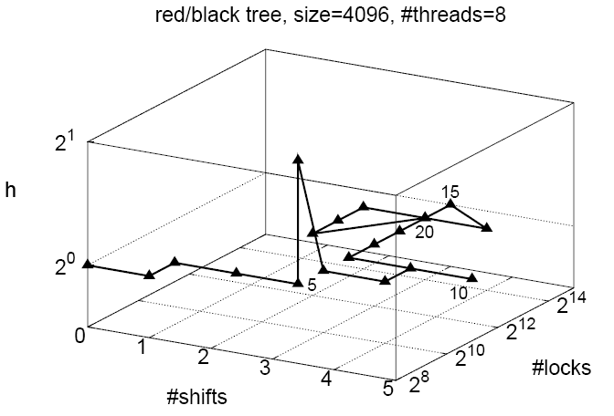
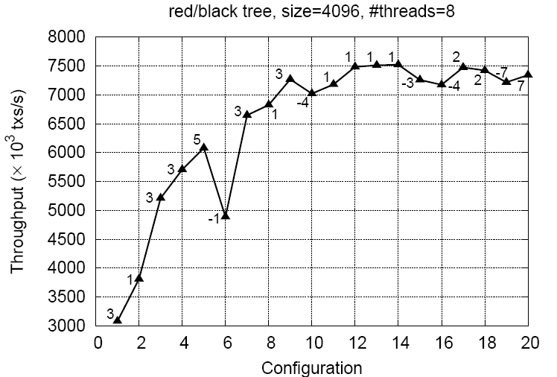
Red-black tree
8-core Intel Xeon at 2 GHz, Linux 2.6.18-4 (64-bit)
Throughput more than doubles from initial configuration

Slide 21
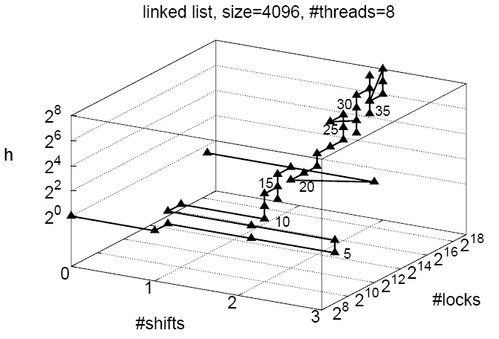
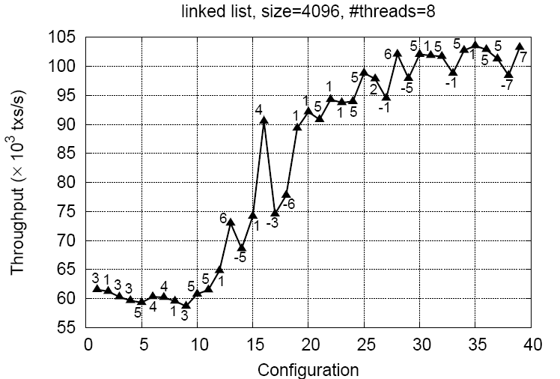
Linked list
8-core Intel Xeon at 2 GHz, Linux 2.6.18-4 (64-bit)
Throughput almost doubles from initial configuration

Slide 22
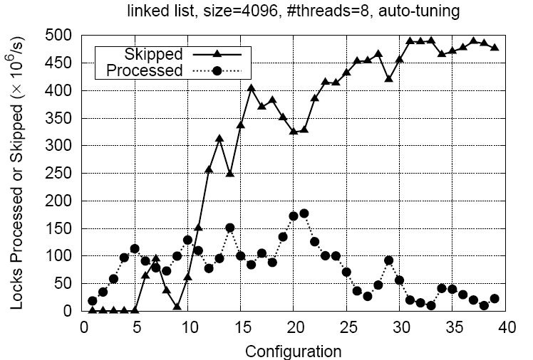
Validation costs (linked list)
8-core Intel Xeon at 2 GHz, Linux 2.6.18-4 (64-bit)
Dynamic tuning allows skipping most of validation checks.

Slide 23
Conclusions
Performance of STM depends on design and configuration parameters, and workload
  No “one-size-fits-all” STM
Dynamic tuning adapts configuration to workload
Simple hill-climbing algorithm shows significant performance improvements
More configuration parameters to explore
http://www.tinystm.org

Slide 24
Thank you!
????????

Slide 25
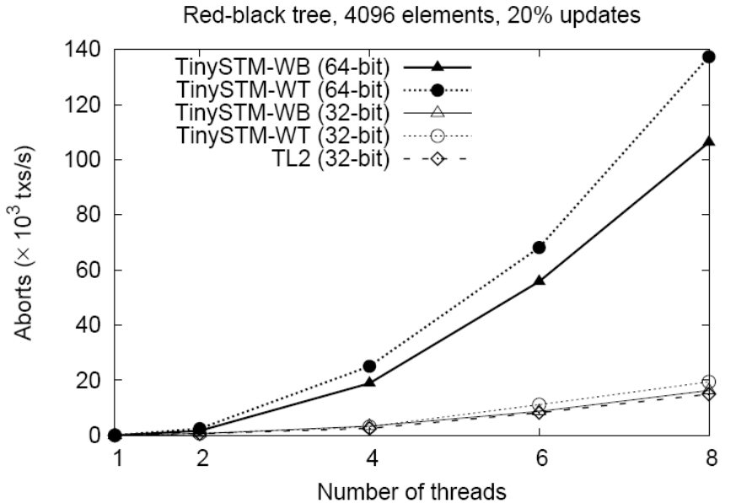
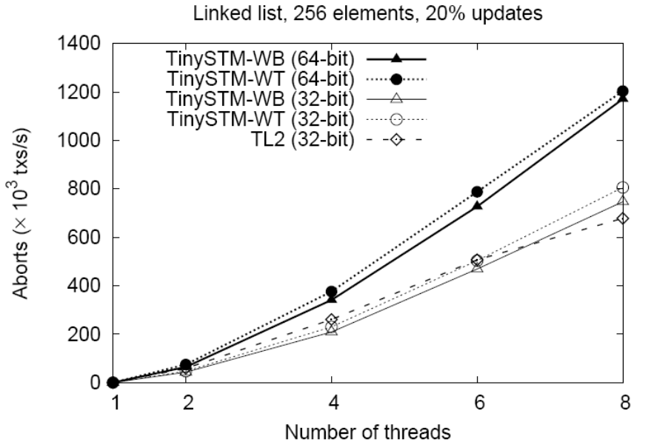
Abort rates
8-core Intel Xeon at 2 GHz, Linux 2.6.18-4 (64-bit)
L=2²⁰, #shifts=2/3
Abort rates increase upon contention, as expected.
64-bit has higher abort rate.
CTL has slightly less aborts.

Slide 26
ETL vs. CTL
Encounter-time locking
Acquire locks when memory is written
Detect conflicts early
Commit-time locking
Acquire locks at commit time
Detects conflicts late
Avoids executing doomed transactions
Fast RW-after-write
May reduce conflicts with some workloads

