Slide 1
KGCOMPASS PROGRESS UPDATE
GraphJudge: Study, Reproduction,
and First Steps on the Animal Science KG
Paper: Can LLMs be Good Graph Judge for Knowledge Graph Construction? (EMNLP 2025 Main, arXiv 2411.17388)
Srikar Sankranti · TAU Group · Directed Studies, Prof. Jian Tao
Notes:
Hi everyone, quick progress update from my side. First: I read the paper shared in the group thoroughly, end to end including the appendices, and everything today builds on it. It was accepted at EMNLP 2025 main conference and the authors released their code and trained judge weights, which saves us a lot of work.

Slide 2
THE PAPER IN ONE SLIDE
Generate for recall, judge for precision
Naive LLM extraction fails 3 ways: noise, missing domain knowledge, hallucination - all wrong triples entering the KG.
GraphJudge: a big LLM over-generates candidate triples (recall), then a small LoRA fine-tuned 7B judge answers per triple: 'Is this true given the document?' and filters (precision).
Judge accuracy >90%, beating GPT-4o (64-74%) at that narrow task. Training: 500 steps, one 48GB GPU - fits HPRC.
G-BERTScore F1, best in bold-green:
Method | REBEL | GenWiki | SCIERC
GPT-4o | 0.4163 | 0.8428 | 0.7035
PiVe (70B) | 0.4090 | 0.8230 | 0.6725
GraphJudge | 0.5796 | 0.8457 | 0.7283
Why it matters for us: triplet accuracy is the gate before GraphRAG - this is the published state of the art for exactly that step.
Notes:
The paper in one line: do not trust one LLM pass. A big model over-generates candidate triples so recall stays high, then a small fine-tuned 7B judge checks each triple against the source document and filters the wrong ones. The judge is over 90 percent accurate, better than GPT-4o at that narrow task, and training it took only 500 steps on a single 48 GB GPU, so this fits HPRC easily. The table shows it is state of the art on all benchmarks against much bigger systems.

Slide 3
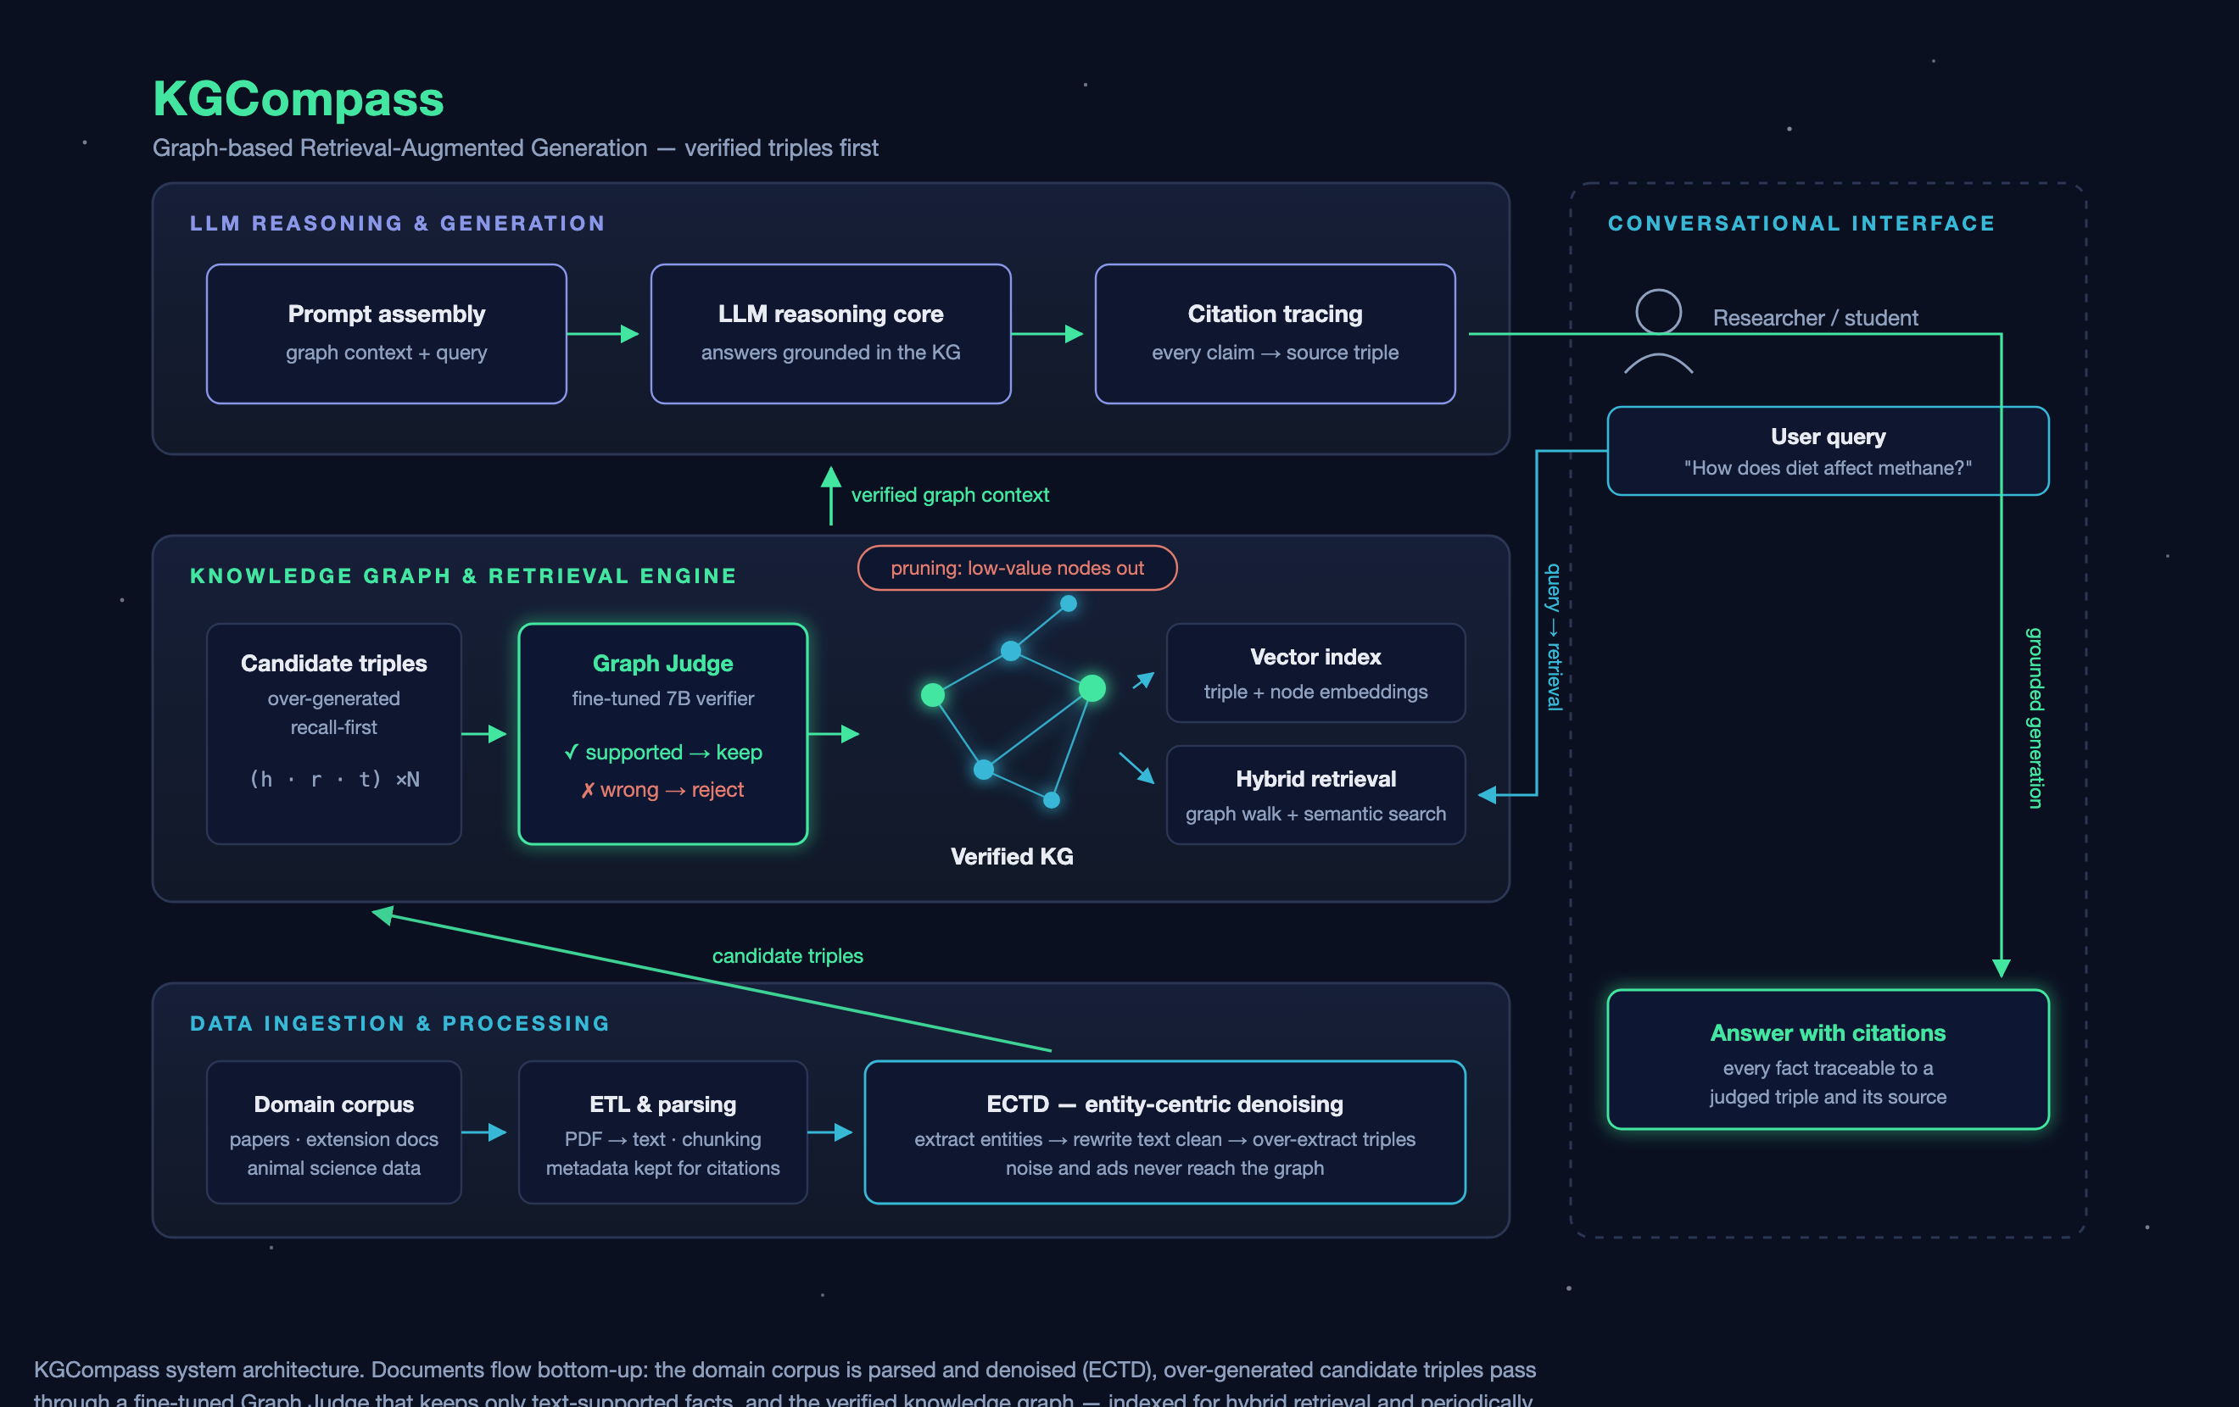
Notes:
This is how it all fits together as a system. Bottom: our corpus gets parsed and denoised. Middle: candidate triples pass through the graph judge, only text-supported facts enter the verified KG, which is indexed for retrieval and later pruned. Top: the LLM answers user questions grounded in the KG with citations. The right side is the user loop.

Slide 4
HANDS-ON PROGRESS
Reproduced the pipeline, inspected every triple
• Official repo running locally (env built, Mac device bug patched).
• 15 SCIERC abstracts: extraction (129 triples) then strict support filter (95 kept), scored with the paper's own metric code.
• Filtering raised precision on EVERY metric (G-BS P 0.9006 -> 0.9391); crude filters cut recall - why the judge must be trained.
• Per-triple inspection CSV: all 129 triples with verdict + quoted evidence or the exact error (inverted relation, dropped negation, vague entity).
Shared with the team:
• PR #1 to KG_Bench_TAU_Group: GraphJudge study mapped into our framework as a construction-time filter stage, with repro results and Mac patch.
• Repo: github.com/ssrikar1503/directed-studies-kgcompass (plans, results, inspection CSV).
• Released judge LoRA weights exist on HuggingFace - we can run judging with zero training first.
Notes:
What I actually ran: I have the official repo working locally, reproduced their evaluation on 15 SCIERC abstracts with their own metric code, and the key finding is that filtering raised precision on every single metric but a crude filter also cut recall, which is exactly why the judge has to be a trained model and not rules. I also built a per-triple inspection sheet, 129 triples each with a verdict and the quoted evidence or the exact error, that is directly the triplet accuracy check Professor Tao asked for. And I raised PR number 1 on Sumanth's KG_Bench repo so all of this lives in the team framework.

Slide 5
ANIMAL SCIENCE CORPUS - STARTED THIS WEEK
First triples extracted from our own domain
• Drive corpus mapped: ~105 nutrition papers + 4 QA cases from the existing query-expansion RAG pipeline (e.g. monensin vs metritis).
• Those QA cases become our evaluation targets: the KG must answer the same questions, with citations.
• First extraction: Arieli 1998 whole-cottonseed review -> 35 triples, 31 kept with quoted evidence, 4 rejected with reasons.
Rejected examples = the paper's failure modes, live in our domain:
• 'WCS increases milk production' - source says the response is VARIABLE.
• 'Gossypol toxic to dairy cows' - source says ruminant females are relatively INSENSITIVE; toxic to monogastrics and males.
• Species-conditional facts get flattened by naive extraction - a concrete research angle (richer knowledge units).
Notes:
This week I got access to the animal science Drive folder, thanks Surabhi. About 105 papers plus four QA cases from the existing RAG pipeline, the monensin and metritis question. Those cases are perfect evaluation targets for our KG. I did a first manual extraction from the whole cottonseed review: 35 triples, 31 kept with quoted evidence, 4 rejected. The rejected ones matter most: naive extraction turns 'variable response' into 'increases milk production' and flattens species-conditional facts like gossypol toxicity. That conditional-facts problem is a concrete research angle nobody has published on.

Slide 6
FUTURE STEPS
From reproduction to our own results (next 2 months)
• Weeks 1-2: full 100-doc SCIERC run with released judge weights; HPRC access + GPU allocation.
• Weeks 3-4: batch-extract triples over the full animal science corpus (ECTD-style); grow the inspection sheet.
• Weeks 5-6: team labeling sprint -> domain gold triple set (judge training data + evaluation standard); fine-tune the domain judge on HPRC.
• Weeks 7-8: judge-filter the full KG, evaluate on the existing QA cases vs the text-RAG baseline; first pruning experiments.
Asks: gold-set labeling split among the team · HPRC allocation · relation vocabulary sign-off
Notes:
The plan for the next two months, roughly two-week blocks: full SCIERC reproduction with the released weights, then batch extraction over the whole corpus, then a team labeling sprint to build the gold set which doubles as judge training data, then fine-tune the domain judge, evaluate against the existing QA cases, and start pruning experiments. Three asks from the team: how we split the labeling work, HPRC allocation, and agreement on the relation vocabulary. Happy to adjust the timeline with everyone's availability.

