Slide 1
Animal Science Knowledge Graphs
Midpoint Review - Fall 2026
RAG vs GraphRAG on 283 papers - construction, head-to-head evaluation, and triplet-level quality
TAU Group - Sumanth Nalamalapu, Srikar Sankranti, Deepmoy Hazra | Advisor: Prof. Jian Tao
Notes:
Good afternoon everyone. This is our midpoint review. In one line: we built both a RAG system and a knowledge-graph GraphRAG system over 283 animal science papers in a single codebase, compared them head to head at two scales, then went one level deeper and evaluated the knowledge graph at the level of individual triplets. I will show what we built with code, what the comparisons found, why the giant graph underperformed, the five reasons triplets fail, and how we are correcting and re-verifying them so the KG quality rises.

Slide 2
The project at a glance
283
2
83,554
1,689
animal science papers, 42 topic groups
pipelines in one codebase: RAG + KG/GraphRAG
triples extracted into 39 graphs + 1 giant graph
answers judged head-to-head (739x2 + test set)
Goal: a trustworthy, queryable knowledge graph of animal science - where GraphRAG answers beat plain RAG because the graph's facts are verified. Foundation: GraphJudge (EMNLP 2025) - generate triples for recall, judge them for precision.
Semester so far: corpus organized into groups -> both pipelines built -> 46-hour groupwise RAG vs GraphRAG evaluation -> giant all-papers graph built -> full triplet-level quality evaluation -> correction + re-verification loop started
Everything reproducible: shared extraction cache, per-run manifests, evaluation scripts and all data in the team repos
Notes:
The corpus is 283 animal science and nutrition papers organized into 42 topic groups. One codebase holds both pipelines: the original AnimalRAG retrieval pipeline, and the new knowledge-graph pipeline that builds graphs and answers with GraphRAG. We extracted 83 and a half thousand triples, built one graph per group plus one giant graph over all papers, and judged over sixteen hundred answer pairs plus nine hundred fifty individual triplets. The goal driving all of it: a knowledge graph trustworthy enough that GraphRAG reliably beats RAG.

Slide 3
Why a knowledge graph: search misses the links
One Health questions span veterinary, climate and public-health papers that rarely cite each other
Keyword/vector search returns passages that SHARE WORDS - not the chain of findings that answers the question
A knowledge graph can return the traceable path across papers, with each hop cited
Climate stressor (e.g. heat stress)
v
Effect on animal physiology
v
Disease susceptibility
v
Human exposure pathway
the traceable path KGCompass should find
Notes:
Before the how, the why. One Health questions, how a climate stressor ends up as a human exposure risk, span veterinary, climate and public-health literatures that rarely cite each other. Keyword and vector search return passages that share words with the question, not the chain of findings that actually answers it. A knowledge graph is the structure that can return that traceable path, each hop cited to its paper. That is the promise everything else in this talk is testing.

Slide 4
One codebase, two pipelines
RAG (baseline - backend/)
GraphRAG (new - knowledge_graph/)
Query rewriting: LLM expands the question into ~25 search queries
Hybrid retrieval: dense vectors (nomic-embed-text, ChromaDB) + BM25, fused by reciprocal rank
Reranking: cross-encoder ms-marco-MiniLM-L6-v2 scores every chunk
Selection: chunks scoring >= 0.05 (or top 10)
Answer with per-claim citations; self-check by a second LLM (llama3.1 8B)
Build once per corpus: same chunks (1,024 chars / 120 overlap) -> LLM extracts entities (14 domain types) + relations with effect direction
Merge entities across chunks and papers; Louvain communities + LLM summaries; stored in FalkorDB with vector indexes
Answer: seed entities -> 1-hop expansion (<=40 entities) -> strongest <=60 relations -> 8 source chunks -> <=3 community summaries -> cited answer
No reranker on this path (relevant later)
one command compares both pipelines
# shared run settings (per-run manifest): LLM gemma4:12b (answers + extraction + judge) - embeddings nomic-embed-text - chunks 1024/120
$ python knowledge_graph/cli.py evaluate --group 21 --rag rerun # live RAG vs GraphRAG on the same corpus, judged both orders
$ python knowledge_graph/cli.py evaluate --group 21 --all # group questions answered from the GIANT graph
Notes:
Both pipelines live in one repository and share everything that must be fair: the same chunking, the same embedding model, the same LLM, gemma4 12B, for extraction, answering and judging. The RAG path is retrieval engineering: query expansion, hybrid dense plus keyword search, a cross-encoder reranker, then an answer with citations and a self-check. The GraphRAG path first builds a knowledge graph per corpus, then answers by walking the graph: seed entities, one hop out, top relationships, the chunks behind them and community summaries. Note one asymmetry now, it matters later: RAG has a reranker, the graph path does not.

Slide 5
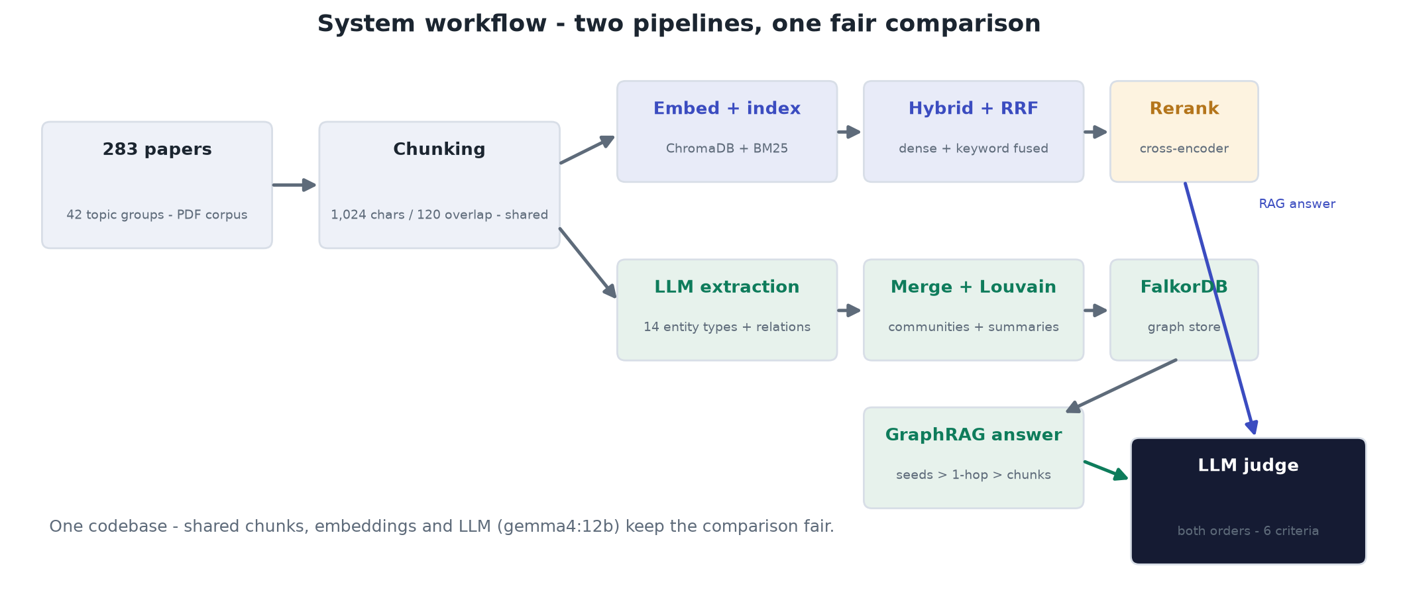
System workflow
Notes:
This is the whole system on one picture. The corpus is chunked once, and both pipelines consume the same chunks. The top branch is RAG: embed and index into ChromaDB plus BM25, hybrid retrieval fused by reciprocal rank, then the cross-encoder reranker. The bottom branch builds the knowledge graph: LLM extraction with fourteen entity types, merging and community detection, storage in FalkorDB, and GraphRAG answering walks that graph. Both answers meet at the same LLM judge, scored in both orders on six criteria. The fairness controls matter: same chunks, same embeddings, same model everywhere.

Slide 6
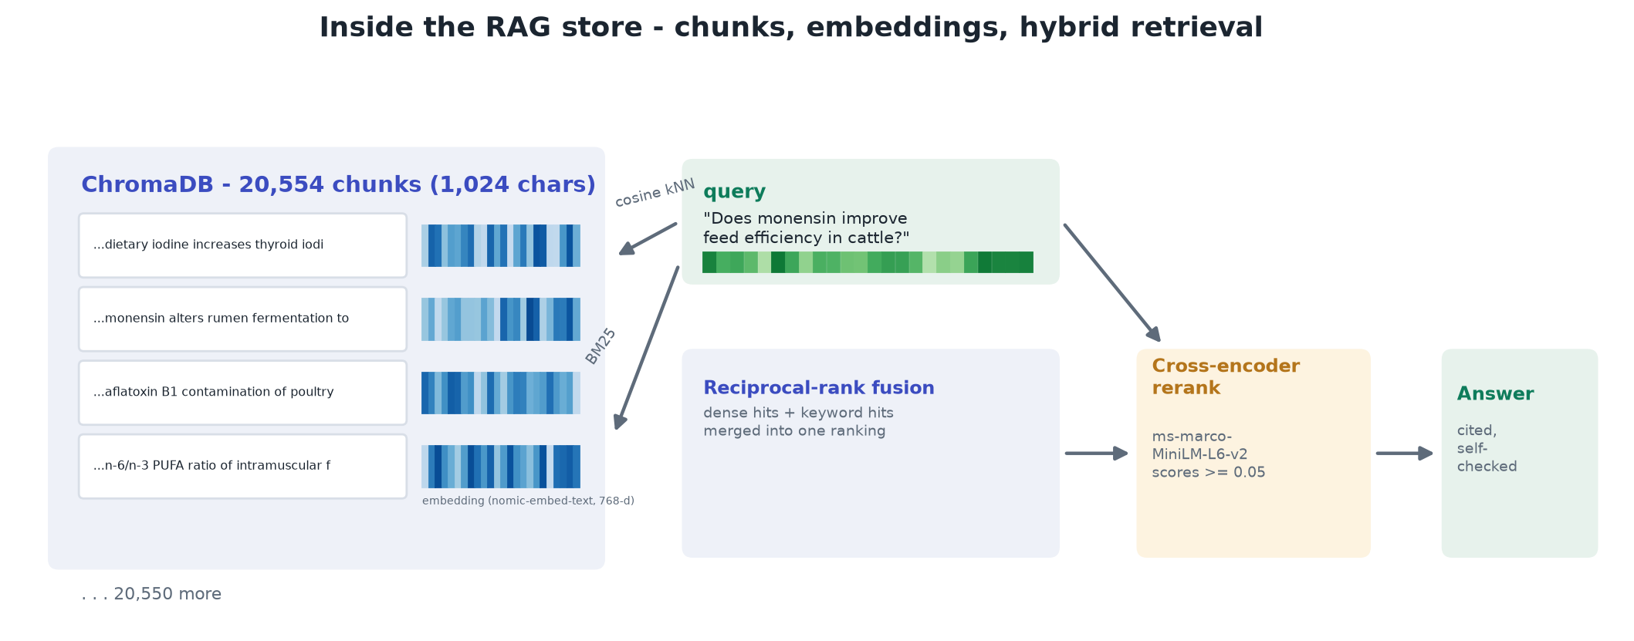
Inside the RAG store - chunks and embeddings
Real chunk texts from the corpus; vectors illustrative (nomic-embed-text, 768-d)
Notes:
Before the graphs, here is what the RAG side actually stores: twenty thousand chunks in ChromaDB, each with its seven-hundred-sixty-eight-dimension embedding, pictured as the blue strips. A question becomes its own vector, finds nearest neighbours by cosine similarity, BM25 finds keyword matches in parallel, reciprocal-rank fusion merges the two lists, and the cross-encoder reranks before answering. Keep this picture in mind - the reranker on the right is the piece the graph path is missing.

Slide 7
The KG build pipeline - from the codebase
knowledge_graph/cli.py
# knowledge_graph/cli.py - cmd_build (actual pipeline)
chunks = prepare_corpus(name, pdf_paths=pdfs)
extractions = run_extraction(chunks, model=args.model,
workers=args.workers) # cached per chunk
graph = build_graph(extractions) # merge entities
communities = detect_communities(graph) # Louvain
reports = summarize_communities(graph, communities, name)
texts, vectors = entity_embeddings(graph, name)
falkor_store.write_graph(name, graph, reports, chunks,
chunk_vectors, texts, vectors)
export_graphml(graph, name); export_tables(graph, ...)
20,554
55,008
chunks processed (cached, never twice)
entities across 38 group graphs
80,057
30,515
relationships with effect direction
entities in the giant graph (-45% by merging)
Giant graph: 79,855 relations, 6,319 communities - entity merging halves the nodes but keeps 95.6% of the edges
usage
$ python knowledge_graph/cli.py build --group 21
$ python knowledge_graph/cli.py ask --group 21 "How do mycotoxins induce ferroptosis?"
$ python knowledge_graph/cli.py build --all # one graph, all 283 papers
Notes:
This is the actual build pipeline from the CLI, not pseudocode: prepare corpus, run extraction with a per-chunk cache so no chunk is ever paid for twice, build and merge the graph, detect communities, write summaries, embed entities, store everything in FalkorDB and export readable tables. One command builds a group graph, one command builds the giant graph over all 283 papers. The numbers on the right: twenty thousand chunks, fifty-five thousand entities across the group graphs. Notice the giant graph: merging across the whole corpus collapses entities by forty-five percent while keeping nearly all edges. Hold that thought, it explains a result coming up.

Slide 8
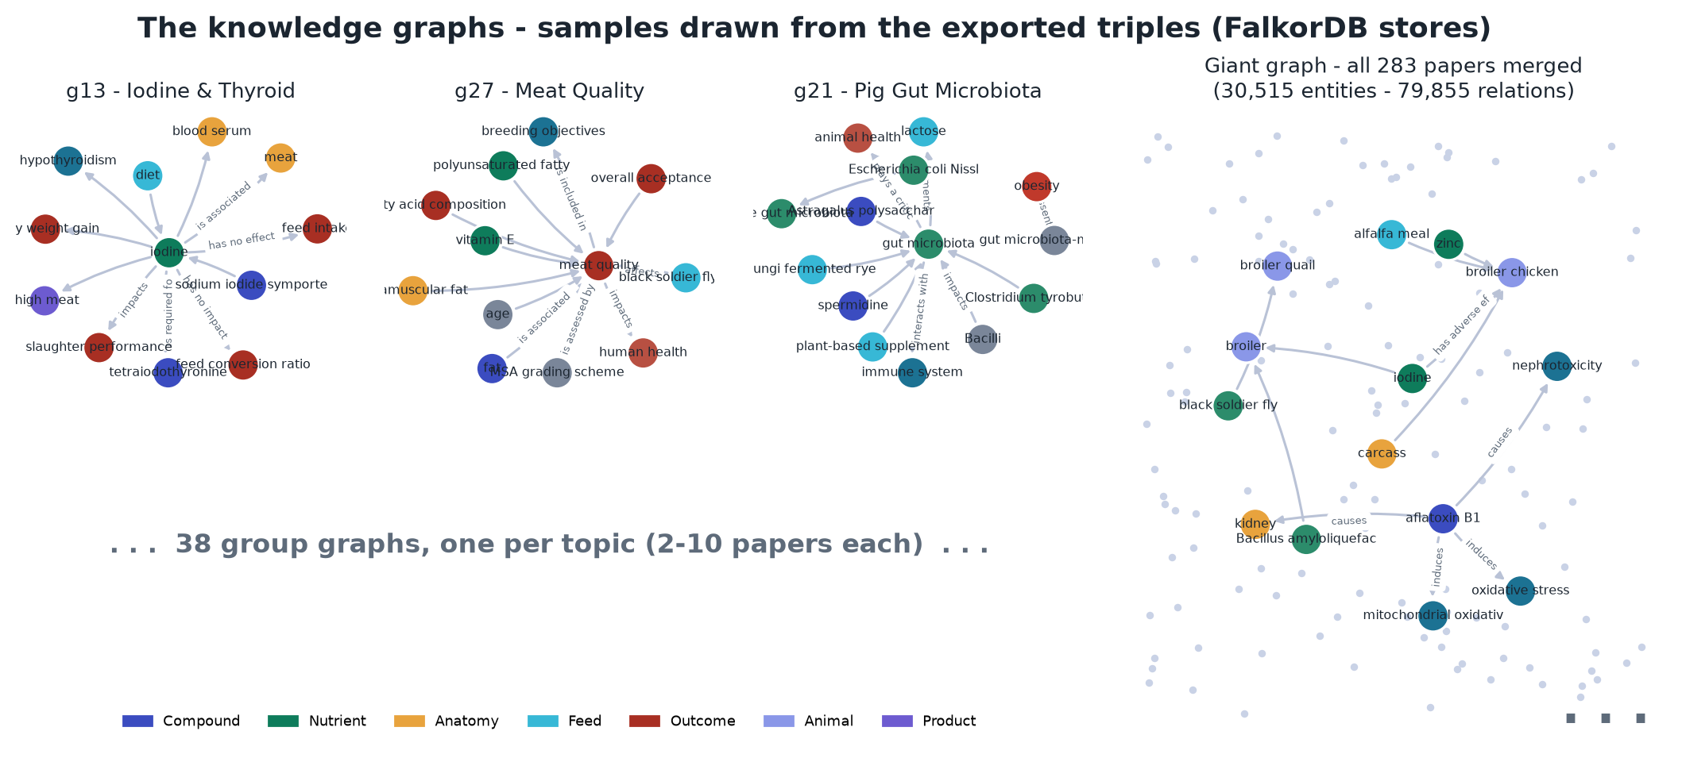
The graphs themselves - real samples
Every node and edge drawn from the exported triples.csv of the FalkorDB stores
Notes:
And here are the graphs themselves, not a schematic: every node and edge on this slide is drawn from the exported triples. Left to right: the iodine and thyroid group with iodine as its hub, the meat quality group, the pig gut microbiota group - and there are thirty-eight of these, one per topic. On the right, the giant graph over all two hundred eighty-three papers: the sample neighbourhood shows how merging connects entities across topics - aflatoxin linking kidney, broilers and oxidative stress - and the faded dots stand for the other thirty thousand entities. Node colors are the extraction's own entity types.

Slide 9
Groupwise: GraphRAG wins the head-to-head
Groups won: GraphRAG 35, RAG 1, tied 2 (p = 1e-9); sign test on verdicts p = 6e-27
Test set vs expert answers: correctness tied at the ceiling (9.4-9.5/10); completeness 6.28 vs 5.80; paper recall 0.53 vs 0.42 - GraphRAG finds more of the right papers
GraphRAG also faster: 17.7s vs 22.8s per answer (RAG spends calls on rewrite + self-check)
Honest caveat: the judge tracks answer LENGTH - at equal length the systems tie (p = 0.4). Win counts alone do not prove better answers
Notes:
First comparison: one graph per topic group, 739 questions, every pair judged twice with the order swapped to kill position bias. GraphRAG wins 455 to 186, takes 35 of 38 groups, and on the expert test set it finds more of the right papers, recall 0.53 versus 0.42, while correctness is tied at the ceiling for both. It is also faster because RAG spends extra LLM calls on query rewriting and self-checking. The honest caveat we flagged ourselves: the LLM judge prefers longer answers, and when answers are the same length the two systems tie. So the groupwise result says GraphRAG retrieves richer context, not yet that its answers are strictly better.

Slide 10
Giant graph (283 papers): RAG wins - and we know why
Setting B (one graph, 283 papers): RAG 431 - GraphRAG 221 - ties 87; RAG takes 33 of 38 groups; paper recall collapses 0.29 vs 0.15. Not a length effect: RAG also wins at equal length (116 vs 33) and on expert-scored correctness (9.56 vs 8.68).
1
1-hop retrieval only
2
Fixed caps lose the relevant chunk
Multi-concept questions need 2+ hops; one hop in a 30,515-entity graph surfaces the mega-hubs ('bovine milk': 1,576 edges), not the specific path.
<=40 entities, <=60 relations, 8 chunks were tuned for ~2,000-entity graphs. In the giant graph the budget fills with hub neighbours and the chunk that answers the question falls outside the cap.
3
No reranking on the graph path
4
Merging concentrates the graph
RAG reranks every candidate with a cross-encoder; GraphRAG selects chunks by graph weight + similarity only - exactly the step that saves RAG at scale is missing.
Entities -45%, edges -4%: double the edges per node pair, so hub expansion gets noisier while cap budgets stay fixed.
Measured root cause: only 27% of GraphRAG's seed entities come from the question's own papers - so just 26% of its passages are on-topic, vs 51% for RAG.
Notes:
Second comparison, and the interesting one: on the single giant graph over all 283 papers, RAG wins decisively - 431 to 221 with 87 ties, taking 33 of 38 groups, and GraphRAG paper recall collapses to 0.15 against RAG 0.29. And this time it is NOT the length artifact: RAG also wins at equal answer length and on expert-scored correctness. We measured the root cause: only 27 percent of GraphRAG seed entities come from the question own papers, so only about a quarter of its retrieved passages are on topic versus half for RAG. We can explain it mechanically, four compounding causes. One: retrieval expands only one hop, and in a thirty-thousand-entity graph one hop lands on mega-hubs like bovine milk with fifteen hundred edges rather than the specific path a multi-concept question needs. Two: the retrieval caps, forty entities, sixty relations, eight chunks, were sized for two-thousand-entity group graphs; at giant scale the budget fills with hub neighbours and the relevant chunk gets cut. Three: the step that rescues RAG at scale, cross-encoder reranking, simply does not exist on the graph path yet. Four: cross-corpus merging halved the entities but kept the edges, concentrating the graph and making hub expansion noisier. None of these is fundamental, all four are fixable retrieval engineering, which is exactly our plan.

Slide 11
Going deeper: evaluating the triplets themselves
Why: answer-level judging is blind to KG errors - faithfulness tied 83% of the time while wrong facts sat in the graph. Prof. Tao's directive: verify triplet accuracy directly.
Full-coverage scan (code): all 83,554 triples - relation vocabulary, trivial triples, vague entities, contradictions
LLM-judged sample (reasoning): 950 triples (25 per group) verified against the FULL TEXT of their source papers; every verdict carries quoted evidence
Calibration: 50-triple deep dive judged independently by two models - 84% exact / 94% binary agreement, zero correct-wrong flips
Per-group correct: 48% - 88% (median 72%). Every group has flawed triples.
Notes:
The answer-level comparison could not see graph errors: the judge called faithfulness a tie 83 percent of the time even though wrong facts sat in the graph. So, following Professor Tao's directive, we evaluated triplets directly, two layers. A deterministic code scan over every one of the 83,554 triples. And an LLM-judged sample: 950 triples, twenty-five per group, each verified against the full text of its actual source paper, every verdict with quoted evidence, and the method calibrated by two independent judges agreeing 94 percent on correct-versus-flawed. Result: 69 and a half percent fully correct, 26 percent imprecise, 4.4 percent outright wrong, and no group is clean.

Slide 12
Why triplets fail: the five reasons
1 - Factual
'alfalfa silage increases milk yield' - the paper shows LOWER yield (P=0.011); negative results stored as positive; GEM expanded to the wrong drug
Inverted or false as stated
2 - Precision
'selenium increases liver' (the Se CONCENTRATION in liver); 'iodine causes hypothyroidism' (source says EXCESS iodine) - quantity and conditions dropped
True idea, meaning lost
3 - Consistency
495 pairs like 'monensin increases AND reduces feed efficiency' - no dose/species qualifiers, so both sit as flat facts
Graph contradicts itself
4 - Form
OCR mangles: 'n-6' became 'n/C06' (30 of 34 garbles from this one corruption); nonsense like 'maize is source of broiler chicken'
Garbled surface
5 - Noise
3,474 'is measured in' triples; 7,603 relation types with 56% used once - retrieval slots fill with filler instead of facts
True but worthless
Notes:
Every failed triplet falls into one of five reasons. One, factual: the triple states something false, inverted directions, negative results flipped positive, abbreviations expanded into the wrong entity. Two, precision: the idea is right but the measured quantity or the condition was dropped, selenium increases liver instead of the selenium concentration in liver. Three, consistency: 495 pairs where the graph asserts both a claim and its opposite with no qualifiers. Four, form: OCR garbling, thirty of our thirty-four garbled entities come from one single corruption of the omega notation. Five, noise: triples that are true but worthless, is-measured-in facts and a seven-thousand-type relation vocabulary that dilute retrieval. Every example on this slide is a real triple from our graphs.

Slide 13
Correct, re-verify, repeat: quality goes up
Detect
Reason
Correct
Re-verify
15,466 triples flagged by full-coverage detectors (18.5%) + 950 paper-verified verdicts
All 495 contradictions adjudicated case-by-case: 56% conditional (qualify, don't delete), 21% extraction errors, 14% real cross-paper disagreement; 48 garbles corrected - 14 were detector false positives
One normalization rule fixes 30/34 garbles; extraction-error sides deleted; conditional pairs get dose/species qualifiers; trivial + singleton relations pruned/merged
Corrected triples re-judged against their own source chunks (chunk ids already stored per triple) - two-judge agreement protocol, 94% binary
>
>
>
The loop is the point: each pass removes a named error class and is re-verified before it lands - so KG quality rises measurably, release by release, instead of by hope.
Notes:
Finding errors is only useful if it changes the graph, so we closed the loop. Detect: full-coverage detectors flag fifteen and a half thousand triples. Reason: every one of the 495 contradictions was adjudicated individually, and the headline is that fifty-six percent are not errors at all, they are dose or species conditional findings that need qualifiers, not deletion; twenty-one percent are extraction errors where one side gets deleted. The garbles were corrected, and the review also caught fourteen false positives from our own detector, which is why reasoning sits on top of rules. Correct, then re-verify against the source chunks which the schema already stores per triple. Each pass through this loop removes a named error class and is verified before it lands, so quality rises measurably.

Slide 14
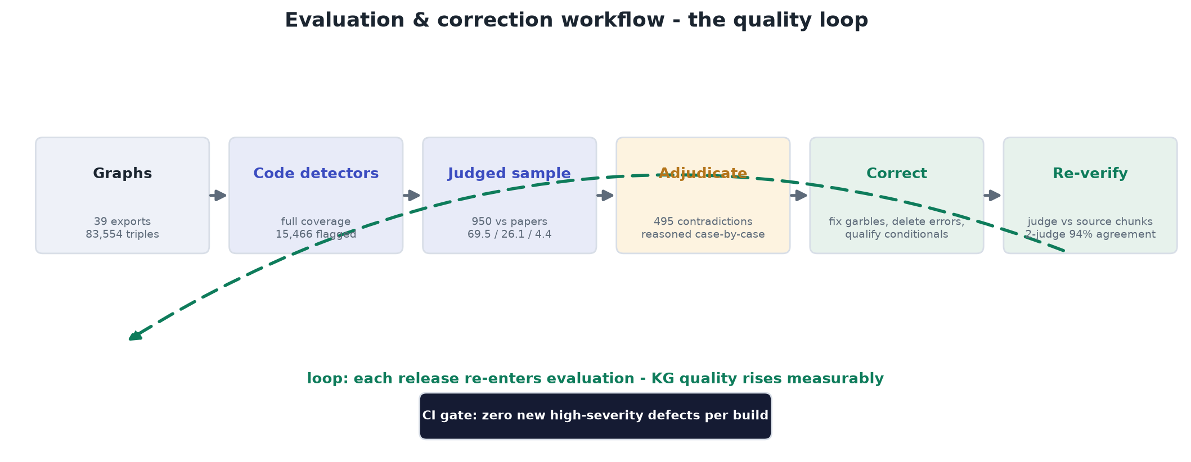
The quality loop as a workflow
Notes:
The same loop as a workflow diagram, because this is what runs from now on: graphs in, deterministic detectors over every triple, a judged sample against the papers, case-by-case adjudication of contradictions, corrections, and re-verification against the source chunks - with the dashed arrow closing the loop so every release re-enters evaluation, and the CI gate guaranteeing no new mechanically-detectable defect ever lands.

Slide 15
Second half: make the KG pass its own evaluation
Find the best evaluation methods
Improve the KG until it passes
CI gate on every graph build: deterministic detectors, zero new high-severity defects
Judge stage: every triple vs its own source chunk (GraphJudge released weights now; domain fine-tune on HPRC - allocation in hand)
Gold set: expand the 950 verified triples into the team's labeled standard
Keep the answer-level benchmark, but length-controlled and with an independent judge model
Fix giant-graph retrieval: add cross-encoder reranking to the graph path; go beyond 1-hop (path search / Personalized PageRank); scale caps with graph size
Qualified triples: dose / species / phase fields - turns the 56% conditional contradictions into coexisting correct facts (our research contribution)
OCR normalization + abbreviation tables before extraction; controlled ~40-relation vocabulary
Success test: on the whole corpus, GraphRAG ties or beats RAG with length-matched answers, an independent judge, and an expert spot-check
Notes:
The second half of the semester has one sentence as its plan: find the best evaluation methods, and improve the knowledge graph until it passes them. Left side, evaluation: a CI gate so no mechanically detectable error ever enters a build, a judge stage checking every triple against its own source chunk, with HPRC allocation already in hand for the domain fine-tune, the gold set grown from our 950 verified triples, and the answer benchmark kept but length-controlled with an independent judge. Right side, improvement: fix exactly the four giant-graph causes, reranking on the graph path, multi-hop retrieval, adaptive caps; add qualifier fields, which is also our publishable contribution; normalize text before extraction. And then the rematch: re-run RAG versus GraphRAG at both scales with the cleaned graph.

Slide 16
Where we stand
Built: both pipelines, 39 graphs + the giant graph, 83,554 triples, full evaluation stack
Learned: GraphRAG wins groupwise; at 283-paper scale retrieval design (1-hop, caps, no reranker) hands the win to RAG; ~30% of triplets are flawed for 5 nameable reasons
Doing: detect -> reason -> correct -> re-verify loop; evaluation harness; graph-retrieval fixes; qualified triples
Deliverables: evaluation report + bad-triple catalog + reproducible codebase in the team repos
Questions - TAU Group
Notes:
To close. We built both systems end to end and evaluated them at every level, answers and triplets. We learned that GraphRAG wins when graphs are small, that at full scale the retrieval design gives the win back to RAG for four fixable reasons, and that about thirty percent of triplets are flawed for five nameable reasons, most of which are correctable and many of which are actually conditional science that needs a richer representation. That representation, qualified triples, is our research direction, and the correction and re-verification loop is already raising graph quality. By the final review we intend to show the rematch: the cleaned, re-verified knowledge graph passing its evaluation and beating RAG at full scale. Happy to take questions.

