Slide 1
DATA MINING FINAL PROJECT
Team: DataQuarry Innovators
Team Members: Gautam Raghu Mithila Reddy Chitukula Srinija Srimamilla

Slide 2
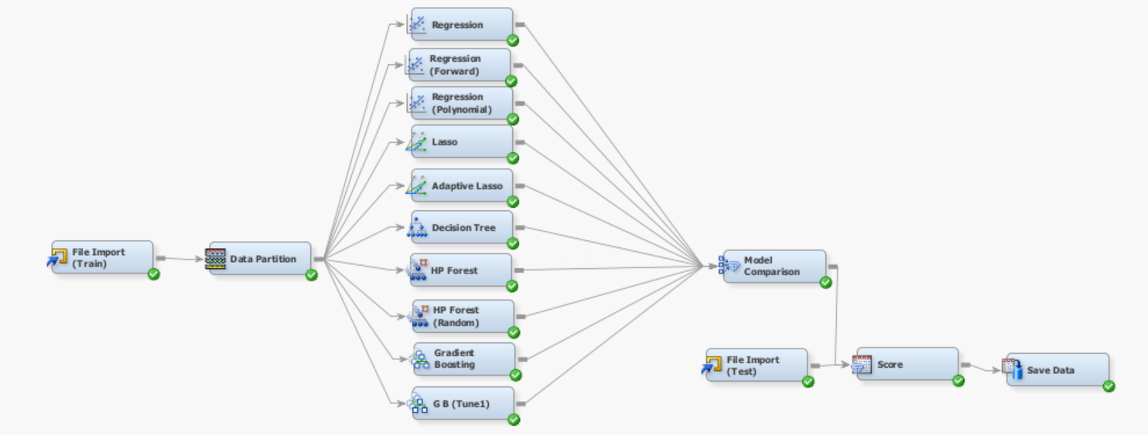
Test-0

Slide 3
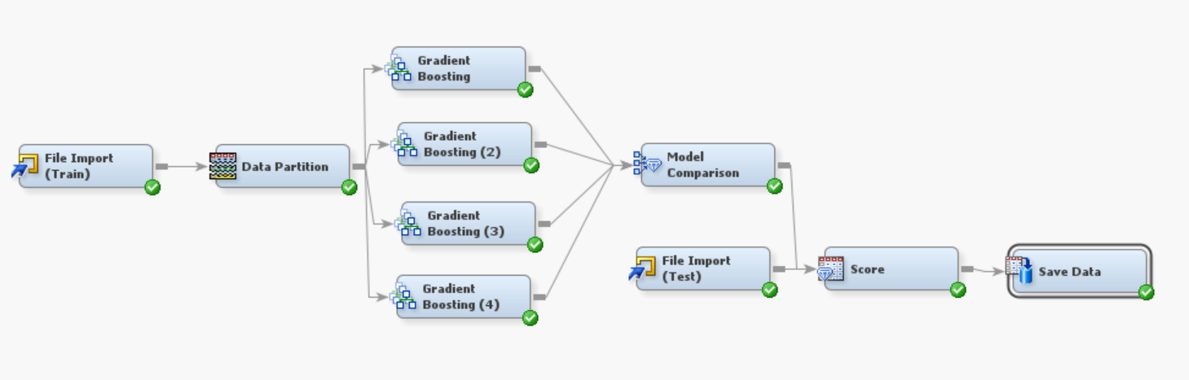
Test-1

Slide 4
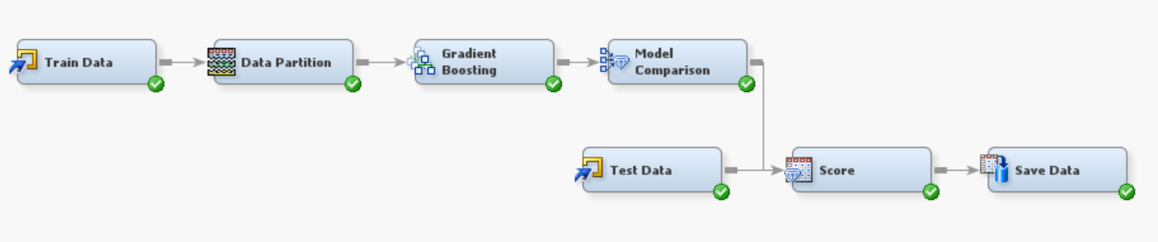
Second-Best Model
Public Score: 0.92221 Private Score: 0.91615

Slide 5
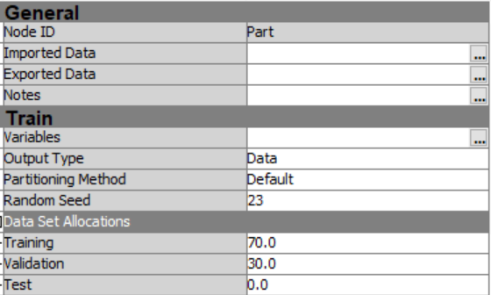
Data Partition Node
-Training Set: 70% -Validation Set: 30%

Slide 6
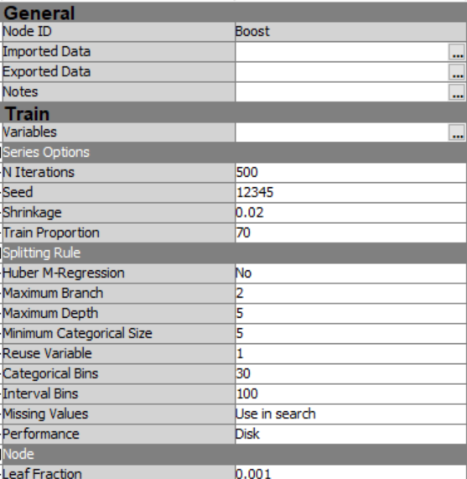
Gradient Boosting Node

Slide 7
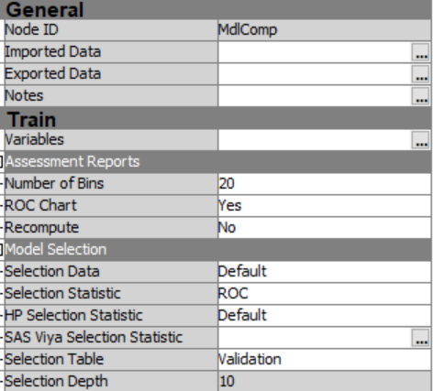
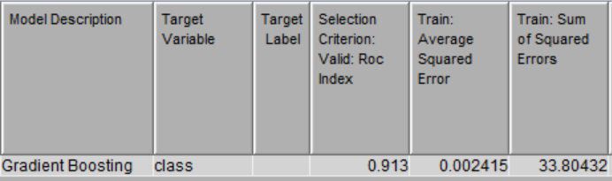
Model Comparison Node
-Selection Stat: ROC

Slide 8
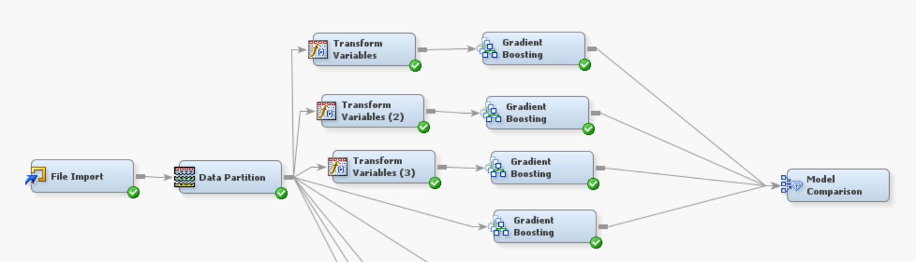
Test-3

Slide 9
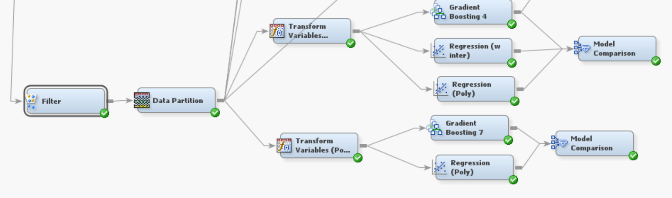
Test-4

Slide 10
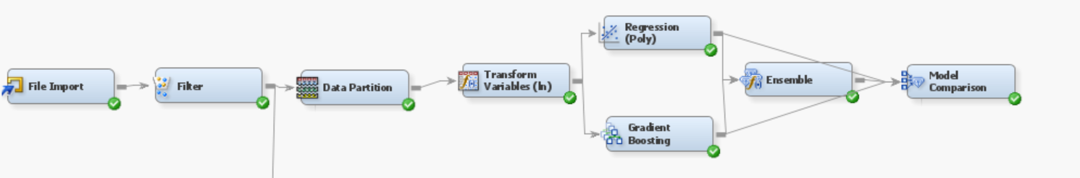
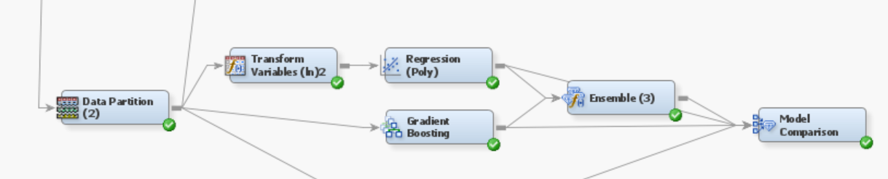
Test-5

Slide 11
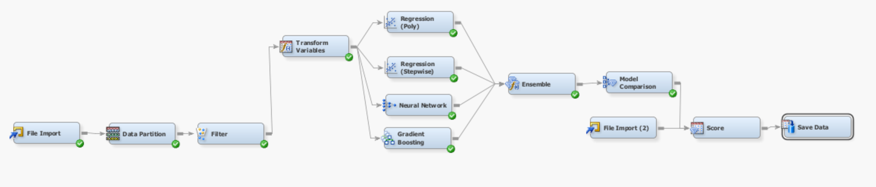
Test-6

Slide 12
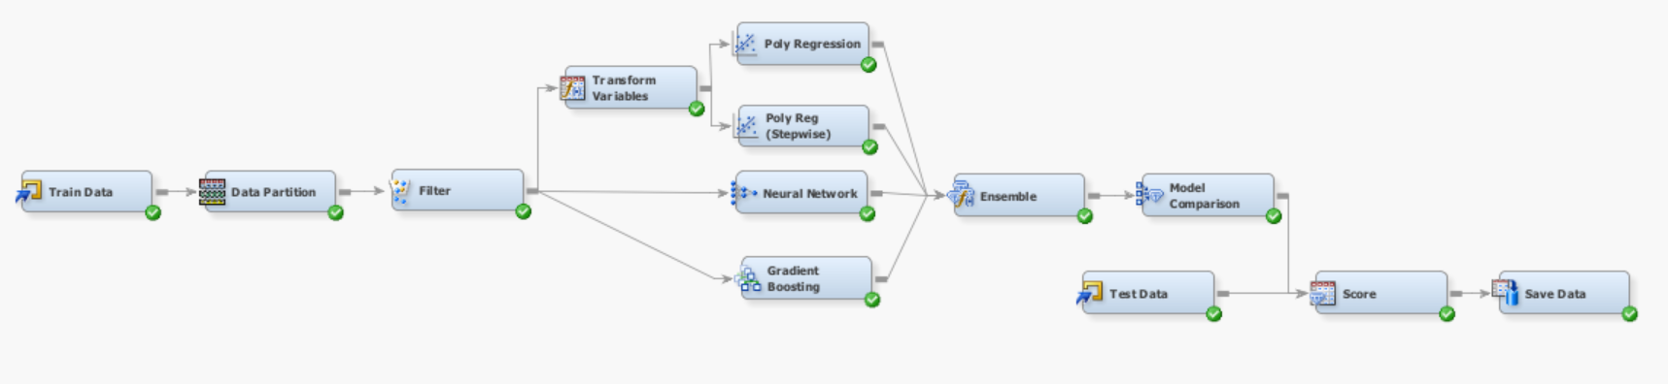
Final Model
Public Score: 0.94397 Private Score: 0.94891

Slide 13
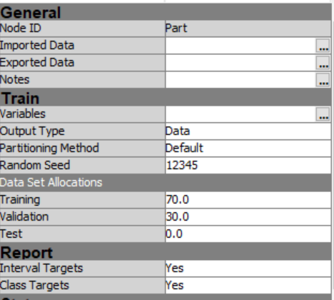
Sample
Data Partition Node -Training Set: 70% -Validation Set: 30%

Slide 14
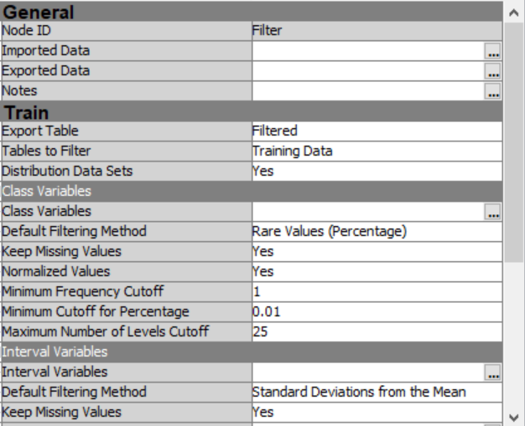
Filter Node
-Default properties

Slide 15
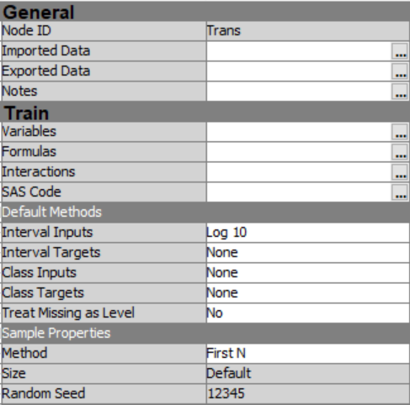
Modify
Transform Variables Node

Slide 16
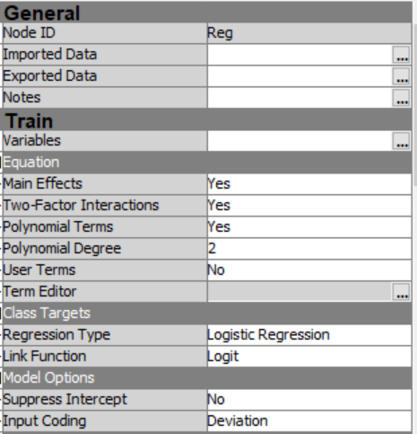
Model
Regression Node (Polynomial)

Slide 17
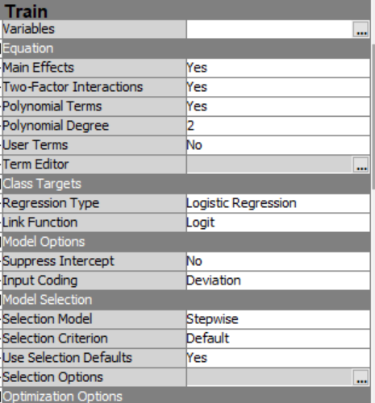
Regression Node (Stepwise)

Slide 18
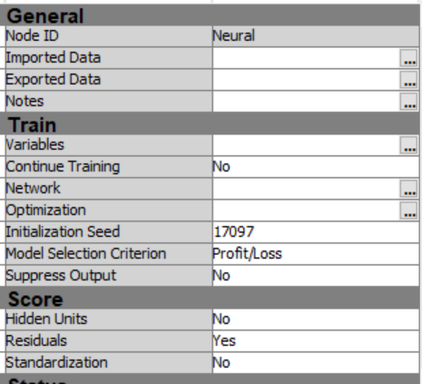
Neural Network Node
-Seed(Random) - Property Changes in Network and Optimizatrion

Slide 19
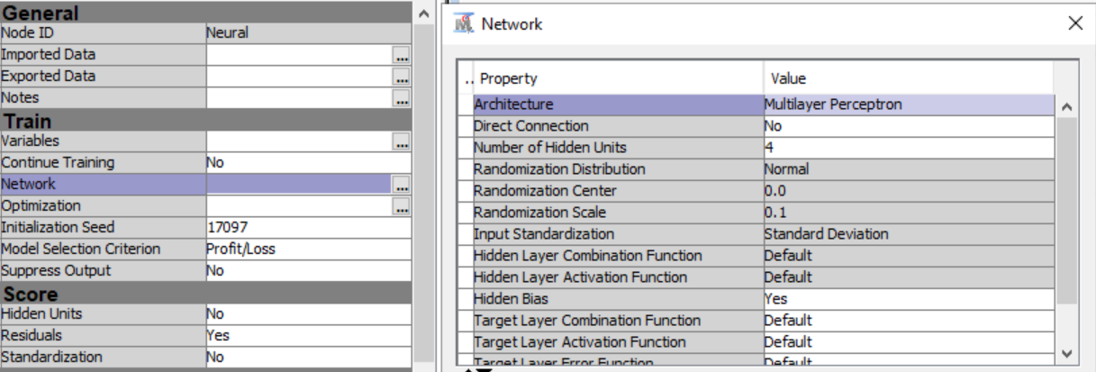
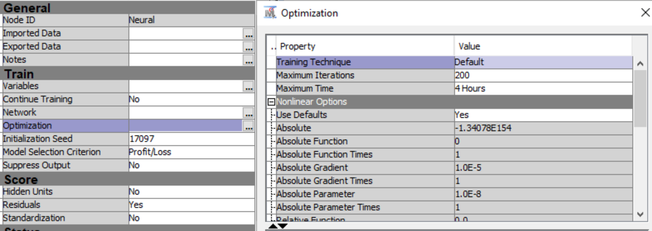
Network Properties
Optimization Properties

Slide 20
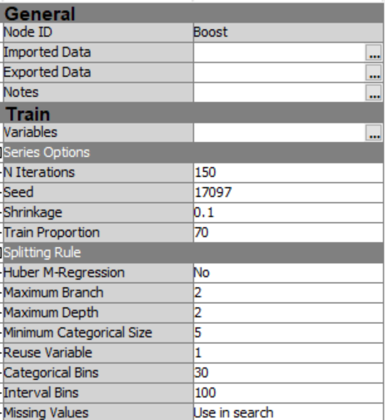
Gradient Boosting Node

Slide 21
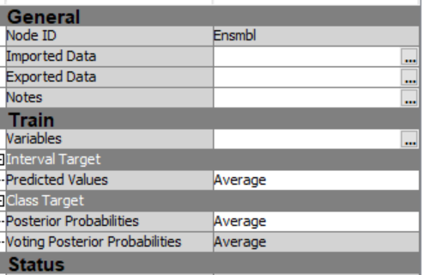
Ensemble Node
-Default Properties

Slide 22
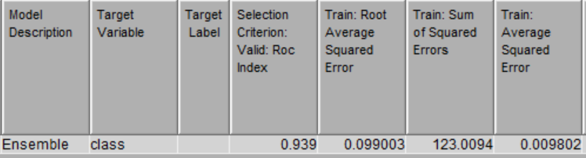
Model Comparison Node
-Selection Stat: ROC

Slide 23
Thank You

