Slide 1
CS 334 / CS 534 Networking
Lecture 08.1
Network

Slide 2
Network Layer
Application
Function:
Route packets end-to-end on a network, through multiple hops
Key challenge:
How to represent addresses
How to route packets
Scalability
Convergence
Presentation
Session
Transport
Network
Data Link
Physical

Slide 3



Routers, revisited
How to connect multiple LANs?
LANs may be incompatible
Ethernet, WiFi, etc…
Connected networks for an internetwork
The Internet is the best known example
Routers

Slide 4
Structure of the Internet
Network 3
Network 1
Network 4
Network 2
Ad-hoc interconnection of networks
No organized topology
Vastly different technologies, link capacities
Packets travel end-to-end by hopping through networks
Routers “peer” (connect) different networks
Different packets may take different routes

Slide 5
Internetworking Issues
Naming / Addressing
How do you designate hosts?
Routing
Must be scalable (i.e. a switched Internet won’t work)
Service Model
What gets sent?
How fast will it go?
What happens if there are failures?
Must deal with heterogeneity
Remember, every network is different
Internet Service Model
Best-effort (i.e. things may break)
Store-and-forward datagram network
Lowest common denominator

Slide 6
Possible Addressing Schemes
Flat
e.g. each host is identified by a 48-bit MAC address
Router needs an entry for every host in the world
Too big
Too hard to maintain (hosts come and go all the time)
Hierarchy
Addresses broken down into segments
Each segment has a different level of specificity

Slide 7
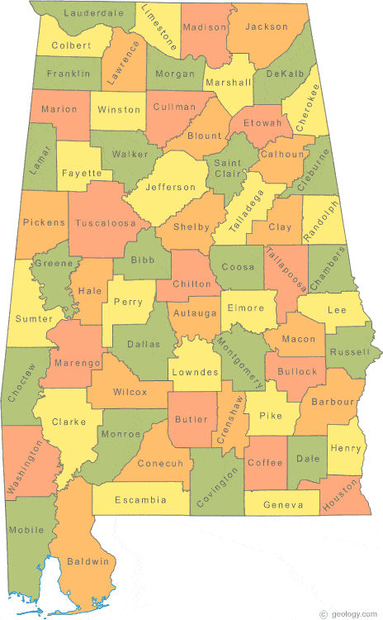
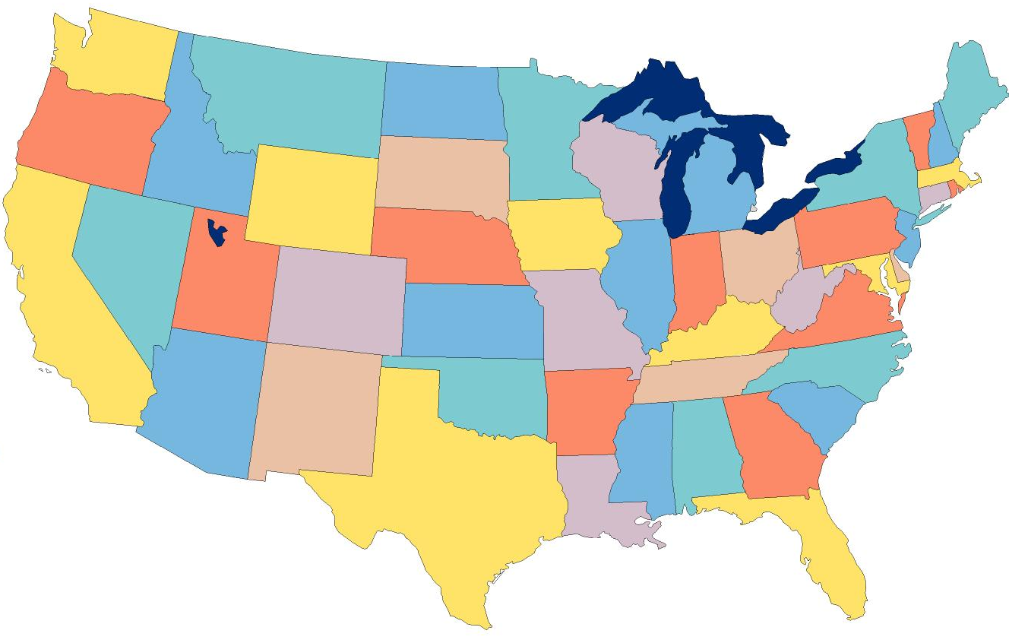

Example: Telephone Numbers
5473
1-205-934-2197
Very General
Campbell Hall
Room 132
Campbell Hall
Rom 141
Updates are Local
Very Specific

Slide 8
Binary Hierarchy Example
1**
Datagram, Destination = 101
10*
100
101
11*
0**
110
00*
111
000
001
01*
010
011

Slide 9
IP Addressing
IPv4: 32-bit addresses
Usually written in dotted notation, e.g. 192.168.21.76
Each number is a byte
Stored in Big Endian order
0
8
16
24
31
Decimal
192
168
21
76
Hex
C0
A8
15
4C
Binary
11000000
10101000
00010101
01001100

Slide 10
IP Addressing and Forwarding
Routing Table Requirements
For every possible IP, give the next hop
But for 32-bit addresses, 2³² possibilities!
Hierarchical address scheme
Separate the address into a network and a host
0
31
Pfx
Network
Host
Known by all routers
Known by edge (LAN) routers
Notes:
Prefix – Essentially what you are assignened

Slide 11
Classes of IP Addresses
0
1
8
16
24
31
Class A
0
Ntwk
Host
Example: MIT
18.*.*.*
1-126
0
2
8
16
24
31
Class B
10
Network
Host
Example: UAB
138.26.*.*
128-191
0
3
8
16
24
31
Class C
110
Network
Host
Example:
216.63.78.*
192-223

Slide 12
How Do You Get Ips?
IP address ranges controlled by IANA
Internet Assigned Numbers Authority
Roots go back to 1972, ARPANET, UCLA
Today, part of ICANN
IANA may grant you a class of IPs
You may then begin installing routers that advertise routes to your new IP range

Slide 13
Two Level Hierarchy
Pfx
Network
Host
…
Subtree size determined by network class
…

Slide 14
Class Sizes
Way too big
Class | Prefix Bits | Network Bits | Number of Classes | Hosts per Class
A | 1 | 7 | 2⁷ – 2 = 126 (0 and 127 are reserved) | 2²⁴ – 2 = 16,777,214 (All 0 and all 1 are reserved)
B | 2 | 14 | 2¹⁴ = 16,398 | 2¹⁶ – 2 = 65,534 (All 0 and all 1 are reserved)
C | 3 | 21 | 2²¹ = 2,097,512 | 2⁸ – 2 = 254 (All 0 and all 1 are reserved)
 |  |  | Total: 2,114,036
Too many network IDs
Too small to be useful
Notes:
… why minus 2? Network address and Broadcast Address
Who owns Class A Spaces? IANA (Internet Assigned Numbers Authroity), Apple, Ford, ATT
Who owns Class B Spaces? UAB Owns 2 Rents some address space out. EBSCO owns 2 We Use A LOT
ALL 0 and ALL 1 reservered (BINARY) what it is really saying is .0 and .255 of the network address is used for a broadcast

Slide 15
Subnets
Problem: need to break up large A and B classes
Solution: add another layer to the hierarchy
From the outside, appears to be a single network
Only 1 entry in routing tables
Internally, manage multiple subnetworks
Split the address range using a subnet mask
Pfx
Ntwk
Subnet
Host
Subnet Mask:
11111111 11111111 11000000 00000000
Notes:
A subnet mask is a number that defines a range of IP addresses that can be used in a network. ... A subnet mask hides, or "masks," the network part of a system's IP address and leaves only the host part as the machine identifier.

Slide 16
Subnet Example
Extract network:
IP Address:
10110101 11011101 01010100 01110010
Subnet Mask:
& 11111111 11111111 11000000 00000000
Result:
10110101 11011101 01000000 00000000
Extract host:
IP Address:
10110101 11011101 01010100 01110010
Subnet Mask:
& ~(11111111 11111111 11000000 00000000)
Result:
00000000 00000000 00010100 01110010
Notes:
Calculate Network = Bitwise AND
Calculate Host = Negation of Bitwise AND

Slide 17
N-Level Subnet Hierarchy
Pfx
Network
Subnet
Host
…
Tree does not have a fixed depth
Increasingly specific subnet masks
…
Subtree size determined by length of subnet mask
…
Notes:
Increasingly Specfic – IANA gives you a Class B, you subnet that class B into 256 Class C, you subnet each class C into ½ of a Class C. We will look at this with CIDR

Slide 18
Example Routing Table
Address Pattern | Subnet Mask | Destination Router
0.0.0.0 | 0.0.0.0 | Router 4
18.0.0.0 | 255.0.0.0 | Router 2
128.42.0.0 | 255.255.0.0 | Router 3
128.42.128.0 | 255.255.128.0 | Router 5
128.42.222.0 | 255.255.255.0 | Router 1
Question: 128.42.222.198 matches four rows
Which router do we forward to?
Longest prefix matching
Use the row with the longest number of 1’s in the mask
This is the most specific match
Notes:
Significance of 0.0.0.0 – Default Route, represents ALL possible IP addresses. Careful leaving this rule. Talk about Implicit Deny. Make them remember it! It will be on a quiz.

Slide 19
Subnetting Revisited
Question: does subnetting solve all the problems of class-based routing?
NO
Classes are still too coarse
Class A can be subnetted, but only 126 available
Class C is too small
Class B is nice, but there are only 16,398 available
Routing tables are still too big
2.1 million entries per router

Slide 20
Classless Inter Domain Routing
CIDR, pronounced ‘cider’
Key ideas:
Get rid of IP classes
Use bitmasks for all levels of routing
Arbitrary split between network and host
Specified as a bitmask or prefix length
Example: Northeastern
129.10.0.0 with netmask 255.255.0.0
129.10.0.0 / 16
Notes:
CIDR is basically saying how many bits (starting from left to right) are frozen

Slide 21
Aggregation with CIDR
Original use: aggregating class C ranges
One organization given contiguous class C ranges
Example: Microsoft, 207.46.192.* – 207.46.255.*
Represents 2⁶ = 64 class C ranges
Specified as CIDR address 207.46.192.0/18
0
8
16
24
31
Decimal
207
46
192
0
Hex
CF
2E
C0
00
Binary
11001111
00101110
11xxxxxx
xxxxxxxx
18 Bits Frozen By Netmask
14 Arbitrary Bits

Slide 22
Example CIDR Routing Table
Address | Netmask | Third Byte | Byte Range
207.46.0.0 | 19 | 000xxxxx | 0 – 31
207.46.32.0 | 19 | 001xxxxx | 32 – 63
207.46.64.0 | 19 | 010xxxxx | 64 – 95
207.46.128.0 | 18 | 10xxxxxx | 128 – 191
207.46.192.0 | 18 | 11xxxxxx | 192 – 255
Hole in the Routing Table: No coverage for 96 – 127
207.46.96.0/19
Notes:
NetMask = 19 means first 19 bits ”frozen” your third byte will have 5 “unfrozen” bits 2^5 = 32 | Byte Range starts at 0, therefore, 0-31 byte range
Netmask = same as above, however, the 19th bit is ”frozen” as a 1 which equates to 32, so you will start byte range at 32.
What happens when there is no route? Drops the packet and sends ICMP to source informing source

Slide 23
Size of CIDR Routing Tables
From www.cidr-report.org
CIDR has kept IP routing table sizes in check
Currently ~700,000 entries for a complete IP routing table
Was ~450,000 in 2015 or so…
Only required by backbone routers
Notes:
Simplify(Backbone router) == Integral Piece of Enterprise Network

Slide 24
Takeaways
Hierarchical addressing is critical for scalability
Not all routers need all information
Limited number of routers need to know about changes
Non-uniform hierarchy useful for heterogeneous networks
Class-based addressing is too coarse
CIDR improves scalability and granularity
Implementation challenges
Longest prefix matching is more difficult than schemes with no ambiguity
Notes:
Literal would be better, just not more efficient

Slide 25
Next class
We finish up the networking layer

