Slide 1
CS 334 / CS 534 Networking
Lecture 08.2
Networking

Slide 2
IP Datagrams
IP Datagrams are like a letter
Totally self-contained
Include all necessary addressing information
No advanced setup of connections or circuits
0
4
8
12
16
19
24
31
Version
HLen
DSCP/ECN
Datagram Length
Identifier
Flags
Offset
TTL
Protocol
Checksum
Source IP Address
Destination IP Address
Options (if any, usually not)
Data

Slide 3
IP Header Fields: Word 1
Version: 4 for IPv4
Header Length: Number of 32-bit words (usually 5)
Type of Service: Priority information (unused)
Datagram Length: Length of header + data in bytes
0
4
8
12
16
19
24
31
Version
HLen
DSCP/ECN
Datagram Length
Identifier
Flags
Offset
TTL
Protocol
Checksum
Limits packets to 65,535 bytes
Source IP Address
Destination IP Address
Options (if any, usually not)
Data
Notes:
2^16 appx 65535

Slide 4
IP Header Fields: Word 3
Time to Live: decremented by each router
Used to kill looping packets
Protocol: ID of encapsulated protocol
6 = TCP, 17 = UDP
Checksum
0
4
8
12
16
19
24
31
Version
HLen
DSCP/ECN
Datagram Length
Identifier
Flags
Offset
TTL
Protocol
Checksum
Source IP Address
Used to implement trace route
Destination IP Address
Options (if any, usually not)
Data

Slide 5
IP Header Fields: Word 4 and 5
Source and destination address
In theory, must be globally unique
In practice, this is often violated
0
4
8
12
16
19
24
31
Version
HLen
DSCP/ECN
Datagram Length
Identifier
Flags
Offset
TTL
Protocol
Checksum
Source IP Address
Destination IP Address
Options (if any, usually not)
Data

Slide 6


Problem: Fragmentation
MTU = 4000
MTU = 2000
MTU = 1500
Datagram
Dgram1
Dgram2
1
2
3
4
Problem: each network has its own MTU
DARPA principles: networks allowed to be heterogeneous
Minimum MTU may not be known for a given path
IP Solution: fragmentation
Split datagrams into pieces when MTU is reduced
Reassemble original datagram at the receiver
Notes:
A maximum transmission unit (MTU) is the largest size packet or frame, specified in octets (eight-bit bytes)

Slide 7
IP Header Fields: Word 2
Identifier: a unique number for the original datagram
Flags: M flag, i.e., this is the last fragment
Offset: byte position of the first byte in the fragment
Divided by 8
0
4
8
12
16
19
24
31
Version
HLen
TOS
Datagram Length
Identifier
Flags
Offset
TTL
Protocol
Checksum
Source IP Address
Destination IP Address
Options (if any, usually not)
Data
Notes:
Divide by 8 because you need 16 bits (2^16) - 1 = 65,535 to inform how many bytes you are sending, however, you only have 13 bits to do this. So to represent efficiently we need to scale down fragment offset field by (2^16)/(2^13) = 8

Slide 8
Fragmentation Example
MTU = 4000
MTU = 2000
MTU = 1500
Length = 2000, M = 1
Offset = 0
IP
Data
Length = 3820, M = 0
20
1980
IP Hdr
Data
3800
1980
+ 1820
= 3800
20
Length = 1840, M = 0
Offset = 1980
IP
Data
20
1820

Slide 9
IP Fragment Reassembly
Length = 1500, M = 1, Offset = 0
Performed at destination
M = 0 fragment gives us total data size
360 – 20 + 3460 = 3800
Challenges:
Out-of-order fragments
Duplicate fragments
Missing fragments
Basically, memory management nightmare
IP
Data
20
1480
Length = 520, M = 1, Offset = 1480
IP
Data
20
500
Length = 1500, M = 1, Offset = 1980
IP
Data
20
1480
Length = 360, M = 0, Offset = 3460
IP
Data
20
340
Notes:
Fragments need fragments because Datagram already fragmented when MTU went from 4000 to 2000. Then it dropped to 1500, thus needing the fragments to break into more fragments.

Slide 10
Fragmentation Concepts
Highlights many key Internet characteristics
Decentralized and heterogeneous
Each network may choose its own MTU
Connectionless datagram protocol
Each fragment contains full routing information
Fragments can travel independently, on different paths
Best effort network
Routers/receiver may silently drop fragments
No requirement to alert the sender!
Most work is done at the endpoints
E.g., reassembly

Slide 11
Fragmentation in Reality
Fragmentation is expensive
Memory and CPU overhead for datagram reconstruction
Want to avoid fragmentation if possible
MTU discovery protocol
Send a packet with “don’t fragment” bit set
Keep decreasing message length until one arrives
May get “can’t fragment” error from a router, which will explicitly state the supported MTU
Router handling of fragments
Fast, specialized hardware handles the common case
Dedicated, general purpose CPU just for handling fragments

Slide 12
The IPv4 Address Space Crisis
Problem: the IPv4 address space is too small
2³² = 4,294,967,296 possible addresses
Less than one IP per person! (7+ billion people on Earth!)
Parts of the world have already run out of addresses
IANA assigned the last /8 block of addresses in 2011
Region | Regional Internet Registry (RIR) | Exhaustion Date
Asia/Pacific | APNIC | April 19, 2011
Europe/Middle East | RIPE | September 14, 2012
North America | ARIN | August 2013 (Projected)
South America | LACNIC | May 2015 (Projected)
Africa | AFRINIC | November 2019 (Projected)

Slide 13
IPv6
IPv6, first introduced in 1998
128-bit addresses
4.8 * 10²⁸ addresses per person
Address format
8 groups of 16-bit values, separated by ‘:’
Leading zeroes in each group may be omitted
Groups of zeroes can be omitted using ‘::’
2001:0db8:0000:0000:0000:ff00:0042:8329
2001:0db8:0:0:0:ff00:42:8329
2001:0db8::ff00:42:8329

Slide 14
IPv6
Who knows the IP for localhost?
127.0.0.1
What is localhost in IPv6?
::1

Slide 15
IPv6 Header
Double the size of IPv4 (320 bits vs. 160 bits)
0
4
8
12
16
19
24
31
Version
DSCP/ECN
Flow Label
Datagram Length
Next Header
Hop Limit
Version = 6
Same as IPv4
Groups packets into flows, used for QoS
Source IP Address
Same as IPv4
Same as Protocol in IPv4
Same as TTL in IPv4
Destination IP Address

Slide 16
Differences from IPv4 Header
Several header fields are missing in IPv6
Header length – rolled into Next Header field
Checksum – was useless, so why keep it
Identifier, Flags, Offset
IPv6 routers do not support fragmentation
Hosts are expected to use path MTU discovery
Reflects changing Internet priorities
Today’s networks are more homogeneous
Instead, routing cost and complexity dominate
No security vulnerabilities due to IP fragments

Slide 17
Performance Improvements
No checksums to verify
No need for routers to handle fragmentation
Simplified routing table design
Address space is huge
No need for CIDR
Standard subnet size is 2⁶⁴ addresses
Simplified auto-configuration
Neighbor Discovery Protocol
Used by hosts to determine network ID
Host ID can be random!!!!

Slide 18
Additional IPv6 Features
Source Routing
Host specifies the route it wants packet to take
Mobile IP
Hosts can take their IP with them to other networks
Use source routing to direct packets
Privacy Extensions
Randomly generate host identifiers
Make it difficult to associate one IP to a host
Jumbograms
Support for 4Gb datagrams

Slide 19
Deployment Challenges
HTTP, FTP, SMTP, RTP, IMAP, …
TCP, UDP, ICMP
IPv4
Ethernet, 802.11x, DOCSIS, …
Fiber, Coax, Twisted Pair, Radio, …
Switching to IPv6 is a whole-Internet upgrade
All routers, all hosts
ICMPv6, DHCPv6, DNSv6
June 2012: 0.2% of global traffic was IPv6

Slide 20
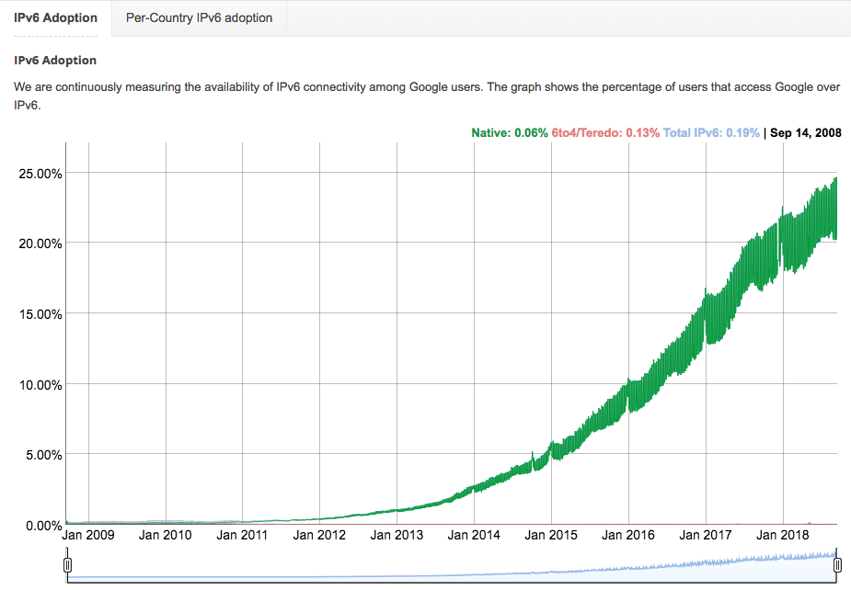
Update on IPv6 Adoption
https://www.google.com/intl/en/ipv6/statistics.html

Slide 21
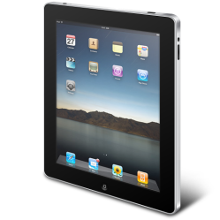
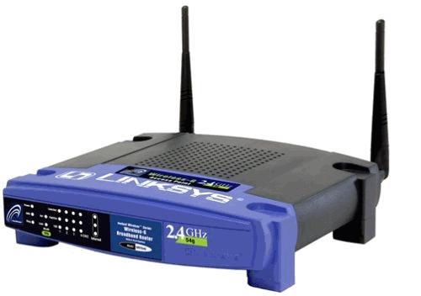
Transitioning to IPv6
How do we ease the transition from IPv4 to IPv6?
Today, most network edges are IPv6 ready
Windows/OSX/iOS/Android all support IPv6
Your wireless access point probably supports IPv6
The Internet core is hard to upgrade
… but a IPv4 core cannot route IPv6 traffic
IPv6 Ready
IPv4 Only :(
IPv6 Ready
IPv6 Packets
Home
Network
Core
Internet
Business
Network

Slide 22
Transition Technologies
How do you route IPv6 packets over an IPv4 Internet?
Transition Technologies
Use tunnels to encapsulate and route IPv6 packets over the IPv4 Internet
Several different implementations
6to4
IPv6 Rapid Deployment (6rd)
Teredo
etc.

Slide 23
6to4 Basics
Problem: you’ve been assigned an IPv4 address, but you want an IPv6 address
Your ISP can’t or won’t give you an IPv6 address
You can’t just arbitrarily choose an IPv6 address
Solution: construct a 6to4 address
6to4 addresses always start with 2002::
Embed the 32-bit IPv4 inside the 128-bit IPv6 address
IPv4:
207.
46.
192.
0
IPv6:
20 02:
CF 2E:
C0 00:
0000

Slide 24
Routing from 6to4 to 6to4
How does a host using 6to4 send a packet to another host using 6to4?
Dest: 16.79.8.0
Dest: 2002:104F:0800::
IPv4
Internet
IPv4 – 207.46.192.0
IPv6 – 2002:CF2E:C000::
IPv4 – 16.79.8.0
IPv6 – 2002:104F:0800::

Slide 25
Routing from 6to4 to Native IPv6
Special, anycasted IPv4 address for
6to4 Relay Routers
Dest: 192. 88.99.1
Dest: 1893:92:13:99::
IPv4
Internet
IPv4 – 192.88.99.1
IPv6 – 2002:: /16
IPv4 – 207.46.192.0
IPv6 – 2002:CF2E:C000::
IPv6
Internet
Many ISPs provide 6to4 relay routers
IPv6 – 1893:92:13:99::

Slide 26
Routing from Native IPv6 to 6to4
IPv4
Internet
Dest: 207.46.192.0
IPv4 – 192.88.99.1
IPv6 – 2002:: /16
IPv4 – 207.46.192.0
IPv6 – 2002:CF2E:C000::
IPv6
Internet
Dest: 2002:CF2E:C000::
Use normal IPv6 routing to reach a 6to4 relay router
IPv6 – 1893:92:13:99::

Slide 27
Problems with 6to4
Uniformity
Not all ISPs have deployed 6to4 relays
Quality of service
Third-party 6to4 relays are available
…but, they may be overloaded or unreliable
Reachability
6to4 doesn’t work if you are behind a NAT
Possible solutions
IPv6 Rapid Deployment (6rd)
Each ISP sets up relays for its customers
Does not leverage the 2002:: address space
Teredo
Tunnels IPv6 packets through UDP/IPv4 tunnels
Can tunnel through NATs, but requires special relays

Slide 28
Consequences of IPv6
Beware unintended consequences of IPv6
Example: IP blacklists
Currently, blacklists track IPs of spammers/bots
Few IPv4 addresses mean list sizes are reasonable
Hard for spammers/bots to acquire new IPs
Blacklists will not work with IPv6
Address space is enormous
Acquiring new IP addresses is trivial

