Slide 1

Additional Introduction
Instructor: Da (Daniel) Yan

Slide 2
















A closer look at network structure:
network edge:
  hosts: clients and servers
  servers often in data centers
mobile network
global ISP
access networks, physical media: wired, wireless communication links
home
network
regional ISP
network core:
  interconnected routers
  network of networks
institutional
network
Introduction
1-<number>

Slide 3

Access networks and physical media
Q: How to connect end systems to edge router?
residential access nets
institutional access networks (school, company)
mobile access networks
keep in mind:
bandwidth (bits per second) of access network?
shared or dedicated?
Introduction
1-<number>

Slide 4


Access net: digital subscriber line (DSL)
central office
telephone
network
DSL
modem
splitter
DSLAM
ISP
voice, data transmitted
at different frequencies over
dedicated line to central office
DSL access
multiplexer
  use existing telephone line to central office DSLAM
    data over DSL phone line goes to Internet
    voice over DSL phone line goes to telephone net
  < 2.5 Mbps upstream transmission rate (typically < 1 Mbps)
  < 24 Mbps downstream transmission rate (typically < 10 Mbps)
Introduction
1-<number>

Slide 5
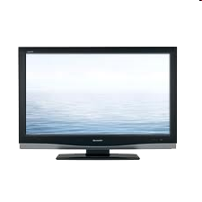


Access net: cable network
cable headend
…
cable
modem
splitter
C
O
N
T
R
O
L
V
I
D
E
O
V
I
D
E
O
V
I
D
E
O
V
I
D
E
O
V
I
D
E
O
V
I
D
E
O
D
A
T
A
D
A
T
A
1
2
3
4
5
6
7
8
9
Channels
frequency division multiplexing: different channels transmitted
in different frequency bands
Introduction
1-<number>

Slide 6
Access net: cable network
cable headend
…
cable
modem
splitter
CMTS
cable modem
termination system
data, TV transmitted at different
frequencies over shared cable
distribution network
ISP
HFC: hybrid fiber coax
  asymmetric: up to 30Mbps downstream transmission rate, 2 Mbps upstream transmission rate
network of cable, fiber attaches homes to ISP router
  homes share access network to cable headend
  unlike DSL, which has dedicated access to central office
Introduction
1-<number>

Slide 7





Access net: home network
wireless
devices
to/from headend or central office
often combined
in single box
cable or DSL modem
wireless access
point (54 Mbps)
router, firewall, NAT
wired Ethernet (100 Mbps)
Introduction
1-<number>

Slide 8









Enterprise access networks (Ethernet)
institutional link to
ISP (Internet)
institutional router
Ethernet
switch
institutional mail,
web servers
typically used in companies, universities, etc
  10 Mbps, 100Mbps, 1Gbps, 10Gbps transmission rates
  today, end systems typically connect into Ethernet switch
Introduction
1-<number>

Slide 9








Wireless access networks
shared wireless access network connects end system to router
  via base station aka “access point”
wide-area wireless access
  provided by telco (cellular) operator, 10’s km
  between 1 and 10 Mbps
  3G, 4G: LTE
wireless LANs:
  within building (100 ft)
  802.11b/g (WiFi): 11, 54 Mbps transmission rate
to Internet
to Internet
Introduction
1-<number>

Slide 10


Host: sends packets of data
host sending function:
takes application message
breaks into smaller chunks, known as packets, of length L bits
transmits packet into access network at transmission rate R
  link transmission rate, aka link capacity, aka link bandwidth
two packets,
L bits each
2
1
R: link transmission rate
host
packet
transmission
delay
time needed to
transmit L-bit
packet into link
L (bits)
R (bits/sec)
=
=
1-<number>

Slide 11
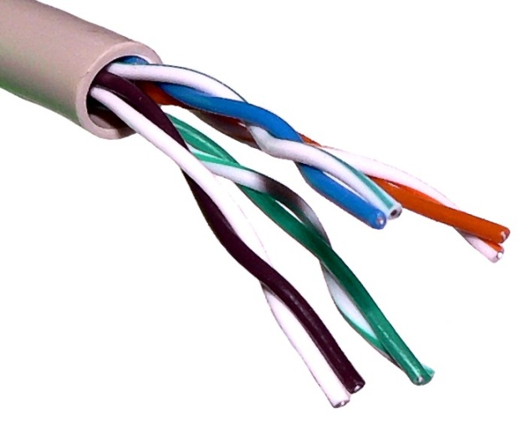

Physical media
bit: propagates between
transmitter/receiver pairs
physical link: what lies between transmitter & receiver
guided media:
  signals propagate in solid media: copper, fiber, coax
unguided media:
  signals propagate freely, e.g., radio
twisted pair (TP)
two insulated copper wires
  Category 5: 100 Mbps, 1 Gpbs Ethernet
  Category 6: 10Gbps
Introduction
1-<number>

Slide 12


Physical media: coax, fiber
coaxial cable:
two concentric copper conductors
bidirectional
broadband:
  multiple channels on cable
  HFC
fiber optic cable:
glass fiber carrying light pulses, each pulse a bit
high-speed operation:
  high-speed point-to-point transmission (e.g., 10’s-100’s Gbps transmission rate)
low error rate:
  repeaters spaced far apart
  immune to electromagnetic noise
Introduction
1-<number>

Slide 13
Physical media: radio
signal carried in electromagnetic spectrum
no physical “wire”
bidirectional
propagation environment effects:
  reflection
  obstruction by objects
  interference
radio link types:
terrestrial microwave
  e.g. up to 45 Mbps channels
  LAN (e.g., WiFi)
    11Mbps, 54 Mbps
  wide-area (e.g., cellular)
    3G cellular: ~ few Mbps
satellite
  Kbps to 45Mbps channel (or multiple smaller channels)
  270 msec end-end delay
  geostationary satellites
  low earth-orbiting (LEO) satellites
Introduction
1-<number>

Slide 14
How do loss and delay occur?
packets queue in router buffers
packet arrival rate to link (temporarily) exceeds output link capacity
packets queue, wait for turn
packet being transmitted (delay)
A
B
packets queueing (delay)
free (available) buffers: arriving packets
dropped (loss) if no free buffers
Introduction
1-<number>

Slide 15
Four sources of packet delay
transmission
A
propagation
B
nodal
processing
queueing
d_{nodal} = d_{proc} + d_{queue} + d_{trans} + d_{prop}
d_{proc}: nodal processing
check bit errors
determine output link
typically < msec
d_{queue}: queueing delay
time waiting at output link for transmission
depends on congestion level of router
Introduction
1-<number>

Slide 16
Four sources of packet delay
transmission
A
propagation
B
nodal
processing
queueing
d_{nodal} = d_{proc} + d_{queue} + d_{trans} + d_{prop}
d_{trans}: transmission delay:
L: packet length (bits)
R: link bandwidth (bps)
d_{trans} = L/R
d_{prop}: propagation delay:
d: length of physical link
s: propagation speed in medium (~2x10⁸ m/sec)
d_{prop} = d/s
d_{trans} and d_{prop}
very different
* Check out the Java applet for an interactive animation on trans vs. prop delay
1-<number>
Introduction

Slide 17


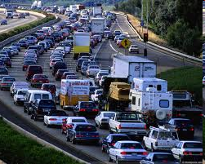
Queueing delay (revisited)
R: link bandwidth (bps)
L: packet length (bits)
a: average packet arrival rate
average queueing delay
traffic intensity
= La/R
La/R ~ 0: avg. queueing delay small
La/R -> 1: avg. queueing delay large
La/R > 1: more “work” arriving
than can be serviced, average delay infinite!
La/R ~ 0
* Check out the Java applet for an interactive animation on queuing and loss
La/R -> 1
Introduction
1-<number>

Slide 18
“Real” Internet delays and routes
what do “real” Internet delay & loss look like?
traceroute program: provides delay measurement from source to router along end-end Internet path towards destination. For all i:
  sends three packets that will reach router i on path towards destination
  router i will return packets to sender
  sender times interval between transmission and reply.
3 probes
3 probes
3 probes
Introduction
1-<number>

Slide 19
“Real” Internet delays, routes
traceroute: gaia.cs.umass.edu to www.eurecom.fr
3 delay measurements from
gaia.cs.umass.edu to cs-gw.cs.umass.edu
1 cs-gw (128.119.240.254) 1 ms 1 ms 2 ms
2 border1-rt-fa5-1-0.gw.umass.edu (128.119.3.145) 1 ms 1 ms 2 ms
3 cht-vbns.gw.umass.edu (128.119.3.130) 6 ms 5 ms 5 ms
4 jn1-at1-0-0-19.wor.vbns.net (204.147.132.129) 16 ms 11 ms 13 ms
5 jn1-so7-0-0-0.wae.vbns.net (204.147.136.136) 21 ms 18 ms 18 ms
6 abilene-vbns.abilene.ucaid.edu (198.32.11.9) 22 ms 18 ms 22 ms
7 nycm-wash.abilene.ucaid.edu (198.32.8.46) 22 ms 22 ms 22 ms
8 62.40.103.253 (62.40.103.253) 104 ms 109 ms 106 ms
9 de2-1.de1.de.geant.net (62.40.96.129) 109 ms 102 ms 104 ms
10 de.fr1.fr.geant.net (62.40.96.50) 113 ms 121 ms 114 ms
11 renater-gw.fr1.fr.geant.net (62.40.103.54) 112 ms 114 ms 112 ms
12 nio-n2.cssi.renater.fr (193.51.206.13) 111 ms 114 ms 116 ms
13 nice.cssi.renater.fr (195.220.98.102) 123 ms 125 ms 124 ms
14 r3t2-nice.cssi.renater.fr (195.220.98.110) 126 ms 126 ms 124 ms
15 eurecom-valbonne.r3t2.ft.net (193.48.50.54) 135 ms 128 ms 133 ms
16 194.214.211.25 (194.214.211.25) 126 ms 128 ms 126 ms
17 * * *
18 * * *
19 fantasia.eurecom.fr (193.55.113.142) 132 ms 128 ms 136 ms
trans-oceanic
link
* means no response (probe lost, router not replying)
* Do some traceroutes from exotic countries at www.traceroute.org
Introduction
1-<number>

Slide 20
Packet loss
queue (aka buffer) preceding link in buffer has finite capacity
packet arriving to full queue dropped (aka lost)
lost packet may be retransmitted by previous node, by source end system, or not at all
buffer
(waiting area)
A
packet being transmitted
B
packet arriving to
full buffer is lost
* Check out the Java applet for an interactive animation on queuing and loss
Introduction
1-<number>

Slide 21
Throughput
throughput: rate (bits/time unit) at which bits transferred between sender/receiver
  instantaneous: rate at given point in time
  average: rate over longer period of time
server, with
file of F bits
to send to client
link capacity
R_{s} bits/sec
link capacity
R_{c} bits/sec
server sends bits
(fluid) into pipe
pipe that can carry
fluid at rate
R_{s} bits/sec)
pipe that can carry
fluid at rate
R_{c} bits/sec)
Introduction
1-<number>

Slide 22
Throughput (more)
R_{s} < R_{c} What is average end-end throughput?
R_{s} bits/sec
R_{c} bits/sec
R_{s} > R_{c} What is average end-end throughput?
R_{s} bits/sec
R_{c} bits/sec
bottleneck link
link on end-end path that constrains end-end throughput
Introduction
1-<number>

Slide 23
Throughput: Internet scenario
per-connection end-end throughput: min(R_{c},R_{s},R/10)
in practice: R_{c} or R_{s} is often bottleneck
R_{s}
R_{s}
R_{s}
R
R_{c}
R_{c}
R_{c}
10 connections (fairly) share backbone bottleneck link R bits/sec
Introduction
1-<number>

