Slide 1
- VISCUM - A New Light Weight Software Architecture of MEC
Feng Li, Sriram Sidhar, Jae Won Chung and Jamal Hadi Salim
Notes:
Default cover design.

Slide 2
Outline
Introduction
Related Work
Viscum: process level virtualization
Conclusion

Slide 3
Mobile Edge Computing (MEC)
Mobile Cloud Computing (MCC)
Pros:
Offloading battery consuming computation tasks from UE to cloud;
Supporting mobile user access complicated service in cloud;
Providing high volume storage resources for mobile users.
Cons:
Introducing additional network load on both radio and core networks;
Increasing higher latencies, data has to be sent to cloud servers.
MEC to Address Challenges on MCC
Move cloud service to mobile edges;
Reducing latencies and allowing interactive between service providers and customers.
Reducing load on mobile providers’ core network and/or radio networks.

Slide 4
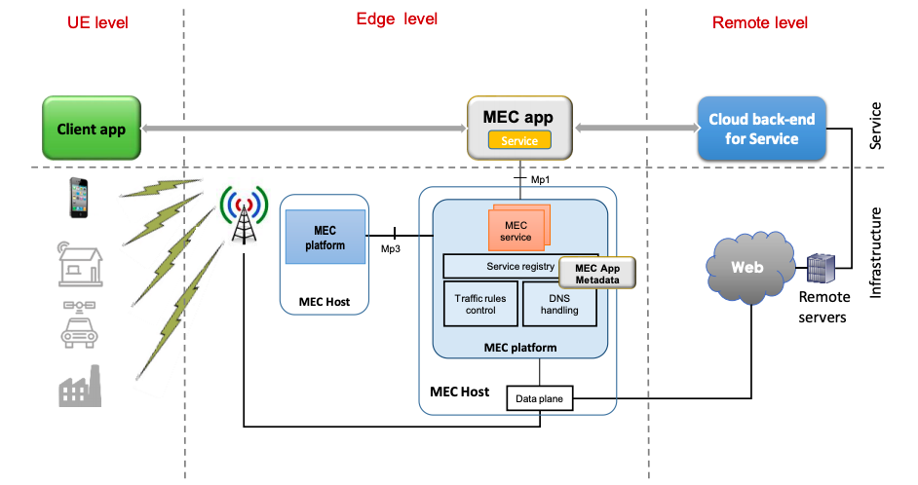
Software Architecture in MEC
Fig 1 ETSI MEC Software Model

Slide 5
ETSI Software Model
Split cloud service into edge and cloud components.
Extra development efforts.
Balancing between edge nodes and cloud nodes.
Different management for edge and cloud components.
MEC Platform
Traffic steering
Horizontal scalability
Virtualization technology
Service management

Slide 6
MEC Questions?
Where is Edge?
When will MEC be ready to host applications?
Can we gradually deploy applications on MEC as they are ready?

Slide 7
Think small and be practical
Let’s start from the edge devices

Slide 8
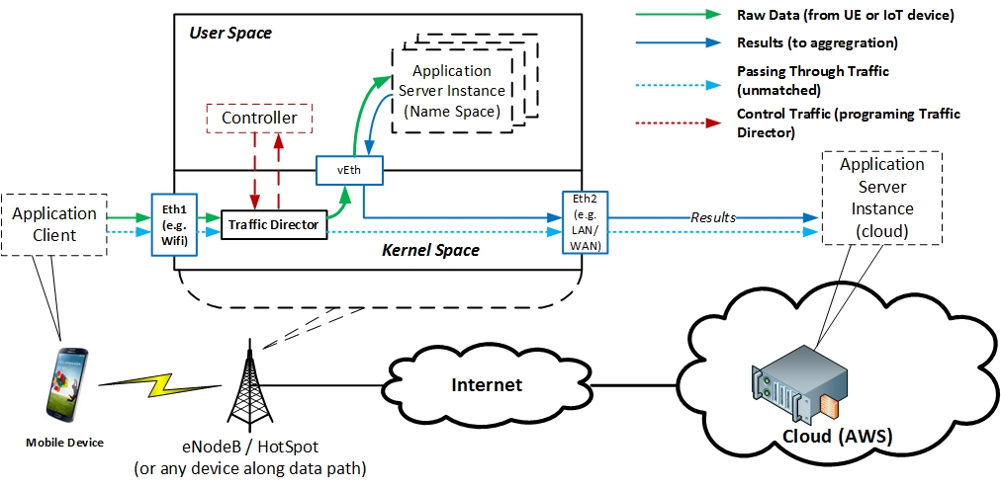
Viscum Architecture

Slide 9
Viscum
Light weight process level virtualization
Consists of four components
Linux Network Namespace contains applications;
Linux Traffic Control (TC) based traffic redirector;
A pair of Virtual Ethernet Interfaces (veth) as a pipe between two namespaces;
Control module manages above components.
Named it Viscum to mimic the small MEC service deployed onto edge routers (hosts).

Slide 10
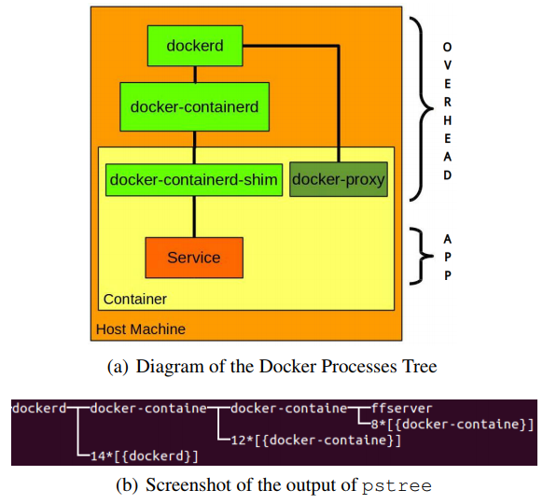
Why not use full containers ?
Container overheads
At least four more process need to be created for one service process.
Not required for simple service deployment.
Network namespace
Providing network resource duplication.
Reusing existing control plane function to manager namespaces.
Support embedded devices, or Linux distribution with old kernel release. (Redhat supports docker from 7.0, while namespace is supported from 2.6.32.

Slide 11
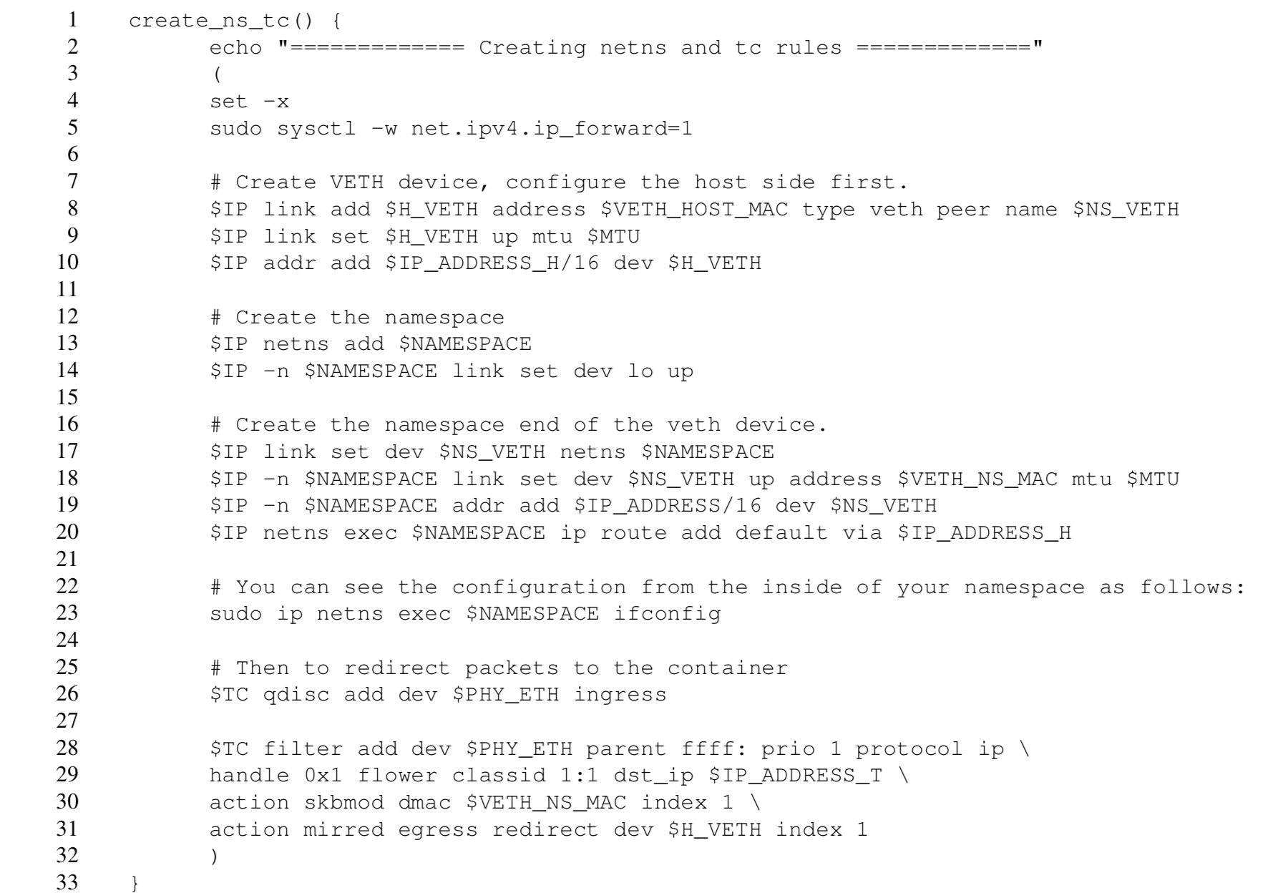
Create Viscum Host
1. Create veth inside host namespace
2. Create namespace to host MEC service.
3. Create veth inside guest namespace
4. Create TC based Traffic Redirector

Slide 12
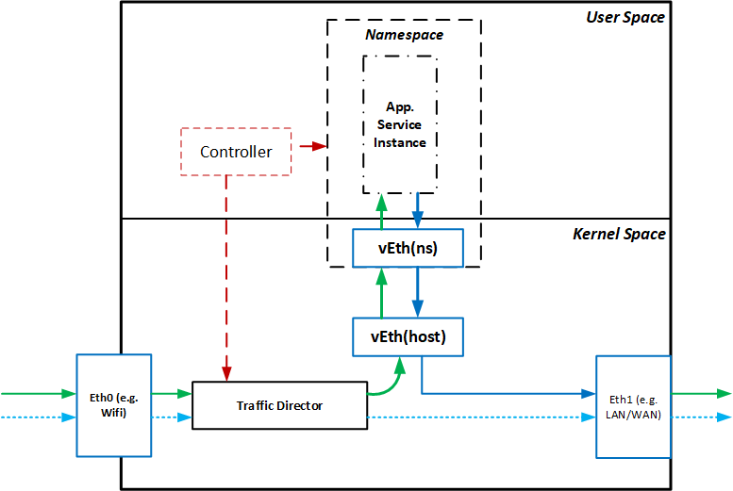

Sample Use Case 1 : License Plate Detection
openalpr
Reducing data to cloud from hundred kbytes to hundred bytes.
Could be done on wifi hotspot, eNodeB.
Huge saving on bill and RTT if using expensive links, e.g. satellite links
NY, ABC 123
Running on AP

Slide 13
Sample Use Case 2 : SpeedTest Server on Edge
Motivation
Wireless link (e.g. 5G) may not be bottleneck link anymore.
Current cloud based speed test framework may report inter-domain congestion while customer and mobile provider has more concern on wireless link congestion.
Saturate 5G wireless link from cloud may not be a trivial task.
Bandwidth measurement traffic is meaning less on non bottle neck links.
Viscum Solution
Simply deploy iperf3 daemon inside a Viscum host AP.
No new hardware, no traffic on core network, and accurately measures wireless link capacity.

Slide 14
Conclusions
Viscum
A light-weight software architecture for edge device MEC
Support gradually deployment model.
Convert any Linux based network node into MEC application servers.
Deploy off-the-shelf software onto mobile edge nodes (e.g. WIFI hotspot, eNodeB) without software splitting.
Reduce service delay and traffic volume in mobile providers’ core networks and/or radio access networks.
Future works
Distributed application deployment and management
Viscum on OpenWRT WIFI routers

