Slide 1

SUDOKUva
Relaxation
Labeling
MIS – 111903107
NAME – Soham chougule

Slide 2
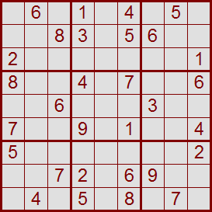
SuDoku Puzzle
What is SuDoku?
The Sudoku grid consists of eighty-one squares in a nine by nine grid.
There is just one simple rule controlling where you can place numbers in the grid:
Fill in the grid so that
every row,
every column, and
every 3 x 3 box (region)
contains the digits 1 through 9.

Slide 3

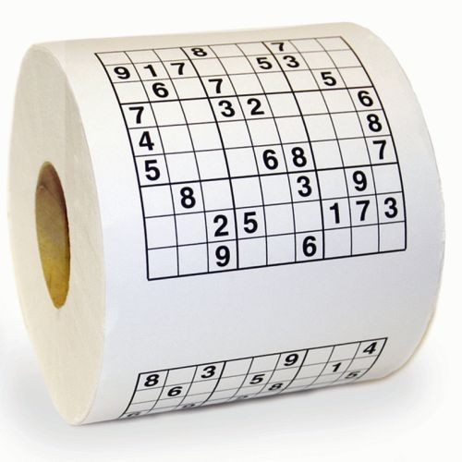
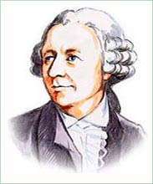
SuDoku Puzzle
Some History of the SuDoku
The name Sudoku comes from Japan: Su - 'number' ,Doku - 'single'.
puzzle itself originates from Switzerland and then travels to Japan by way of America
Leonhard Euler

Slide 4
Functions implemwnted
Sudoku generator -
It takes random cells from board and assign random numbers between 1 to 9.
Sudoku solver –
It solve sudoku using backtracking algorithm

Slide 5
Backtracking algorithm
Here for every empty cell we put number between 1 and 9 then go ahead.
For next empty cell it check by putting number is sudoku valid or not.
If not then it will come back again and ckeck for next number until all cells not filled

Slide 6
Conclusion:
This interpretation (variation) of backtracking algorithm is good for generating/solving SuDoku puzzle problem.
For small SuDoku puzzle 4x4 it works perfectly! For normal Sudoku puzzle 9x9 it also works good. But running time is not the best. It is O(9^(n*n)).
Addition of backtracking mechanism improve results .
There exist many other better and faster techniques for generation/solving SuDoku problem that can solve even bigger and different kinds of SuDoku.

Slide 7
Reference
On the Foundations of Relaxation Labeling Processes, by Hummel and Zucker 1983
Relaxation Labeling Algorithms – A Review, by Kittler and Illingworth, 1985
Perceptual Organization (III), CS 202-1-5251, BGU, Ohad Ben-Shahar
Relaxation Labeling techniques - Computer Science, Cardiff University
SuDoku Puzzle Theory.
SuDoku Puzzle site.
Sudoku Science.

Slide 8
Questions
???
Thanks!

