Slide 1
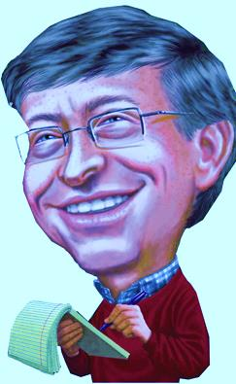
Brainstorming Session: How to Boost Sales at Northwind
“Customers order different quantities when offered discounts.”
“The reps in London aren’t selling as much as the reps in the PNW.”
“Our customers seemed to buy more in 2013.”
“When we push beverages, we bring in more revenue.”
Will Graits

Slide 2
“Customers order different quantities when offered discounts.”

Slide 4
“The reps in London aren’t selling as much as the reps in the PNW.”

Slide 6
“Our customers seemed to buy more in 2013.”

Slide 8
“When we push beverages, we bring in more revenue.”

