Slide 1
Road Marking Extraction Error Analysis

Slide 2
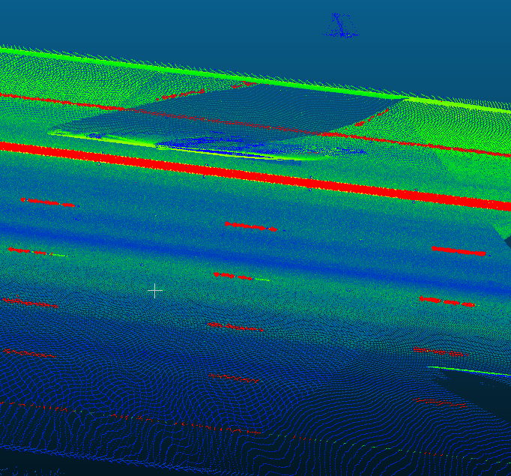
Shadow of cars

Slide 3
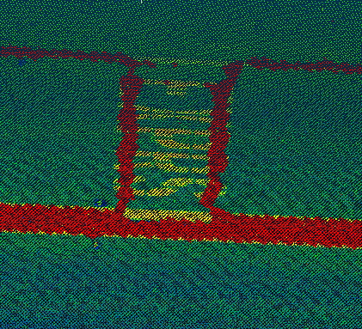
Letters not extracted

Slide 4
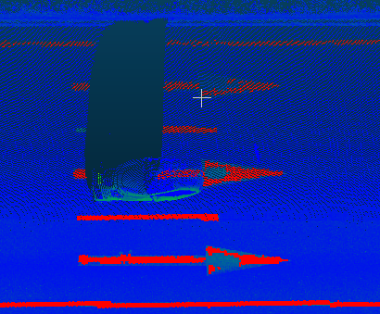
In completed marks

Slide 5
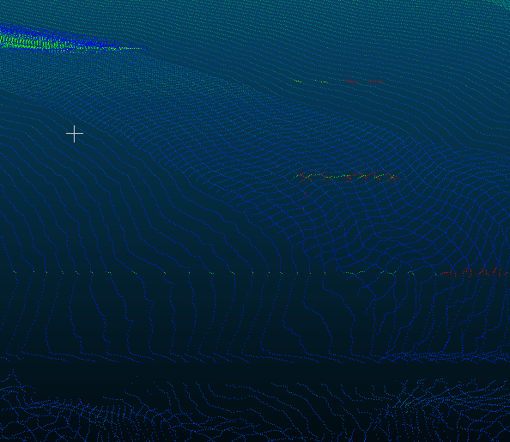
Marks of low density and intensity

Slide 6

False positive

