Slide 1
CAT AND DOG IMAGE CLASSIFICATION USING KERAS
Goal: To automate a machine learning project’s repetitive steps using a scientific workflow with Pegasus API.

Slide 2
Overview: This project aims at classifying whether images contain either a dog or a cat.
Dataset: Microsoft Research Data for Kaggle Cats vs Dogs Dataset: https://download.microsoft.com/download/3/E/1/3E1C3F21-ECDB-4869-8368-6DEBA77B919F/kagglecatsanddogs_3367a.zip
- The Dataset contains 12500 images of Cats and 12500 images of Dogs.
Architecture/Neural Network Used: A pretrained VGG16 model using Keras.
- VGG16 is a Convolutional Neural Network that is predominantly used for Classification and Detection problems.

Slide 3
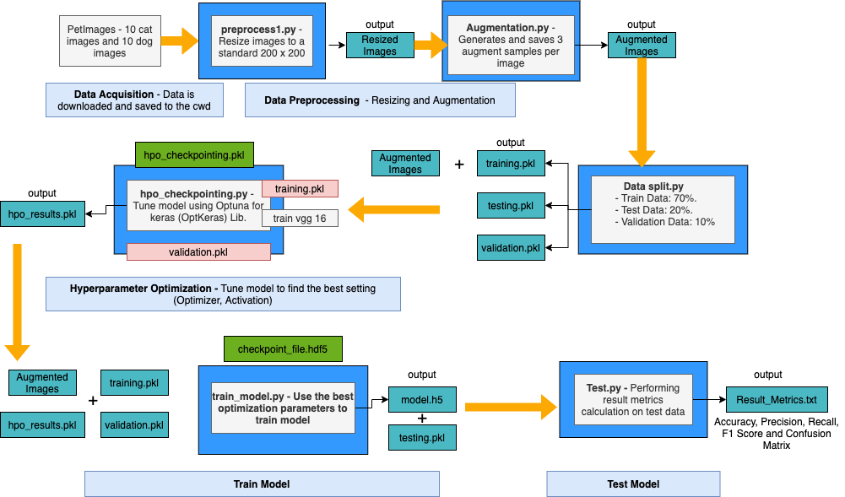
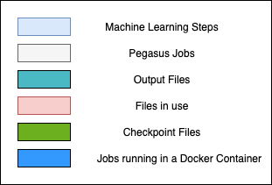
Illustration of the workflow:

Slide 4
Ongoing:
Scaling up the workflow using larger portion of the dataset on OSG.
Replacing the Cat and Dog dataset with Galaxy Classification (into one of 5 galaxy shape categories) linked to research paper: https://link.springer.com/article/10.1007/s10509-019-3540-1
Look at research papers – find a scientific machine learning problem to implement on Pegasus.

