Slide 1






Core Expertise
Excella Engineering & Design Solutions
Offered Services and Key highlights

Slide 2
About Excella Engineering & Design Solutions
Excella Engineering and Design Solutions (EXCELLA) offers complete solutions in the field of Power Electronics, Power Energy Storage, Batteries, Renewable Energy Systems, Telecom infrastructure including porta cabin, Chemical Earthing, Lightening Arrestors, Batteries.
Authorized channel Partner of “PROSTARM” make UPS with pan India services through “PROSTARM” service network. Excella also offers refurbished UPS depending upon availability with warranty of one year.

Slide 3
About Excella Engineering & Design Solutions
Excella offers all types of batteries like Lithium batteries for vehicle or any other application, VRLS & Flooded Batteries, SMF batteries with services.
Excella is expert in making Bio toilets made of puff Panels, Made Many Sites of CSR Projects by RITES in UP
Excella is providing I&C services to Air Quality index service providers
Excella being expert in Solar systems, offers complete solution for Solar systems including energy storage.
Excella is also having solutions for Chemical Earthing, Lightening arrestors,

Slide 4
About Excella Engineering & Design Solutions
Excella is also offering Porta Cabins for offices, Telecom systems, Security Guards Cabin on order basis.
Excella is also offering table top and hand held Electrical and Electronics Measurement systems, power supplies, etc.

Slide 5
About Excella Engineering & Design Solutions
Excella Engineering and Design Solutions is a proprietary MSME company of micro scale owned by Mr Ziaul Islam, who is having vast experience of 35 years in the field of UPS, Batteries, Solar Systems, Electrical and Electronic Measurement equipments, Telecom infrastructures solutions. Mr. Ziaul Islam is also offering consultancy to companies interested in manufacturing of Lithium Batteries in India. Excella is having experienced team of every field who excels the work in the company.

Slide 6
Current Business Model
EPC Contracts & Managed Energy Provider for Telecom Sites
System with Power Equipment Integration
Integrator of Power Electronics & Energy Storage Solutions
Excella Provides complete Integration solution for Remote Infrastructure

Slide 7
Resources
Manufacturing
Contract manufacturing available at Delhi, Karnal, Manesar, Noida
EPC Contracts & System Integration
PAN INDIA
Managed Services
AMI Integration Services .
Preventive Maintenance /Repairs

Slide 8
Human Capital
Team Strength |  | Location
Sales Personnel | 2 | Pan India
Service | 29 | Pan India
Manufacturing | 12 | In Manesar/ Noida
Design , R&D | 3 | Delhi
Commercial | 4 | Delhi/Ghaziabad
HQ- Control | 1 | Delhi/Ghaziabad
EPC & TSP Services | 11 | Pan India, capable
O&M Services | 15 | Pan India , capable
Committed to build the team as per business/service requirements ahead of schedule

Slide 9
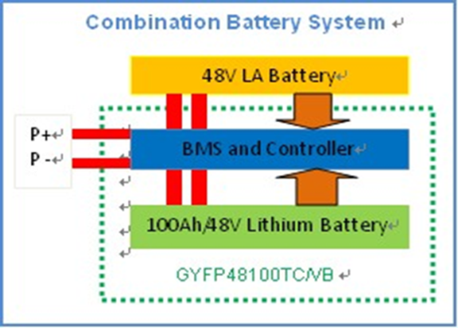
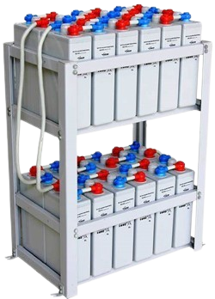
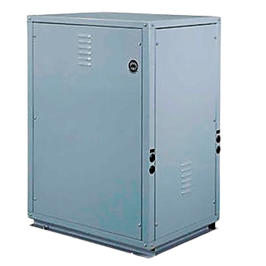

Integration Capabilities
Lithium Ion + VRLA Hybrid
LFP Battery with BMS
Existing VRLA
Excella is Authorized System Integrator & Service partner

Slide 10
Combination Battery System
48V LA Battery
P +
BMS and Controller
P -
100Ah/48V Lithium Battery
GYFP48100TC/VB

Slide 11
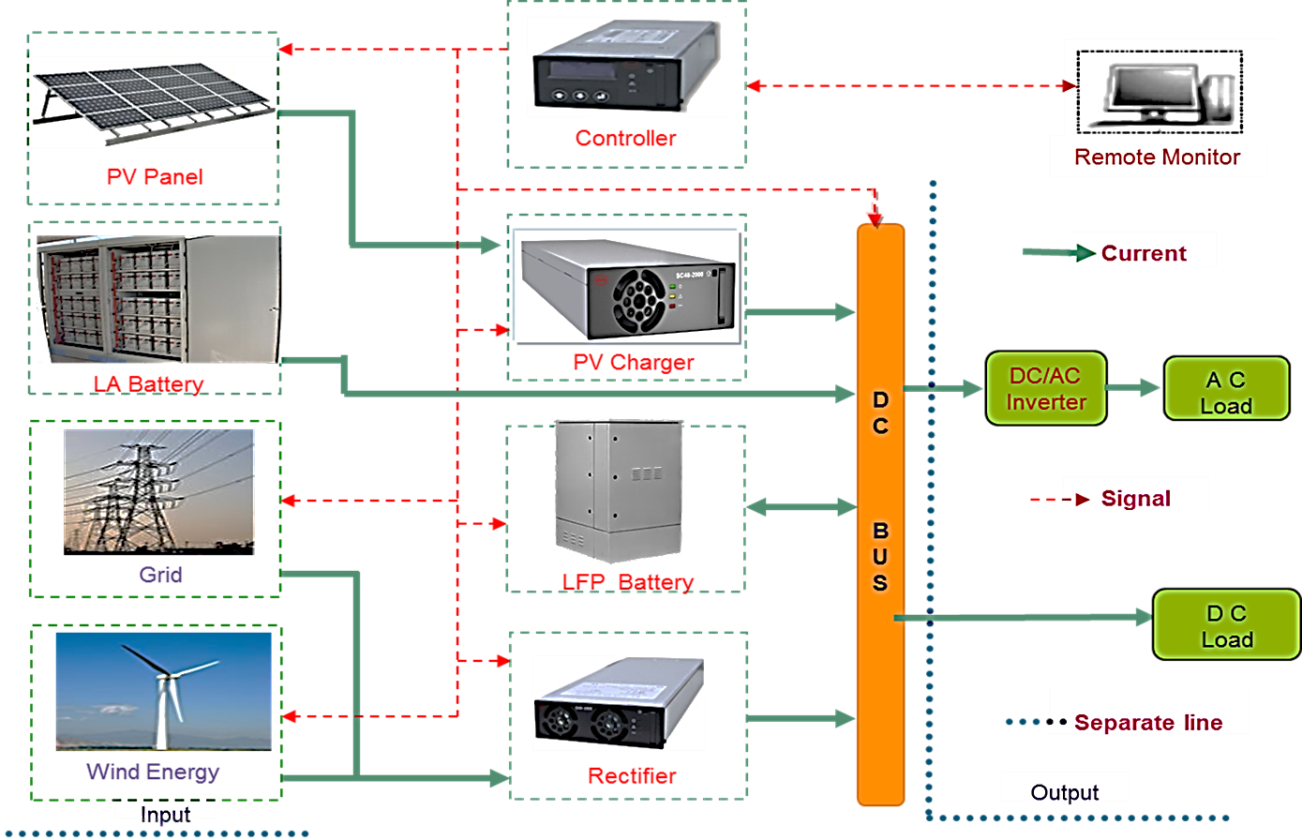
Integration Capabilities across all Renewables

Slide 12

CONNECT WITH US
Excella Engineering And Design Solutions
excellaengineering@gmail.com zia@excellaengineering.com
Mobile:9810903316
Registered Office : N-71 4th Floor Batla House , Jamia Nagar , New Delhi 110025
Branch Office :C-11,Sector 16,Shastri Nagar ,Jeevan Vihar Ghaziabad
Utter Pradesh 201002

