Slide 1

CMSC335 Web Application Development with JavaScript
JavaScript IV
Department of Computer Science
University of MD, College Park
Slides material developed by Ilchul Yoon, Nelson Padua-Perez

Slide 2
typeof and instanceof operator
typeof (returns string)
Returns “object” for all reference types
Name of primitive (e.g., boolean) for primitive types
instanceof operator (returns boolean)
Returns true if a value is an instance of the specified type and false otherwise
instanceof can identify inherited types
Note: every object is an instance of Object
Checking if an object is an array or not
Although instanceof can identify arrays, use Array.isArray() instead, as instanceof will not work in all cases
Approach to follow
Use typeof first, then instanceof if it is an object
Example: TypeOfInstanceOf.html

Slide 3
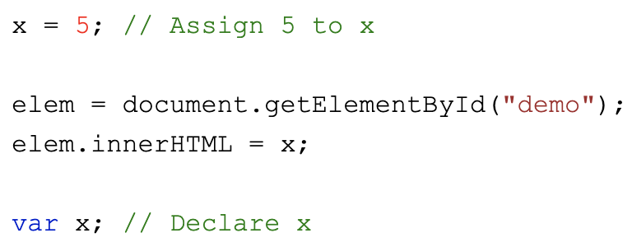
let and const
var declarations are moved to the top implicitly
So, a variable can be declared after it is used (e.g., assigning a value to it) -- called Hoisting
Only declaration will be hoisted, not initialized value
Example: Hoisting.html
let replaces var for variable declarations and provides block scoping
Does not allow hoisting!
Example: BlockScope.html
const allows you to declare a constant variable that has block scope
Example: Const.html
No block scope and no const before ES6

Slide 4
Null and undefined
null
A value indicating no value (nothing)
Has type “object”
undefined
Value associated with uninitialized variables
Has type “undefined”
Cases where undefined appears
let x; /* In a function */
undefined is returned by a function when no explicit value is returned (IMPORTANT case) - You forgot a return
Value associated with object properties that do not exist
== considers null and undefined equal
=== considers null and undefined different
Example: NullAndUndefined.html

Slide 5
Truthy vs. Falsy
A falsy - Definition: value that is considered false in a boolean context
Falsy values are:
false
0
""
null
undefined
NaN
A truthy value is:
A value that is considered true in a boolean context
All values are truthy unless they are defined as falsy
Example: TruthyFalsy.html
Notice use of the library lodash.min.js included using <script></script>

Slide 6
Numeric Values
Infinity is a global property
Default: Number.POSITIVE_INFINITY
isFinite()
Returns false if the argument is NaN, positive/negative infinity;
Otherwise, it returns true.
isFinite() vs. Number.isFinite()
isFinite() function converts the value to a Number, then tests it
Number.isFinite() does not convert the values to a Number and will return false for any value that is not of the type Number
Example: NumericValues.html

