Slide 1
A Lumped-Parameter Modeling, Calibration, and Capacity-Measure Framework for Flux Generation in Symmetric Multipole Electromagnetic Actuators
KUO,CHIEN-CHI

Slide 2
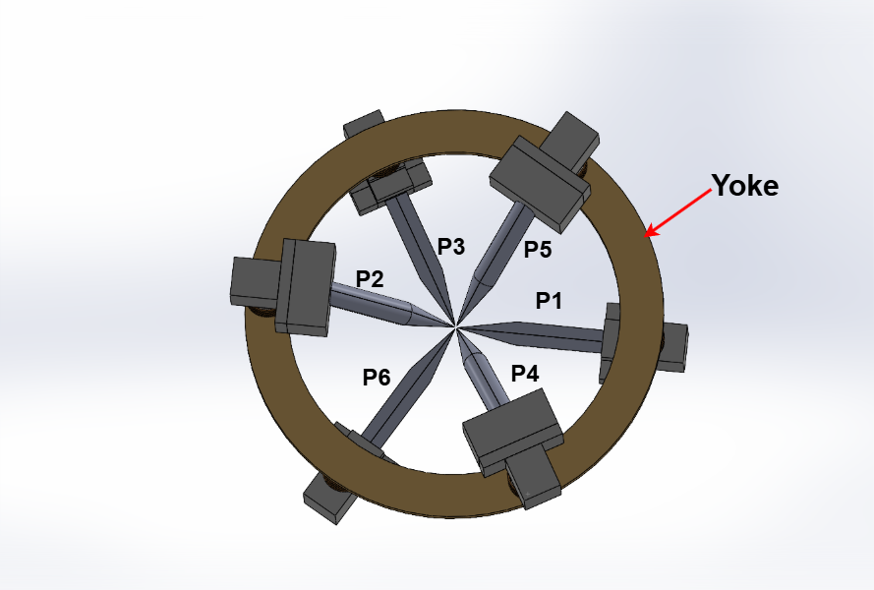
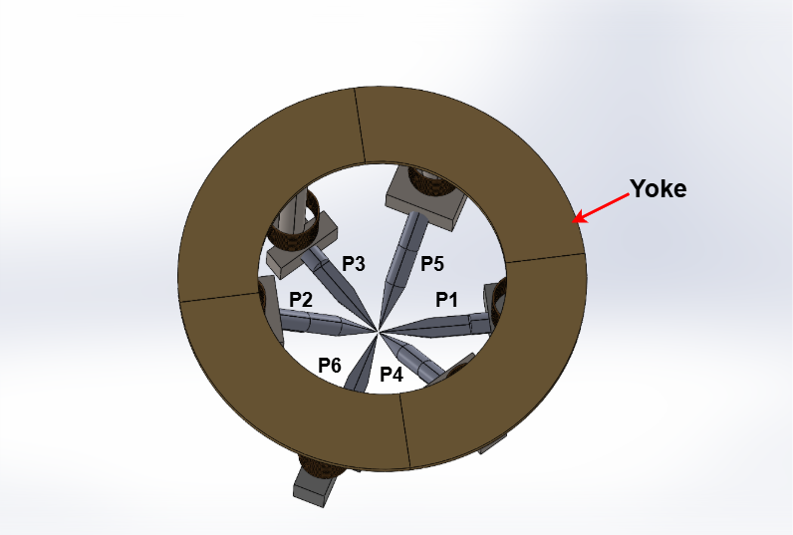
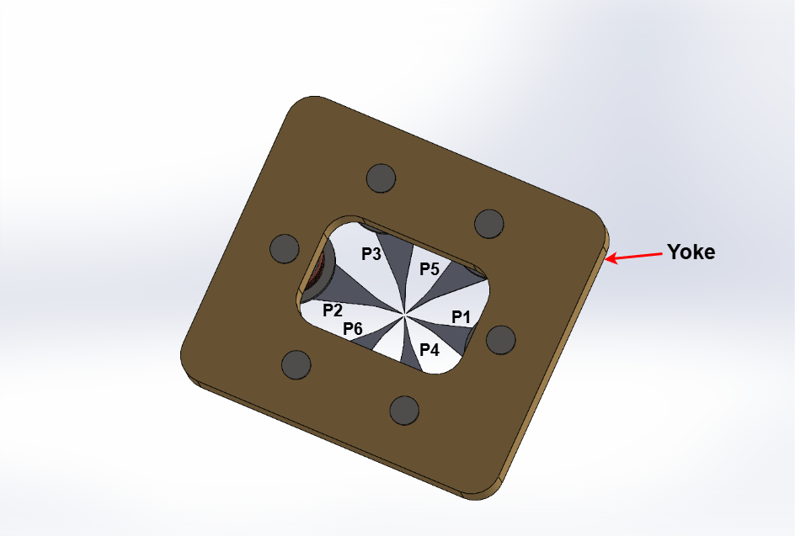
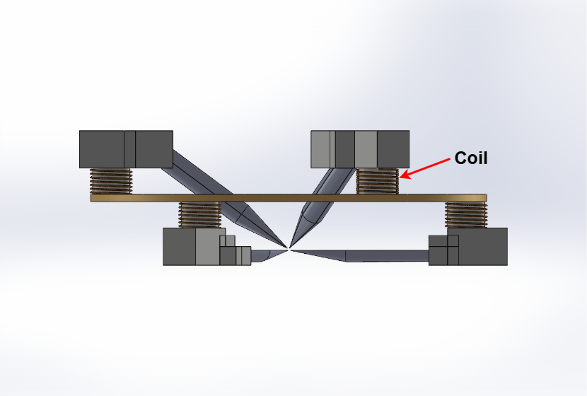
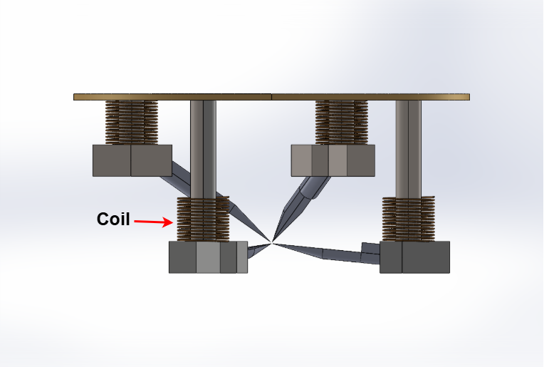
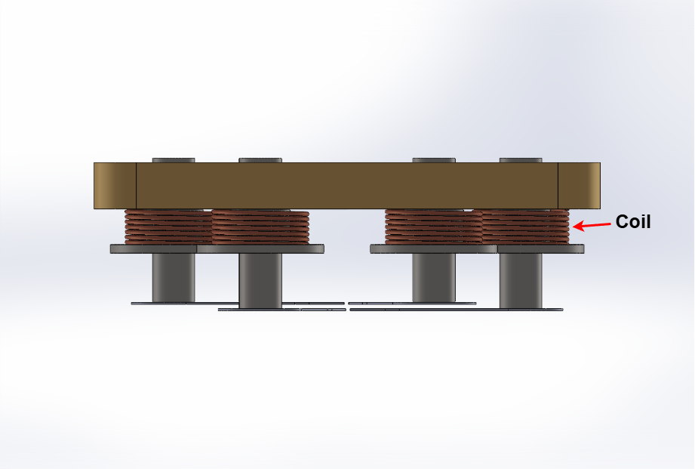
Current-based lumped-parameter modeling and calibration
Multiple-electromagnetic-pole actuation
 | Long | Hung | NTU
View1
View2
The upper three figures show the CAD models of the geometries developed by Longfei, Hung, and NTU, respectively. View 1 labels the yoke and the individual numbers of the six magnetic poles, while View 2 presents a side view. From the side view, the coil can be seen wound around the magnetic core to generate the magnetic field. The number of coil turns shown does not correspond to the actual number of turns; the purpose of the figure is to illustrate the coil location and its function.

Slide 3
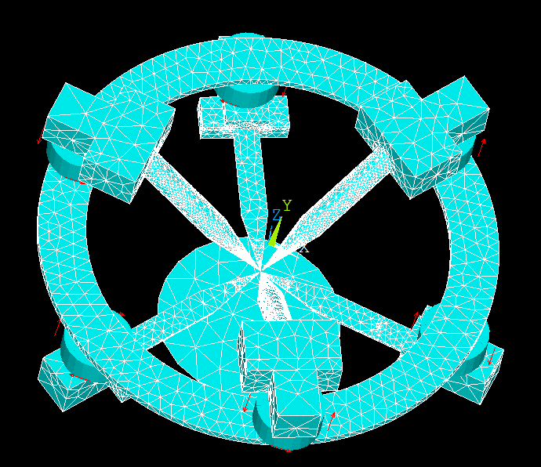
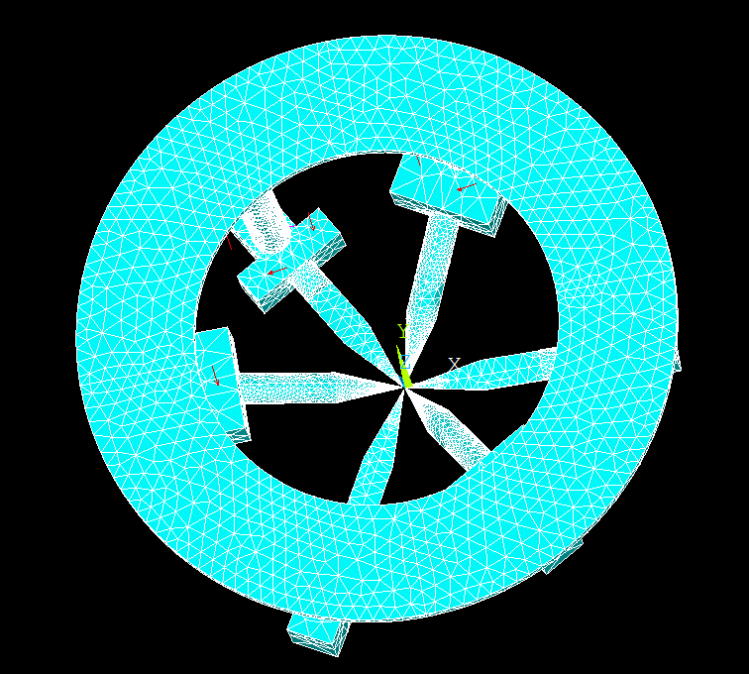
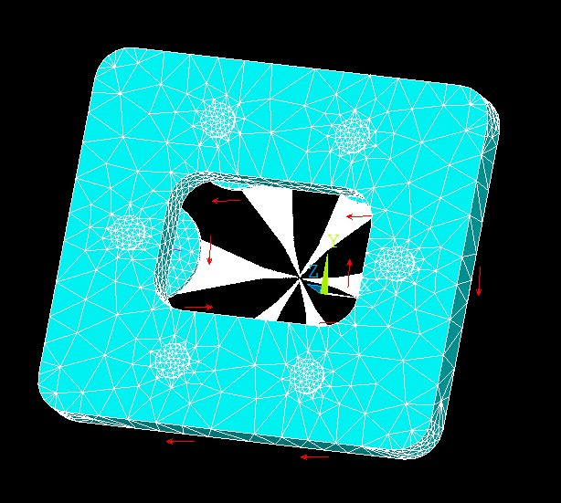
Current-based lumped-parameter modeling and calibration
Multiple-electromagnetic-pole actuation
Long | Hung | NTU
The simulation environment used in this study is ANSYS Mechanical APDL 2025 R2. After the geometric model is created in SolidWorks, the dimensions of each component are extracted and used as parameters in an APDL script to reconstruct the geometry. Once the geometry has been generated, the model is meshed and solved. The red arrows in the figure indicate the location and winding direction of the coils, which correspond to the coil positions shown on the previous slide.

Slide 4
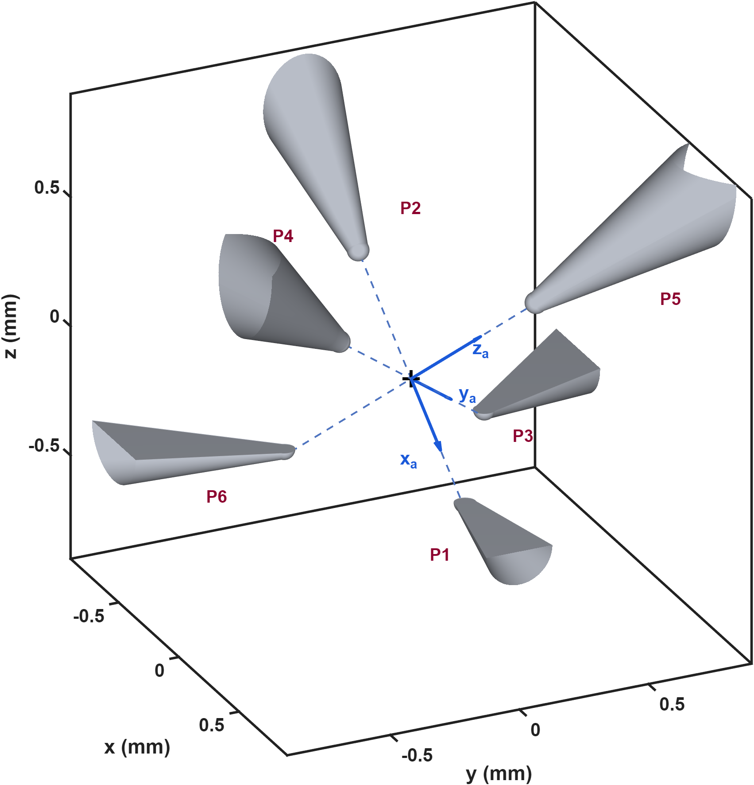
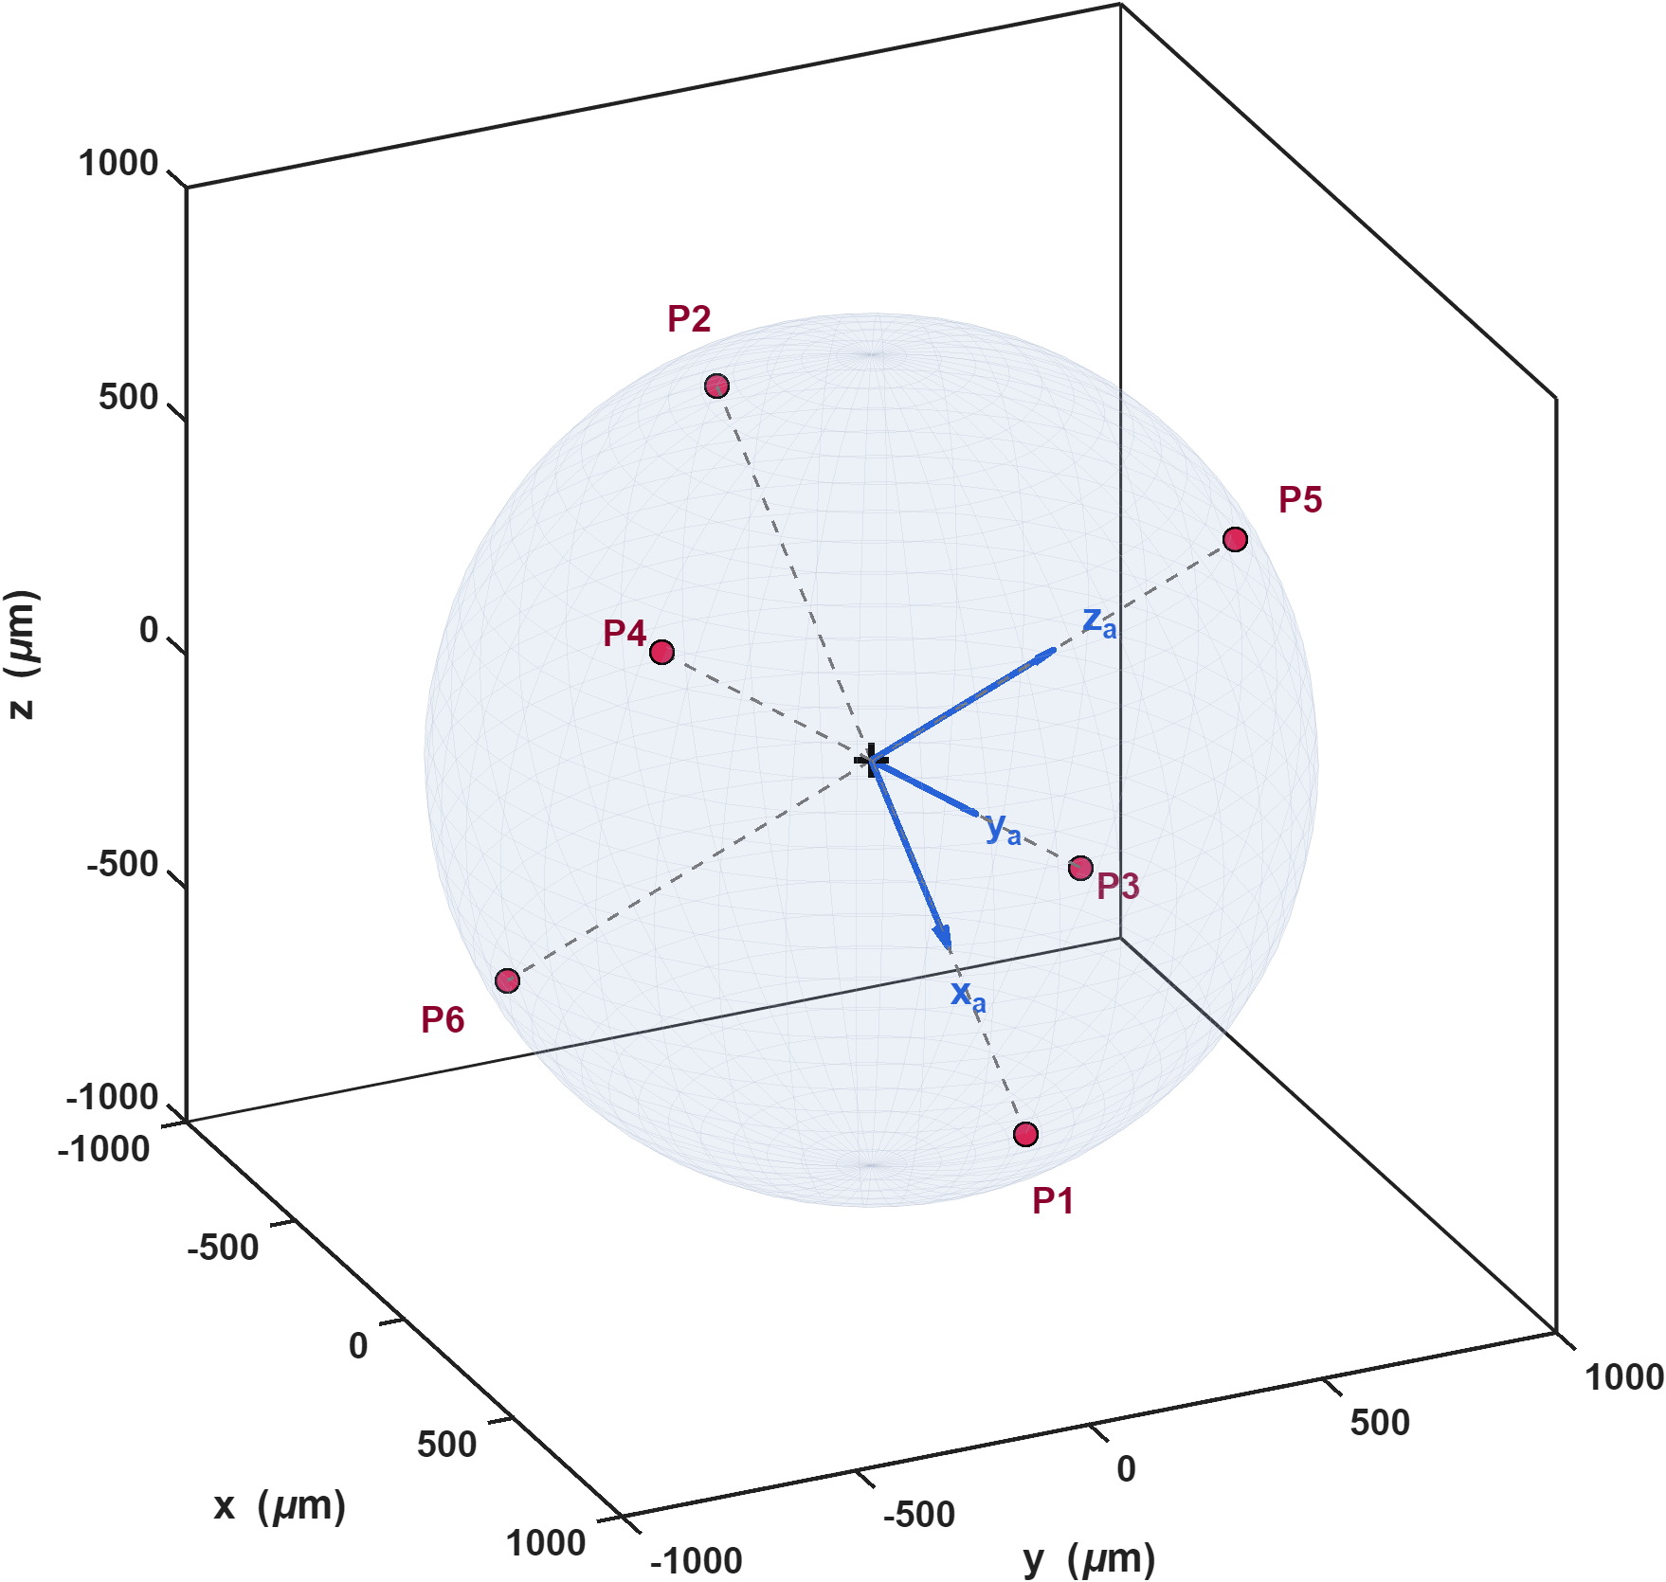
Current-based lumped-parameter modeling and calibration
Multiple-electromagnetic-pole actuation
The left figure shows the orientation of the actuator coordinate system within the multipole electromagnetic actuator. All subsequent model calibration and analysis are conducted in this coordinate system. The right figure shows that the six magnetic pole tips, indicated by the red points, lie on a spherical surface. The radius of this spherical surface is determined by the design dimensions of the magnetic tweezer.

Slide 5
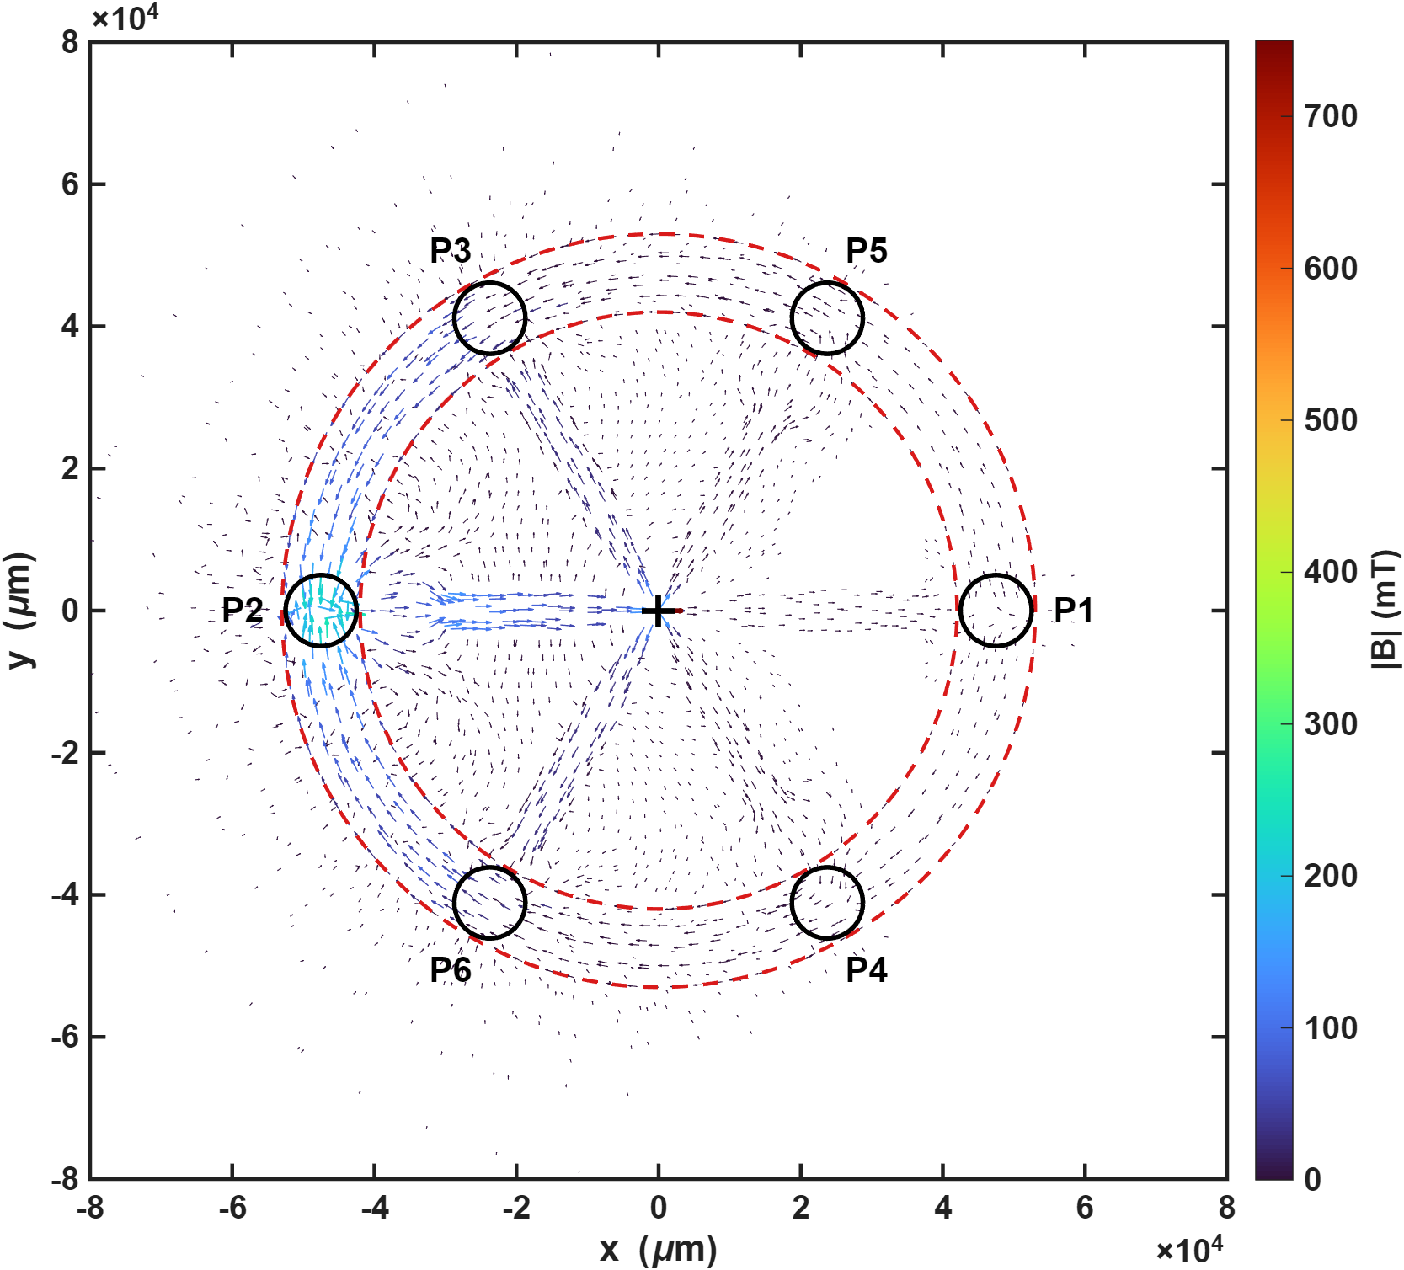
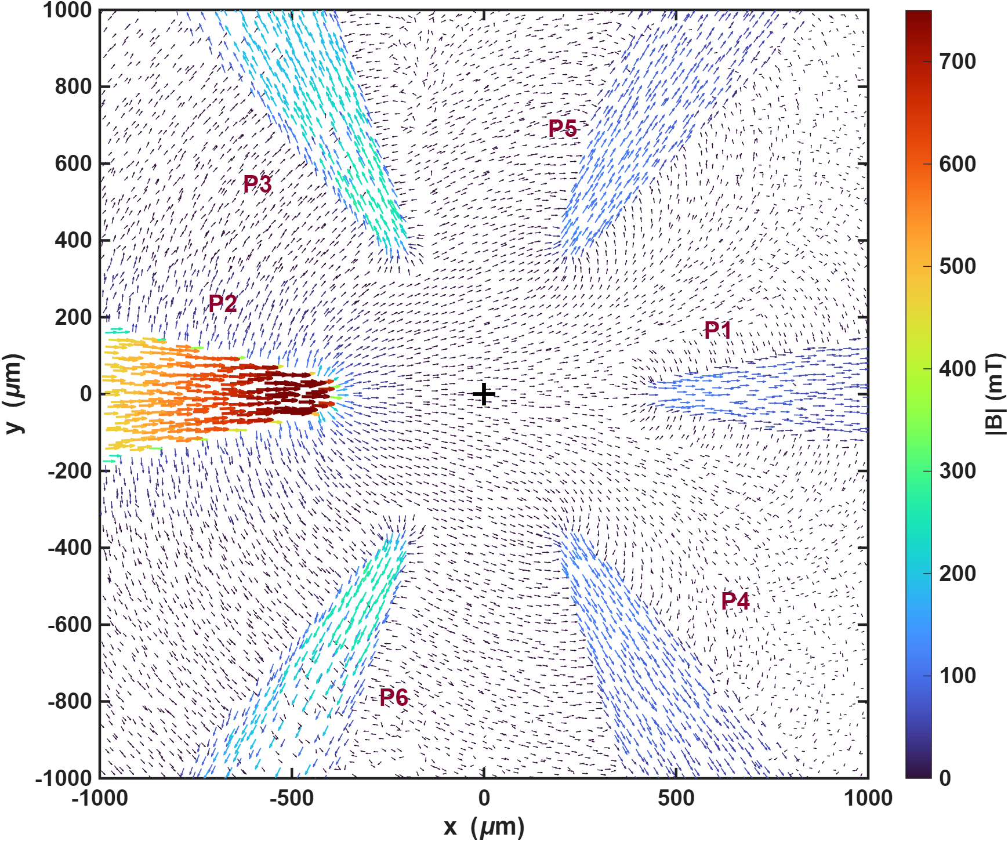
Current-based lumped-parameter modeling and calibration
Multiple-electromagnetic-pole actuation
The simulation conditions are an excitation current of 1 A and a 70-turn coil, and the results shown are obtained from Long’s model. The left figure presents a top view of the magnetic flux path through the entire structure when pole P2 is excited. The magnetic flux emerges from pole P2, enters the other poles, and then returns through the yoke. The right figure is an enlarged view of the central region in the left figure, allowing the magnetic flux path to be observed more clearly.

Slide 6
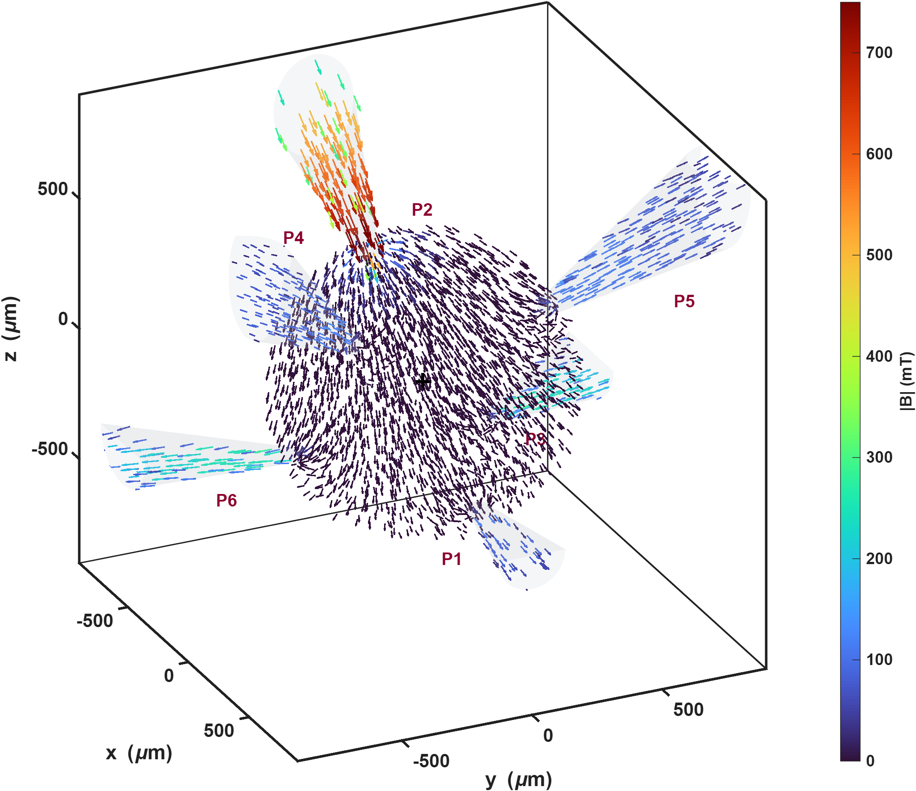
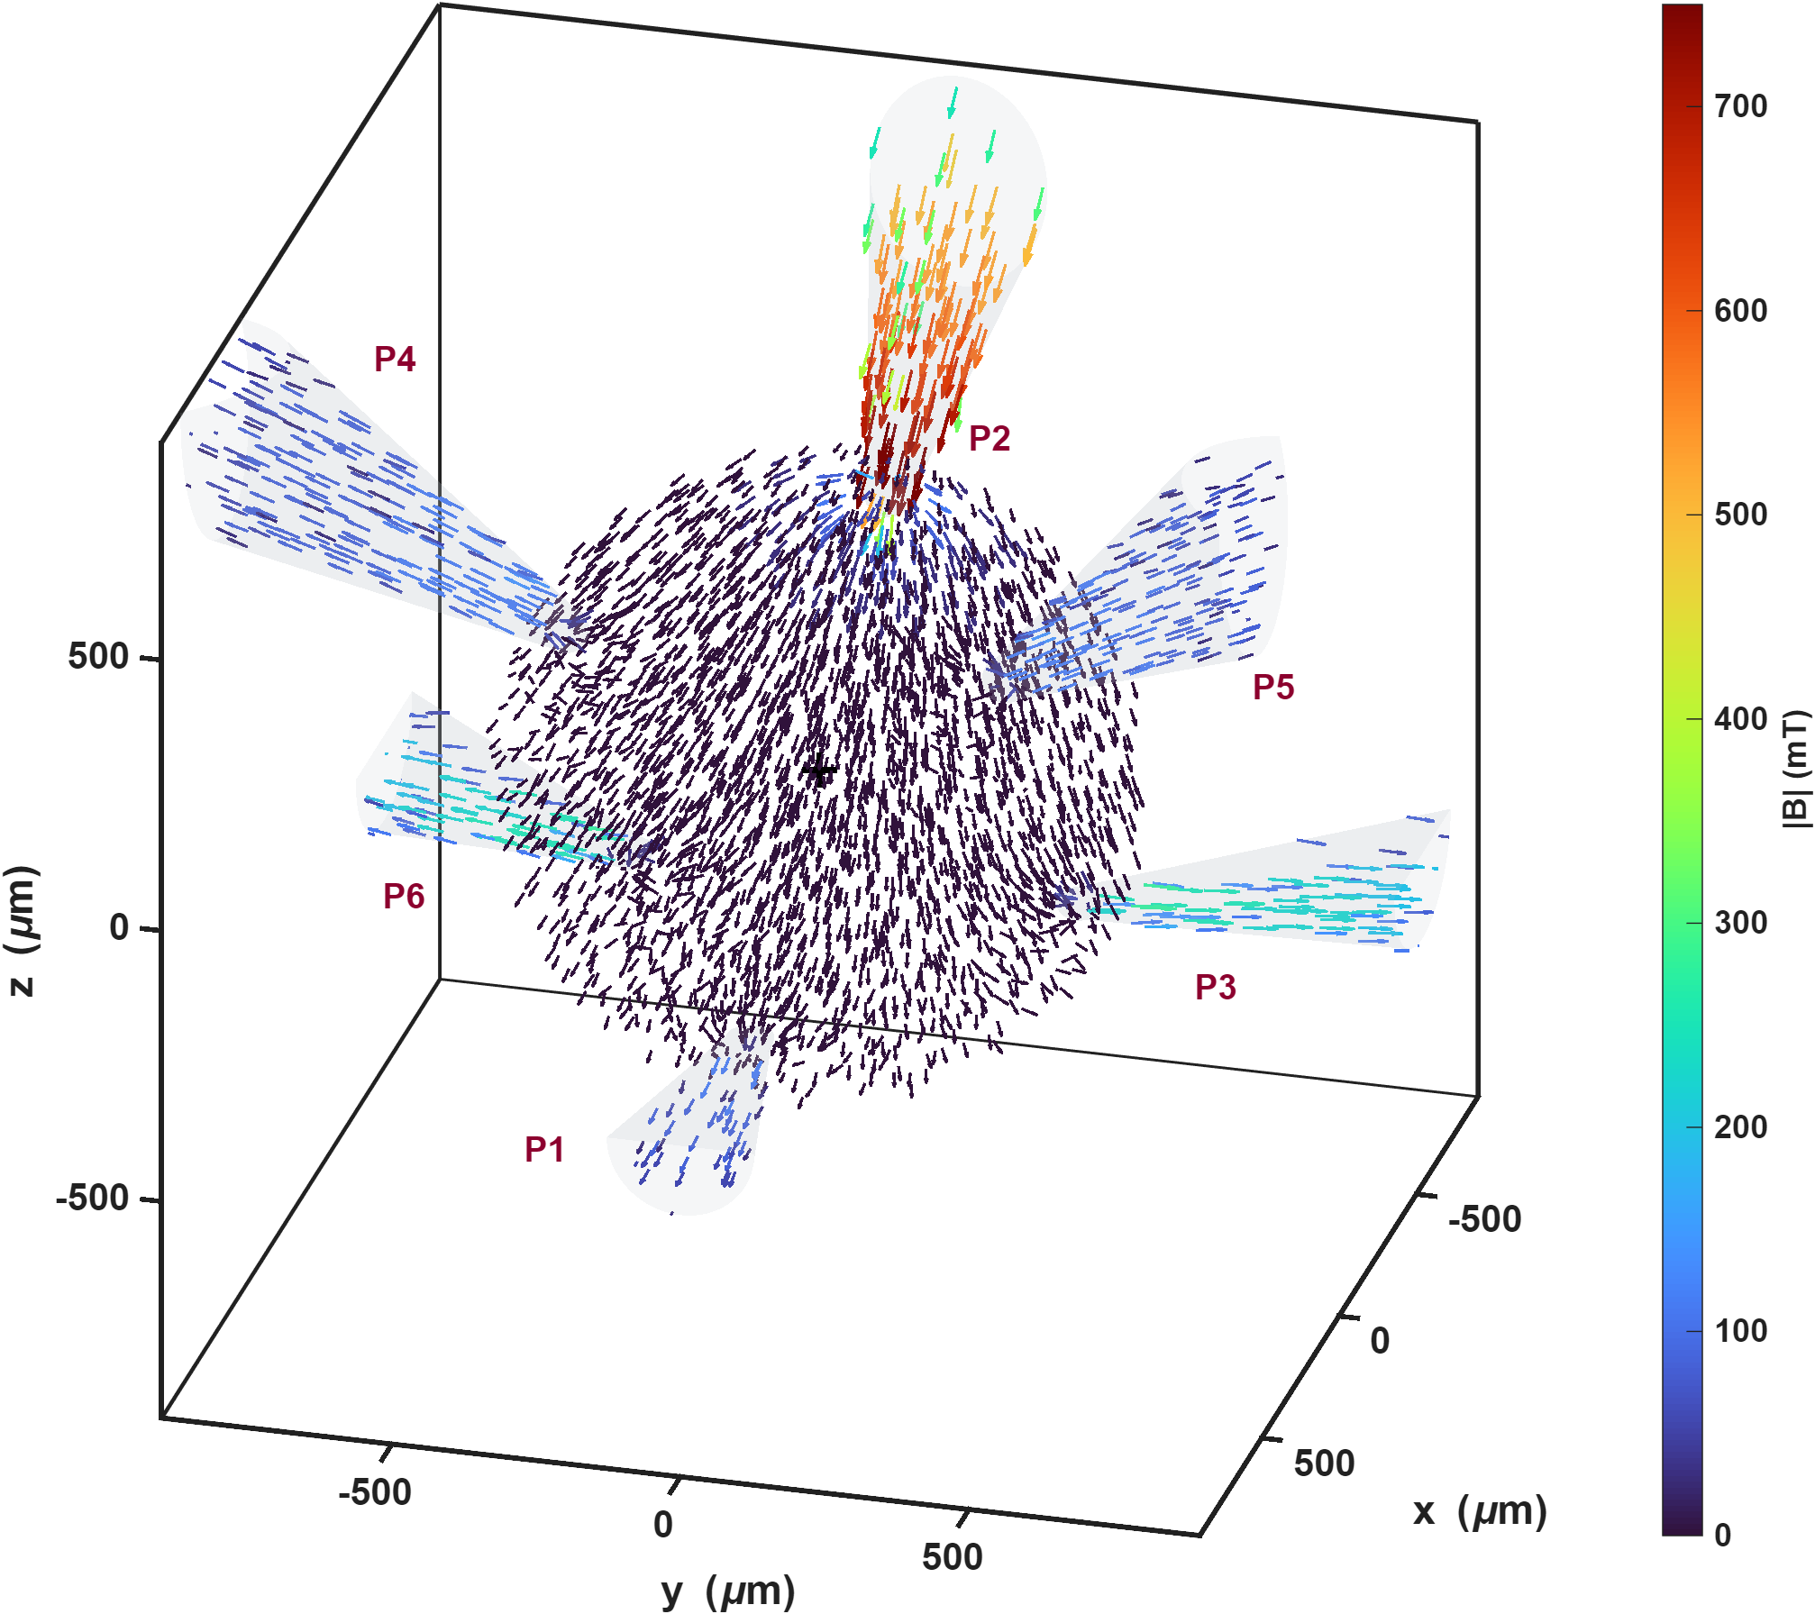
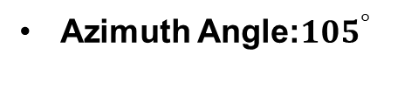
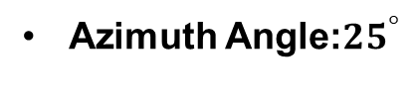
Current-based lumped-parameter modeling and calibration
Multiple-electromagnetic-pole actuation
Azimuth Angle:${25}^{°}$
Azimuth Angle:${105}^{°}$
Two 3D views of the central spherical region are also presented. These views clearly show that the magnetic flux emerges from pole P2 and is then received by the other magnetic poles.

