Slide 1
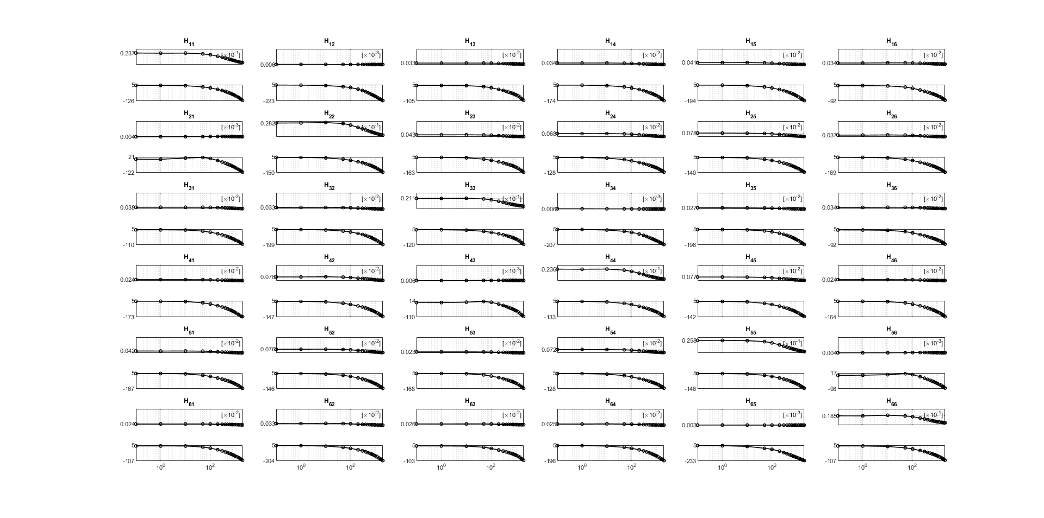

Slide 2
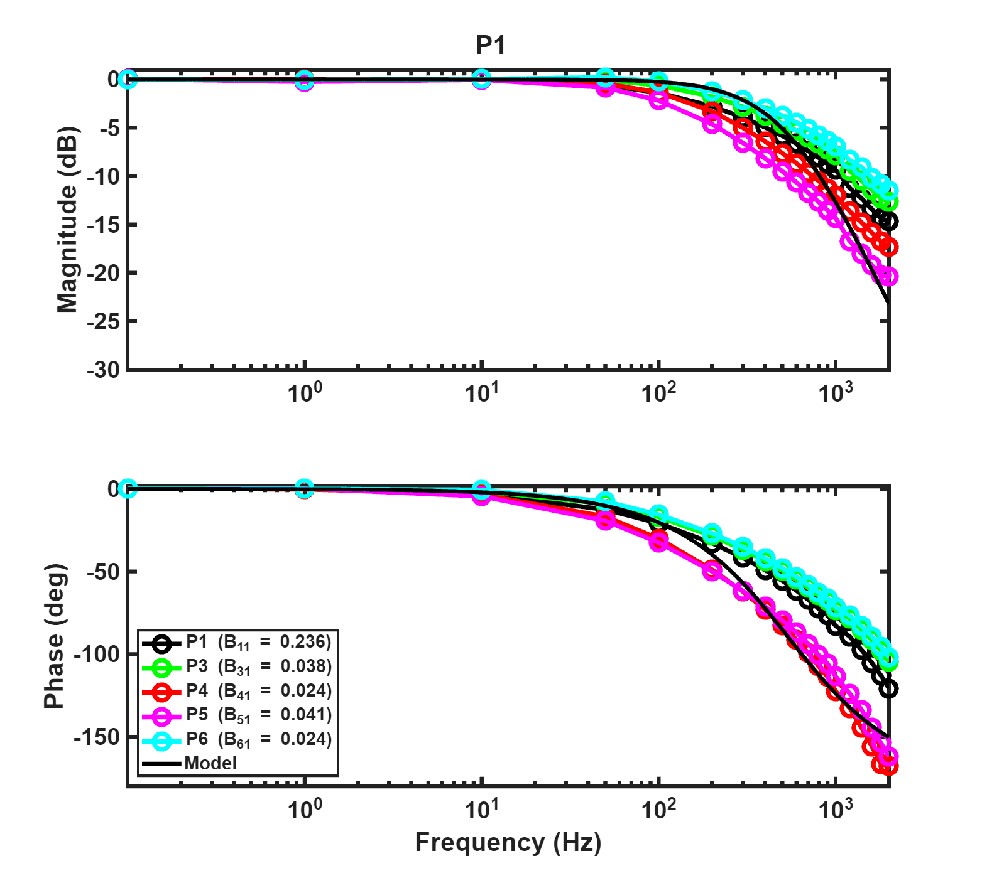
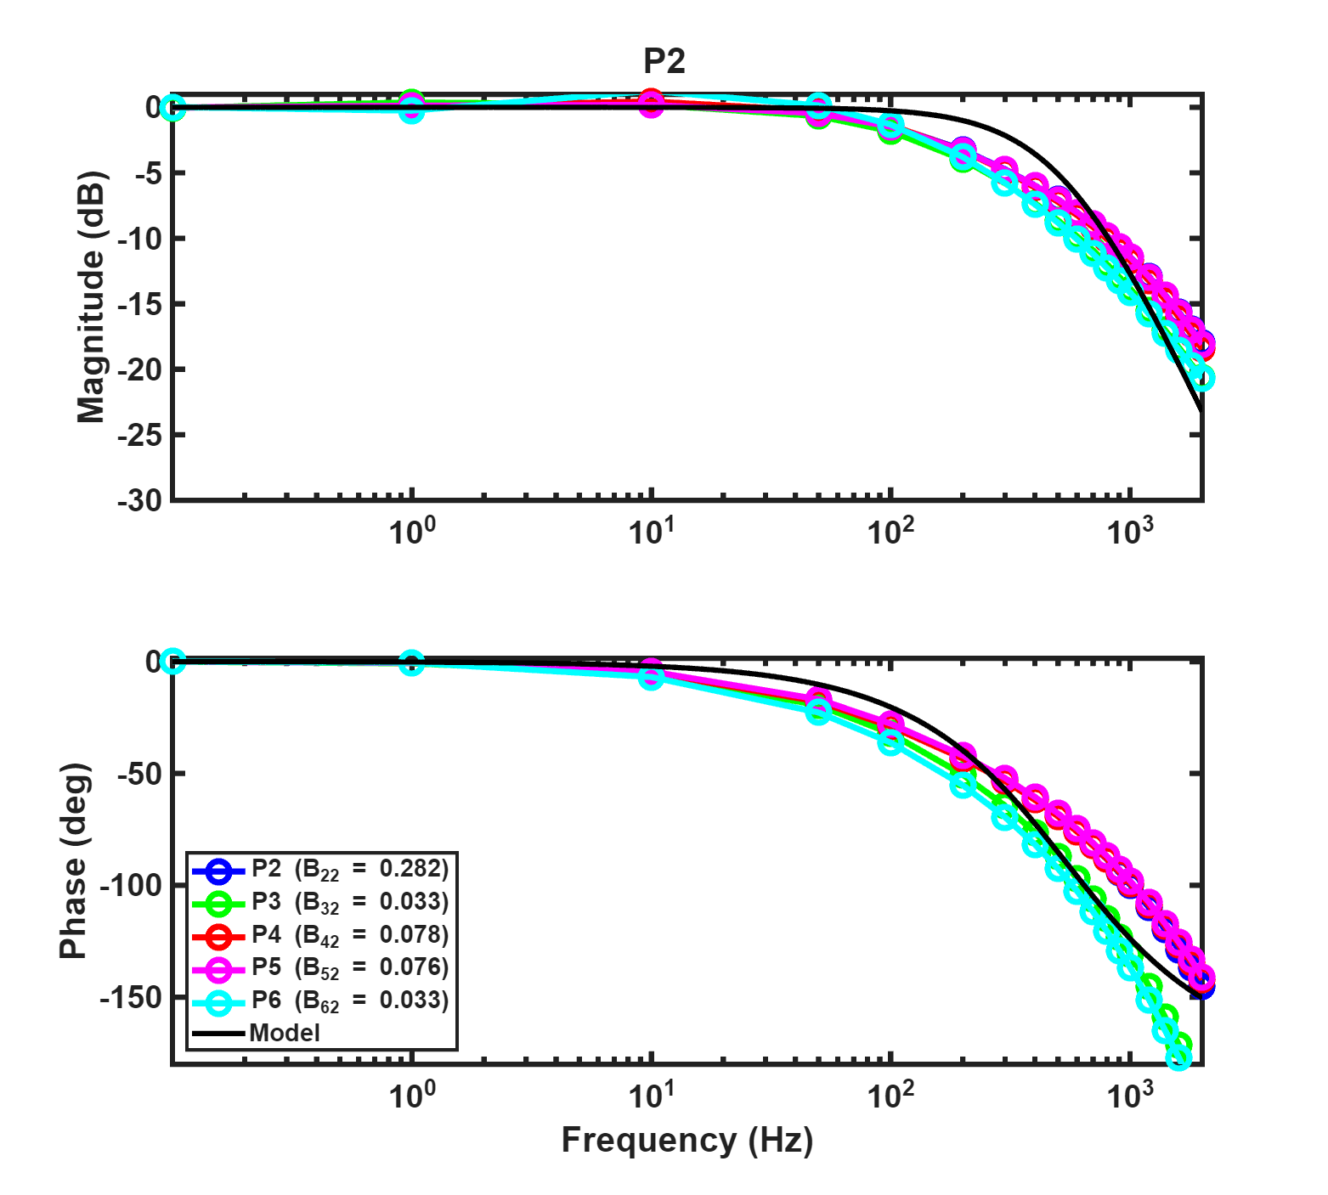
Multiple curve fitting

Slide 3
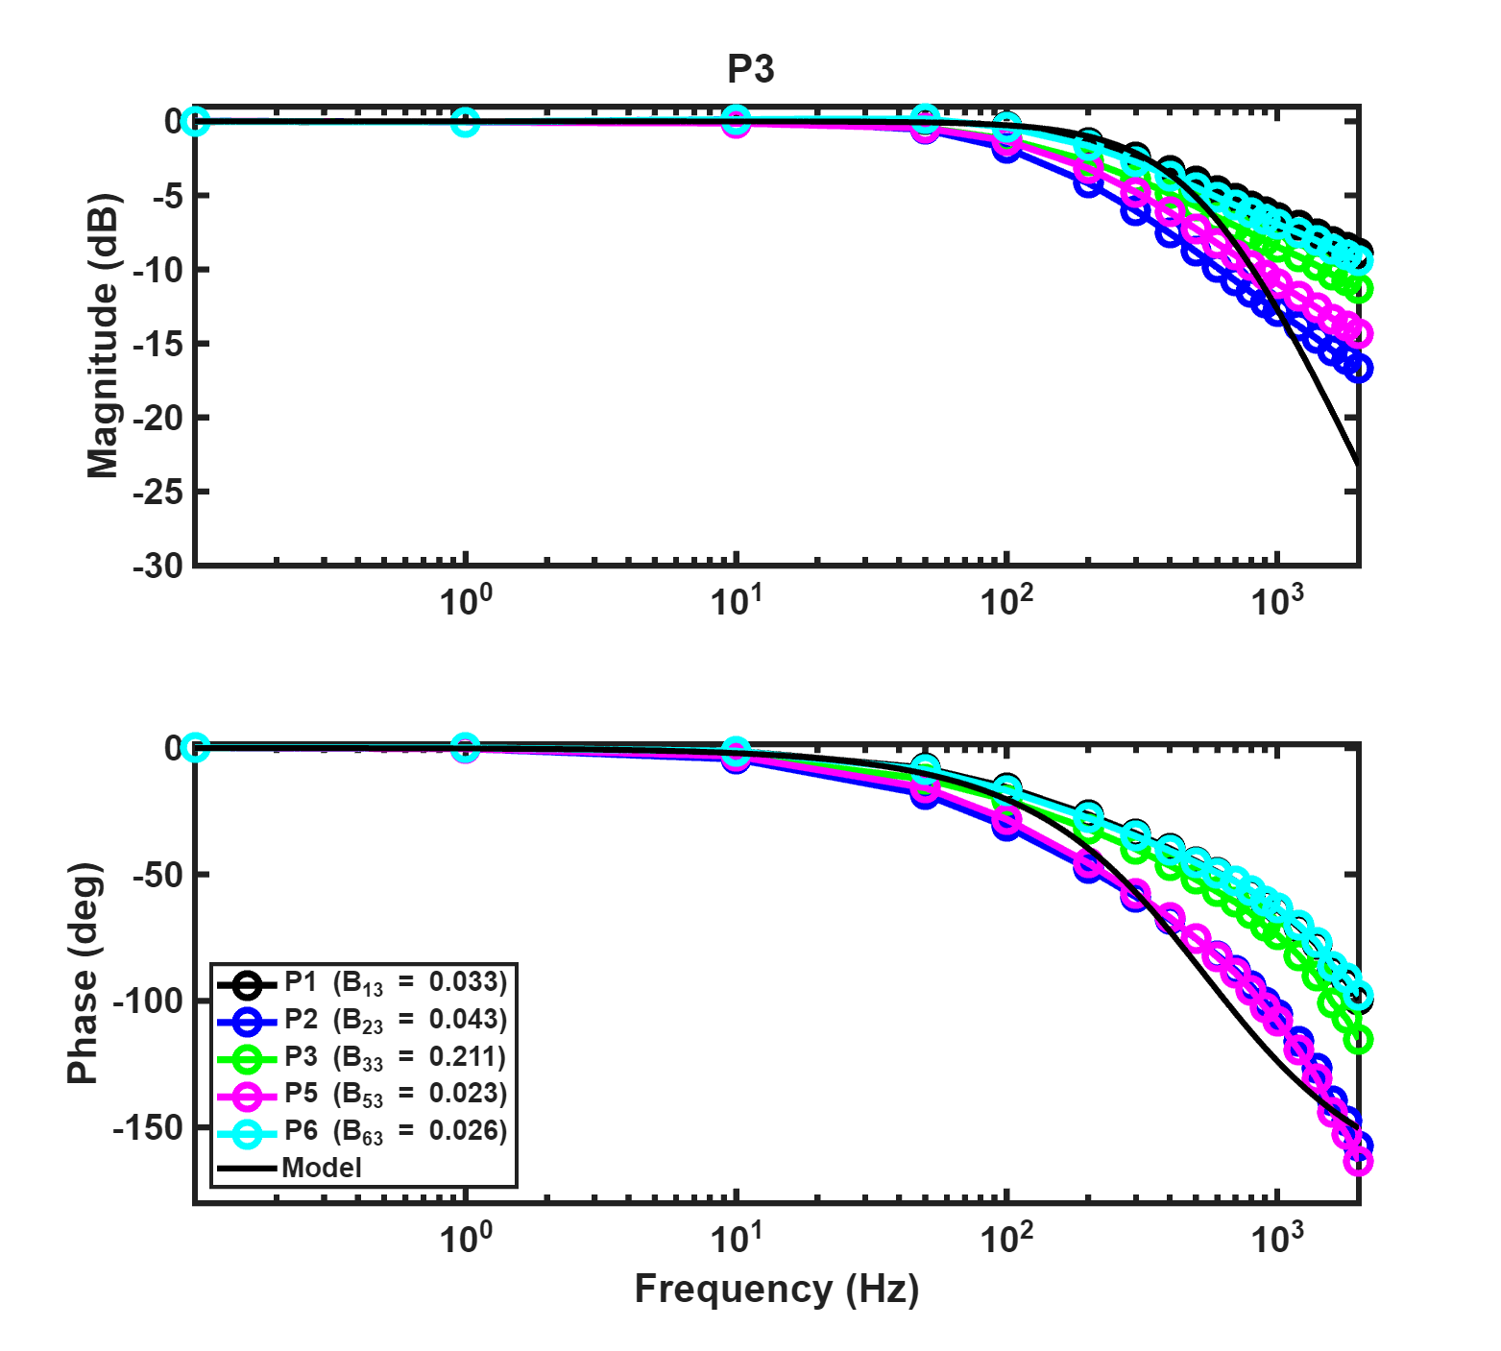
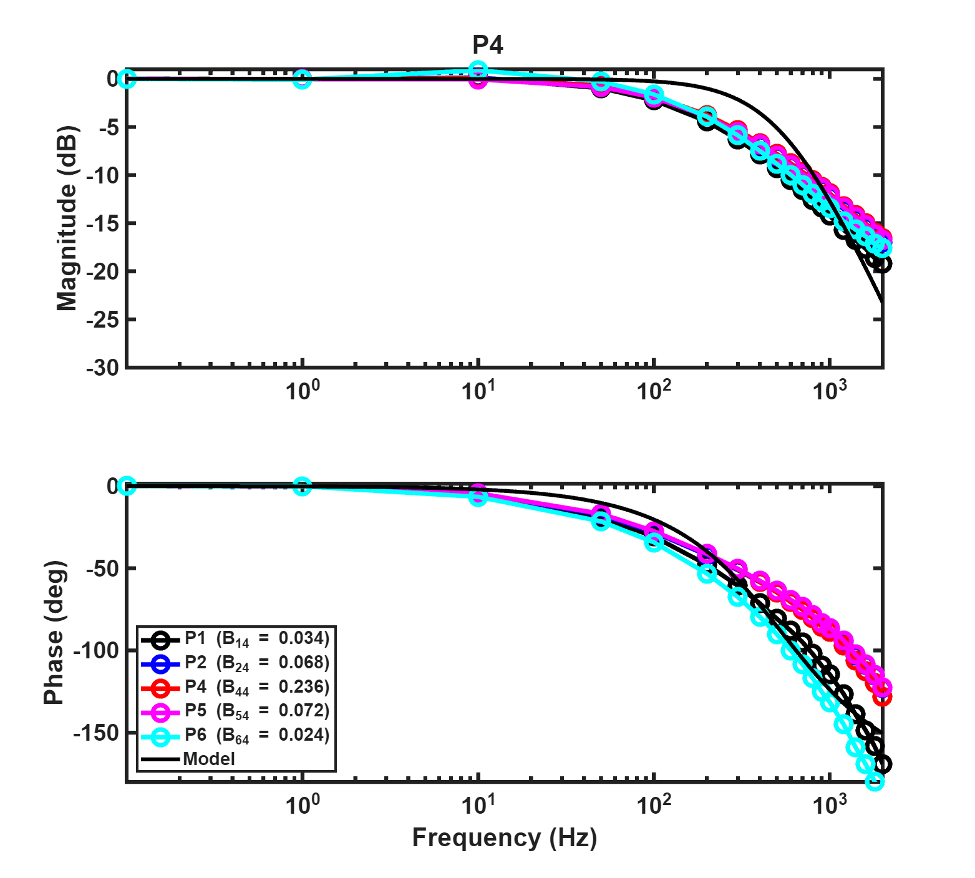
Multiple curve fitting

Slide 4
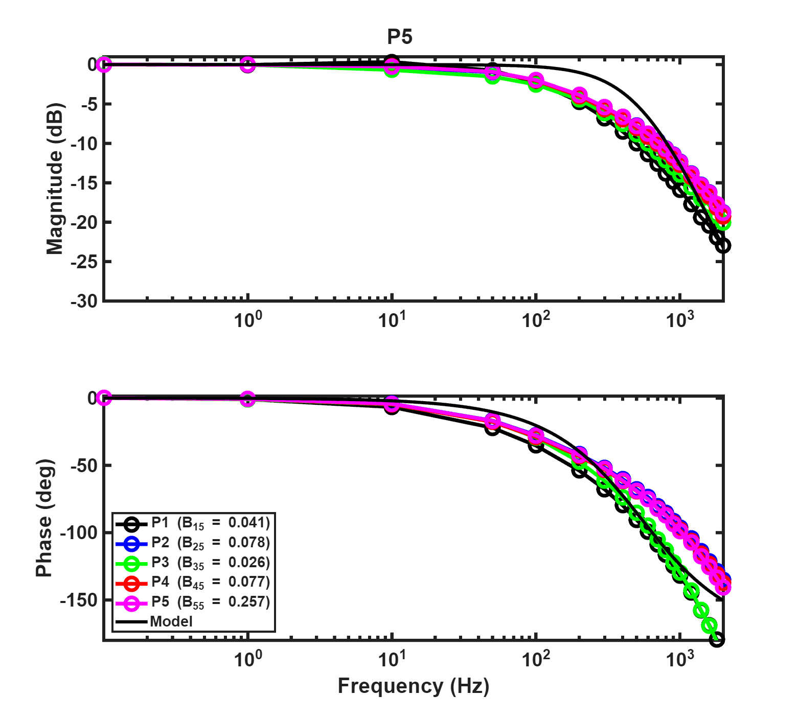
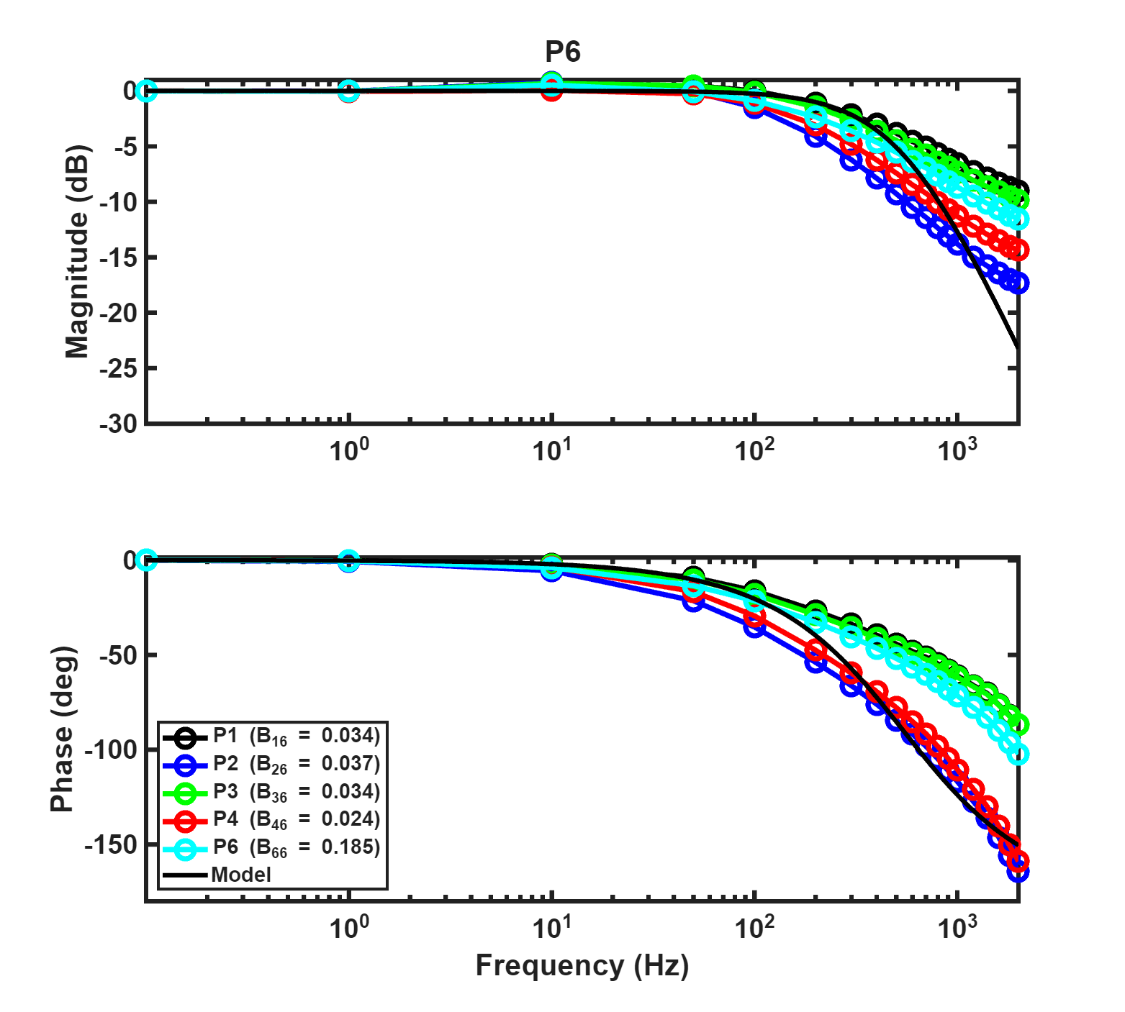
Multiple curve fitting

Slide 5


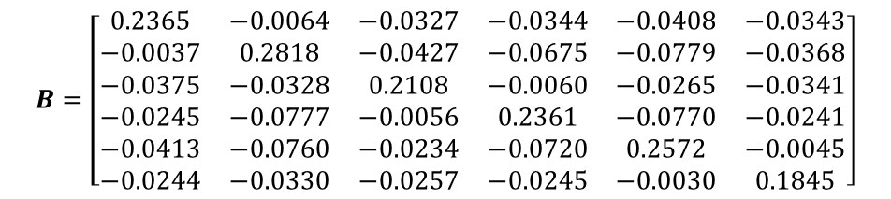
Multiple curve fitting
$$H\left(s\right)=\frac{1.1592×{10}^{7}B}{s^{2}+6.6172×{10}^{3}s+1.1592×{10}^{7}}$$
$$H\left(z^{−1}\right)=z^{−1}\frac{5.6695×{10}^{−4}×\left(1+0.9782z^{−1}\right)B}{1−1.9348z^{−1}+0.9359z^{−2}}$$
$$B=\left[\begin{matrix}0.2365 & −0.0064 & −0.0327 & −0.0344 & −0.0408 & −0.0343 \\ −0.0037 & 0.2818 & −0.0427 & −0.0675 & −0.0779 & −0.0368 \\ −0.0375 & −0.0328 & 0.2108 & −0.0060 & −0.0265 & −0.0341 \\ −0.0245 & −0.0777 & −0.0056 & 0.2361 & −0.0770 & −0.0241 \\ −0.0413 & −0.0760 & −0.0234 & −0.0720 & 0.2572 & −0.0045 \\ −0.0244 & −0.0330 & −0.0257 & −0.0245 & −0.0030 & 0.1845\end{matrix}\right]$$

Slide 6
Flux Control Simulation
After obtaining the transfer functions, an actuator model can be established for simulation purposes. The primary objective of this model is to construct a six-input six-output coupled system that replicates the behavior of the actual actuator. However, two main limitations exist in the current modeling approach. First, the inability to simulate hysteresis effects, and the presence of modeling errors. Nevertheless, the coupling characteristics between inputs and outputs have been captured in the model.

Slide 7
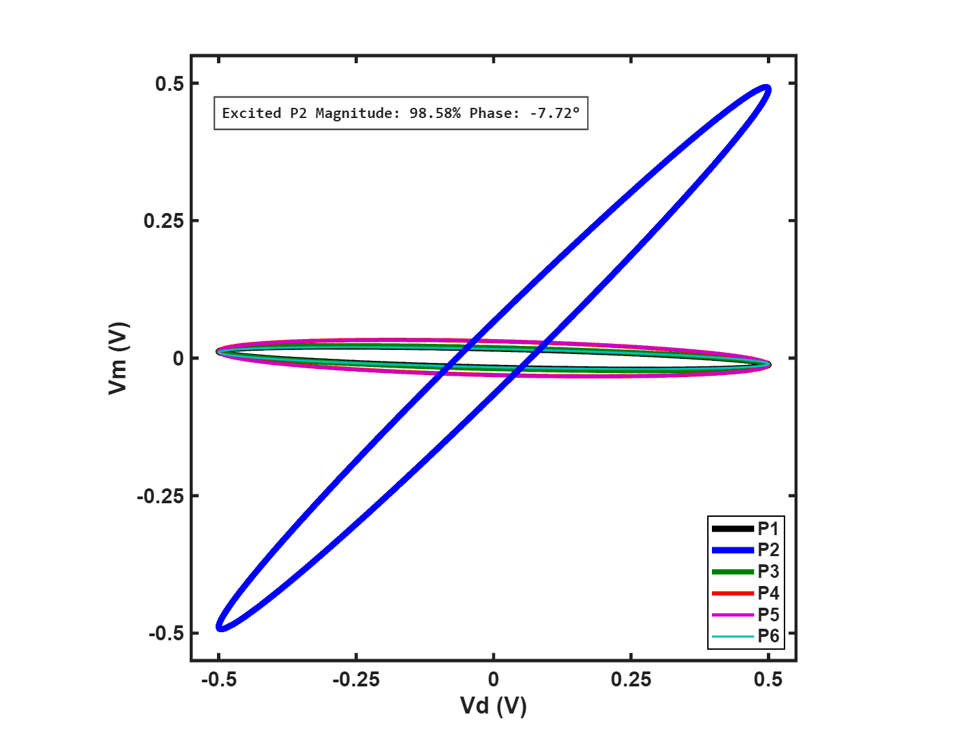
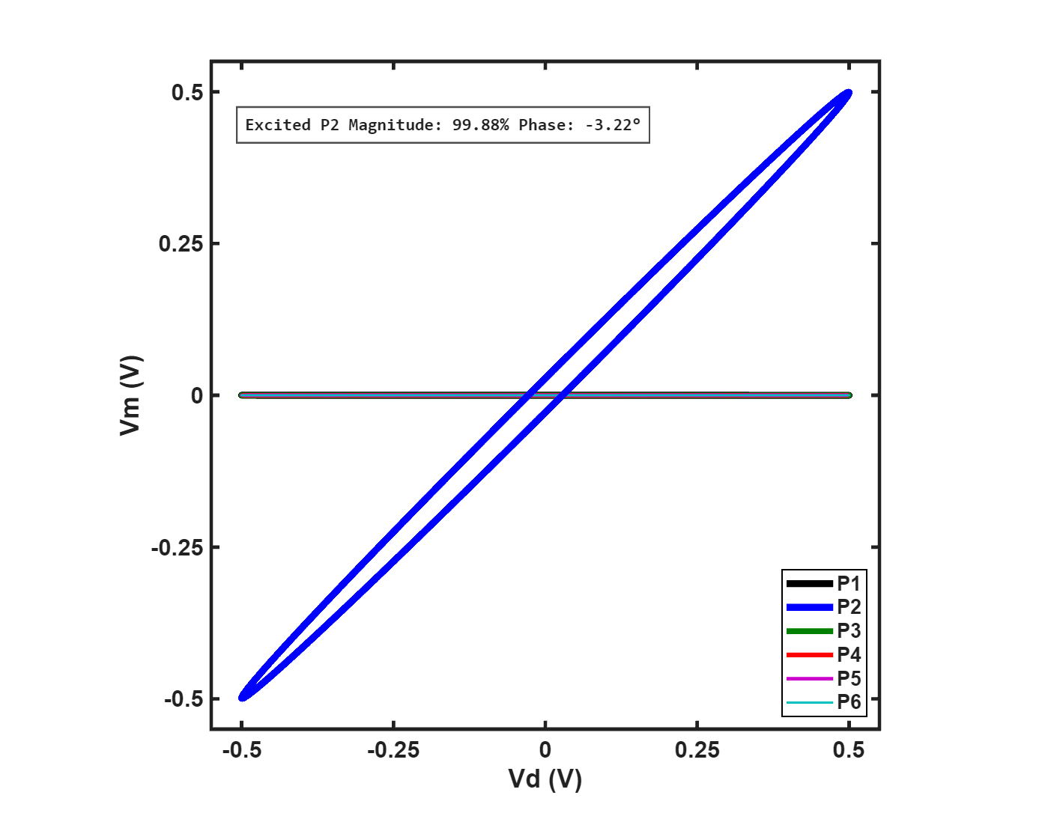
Flux Control Simulation - PI control
Under PI control, a comparative analysis was conducted between the system with and without decoupling using the identified B matrix. The test was performed by applying a sinusoidal control command to input P2 with an amplitude of 0.5V at 100Hz. The results clearly demonstrate the effectiveness of the decoupling approach.

Slide 8
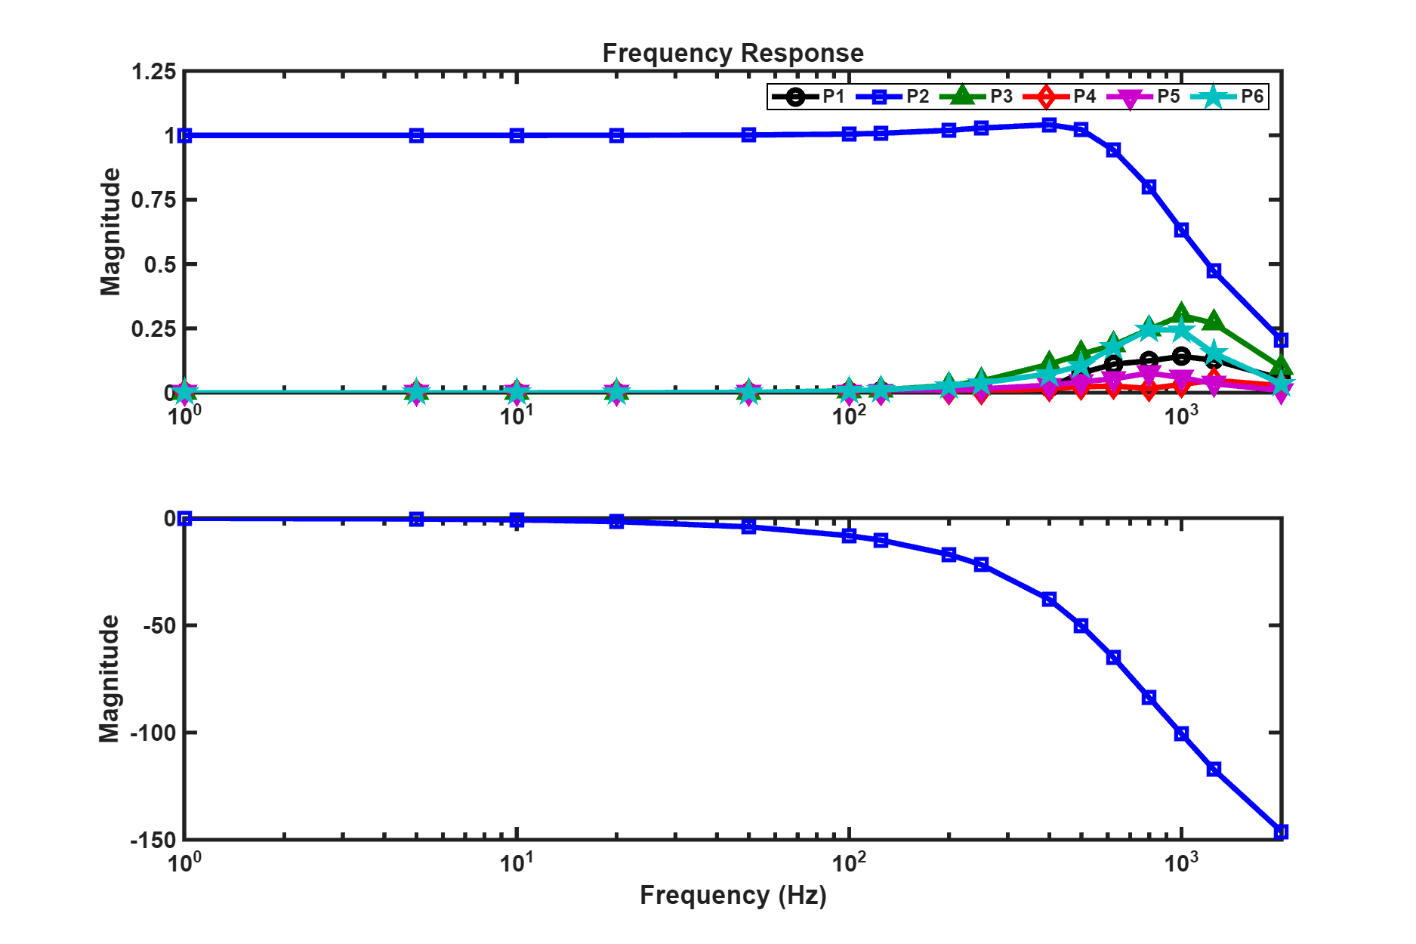
Flux Control Simulation - PI control
To further characterize the decoupling performance across different frequencies, a frequency sweep test was conducted. The results demonstrate that the PI controller maintains excellent decoupling effectiveness at frequencies below 100Hz, with the overall control bandwidth approaching 1000Hz

Slide 9
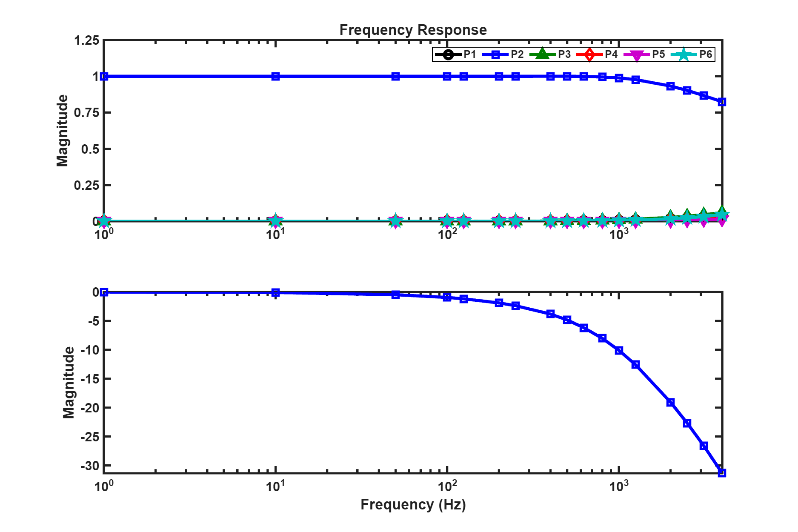
Flux Control Simulation - model-base control
To overcome the effects of hysteresis and compensate for modeling errors, as well as to enhance the overall control bandwidth, an advanced controller and disturbance observer were further developed . In the simulation, where only modeling errors are present without additional external disturbances, the controller parameters were configured as λ_f = 0.6859 (6000 Hz), λ_c = 0.8179 (3200 Hz), and λ_e = 0.3659 (16000 Hz). The frequency response results demonstrate that the overall control bandwidth exceeds 4000 Hz

Slide 10
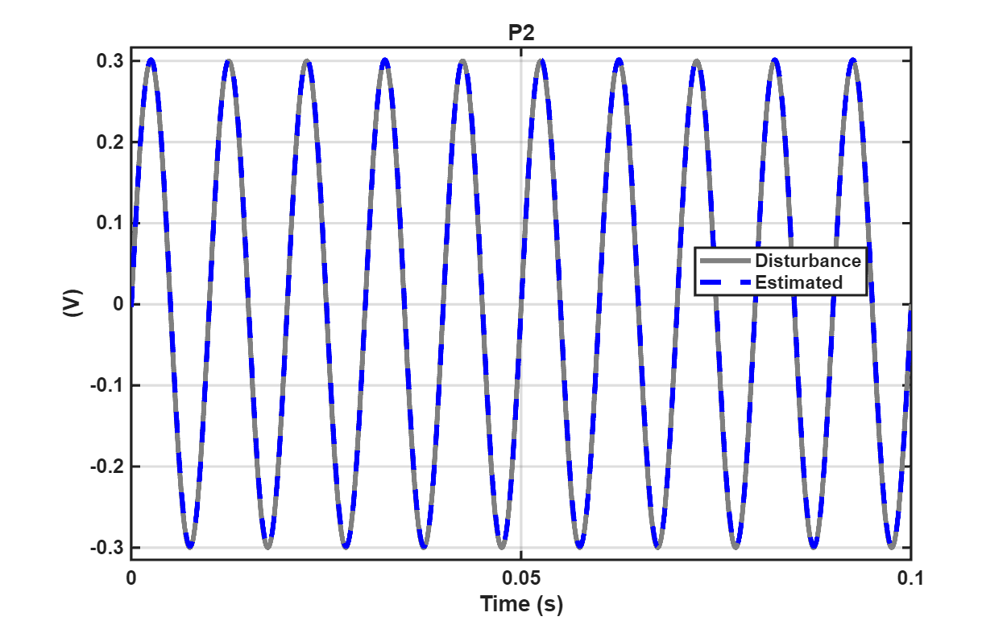
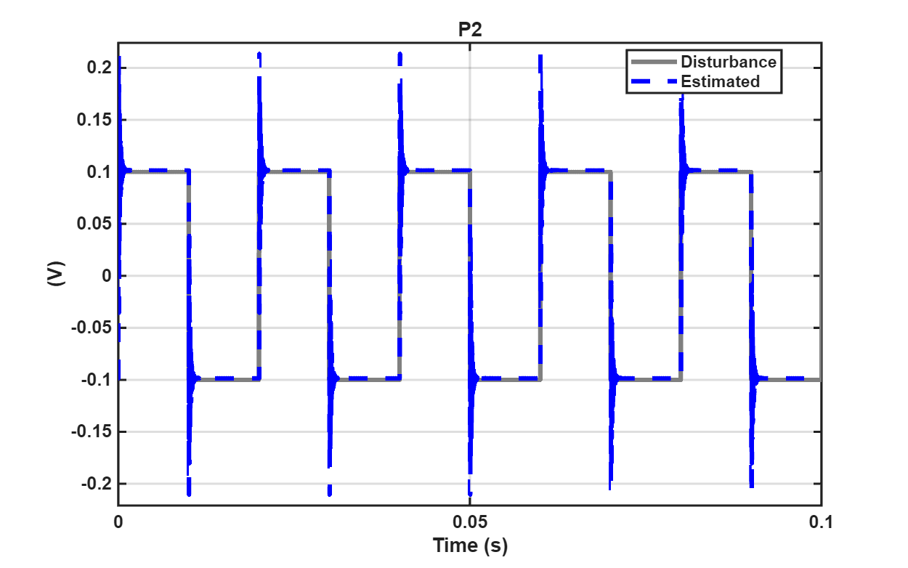
Flux Control Simulation - model-base control
To evaluate the functionality of the disturbance observer, additional disturbances were introduced at the controller output in the simulation. The test was conducted under a constant control command to assess the disturbance rejection capability.

Slide 11
