Slide 1
A Lumped-Parameter Modeling, Calibration, and Capacity-Measure Framework for Flux Generation in Symmetric Multipole Electromagnetic Actuators

Slide 2
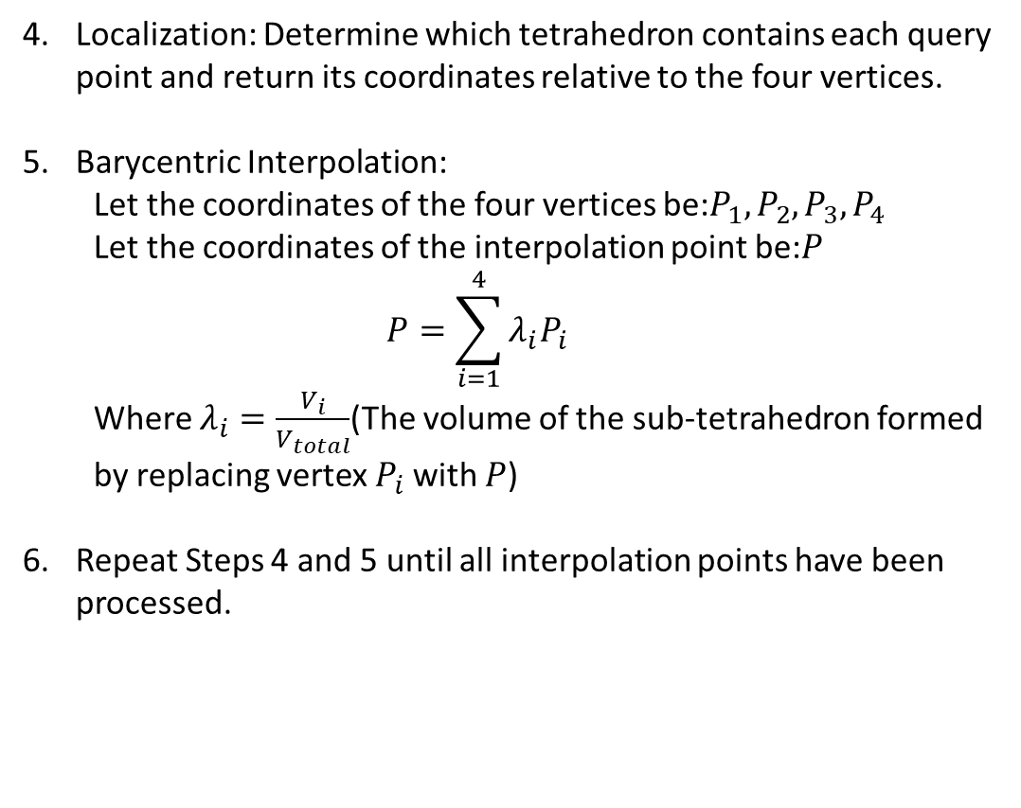

Zhi peng’s model compare
Interpolation Point Algorithm for workspace
Localization: Determine which tetrahedron contains each query point and return its coordinates relative to the four vertices.
Barycentric Interpolation:
Let the coordinates of the four vertices be:$P_{1},P_{2},P_{3},P_{4}$
Let the coordinates of the interpolation point be:$P$
$$P=\sum_{i=1}^{4}{λ_{i}P_{i}}$$
Where $λ_{i}=\frac{V_{i}}{V_{total}}$(The volume of the sub-tetrahedron formed by replacing vertex $P_{i}$ with $P$)
Repeat Steps 4 and 5 until all interpolation points have been processed.
Input $N_{r},R$， These represent the numbers of divisions required along the three coordinate directions of the sphere， where $rε(0 R]$，$θε\left[0 2π\right]$，$φε[0 π]$。
Assuming uniform spacing, let the distance between two adjacent points be $d$. Then$d=\frac{R}{N_{r}}$, . Therefore
$$r_{i}=\frac{R}{N_{r}}\left(i−0.5\right)=d(i−0.5),i=1…N_{r}$$
$$φ_{j}=\frac{π}{N_{φ}}(j−0.5),j=1…N_{φ}$$
$$θ_{k}=\frac{π}{N_{θ}}(2k−1),k=1…N_{θ}$$
Where: $N_{φ}=π\left(i−0.5\right)$
$N_{θ}=2π sinφ_{j}(i−0.5)$
Load the FEM data and filter out the air nodes.
Therefore, only Nr​ needs to be specified, while the other two parameters vary accordingly with Nr​. Thus, Nr​ is incremented starting from 1.

Slide 3
Zhi peng’s model compare
Calibrate results
Convergence criteria: The relative errors of $\hat{ℓ}$ and ${}_{}^{B}{{\hat{g}}_{I}}$ with respect to the calibration results obtained using all nodes are less than 0.5%, and ${\overline{K}}_{I}$​ exhibits a physically meaningful distribution.
Single(Long fei 269 points)
Single(Zhi peng 35 points)
$${\bar{K}}_{I} = \left[\begin{matrix}0.8333 & −0.0984 & −0.1907 & −0.1687 & −0.1671 & −0.1923 \\ −0.2185 & 0.9619 & −0.2085 & −0.1530 & −0.1508 & −0.2098 \\ −0.1912 & −0.1680 & 0.8370 & −0.1012 & −0.1673 & −0.1924 \\ −0.2082 & −0.1513 & −0.2165 & 0.9559 & −0.1501 & −0.2091 \\ −0.2088 & −0.1515 & −0.2081 & −0.1530 & 0.9626 & −0.2193 \\ −0.1912 & −0.1677 & −0.1901 & −0.1687 & −0.0982 & 0.8326\end{matrix}\right]$$
$${\bar{K}}_{I} = \left[\begin{matrix}0.8333 & −0.0480 & −0.2315 & −0.0873 & −0.0853 & −0.2303 \\ −0.0842 & 0.8625 & −0.1198 & −0.2032 & −0.2014 & −0.1185 \\ −0.2645 & −0.0755 & 0.7436 & −0.0436 & −0.0481 & −0.2480 \\ −0.1121 & −0.2322 & −0.0759 & 0.7685 & −0.2192 & −0.0821 \\ −0.1121 & −0.2321 & −0.0830 & −0.2211 & 0.7695 & −0.0744 \\ −0.2645 & −0.0755 & −0.2491 & −0.0502 & −0.0420 & 0.7454\end{matrix}\right]$$
$$\hat{ℓ} = 874.5 μm {}_{}^{B}{{\hat{g}}_{I}} = 9.6353 mT/A$$
$$\hat{ℓ} = 744.9 μm {}_{}^{B}{{\hat{g}}_{I}} = 32.7350 mT/A$$
NMAE = 2.81%
NMAE = 10.50%

Slide 4
Zhi peng’s model compare
Calibrate results
However, Longfei’s model was found to still require too many points. Therefore, the convergence criterion was relaxed to <3%. Even with this relaxed criterion, the model’s ability to predict the magnetic field within the workspace was not significantly affected.
Single(Long fei 35 points)
Single(Zhi peng 35 points)
$${\bar{K}}_{I} = \left[\begin{matrix}0.8333 & −0.1200 & −0.1488 & −0.1974 & −0.1895 & −0.1529 \\ −0.1849 & 0.9067 & −0.1661 & −0.1825 & −0.1740 & −0.1699 \\ −0.1574 & −0.1882 & 0.8444 & −0.1319 & −0.1902 & −0.1525 \\ −0.1740 & −0.1722 & −0.1752 & 0.8917 & −0.1737 & −0.1687 \\ −0.1745 & −0.1722 & −0.1656 & −0.1828 & 0.9044 & −0.1799 \\ −0.1574 & −0.1877 & −0.1481 & −0.1980 & −0.1228 & 0.8384\end{matrix}\right]$$
$${\bar{K}}_{I} = \left[\begin{matrix}0.8333 & −0.0480 & −0.2315 & −0.0873 & −0.0853 & −0.2303 \\ −0.0842 & 0.8625 & −0.1198 & −0.2032 & −0.2014 & −0.1185 \\ −0.2645 & −0.0755 & 0.7436 & −0.0436 & −0.0481 & −0.2480 \\ −0.1121 & −0.2322 & −0.0759 & 0.7685 & −0.2192 & −0.0821 \\ −0.1121 & −0.2321 & −0.0830 & −0.2211 & 0.7695 & −0.0744 \\ −0.2645 & −0.0755 & −0.2491 & −0.0502 & −0.0420 & 0.7454\end{matrix}\right]$$
$$\hat{ℓ} = 875.9 μm {}_{}^{B}{{\hat{g}}_{I}} = 9.9505 mT/A$$
$$\hat{ℓ} = 744.9 μm {}_{}^{B}{{\hat{g}}_{I}} = 32.7350 mT/A$$
NMAE = 2.81%
NMAE = 10.50%

Slide 5


Zhi peng’s model compare
Calibrate results
This is the calibration result using the eighteen-parameter model.
Eighteen(Long fei 35 points)
Eighteen(Zhi peng 35 points)
$${\bar{K}}_{I} = \left[\begin{matrix}0.8333 & −0.1344 & −0.1283 & −0.1953 & −0.1937 & −0.1284 \\ −0.1339 & 0.8277 & −0.2027 & −0.1241 & −0.1236 & −0.2027 \\ −0.1236 & −0.1908 & 0.8235 & −0.1350 & −0.1939 & −0.1277 \\ −0.2021 & −0.1233 & −0.1404 & 0.8372 & −0.1248 & −0.2065 \\ −0.1988 & −0.1211 & −0.2029 & −0.1236 & 0.8255 & −0.1380 \\ −0.1227 & −0.1899 & −0.1268 & −0.1950 & −0.1369 & 0.8240\end{matrix}\right]$$
$${\bar{K}}_{I} = \left[\begin{matrix}0.8333 & −0.1068 & −0.1150 & −0.1881 & −0.1875 & −0.1150 \\ −0.1114 & 0.8296 & −0.1932 & −0.1195 & −0.1193 & −0.1928 \\ −0.1336 & −0.1957 & 0.7488 & −0.0923 & −0.1578 & −0.1300 \\ −0.2009 & −0.1382 & −0.0977 & 0.7452 & −0.1346 & −0.1634 \\ −0.2002 & −0.1378 & −0.1631 & −0.1345 & 0.7427 & −0.0970 \\ −0.1335 & −0.1954 & −0.1298 & −0.1585 & −0.0925 & 0.7492\end{matrix}\right]$$
$$\hat{e}= \left[\begin{matrix}0.0187 & 0.0190 & −0.1178 & 0.0032 & 0.0015 & −0.1180 \\ −0.1174 & 0.0026 & 0.0150 & 0.0114 & 0.0030 & −0.1195 \\ 0.1177 & −0.0023 & 0.1184 & −0.0044 & −0.0191 & −0.0157\end{matrix}\right]$$
$$\hat{e}= \left[\begin{matrix}−0.0024 & 0.0010 & −0.2168 & 0.2168 & 0.2165 & −0.2164 \\ −0.2162 & 0.2166 & 0.0001 & −0.0020 & 0.2173 & −0.2162 \\ 0.2159 & −0.2162 & 0.2165 & −0.2176 & 0.0010 & −0.0003\end{matrix}\right]$$
$$\hat{ℓ} = 876.0 μm {}_{}^{B}{{\hat{g}}_{I}} = 10.8230 mT/A$$
$$\hat{ℓ} = 604.8 μm {}_{}^{B}{{\hat{g}}_{I}} = 37.3928 mT/A$$
NMAE = 0.27%
NMAE = 0.68%

Slide 6
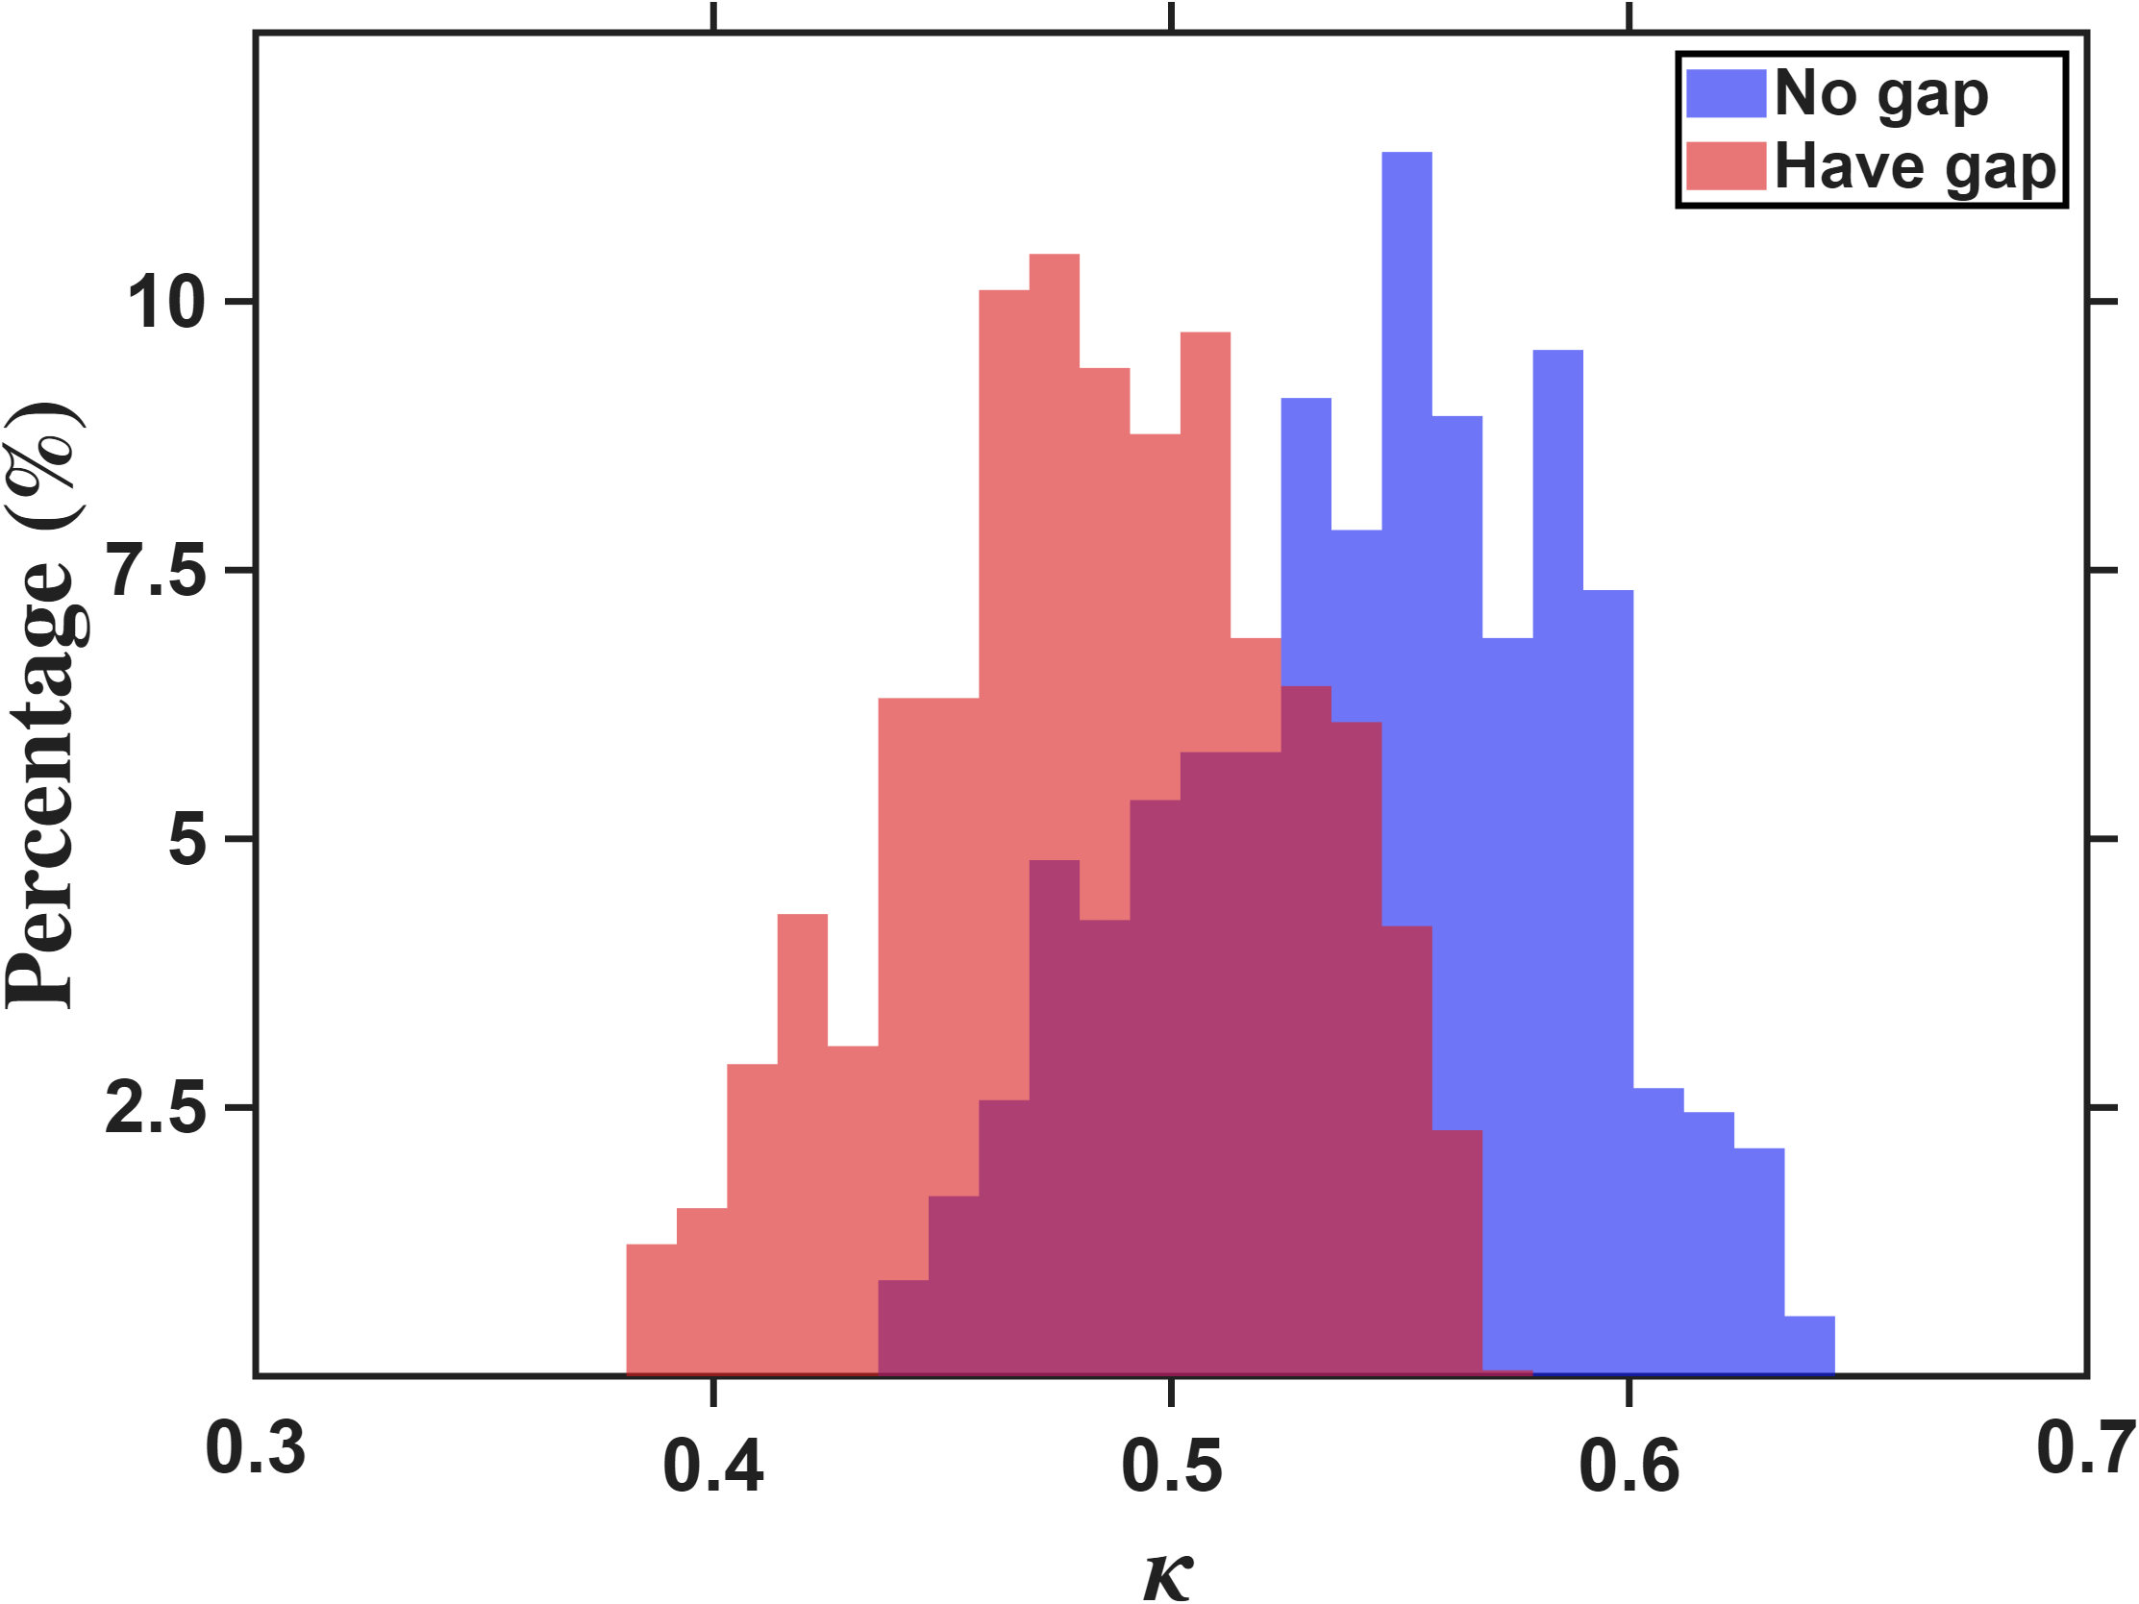
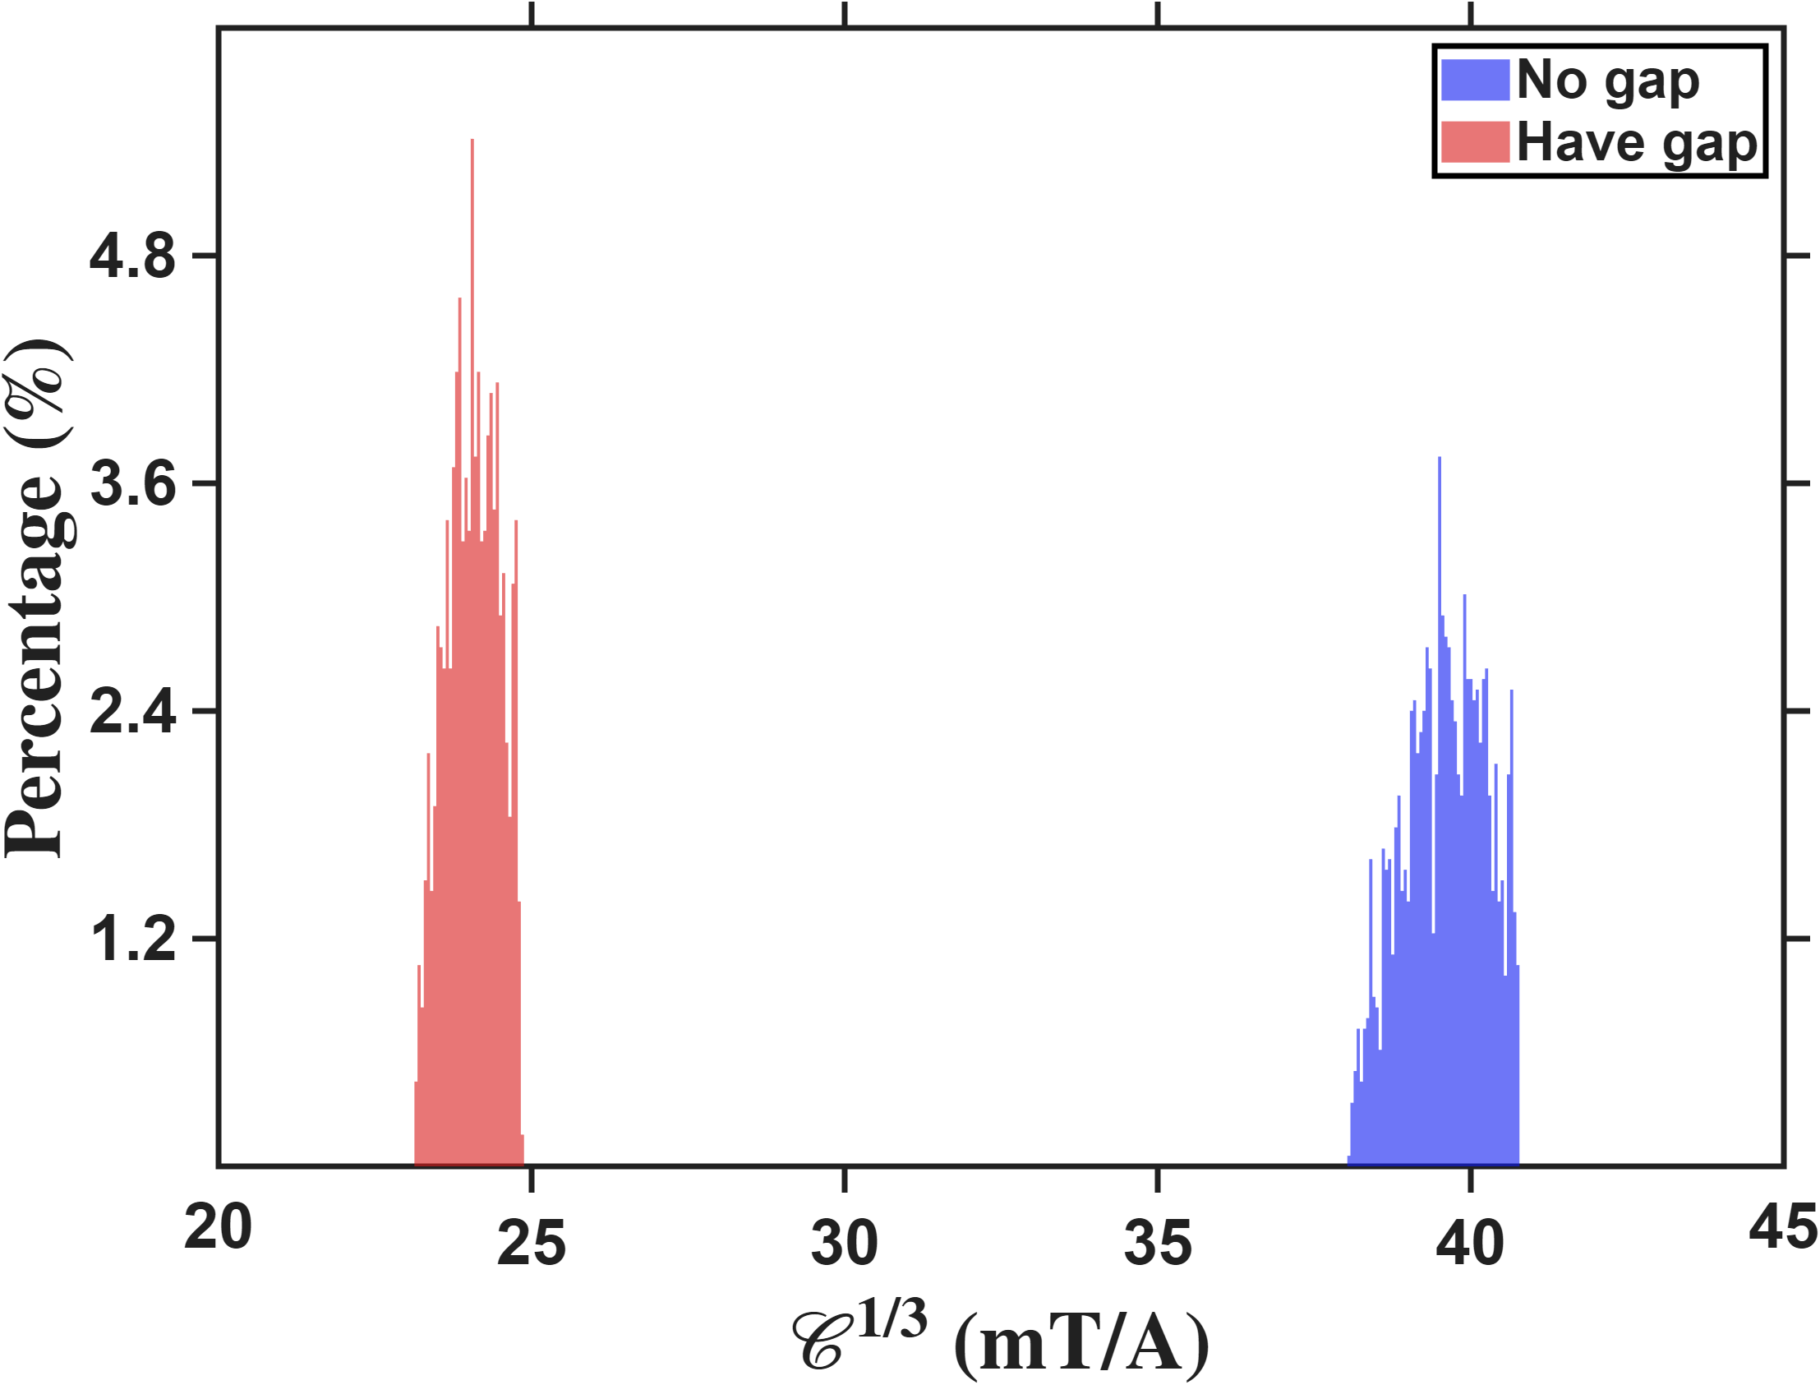

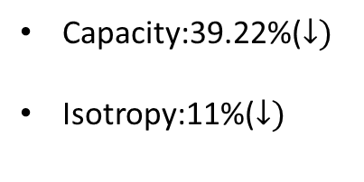
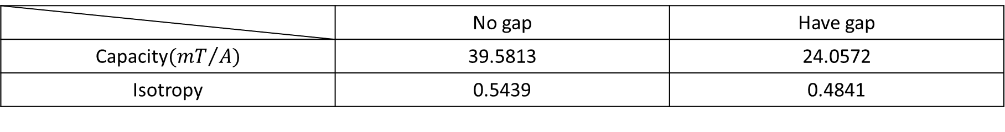

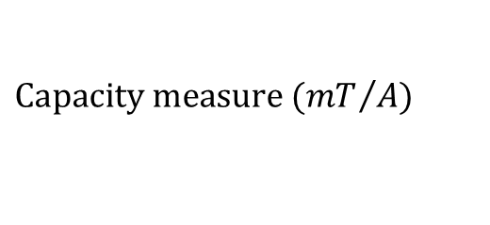

Zhi peng’s model compare
Capacity:39.22%($↓)$
Isotropy:11%($↓)$
No gap & Have gap
Capacity
Isotropy
$$Percentage count(\%)$$
$$Percentage count(\%)$$
$$Capacity measure ({mT}/A)$$
$$Isotropy$$
This figure resolution is 0.05mT/A
This figure resolution is 0.01
 | No gap | Have gap
Capacity$({mT}/A)$ | 39.5813 | 24.0572
Isotropy | 0.5439 | 0.4841

Slide 7
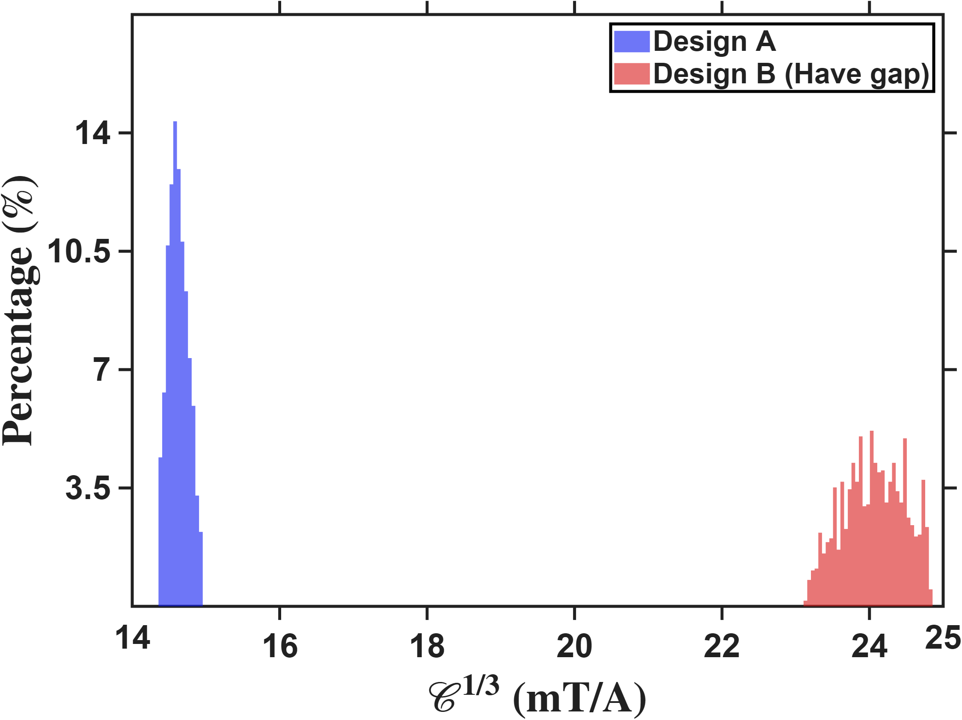
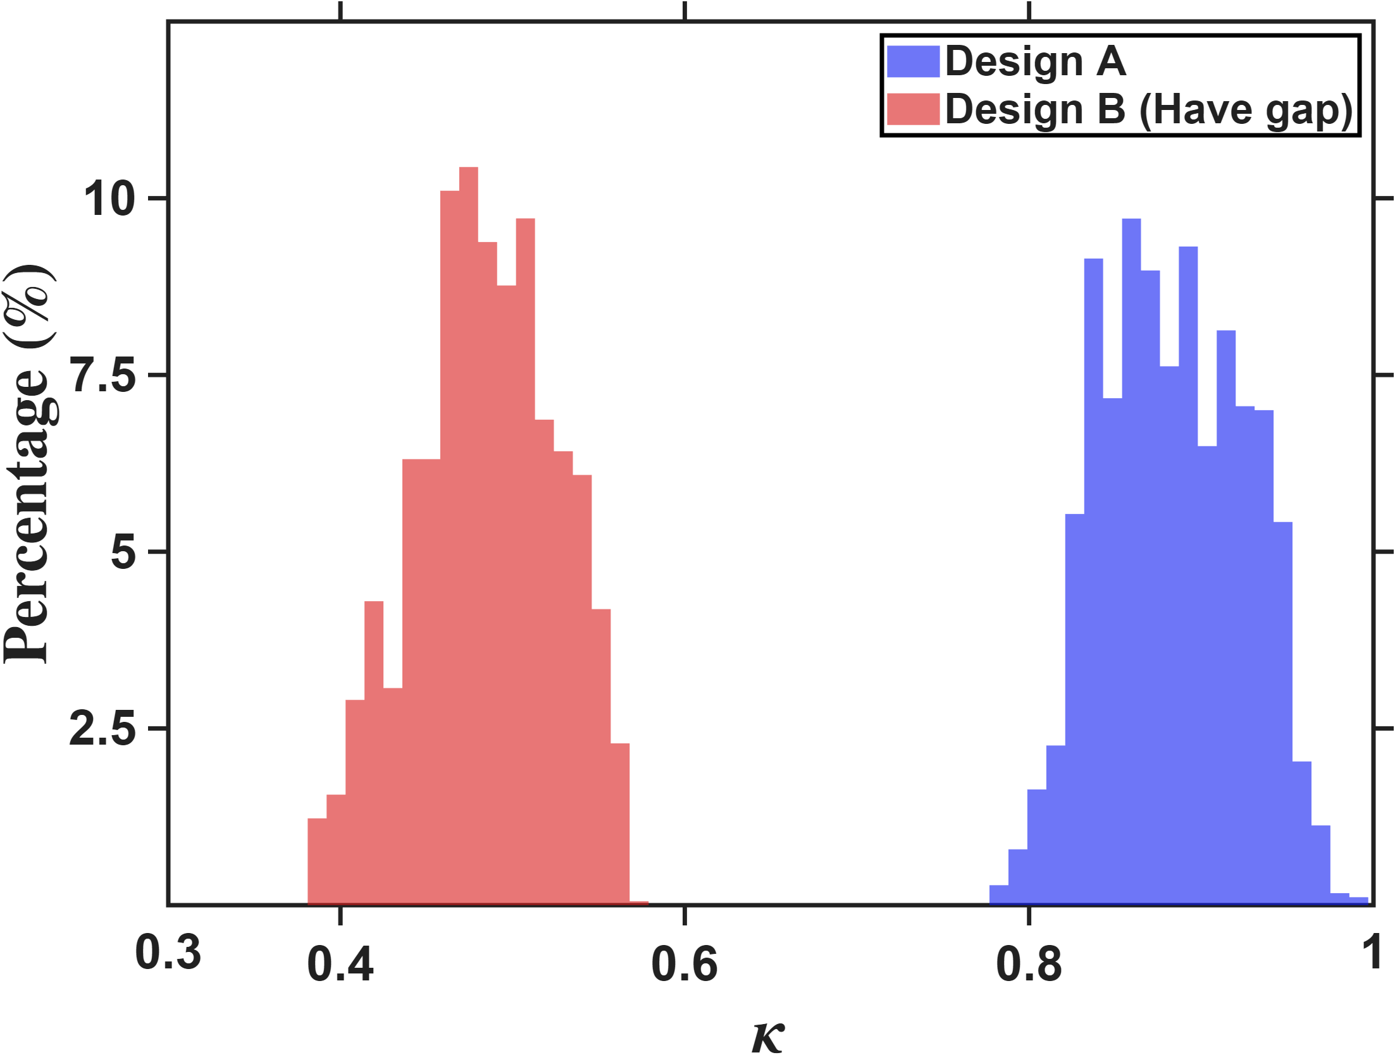

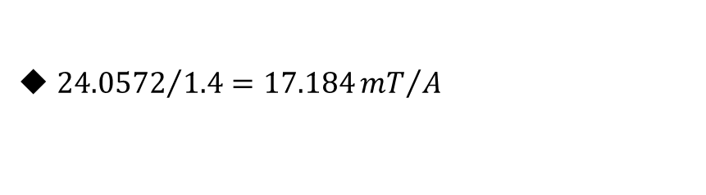
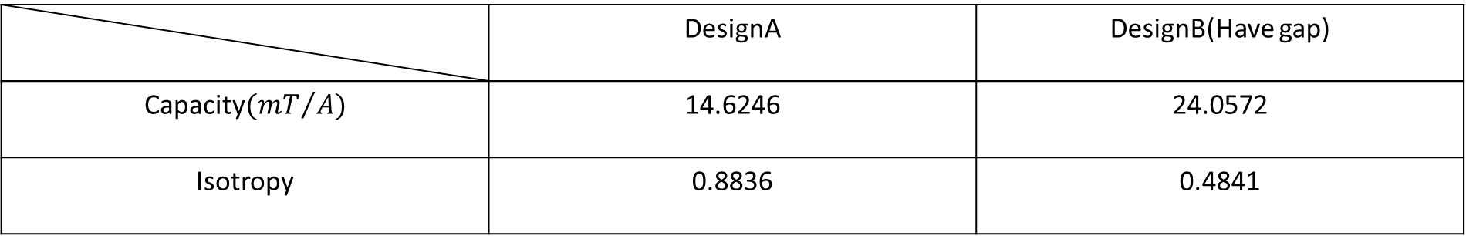

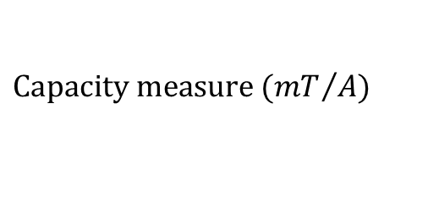

Zhi peng’s model compare
Capacity:DesignA<DesignB:39.2%
Isotropy: DesignA>DesignB:45.21%
No gap & Have gap
$$Percentage count(\%)$$
$$Percentage count(\%)$$
$$Capacity measure ({mT}/A)$$
$$Isotropy$$
 | DesignA | DesignB(Have gap)
Capacity$({mT}/A)$ | 14.6246 | 24.0572
Isotropy | 0.8836 | 0.4841
${24.0572}/{1.4}=17.184{mT}/A$

Slide 8
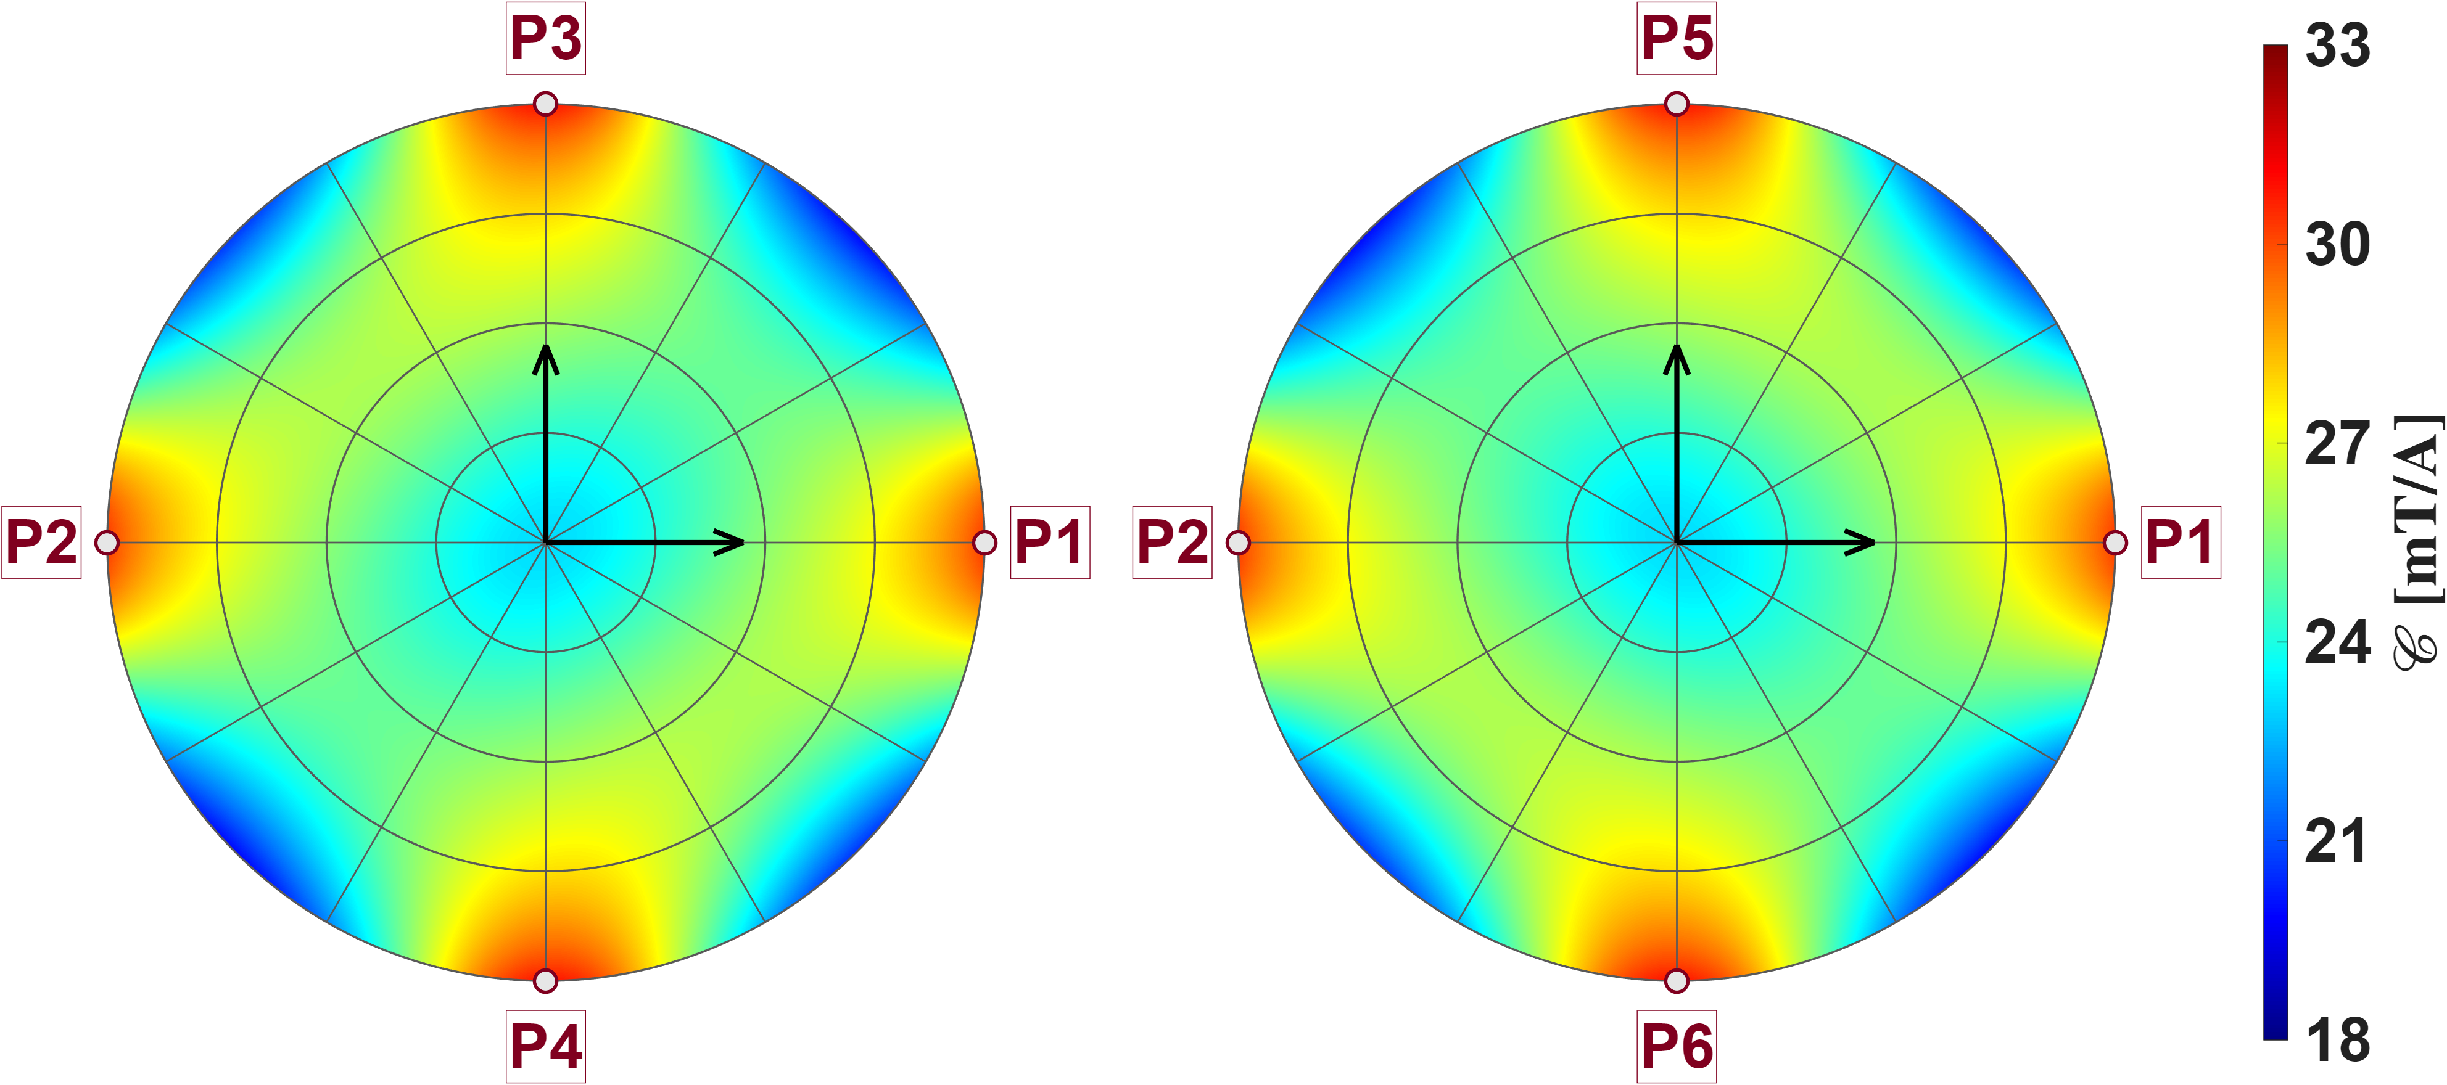
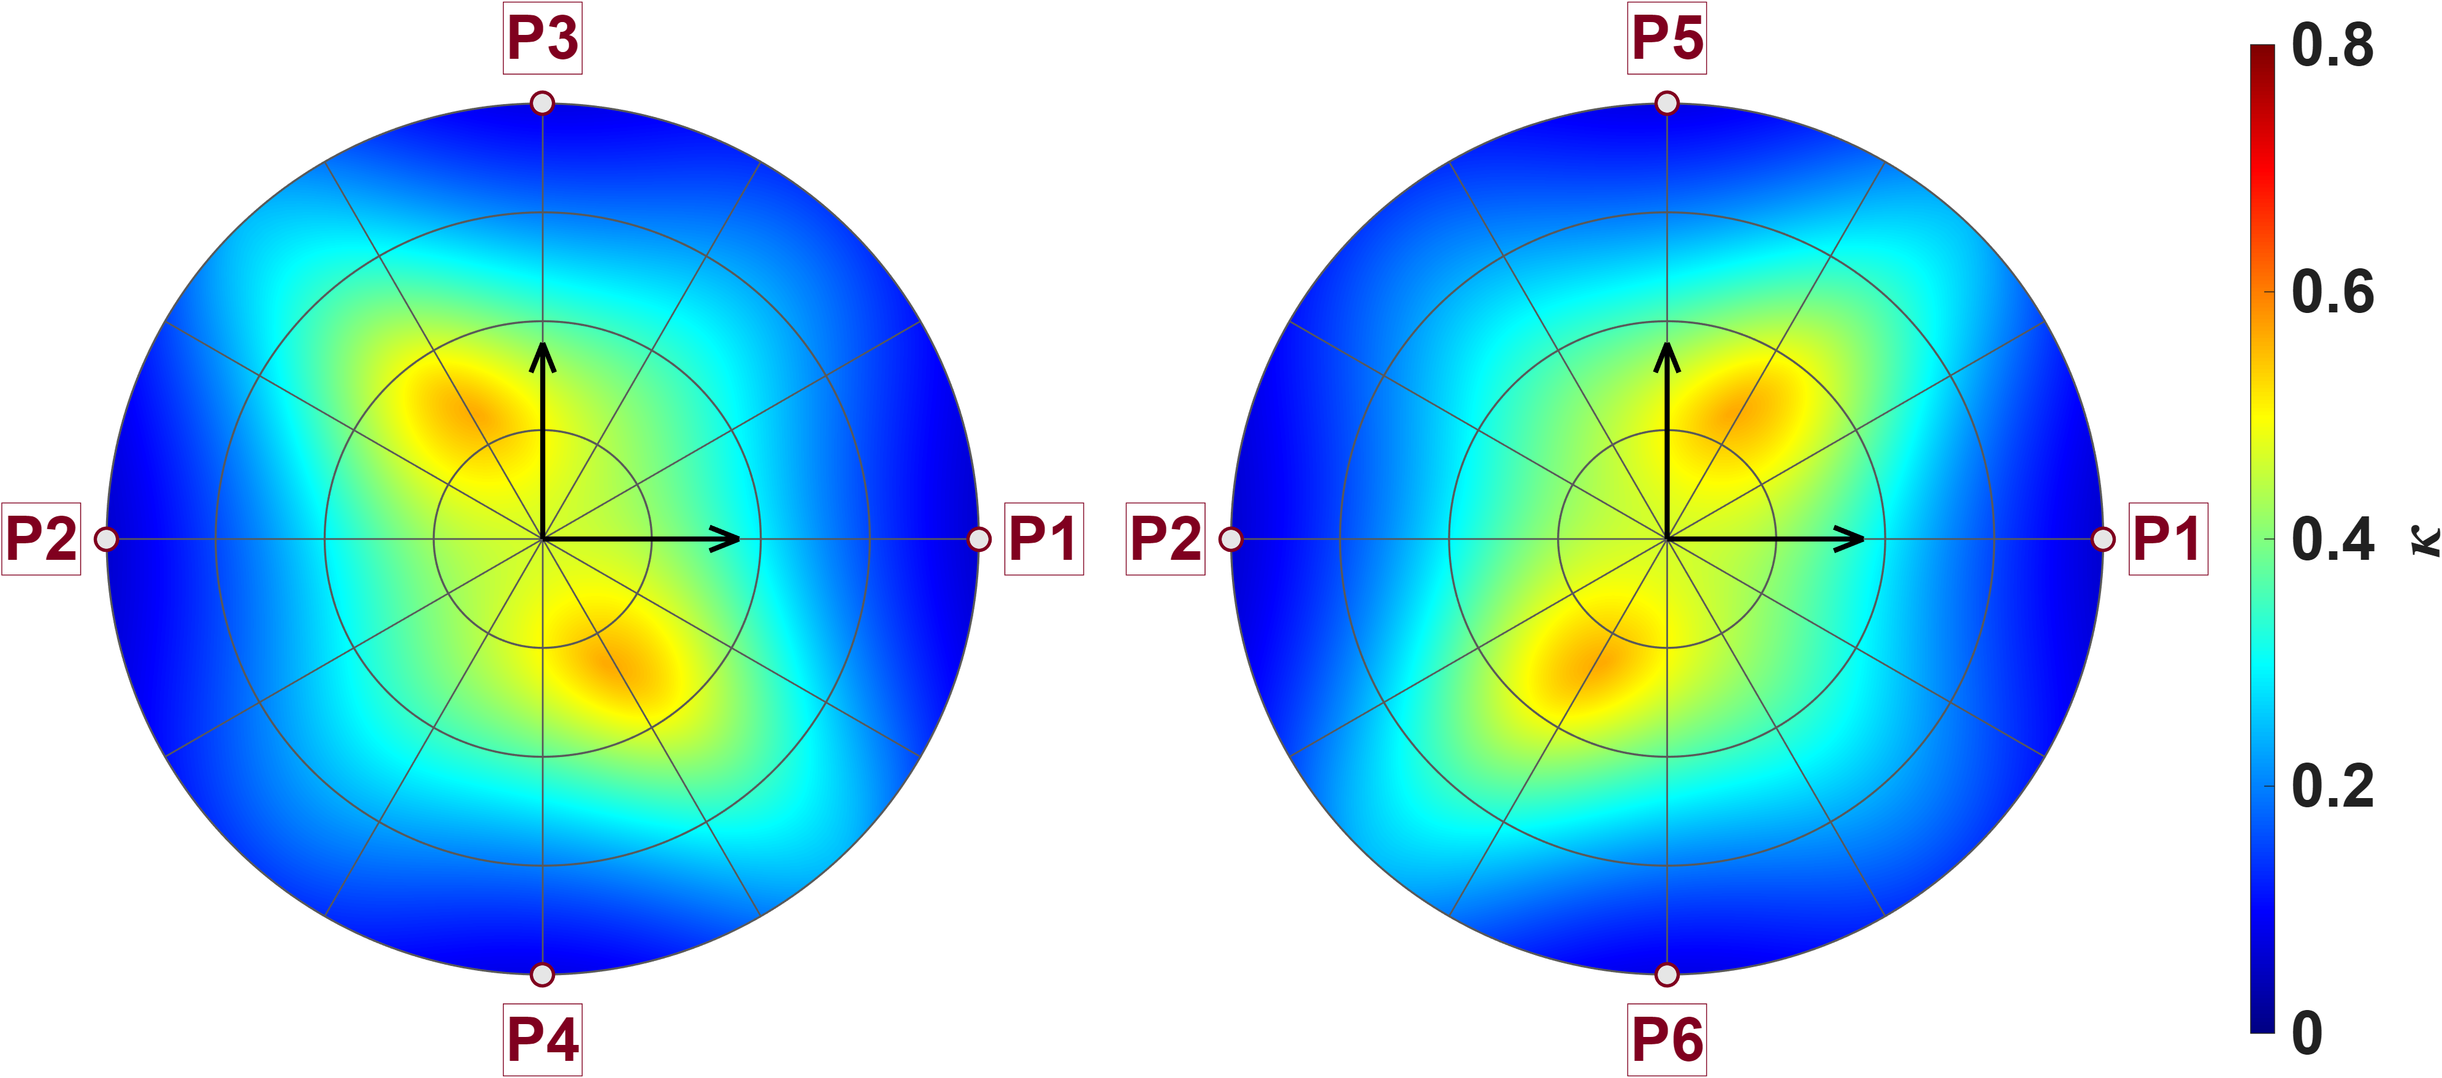
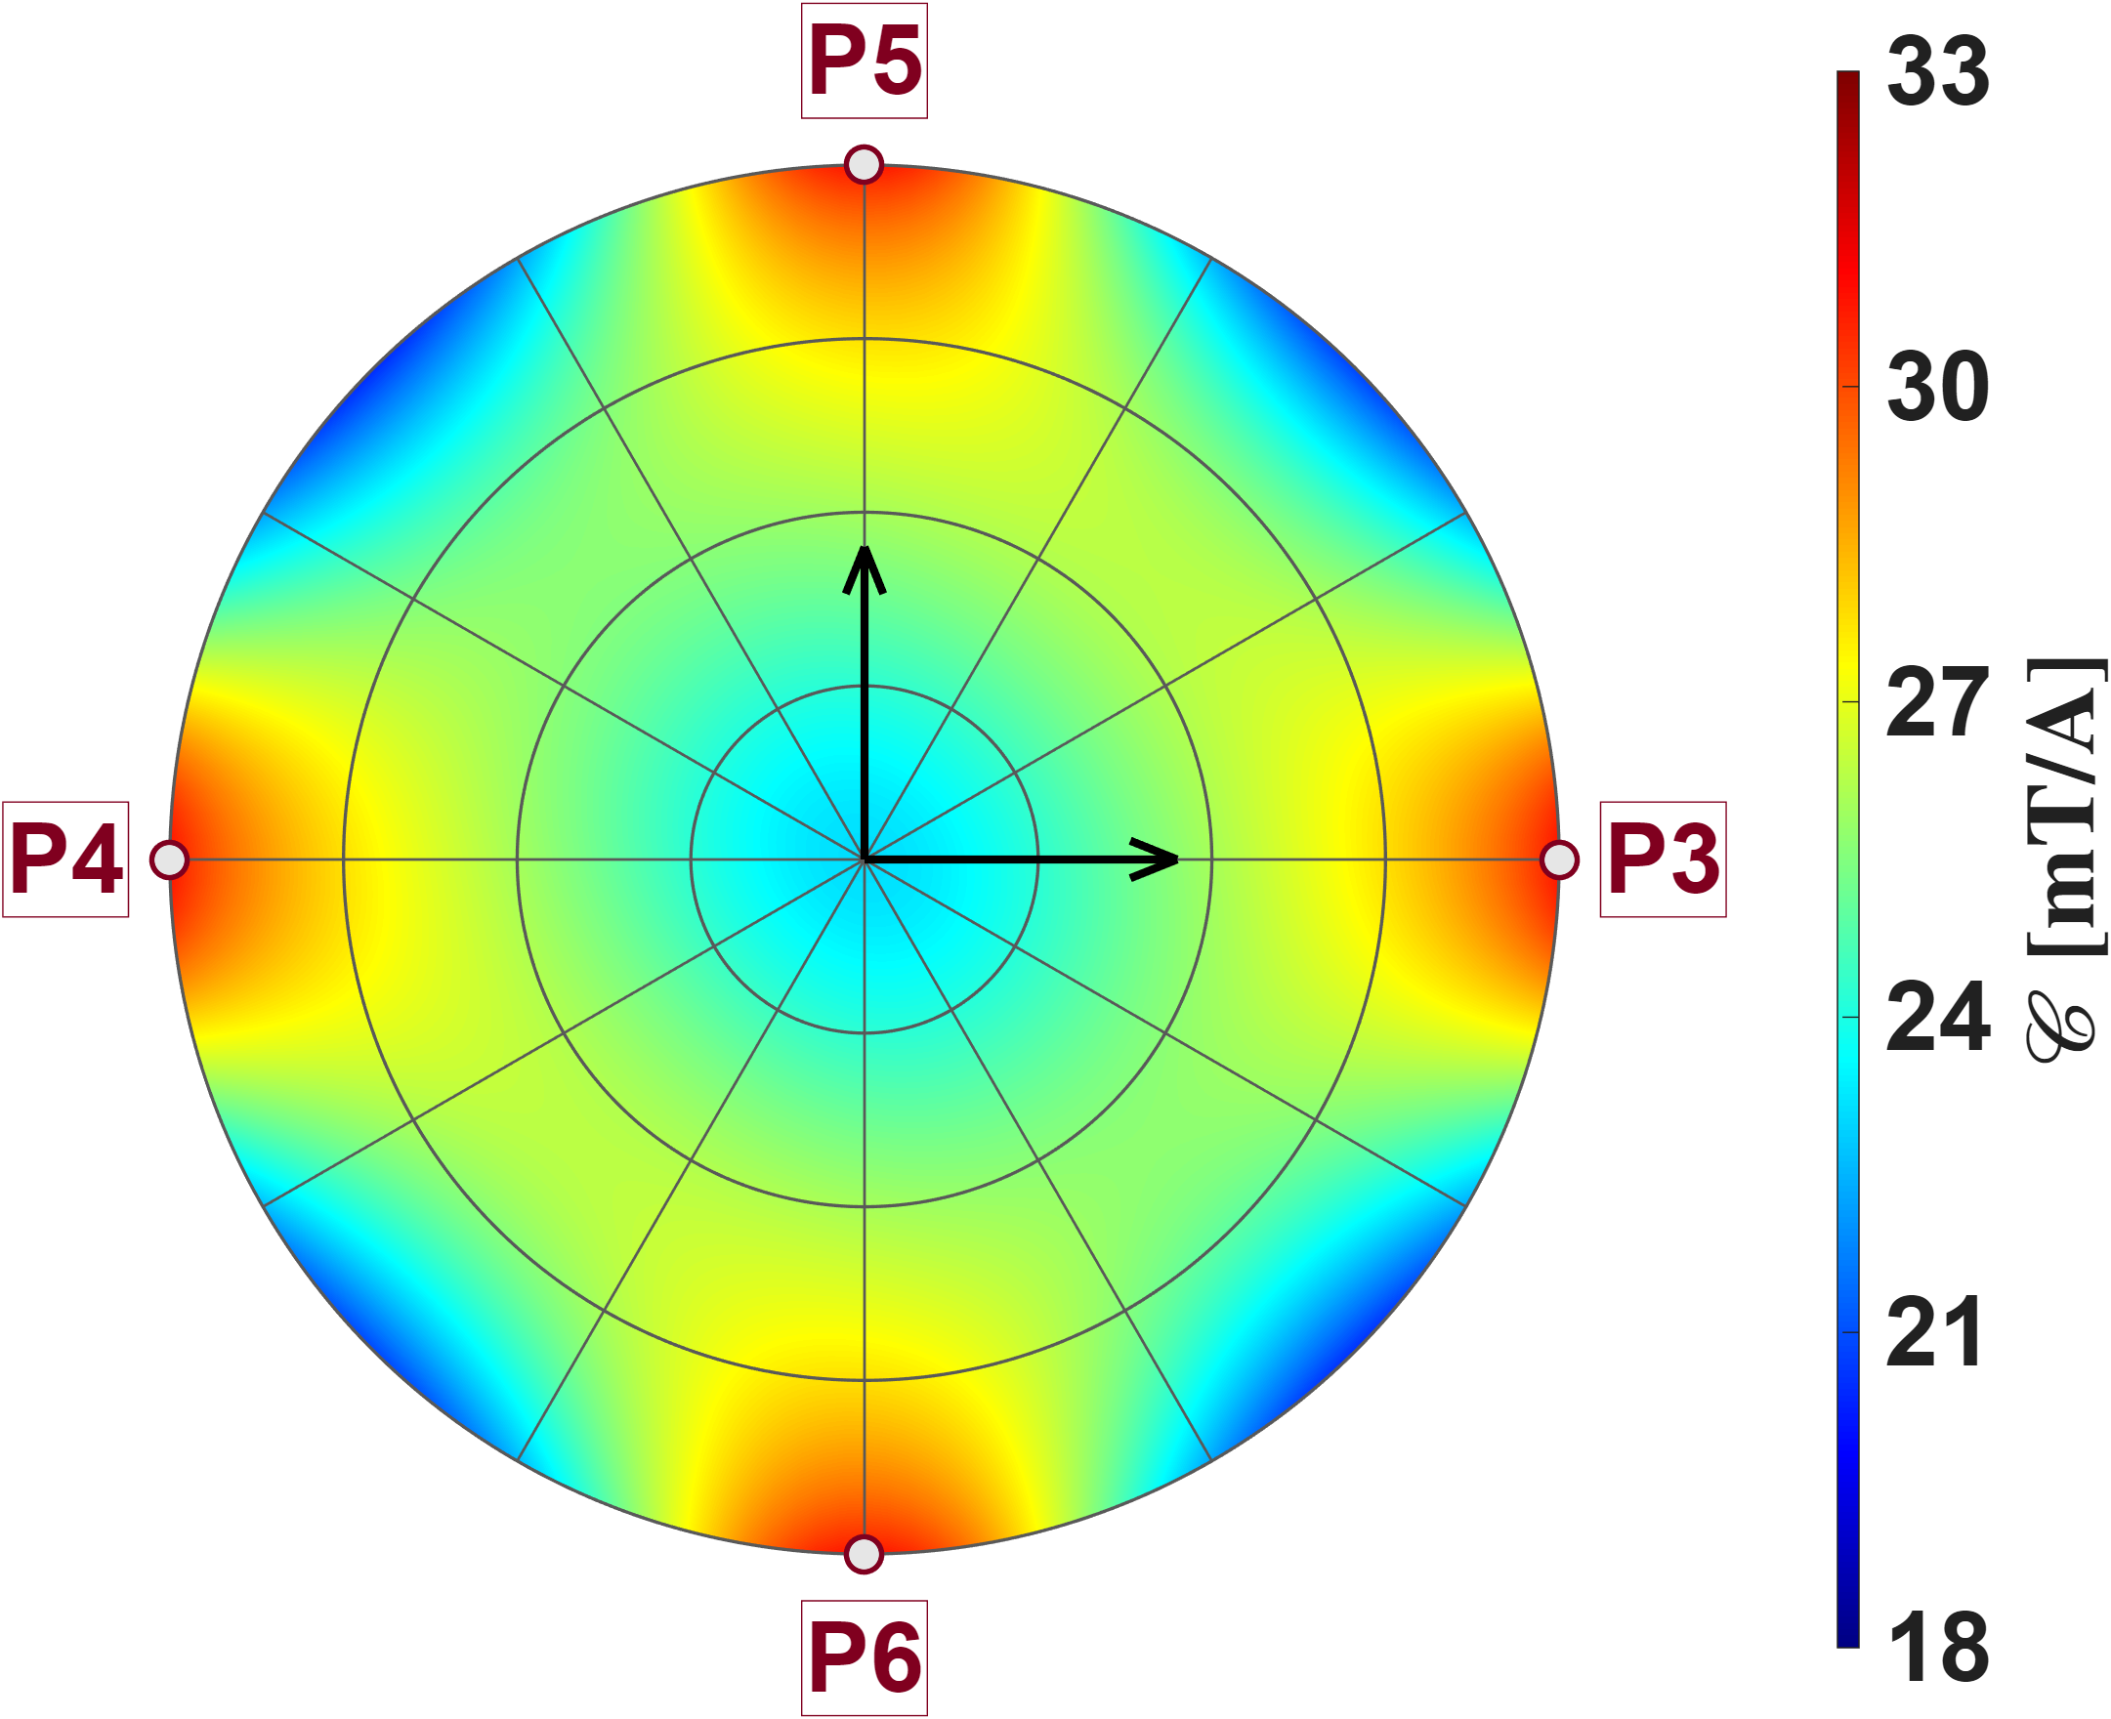
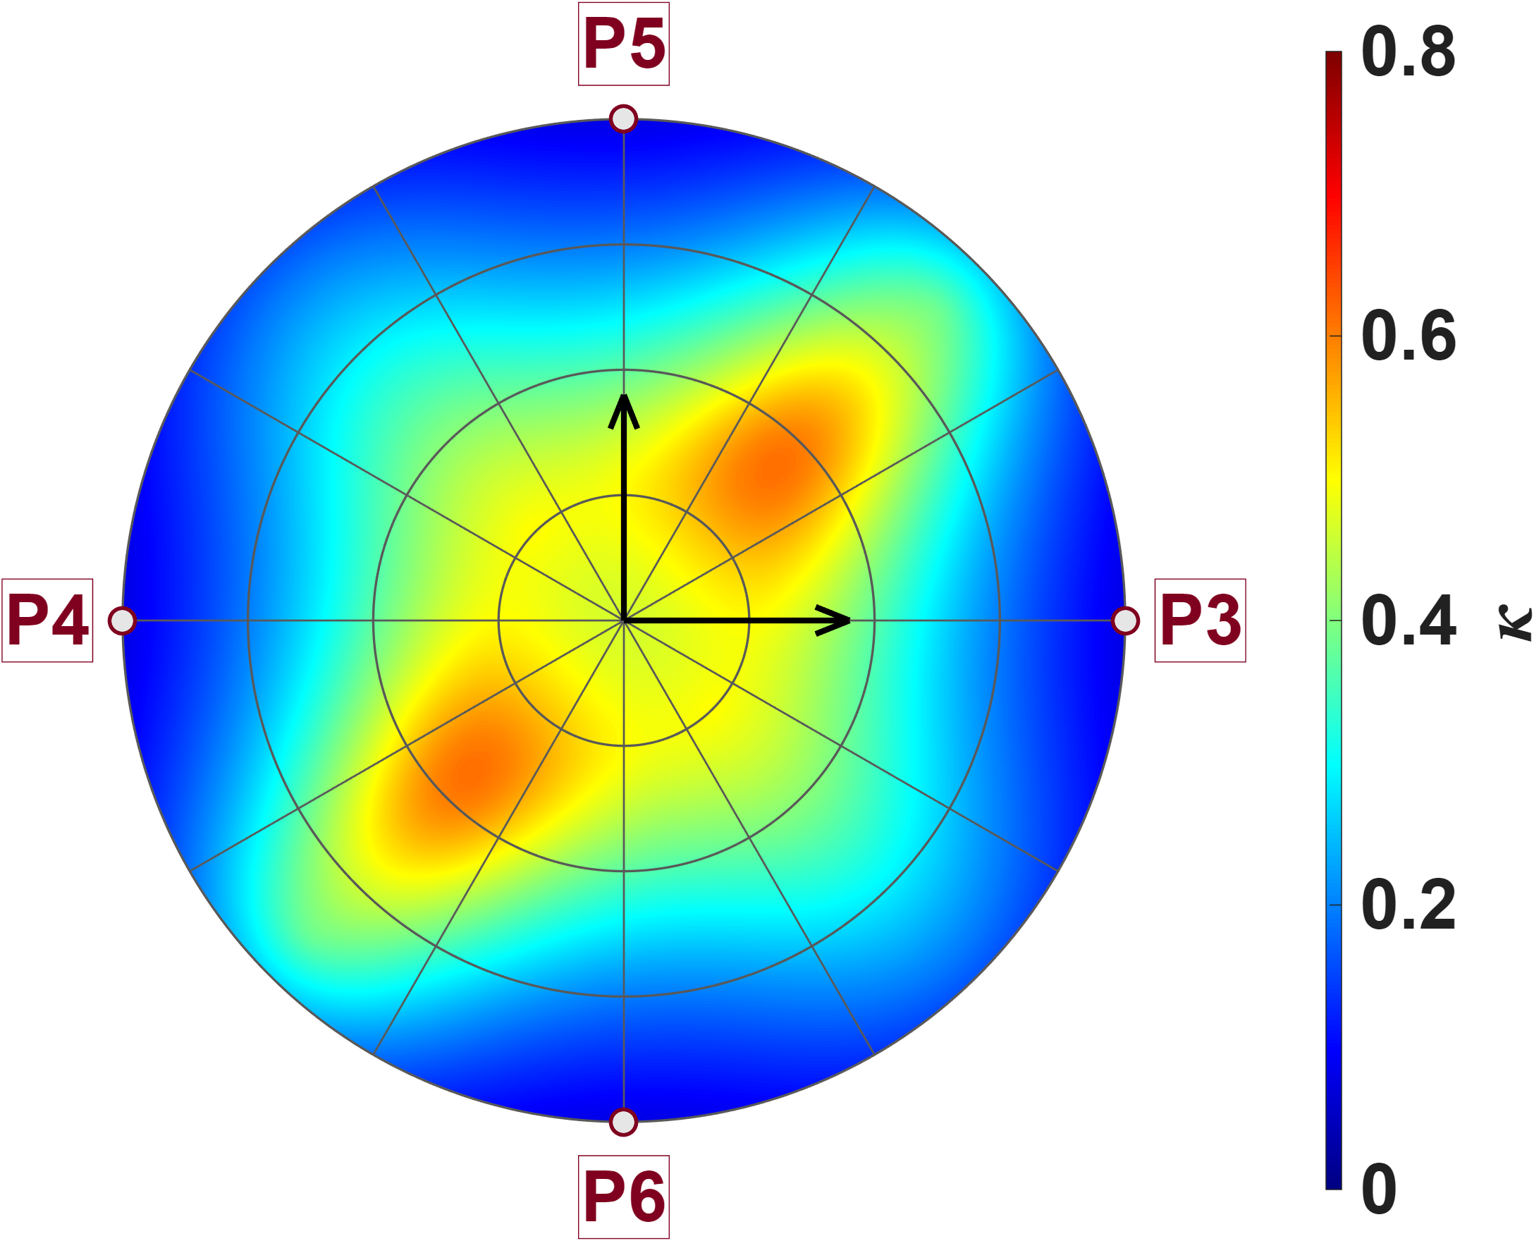

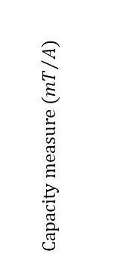









Zhi peng’s model compare
DesignB (polar plot)
Capacity
Isotropy
P3
P5
P3
P5
$$y_{a}$$
$$z_{a}$$
$$y_{a}$$
$$z_{a}$$
P2
P2
P2
P2
$$Isotropy$$
$$x_{a}$$
P1
$$x_{a}$$
$$Capacity measure ({mT}/A)$$
$$x_{a}$$
P1
$$x_{a}$$
P1
P1
P4
P6
P4
P6
P5
P5
$$z_{a}$$
$$z_{a}$$
P4
$$y_{a}$$
$$Capacity measure ({mT}/A)$$
P4
$$Isotropy$$
P3
$$y_{a}$$
P3
P6
P6

Slide 9


Reference
Calibrate results (Zhipeng’s model)
No gap(Single,35points)
Have gap(Single,35points)
$${\bar{K}}_{I} = \left[\begin{matrix}0.8333 & −0.0480 & −0.2315 & −0.0873 & −0.0853 & −0.2303 \\ −0.0842 & 0.8625 & −0.1198 & −0.2032 & −0.2014 & −0.1185 \\ −0.2645 & −0.0755 & 0.7436 & −0.0436 & −0.0481 & −0.2480 \\ −0.1121 & −0.2322 & −0.0759 & 0.7685 & −0.2192 & −0.0821 \\ −0.1121 & −0.2321 & −0.0830 & −0.2211 & 0.7695 & −0.0744 \\ −0.2645 & −0.0755 & −0.2491 & −0.0502 & −0.0420 & 0.7454\end{matrix}\right]$$
$${\bar{K}}_{I} = \left[\begin{matrix}0.8333 & −0.0480 & −0.2107 & −0.0554 & −0.0533 & −0.2085 \\ −0.0898 & 0.8681 & −0.0850 & −0.1864 & −0.1845 & −0.0828 \\ −0.2722 & −0.0592 & 0.6645 & −0.0441 & −0.0402 & −0.2218 \\ −0.1003 & −0.2364 & −0.0725 & 0.6847 & −0.1978 & −0.0695 \\ −0.0999 & −0.2360 & −0.0715 & −0.1995 & 0.6853 & −0.0700 \\ −0.2722 & −0.0592 & −0.2241 & −0.0422 & −0.0424 & 0.6671\end{matrix}\right]$$
$$\hat{ℓ} = 744.9 μm {}_{}^{B}{{\hat{g}}_{I}} = 32.7350 mT/A$$
$$\hat{ℓ} = 764.1 μm {}_{}^{B}{{\hat{g}}_{I}} = 21.5378 mT/A$$
NMAE = 10.50%
NMAE = 9.98%
No gap(Eighteen,35points)
Have gap(Eighteen,35points)
$${\bar{K}}_{I} = \left[\begin{matrix}0.8333 & −0.1068 & −0.1150 & −0.1881 & −0.1875 & −0.1150 \\ −0.1114 & 0.8296 & −0.1932 & −0.1195 & −0.1193 & −0.1928 \\ −0.1336 & −0.1957 & 0.7488 & −0.0923 & −0.1578 & −0.1300 \\ −0.2009 & −0.1382 & −0.0977 & 0.7452 & −0.1346 & −0.1634 \\ −0.2002 & −0.1378 & −0.1631 & −0.1345 & 0.7427 & −0.0970 \\ −0.1335 & −0.1954 & −0.1298 & −0.1585 & −0.0925 & 0.7492\end{matrix}\right]$$
$${\bar{K}}_{I} = \left[\begin{matrix}0.8333 & −0.1154 & −0.1086 & −0.1436 & −0.1433 & −0.1086 \\ −0.1176 & 0.8165 & −0.1475 & −0.1123 & −0.1121 & −0.1472 \\ −0.1412 & −0.1753 & 0.6595 & −0.0906 & −0.1328 & −0.1199 \\ −0.1820 & −0.1469 & −0.0964 & 0.6555 & −0.1250 & −0.1385 \\ −0.1807 & −0.1461 & −0.1383 & −0.1246 & 0.6528 & −0.0961 \\ −0.1408 & −0.1747 & −0.1197 & −0.1325 & −0.0906 & 0.6581\end{matrix}\right]$$
$$\hat{e}= \left[\begin{matrix}−0.0024 & 0.0010 & −0.2168 & 0.2168 & 0.2165 & −0.2164 \\ −0.2162 & 0.2166 & 0.0001 & −0.0020 & 0.2173 & −0.2162 \\ 0.2159 & −0.2162 & 0.2165 & −0.2176 & 0.0010 & −0.0003\end{matrix}\right]$$
$$\hat{e}= \left[\begin{matrix}0.0019 & 0.0031 & −0.2159 & 0.2165 & 0.2166 & −0.2155 \\ −0.2170 & 0.2151 & −0.0004 & −0.0020 & 0.2175 & −0.2156 \\ 0.2160 & −0.2153 & 0.2163 & −0.2175 & 0.0008 & 0.0013\end{matrix}\right]$$
$$\hat{ℓ} = 604.8 μm {}_{}^{B}{{\hat{g}}_{I}} = 37.3928 mT/A$$
NMAE = 0.68%
$$\hat{ℓ} = 605.5 μm {}_{}^{B}{{\hat{g}}_{I}} = 24.4465 mT/A$$
NMAE = 0.68%

Slide 10



Reference
Calibrate results(All FEM nodes)
Long
Zhi peng
Single
Single
$${\bar{K}}_{I} = \left[\begin{matrix}0.8333 & −0.1046 & −0.1809 & −0.1745 & −0.1737 & −0.1827 \\ −0.2145 & 0.9517 & −0.1986 & −0.1589 & −0.1576 & −0.2002 \\ −0.1870 & −0.1737 & 0.8427 & −0.1076 & −0.1740 & −0.1827 \\ −0.2040 & −0.1571 & −0.2068 & 0.9456 & −0.1569 & −0.1994 \\ −0.2045 & −0.1573 & −0.1983 & −0.1589 & 0.9514 & −0.2097 \\ −0.1870 & −0.1734 & −0.1804 & −0.1746 & −0.1054 & 0.8382\end{matrix}\right]$$
$${\bar{K}}_{I} = \left[\begin{matrix}0.8333 & −0.0649 & −0.2224 & −0.1009 & −0.1009 & −0.2226 \\ −0.0764 & 0.8376 & −0.1125 & −0.2147 & −0.2148 & −0.1127 \\ −0.2595 & −0.0965 & 0.7482 & −0.0526 & −0.0643 & −0.2407 \\ −0.1091 & −0.2511 & −0.0638 & 0.7518 & −0.2331 & −0.0768 \\ −0.1090 & −0.2510 & −0.0765 & −0.2329 & 0.7509 & −0.0638 \\ −0.2596 & −0.0966 & −0.2405 & −0.0643 & −0.0529 & 0.7485\end{matrix}\right]$$
$$\hat{ℓ} = 874.3 μm {}_{}^{B}{{\hat{g}}_{I}} = 9.6717 mT/A$$
NMAE = 2.81%
$$\hat{ℓ} = 745.0 μm {}_{}^{B}{{\hat{g}}_{I}} = 33.0870 mT/A$$
NMAE = 10.50%
Eighteen
Eighteen
$${\bar{K}}_{I} = \left[\begin{matrix}0.8333 & −0.1369 & −0.1291 & −0.1933 & −0.1926 & −0.1289 \\ −0.1380 & 0.8309 & −0.2033 & −0.1231 & −0.1230 & −0.2030 \\ −0.1276 & −0.1923 & 0.8291 & −0.1358 & −0.1920 & −0.1284 \\ −0.2042 & −0.1233 & −0.1403 & 0.8365 & −0.1235 & −0.2048 \\ −0.2033 & −0.1230 & −0.2038 & −0.1234 & 0.8338 & −0.1392 \\ −0.1279 & −0.1928 & −0.1288 & −0.1936 & −0.1366 & 0.8328\end{matrix}\right]$$
$${\bar{K}}_{I} = \left[\begin{matrix}0.8333 & −0.1070 & −0.1150 & −0.1879 & −0.1878 & −0.1150 \\ −0.1106 & 0.8267 & −0.1923 & −0.1191 & −0.1190 & −0.1923 \\ −0.1328 & −0.1947 & 0.7452 & −0.0927 & −0.1569 & −0.1292 \\ −0.1986 & −0.1368 & −0.0967 & 0.7376 & −0.1333 & −0.1617 \\ −0.1985 & −0.1367 & −0.1616 & −0.1333 & 0.7371 & −0.0967 \\ −0.1328 & −0.1946 & −0.1292 & −0.1571 & −0.0926 & 0.7454\end{matrix}\right]$$
$$\hat{e}= \left[\begin{matrix}0.0183 & 0.0195 & −0.1173 & 0.0021 & 0.0012 & −0.1180 \\ −0.1178 & 0.0024 & 0.0155 & 0.0147 & 0.0016 & −0.1180 \\ 0.1176 & −0.0022 & 0.1167 & −0.0029 & −0.0178 & −0.0181\end{matrix}\right]$$
$$\hat{e}= \left[\begin{matrix}−0.0002 & 0.0004 & −0.2164 & 0.2160 & 0.2165 & −0.2161 \\ −0.2162 & 0.2165 & 0.0003 & −0.0000 & 0.2168 & −0.2161 \\ 0.2161 & −0.2164 & 0.2162 & −0.2166 & −0.0001 & −0.0003\end{matrix}\right]$$
$$\hat{ℓ} = 874.0 μm {}_{}^{B}{{\hat{g}}_{I}} = 10.7518 mT/A$$
NMAE = 0.27%
$$\hat{ℓ} = 604.1 μm {}_{}^{B}{{\hat{g}}_{I}} = 37.5562 mT/A$$
NMAE = 0.68%

Slide 11
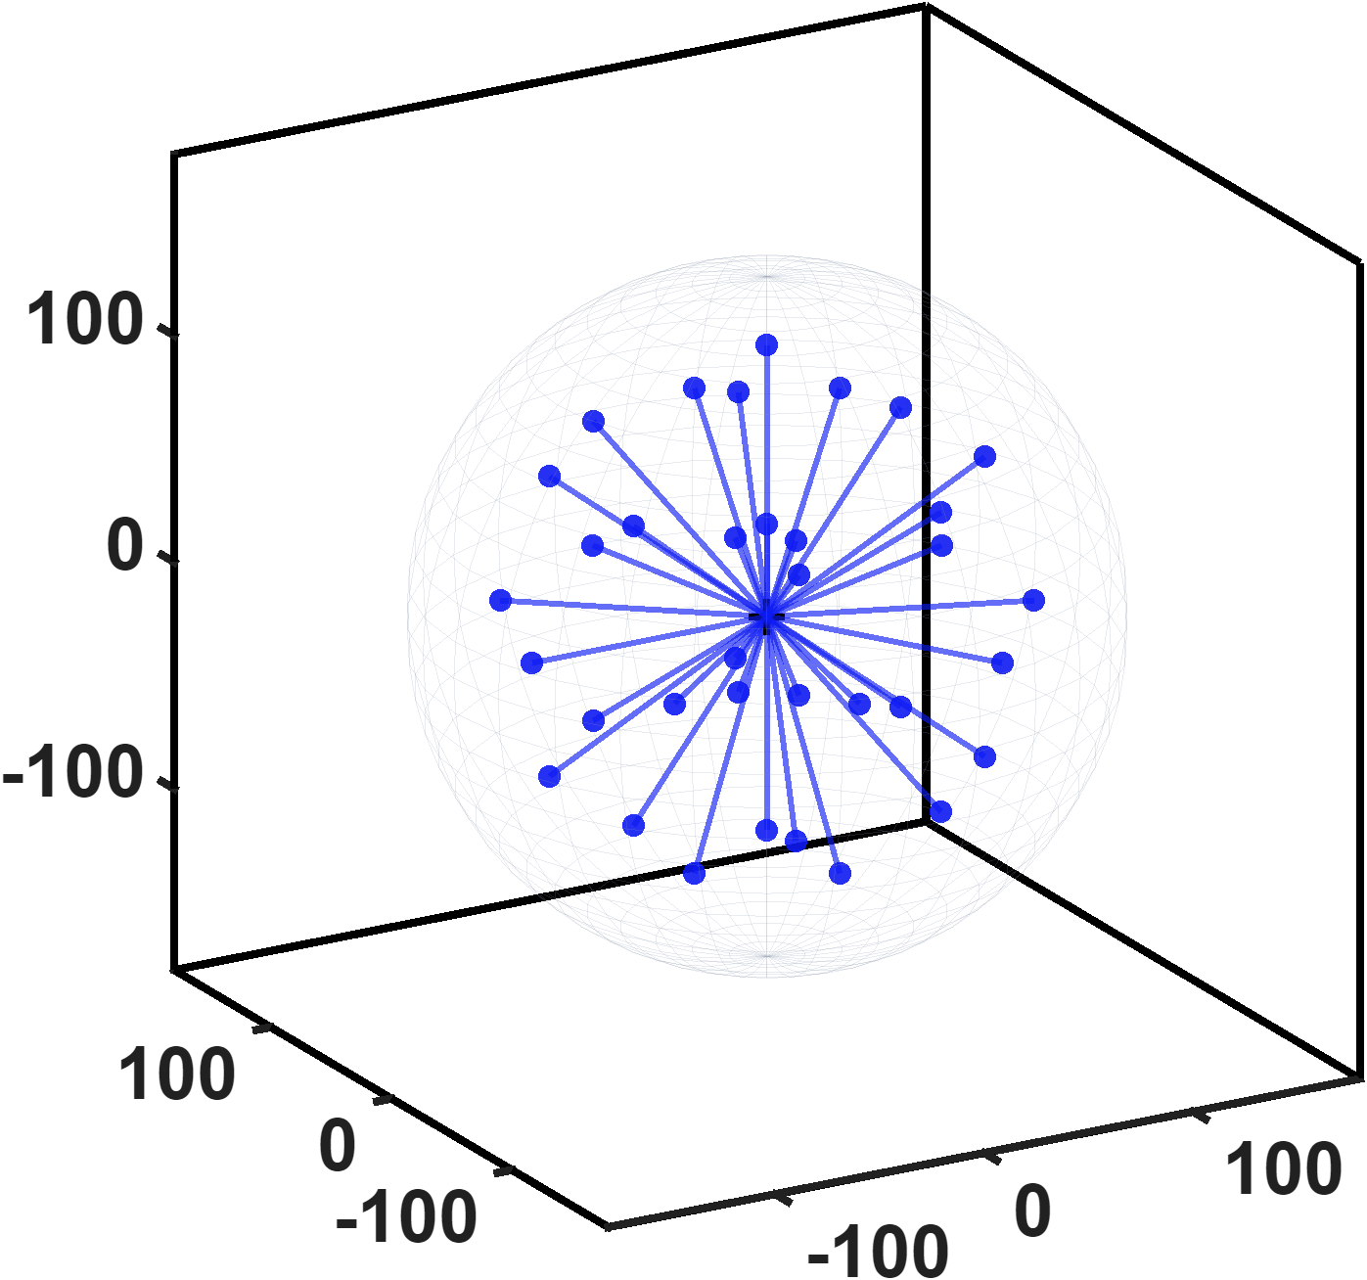
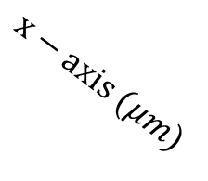

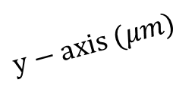
Reference
Data point distribution
All models satisfy the convergence criteria with only 35 points, while their prediction performance remains unaffected.
$$z−axis (μm)$$
$$x−axis (μm)$$
$$y−axis (μm)$$

