Slide 1
A Lumped-Parameter Modeling, Calibration, and Capacity-Measure Framework for Flux Generation in Symmetric
Multipole Electromagnetic Actuators

Slide 2
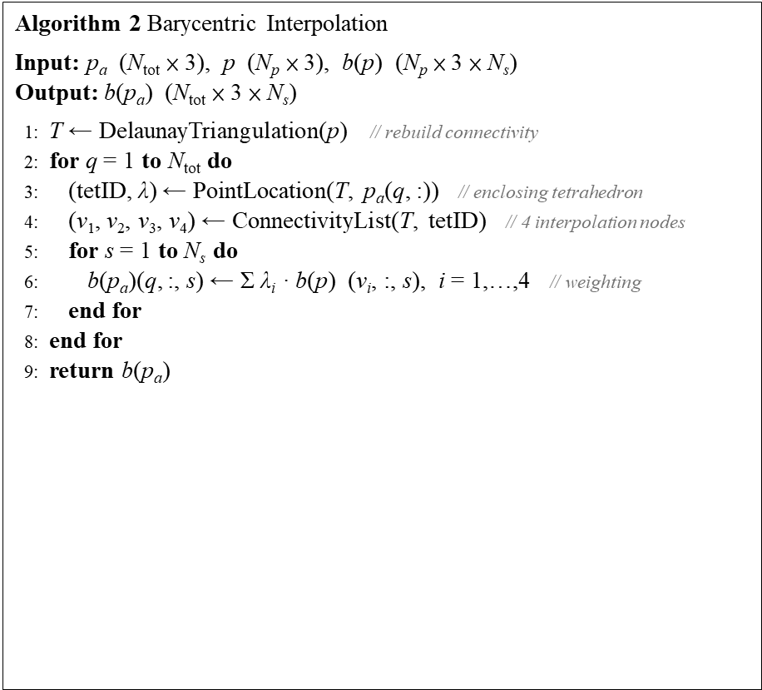
Current-based lumped-parameter modeling and calibration
E. Validation
Interpolation Point Algorithm for workspace pseudocode
Algorithm 1 Generate Interpolation Points
Input: N_{a}, R
Output: p_{a} (N_{tot} × 3)
1: d ← R / N_{a} // division spacing
2: N_{tot} ← 1 + 6·N_{a} // total number of points
3: p_{a} ← zeros(N_{tot}, 3)
4: E ← eye(3) // unit vectors of three axes
5: cnt ← 1; p_{a}(cnt, :) ← [0, 0, 0] // center point
6: for j = 1 to 3 do
7: for s ∈ {+1, −1} do // ± direction
8: for i = 1 to N_{a} do
9: cnt ← cnt + 1
10: p_{a}(cnt, :) ← s · i · d · E(j, :) // i-th point on axis j
11: end for
12: end for
13: end for
14: return p_{a}
Algorithm 2 Barycentric Interpolation
Input: p_{a} (N_{tot} × 3), p (N_{p} × 3), b(p) (N_{p} × 3 × N_{s})
Output: b(p_{a}) (N_{tot} × 3 × N_{s})
1: T ← DelaunayTriangulation(p) // rebuild connectivity
2: for q = 1 to N_{tot} do
3: (tetID, λ) ← PointLocation(T, p_{a}(q, :)) // enclosing tetrahedron
4: (v₁, v₂, v₃, v₄) ← ConnectivityList(T, tetID) // 4 interpolation nodes
5: for s = 1 to N_{s} do
6: b(p_{a})(q, :, s) ← Σ λ_{i} · b(p) (v_{i}, :, s), i = 1,…,4 // weighting
7: end for
8: end for
9: return b(p_{a})

Slide 3
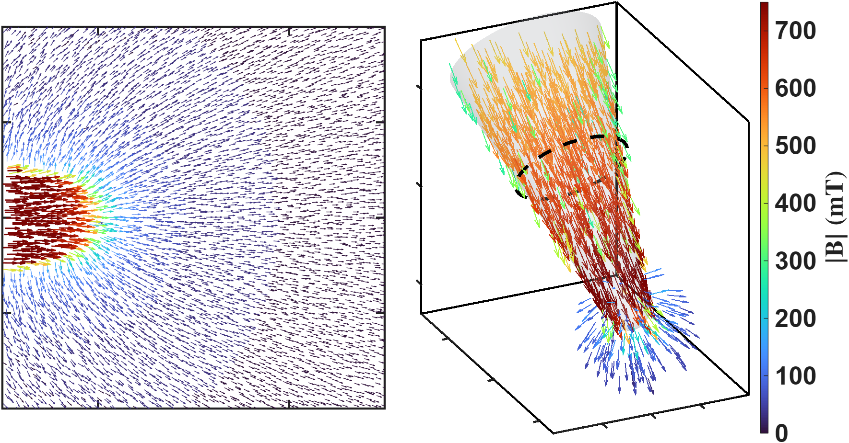



Current-based lumped-parameter modeling and calibration
E. Validation
This figure illustrates the magnetic flux path when pole P2 is excited. The left figure presents a top view, with the theoretical magnetic charge locations labeled to clarify the magnetic charge concept used in this study. The right figure shows a three-dimensional view of the same model, in which the theoretical magnetic charge locations and the magnetic flux distribution can be clearly observed.
The threshold used in the 3D plot on the right is 0.1 mT, meaning that only values greater than 0.1 mT are displayed in the figure.
$$Φ$$
$$q$$
$$q$$

Slide 4
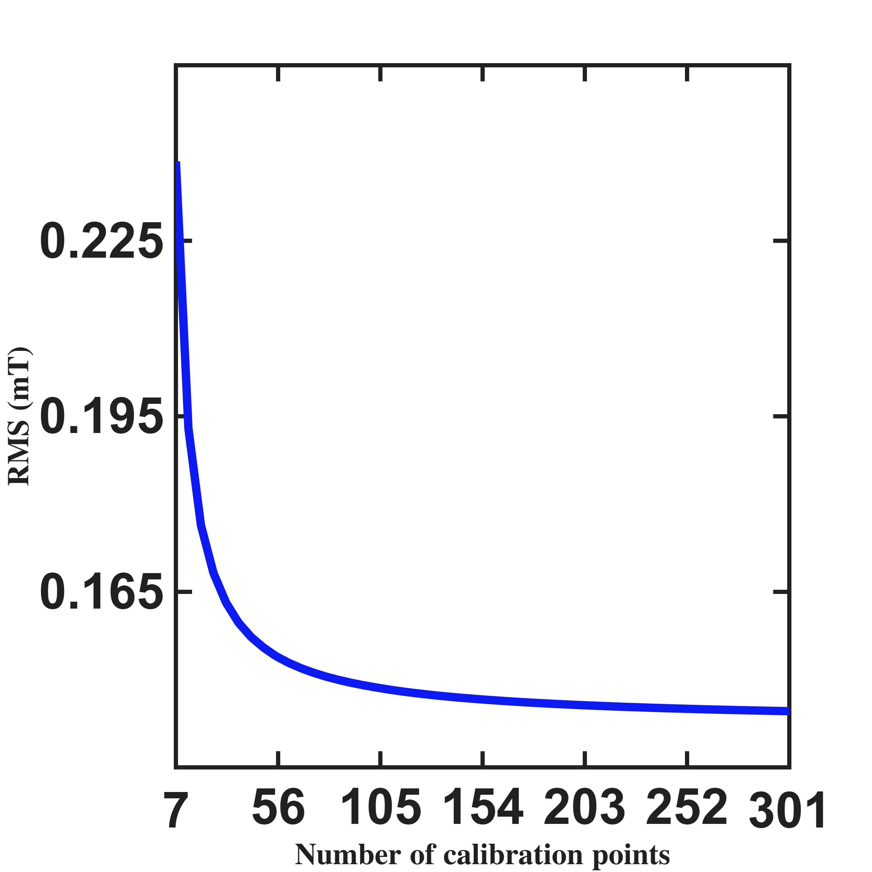
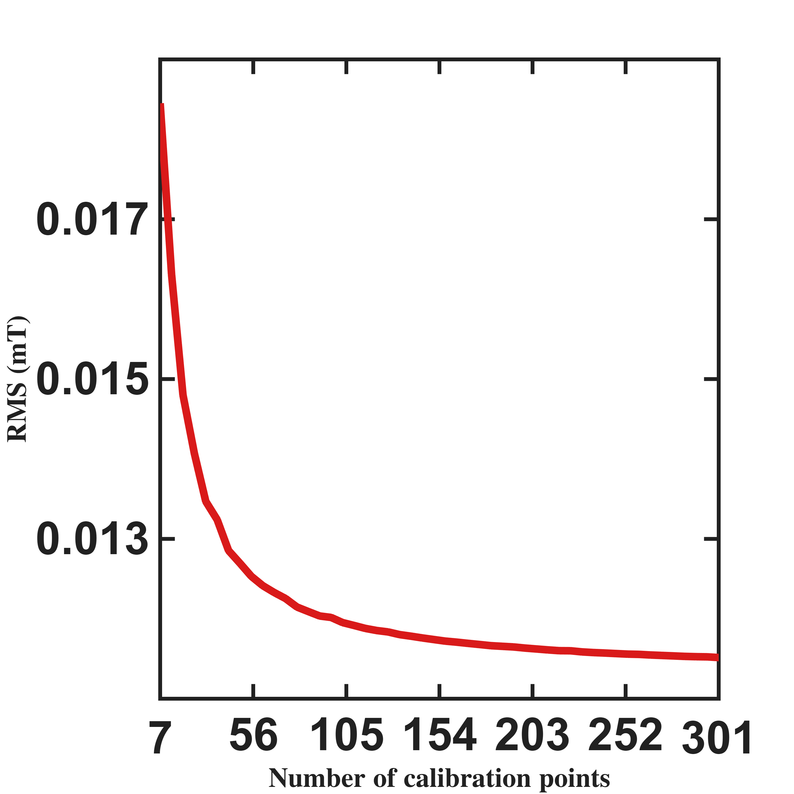
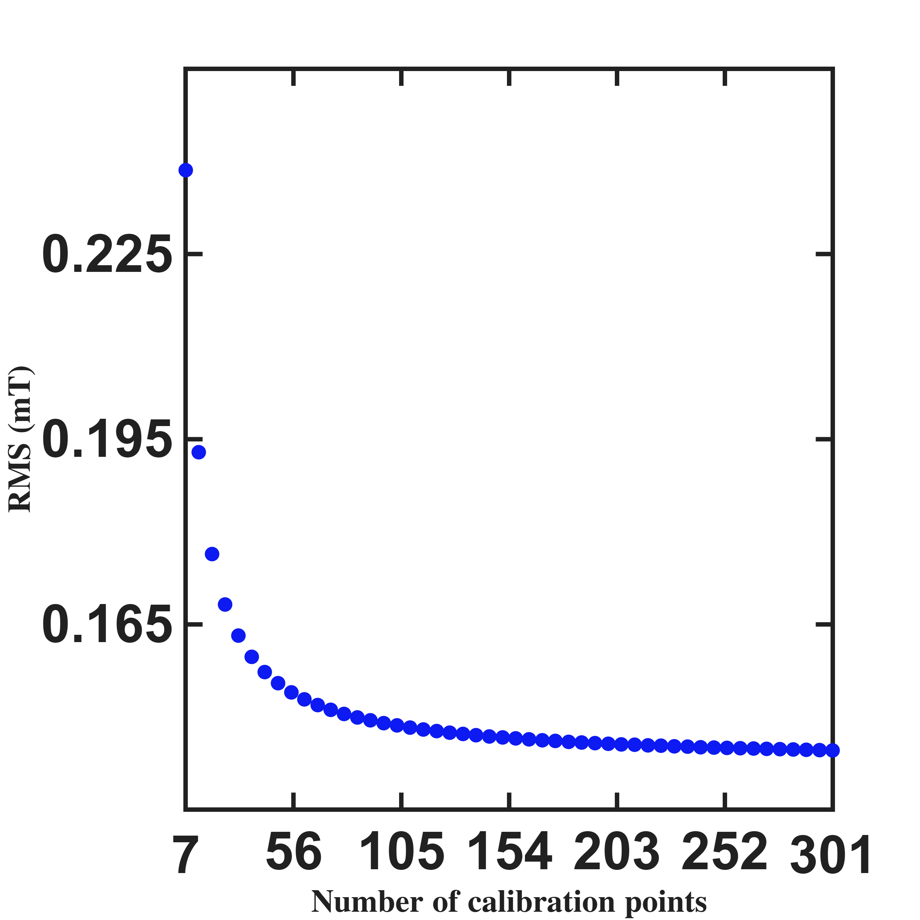
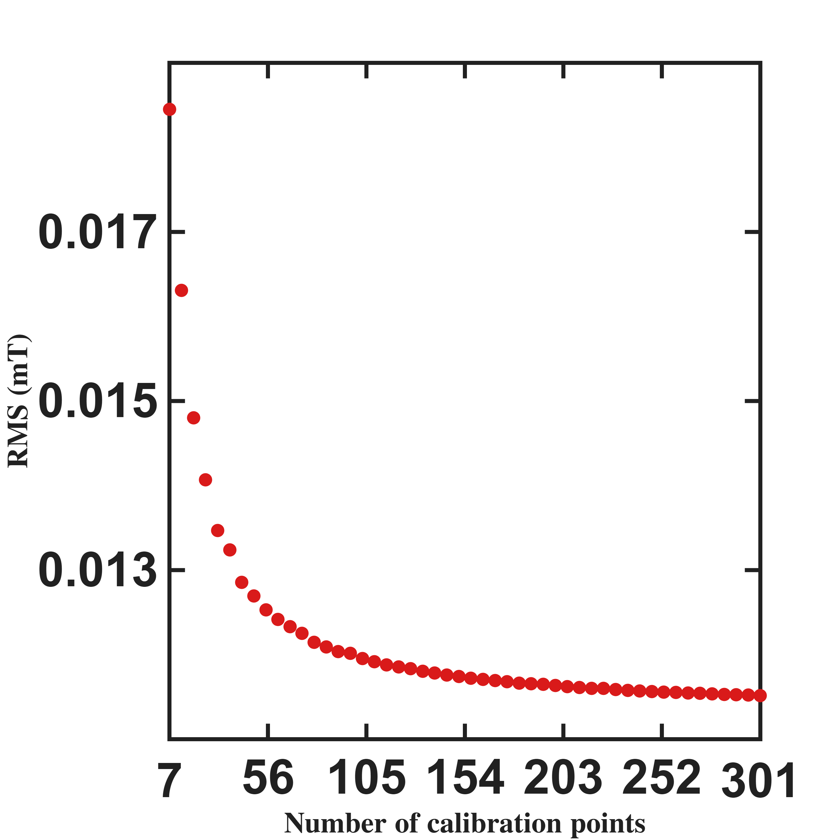



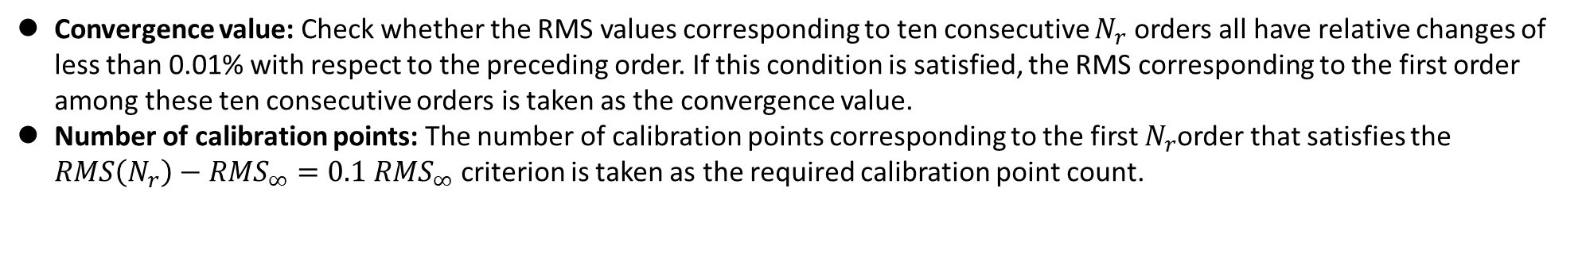





Current-based lumped-parameter modeling and calibration
E. Validation
Convergence value: Check whether the RMS values corresponding to ten consecutive $N_{r}$ orders all have relative changes of less than 0.01% with respect to the preceding order. If this condition is satisfied, the RMS corresponding to the first order among these ten consecutive orders is taken as the convergence value.
Number of calibration points: The required calibration point count is taken at the first order from which ten consecutive $N_{r}$orders all lie within 10% of the convergence value, i.e. $RMS\left(N_{r}\right)−{RMS}_{∞}≤0.1 {RMS}_{∞}$.
RMS $(mT)$
RMS $(mT)$
 | Number of calibration points | Convergence value
Single parameter | 43 | 0.1437mT
Eighteen parameters | 55 | 0.0114mT
Number of calibration points $(N_{c})$
Number of calibration points $(N_{c})$
RMS $(mT)$
RMS $(mT)$
Number of calibration points $(N_{c})$
Number of calibration points $(N_{c})$

Slide 5
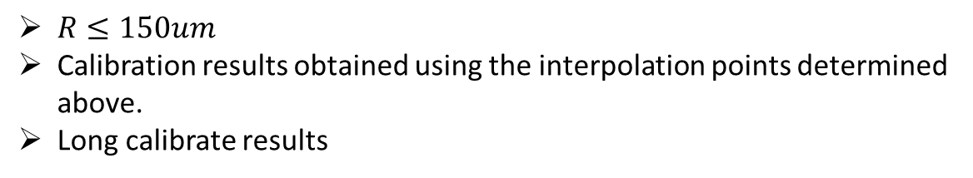





Current-based lumped-parameter modeling and calibration
E. Validation
Calibration results
$$Calibrate model→b_{ij}=S_{i}{}_{}^{B}{{\hat{g}}_{I}}{\overline{K}}_{I}I_{j}$$
$R≤150um$
Calibration results obtained using the interpolation points determined above.
Long calibrate results
Single parameter(43 points)
$${\bar{K}}_{I} = \left[\begin{matrix}0.8333 & −0.0962 & −0.1983 & −0.1667 & −0.1721 & −0.1955 \\ −0.2134 & 0.9594 & −0.2162 & −0.1512 & −0.1561 & −0.2129 \\ −0.1888 & −0.1683 & 0.8263 & −0.0977 & −0.1720 & −0.1954 \\ −0.2056 & −0.1517 & −0.2221 & 0.9547 & −0.1549 & −0.2120 \\ −0.2063 & −0.1518 & −0.2157 & −0.1514 & 0.9542 & −0.2205 \\ −0.1886 & −0.1678 & −0.1979 & −0.1670 & −0.1014 & 0.8266\end{matrix}\right]$$
$$\hat{ℓ} = 870.7 μm {}_{}^{B}{{\hat{g}}_{I}} = 9.68 mT/A$$
$$NMAE=\frac{\sum_{j}{\sum_{i}{\left\|b_{ij}−S_{i}{}_{}^{B}{{\hat{g}}_{I}}{\overline{K}}_{I}I_{j}\right\|}}}{\sum_{j}{\sum_{i}{\left\|b_{ij}\right\|}}}∙100\%=2.81\%$$
Eighteen parameters(55 points)
$${\bar{K}}_{I} = \left[\begin{matrix}0.8333 & −0.1380 & −0.1301 & −0.1909 & −0.1922 & −0.1299 \\ −0.1390 & 0.8384 & −0.2057 & −0.1230 & −0.1248 & −0.2050 \\ −0.1300 & −0.1977 & 0.8440 & −0.1371 & −0.1949 & −0.1317 \\ −0.2044 & −0.1259 & −0.1398 & 0.8419 & −0.1253 & −0.2064 \\ −0.2067 & −0.1273 & −0.2090 & −0.1257 & 0.8512 & −0.1418 \\ −0.1302 & −0.1975 & −0.1323 & −0.1943 & −0.1359 & 0.8425\end{matrix}\right]$$
$$\hat{ℓ} = 868.4 μm {}_{}^{B}{{\hat{g}}_{I}} = 10.64 mT/A$$
$$NMAE=\frac{\sum_{j}{\sum_{i}{\left\|b_{ij}−S_{i}{}_{}^{B}{{\hat{g}}_{I}}{\overline{K}}_{I}I_{j}\right\|}}}{\sum_{j}{\sum_{i}{\left\|b_{ij}\right\|}}}∙100\%=0.32\%$$
$$\hat{e}= \left[\begin{matrix}0.0134 & 0.0200 & −0.1170 & 0.0016 & 0.0006 & −0.1170 \\ −0.1155 & 0.0028 & 0.0185 & 0.0168 & 0.0012 & −0.1168 \\ 0.1152 & −0.0026 & 0.1159 & −0.0025 & −0.0137 & −0.0187\end{matrix}\right]$$

Slide 6
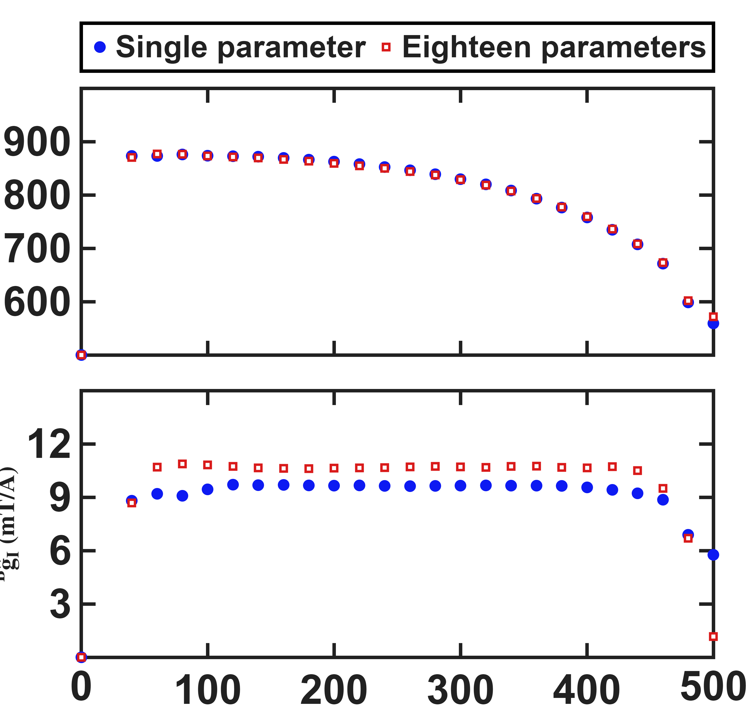
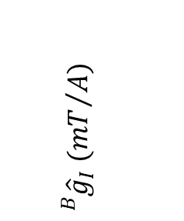


Current-based lumped-parameter modeling and calibration
E. Validation
This figure shows the trends of the calibration results for $\hat{ℓ }$and ${}_{}^{B}{{\hat{g}}_{I}}$ for Long-Fei using the number of calibration points required for each working range.
$$\hat{ℓ} (μm)$$
$${}_{}^{B}{{\hat{g}}_{I}} ({mT}/A)$$
Workspace radius $(μm)$

Slide 7
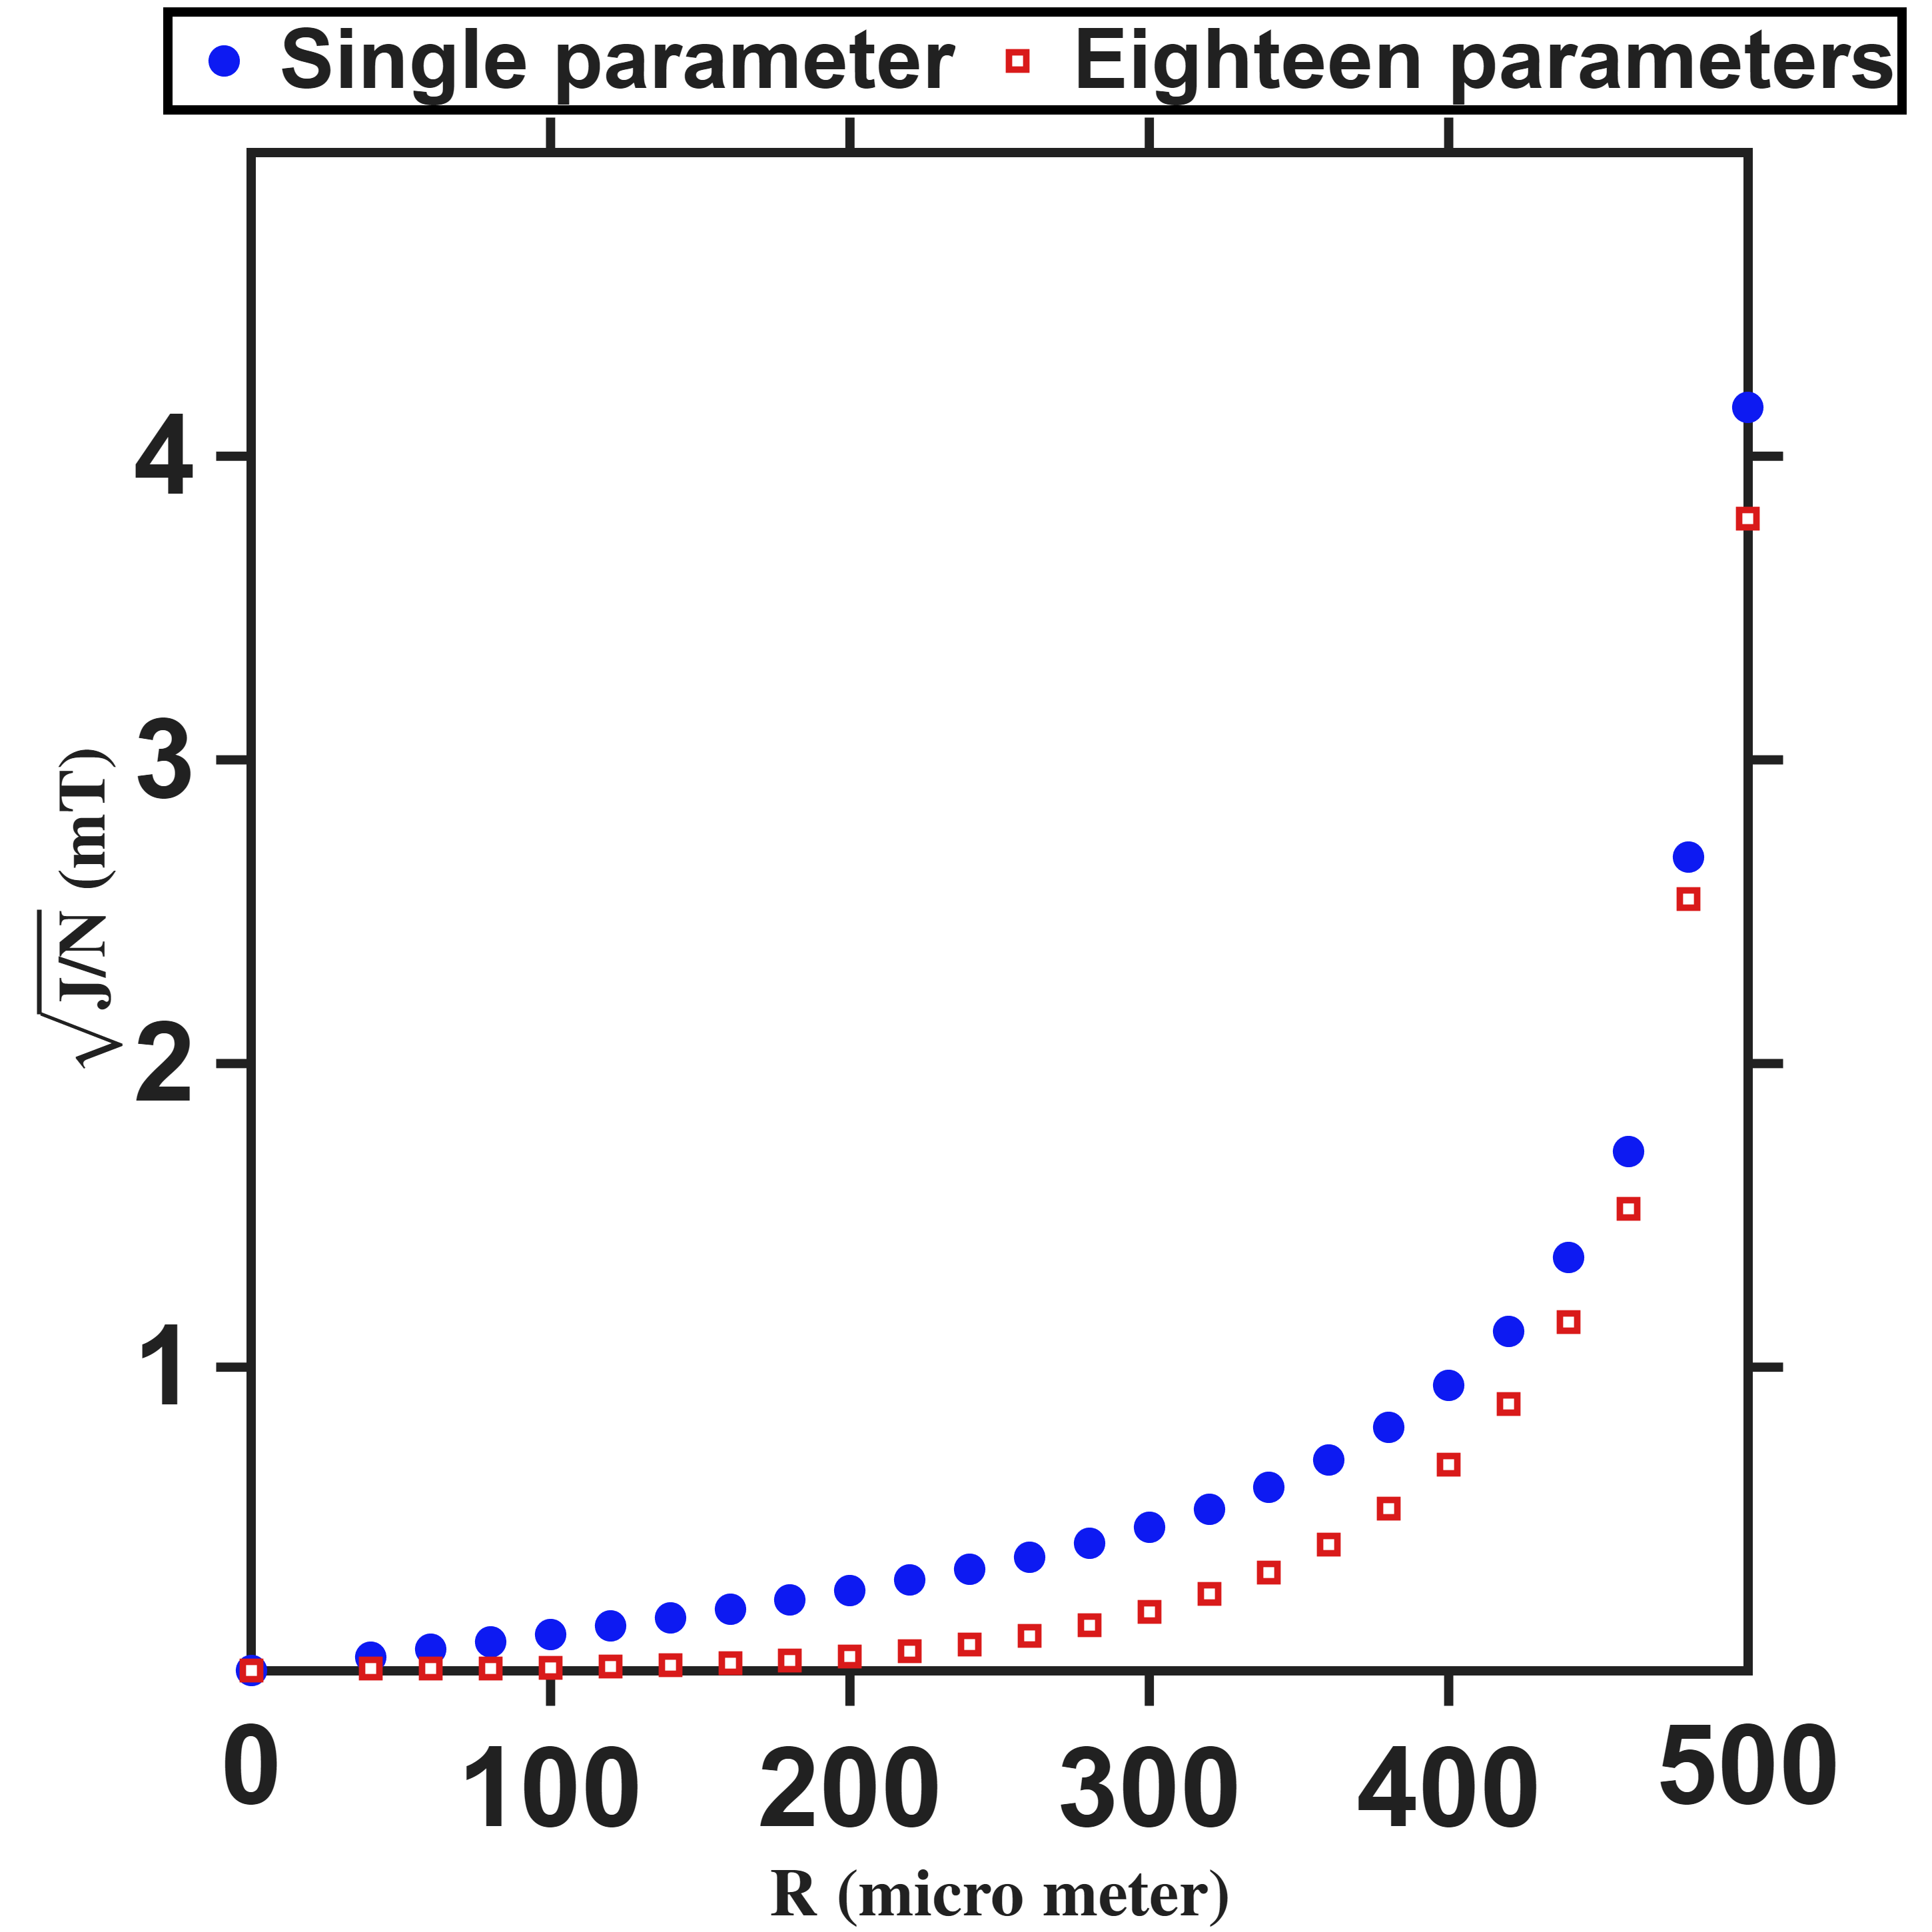


Current-based lumped-parameter modeling and calibration
E. Validation
Setup: The calibration side is identical to the previous slide: the same R sweep, the same converged reduced design at each R. What changes is the evaluation: the prediction is computed on every real FEM node inside R.
Prediction error grows with workspace radius and degrades sharply beyond the 150 µm calibration radius: the single-parameter error grows from 0.20 mT at R = 160 µm to 0.94 mT at 400 µm and 4.16 mT at 500 µm. The eighteen-parameter fit is lower at every radius, but its advantage collapses with R — from 8.1× at 160 µm to 1.10× at 500 µm — showing that charge offsets correct near-field structure only and cannot compensate the far-field model error. The model is therefore trustworthy only near the calibration radius.
RMS $(mT)$
Workspace radius $(μm)$

Slide 8
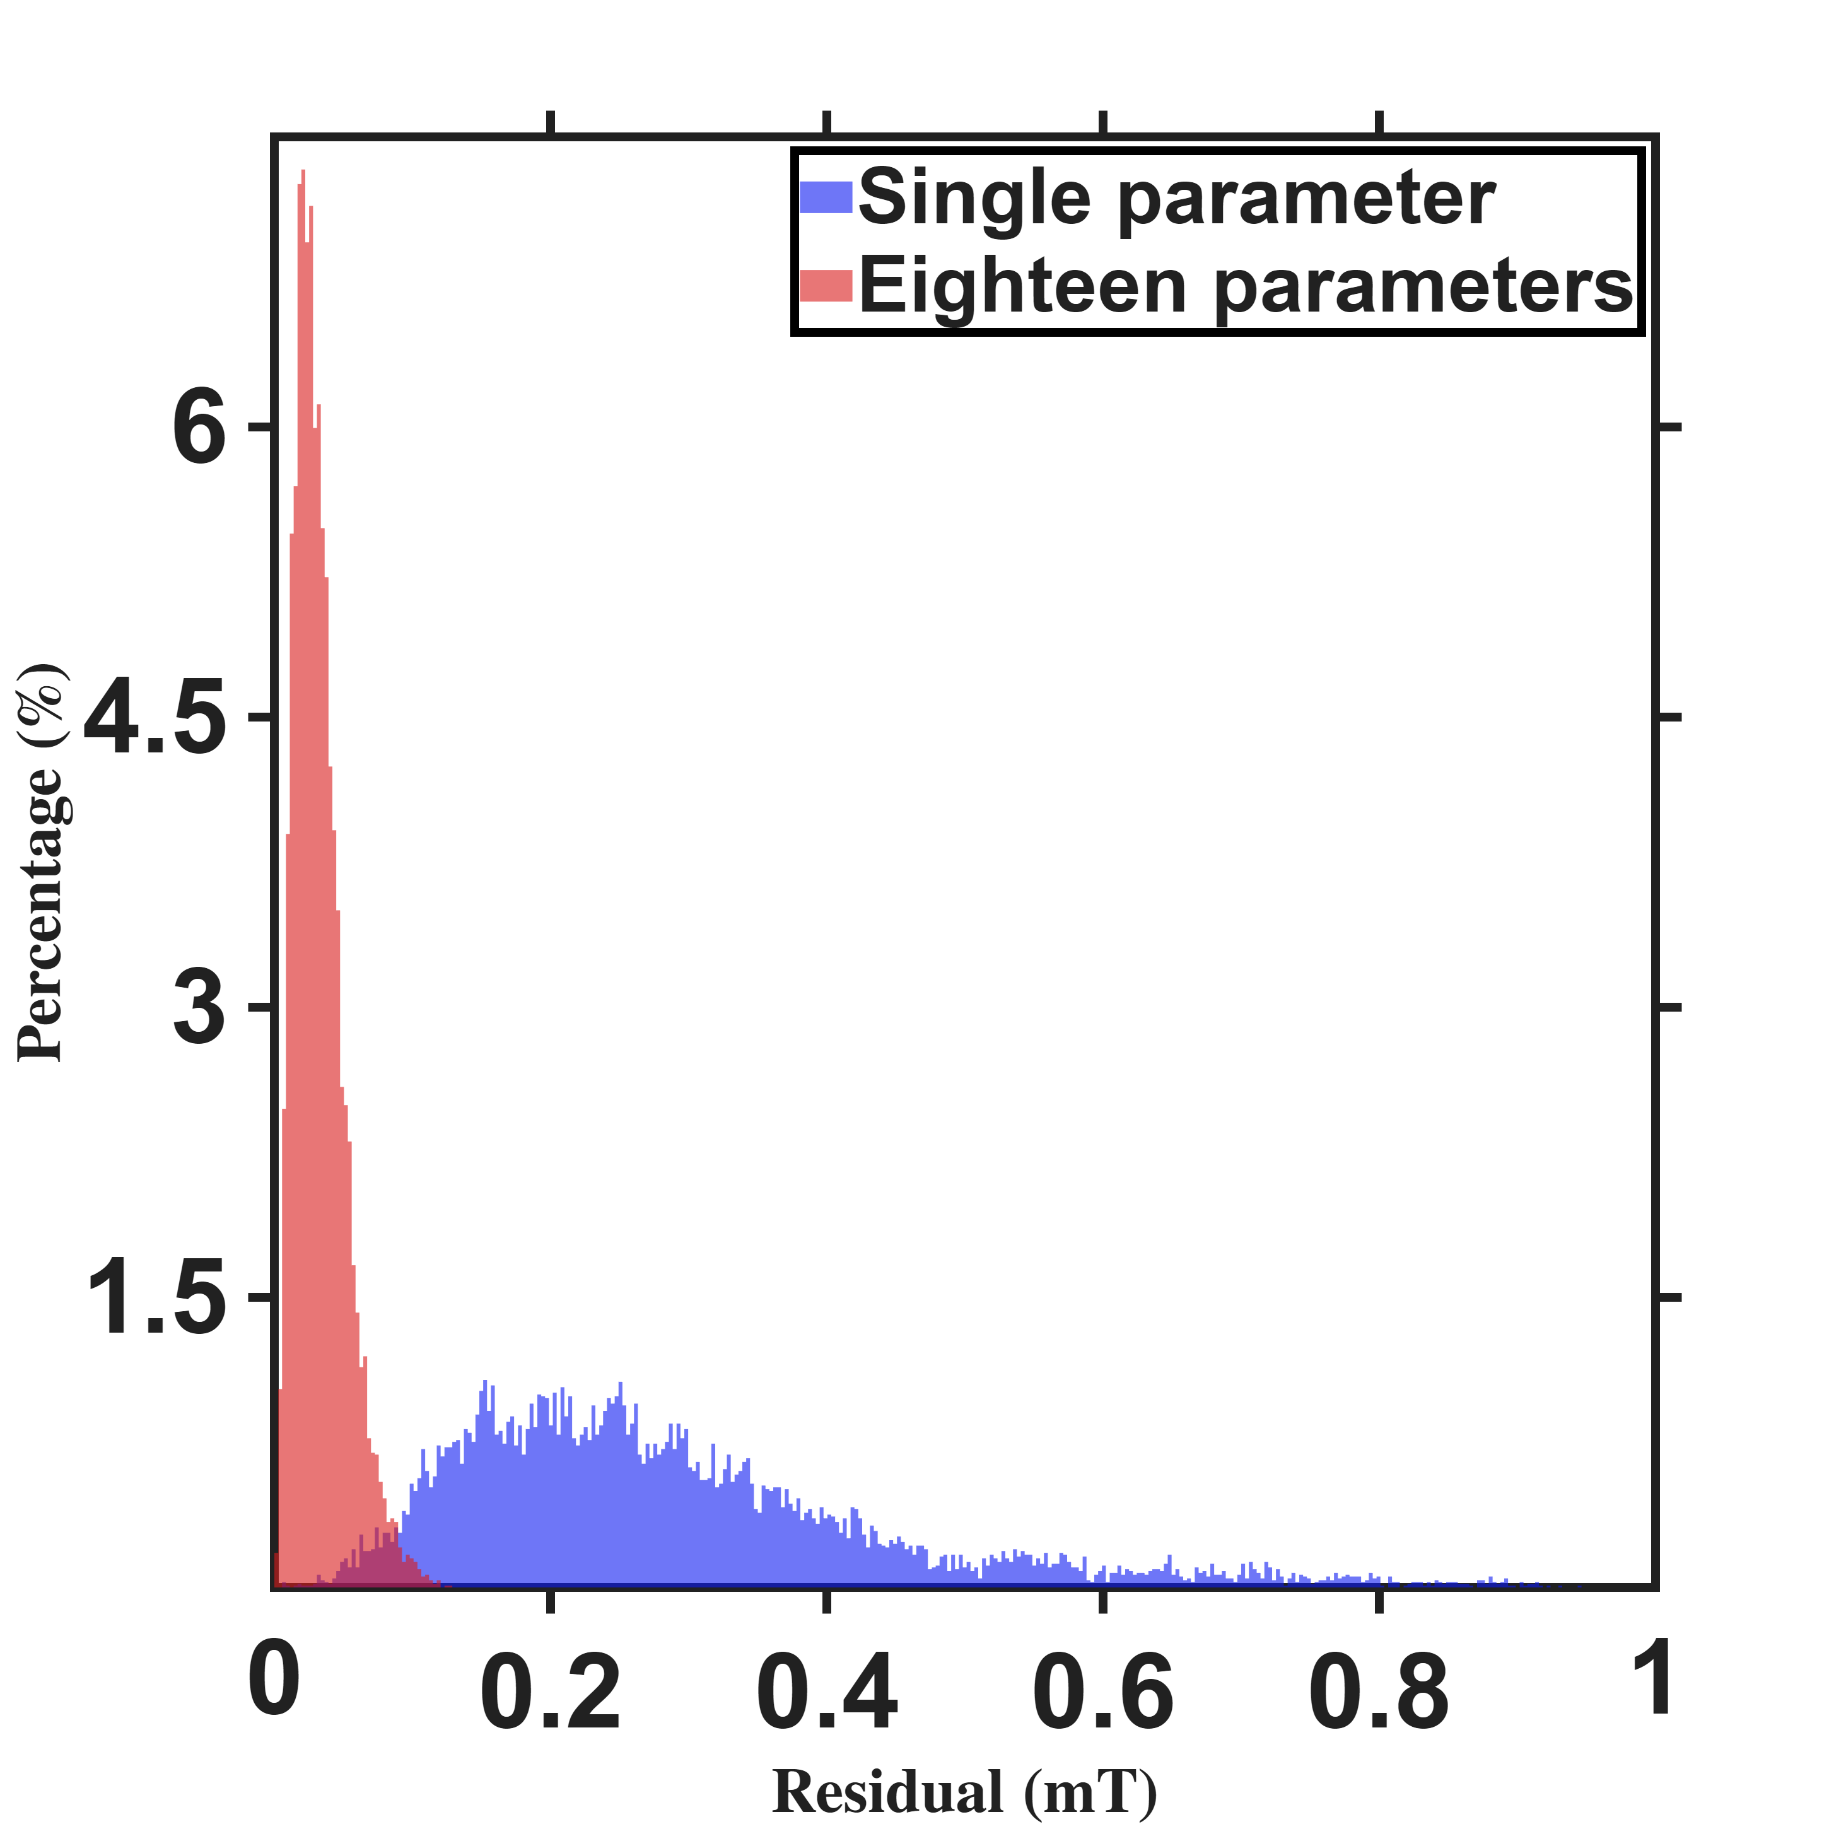



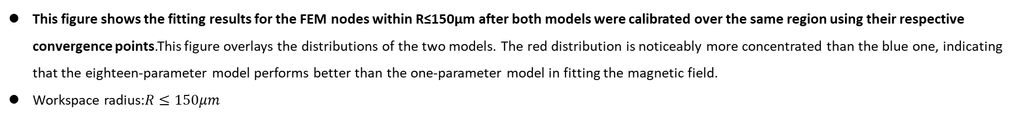
Current-based lumped-parameter modeling and calibration
E. Validation
$$Calibrate model→b_{ij}=S_{i}{}_{}^{B}{{\hat{g}}_{I}}{\overline{K}}_{I}I_{j}$$
This figure shows the fitting results for the FEM nodes within R≤150μm after both models were calibrated over the same region using their respective convergence points. This figure overlays the distributions of the two models. The red distribution is noticeably more concentrated than the blue one, indicating that the eighteen-parameter model performs better than the one-parameter model in fitting the magnetic field.
Workspace radius:$R≤150μm$
Resolution:2.8uT
Percentage count$(\%)$
 | Single | Eighteen
Mean | 0.2877mT | 0.0327mT
Modeling error $(mT)$

Slide 9
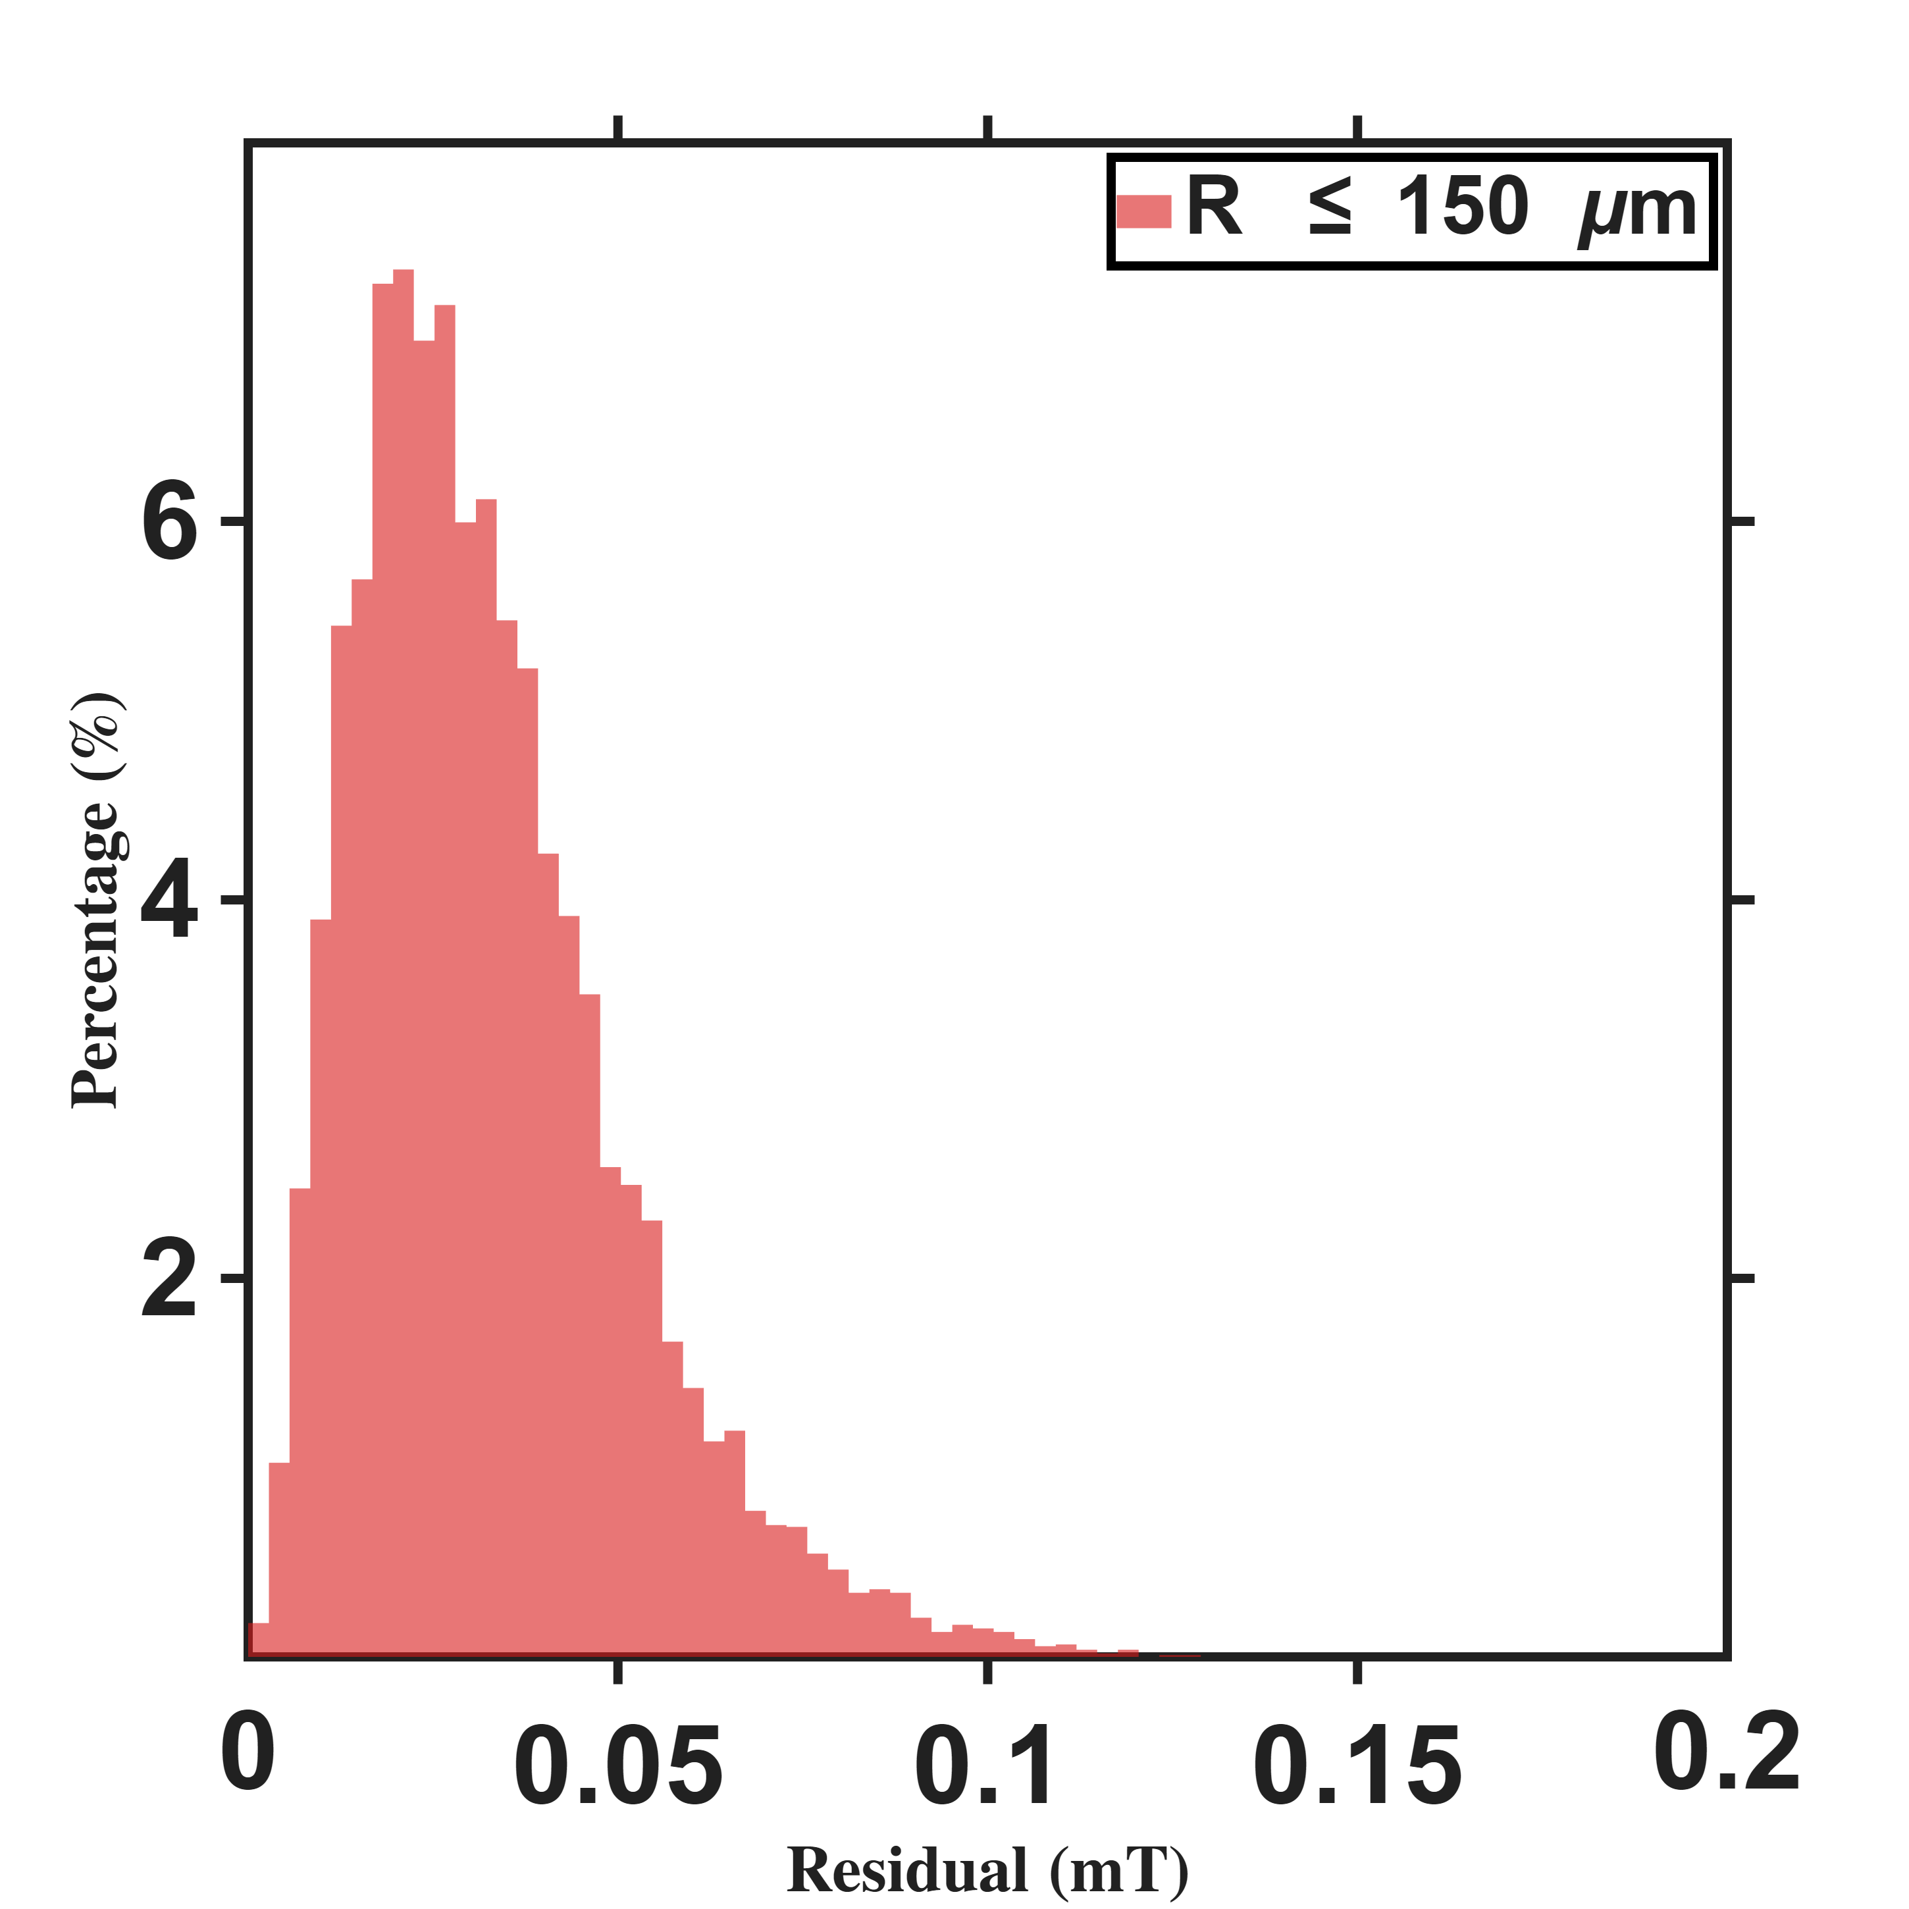
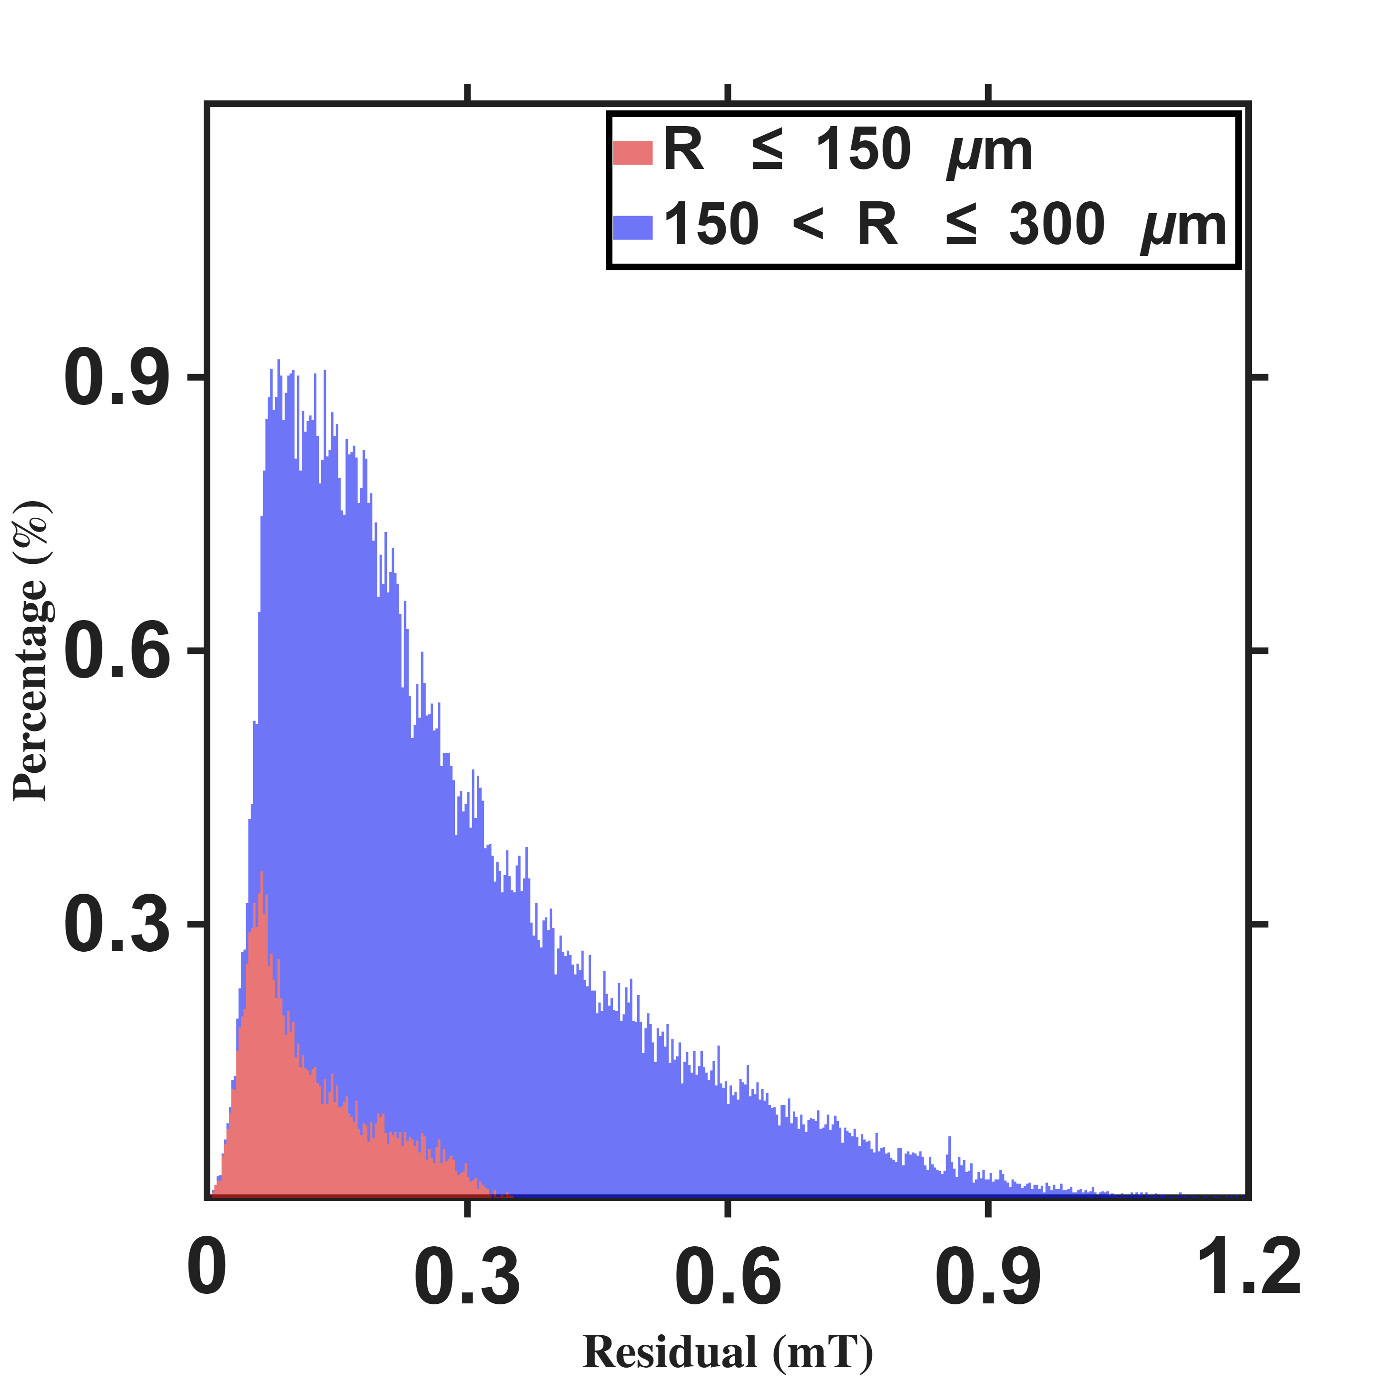



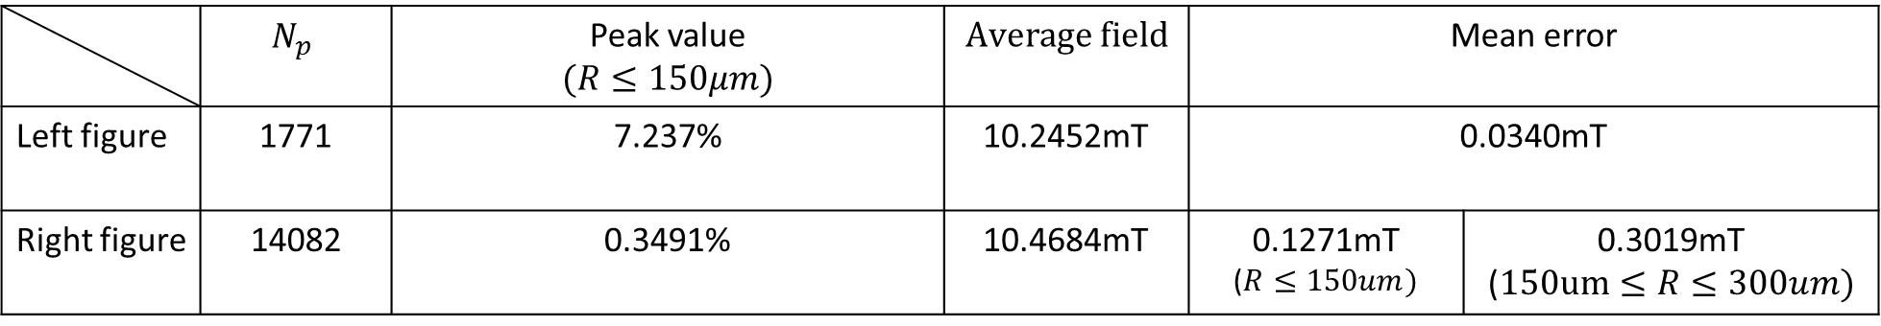

Current-based lumped-parameter modeling and calibration
E. Validation
Setup: Calibration is performed using the eighteen-parameter calibration points, followed by fitting to the FEM nodes within the workspace (left: calibrated within R ≤ 150 µm with 55 points; right: calibrated within R ≤ 300 µm with 127 points).
Percentage count$(\%)$
Percentage count$(\%)$
Modeling error $(mT)$
Modeling error $(mT)$
 | $$N_{p}$$ | Peak value $$(R≤150μm)$$ | $$Average field$$ | Mean error
Left figure | 1771 | 7.331% | 10.2452mT | 0.0327mT
Right figure | 14082 | 0.3586% | 10.4684mT | 0.1193mT ($R≤150um)$ | 0.2978mT ($150um≤R≤300um)$
Resolution:2.8uT

Slide 10
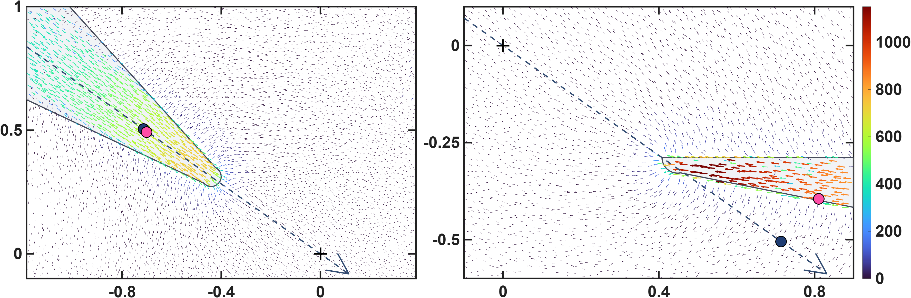








Current-based lumped-parameter modeling and calibration
E. Validation
$$Calibrate model→b_{ij}=S_{i}{}_{}^{B}{{\hat{g}}_{I}}{\overline{K}}_{I}I_{j}$$
Long
These two figures compare the calibrated magnetic charge locations of the two models in side views of poles P2 (left, upper pole) and P1 (right, lower pole); the navy dots are the one-parameter charges and the pink dots the eighteen-parameter charges. For the lower pole, the one-parameter charge lies outside the pole, because the one-parameter model constrains the magnetic charges to lie along the actuator coordinate axes. The eighteen-parameter model moves this charge inside the pole, which is more consistent with the expected physical situation, while for the upper pole the two charges almost coincide. Moreover, the error histograms shown above also indicate that these magnetic charge locations are more consistent with the theoretical positions.
$${\hat{x}}_{a}$$
$$z−axis(mm)$$
$$q_{c2}$$
$$\left\|b\right\|(mT)$$
$${\hat{x}}_{a}$$
$$q_{c1}$$
$$x−axis(mm)$$
$$x−axis(mm)$$

Slide 11
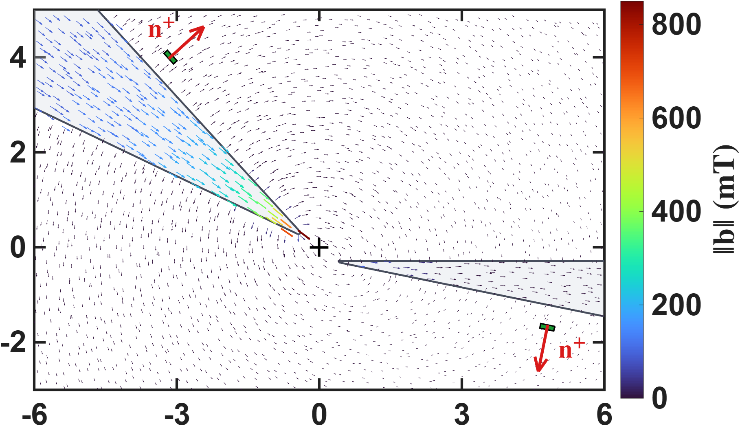



Hall-sensor-voltage-based lumped-parameter modeling and calibration
This figure conveys the sensing concept: the Hall sensor measures the pole's leakage flux. The colour-coded arrows show the flux channelled inside the cone toward the tip, while the dashed arrows around the pole are the part that escapes through the lateral surface and returns through the air. The sensor (green patch) is mounted on that surface, so it sits in the leakage field rather than in the field between the tips, and the red arrow n⁺ marks the positive sense of what it reads (b·n⁺).
$$z−axis(mm)$$
$$\left\|b\right\|(mT)$$
$$x−axis(mm)$$

Slide 12
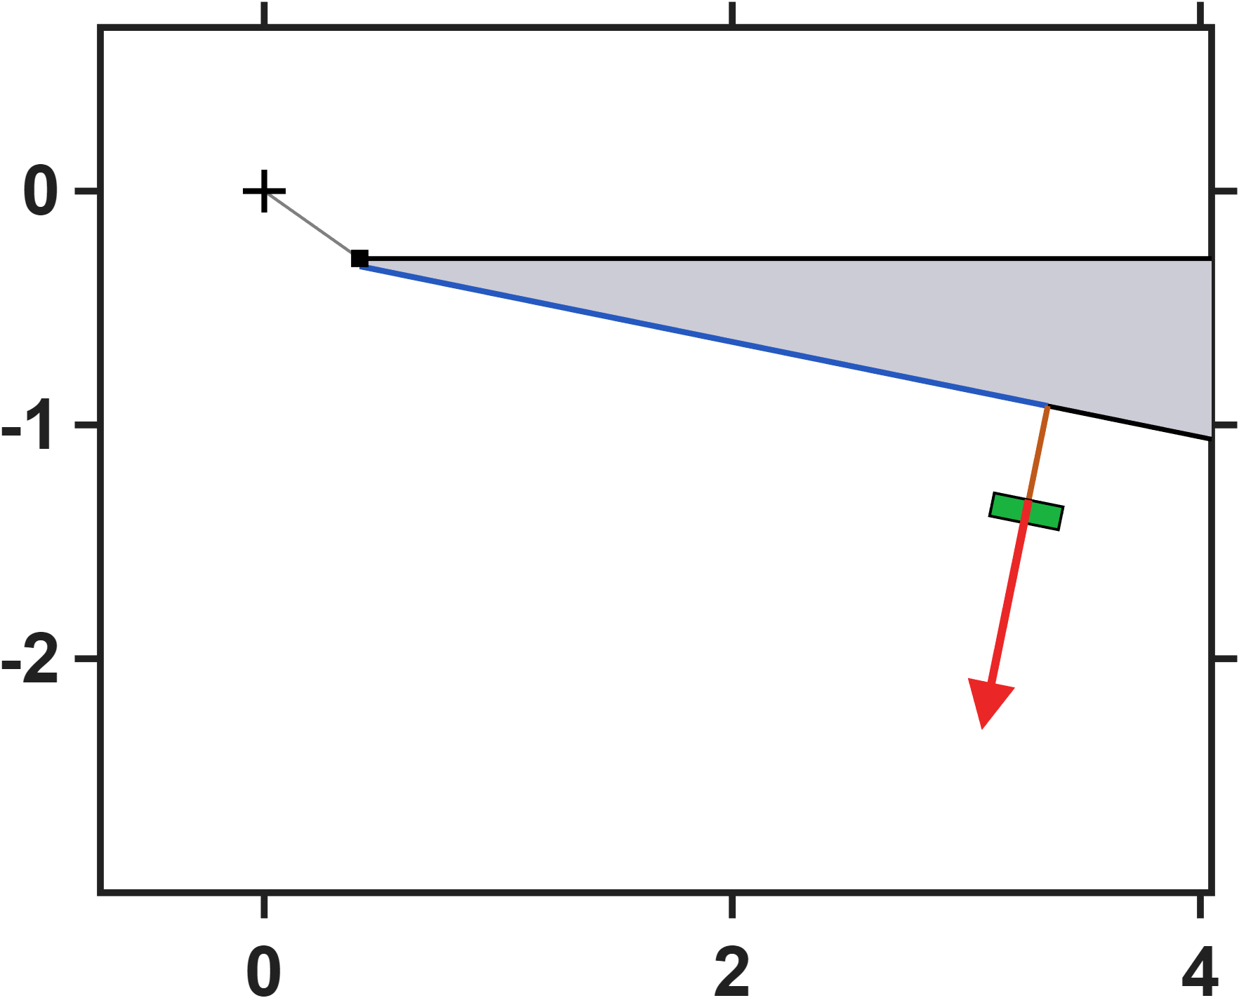
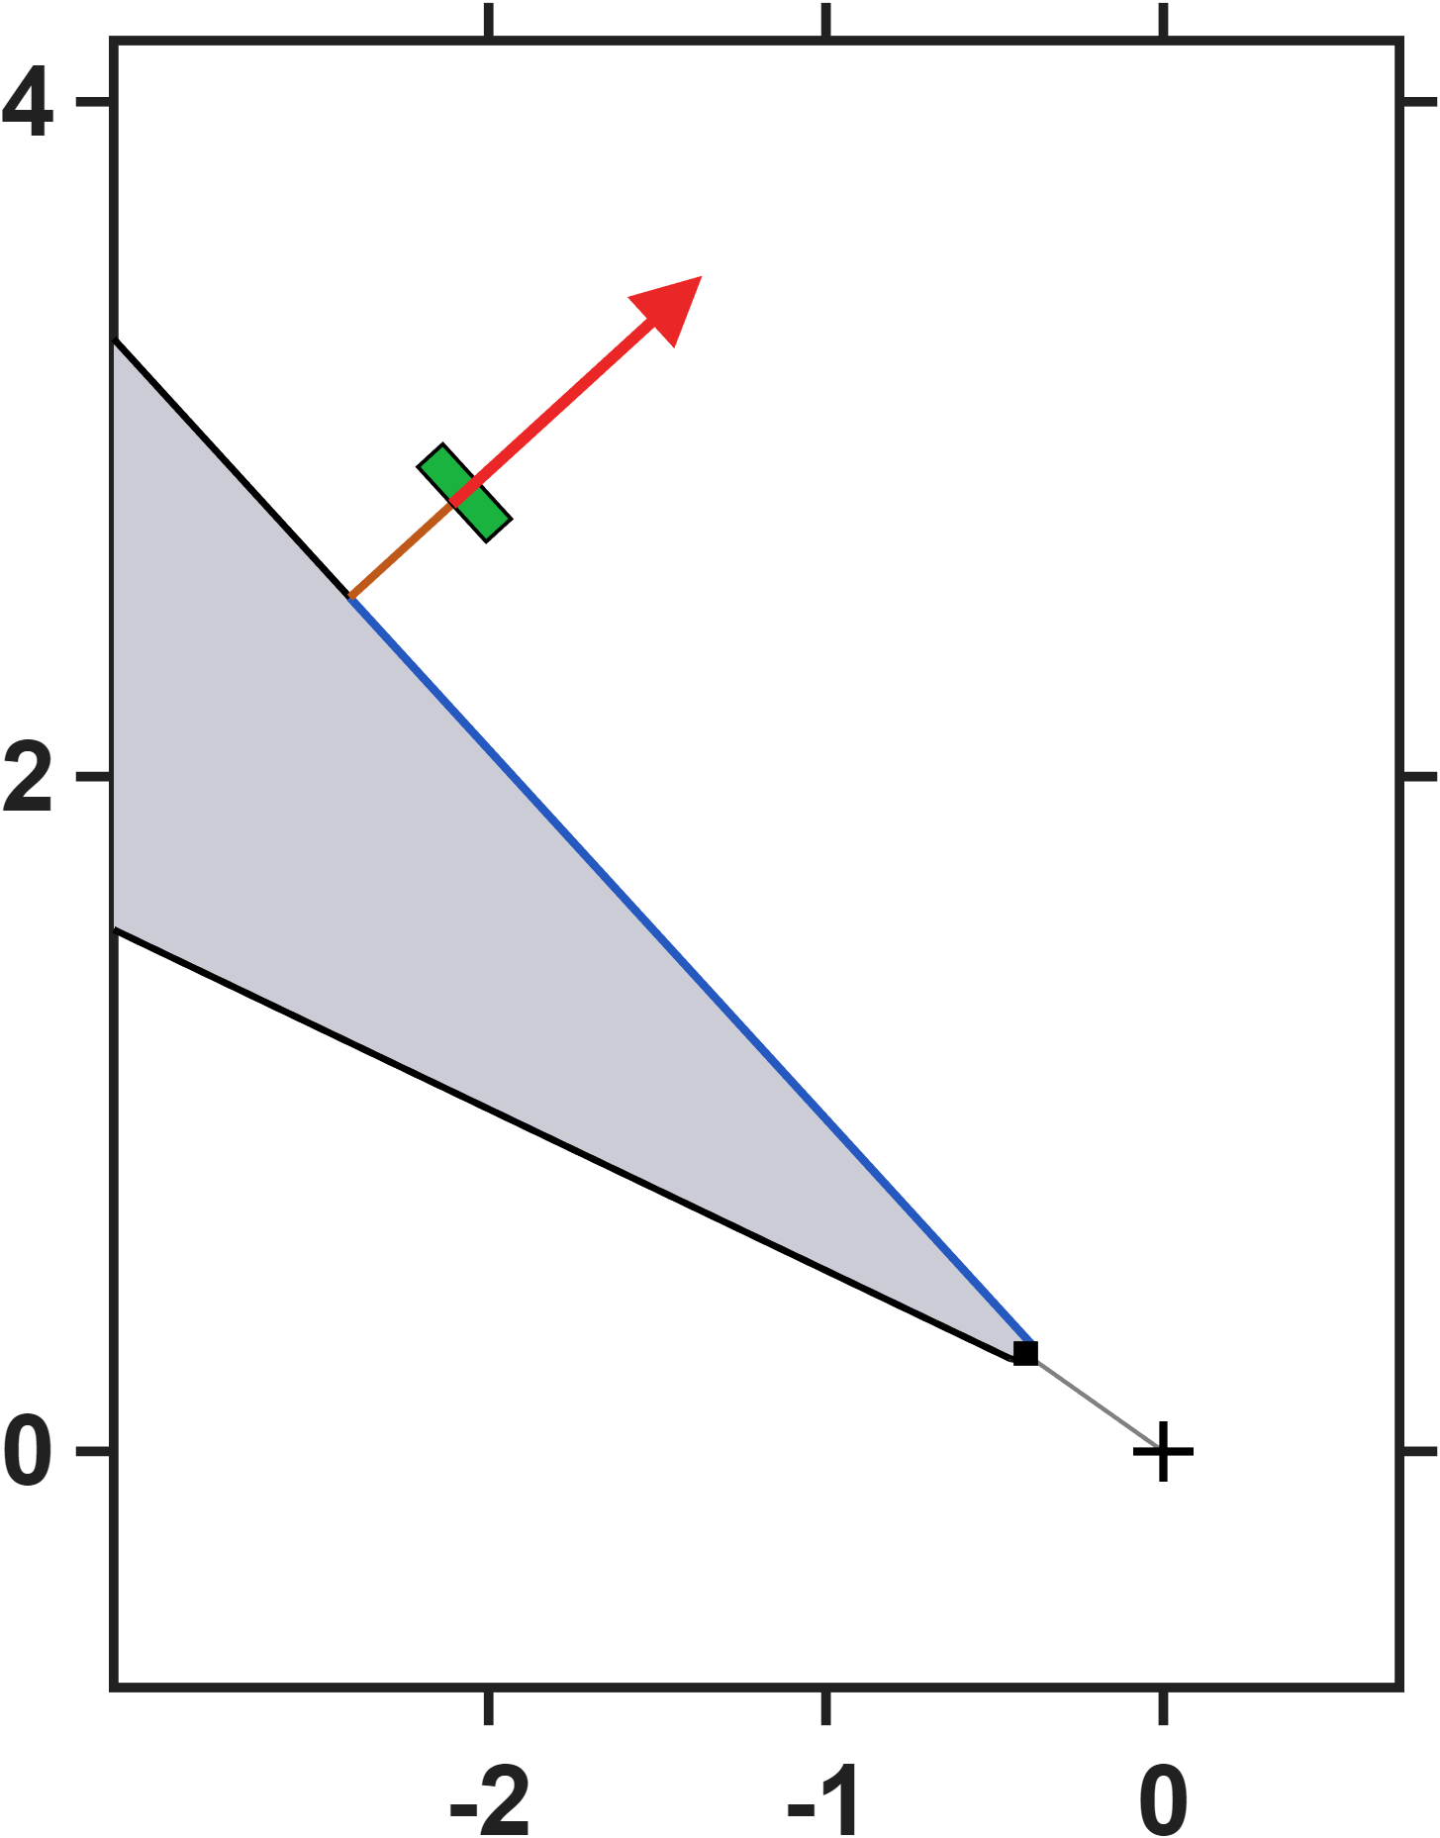



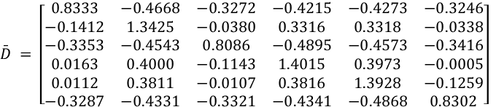






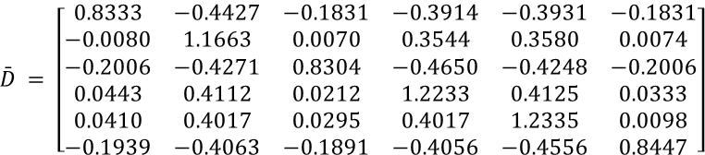
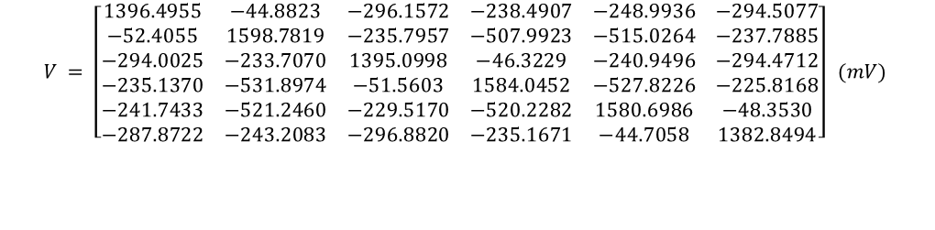



Hall-sensor-voltage-based lumped-parameter modeling and calibration
Long(3mm)
$$Calibrate model→b_{ij}=S_{i}{}_{}^{B}{{\hat{g}}_{V}}\overline{M}V_{j}$$
Single parameter
$$\bar{M} = \left[\begin{matrix}0.8333 & −0.4680 & −0.3269 & −0.4226 & −0.4279 & −0.3247 \\ −0.1416 & 1.3413 & −0.0378 & 0.3304 & 0.3310 & −0.0341 \\ −0.3356 & −0.4554 & 0.8090 & −0.4911 & −0.4580 & −0.3417 \\ 0.0160 & 0.3989 & −0.1142 & 1.4004 & 0.3968 & −0.0006 \\ 0.0112 & 0.3803 & −0.0103 & 0.3807 & 1.3927 & −0.1260 \\ −0.3287 & −0.4340 & −0.3317 & −0.4351 & −0.4873 & 0.8305\end{matrix}\right]$$
$$NMAE=\frac{\sum_{j}{\sum_{i}{\left\|b_{ij}−S_{i}{}_{}^{B}{{\hat{g}}_{V}}\overline{M}V_{j}\right\|}}}{\sum_{j}{\sum_{i}{\left\|b_{ij}\right\|}}}∙100\%=2.81\%$$
$$z−axis(mm)$$
$$d$$
$$h$$
$$\hat{ℓ} = 870.7 μm {}_{}^{B}{{\hat{g}}_{V}} = 5.1056×{10}^{−3} mT/mV$$
Eighteen parameters
$$\bar{M} = \left[\begin{matrix}0.8333 & −0.4405 & −0.1801 & −0.3899 & −0.3907 & −0.1805 \\ −0.0069 & 1.1679 & 0.0087 & 0.3555 & 0.3598 & 0.0089 \\ −0.1985 & −0.4260 & 0.8298 & −0.4640 & −0.4228 & −0.1982 \\ 0.0452 & 0.4119 & 0.0222 & 1.2231 & 0.4136 & 0.0347 \\ 0.0421 & 0.4011 & 0.0309 & 0.4012 & 1.2313 & 0.0113 \\ −0.1925 & −0.4065 & −0.1873 & −0.4061 & −0.4554 & 0.8474\end{matrix}\right]$$
$$NMAE=\frac{\sum_{j}{\sum_{i}{\left\|b_{ij}−S_{i}{}_{}^{B}{{\hat{g}}_{V}}\overline{M}V_{j}\right\|}}}{\sum_{j}{\sum_{i}{\left\|b_{ij}\right\|}}}∙100\%=0.32\%$$
$$x−axis(mm)$$
$$\hat{e}= \left[\begin{matrix}0.0134 & 0.0200 & −0.1170 & 0.0016 & 0.0006 & −0.1170 \\ −0.1155 & 0.0028 & 0.0185 & 0.0168 & 0.0012 & −0.1168 \\ 0.1152 & −0.0026 & 0.1159 & −0.0025 & −0.0137 & −0.0187\end{matrix}\right]$$
$$h$$
$$z−axis(mm)$$
$$\hat{ℓ} = 868.4 μm {}_{}^{B}{{\hat{g}}_{V}} = 6.0002×{10}^{−3} mT/mV$$
$$d$$
$$V = \left[\begin{matrix}1396.5391 & −44.8828 & −296.1518 & −238.5032 & −249.0178 & −294.5193 \\ −52.4041 & 1598.9320 & −235.8027 & −508.0018 & −515.0291 & −237.7953 \\ −294.0077 & −233.6914 & 1395.1399 & −46.3252 & −240.9851 & −294.4827 \\ −235.1490 & −531.9087 & −51.5702 & 1584.0847 & −527.8858 & −225.8234 \\ −241.7258 & −521.2521 & −229.5367 & −520.2476 & 1580.7629 & −48.3601 \\ −287.8687 & −243.2226 & −296.8901 & −235.1820 & −44.7048 & 1382.9382\end{matrix}\right] (mV)$$
$$x−axis(mm)$$

Slide 13

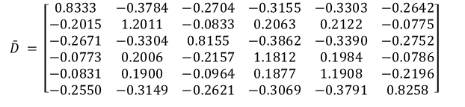

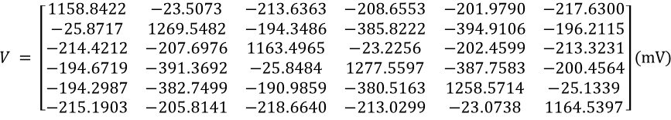


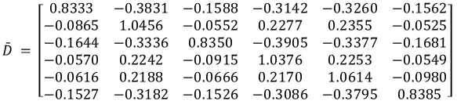



Hall-sensor-voltage-based lumped-parameter modeling and calibration
Long(5mm)
$$Calibrate model→b_{ij}=S_{i}{}_{}^{B}{{\hat{g}}_{V}}\overline{M}V_{j}$$
Single parameter
$$\bar{M} = \left[\begin{matrix}0.8333 & −0.3795 & −0.2701 & −0.3165 & −0.3307 & −0.2642 \\ −0.2016 & 1.2003 & −0.0829 & 0.2056 & 0.2119 & −0.0775 \\ −0.2673 & −0.3313 & 0.8159 & −0.3875 & −0.3395 & −0.2752 \\ −0.0774 & 0.1998 & −0.2154 & 1.1803 & 0.1982 & −0.0786 \\ −0.0829 & 0.1894 & −0.0958 & 0.1871 & 1.1909 & −0.2195 \\ −0.2550 & −0.3158 & −0.2616 & −0.3078 & −0.3794 & 0.8260\end{matrix}\right]$$
$$NMAE=\frac{\sum_{j}{\sum_{i}{\left\|b_{ij}−S_{i}{}_{}^{B}{{\hat{g}}_{V}}\overline{M}V_{j}\right\|}}}{\sum_{j}{\sum_{i}{\left\|b_{ij}\right\|}}}∙100\%=2.81\%$$
$$z−axis(mm)$$
$$d$$
$$h$$
$$\hat{ℓ} = 870.7 μm {}_{}^{B}{{\hat{g}}_{V}} = 6.6358×{10}^{−3} mT/mV$$
Eighteen parameters
$$\bar{M} = \left[\begin{matrix}0.8333 & −0.3820 & −0.1567 & −0.3138 & −0.3247 & −0.1545 \\ −0.0859 & 1.0477 & −0.0540 & 0.2286 & 0.2370 & −0.0514 \\ −0.1629 & −0.3334 & 0.8346 & −0.3904 & −0.3367 & −0.1664 \\ −0.0564 & 0.2248 & −0.0908 & 1.0380 & 0.2264 & −0.0539 \\ −0.0606 & 0.2187 & −0.0654 & 0.2169 & 1.0603 & −0.0966 \\ −0.1518 & −0.3189 & −0.1514 & −0.3097 & −0.3799 & 0.8414\end{matrix}\right]$$
$$NMAE=\frac{\sum_{j}{\sum_{i}{\left\|b_{ij}−S_{i}{}_{}^{B}{{\hat{g}}_{V}}\overline{M}V_{j}\right\|}}}{\sum_{j}{\sum_{i}{\left\|b_{ij}\right\|}}}∙100\%=0.32\%$$
$$x−axis(mm)$$
$$\hat{e}= \left[\begin{matrix}0.0134 & 0.0200 & −0.1170 & 0.0016 & 0.0006 & −0.1170 \\ −0.1155 & 0.0028 & 0.0185 & 0.0168 & 0.0012 & −0.1168 \\ 0.1152 & −0.0026 & 0.1159 & −0.0025 & −0.0137 & −0.0187\end{matrix}\right]$$
$$h$$
$$\hat{ℓ} = 868.4 μm {}_{}^{B}{{\hat{g}}_{V}} = 7.6015×{10}^{−3} mT/mV$$
$$z−axis(mm)$$
$$V = \left[\begin{matrix}1158.8497 & −23.5080 & −213.6410 & −208.6561 & −201.9809 & −217.6408 \\ −25.8727 & 1269.5449 & −194.3448 & −385.8231 & −394.9110 & −196.2160 \\ −214.4307 & −207.7075 & 1163.5390 & −23.2264 & −202.4600 & −213.3320 \\ −194.6750 & −391.3951 & −25.8527 & 1277.5581 & −387.7619 & −200.4448 \\ −194.2998 & −382.7549 & −190.9813 & −380.5144 & 1258.5082 & −25.1365 \\ −215.2013 & −205.8141 & −218.6759 & −213.0352 & −23.0749 & 1164.5885\end{matrix}\right](mV)$$
$$d$$
Moving the sensors further out along the pole flank leaves the field model completely untouched: the effective length, the charge-offset matrix and the fit error are identical to the closer mounting — and identical to the current-based results as well, since both reduce to the same transfer matrix. Only the voltage scale changes: further from the tip the leakage field is weaker, so the measured voltages drop and the voltage gain rises to compensate. This is structural rather than coincidental — the field model is fitted from the workspace field alone, and the sensor geometry enters only afterwards, when the excitation is re-expressed in volts. The predictive accuracy of the model is therefore independent of where the sensor is mounted, and the mounting position becomes a free design choice, bounded in practice only by keeping the sensor voltage within its linear range.
$$x−axis(mm)$$

Slide 14
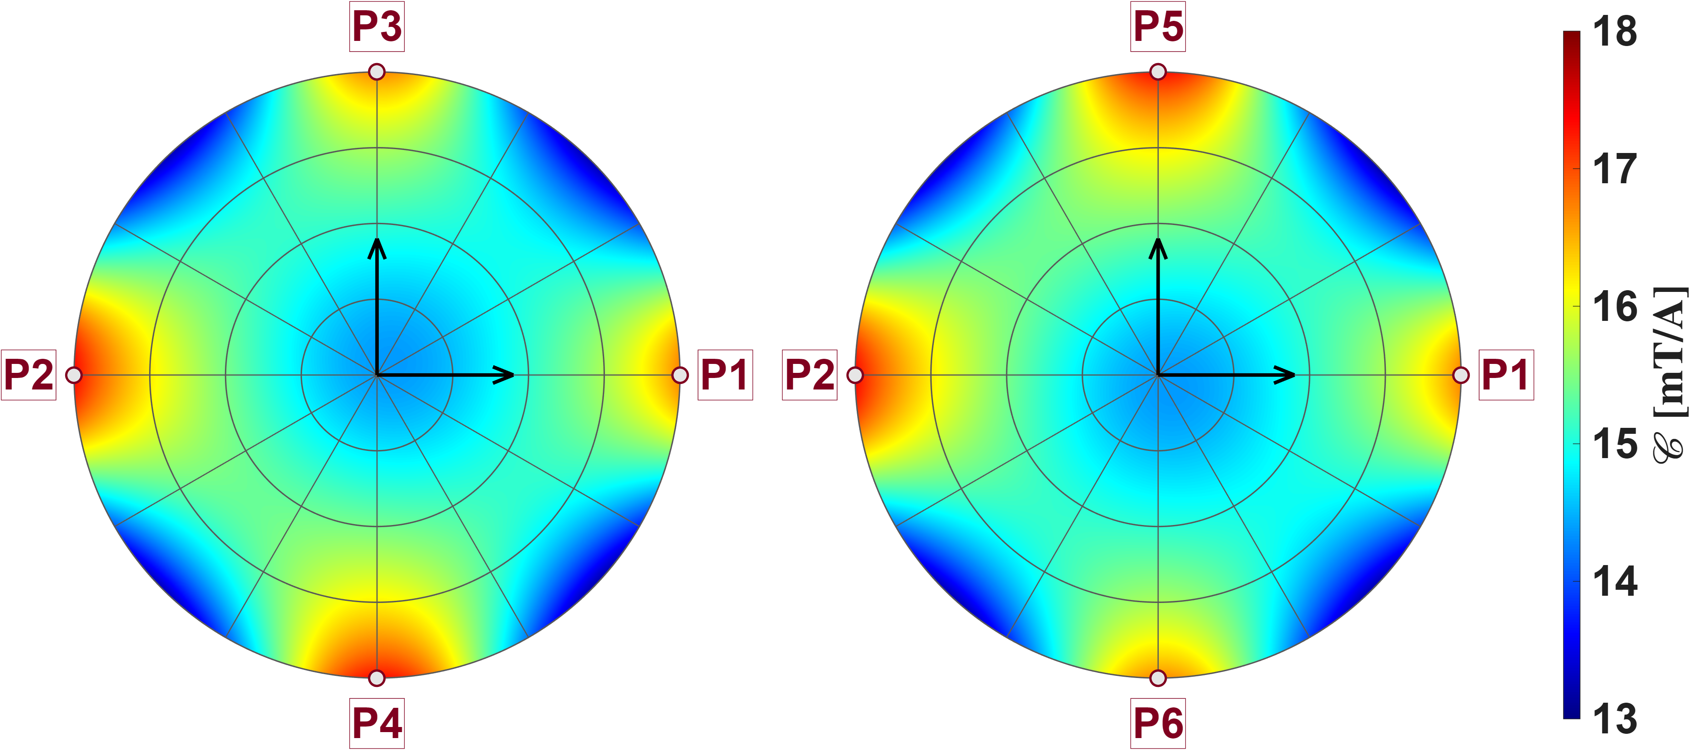
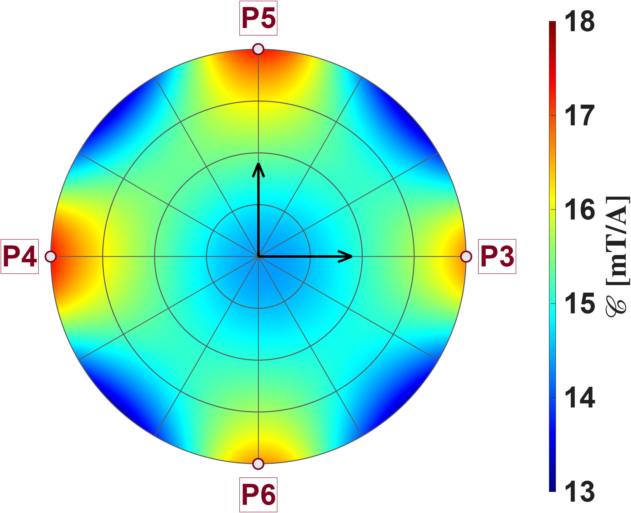

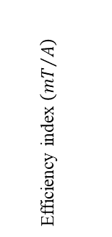


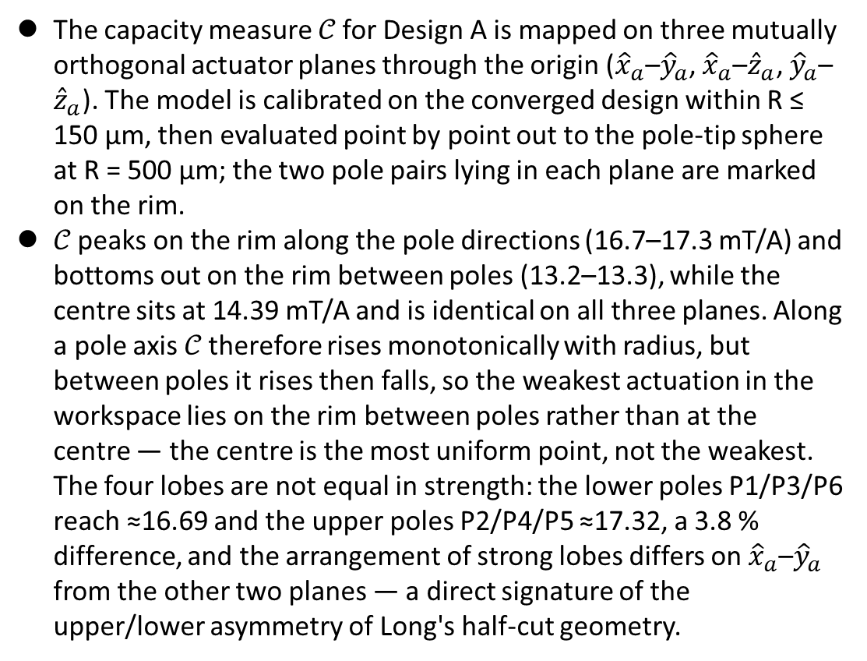

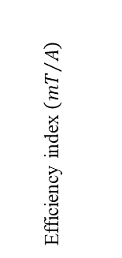

Quantitative Assessment of Multi-Pole Actuators
Long
P3
P5
The efficiency index 𝒞 for the tweezer is mapped on three mutually orthogonal actuator planes through the origin (${\hat{x}}_{a}$–${\hat{y}}_{a}$, ${\hat{x}}_{a}$–${\hat{z}}_{a}$, ${\hat{y}}_{a}$–${\hat{z}}_{a}$). The model is calibrated on the converged design within R ≤ 150 µm, then evaluated point by point out to the pole-tip sphere at R = 500 µm; the two pole pairs lying in each plane are marked on the rim.
𝒞 peaks on the rim along the pole directions (16.7–17.3 mT/A) and bottoms out on the rim between poles (13.2–13.3 mT/A), while the centre sits at 14.39 mT/A and is identical on all three planes. Along a pole axis 𝒞 therefore rises monotonically with radius, but between poles it rises then falls, so the weakest actuation in the workspace lies on the rim between poles rather than at the centre — the centre is the most uniform point, not the weakest. The four lobes are not equal in strength: the lower poles P1/P3/P6 reach ≈16.69 and the upper poles P2/P4/P5 ≈17.31, a 3.7 % difference, and the arrangement of strong lobes differs on ${\hat{x}}_{a}$–${\hat{y}}_{a}$ from the other two planes — a direct signature of the upper/lower asymmetry of Long's half-cut geometry.
$$y_{a}$$
$$z_{a}$$
P2
P2
Efficiency index $\left({mT}/A\right)$
$$x_{a}$$
P1
$$x_{a}$$
P1
P4
P6
P5
$$z_{a}$$
P4
$$y_{a}$$
Efficiency index $\left({mT}/A\right)$
P3
P6

Slide 15
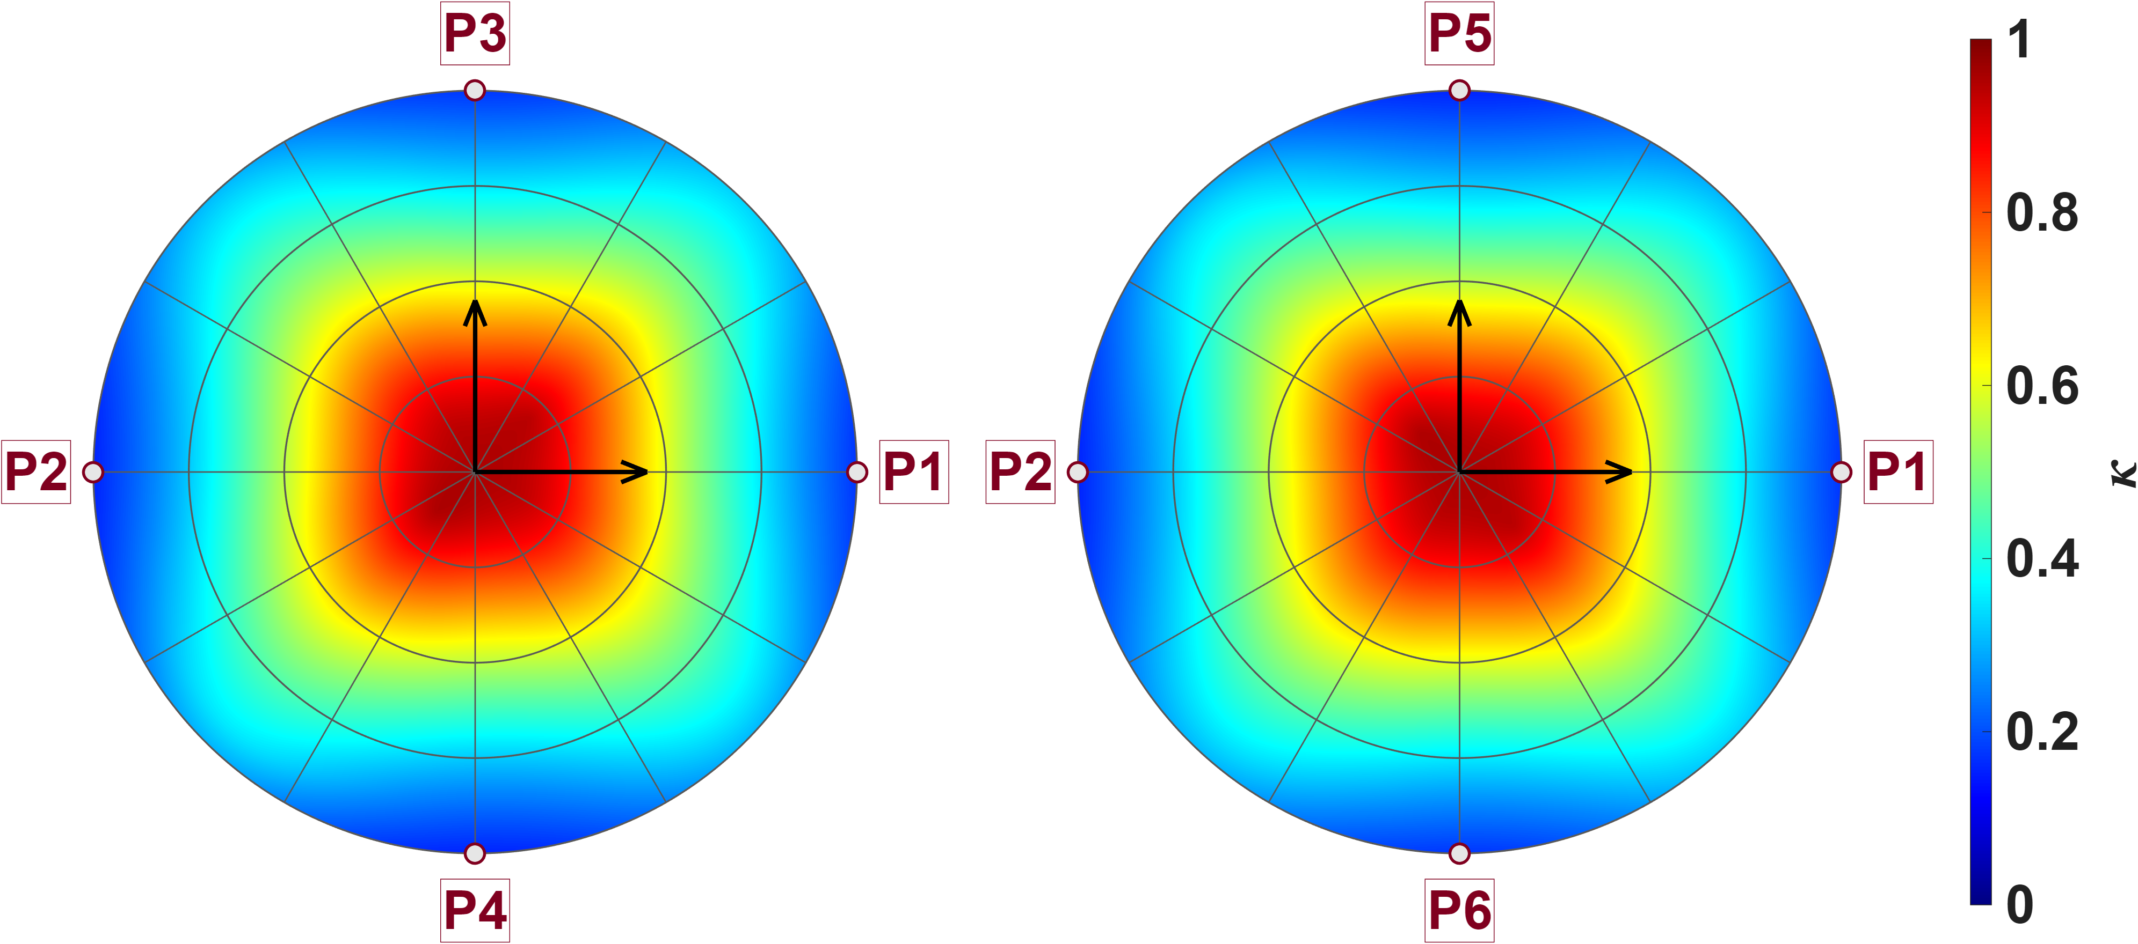
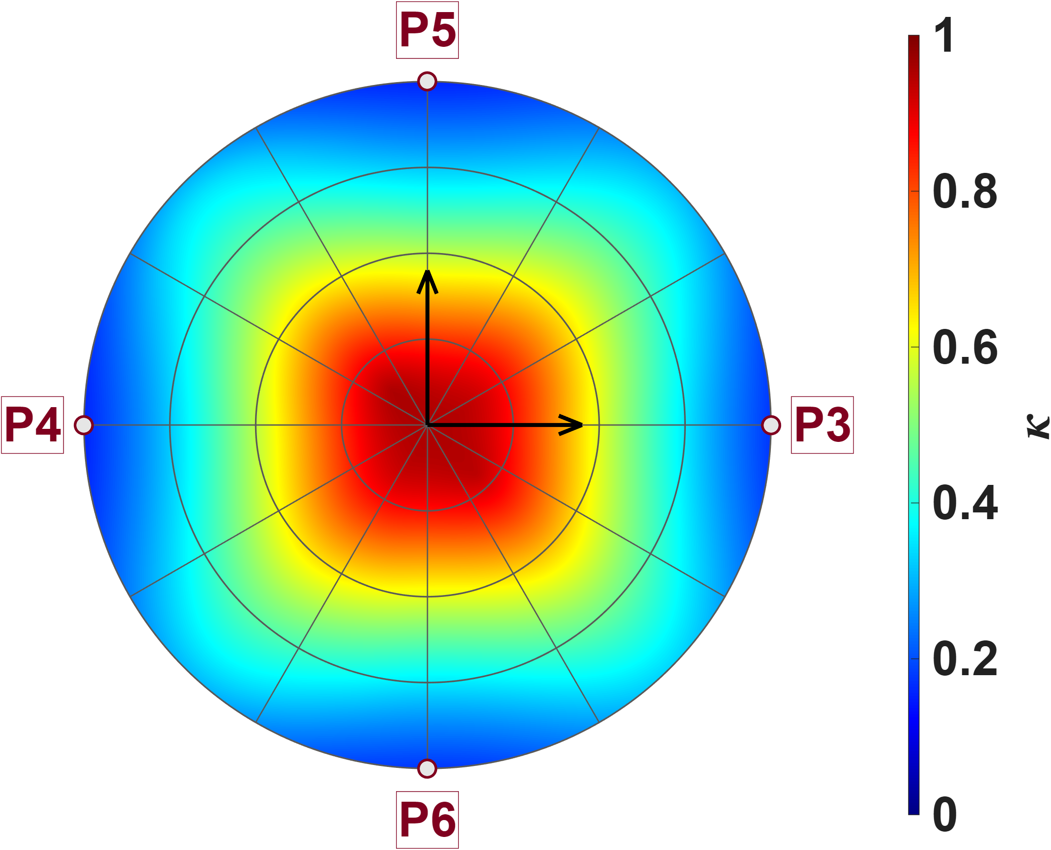



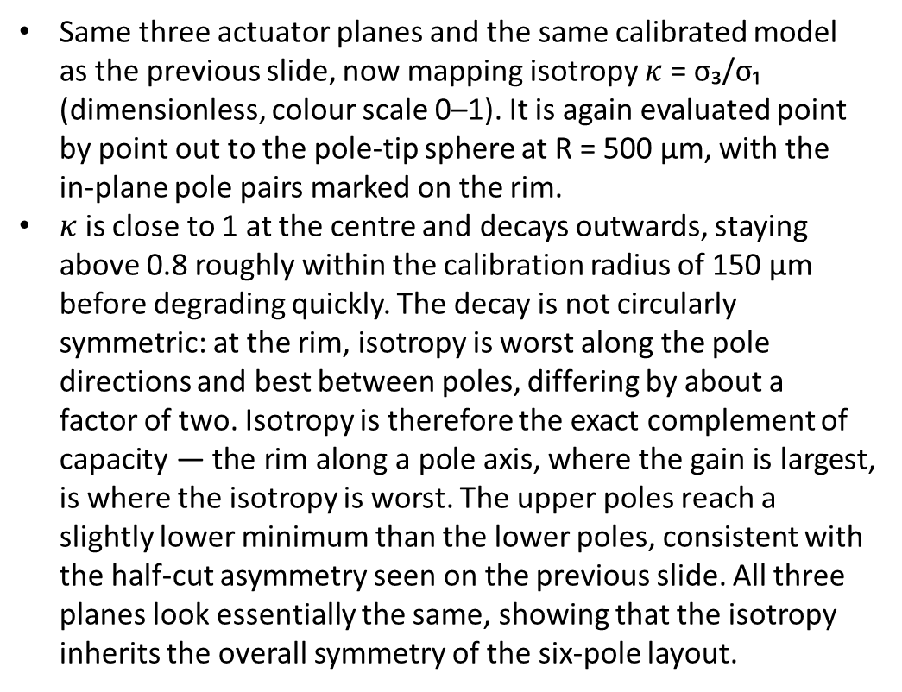



Quantitative Assessment of Multi-Pole Actuators
Long
P3
P5
Same three actuator planes and the same calibrated model as the previous slide, now mapping isotropy $κ$ = σ₃/σ₁ (dimensionless, colour scale 0–1). It is again evaluated point by point out to the pole-tip sphere at R = 500 µm, with the in-plane pole pairs marked on the rim.
$κ$ is close to 1 at the centre and decays outwards, staying above 0.8 roughly within the calibration radius of 150 µm before degrading quickly. The decay is not circularly symmetric: at the rim, isotropy is worst along the pole directions and best between poles, differing by about a factor of two. Isotropy is therefore the exact complement of the efficiency index — the rim along a pole axis, where the gain is largest, is where the isotropy is worst. The upper poles reach a slightly lower minimum than the lower poles, consistent with the half-cut asymmetry seen on the previous slide. All three planes look essentially the same, showing that the isotropy inherits the overall symmetry of the six-pole layout.
$$y_{a}$$
$$z_{a}$$
P2
P2
Isotropy
$$x_{a}$$
P1
$$x_{a}$$
P1
P4
P6
P5
$$z_{a}$$
P4
Isotropy
$$y_{a}$$
P3
P6

Slide 16
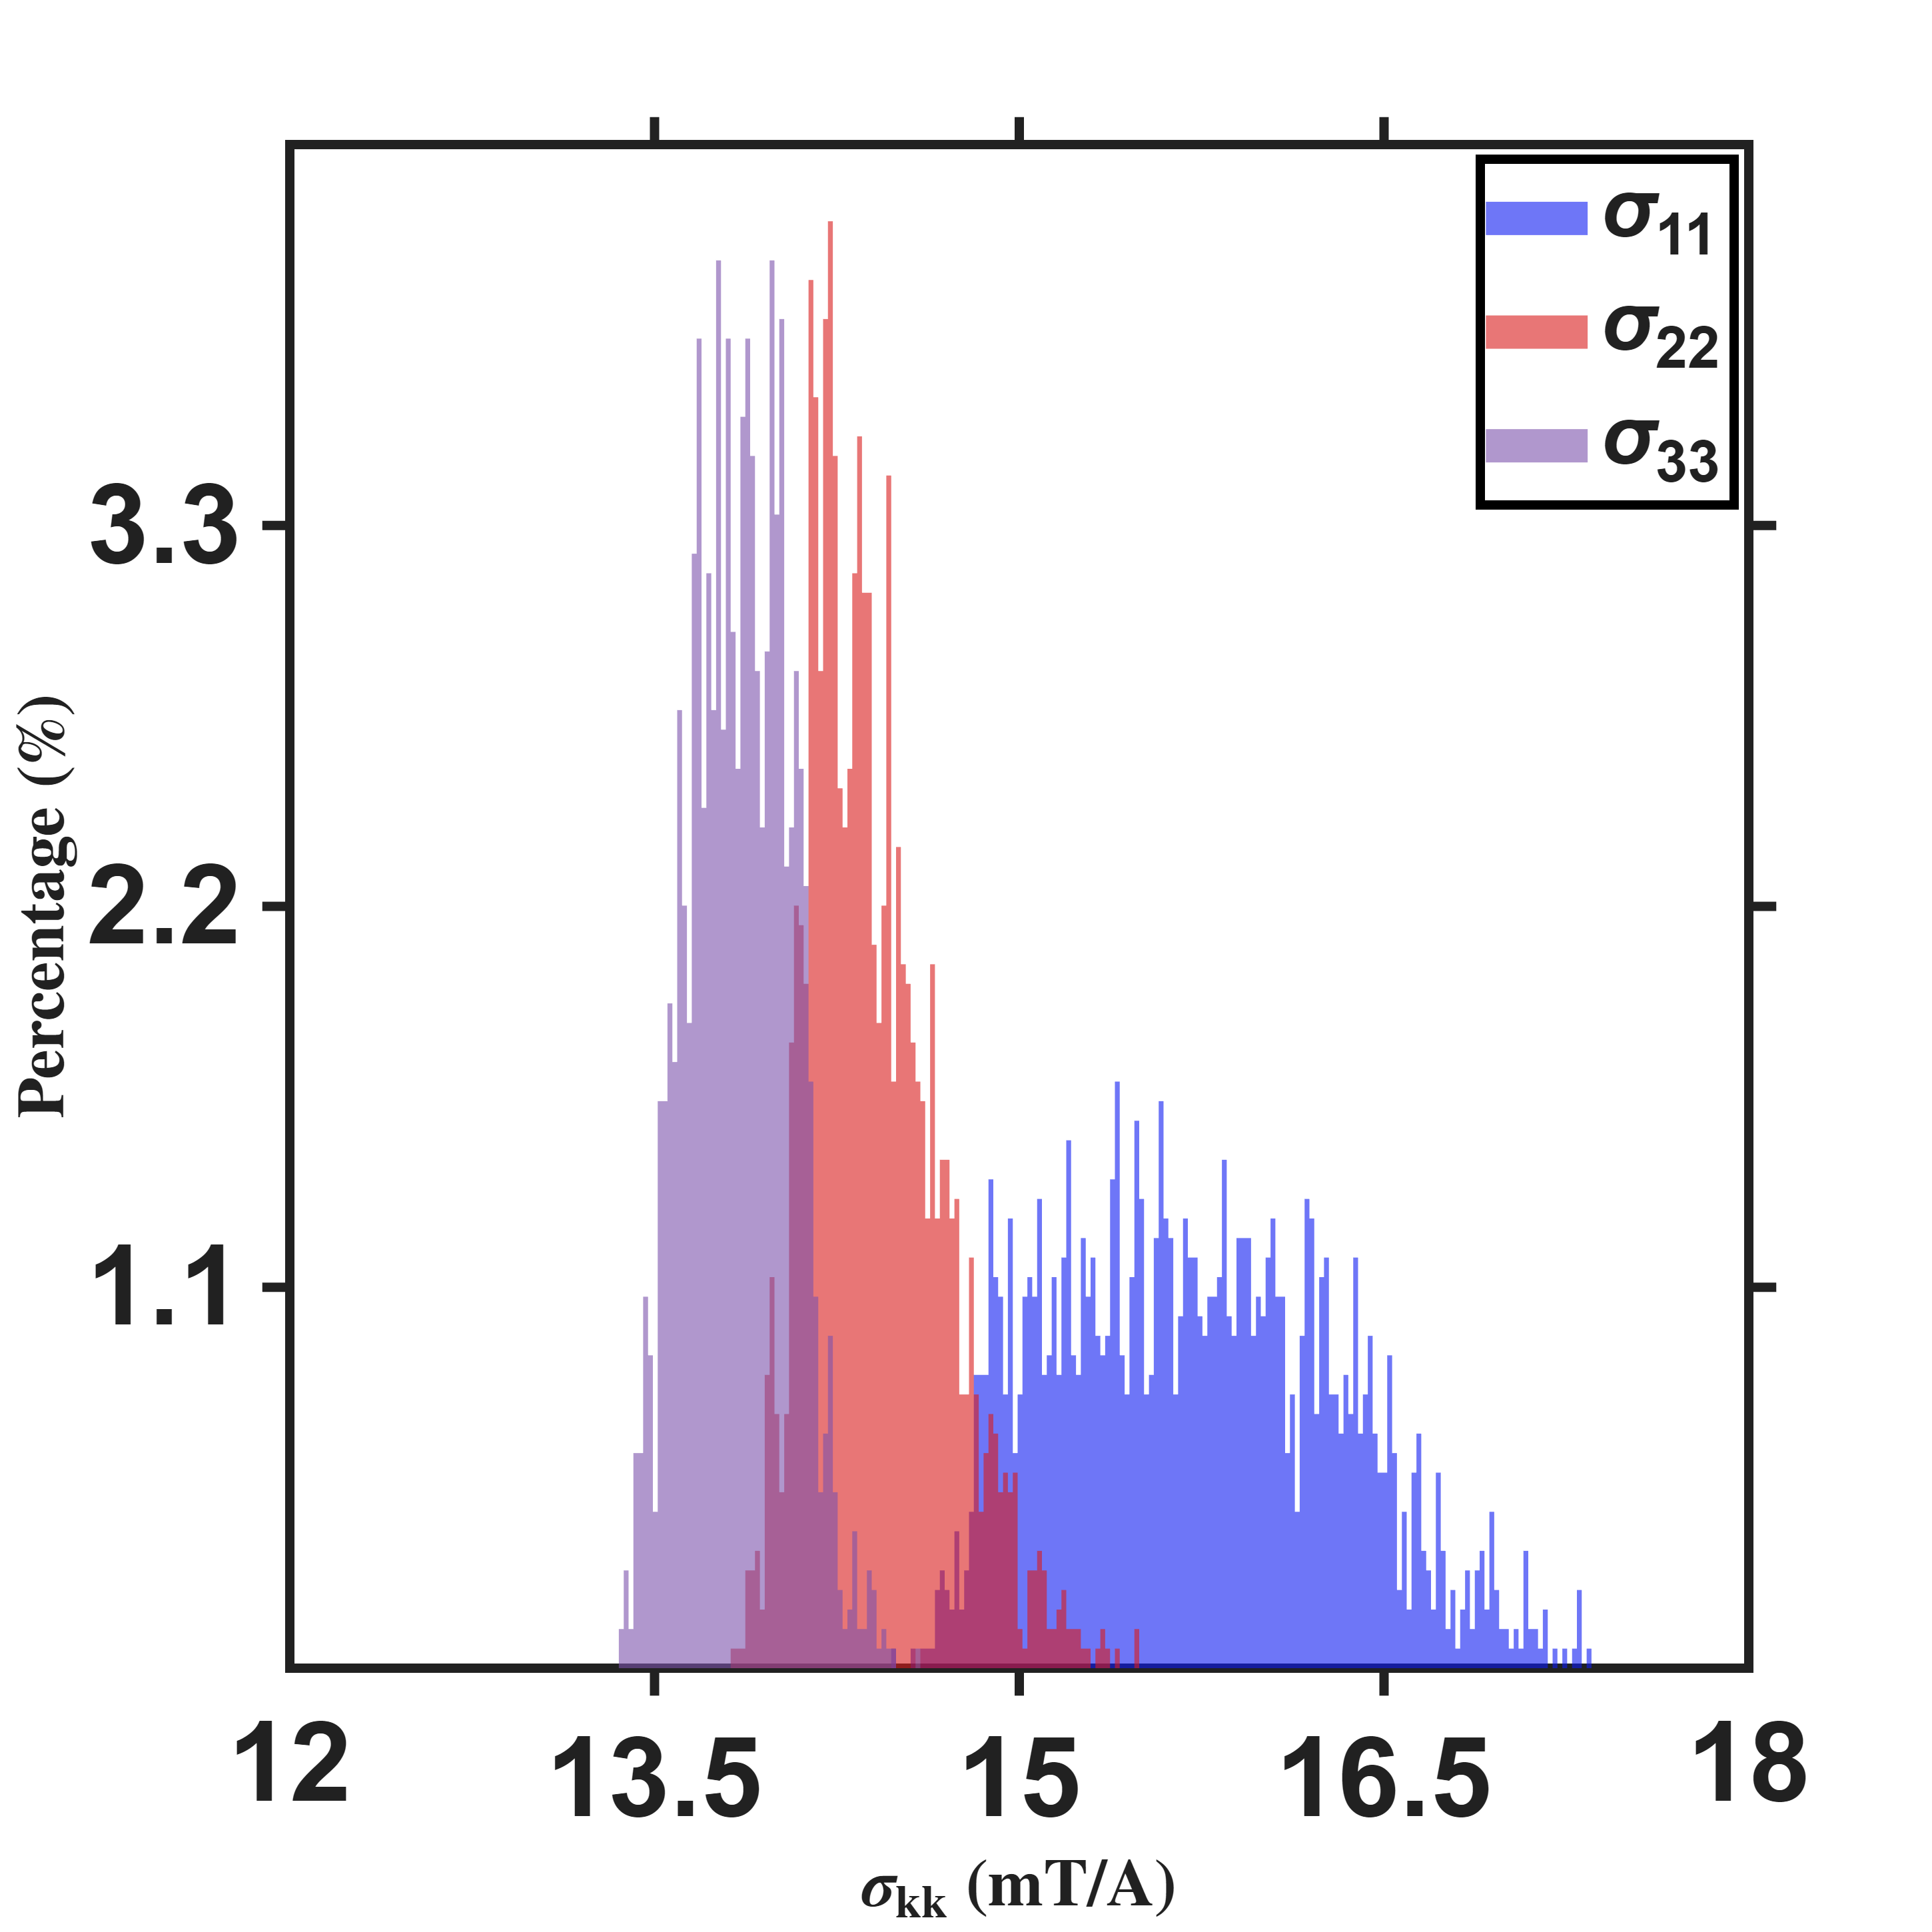
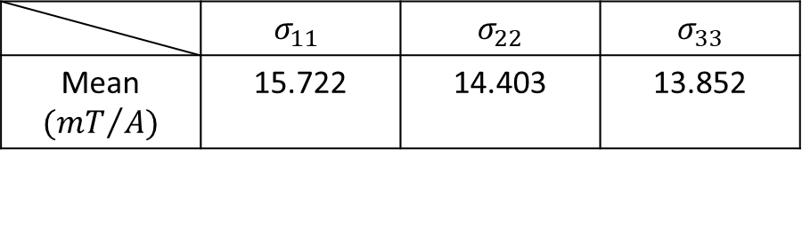

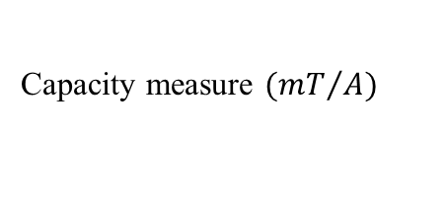
Quantitative Assessment of Multi-Pole Actuators
Long
Using the same calibrated model, the three singular values σ₁ ≥ σ₂ ≥ σ₃ at every real FEM node in the workspace are histogrammed separately. All three share one set of bins and are each normalised to a percentage, so the bar heights are directly comparable. The histogram resolution is 0.02 mT/A, the same as the efficiency-index histogram on the next slide.
Within the calibration radius the tweezer behaves as an essentially direction-independent three-degree-of-freedom actuator: the three principal gains differ by only 13.5 %, no direction is weak enough to be unusable, and the controller needs no extra margin for any particular axis. What sets the usable authority is the weakest axis σ₃, whose mean is 13.85 mT/A with only 1.5 % variation — the worst-case actuation capability is therefore very nearly a constant across the whole workspace and can be taken directly as a design value. Almost all of the spread comes from the strongest axis σ₁ (3.7 % variation), but since performance is governed by the weakest axis this fluctuation does not affect the guaranteed capability. The three peaks are clearly separated yet all fall within the narrow band of 13.4–17.3 mT/A, overlapping only on their adjacent flanks — direct evidence that the hexapole remains well-conditioned at this radius.
Percentage count$(\%)$
Singular value $({mT}/A)$
 | $$σ_{11}$$ | $$σ_{22}$$ | $$σ_{33}$$
Mean$({mT}/{A)}$ | 15.721 | 14.403 | 13.852

Slide 17
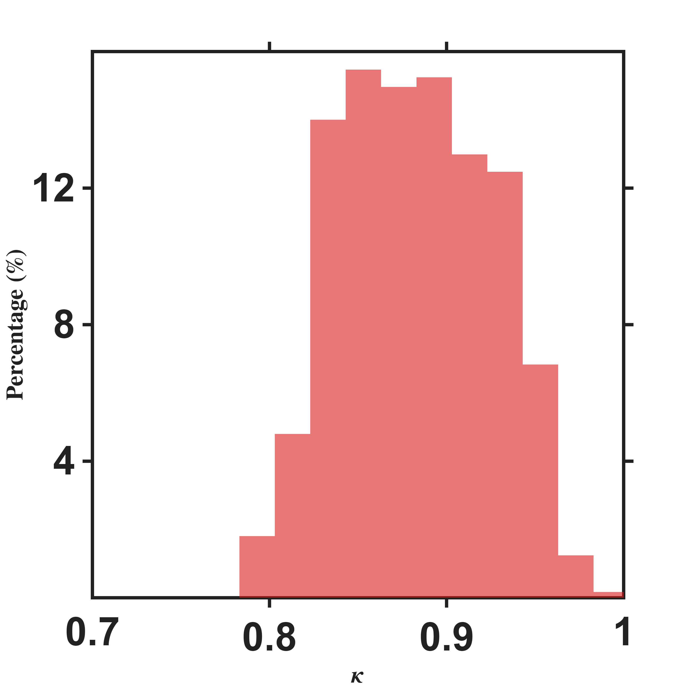
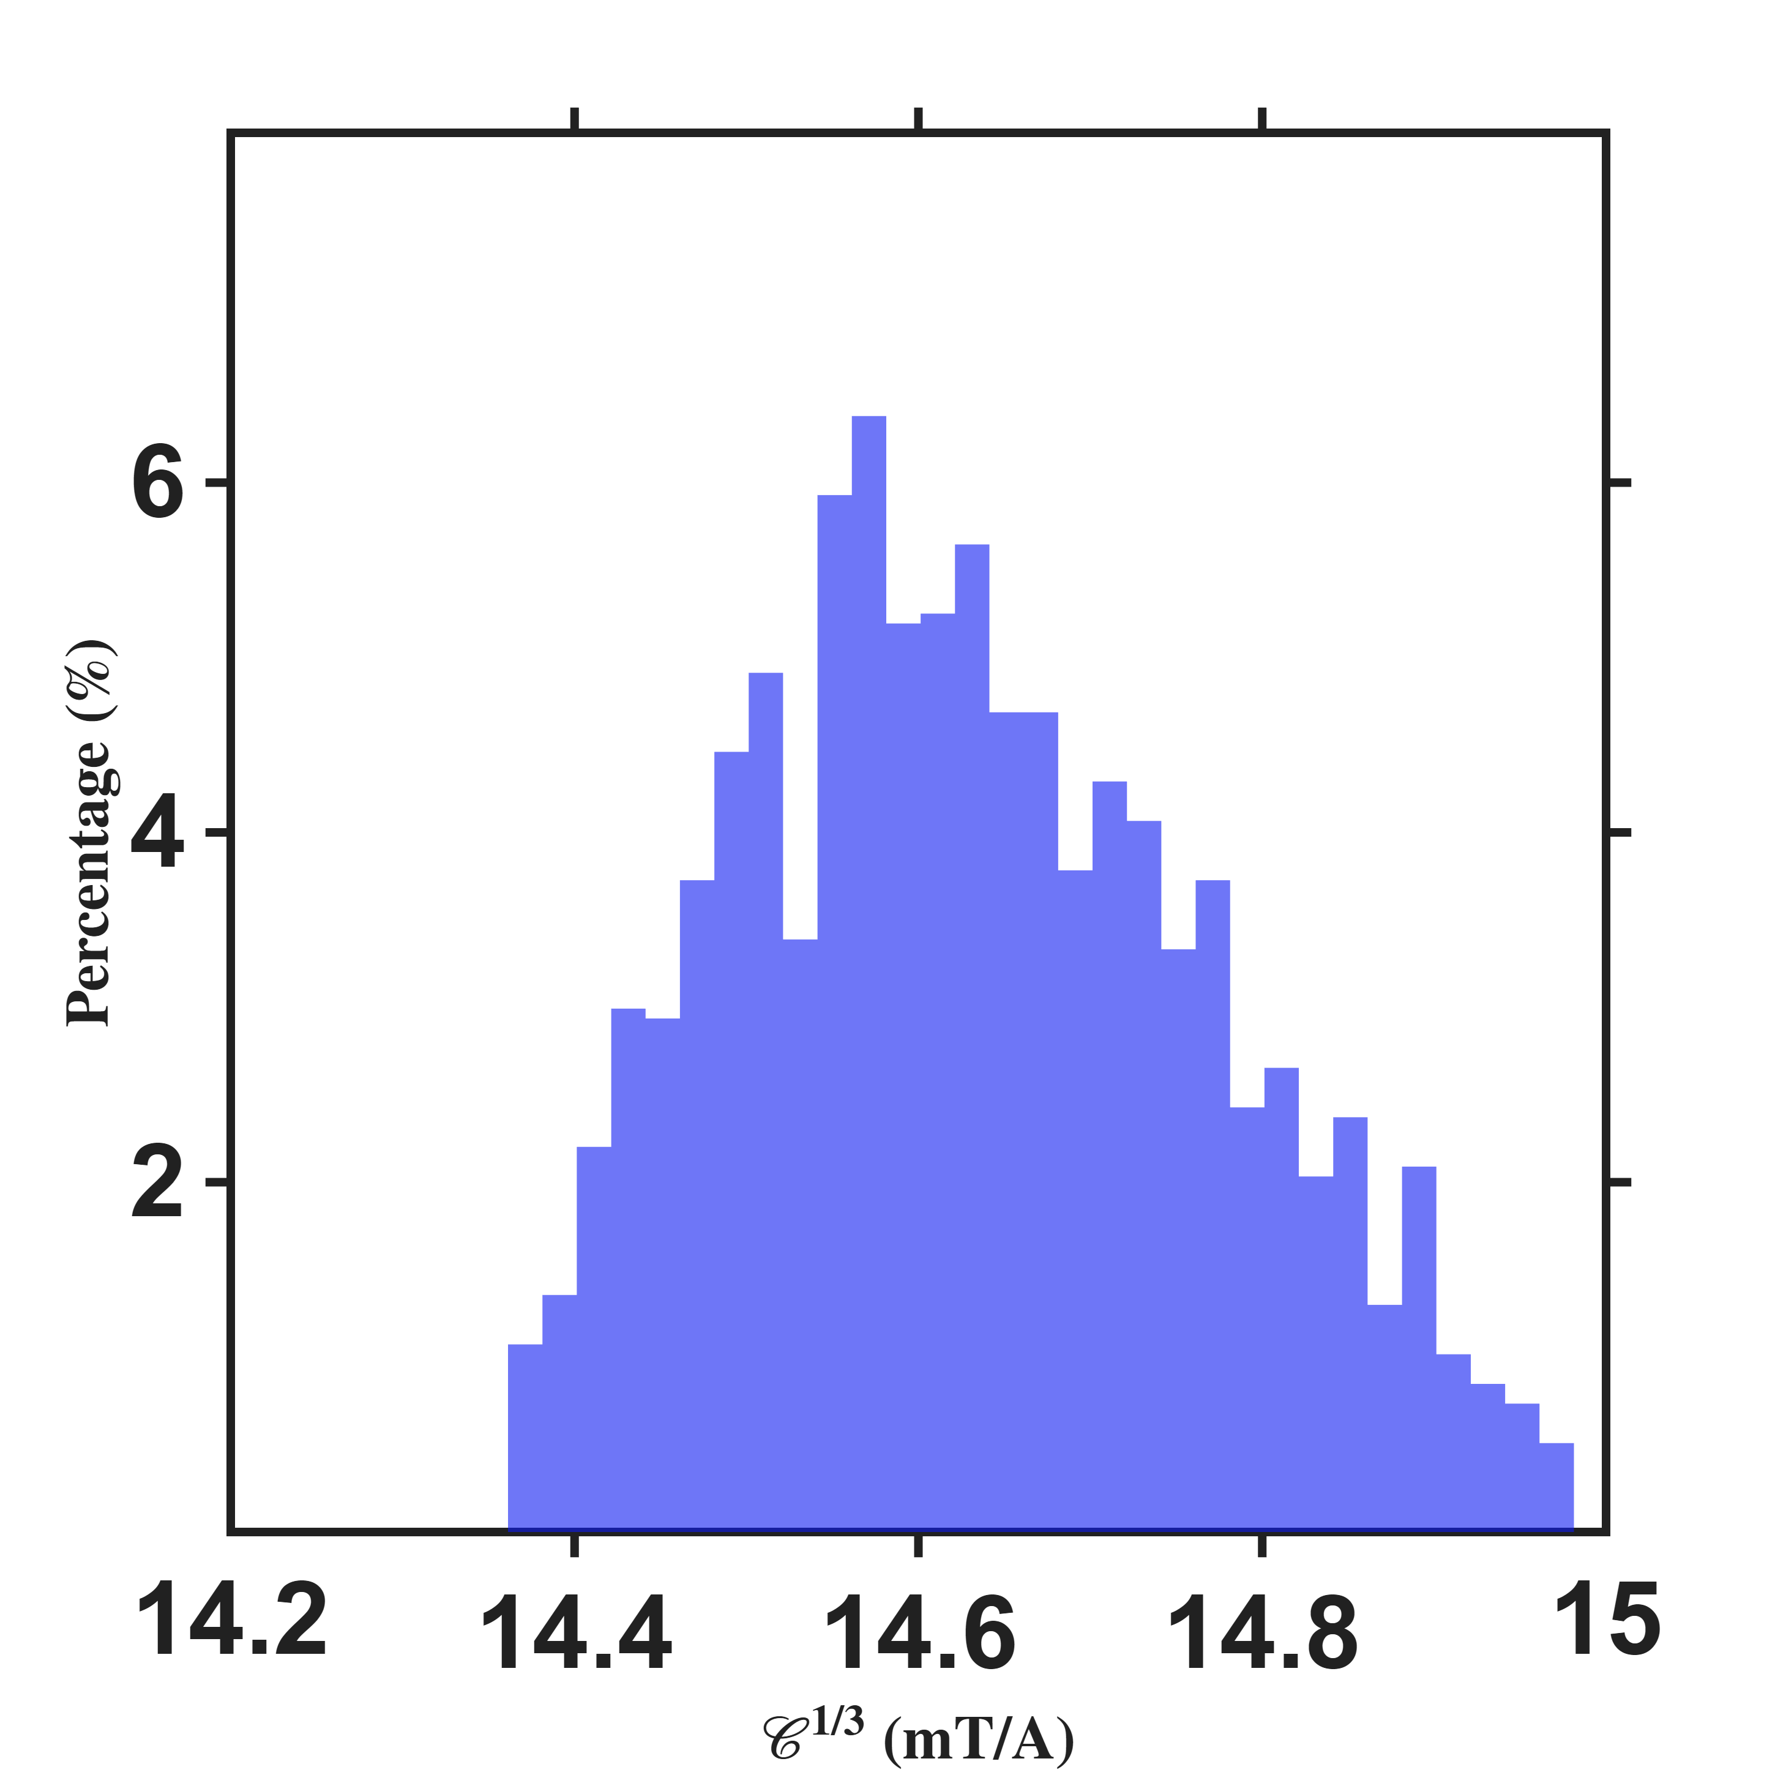

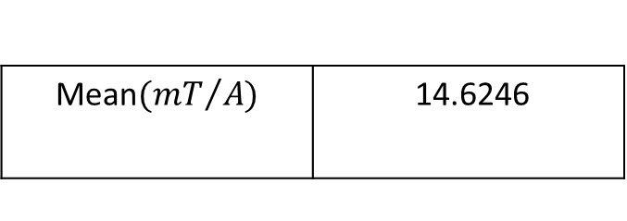

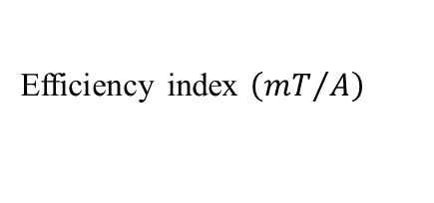
Quantitative Assessment of Multi-Pole Actuators
Percentage count$(\%)$
Percentage count$(\%)$
Efficiency index $\left({mT}/A\right)$
Isotropy
Histogram resolution:0.02 mT/A
Histogram resolution:0.02
Mean$({mT}/{A)}$ | 14.6337
Std$({mT}/{A)}$ | 0.1374
Mean | 0.8826
Std | 0.0417

Slide 18



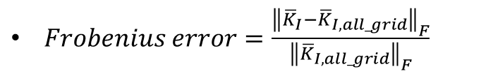
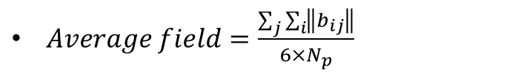

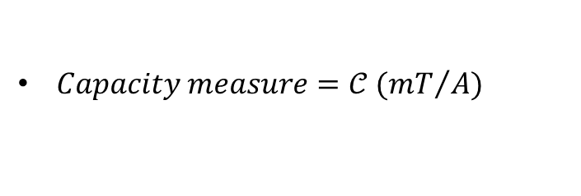
Reference
$Workspace radius=\hat{ℓ}$
$Flux distribution matrix={\overline{K}}_{I}$
$Current to field gain={}_{}^{B}{{\hat{g}}_{I}}$
$Voltage to field gain={}_{}^{B}{{\hat{g}}_{V}}$
$RMS=\sqrt{\frac{J}{N_{C}}}$, where $J=\sum_{j}{\sum_{i}{{ε_{ij}}^{T}ε_{ij}}}$
$Capacity measure=𝒞 ({mT}/A)$
$Isotropy=κ$
$Frobenius error=\frac{{\left\|{\overline{K}}_{I}−{\overline{K}}_{I,all_grid}\right\|}_{F}}{{\left\|{\overline{K}}_{I,all_grid}\right\|}_{F}}$
$Average field=\frac{\sum_{j}{\sum_{i}{\left\|b_{ij}\right\|}}}{6×N_{p}}$

