Slide 1
A Lumped-Parameter Modeling, Calibration, and Capacity-Measure Framework for Flux Generation in Symmetric Multipole Electromagnetic Actuators

Slide 2
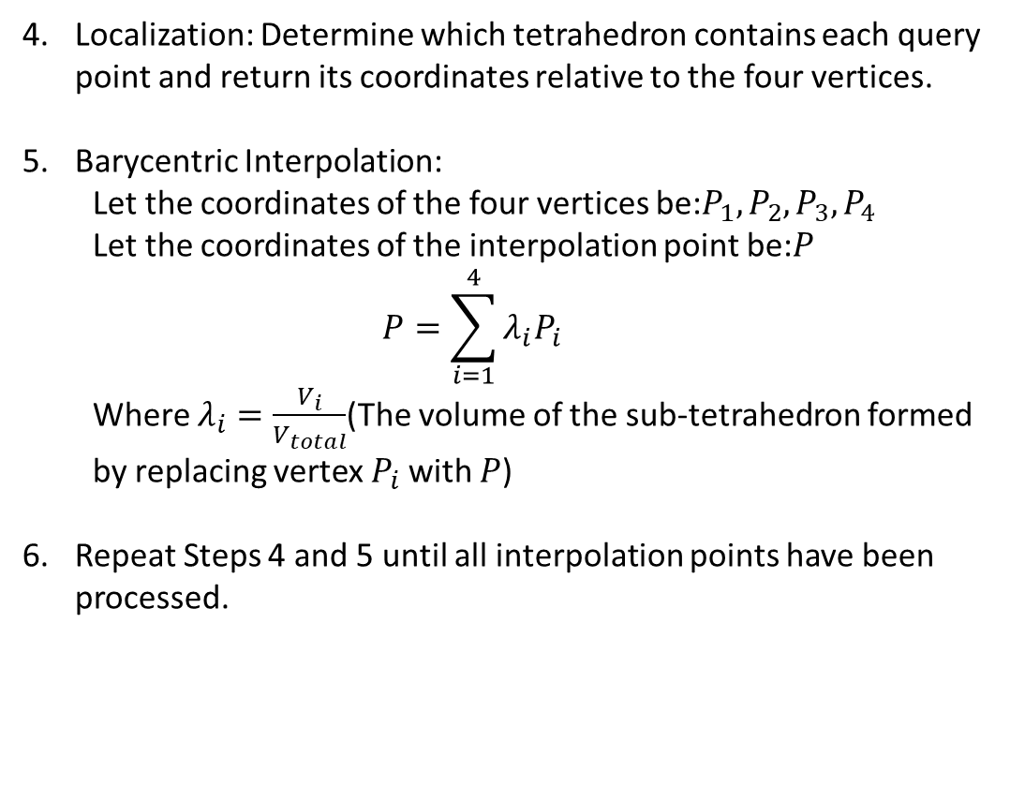
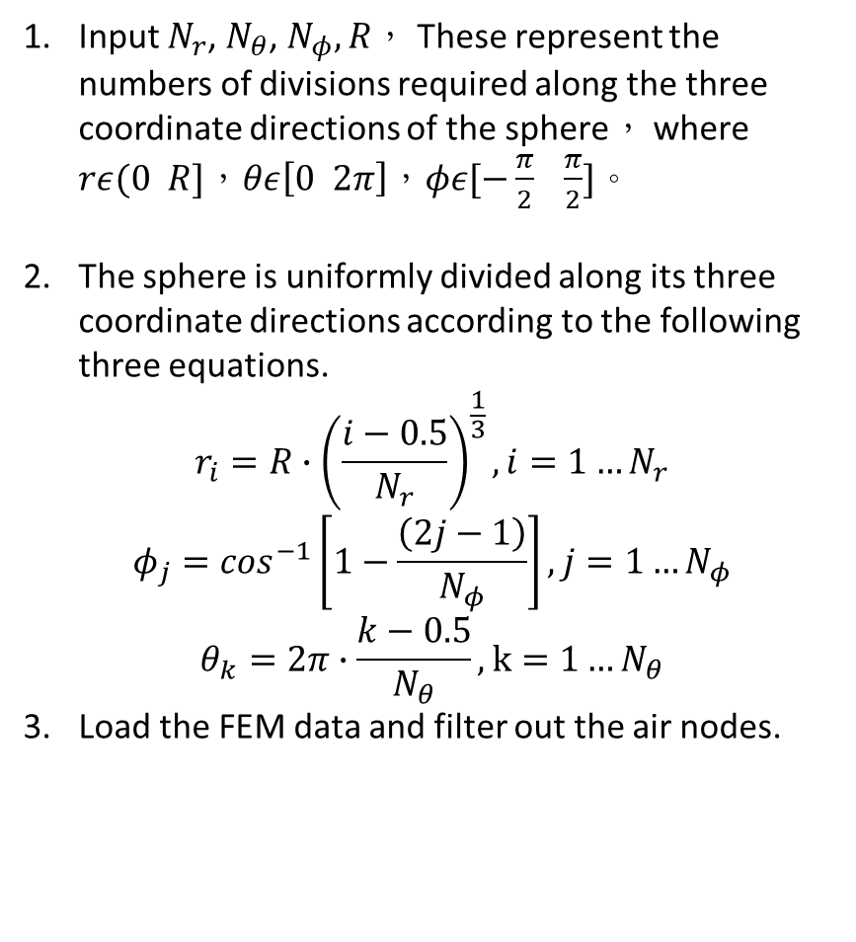

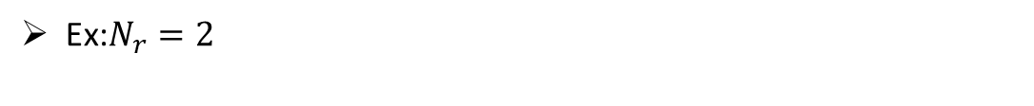
Current-based lumped-parameter modeling and calibration
E. Validation
Interpolation Point Algorithm
Input $N_{r}$, $N_{θ}$, $N_{φ},R$， These represent the numbers of divisions required along the three coordinate directions of the sphere， where $rε(0 R]$，$θε\left[0 2π\right]$，$φε[−\frac{π}{2} \frac{π}{2}]$。
The sphere is uniformly divided along its three coordinate directions according to the following three equations.
$$r_{i}=R∙{\left(\frac{i−0.5}{N_{r}}\right)}^{\frac{1}{3}},i=1…N_{r}$$
$$φ_{j}=\cos^{−1}\left[1−\frac{\left(2j−1\right)}{N_{φ}}\right],j=1…N_{φ}$$
$$θ_{k}=2π∙\frac{k−0.5}{N_{θ}},k=1…N_{θ}$$
Load the FEM data and filter out the air nodes.
Localization: Determine which tetrahedron contains each query point and return its coordinates relative to the four vertices.
Barycentric Interpolation:
Let the coordinates of the four vertices be:$P_{1},P_{2},P_{3},P_{4}$
Let the coordinates of the interpolation point be:$P$
$$P=\sum_{i=1}^{4}{λ_{i}P_{i}}$$
Where $λ_{i}=\frac{V_{i}}{V_{total}}$(The volume of the sub-tetrahedron formed by replacing vertex $P_{i}$ with $P$)
Repeat Steps 4 and 5 until all interpolation points have been processed.
Ex:$N_{r}=2$
$$r$$
Center
Sample point
Sample point

Slide 3
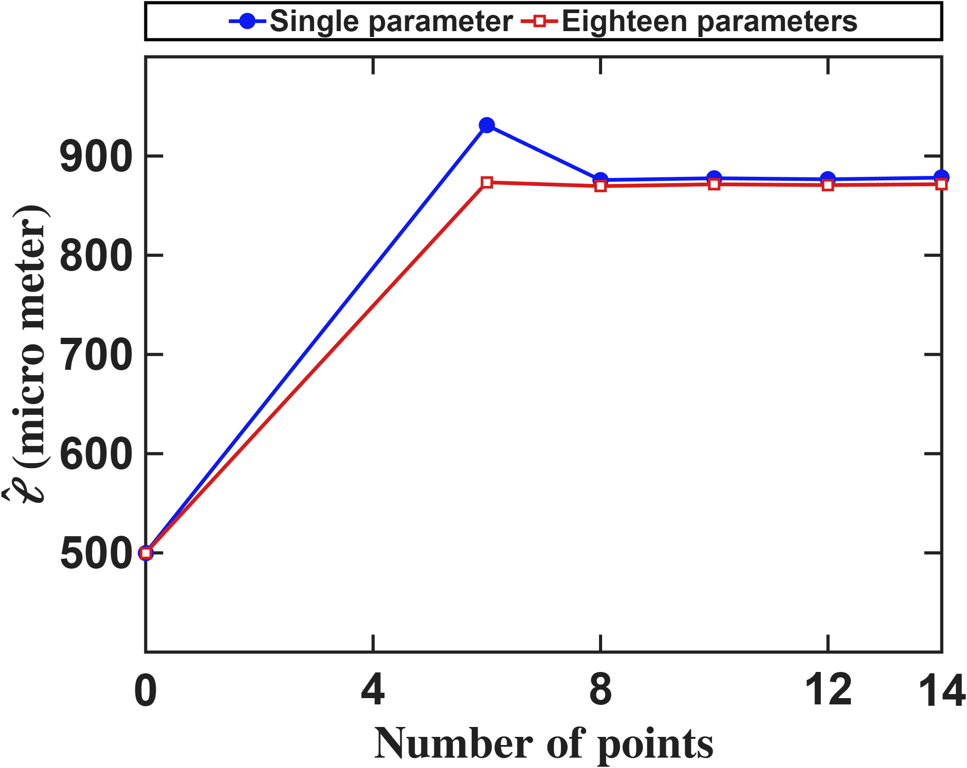
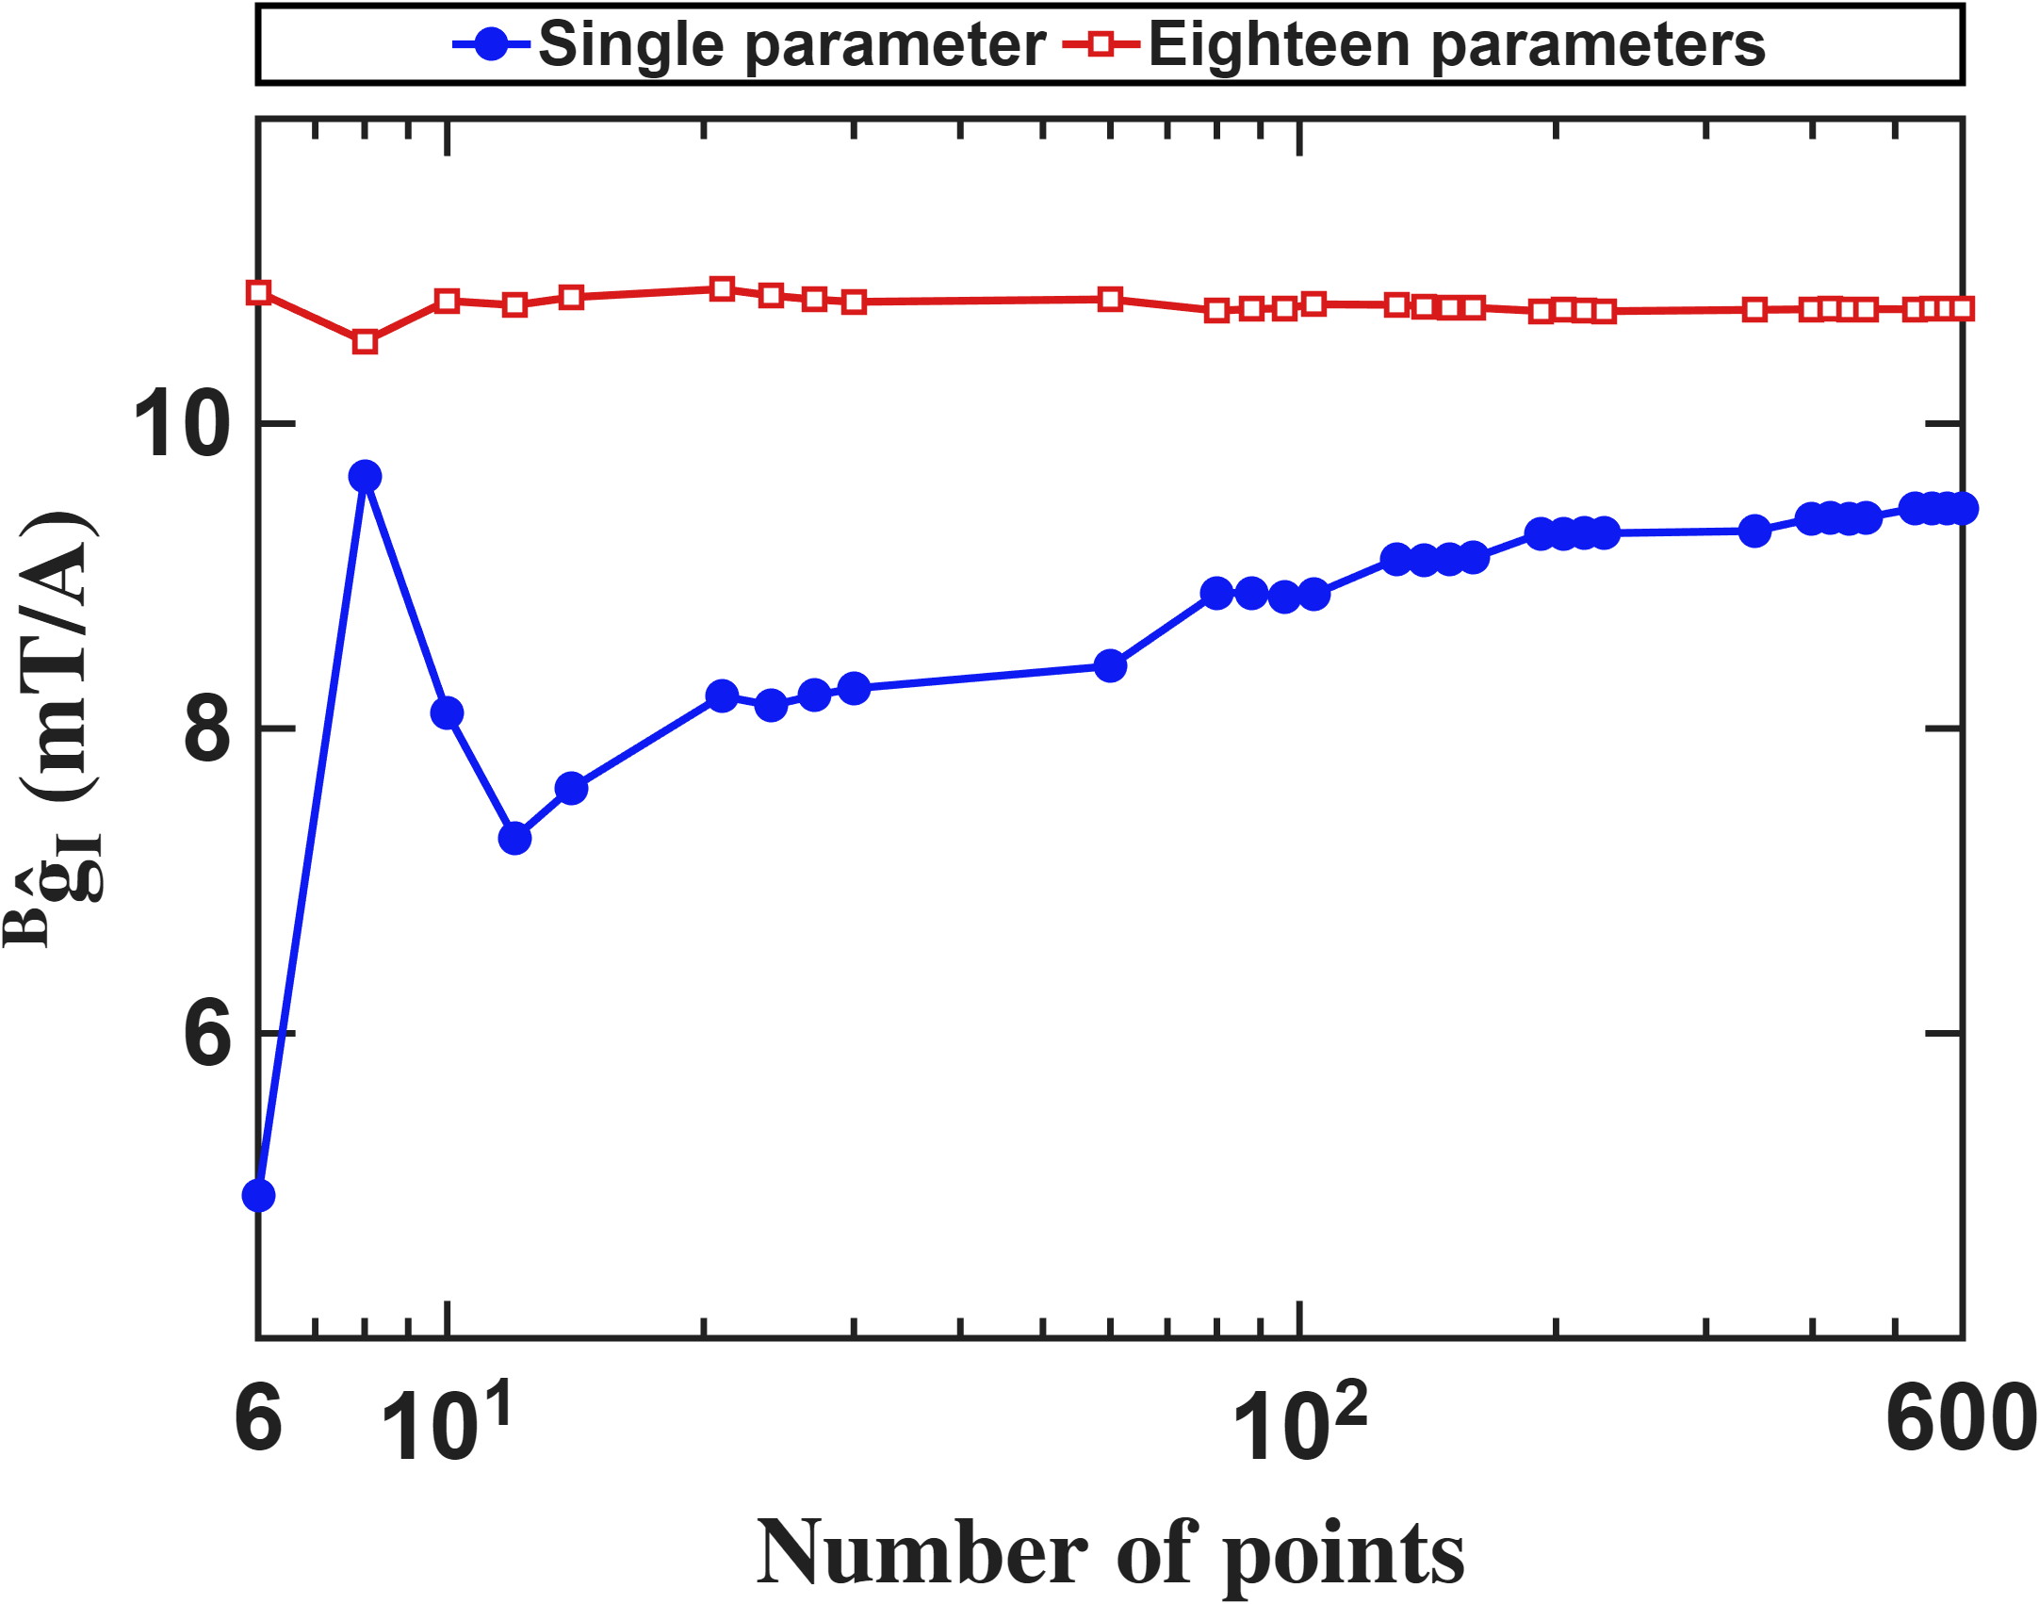


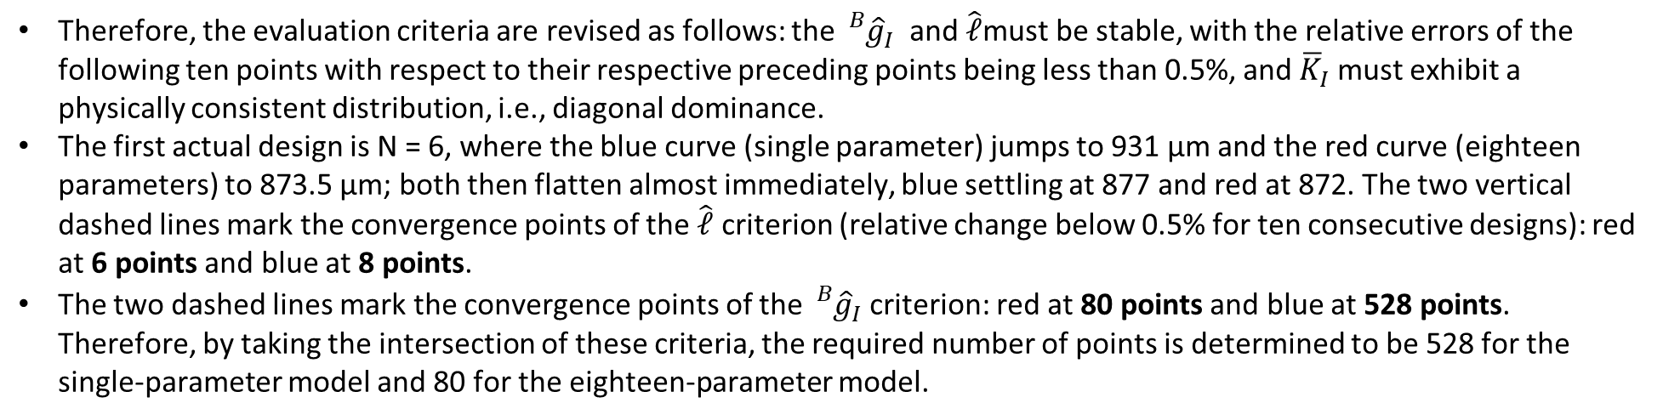
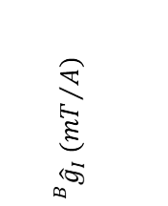
Current-based lumped-parameter modeling and calibration
E. Validation
Interpolation Point Algorithm
Therefore, the evaluation criteria are revised as follows: the ${}_{}^{B}{{\hat{g}}_{I}}$ and $\hat{ℓ}$must be stable, with the relative errors of the following ten points with respect to their respective preceding points being less than 0.5%, and ${\overline{K}}_{I}$​ must exhibit a physically consistent distribution, i.e., diagonal dominance.
The first actual design is N = 6, where the blue curve (single parameter) jumps to 931 µm and the red curve (eighteen parameters) to 873.5 µm; both then flatten almost immediately, blue settling at 877 and red at 872. The two vertical dashed lines mark the convergence points of the $\hat{ℓ}$ criterion (relative change below 0.5% for ten consecutive designs): red at 6 points and blue at 8 points.
The two dashed lines mark the convergence points of the ${}_{}^{B}{{\hat{g}}_{I}}$criterion: red at 80 points and blue at 528 points. Therefore, by taking the intersection of these criteria, the required number of points is determined to be 528 for the single-parameter model and 80 for the eighteen-parameter model.
$$\hat{ℓ} (μm)$$
$${}_{}^{B}{{\hat{g}}_{I}} ({mT}/A)$$
$$Number of points$$
$$Number of points$$

Slide 4

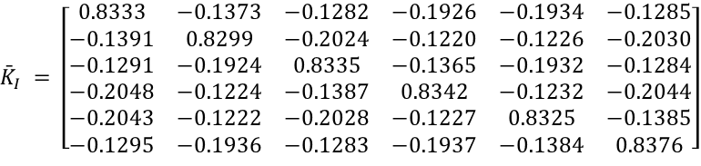

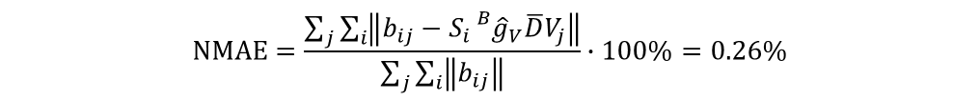


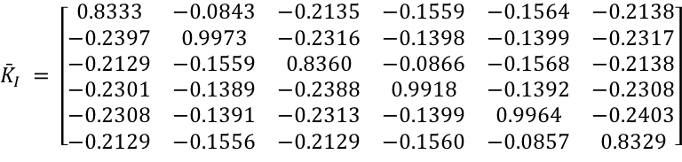
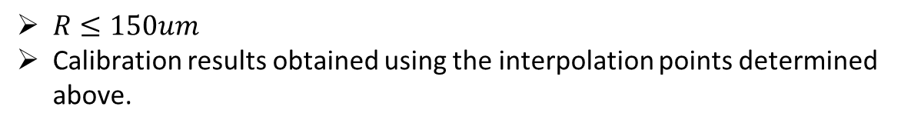
Current-based lumped-parameter modeling and calibration
E. Validation
Calibration results
$$Calibrate model→b_{ij}=S_{i}{}_{}^{B}{{\hat{g}}_{I}}{\overline{K}}_{I}I_{j}$$
$R≤150um$
Calibration results obtained using the interpolation points determined above.
Single parameter(528 points)
$${\bar{K}}_{I} = \left[\begin{matrix}0.8333 & −0.0843 & −0.2135 & −0.1559 & −0.1564 & −0.2138 \\ −0.2397 & 0.9973 & −0.2316 & −0.1398 & −0.1399 & −0.2317 \\ −0.2129 & −0.1559 & 0.8360 & −0.0866 & −0.1568 & −0.2138 \\ −0.2301 & −0.1389 & −0.2388 & 0.9918 & −0.1392 & −0.2308 \\ −0.2308 & −0.1391 & −0.2313 & −0.1399 & 0.9964 & −0.2403 \\ −0.2129 & −0.1556 & −0.2129 & −0.1560 & −0.0857 & 0.8329\end{matrix}\right]$$
$$NMAE=\frac{\sum_{j}{\sum_{i}{\left\|b_{ij}−S_{i}{}_{}^{B}{{\hat{g}}_{V}}\overline{D}V_{j}\right\|}}}{\sum_{j}{\sum_{i}{\left\|b_{ij}\right\|}}}∙100\%=2.85\%$$
$$\hat{ℓ} = 875.1 μm {}_{}^{B}{{\hat{g}}_{I}} = 9.4451 mT/A$$
Eighteen parameters(80 points)
$${\bar{K}}_{I} = \left[\begin{matrix}0.8333 & −0.1373 & −0.1282 & −0.1926 & −0.1934 & −0.1285 \\ −0.1391 & 0.8299 & −0.2024 & −0.1220 & −0.1226 & −0.2030 \\ −0.1291 & −0.1924 & 0.8335 & −0.1365 & −0.1932 & −0.1284 \\ −0.2048 & −0.1224 & −0.1387 & 0.8342 & −0.1232 & −0.2044 \\ −0.2043 & −0.1222 & −0.2028 & −0.1227 & 0.8325 & −0.1385 \\ −0.1295 & −0.1936 & −0.1283 & −0.1937 & −0.1384 & 0.8376\end{matrix}\right]$$
$$NMAE=\frac{\sum_{j}{\sum_{i}{\left\|b_{ij}−S_{i}{}_{}^{B}{{\hat{g}}_{V}}\overline{D}V_{j}\right\|}}}{\sum_{j}{\sum_{i}{\left\|b_{ij}\right\|}}}∙100\%=0.26\%$$
$$\hat{ℓ} = 873.0 μm {}_{}^{B}{{\hat{g}}_{I}} = 10.7405 mT/A$$
$$\hat{e}= \left[\begin{matrix}0.0185 & 0.0203 & −0.1173 & 0.0024 & 0.0018 & −0.1186 \\ −0.1183 & 0.0026 & 0.0168 & 0.0163 & 0.0019 & −0.1185 \\ 0.1182 & −0.0029 & 0.1166 & −0.0029 & −0.0186 & −0.0199\end{matrix}\right]$$

Slide 5
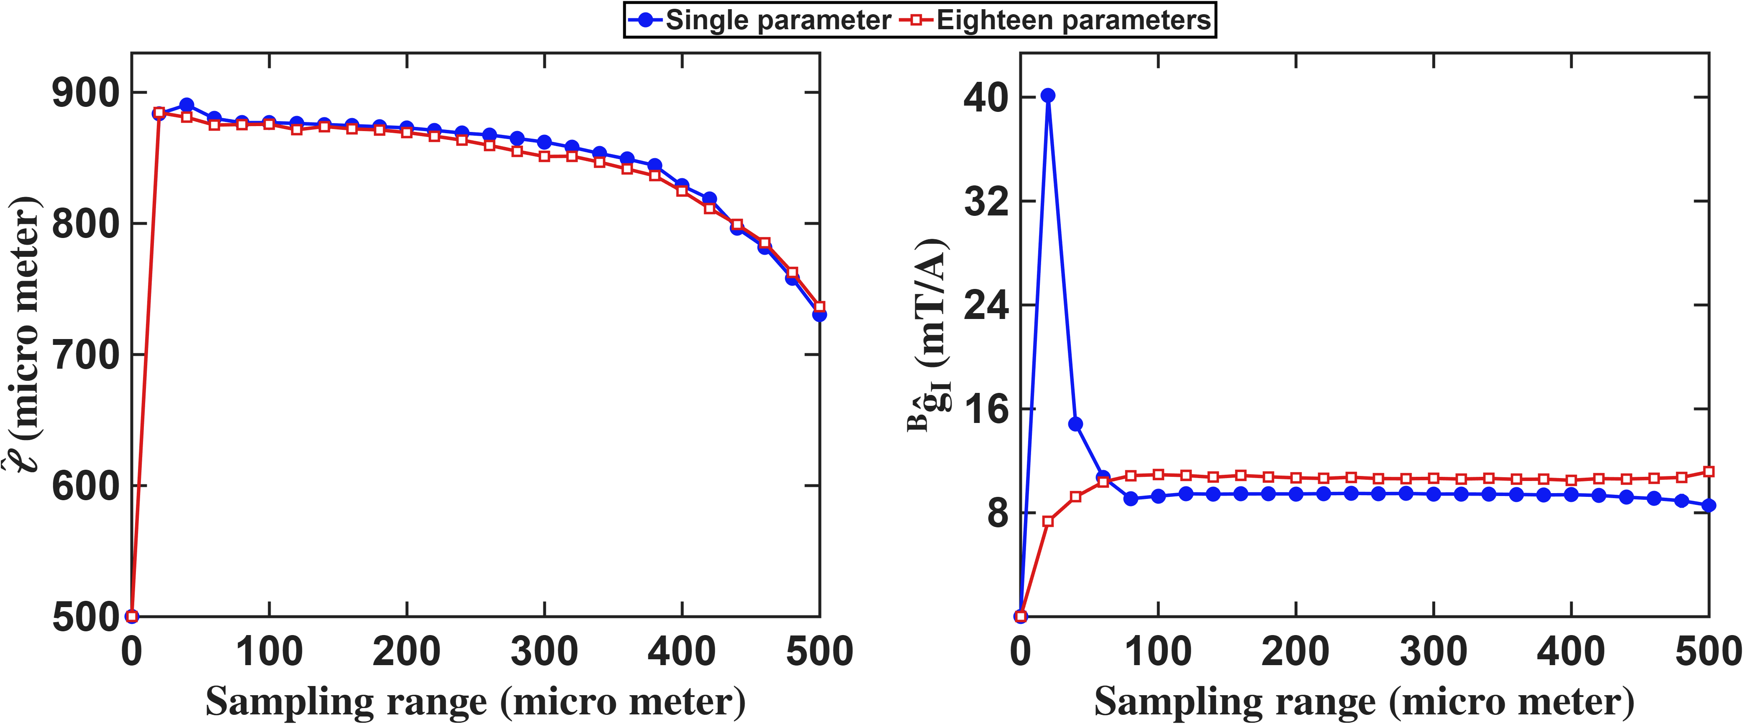

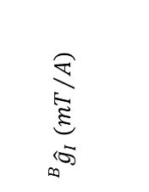


Current-based lumped-parameter modeling and calibration
E. Validation
Setup: For each sampling radius R the model is calibrated on the converged reduced design of that R, sampled from the exported field by trilinear interpolation. R = 20 to 500 um in 20 um steps; blue = single-parameter, red = eighteen-parameter. The segment below R = 20 um is an anchor to the origin, not data.
The workspace radius peaks at 890.5 um at R = 40 um and falls steadily to 797.3 um at R = 500 um. The single-parameter gain is negative below R = 60 um (-40.1 mT/A at R = 20 um) and only settles near 9.4 mT/A from R = 80 um, whereas the eighteen-parameter gain is positive at every radius tested. The eighteen-parameter model is therefore usable over the whole range plotted, the single-parameter model only from R = 80 um.
$$\hat{ℓ} (μm)$$
$${}_{}^{B}{{\hat{g}}_{I}} ({mT}/A)$$
$$Workspace radius(μm)$$
$$Workspace radius(μm)$$

Slide 6
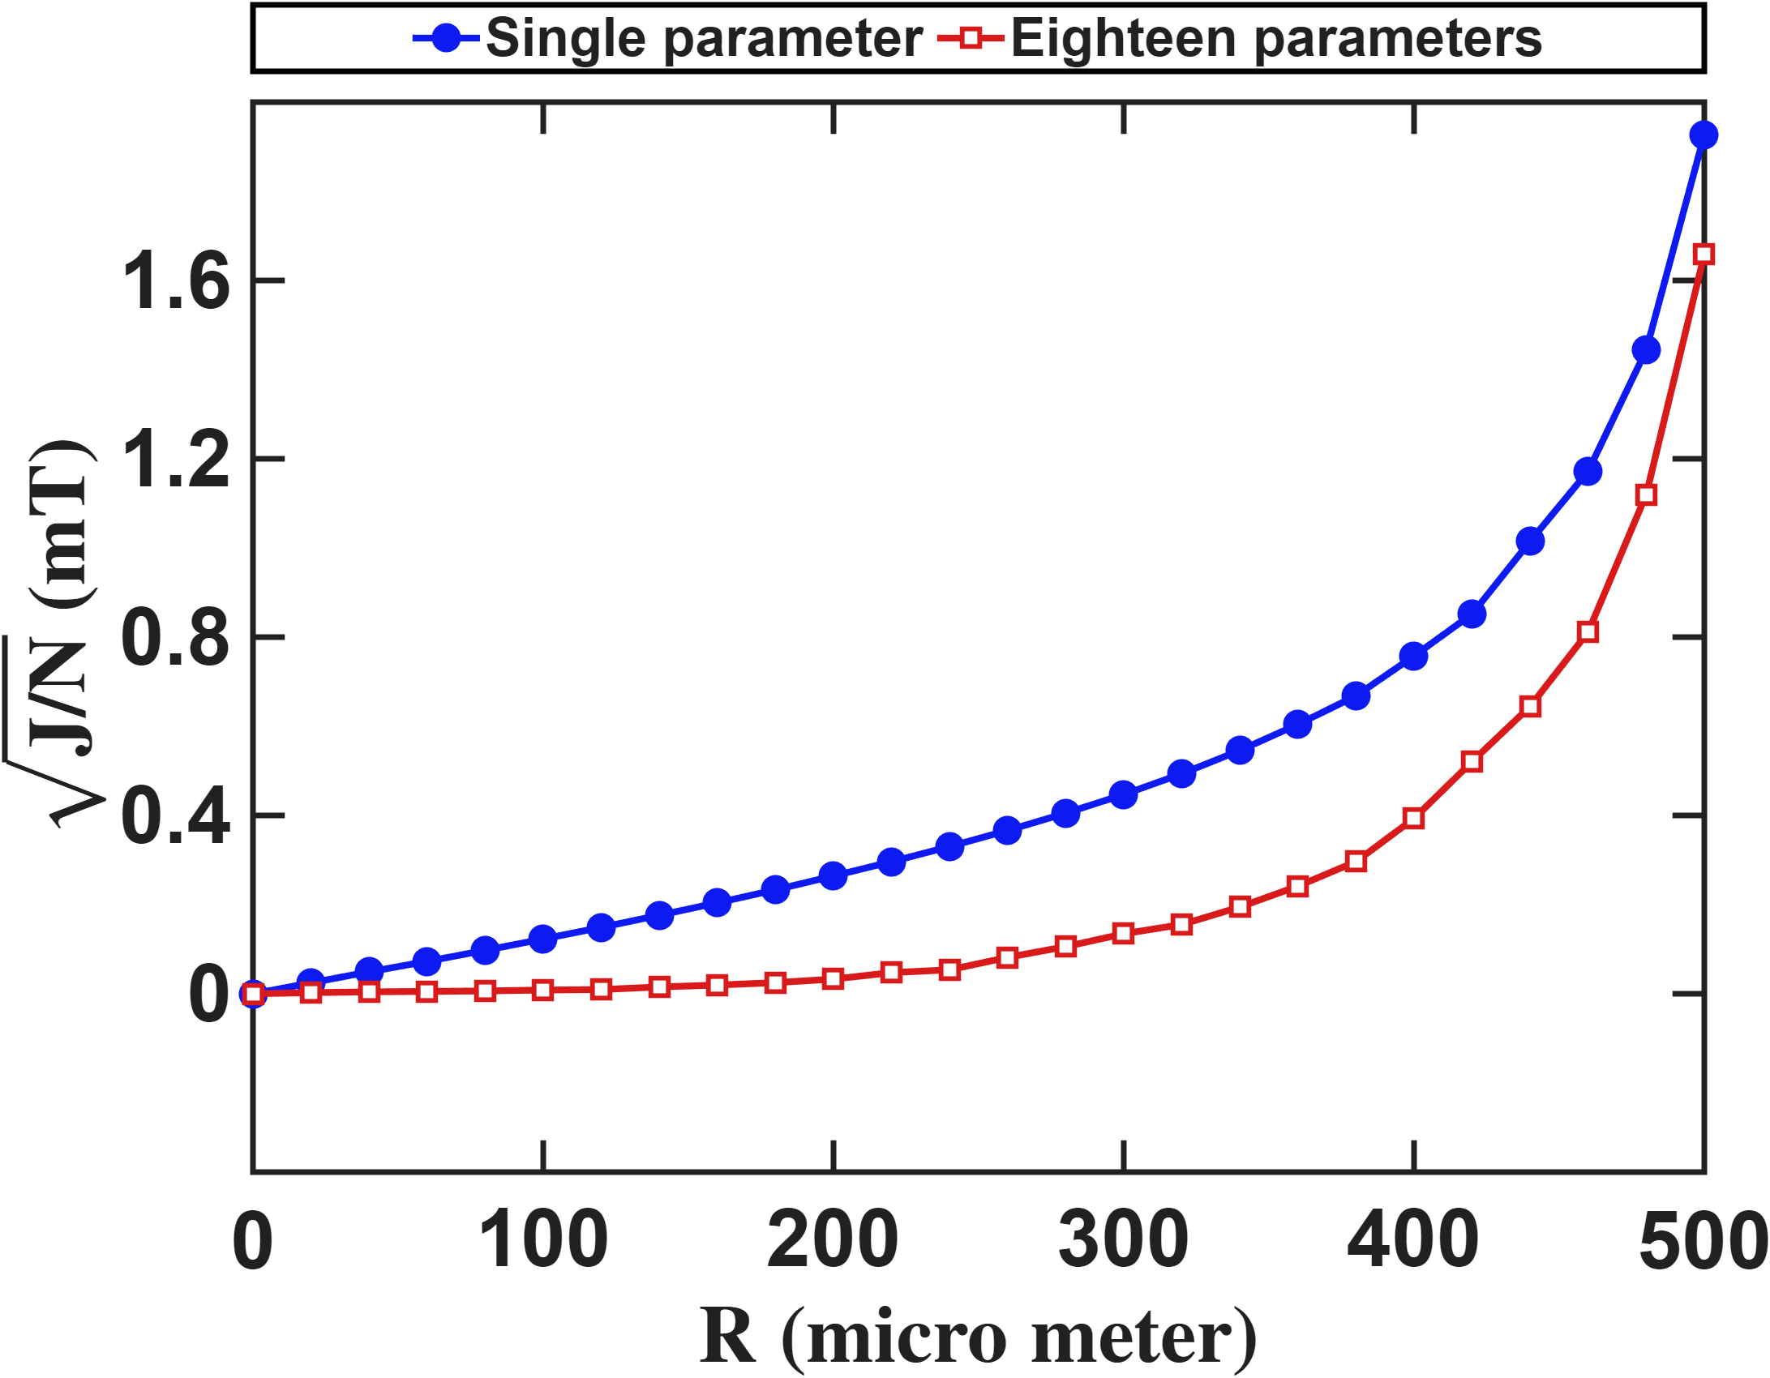


Current-based lumped-parameter modeling and calibration
E. Validation
Setup: Same R sweep and same reduced designs as the previous slide for calibration. The residual field is then evaluated on every real FEM grid point inside R, so calibration points and evaluation points are different sets.
The residual grows monotonically with R for both models. At R = 300 um the single-parameter residual is about 0.45 mT, more than three times the eighteen-parameter value, and the two converge only near R = 500 um. The eighteen-parameter model therefore keeps its accuracy over a much wider sampling range, losing the advantage only as R approaches the pole tips.
$$Residual error (mT)$$
$$Workspace radius (μm)$$

Slide 7
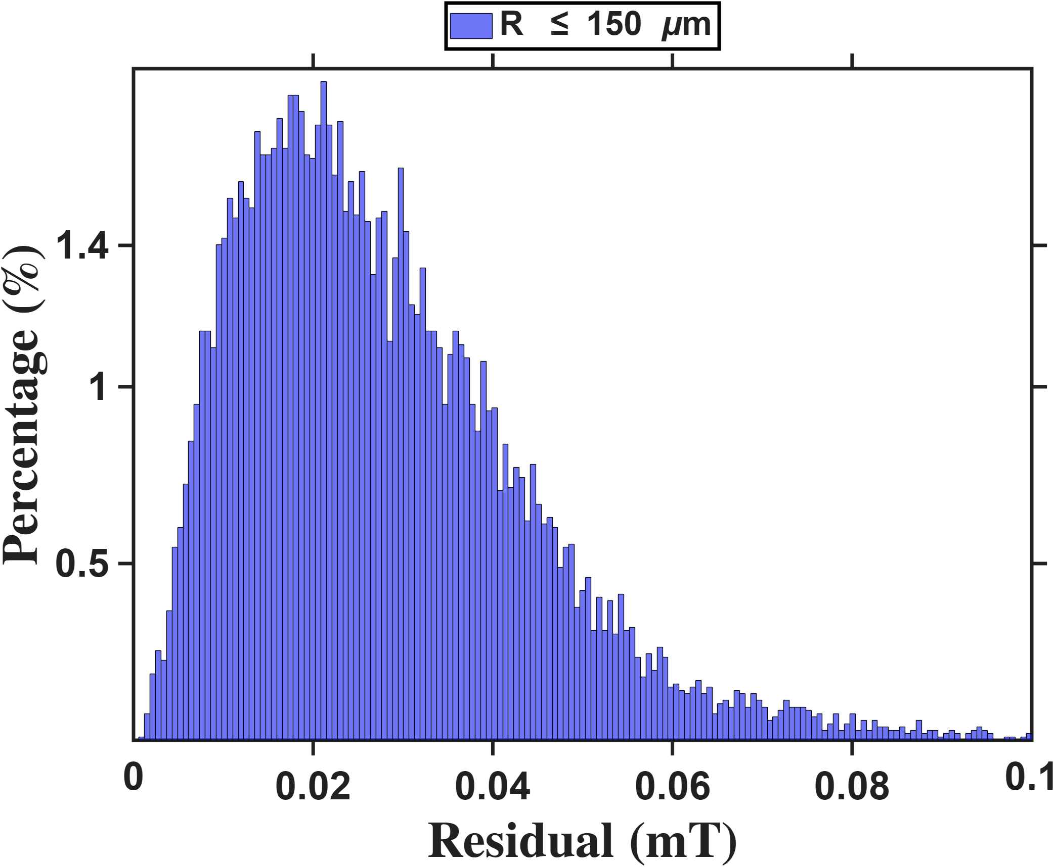
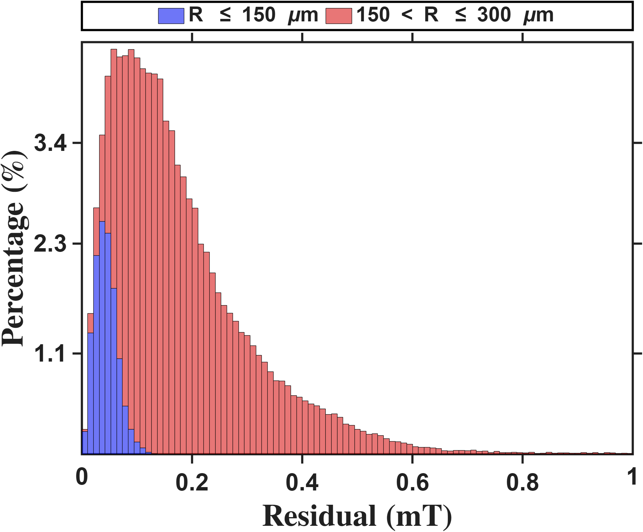




Current-based lumped-parameter modeling and calibration
E. Validation
Setup: Same protocol as the previous slide, with the eighteen-parameter model (80 points).
The mean residual is 0.028 mT inside R = 150 um and 0.181 mT in the 150-300 um shell, about ten and three and a half times smaller than the single-parameter model. Note the horizontal scale: the inner-shell histogram spans only 0-0.125 mT. The eighteen-parameter model therefore holds the residual an order of magnitude lower inside the calibrated core and degrades more slowly outside it.
$$Percentage(\%)$$
$$Residual error (mT)$$
$$Percentage(\%)$$
$$Residual error (mT)$$

Slide 8
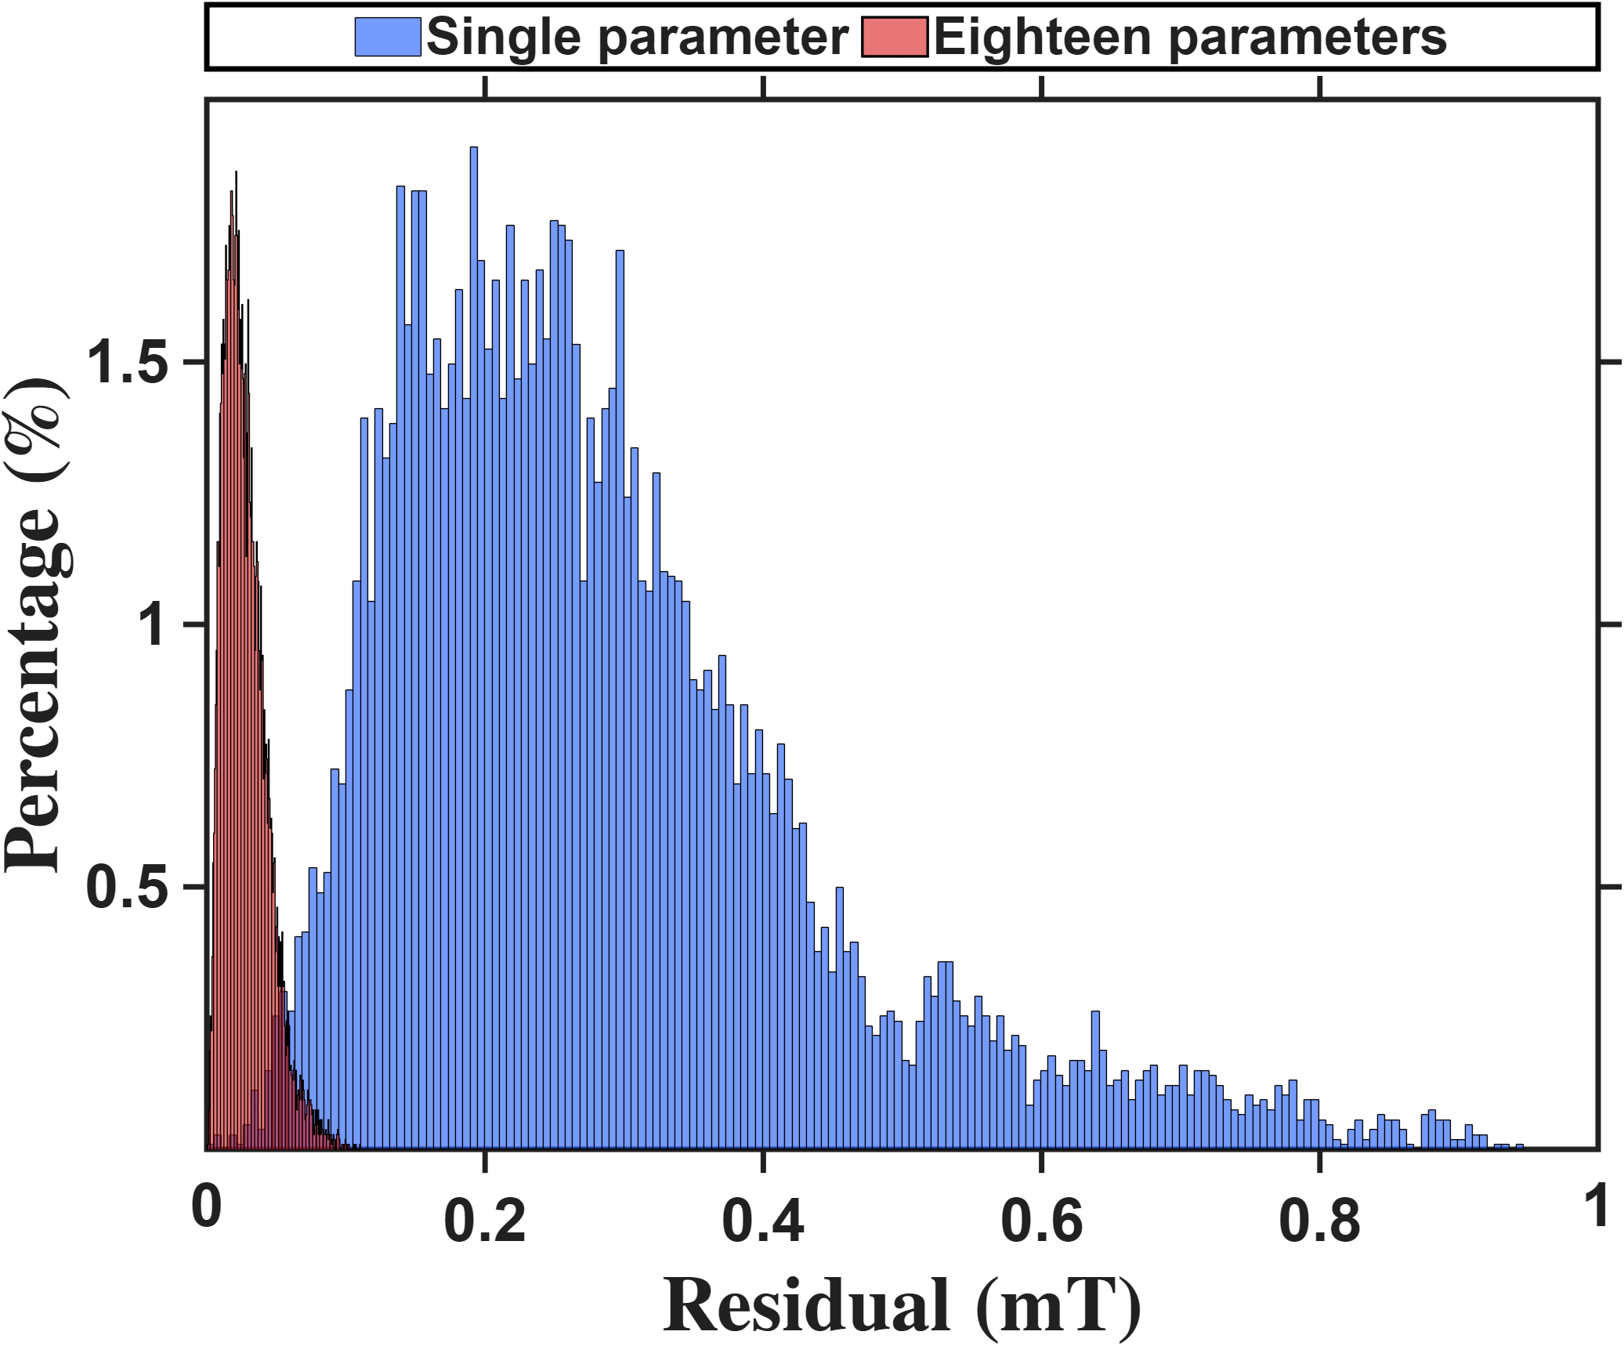
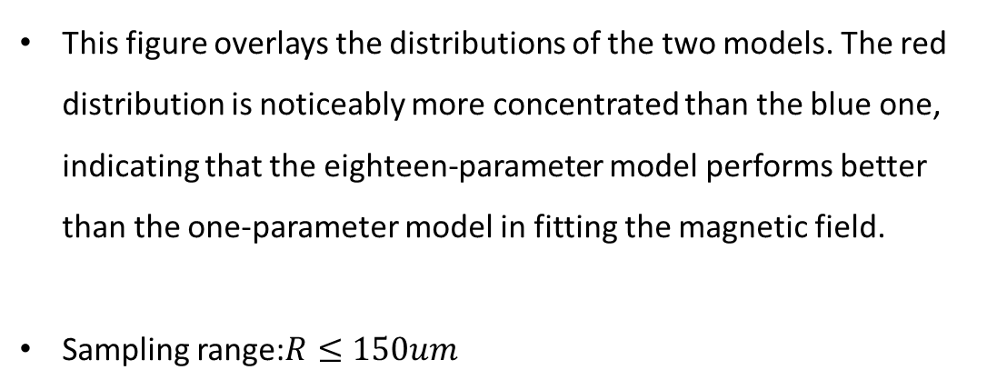



Current-based lumped-parameter modeling and calibration
E. Validation
$$Calibrate model→b_{ij}=S_{i}{}_{}^{B}{{\hat{g}}_{I}}{\overline{K}}_{I}I_{j}$$
This figure overlays the distributions of the two models. The red distribution is noticeably more concentrated than the blue one, indicating that the eighteen-parameter model performs better than the one-parameter model in fitting the magnetic field.
Sampling range:$R≤150um$
$$Percentage(\%)$$
$$Residual error (mT)$$

Slide 9
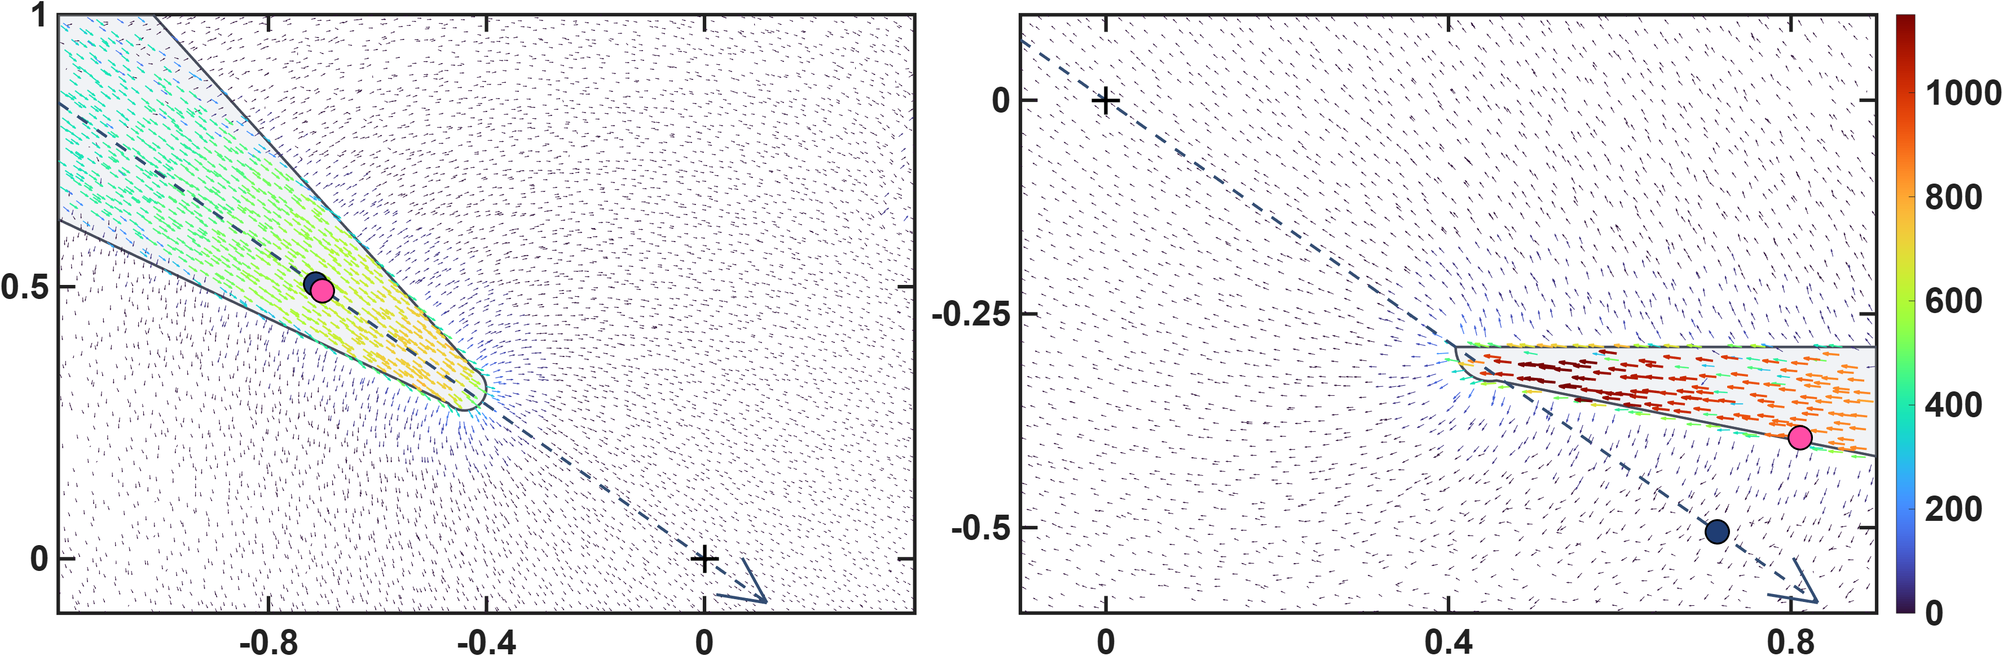








Current-based lumped-parameter modeling and calibration
E. Validation
$$Calibrate model→b_{ij}=S_{i}{}_{}^{B}{{\hat{g}}_{I}}{\overline{K}}_{I}I_{j}$$
These two figures show the differences in the calibrated magnetic charge locations between the two models. The upper row presents the magnetic charge locations calibrated by the one-parameter model, shown using side views of poles P1 and P2. It can be clearly seen that, for the lower pole, some of the magnetic charge locations are located outside the pole. This is because the one-parameter model constrains the magnetic charges to lie along the actuator coordinate axes. The lower row presents the results of the eighteen-parameter model, in which the magnetic charge locations of the lower pole move inside the pole. This is more consistent with the expected physical situation. Moreover, the error histograms shown above also indicate that these magnetic charge locations are more consistent with the theoretical positions.
$${\hat{x}}_{a}$$
$$z−axis(mm)$$
$$q_{c2}$$
$$\left\|b\right\|(mT)$$
$${\hat{x}}_{a}$$
$$q_{c1}$$
$$x−axis(mm)$$
$$x−axis(mm)$$

Slide 10
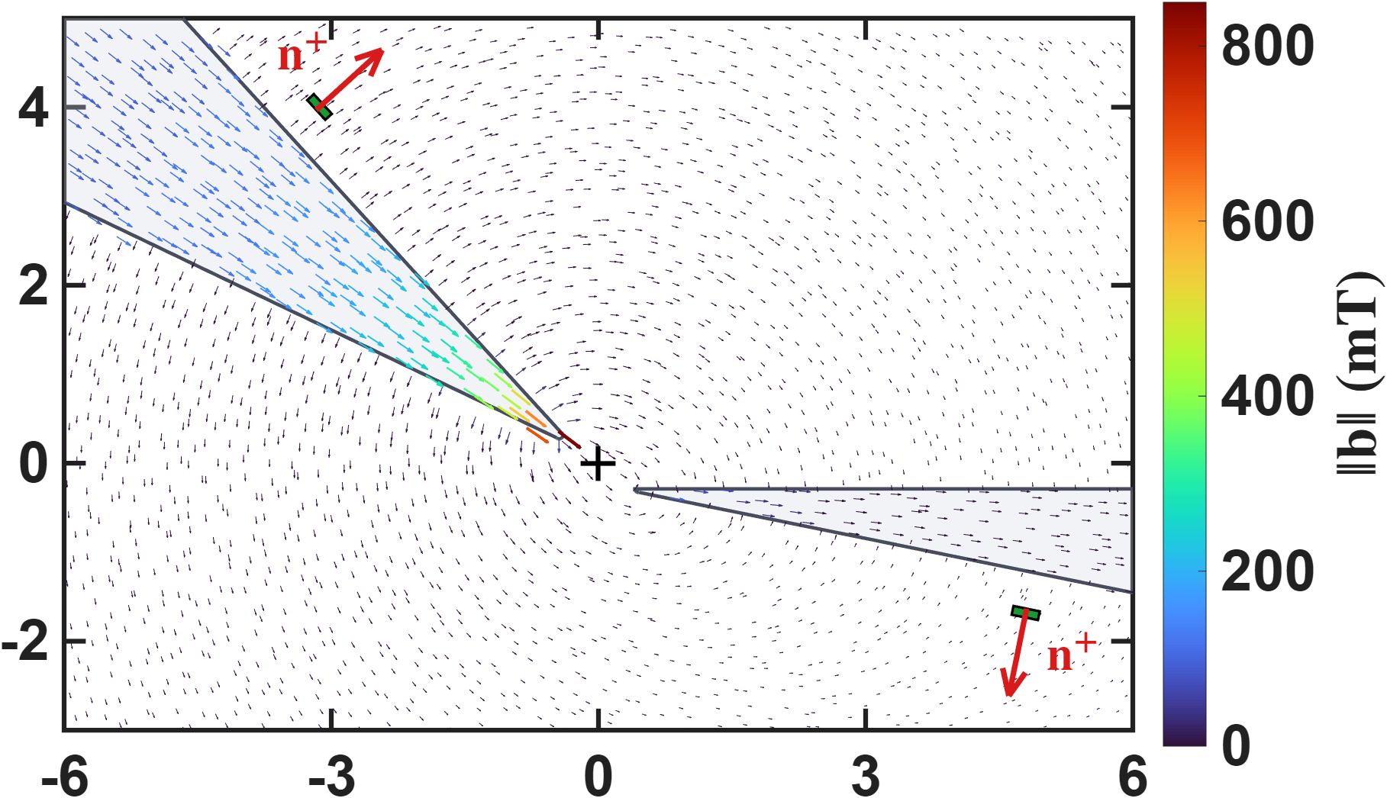



Hall-sensor-voltage-based lumped-parameter modeling and calibration
Setup: Magnetostatic FEM solution with the upper pole P2 excited at 1 A, on the y = 0 plane. Arrows give the direction of the flux density in the x-z plane, coloured by magnitude over 0-800 mT. The two Hall sensors sit flat on the cone flanks, with n+ the outward sensing normal.
The flux stays almost entirely inside the excited pole. Both sensors sit in the leakage field outside the steel, roughly two orders of magnitude weaker; it is this leakage, projected onto n+, that the voltage-based model maps to the field at the workspace. The sensor on the excited pole sits in a visibly stronger leakage field than the one on the unexcited pole, which is the origin of the diagonal dominance of the voltage matrix.
$$z−axis(mm)$$
$$\left\|b\right\|(mT)$$
$$x−axis(mm)$$

Slide 11
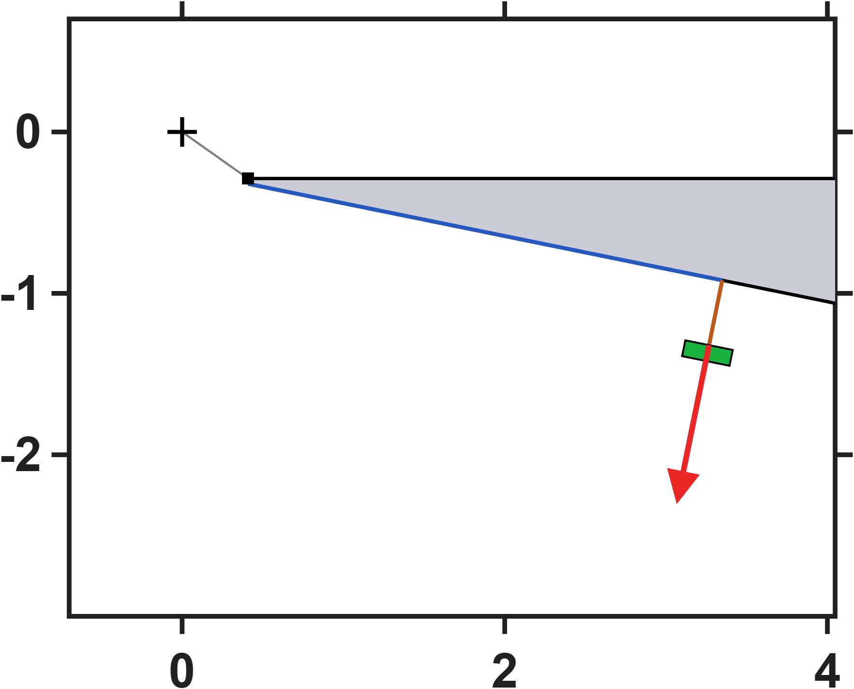
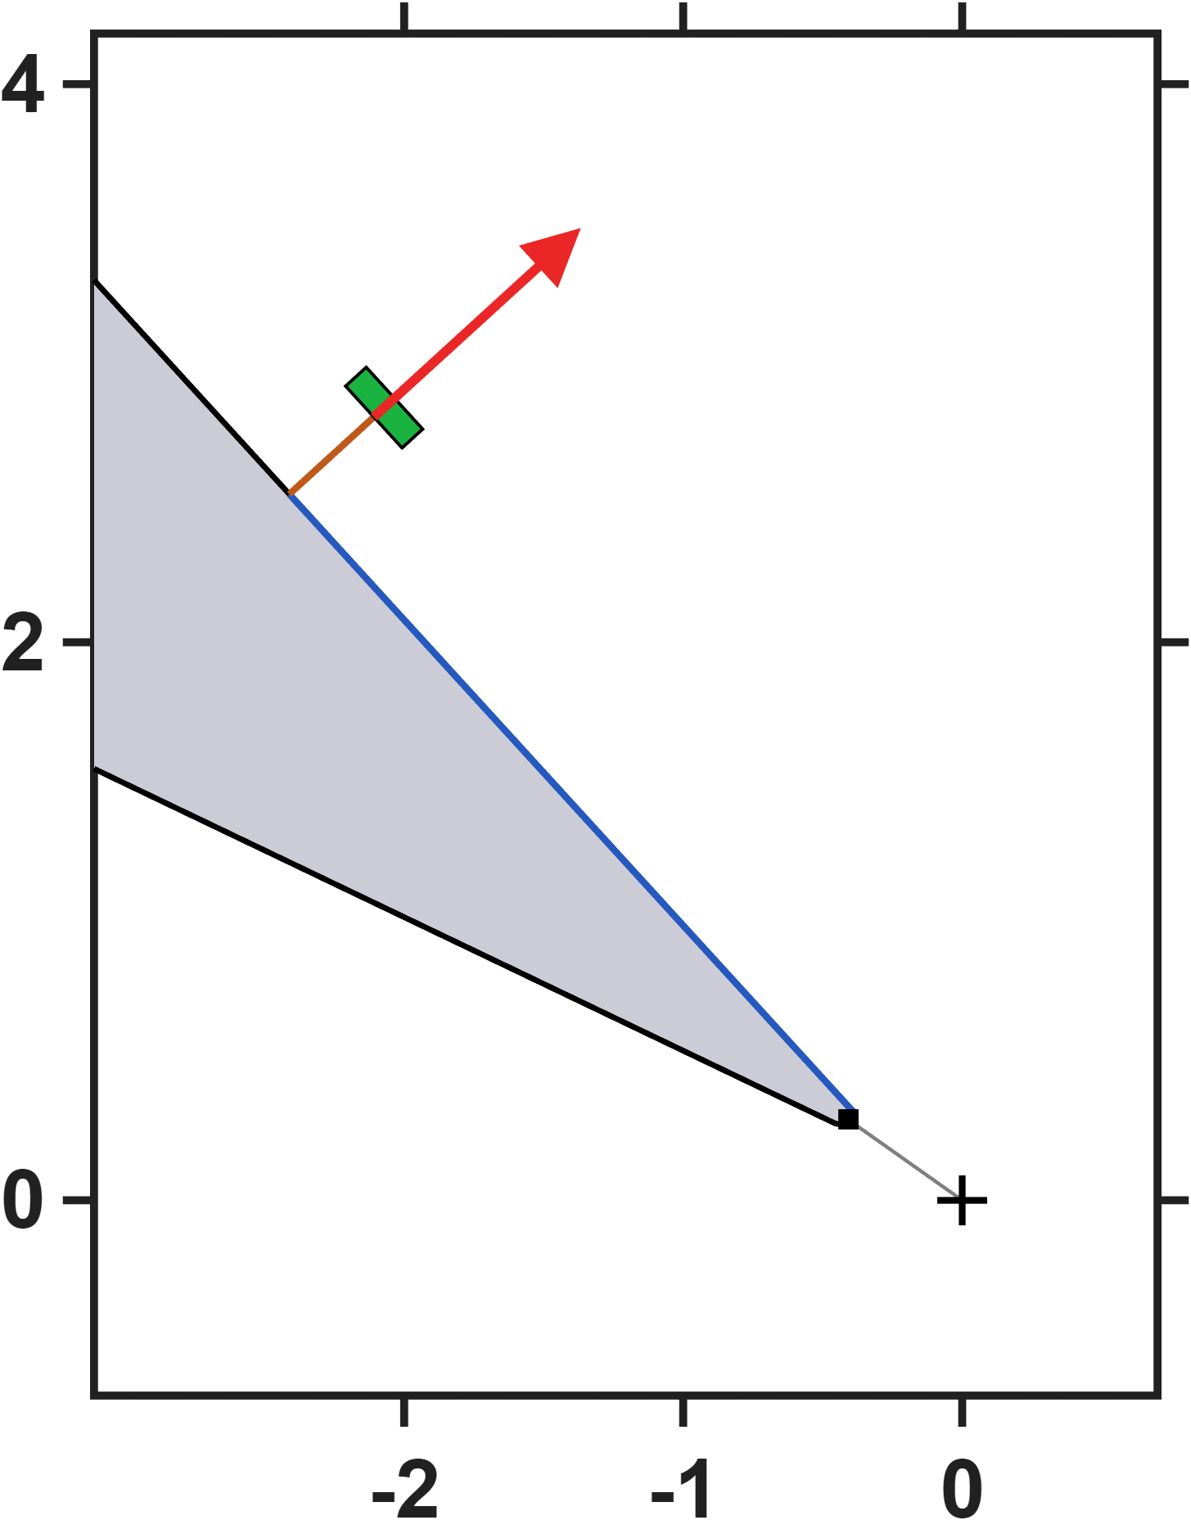



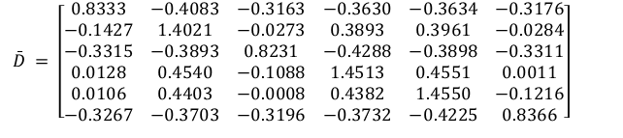


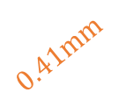


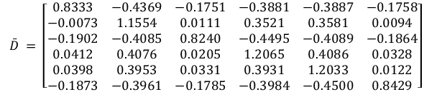




Hall-sensor-voltage-based lumped-parameter modeling and calibration
$$Calibrate model→b_{ij}=S_{i}{}_{}^{B}{{\hat{g}}_{I}}{\overline{K}}_{I}I_{j}$$
Single parameter
$$\bar{D} = \left[\begin{matrix}0.8333 & −0.4083 & −0.3163 & −0.3630 & −0.3634 & −0.3176 \\ −0.1427 & 1.4021 & −0.0273 & 0.3893 & 0.3961 & −0.0284 \\ −0.3315 & −0.3893 & 0.8231 & −0.4288 & −0.3898 & −0.3311 \\ 0.0128 & 0.4540 & −0.1088 & 1.4513 & 0.4551 & 0.0011 \\ 0.0106 & 0.4403 & −0.0008 & 0.4382 & 1.4550 & −0.1216 \\ −0.3267 & −0.3703 & −0.3196 & −0.3732 & −0.4225 & 0.8366\end{matrix}\right]$$
$$NMAE=\frac{\sum_{j}{\sum_{i}{\left\|b_{ij}−S_{i}{}_{}^{B}{{\hat{g}}_{V}}\overline{D}V_{j}\right\|}}}{\sum_{j}{\sum_{i}{\left\|b_{ij}\right\|}}}∙100\%=2.85\%$$
$$z−axis(mm)$$
$$3mm$$
$$0.41mm$$
$$\hat{ℓ} = 875.1 μm {}_{}^{B}{{\hat{g}}_{V}} = 5.0977×{10}^{−3} mT/mV$$
Eighteen parameters
$$\bar{D} = \left[\begin{matrix}0.8333 & −0.4369 & −0.1751 & −0.3881 & −0.3887 & −0.1758 \\ −0.0073 & 1.1554 & 0.0111 & 0.3521 & 0.3581 & 0.0094 \\ −0.1902 & −0.4085 & 0.8240 & −0.4495 & −0.4089 & −0.1864 \\ 0.0412 & 0.4076 & 0.0205 & 1.2065 & 0.4086 & 0.0328 \\ 0.0398 & 0.3953 & 0.0331 & 0.3931 & 1.2033 & 0.0122 \\ −0.1873 & −0.3961 & −0.1785 & −0.3984 & −0.4500 & 0.8429\end{matrix}\right]$$
$$NMAE=\frac{\sum_{j}{\sum_{i}{\left\|b_{ij}−S_{i}{}_{}^{B}{{\hat{g}}_{V}}\overline{D}V_{j}\right\|}}}{\sum_{j}{\sum_{i}{\left\|b_{ij}\right\|}}}∙100\%=0.26\%$$
$$x−axis(mm)$$
$$\hat{e}= \left[\begin{matrix}0.0185 & 0.0203 & −0.1173 & 0.0024 & 0.0018 & −0.1186 \\ −0.1183 & 0.0026 & 0.0168 & 0.0163 & 0.0019 & −0.1185 \\ 0.1182 & −0.0029 & 0.1166 & −0.0029 & −0.0186 & −0.0199\end{matrix}\right]$$
$$0.41mm$$
$$\hat{ℓ} = 873.0 μm {}_{}^{B}{{\hat{g}}_{V}} = 6.0681×{10}^{−3} mT/mV$$
$$z−axis(mm)$$
$V (mV) = \left[\begin{matrix}1397.2735 & −44.8716 & −296.5495 & −238.8386 & −249.5774 & −294.4416 \\ −52.4580 & 1598.5038 & −235.9132 & −508.5162 & −516.0957 & −237.4094 \\ −294.5096 & −234.5870 & 1395.5988 & −46.2246 & −241.6162 & −294.7690 \\ −235.8573 & −530.9619 & −51.6032 & 1587.2805 & −528.2991 & −225.8603 \\ −241.4100 & −521.1573 & −229.5505 & −520.2988 & 1582.0741 & −48.2349 \\ −288.6527 & −244.1620 & −297.5548 & −236.1487 & −44.7574 & 1386.8765\end{matrix}\right]$
$$3mm$$
$$x−axis(mm)$$

Slide 12
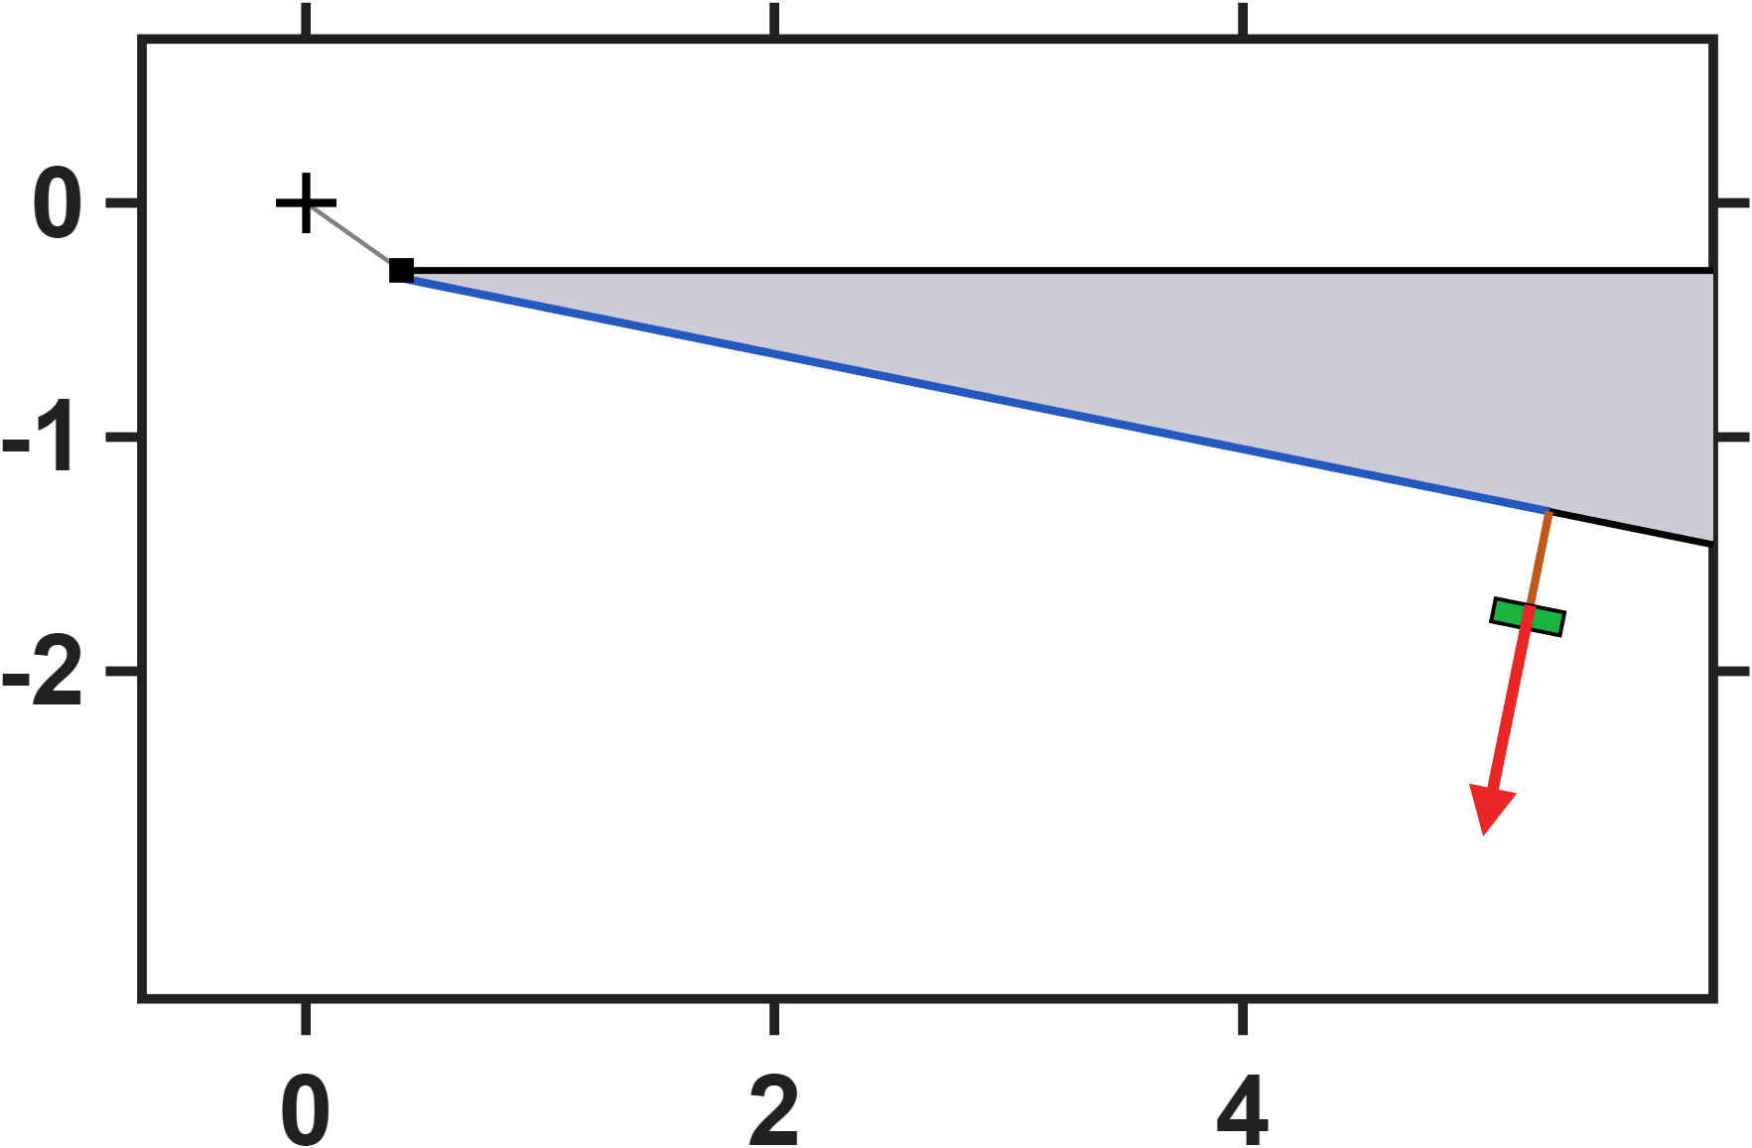
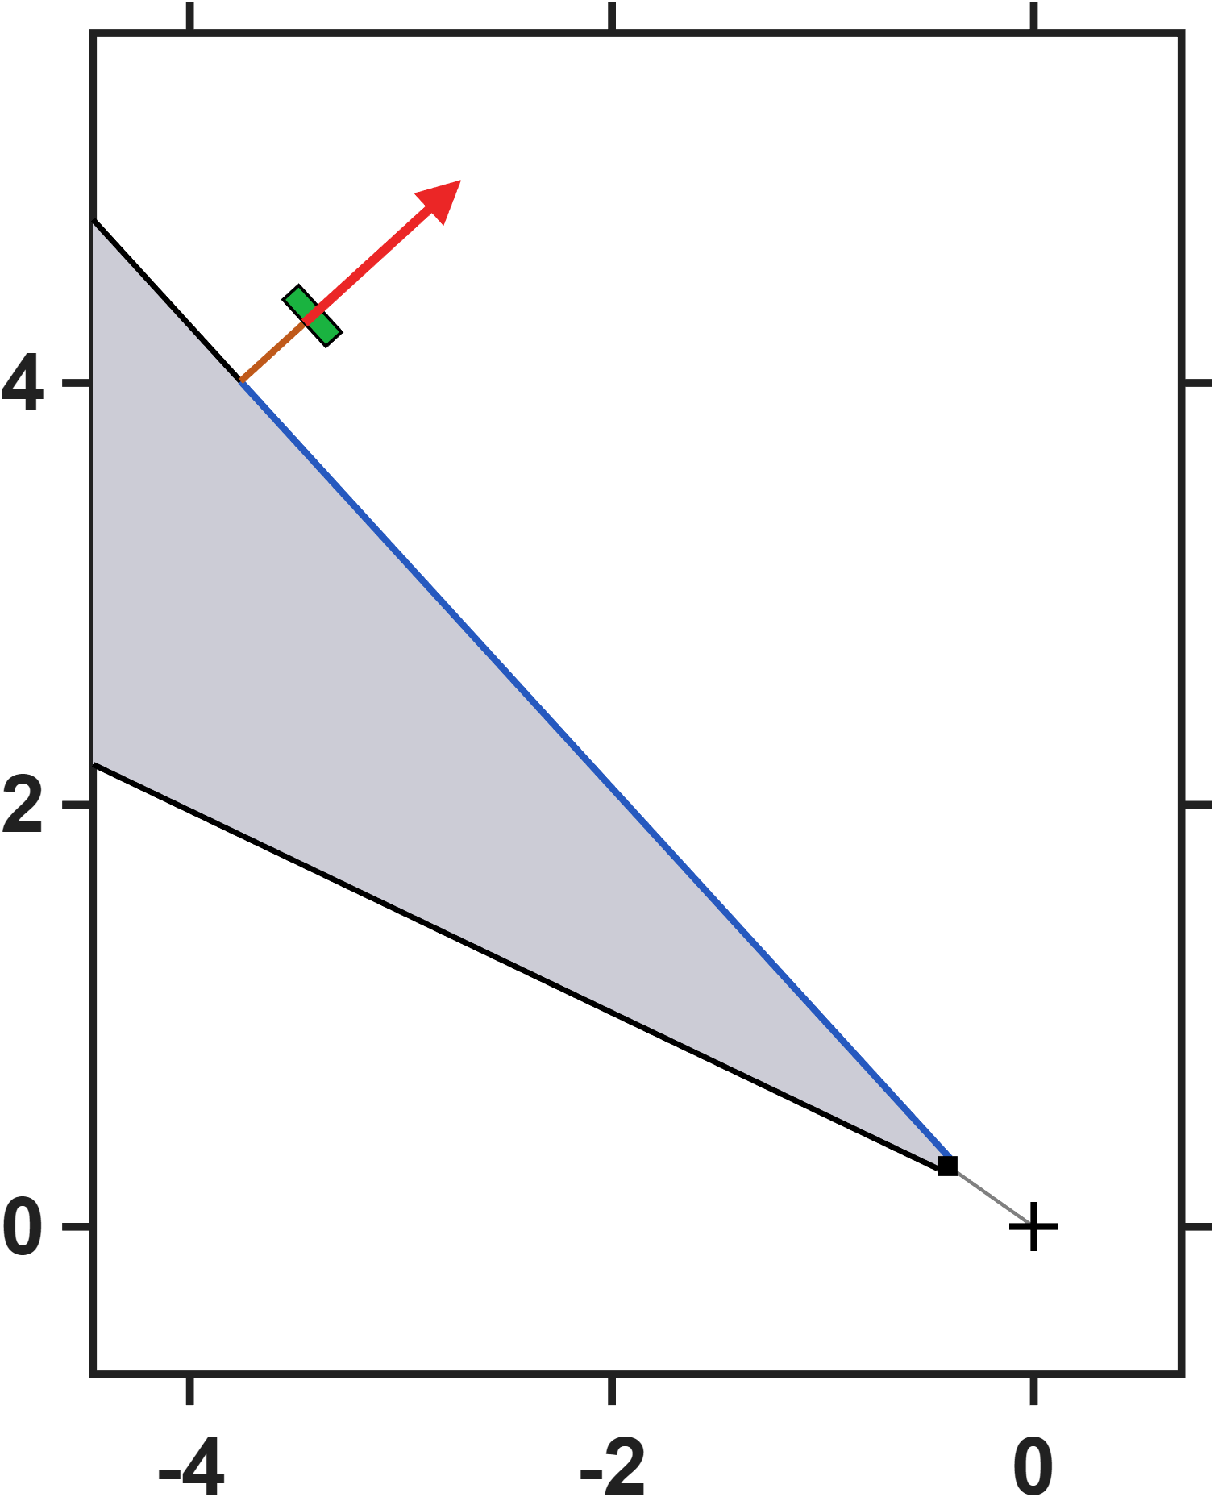



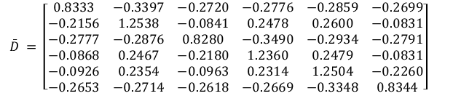


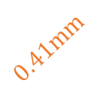

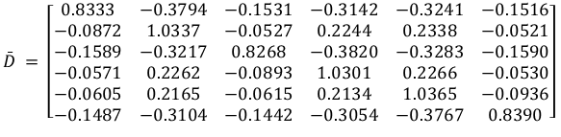



Hall-sensor-voltage-based lumped-parameter modeling and calibration
$$Calibrate model→b_{ij}=S_{i}{}_{}^{B}{{\hat{g}}_{I}}{\overline{K}}_{I}I_{j}$$
Single parameter
$$\bar{D} = \left[\begin{matrix}0.8333 & −0.3397 & −0.2720 & −0.2776 & −0.2859 & −0.2699 \\ −0.2156 & 1.2538 & −0.0841 & 0.2478 & 0.2600 & −0.0831 \\ −0.2777 & −0.2876 & 0.8280 & −0.3490 & −0.2934 & −0.2791 \\ −0.0868 & 0.2467 & −0.2180 & 1.2360 & 0.2479 & −0.0831 \\ −0.0926 & 0.2354 & −0.0963 & 0.2314 & 1.2504 & −0.2260 \\ −0.2653 & −0.2714 & −0.2618 & −0.2669 & −0.3348 & 0.8344\end{matrix}\right]$$
$$NMAE=\frac{\sum_{j}{\sum_{i}{\left\|b_{ij}−S_{i}{}_{}^{B}{{\hat{g}}_{V}}\overline{D}V_{j}\right\|}}}{\sum_{j}{\sum_{i}{\left\|b_{ij}\right\|}}}∙100\%=2.85\%$$
$$z−axis(mm)$$
$$5mm$$
$$0.41mm$$
$$\hat{ℓ} = 875.1 μm {}_{}^{B}{{\hat{g}}_{V}} = 6.5534×{10}^{−3} mT/mV$$
Eighteen parameters
$$x−axis(mm)$$
$$\bar{D} = \left[\begin{matrix}0.8333 & −0.3794 & −0.1531 & −0.3142 & −0.3241 & −0.1516 \\ −0.0872 & 1.0337 & −0.0527 & 0.2244 & 0.2338 & −0.0521 \\ −0.1589 & −0.3217 & 0.8268 & −0.3820 & −0.3283 & −0.1590 \\ −0.0571 & 0.2262 & −0.0893 & 1.0301 & 0.2266 & −0.0530 \\ −0.0605 & 0.2165 & −0.0615 & 0.2134 & 1.0365 & −0.0936 \\ −0.1487 & −0.3104 & −0.1442 & −0.3054 & −0.3767 & 0.8390\end{matrix}\right]$$
$$NMAE=\frac{\sum_{j}{\sum_{i}{\left\|b_{ij}−S_{i}{}_{}^{B}{{\hat{g}}_{V}}\overline{D}V_{j}\right\|}}}{\sum_{j}{\sum_{i}{\left\|b_{ij}\right\|}}}∙100\%=0.26\%$$
$$0.41mm$$
$$\hat{e}= \left[\begin{matrix}0.0185 & 0.0203 & −0.1173 & 0.0024 & 0.0018 & −0.1186 \\ −0.1183 & 0.0026 & 0.0168 & 0.0163 & 0.0019 & −0.1185 \\ 0.1182 & −0.0029 & 0.1166 & −0.0029 & −0.0186 & −0.0199\end{matrix}\right]$$
$$\hat{ℓ} = 873.0 μm {}_{}^{B}{{\hat{g}}_{V}} = 7.6781×{10}^{−3} mT/mV$$
$$5mm$$
$V (mV) = \left[\begin{matrix}1159.3260 & −23.5111 & −213.9402 & −208.5527 & −202.2786 & −217.2689 \\ −25.8981 & 1271.3735 & −194.7679 & −385.7274 & −395.3148 & −196.1269 \\ −214.3757 & −207.4828 & 1163.3877 & −23.2254 & −202.7188 & −213.5051 \\ −194.9926 & −391.1226 & −25.8255 & 1276.7906 & −387.6908 & −199.5871 \\ −194.5579 & −382.2598 & −190.9707 & −380.6571 & 1259.9296 & −25.0977 \\ −215.1316 & −206.2346 & −219.0374 & −212.7324 & −23.0967 & 1164.8521\end{matrix}\right]$
$$z−axis(mm)$$
Moving the sensors from 3 mm to 5 mm along the pole flank leaves the workspace radius and the fit error unchanged (875.1 / 873.0 um, 2.85 / 0.26 percent, identical to the previous slide); only the voltage gain rescales. The predictive accuracy of the model is therefore independent of where the sensor is mounted, so the mounting position can be chosen with considerable freedom.
$$x−axis(mm)$$

Slide 13
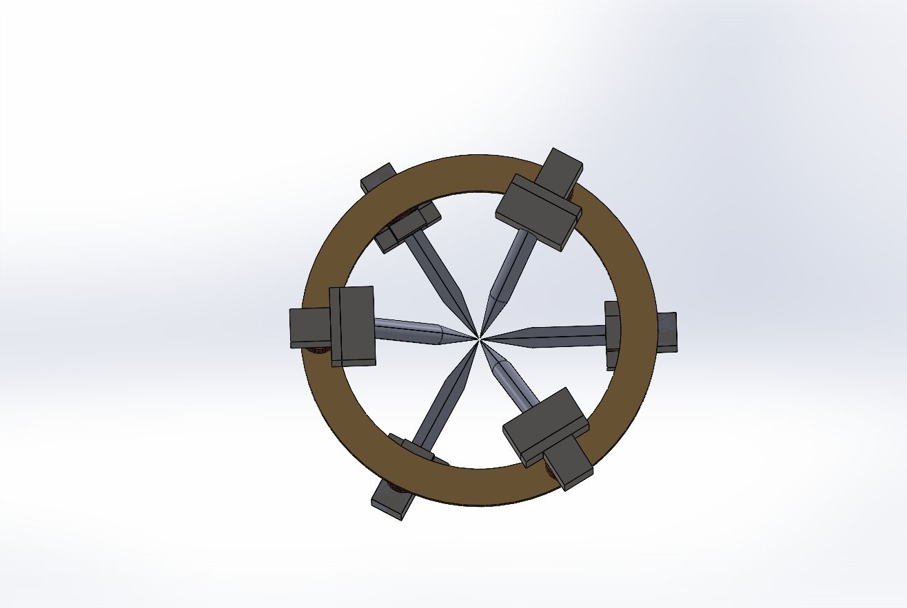
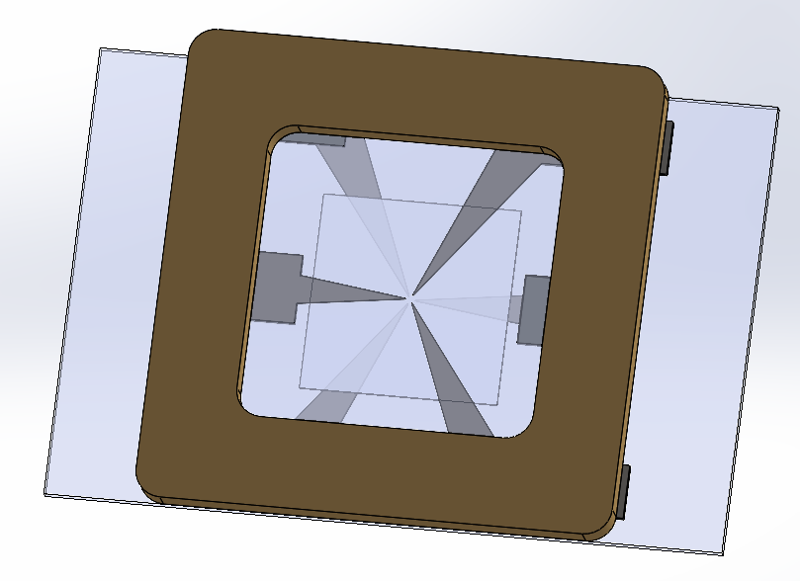
Quantitative Assessment of Multi-Pole Actuators
Setup: The assessment that follows compares two six-pole actuator designs, Design 1 on a circular yoke and Design 2 on a planar square frame. Both are described by the same lumped-parameter model and use the pole numbering P1-P6 shown here.
Sharing the model form and the pole numbering, the two differ only in geometry, so their calibrated parameters can be compared directly in the following slides.
DesignA
DesignB
P5
P3
P5
P3
P1
P1
P2
P2
P4
P4
P6
P6

Slide 14
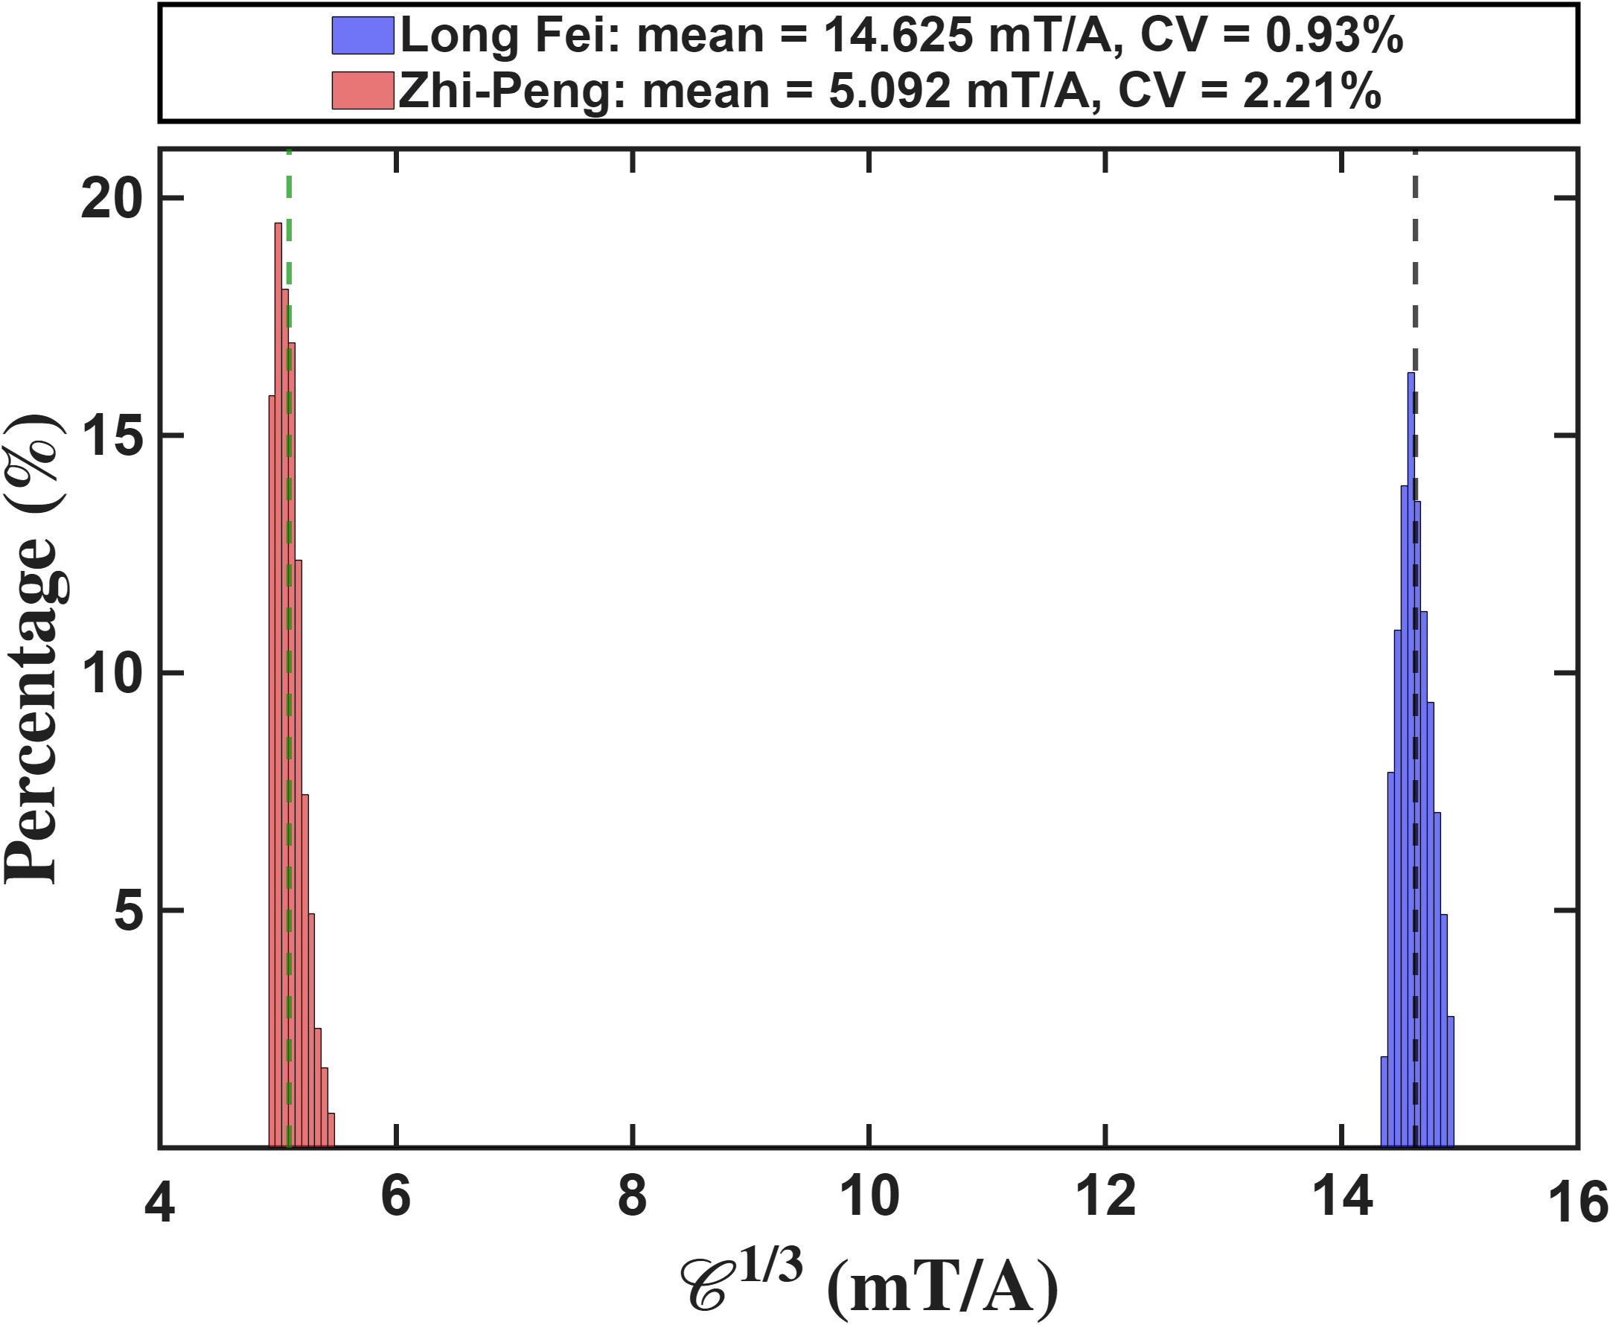
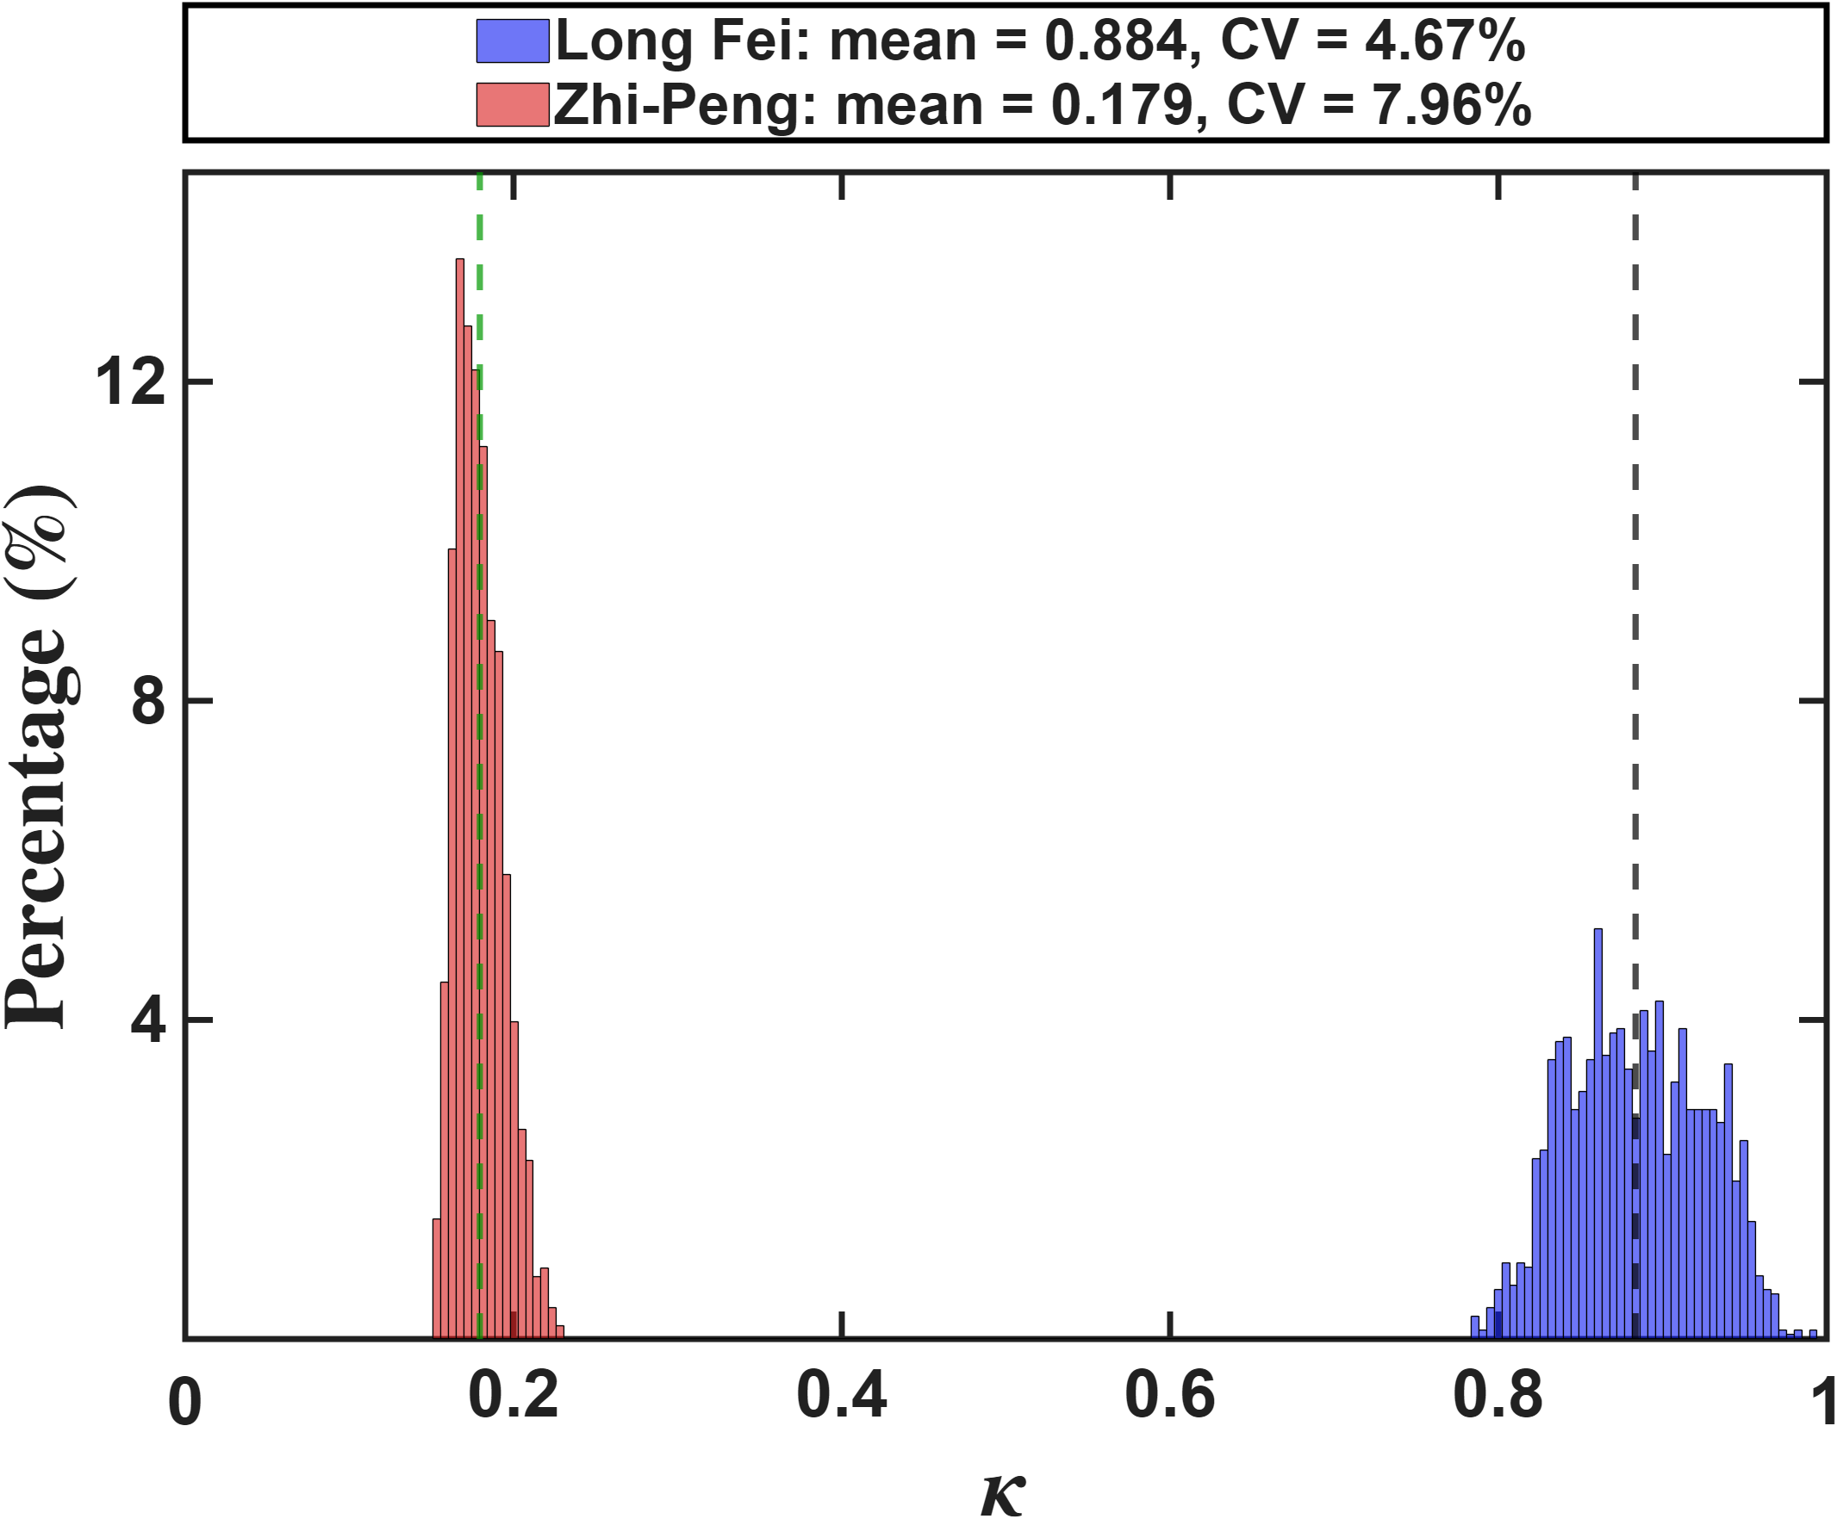
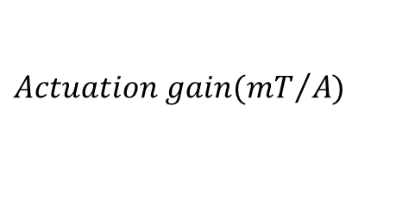



Quantitative Assessment of Multi-Pole Actuators
Setup: Both designs are put on the same footing. Each is calibrated with the single-parameter model on all field grid points inside R = 150 um, and the two control metrics are then evaluated point by point on that same sampling set. The actuation gain plotted here is the cube root of the actuation volume, so it carries the same unit as a field-per-current gain and the two designs are directly comparable. Blue = Design 1, red = Design 2.
Design 1 wins decisively on both counts: 14.625 mT/A against 5.092 mT/A, a factor of 2.9, and an isotropy of 0.884 against 0.179, a factor of 4.9. The isotropy gap is the larger of the two because isotropy measures the balance among the three actuator axes, and Design 2 is intrinsically unbalanced: its two poles on the x_a axis are about 2.2 times stronger than the other four, so one direction dominates everywhere. Both distributions are narrow (CV below 8 percent), so these are properties of the designs, not scatter.
$$Percentage(\%)$$
$$Percentage(\%)$$
$$Actuation gain({mT}/{A)}$$
$$Isotropy$$

Slide 15
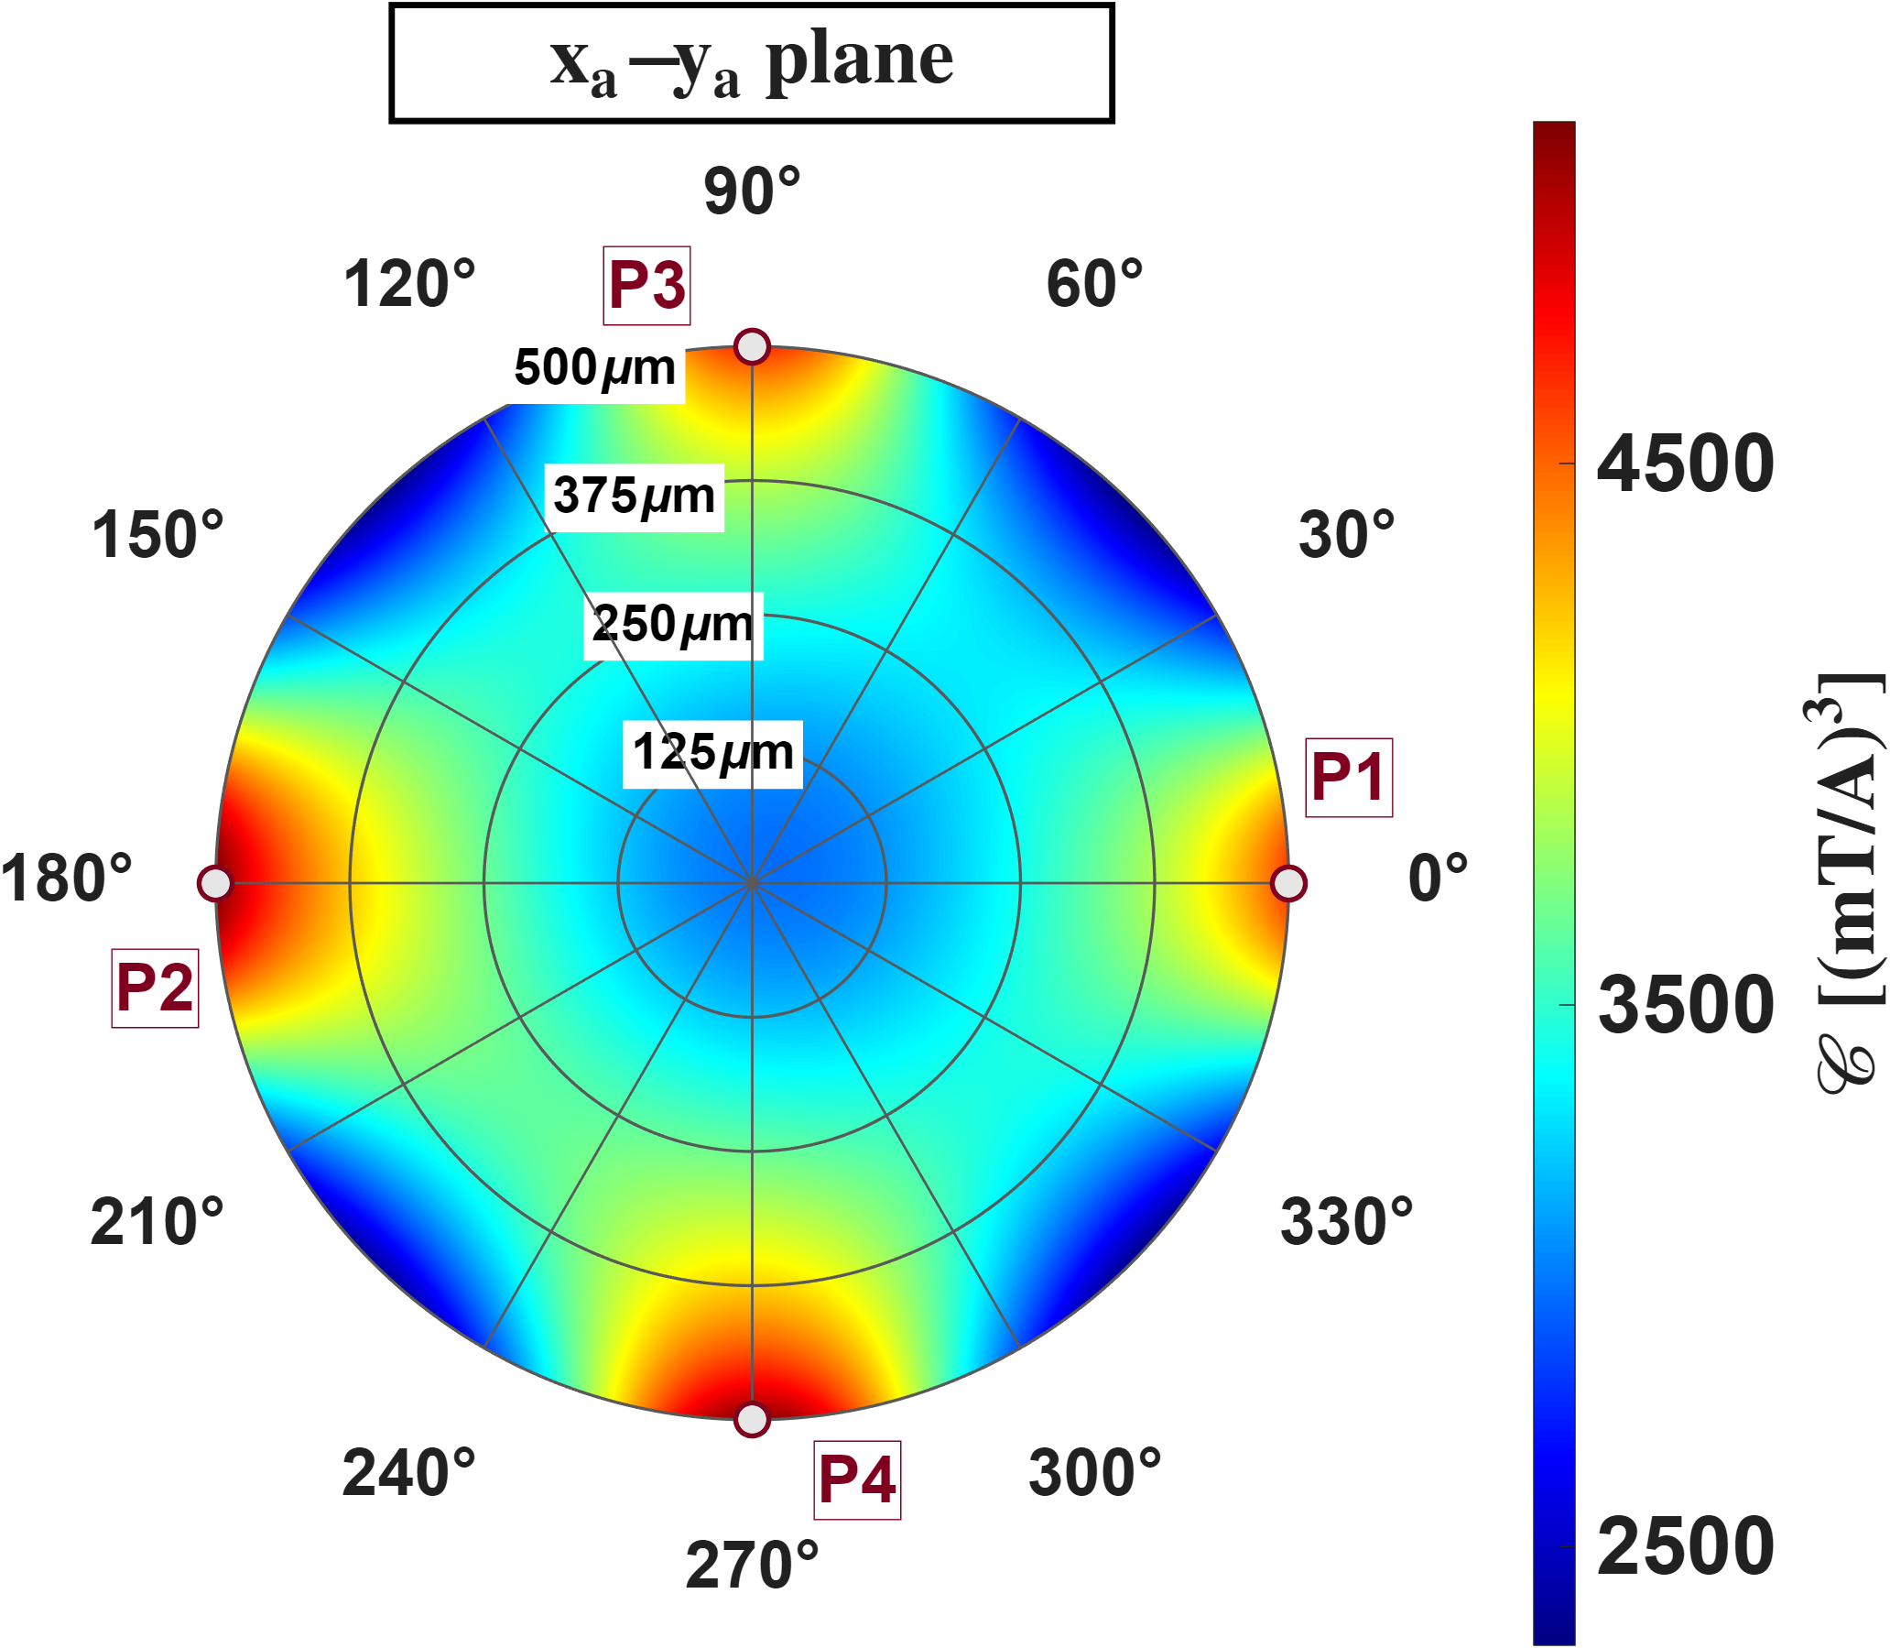
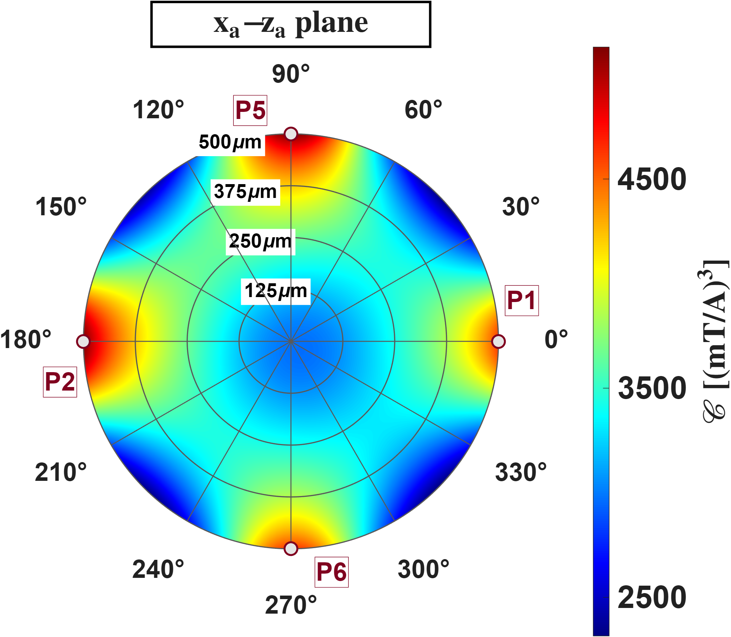
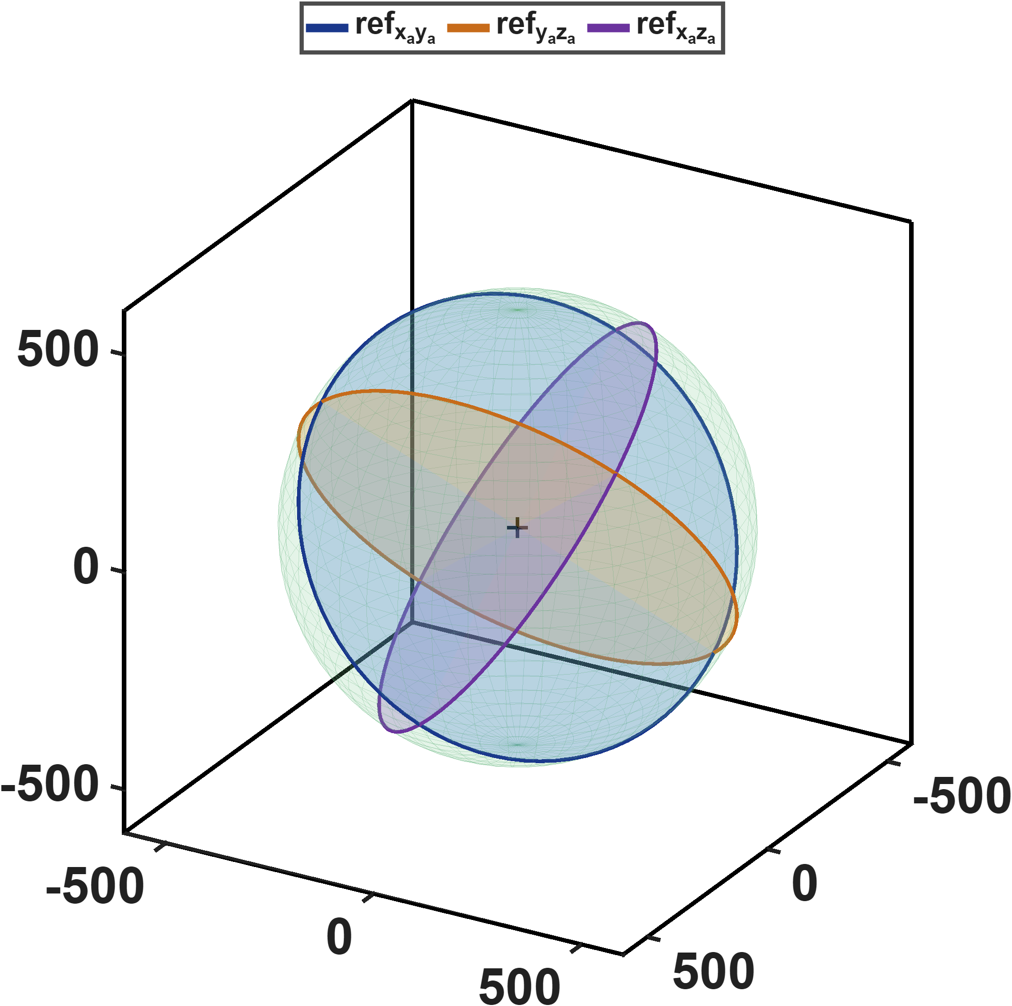

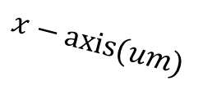
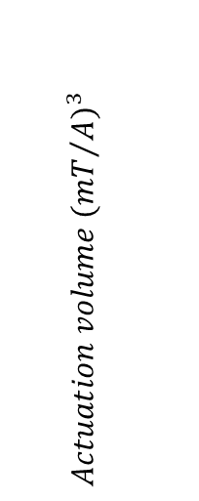
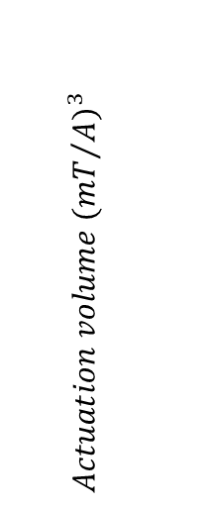

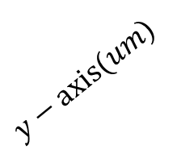
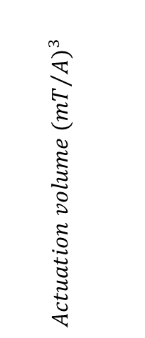
Quantitative Assessment of Multi-Pole Actuators
Design1
Setup: Design 1. Actuation volume from the calibrated model on the three reference planes at left, out to the 500 um pole-tip sphere.
It rises from about 2500 at the centre to above 4500 near the poles, and the four-fold pattern is identical on all three planes. That repetition is the signature of a balanced design: the six poles are equally strong and form three mutually orthogonal pairs, so no plane is preferred.
$Actuation volume$ $({{mT}/A)}^{3}$
$Actuation volume$ $({{mT}/A)}^{3}$
$$z−axis(um)$$
$Actuation volume$ $({{mT}/A)}^{3}$
$$y−axis(um)$$
$$x−axis(um)$$

Slide 16
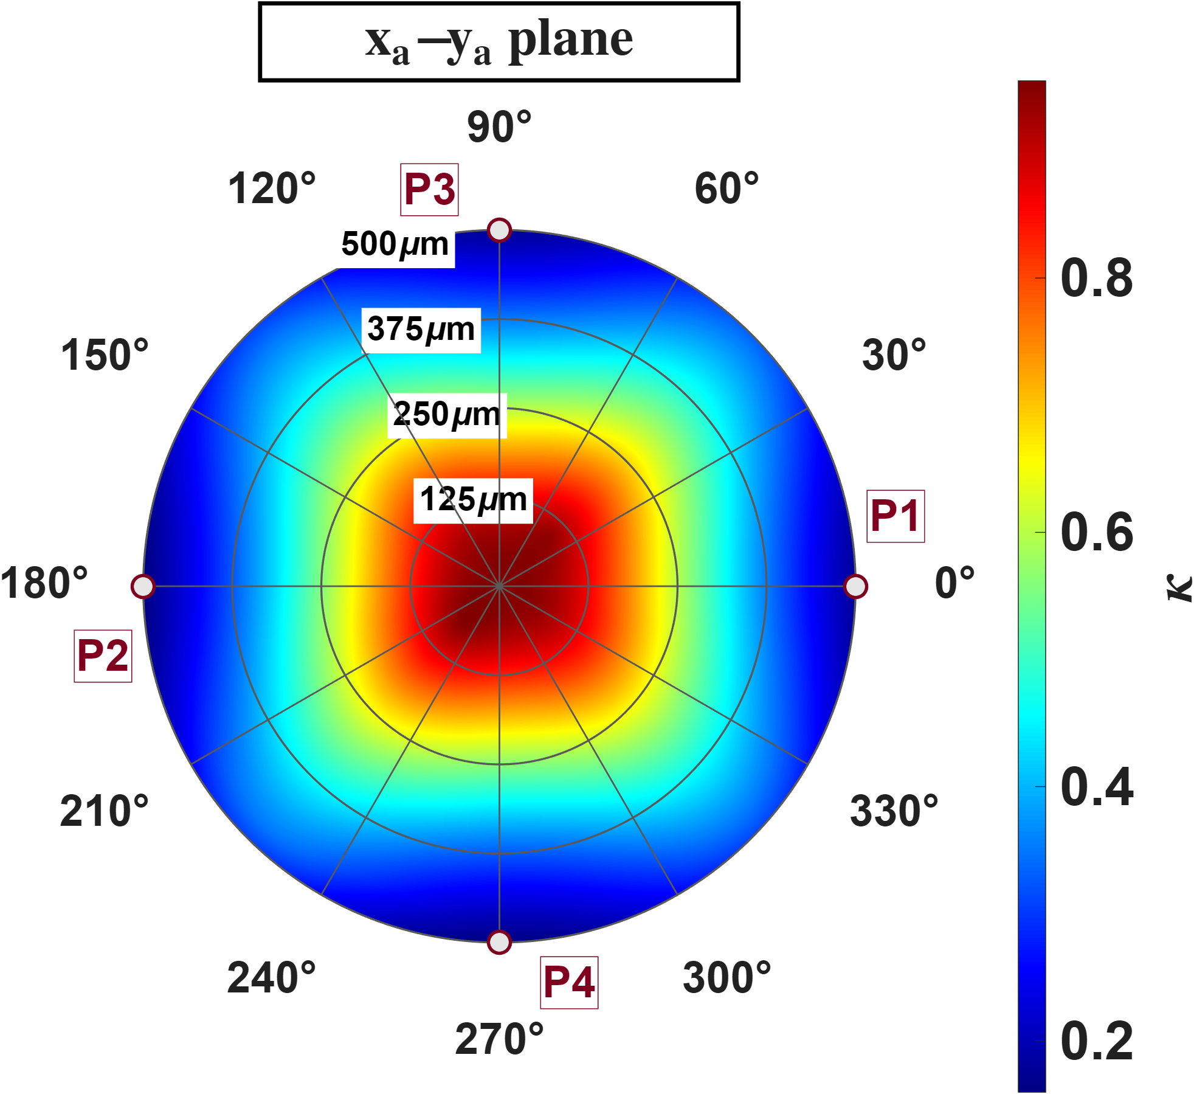
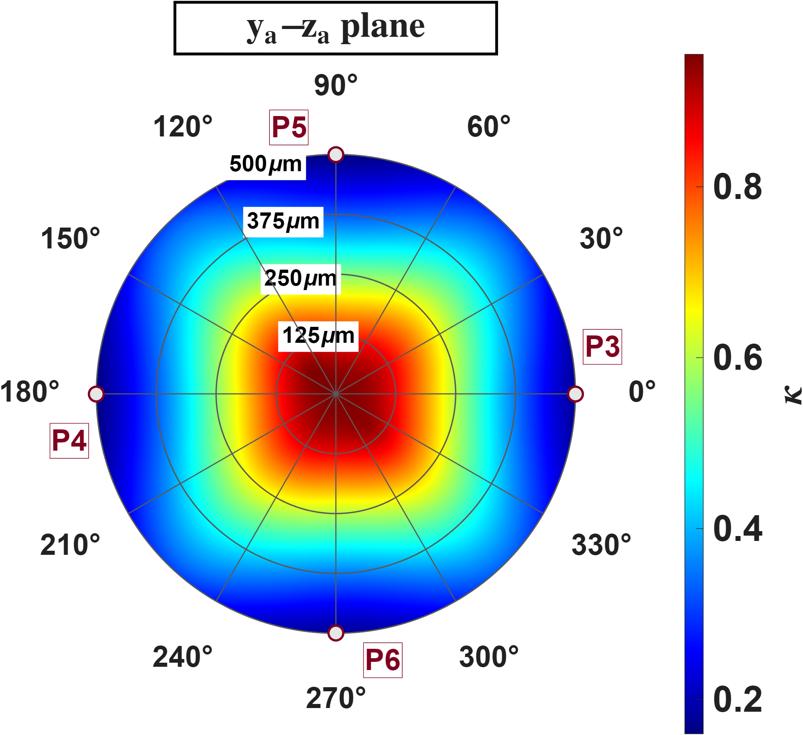




Quantitative Assessment of Multi-Pole Actuators
Design1
Setup: Design 1, same planes and model, now the isotropy.
It peaks near 0.9 at the centre and falls to about 0.2 at the rim. The peak sits at the centre because all six poles are equidistant there, so the three singular values are nearly equal; moving outward you approach one pair and recede from the other two, which collapses the ratio. The well-conditioned core therefore reaches about 250 um, half the tip radius.
$$Isotropy$$
$$Isotropy$$
$$z−axis(um)$$
$$Isotropy$$
$$y−axis(um)$$
$$x−axis(um)$$

Slide 17
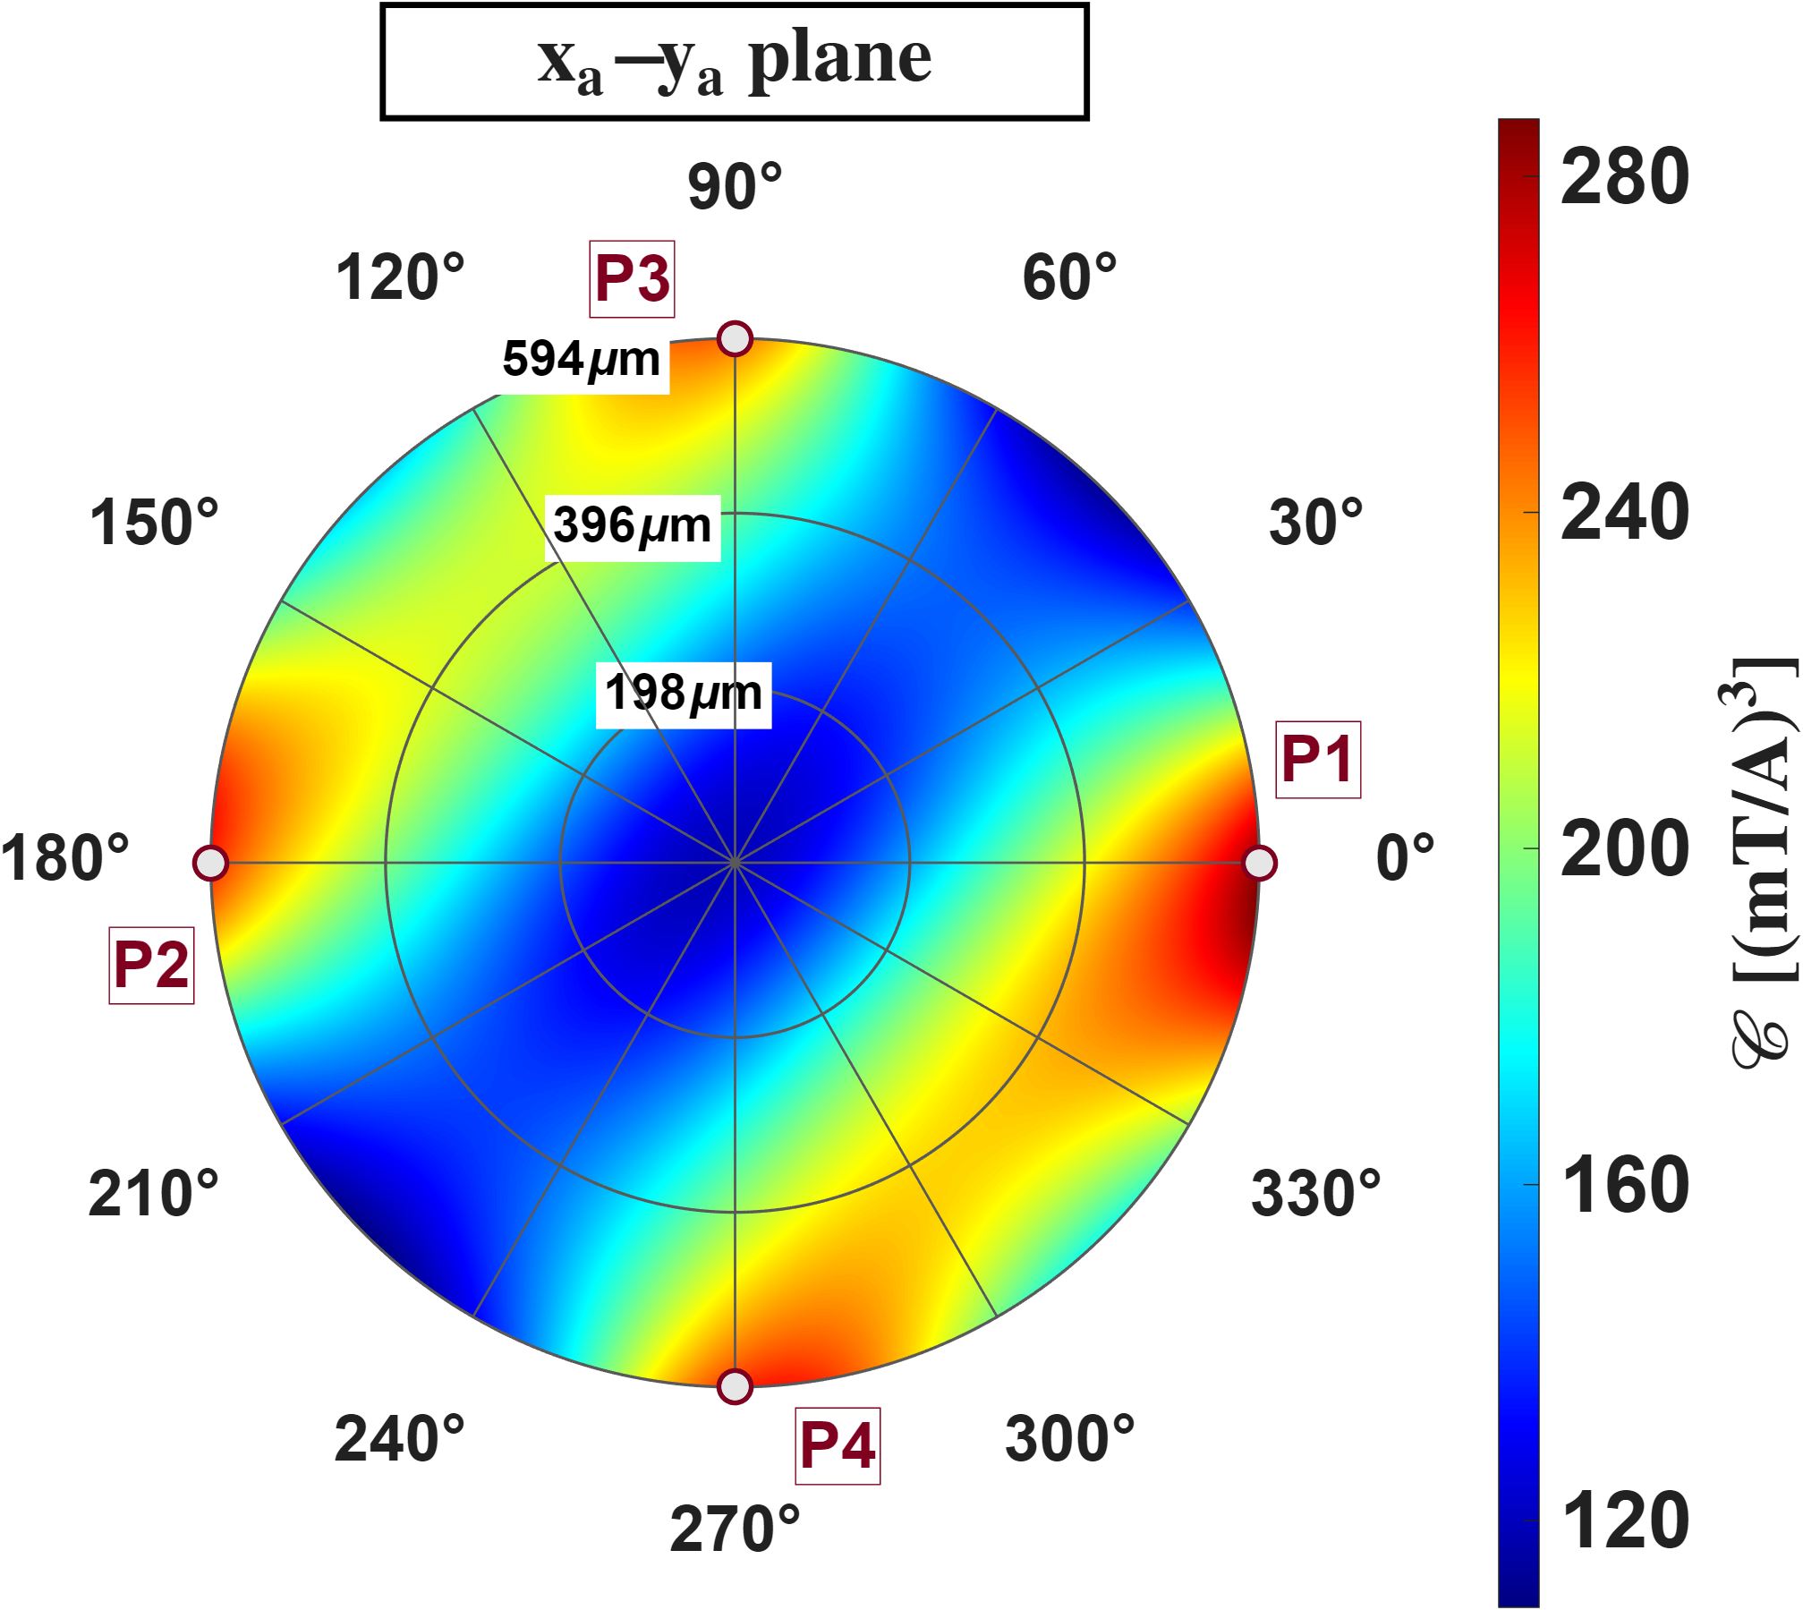
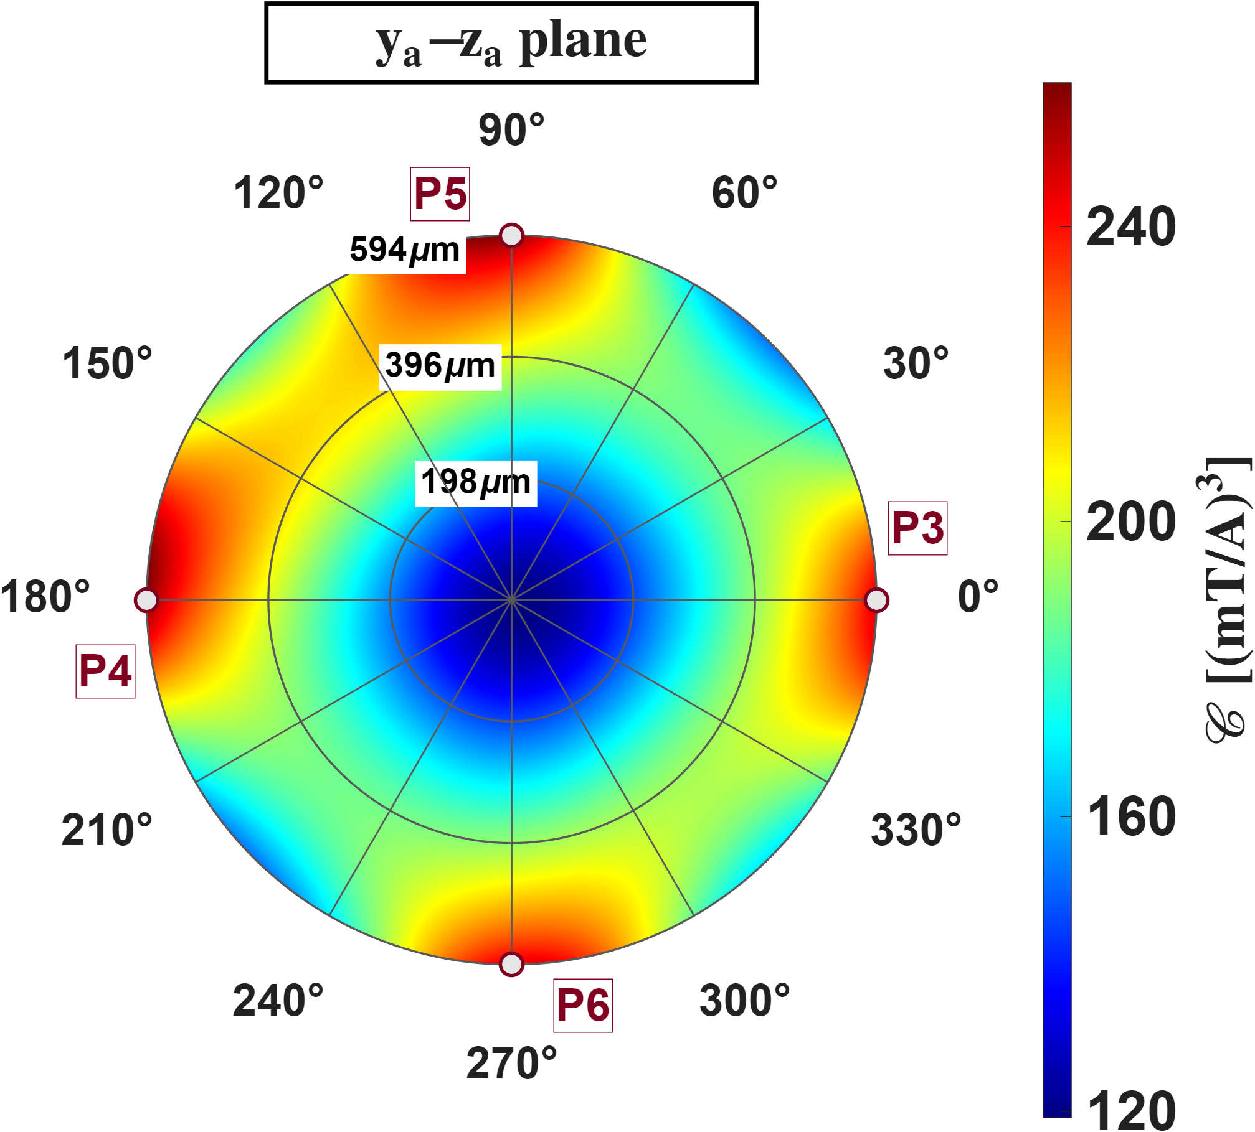
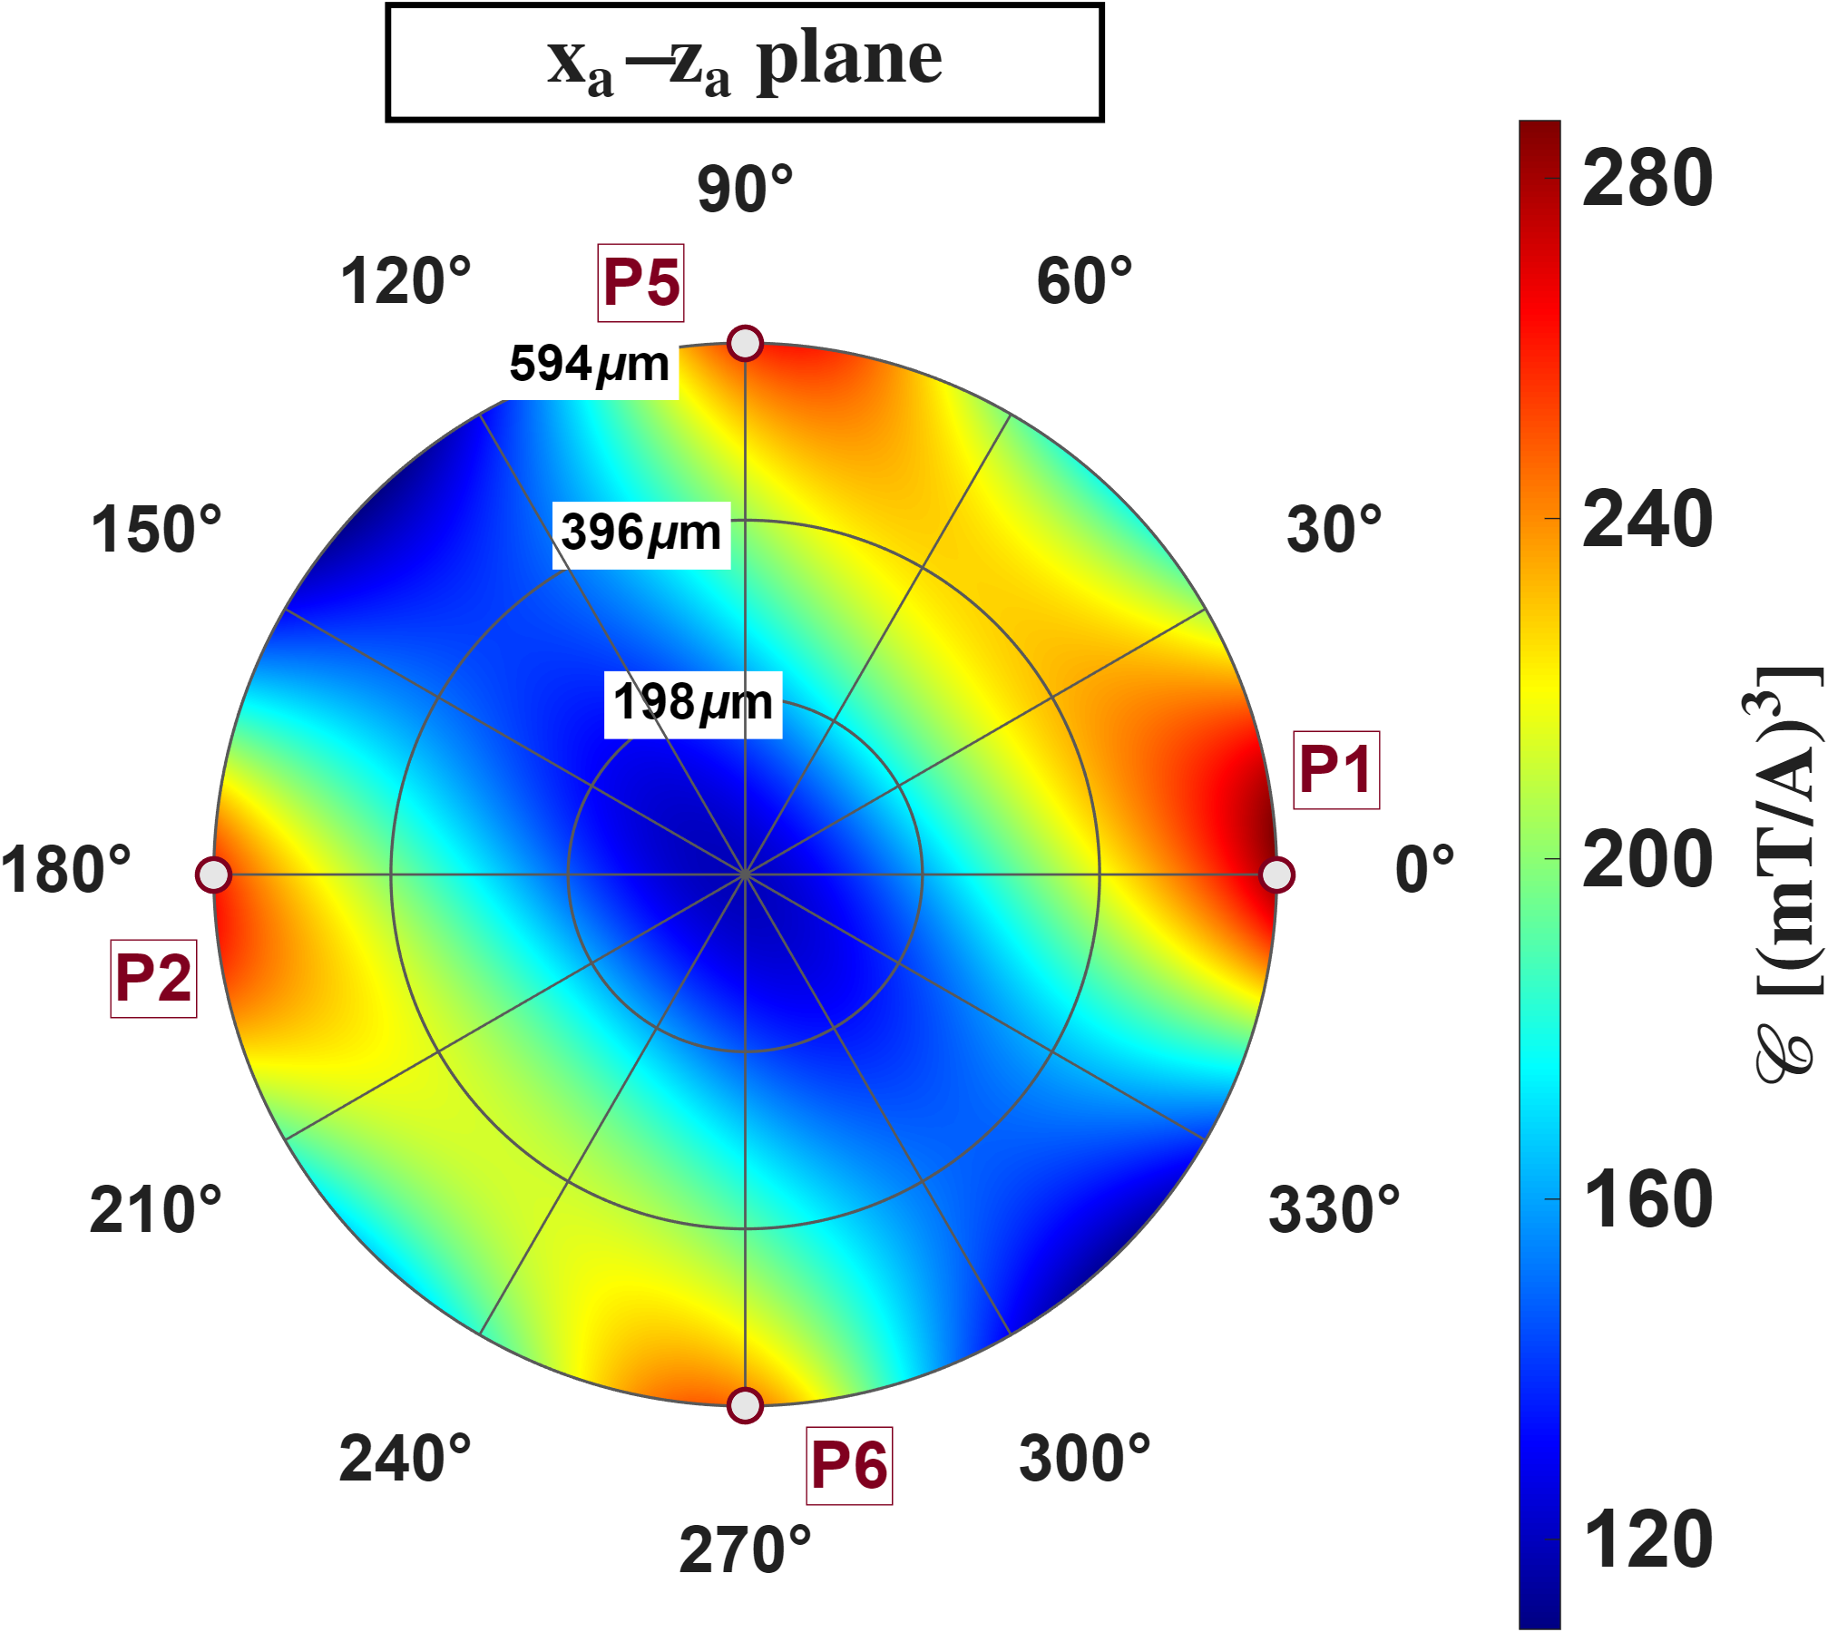
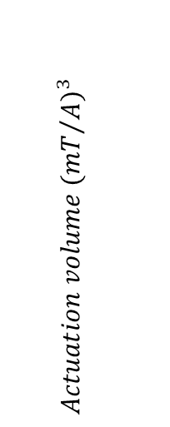
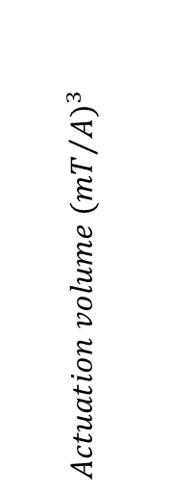
Quantitative Assessment of Multi-Pole Actuators
Design2
Setup: Design 2, same quantity and planes, out to its own 594 um pole-tip sphere.
It runs from about 120 at the centre to 287 near the poles, roughly 24 times below Design 1. That factor is just the per-axis deficit cubed: the actuation volume is a product of three gains, so a gain ratio of 2.9 becomes 2.9 cubed, or 24. The pattern is two-fold rather than four-fold because the P1-P2 pair is about 2.2 times stronger than the other four poles.
$Actuation volume$ $({{mT}/A)}^{3}$
$Actuation volume$ $({{mT}/A)}^{3}$
$$z−axis(um)$$
$Actuation volume$ $({{mT}/A)}^{3}$
$$y−axis(um)$$
$$x−axis(um)$$

Slide 18






Quantitative Assessment of Multi-Pole Actuators
Design2
Setup: Design 2, same planes, isotropy.
It stays between 0.07 and 0.33 everywhere and does not peak at the centre; the maxima sit off-centre near 396 um (six lobes on the y_a-z_a plane, two on the other two). The cause is the same pole imbalance: with the x_a pair about 2.2 times stronger, one singular direction dominates at every point, so the ratio never recovers and there is no isotropic core in which to place a workspace.
$$Isotropy$$
$$Isotropy$$
$$z−axis(um)$$
$$Isotropy$$
$$y−axis(um)$$
$$x−axis(um)$$

Slide 19







Reference
$Workspace radius=\hat{ℓ}$
$Flux distribution matrix={\overline{K}}_{I}$
$Current to field gain={}_{}^{B}{{\hat{g}}_{I}}$
$Voltage to field gain={}_{}^{B}{{\hat{g}}_{V}}$
$Residual field=\sqrt{\frac{minJ}{N}}$
$Actuation volume=𝒞 ({{mT}/A)}^{3}$
$Actuation gain=𝒞^{\frac{1}{3}}({{mT}/A)}^{}$
$Isotropy=κ$

Slide 20








Reference
The blue plot on the left shows the 528 points required by the single-parameter model for $R≤150um$
The red plot on the right shows the 80 points of the eighteen-parameter model for $R≤150um$
$$z (micro meter)$$
$$z (micro meter)$$
$$x (micro meter)$$
$$x (micro meter)$$
$$y (micro meter)$$
$$y (micro meter)$$

Slide 21






Reference
Both models need less than 1% of the available points over the intermediate range, which is highly efficient; but both ends degrade — small R suffers from insufficient information and large R from the model itself beginning to fail, requiring large numbers of points to compensate. The single-parameter curve starts at 140 µm because at smaller radii the number of points it requires exceeds the number of real grid points the region actually contains， since the information it needs exceeds the measurement points the region can supply, whereas the eighteen-parameter model requires less than a quarter of the available grid points over the same region and can therefore be plotted from 80 µm.
$$N/{N_{total}}∙100 (\%)$$
$$N/{N_{total}}∙100 (\%)$$
$$Sampling range(micro meter)$$
$$Sampling range(micro meter)$$

Slide 22





Reference
The number of available sampling points is indeed proportional to the sphere volume, the FEM mesh is of uniform density in this region. All the preceding discussion of "point count" can therefore be converted directly into "sampling radius"
$$×{10}^{3}$$
$$Number of points$$
$$×{10}^{7}$$
$$Sampling range(micro meter)$$

